Slide 1

Complexity management: The role of MBSE and Dependency Structure Matrices
Torben Beernaert, Tim Wilschut
EIROforum Systems Engineering workshop | Feb 5, 2025

Slide 2
Elephant Specification Language (ESL)
Elephant Specification Language (ESL) is a textual systems modelling language. It uses relatively natural language in a structured syntax to specify a system’s
functional architecture
multi-level component breakdown
needs, requirements and constraints
Relations between these design elements are automatically inferred and stored in a graph object. The graph can be visualized via Dependency Structure Matrices (DSM) and other user-defined visualizations. Viewpoints exist to generate functional diagrams, cabling/piping diagrams, interface reports and requirements extracts.
Can be installed in python via ‘pip install raesl’
Open-source: https://gitlab.com/ratio-case-os/python/raesl

Slide 3
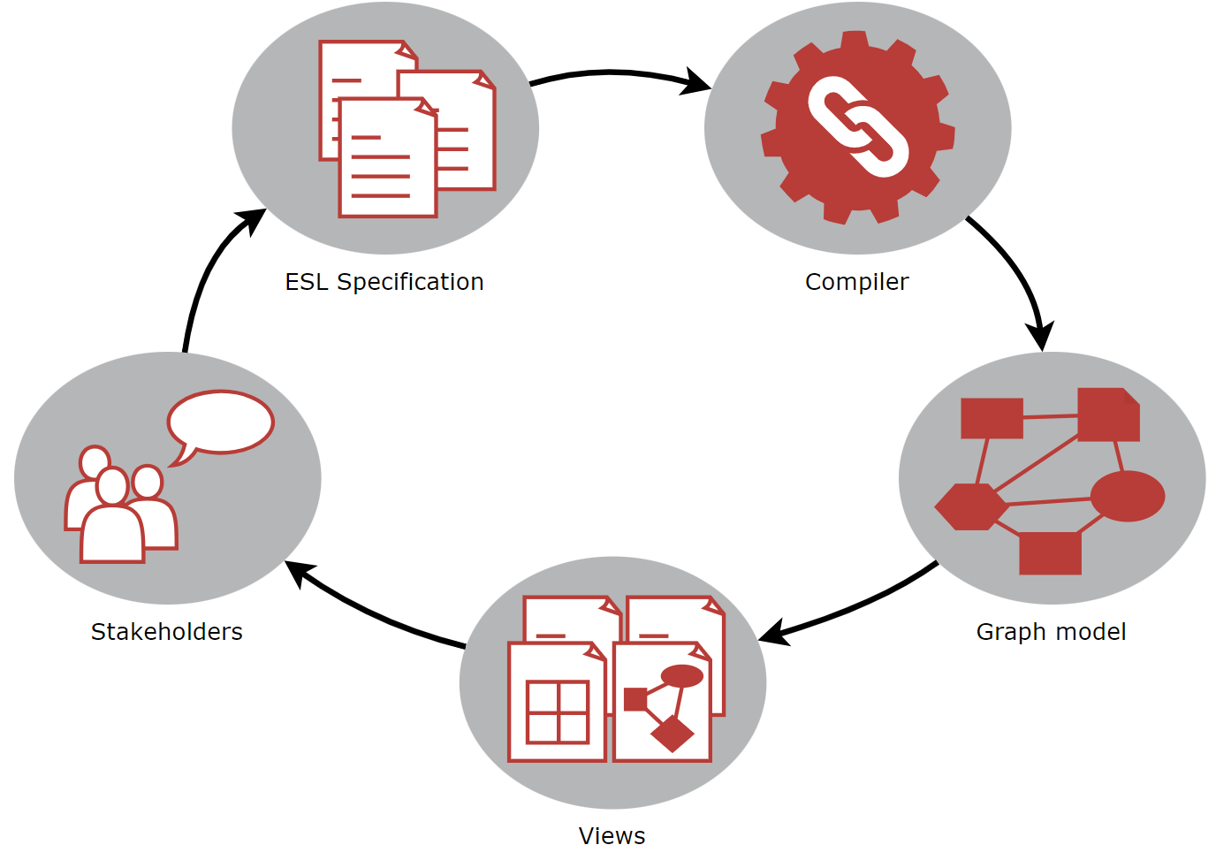
MBSE Workflow

Slide 4
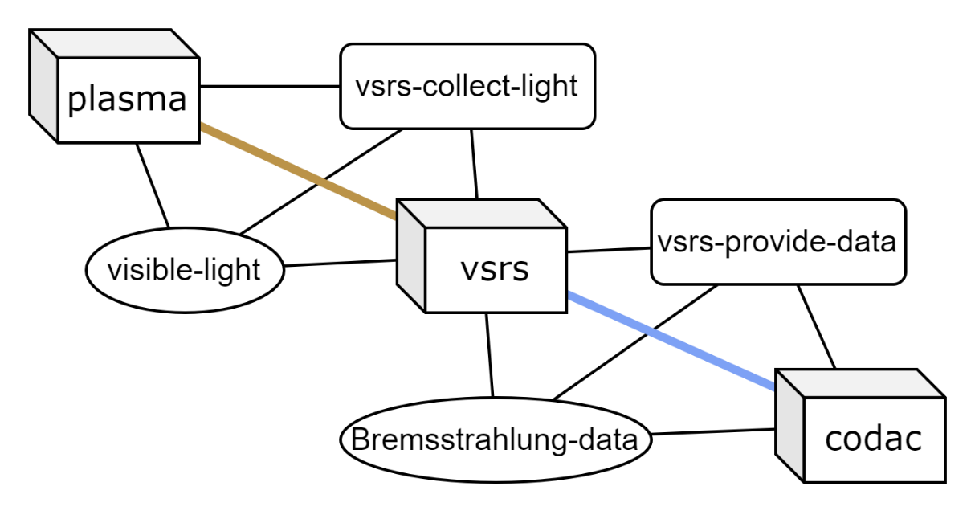
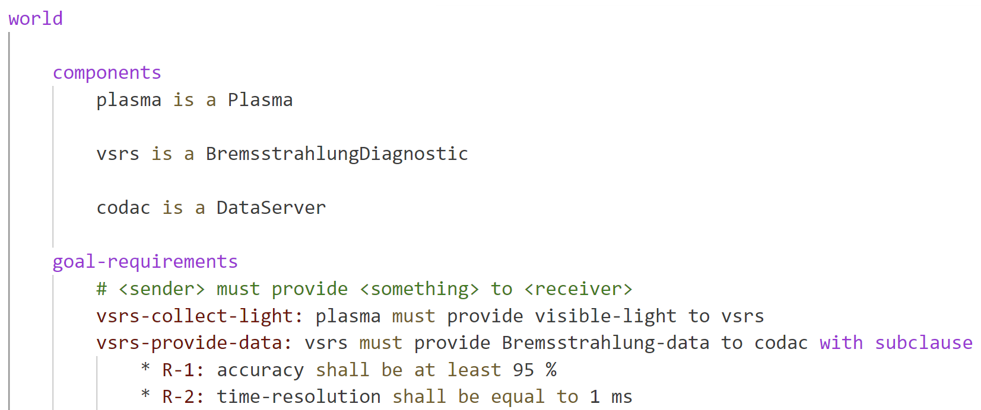
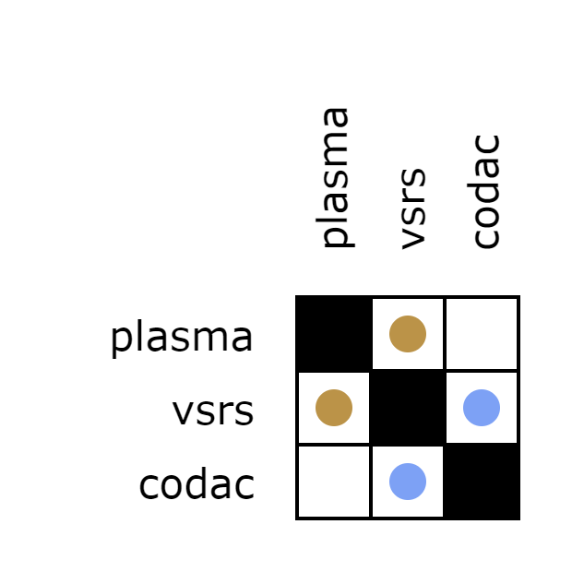
ESL → Graph → DSM

Slide 5
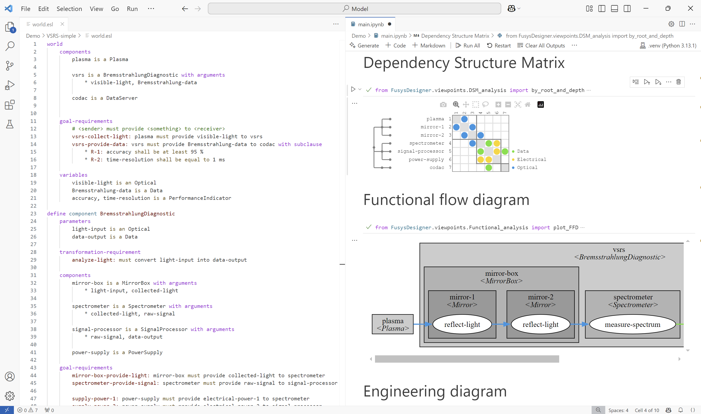
Demo
Jupyter notebook with customizable views
ESL specification
Compiler

Slide 6
DSM view of a nuclear fusion diagnostic
Shows all internal and external interfaces
Organized in a modular structure

Slide 7
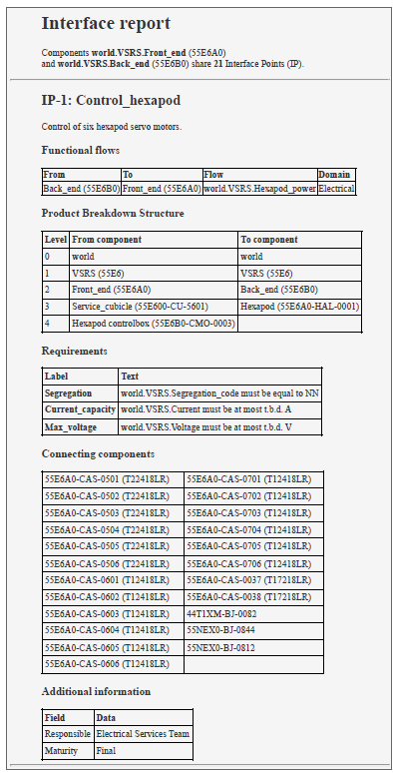
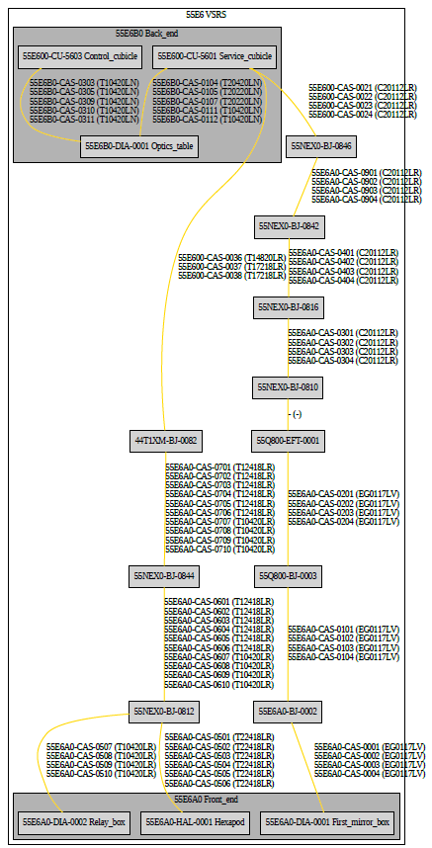
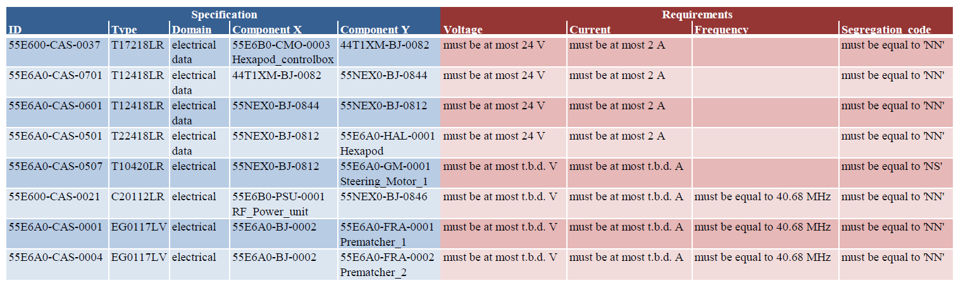
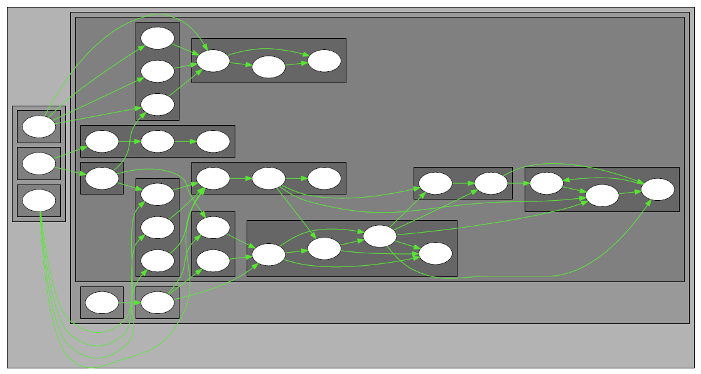
Views for architecture, interface and cable management
Mapping requirements to cables
Functional flow diagram shows components and interactions to realize a particular system function
Interface report can be generated for any two components
Cabling diagram / electrical layout

Slide 8
Further reading
Elephant Specification Language
Wilschut, T. et al. (2024). Bridging the gap between requirements engineering and systems architecting: The Elephant Specification Language. Design Science.
VSRS
Beernaert, T. F. et al. (2024). Multi-Level Architecture Modelling and Analysis: The Case for Model-Based Systems Engineering of Fusion Diagnostics. Fusion Engineering and Design.
Beernaert, T.F. et al. (2022). Challenges Of Big-Science: A Matrix-Based Interface Model To Manage Technical Integration Risks In Multi-Organizational Engineering Projects. Proceedings of the 24th International DSM Conference (DSM 2022), Eindhoven, The Netherlands
DSM & MBSE in fusion
Beernaert, T.F. (2024). Discovering the Potential of Dependency Structure Modelling for Fusion Systems Engineering. PhD Thesis, Eindhoven University of Technology

Slide 9
Complexity management: The role of MBSE and Dependency Structure Matrices
Torben Beernaert, Tim Wilschut
EIROforum Systems Engineering workshop | Feb 5, 2025

