Slide 1
Test-beam 2025
Wolfgang Lohmann

Slide 2
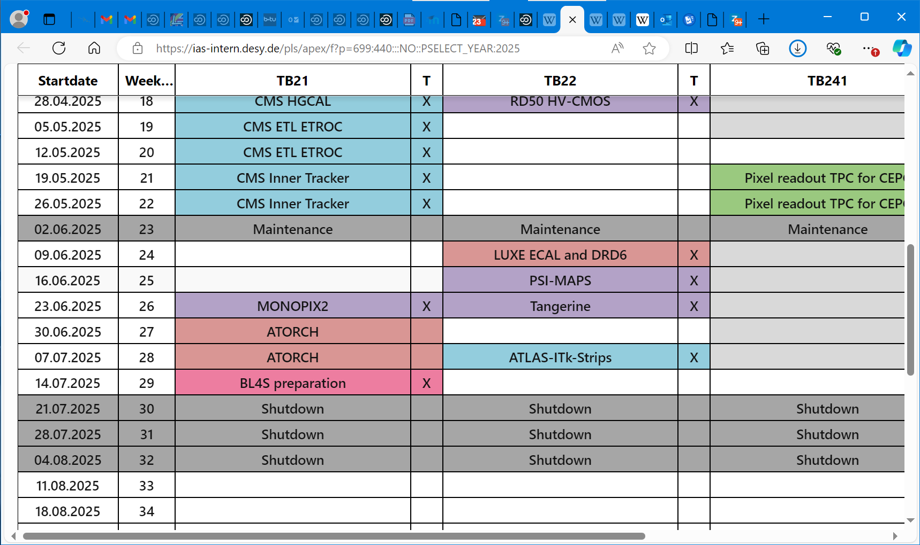
organisational

Slide 3
organisational
A partly instrumented prototype of a highly compact and granular electromagnetic calorimeter will be installed in the area and after a full system test, including a dedicated FE electronics and FPGAs for data preprocessing, the performance will be measured in an electron beam of up to 5 GeV. This includes longitudinal and transversal shower size and energy resolution.
Participating labs are AGH Cracow, IFIC Valencia, ISS Bukharest, University of Warsaw and University of Tel Aviv.

Slide 4
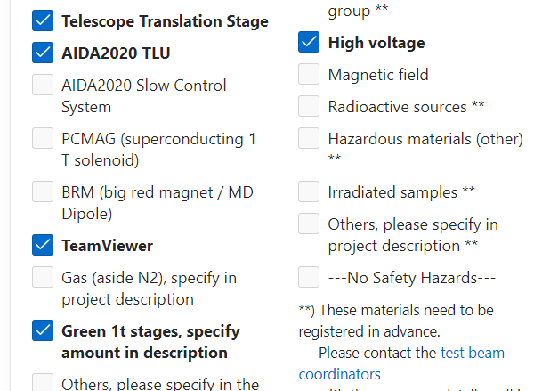
Hardware requests

Slide 5
organisational
Please read the general DESY test beam and safety rules under https://particle-physics.desy.de/test_beams_at_desy/tb_rules__safety_instructions/
All test beam areas are secured by the access control system DACHS (DESY Access Handling System). Therefore you need a valid DACHS card to work in these areas!
In case, you or your group members need a DACHS card we will use your recorded data to issue your DACHS card, but one have to be registered there in a very timely manner. Otherwise we cannot ensure your access to the test beam area. You can obtain your DACHS card at DESY, in bldg. 6/ R110 (Mon-Thu 8:00-12:00 and 13:00-16:00, Fri 8:00-12:00 and 13:00-14:00).

Slide 6
organisational

