Slide 1
News and Dates.
FC @ DESY Meeting
Benno List
13.12.2024

Slide 2
Dates
ESPPU@Germany:
”Non-collider Physics”, 22-24 November 2024, Bad Honnef https://indico.desy.de/event/45358/
”Collider Physics”, 27-29 November 2024 at DESY, Hamburg https://indico.desy.de/event/45276/
”Concluding workshop”, 19-22 January 25 at Bad Honnef https://indico.desy.de/event/46923/overview
LCVision Community Event, Jan 8-10, 2025, CERN
8th FCC Physics workshop, Jan. 13-16,2025, CERN https://indico.cern.ch/event/1439509/
International Muon Collider Collaboration week @ DESY, May 12-16, 2025

Slide 3
European Strategy Update 2026
Strategy group and physics preparatory group members announced
Deadline written input: March 31, 2025
Conclude process June 2026
Web page: https://europeanstrategyupdate.web.cern.ch/welcome
Strategy group set up: https://europeanstrategyupdate.web.cern.ch/european-strategy-group-esg
Chair: Karl Jakobs, Freiburg
For DESY: Beate Heinemann
For Germany: Klaus Desch, Bonn
Physics preparatory group https://europeanstrategyupdate.web.cern.ch/physics-preparatory-group-ppg
Electroweak: Monoca Dunford, Heidelberg
Detectors: Ulrich Husemann, KIT Karlsruhe
https://home.cern/news/press-release/physics/particle-physicists-chart-course-future

Slide 4
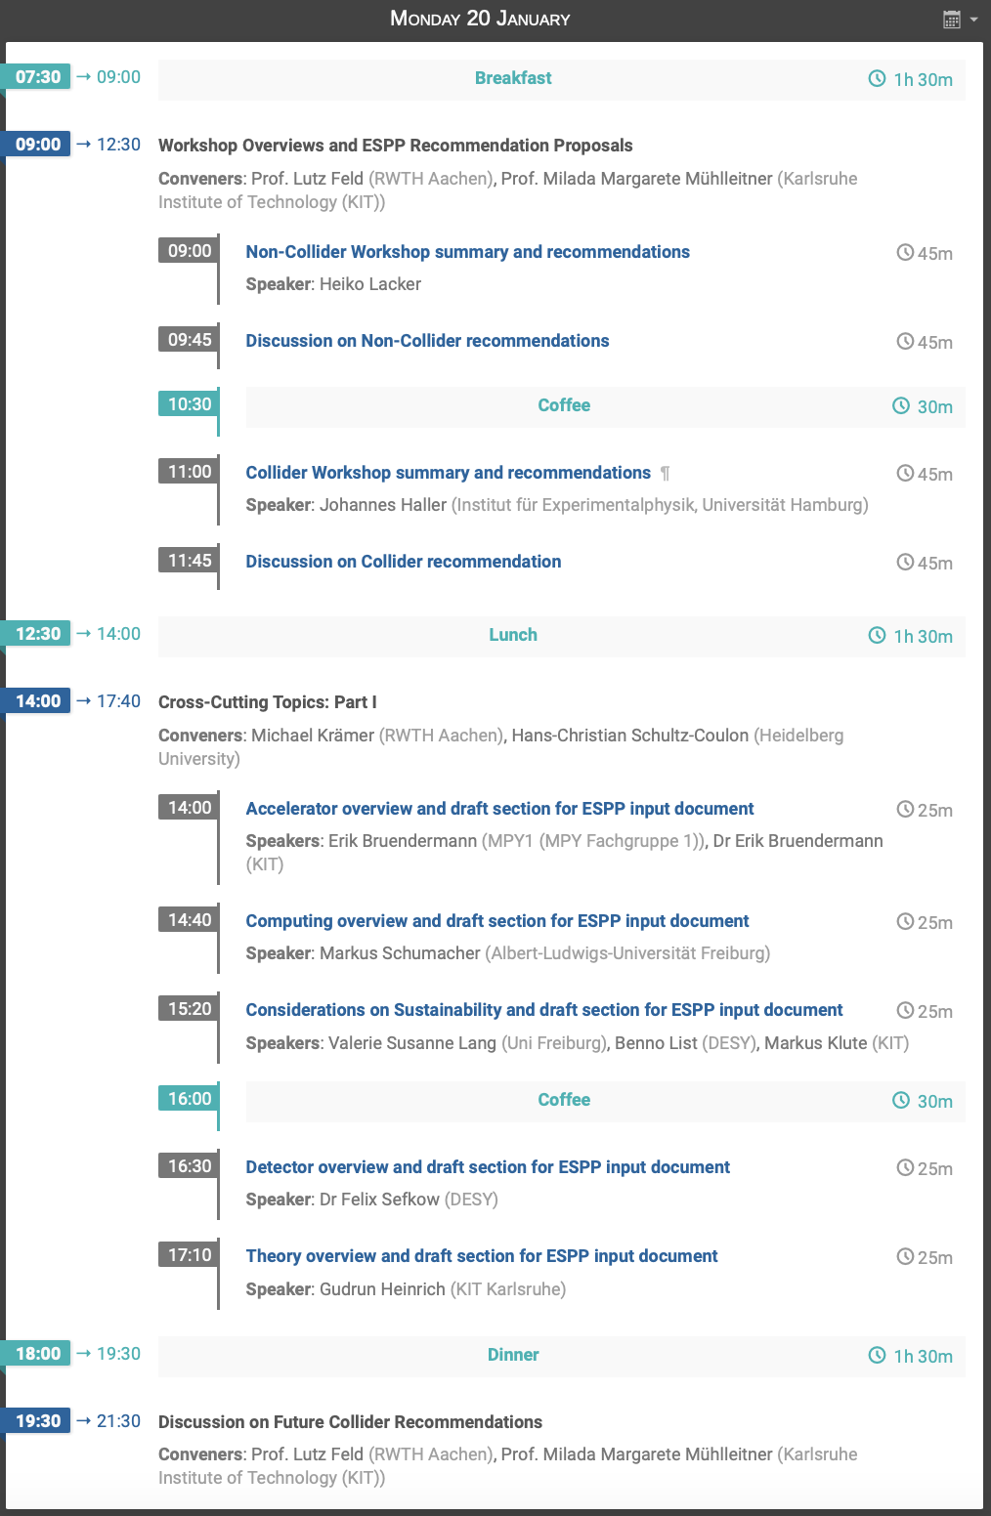
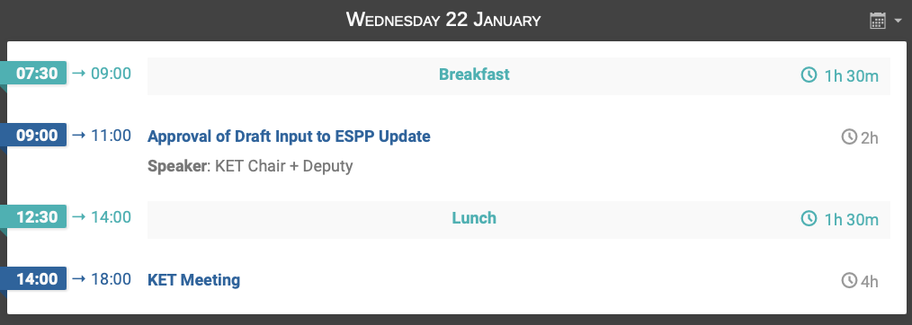
German Input to ESPPU
Statement from 2018: https://www.ketweb.de/stellungnahmen/e298526/KET_ESPP_Statement_2018.pdf
Workshop Jan 19-22 Bad Honnef https://indico.desy.de/event/46923/timetable/
Draft statements are being prepared on basis of preceding workshops, will be presented and discussed
Update workshop later (May?)

