Slide 1

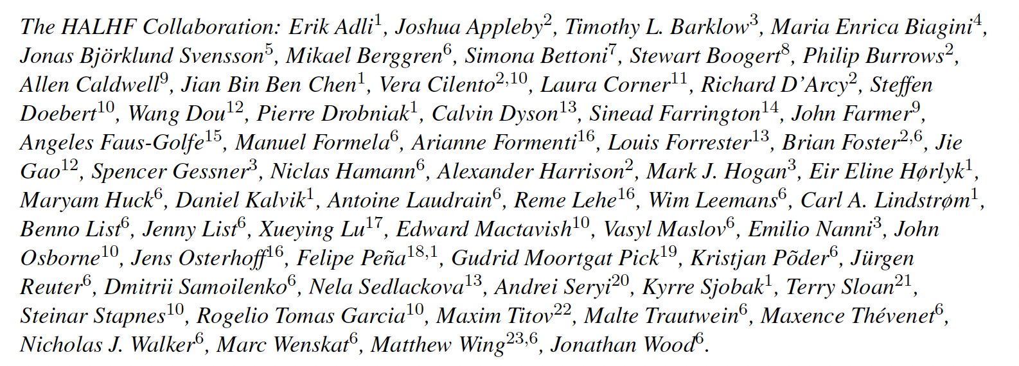
Hybrid Asymmetric Linear Higgs
Factory (HALHF)
10-page: E. Adli et al., https://arxiv.org/abs/2503.19880
Back-up: E. Adli et al., https://arxiv.org/abs/2503.23489

Slide 2

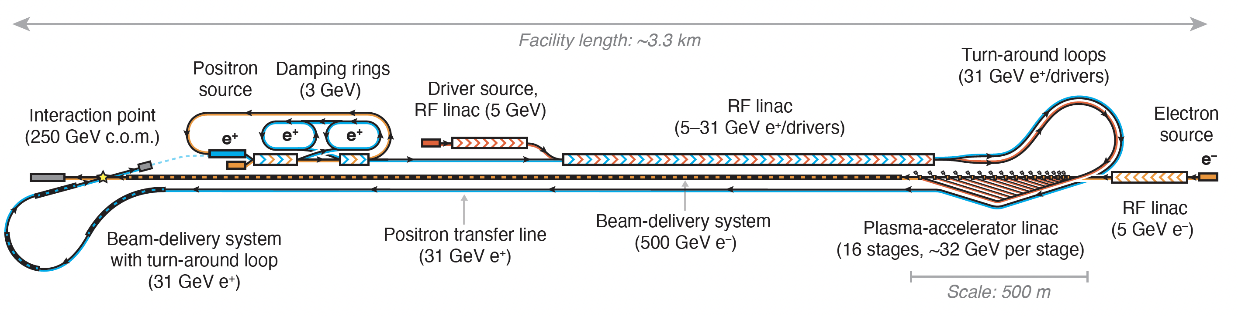
Original Concept
B Foster et al 2023 New J. Phys. 25 093037
e-
e+
e+ BDS
e- BDS
Exploit high gradient of e⁻ acceleration in PWFA and avoid
difficulty of e⁺ acceleration by using conventional RF linac, reducing cost by low E(e⁺) (31 GeV)=> high E(e⁻) (500 GeV), boost γ ~ 2.7 => E_{CM} ~ 250 GeV.
Reduce running costs by increasing current I(e⁺) and reducing I(e⁻); & asymmetric emittance (increased for e⁻) ease PWFA requirements.
Problems: 1) Turn-around problematic & not scalable to high energy
2) Difficult to design “dual-concept” linac.
Addressed by new design – optimisation reduces γ, plasma density etc.

Slide 3
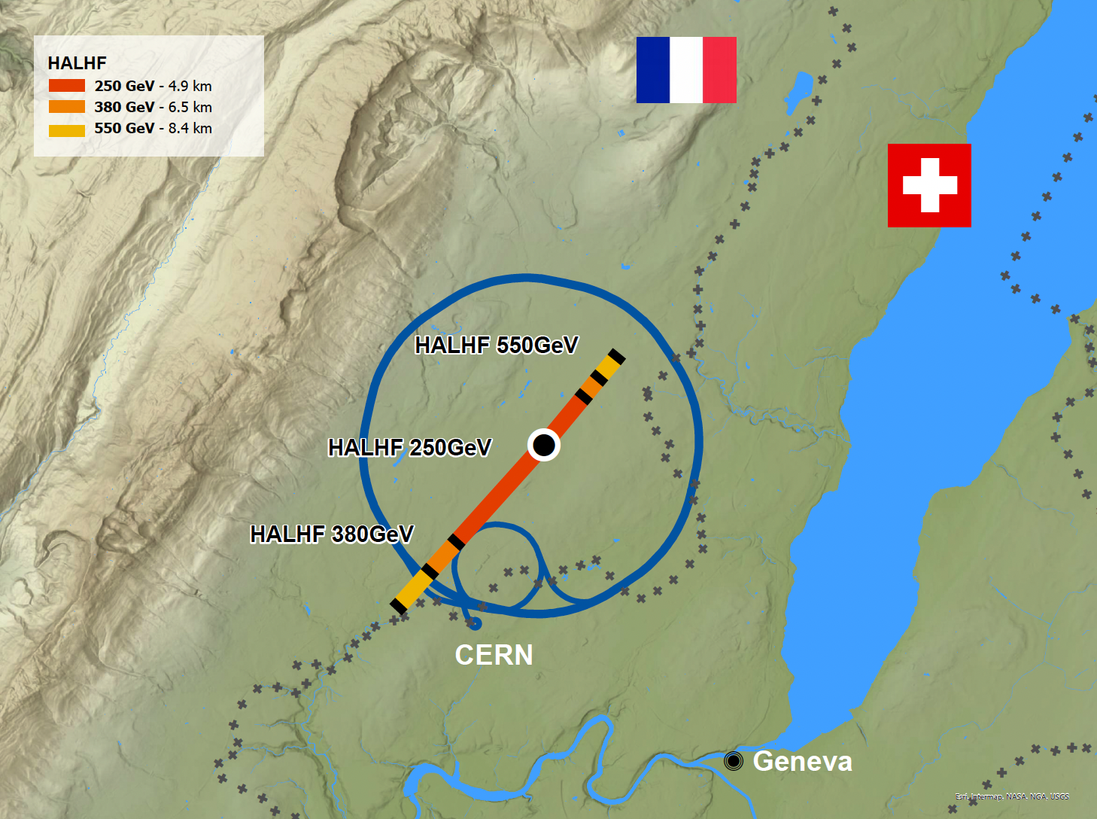
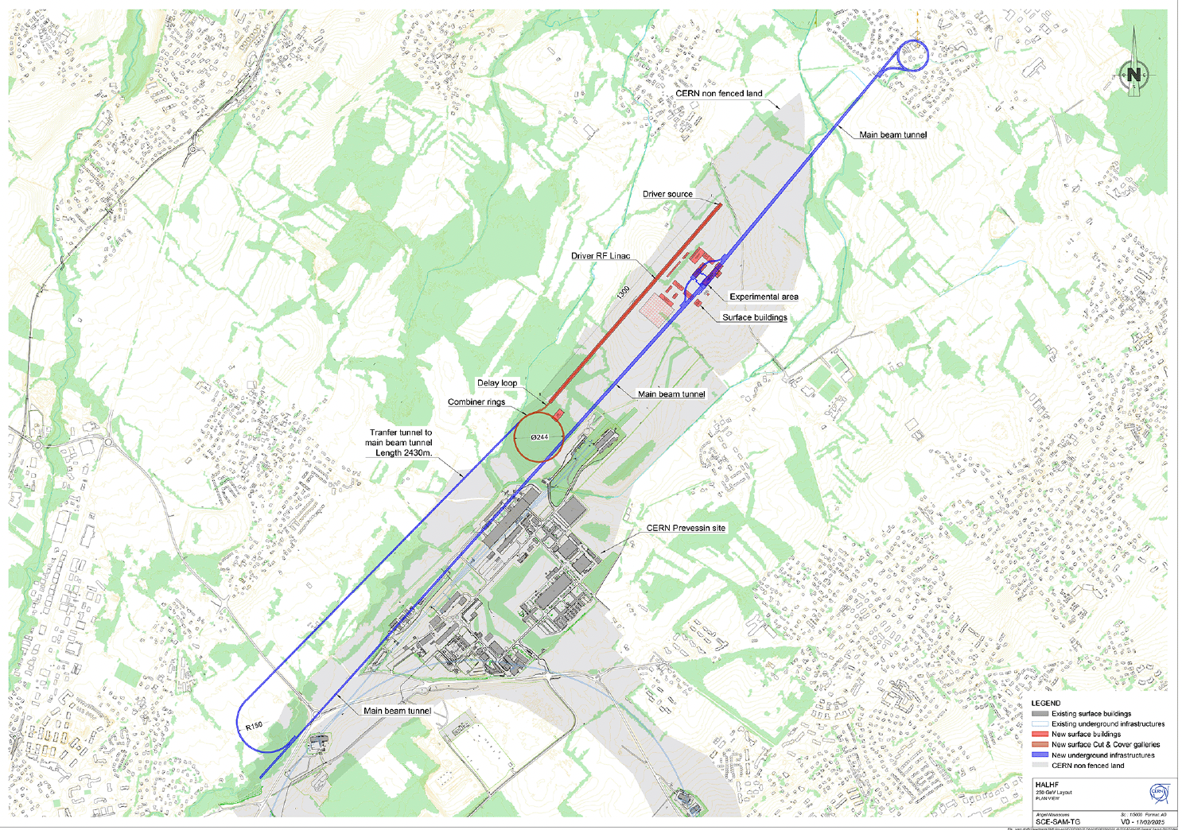
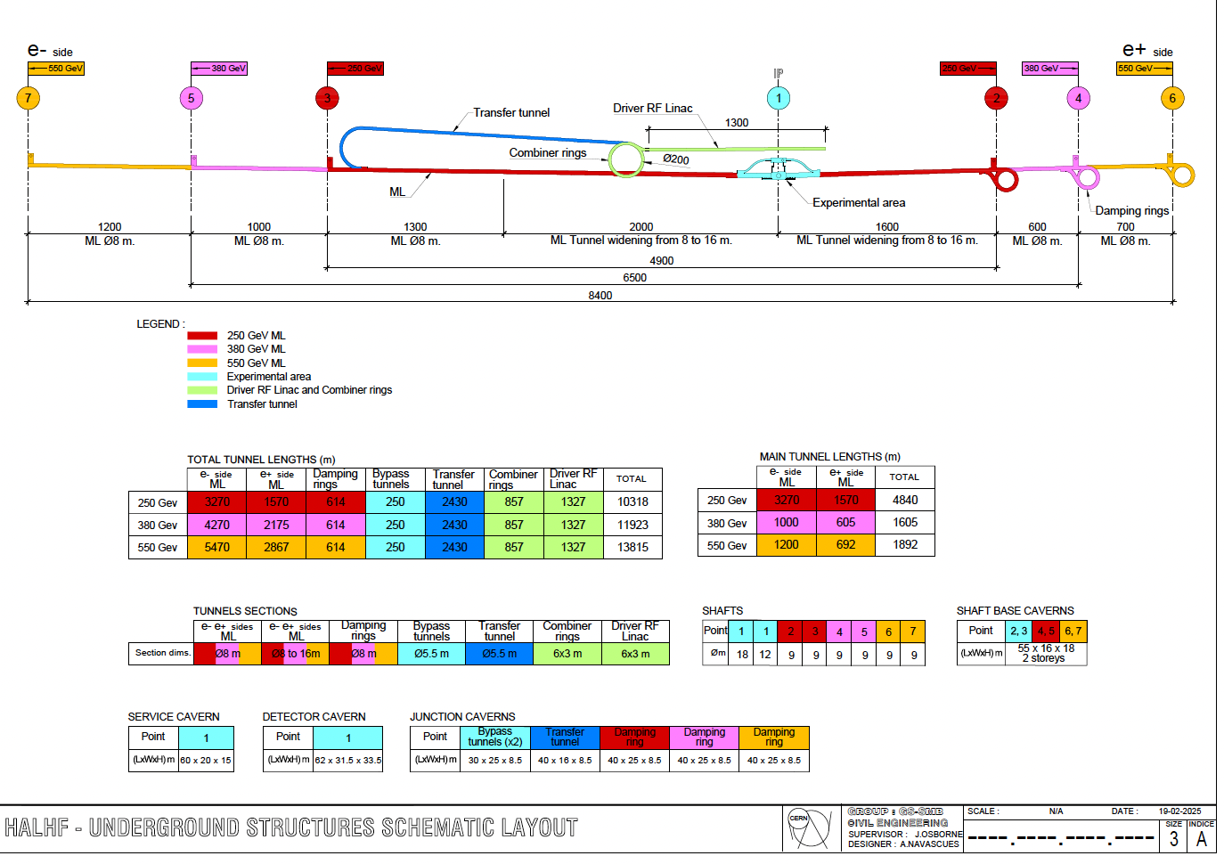
Siting at CERN

Slide 4
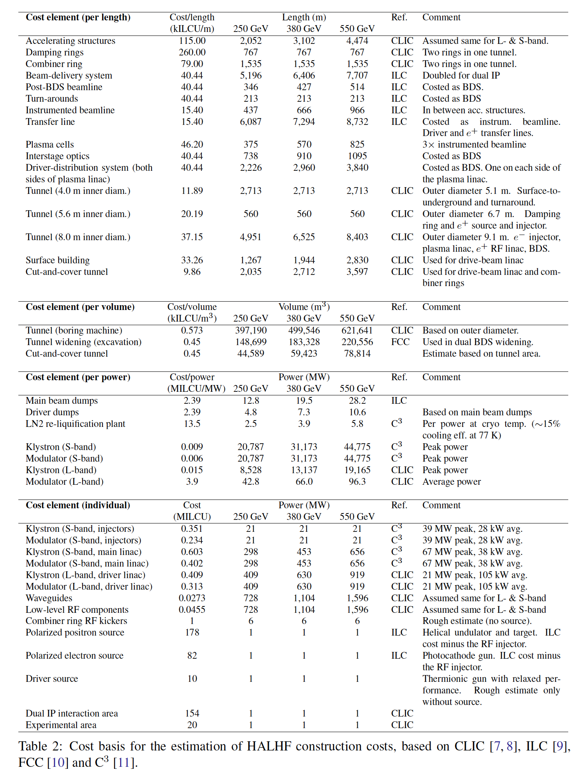
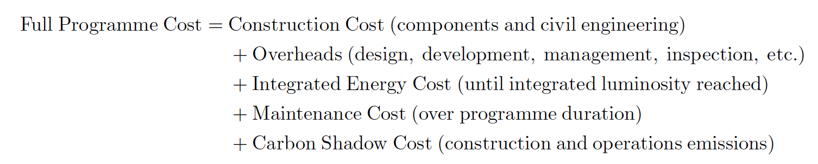
Costing (at CERN)
Full Programme cost – 2 ab⁻¹ @ 250 GeV, 4 ab⁻¹ @ 550 GeV
~ 45% more than capital costs

Slide 5
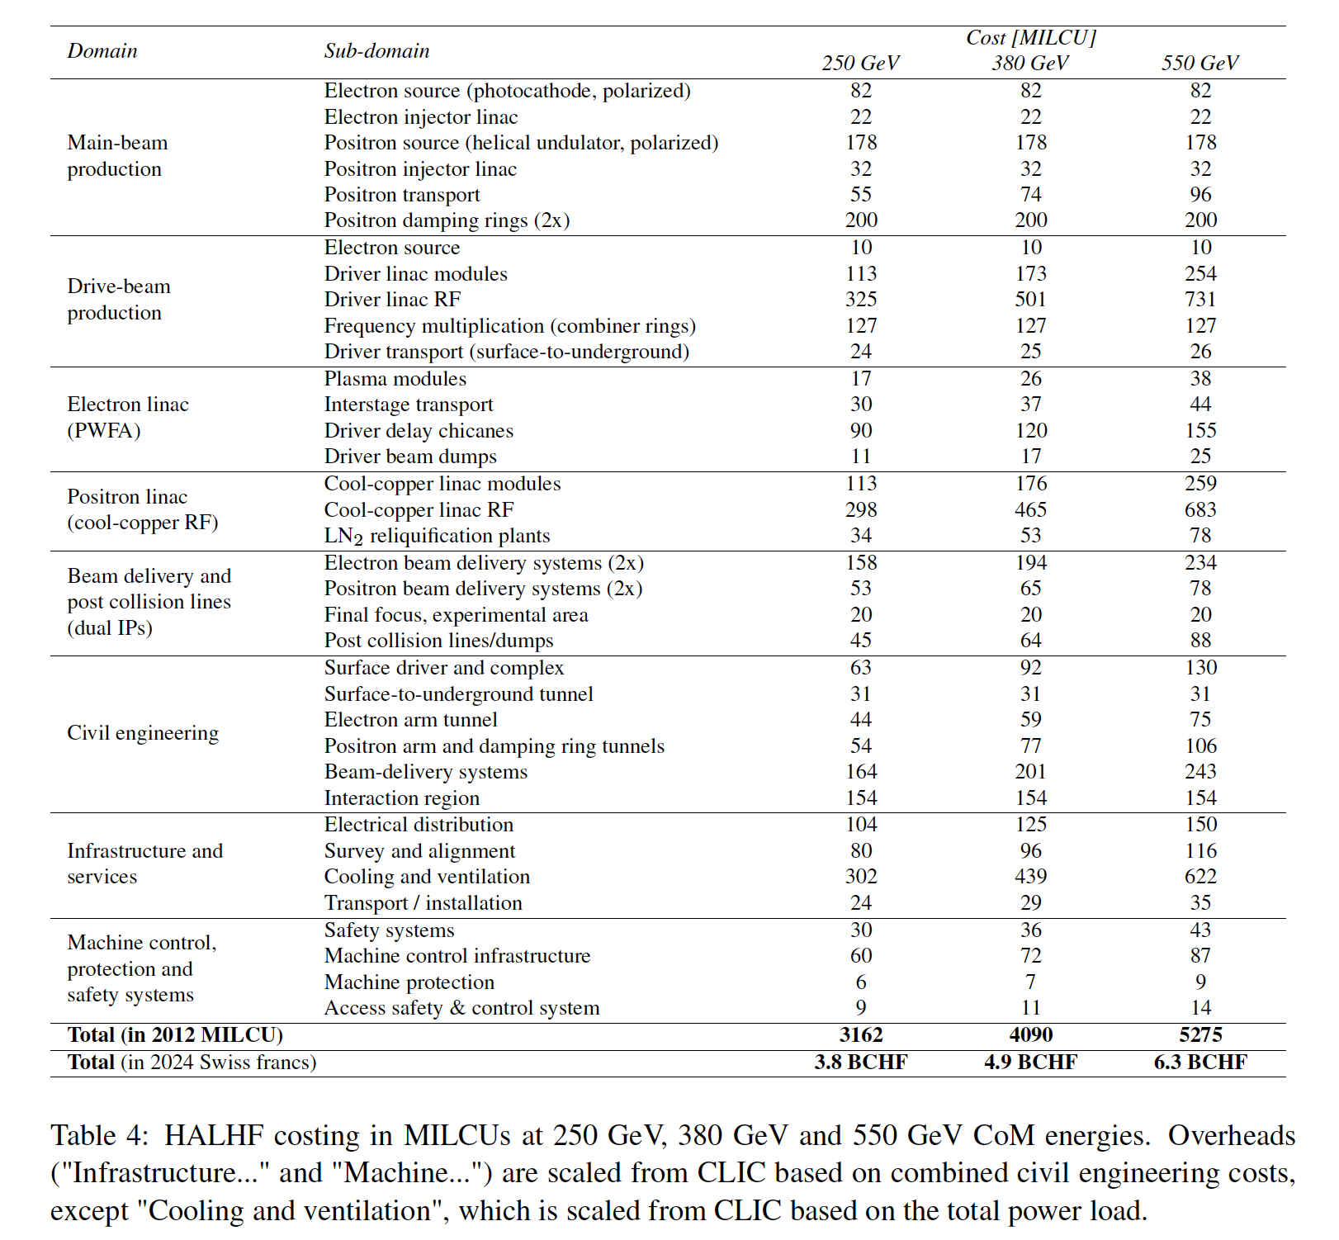
Costing (at CERN)

Slide 6
Summary & Outlook
Despite ~ 0 funding, HALHF is making rapid progress;
Regular monthly HALHF accelerator meetings;
In parallel, physics & detector studies continue (J. List, coord.)
first indications boost does not impact physics reach;
Longer-term goal: pre-CDR & funding to start R&D programme;
HALHF is arguably the only e⁺e⁻ Higgs factory project that CERN can
afford on the current budget (monetary- and carbon-);
HALHF needs 10 - 15 year R&D programme but can still be ready on
~ same time scale as other Higgs factories;
Only way to reach 10 TeV collisions involving electrons; HALHF contributes to 10 TeV design team based in US;
But it might not work!

