Slide 1
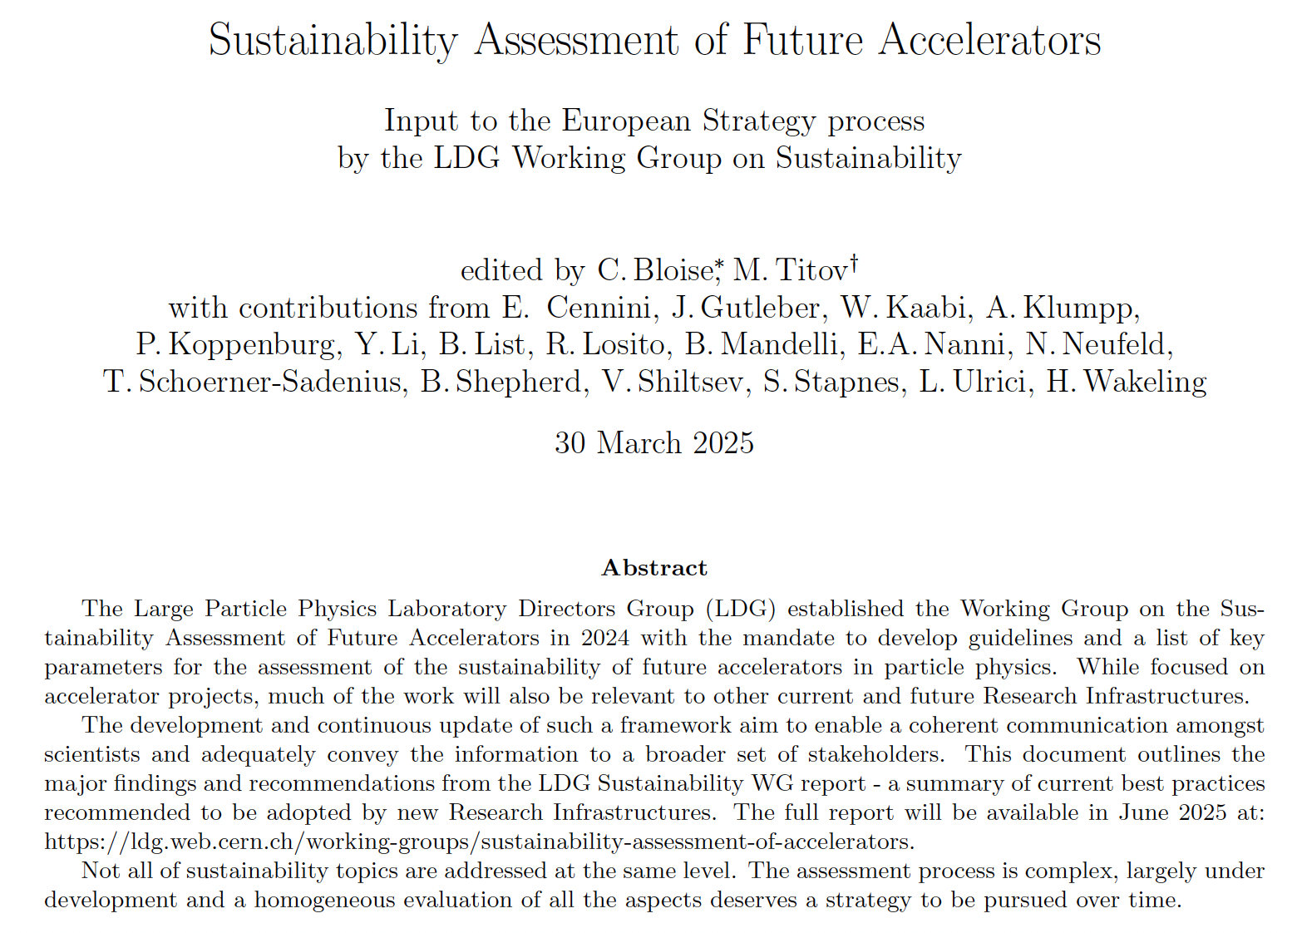
LDG Working Group on Sustainability.
Input to ESUPP
Benno List
4.4.2025
https://arxiv.org/abs/2504.01235

Slide 2
What it is, and is not
It is:
Concise summary of a larger report commissioned by the LDG (Lab Directors Group) on sustainability of future accelerators
A set of recommendations for measuring and improving sustainability of large scale accelerator projects
It is not:
A comparison of projects based on sustainability considerations
Because
No mandate to do this
Insufficient data – studies not finished yet
CERN has set up a separate, internal group to compare proposals for new facilities at CERN

Slide 3
Guidelines and Recommendations
Report explains ways to quantify sustainability: socio-economic impact studies, life cycle assessment
Proposes / recommends use of LCA, with different scope, goal, impact categories depending on project phase
Recommends Greenhouse Gas emissions as key parameter for reporting
Recommends a common reporting format of GHG emissions for large scale projects as basis of comparisons

