Slide 1
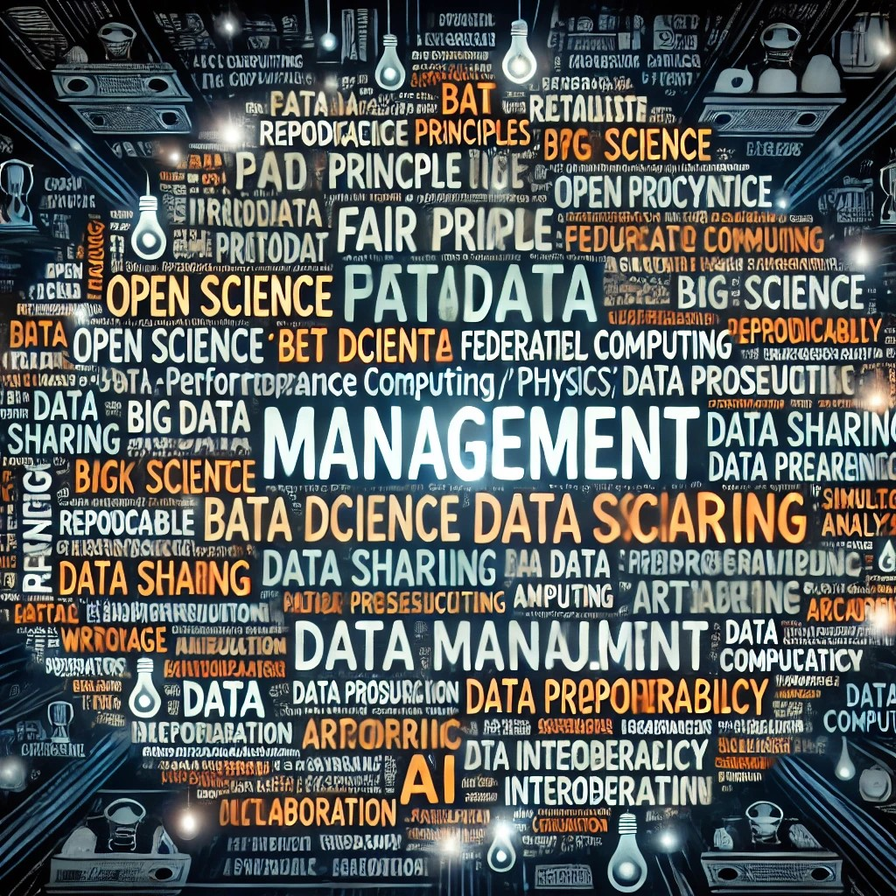
Data Management (1)
FAIR Principles
Metadata
Open Science
Big Data
Federated Computing
Reproducibility
Data Preservation
Data Sharing
High-Performance Computing (HPC)
Machine Learning
Workflows
Simulation Data
Storage
Cloud Computing
Archiving
AI-driven Analysis
Data Provenance
Interoperability
Scientific Computing
Collaboration
Asking chatGPT for wordle data management
PUNCH-2.0 | Kassel 18 February 2025

Slide 2
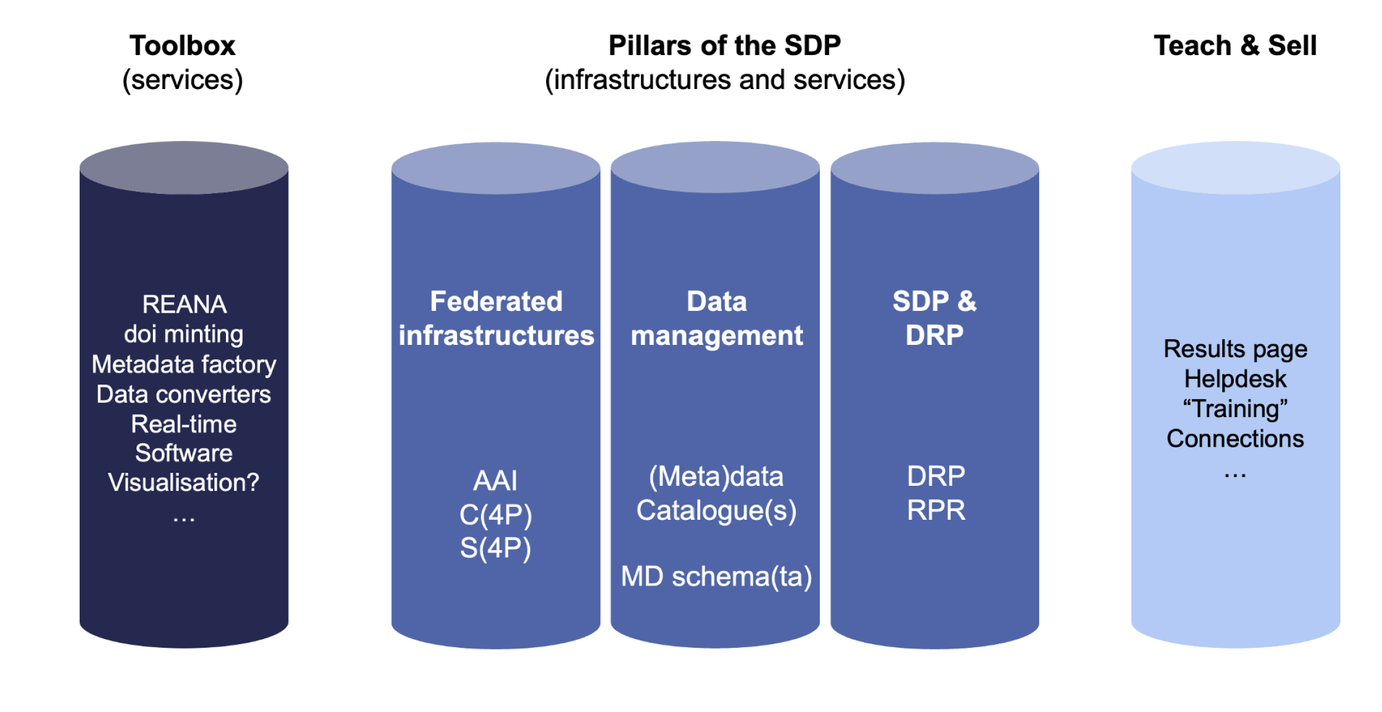
Data Management (2)
Definition of Data Management
Data Management refers to the processes, policies, and tools used to collect, store, organize, preserve, and share data efficiently and securely throughout its lifecycle. In scientific research, data management ensures that data remains accessible, reproducible, and interoperable while adhering to best practices such as the FAIR Principles (Findable, Accessible, Interoperable, Reusable).
PUNCH-2.0 | Kassel 18 February 2025

Slide 3
Common Tools and Services for Research Data Management
Data Storage & Infrastructure
HPC & Cloud Services: AWS, Google Cloud, Microsoft Azure, OpenStack
Federated Computing Systems: Worldwide LHC Computing Grid (WLCG), EOSC (European Open Science Cloud)
Databases: PostgreSQL, MySQL, MongoDB, Apache Cassandra
Data Organization & Curation
Metadata Management: DataCite, Dublin Core, ISO 19115
Data Catalogs & Repositories: Zenodo, Figshare, Dryad, Dataverse
Electronic Lab Notebooks (ELNs): LabArchives, RSpace, eLabFTW
Data Sharing & Accessibility
FAIR Data Repositories: CERN Open Data Portal, OpenAIRE, B2SHARE
Persistent Identifiers (PIDs): DOI (Digital Object Identifier), ORCID, ARK
Data Analysis & Processing
Big Data Processing: Apache Spark, Dask, Hadoop
Machine Learning for Data Management: TensorFlow, PyTorch, Scikit-learn
Workflow Management: Snakemake, Nextflow, Apache Airflow
Data Preservation & Long-Term Archiving
Version Control & Reproducibility: Git, GitHub, GitLab, Zenodo Integration
Backup & Archival Services: LOCKSS, iRODS, DataVerse
Compliance & Policy Support
Regulatory Compliance Tools: GDPR, HIPAA-compliant storage solutions
Data Management Planning Tools: DMPonline, Argos
What is important for PUNCH?
What we define belonging to the pillar RDM?
What tools are approbiate for us?
What results in sustainable services from PUNCH?

Slide 4
Data Management (3) - input
-- DESY will contribute to metadata schemata development and metadata catalogue solutions—e.g.
SciCat and / or ILDG for all DESY activities and beyond (nuclear, small accelerators, ...).
– DESY will develop a defined procedure for a scientific community to arrive at a metadata schema
(best practices, tools, ...)
– DESY will develop metadata schemata & cross-walk registry for conversion between different
metadata schemata for use with various catalogues → would allow for higher degree of interoperability
between different schemata
– DESY will contribute to DOI minting and publication processes.
– FZJ and LRZ will take a role in the next step towards FAIR simulation data by implementing the
strategies developed in PUNCH 1.0 into practice. This includes developing metadata schemes,
easy storage tools, data accessibility tools, connective DOIs, training, etc.)
– FZJ and LRZ will develop workflows and tools for publishing data automatically with metadata, but with the possibility to augment this data by the user, if required. Also, the integration of these published datasets in DRPs is envisaged.
– FZJ will take a role in developing strategies, implementing and teaching energy-efficient research data handling.
– FZJ and LRZ will contribute to connect PUNCH to HPC data handing strategies. JGU is also willing to contribute to this.
PUNCH-2.0 | Kassel 18 February 2025

Slide 5
Data Management (4) -- input
– AIP will contribute to DOI minting and publication processes using DRP
– KIT will contribute to to metadata schemata development and metadata catalogue solutions, in particular taking into account the demands and needs for Astroparticle Physics.
– FAU will contribute to metadata for software (link to CodeMeta)
– AIP will contribute to improve findability of data across PUNCH communities and accessibility using community specific protocols (astropy/TAP, etc)
– GSI will work on enhancing metadata schema for Nuclear physics communities, with improved end-user interfaces and catalogues.
– GSI will contribute to API developments to enable transfer of metadata across interfaces: development of knowledge graphs to link schema with bibliographic systems, data repositories, data management planning tools, code repositories, etc.
– GSI will contribute to establishing metadata cross-links with broader communities like NAPMIX to ensure interoperability.
– UBI will continue to work on metadata catalogue improvement both in lattice and astro
– DZA will contribute to R&D on metadata in the petabyte range (relevant for SKAO) and provide
access to this data.
– DESY, FZJ, UBi and UR will contribute the development of modular distributed (meta-)data management
services for the hep-lat (lattice) and further communities.
– FZJ and DESY will contribute the minting of persistent identifiers (“DOI minting”) and data publishing
workflow as part of a modular distributed (meta-)data management.
– UR will contribute the development and extension of the data provenance information for use in
the modular distributed data and metadata management services.
PUNCH-2.0 | Kassel 18 February 2025

Slide 6
FAIR Principles
Metadata
Open Science
Big Data
Federated Computing
Reproducibility
Data Preservation
Data Sharing
HPC
Machine Learning
Workflows
Simulation Data
Storage
Cloud Computing
Archiving
AI-driven Analysis
Data Provenance
Interoperability
Scientific Computing
Collaboration
Data Management (5)
Data Storage & Infrastructure
Data Organization & Curation
Data Sharing & Accessibility
Data Analysis & Processing
Data Preservation & Long-Term Archiving
Compliance & Policy Support
Matrix?
Metadata schemata ➔
Metadata conversion ➔
Metadata minting/finding ➔
Metadata for simulation / software ➔
Metadata provenance / archive ➔
Energy-efficient data handling ➔
Knowledge Graph ➔
PUNCH-2.0 | Kassel 18 February 2025

