Slide 1
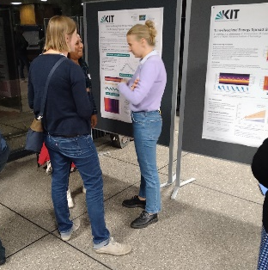
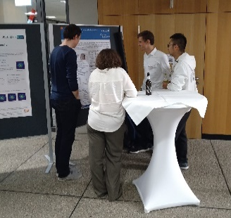
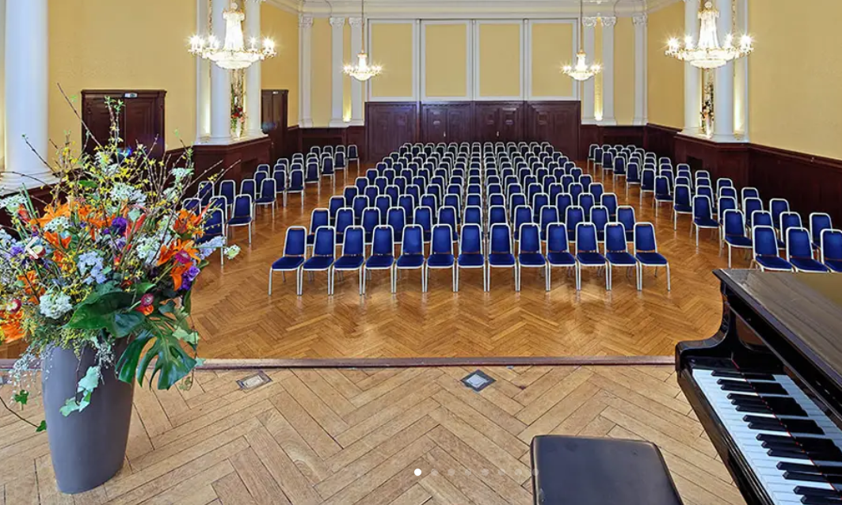
PoF: What, Why and How
The Center Review at DESY in 2025
Ties Behnke
FH PoF Information Meeting 2024

Slide 2
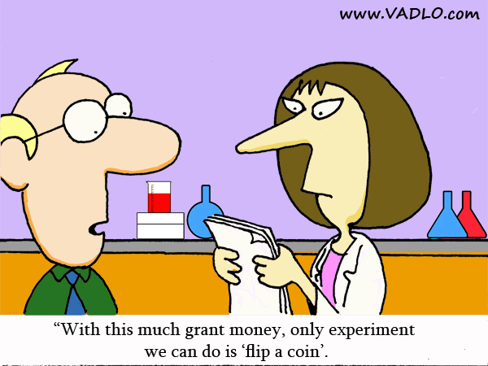

Research Costs Money

Slide 3

Fund your research: PoF
Funding from the government
Pre-2000
Research centers

Slide 4
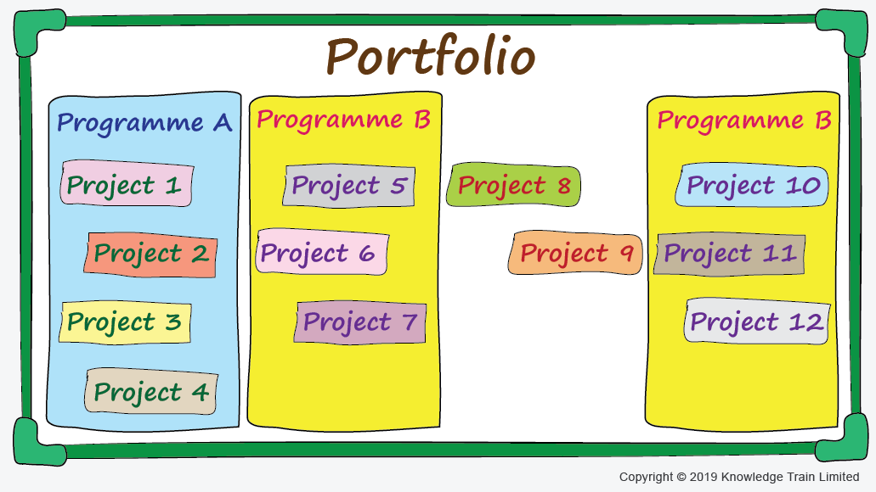
Fund your research
Funding from the government
(our base funding, the majority of the money we have)
Pre-2000
Post-2000
C
Research centers

Slide 5
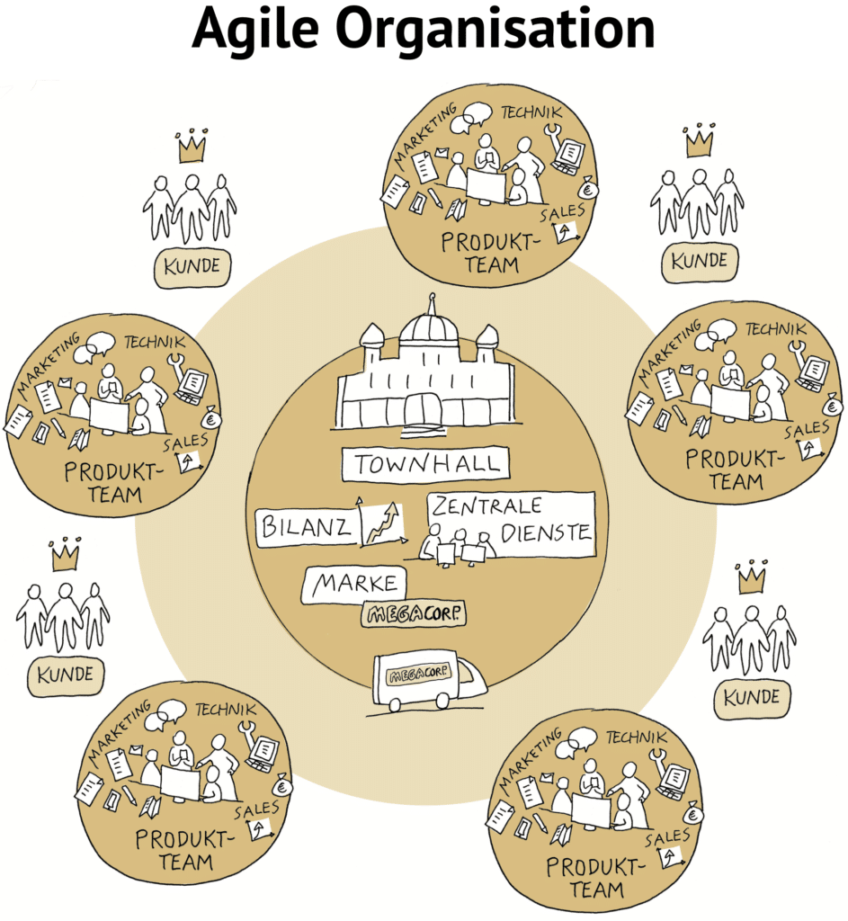

Why a programm structure?
Agility
Adapt to a changing
research landscape
Efficiency
Adjust portfolio more
easily
Exploit synergies
Increase cooperation

Slide 6
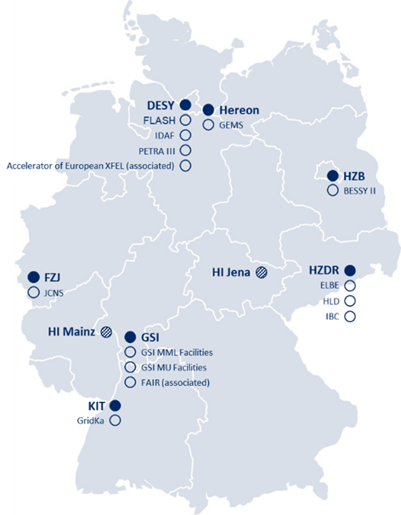
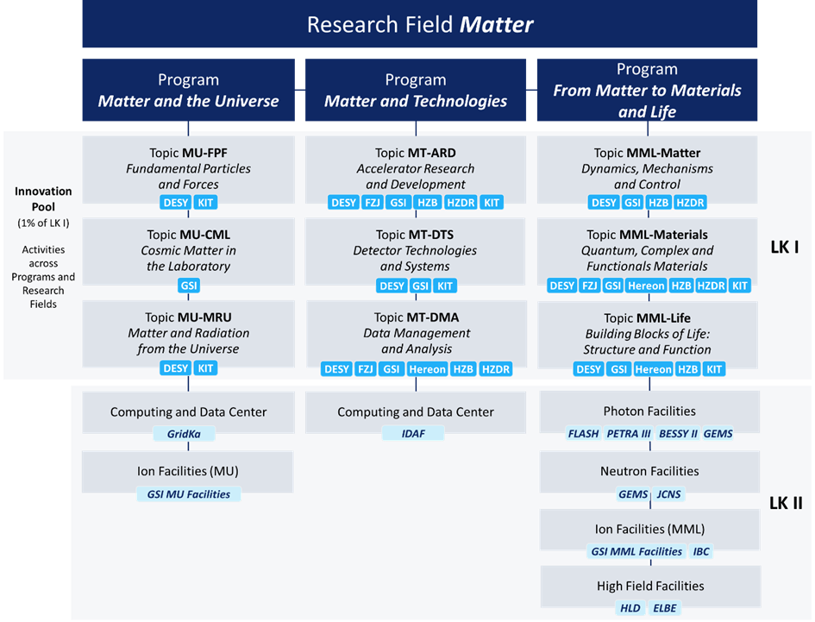
The research field “Matter”: the status quo
The upcoming center review will look at
our achievements within PoF IV!

Slide 7

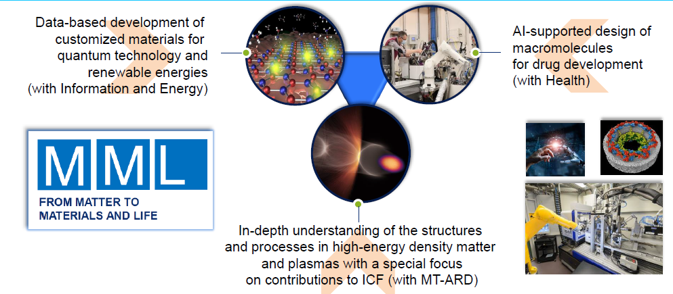

Positioning FH in Matter
ARD, DTS, DMA
FH
FPF
“DTS, DMA”

Slide 8

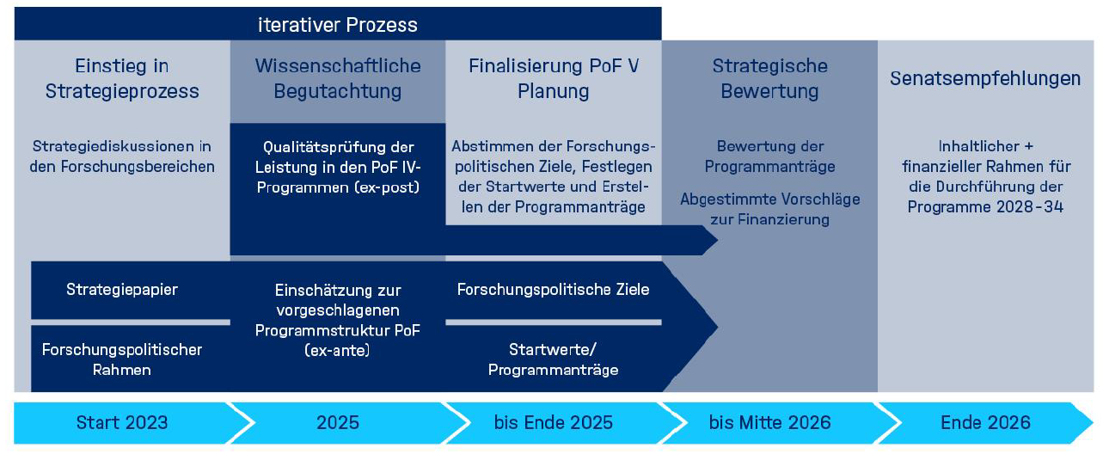
The PoF V process a review cycle every seven years
Step 1: Center review at DESY
Feb 2025
Step 2: Strategic review: 2026
Funding decisions for the next seven years

Slide 9
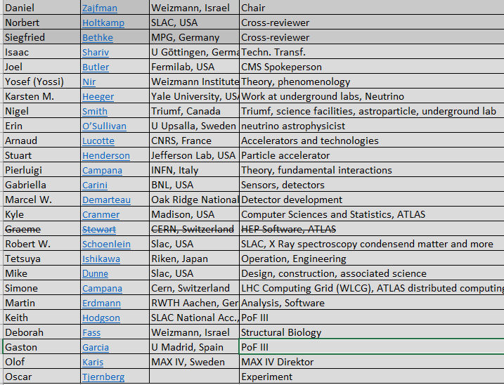
The reviewers team

Slide 10
What the results of the review mean
The DESY base funding will be determined based on the results from the
review
Helmholtz gets an overall increase: distribution of the increase will
depend on the review
In theory reduction of the budget is also possible

Slide 11
The Center Evaluation at DESY
Evaluation is centered on DESY, through structured along program
lines
Evaluation and grades will be given at the levels of topics
  MML RT1-4
  MU FPF (Particle Physics)
  MU MRU (Astroparticle)
  MT-ARD
  MT-DTS
  MT-DMA

Slide 12
Questions to the reviewers I
Review unit is the topic
Scientific performance and impact:
How do you rate the scientific quality and the innovative potential of the research activities?
At what level is the research internationally competitive?
How do you rate the transformative impact of the research on the field and/or potential for significant societal or economic impact?
How do you evaluate the scientific achievements in relation to its size, available infrastructure, and funding?
What are specific strengths and weaknesses?
Can you identify novel contributions to the field? If so, which are they?
Please indicate the most prominent research results (up to three).
Can you identify scientists with exceptional contributions to the field?

Slide 13
Questions to the reviewers II
Review unit is the topic
Contribution to the topic
How do you rate the impact of the center’s contributions to the topic? Which are essential, important, or additional contributions?
Please comment in view of originality and strategic relevance for this research field, the re- search policy objectives as well as the topic’s key objectives and milestones.
How do the different research groups of the topic interact with each other?

Slide 14
Questions to the reviewers III
Review unit is the topic
Potential contributions to future strategic priorities of the research field (future program period)
How do you rate the future scientific prospects and direction of the topics with respect to the strategy of the research field, but also in comparison with national and international roadmaps in the respective research area?

Slide 15
Questions to the reviewers IV
Rating the topic
Scientific achievements and impact
Outstanding | Excellent | Very good | Good | Fair
Originality and innovative potential
Outstanding | Excellent | Very good | Good | Fair
International standing and competiveness
Outstanding | Excellent | Very good | Good | Fair

Slide 16
Organisation of the review
Fundamental Flow of the review
Introduce the research field and the program organization
Introduce the center which is reviewed and where it contributes to the
research field(s)
Introduce the programs at the center
Describe the scientific achievements during PoF IV within the scope of the
program topics
Discuss general strategic questions
  Cooperation strategies
  Diversity and equal opportunity
  Innovation
  Sustainability
  Talend Management

Slide 17
The program
Friday, Feb 07, 2025: Visit to DESY Zeuthen
Monday – Friday, Feb 10-14, 2025: DESY Hamburg

Slide 18
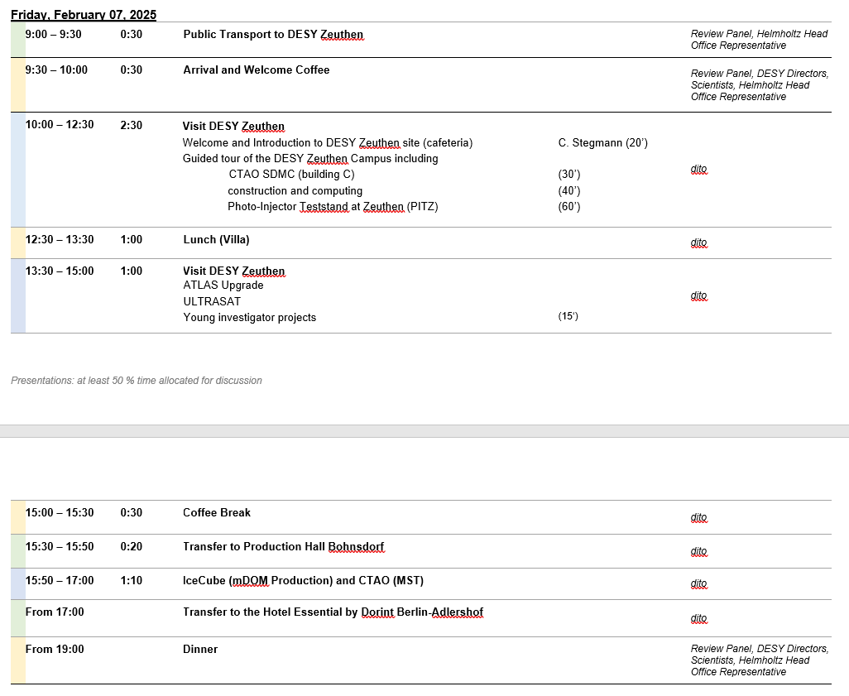
The Zeuthen Visit

Slide 19
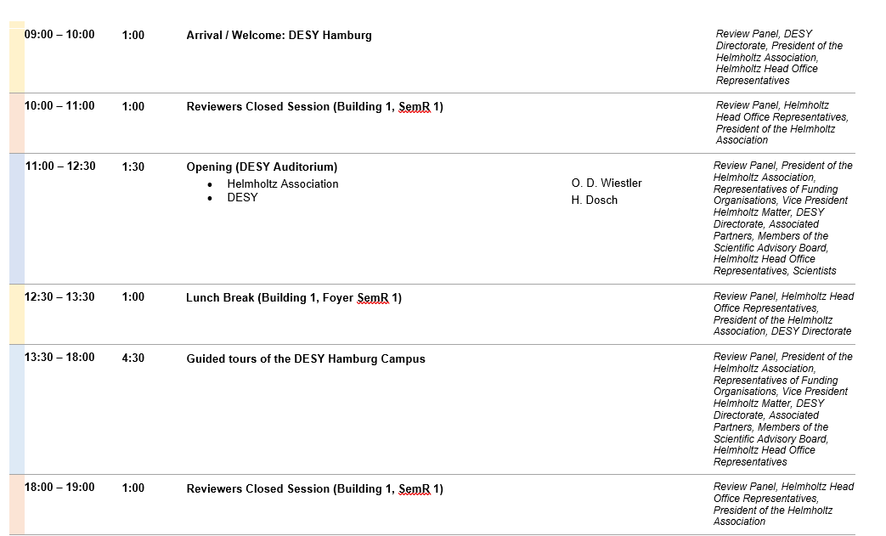
The Hamburg Visit: Monday

Slide 20
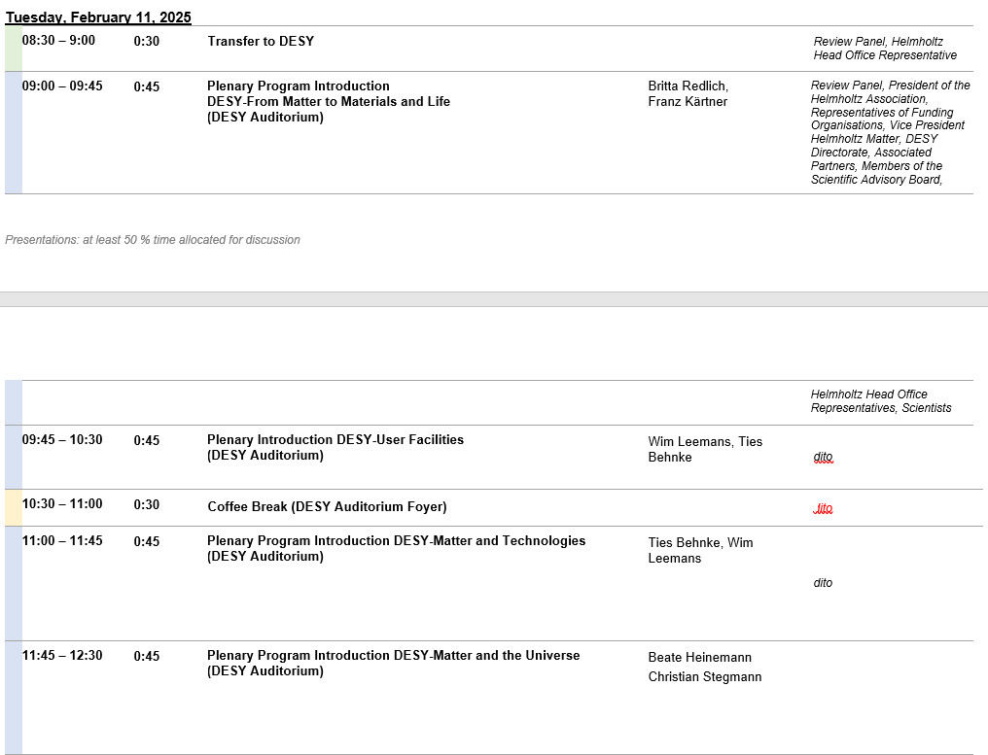
The Plenary Program
Main goal:
Show how DESY is embedded into Matter, and which role DESY plays
Make clear scope and size of the programs at DESY
Prepare the ground for the more detailed parallel discussions of the topics
Present a few scientific highlights which demonstrate the quality and
positioning of the DESY contribution to the topics
Speakers: mostly DESY directorate as they are responsible for the
shaping of the scientific program(s)

Slide 21
The parallel program
Tuesday
Wednesday
 | Market Place
Poster Session | Discussion with strategic partners
Thursday
- last questions
Reviewer work
Friday
Reviewer work
First announcement
of results
MU FPF | MT DMA | MML | Facilities FLASH
MU AP | MT DTS | MML | Facilities IDAF XFEL
MU FPF | MT ARD | MML | Facilities PETRA

Slide 22
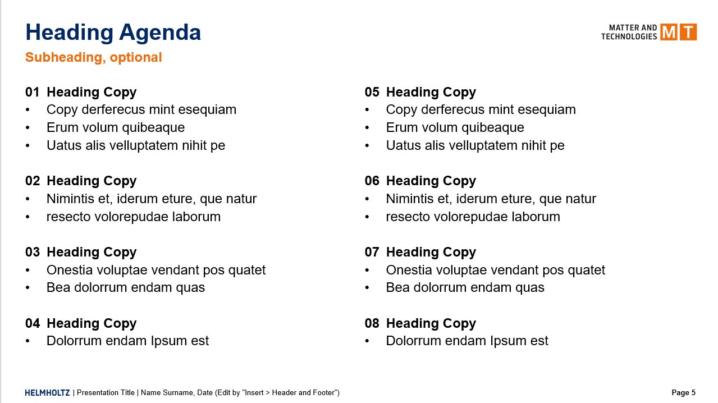

Talks
Still some discussions
on the final layout
Include a clearer DESY
connection?

Slide 23
What the parallel talks should transport
Answer the questions for the reviewers
Show the Impact DESY has had on the topic, be very explicit
Include concrete references to people who have done the work (at DESY)
Make connections to “strategic topics” like innobation/ Talent management in the talk
Character is more strategic than highligh
How do you rate the scientific quality and the innovative potential of the research activities?
At what level is the research internationally competitive?
How do you rate the transformative impact of the research on the field and/or potential for significant societal or economic impact?
How do you evaluate the scientific achievements in relation to its size, available infrastructure, and funding?
What are specific strengths and weaknesses?
Can you identify novel contributions to the field? If so, which are they?
Please indicate the most prominent research results (up to three).
Can you identify scientists with exceptional contributions to the field?

Slide 24
Style of the talks
Follow – as much as possible – the assertion – evidence model
Example:
Introduction into plasma acceleration
We find novel ways to accelerat electrons
More direct communication to the listener
Makes it easy to have a clear message per slide
Invites you to come up with “punchlines”

Slide 25
Poster Session
2 hour session on Tuesday evening (in part before the parallel
Sessions)
Only young researchers
Senior people are not allowed at the session, no backup: you are on your
own
The posters should cover individual research achievements done by
the poster presenters: highlight character
Do not overload the posters

Slide 26




Title: use assertion here
Program and Topic
Poster presenter: only the presenter, if
part of a collaboration, mention this elsewhere
Have a central area on your poster
with the central message/ picture
Proposal: include here a “blob” with
information on the presenter
Logos by collaborators
(but do not overdo it)

Slide 27
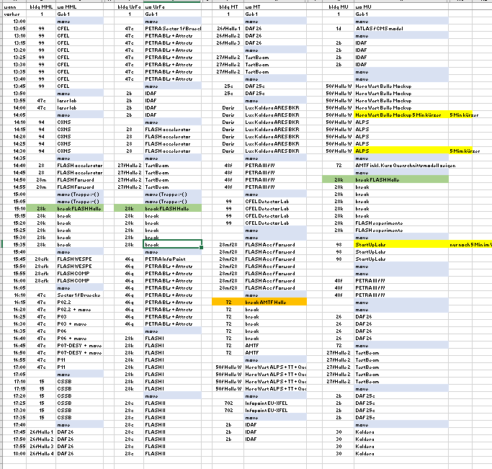
Tours
PETRA IDAF FLASH test beam PETRA FLASH
CEFL Laser CXNS FLASH FLASH PETRA CSSB DAF
DAF TB DAF LUX/Acc PETRA CFEL Det FLASH HERAW XFEL
IDAF HERAW ALPS AMTF FLASH Startup PETRA DAF TB DAF

Slide 28
Tours
High level information at each point
Contact to people at each point
No talks, only short introduction, then showing around
Show activity, show a range of issues and people
Tours will be accompanied by tour guides
Point out DESY sights while walking

Slide 29
Things to remember
Be authentic
You should know “Helmnholtz speak”, but you should not use it much
But know your program/ topic
Know what DESY does in general
Remember: this is a scientific review, so the science should take center stage

Slide 30
Rehearsals and Review
Dress rehearsal:
January 13/14
(will be transmitted by zoom, people should use this possibility)
MU/ MT rehearsals: Jan8 (DMA), Jan 9 (DTS), Jan
Participants:
Every one who makes a contribution
Also at the main review: lists will be distributed
A few others (still to be nominted, numbers are limited)

Slide 31
Towards POF V
Preparations for POF IV center evaluation
Review committee for step 1:
  Chair: Daniel Zajfman
  FPF: Joel Butler (FNAL), Yossi Nir (Weizman), Pierluigi Campana (LNF)
  DTS: Gabriella Carini (BNL), Marcel Demarteau (ORNL)
  DMA: Kyle Cranmer (Wisconsin), Graeme Stewart (CERN), Simone Campana (CERN)
  Tier Computing: Martin Erdmann (CERN)
  Other relevant.known names: Karsten Heeger (Yale), Nigel Smith (TRIUMF), Stuart Hendersen (Jlab), Siggi Bethke (ex MPP), Norbert Holtkamp (SLAC)
Center Review Meeting February 10-14
  Most likely you are needed February 10-12
PoF V is coming
We need to make an excellent show.
There is little to gain, but a lot to loose

