Slide 1
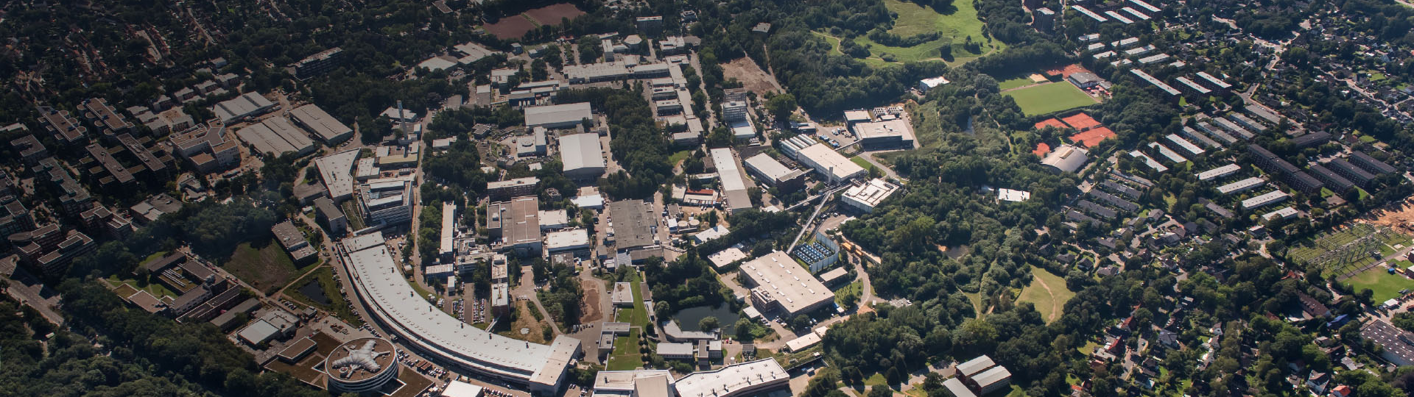

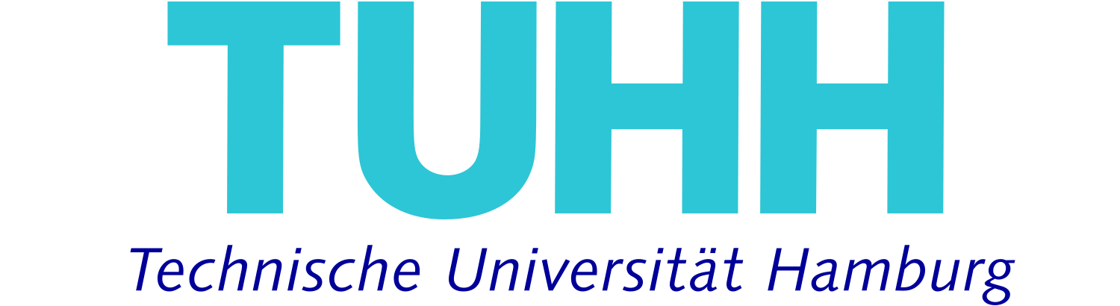

OPAL-FEL General Meeting 14th Jan.
Henrik Tünnermann
Deutsches Elektronen-Synchrotron DESY, Notkestraße 85, 22607 Hamburg, Germany
HIR^3X: Helmholtz International Laboratory on Reliability, Repetition, Results at the most Advanced X-Ray Sources
Notes:
HIRX slac
erwähnen
Push for ai

Slide 2
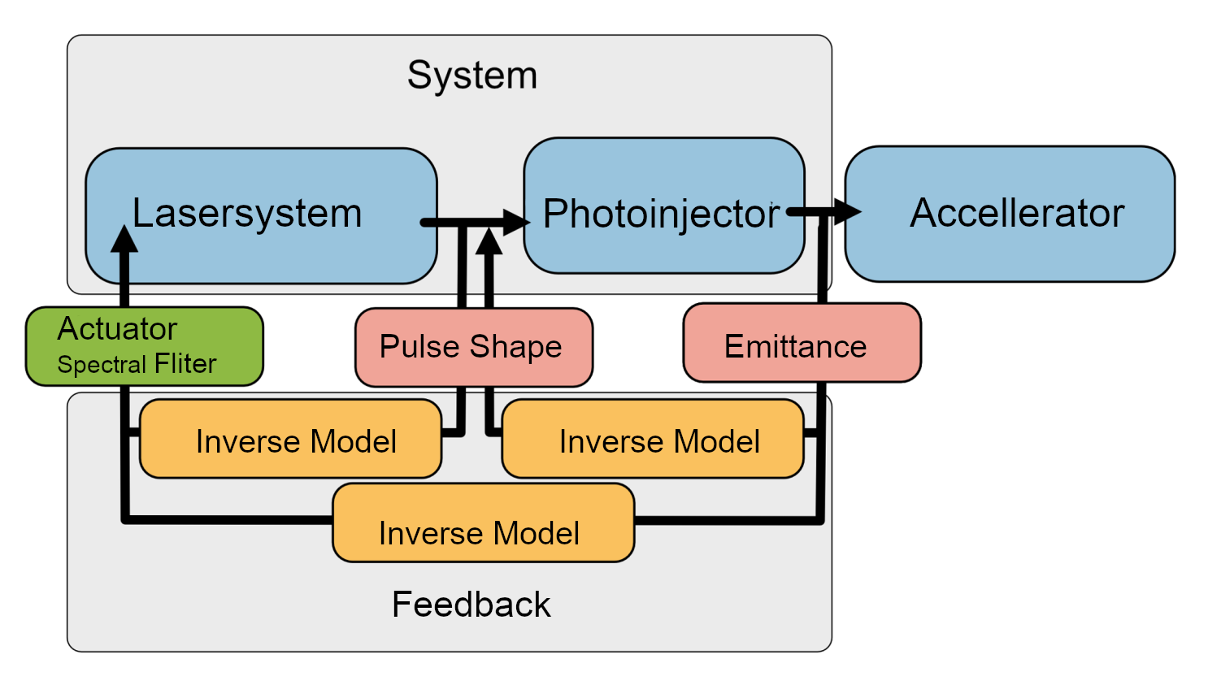
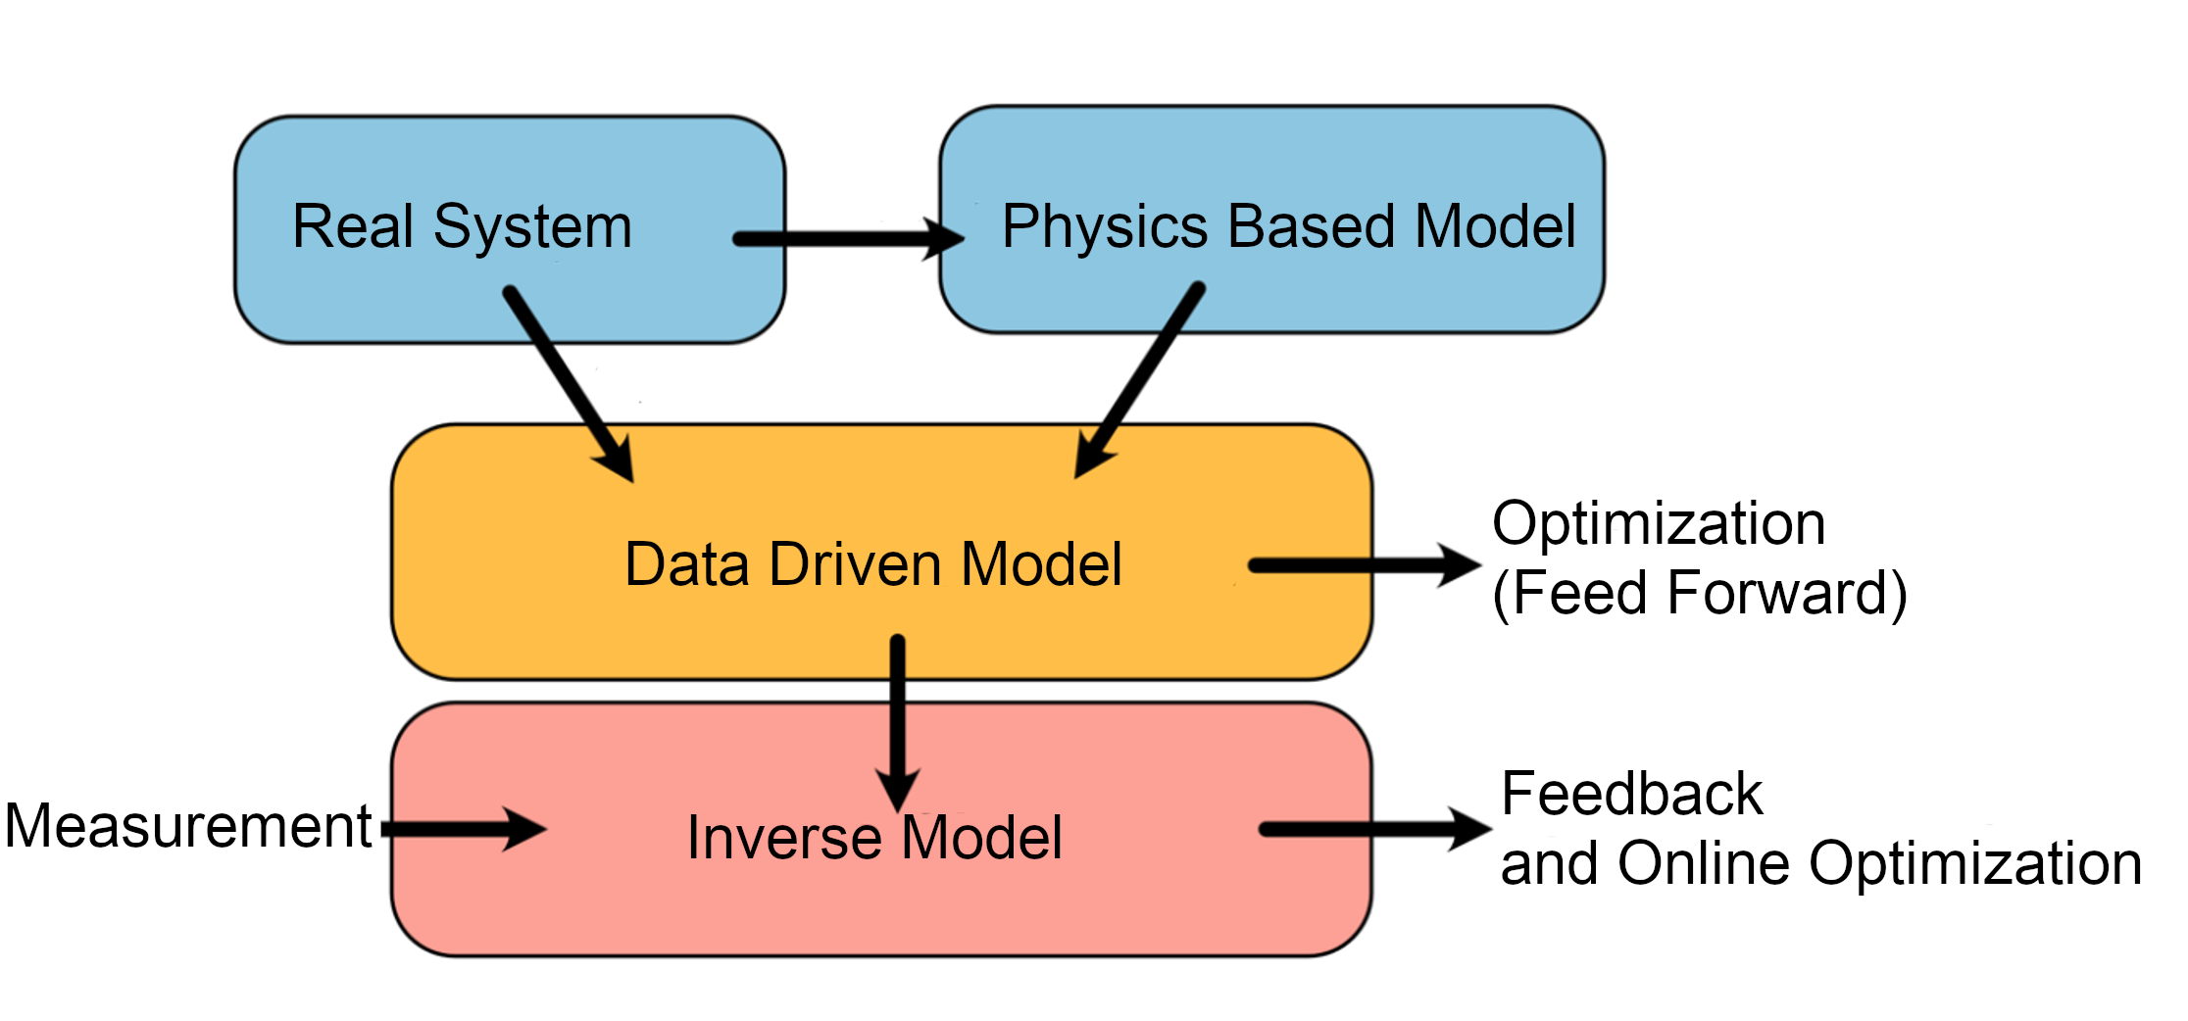
OPAL-FEL Concept

Slide 3
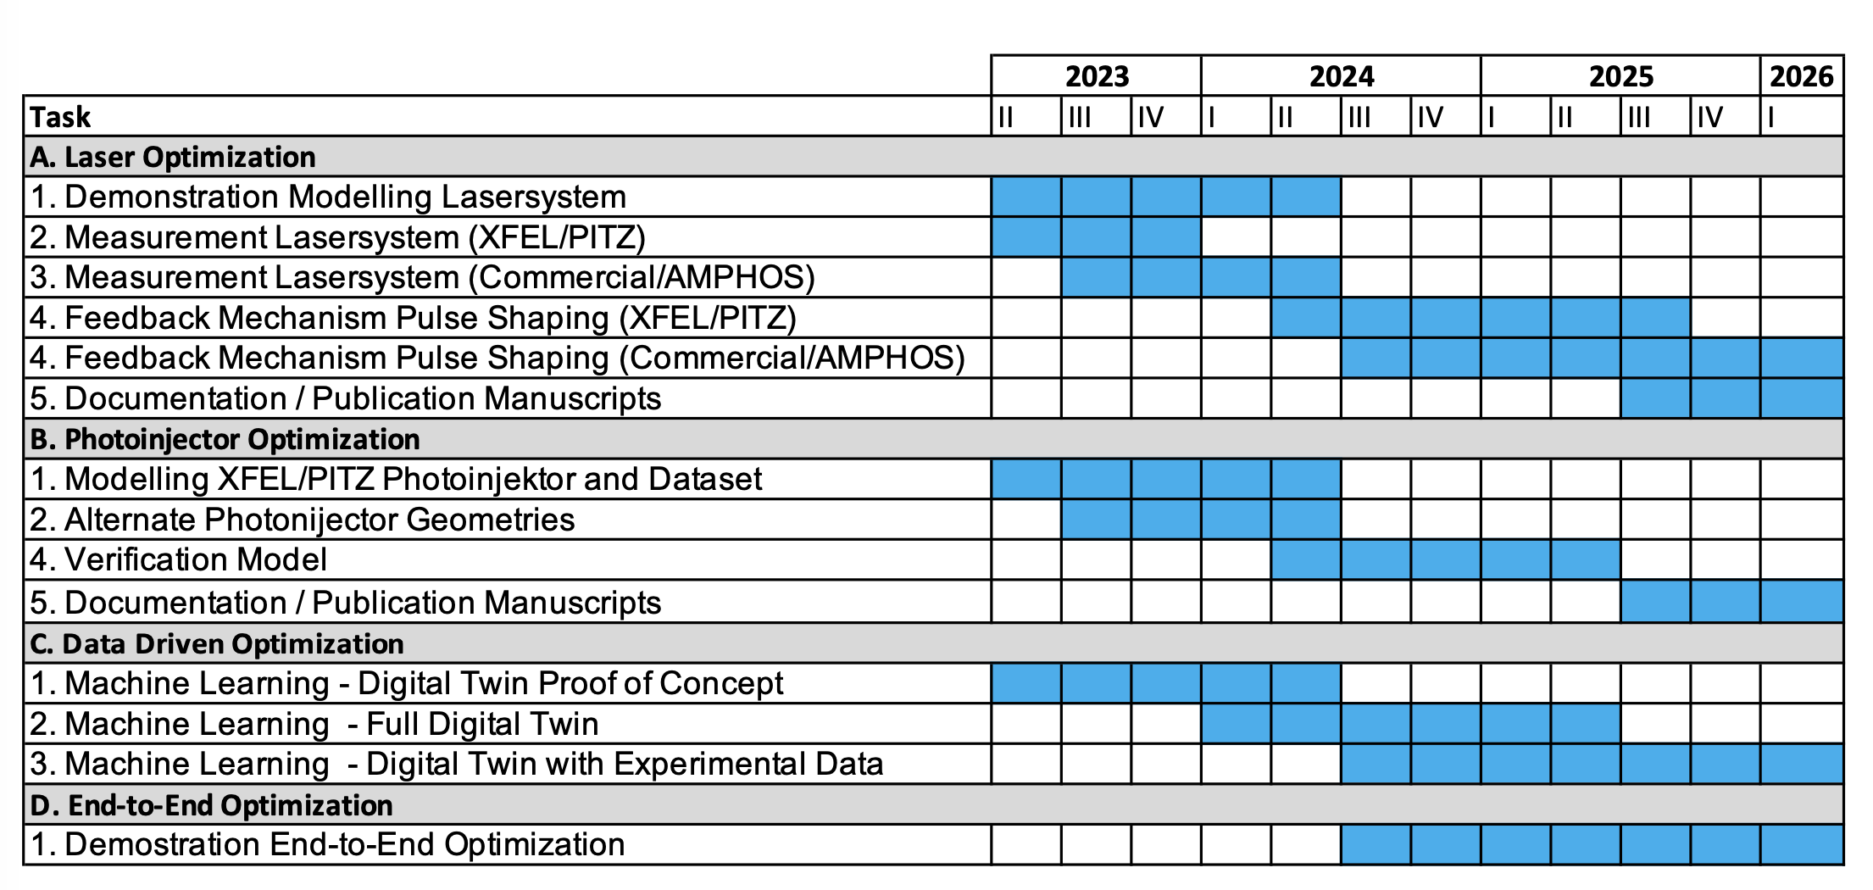
Timeline
We are here

Slide 4
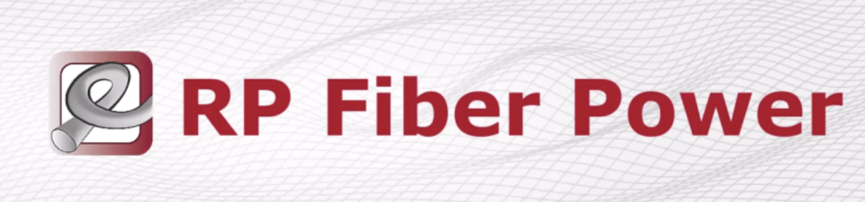
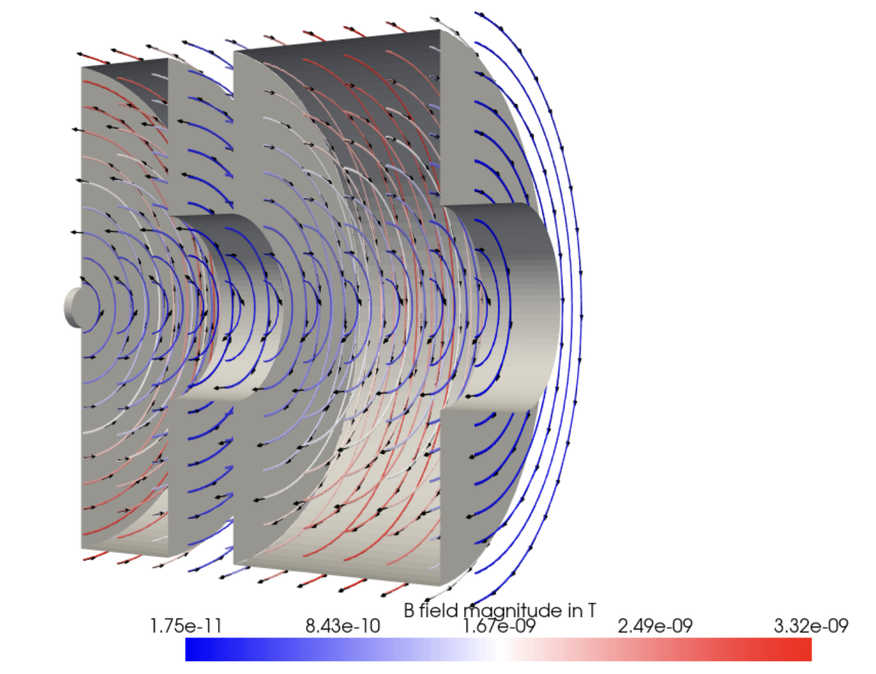
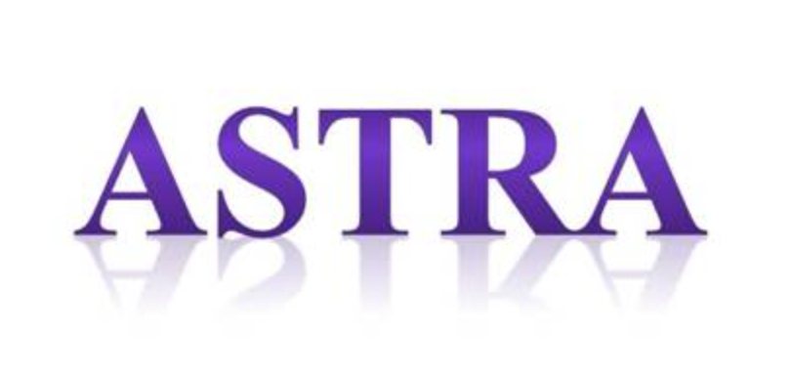
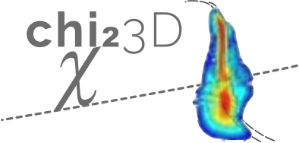
Digital Twin
“Fancy word for a simulation” to be used to test you optimizing or control agent
Idea Simulate the world environment and use this go generate synthetic training data

Slide 5
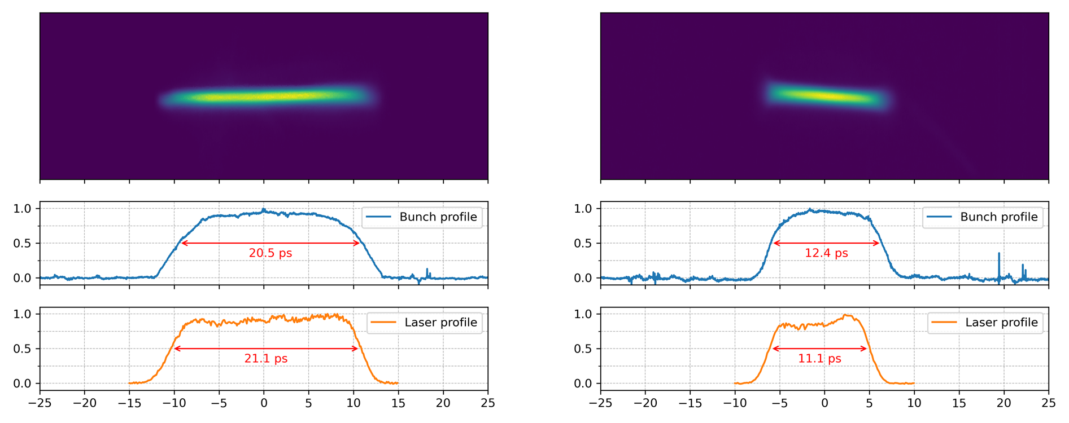
Laser Optimization

Slide 6
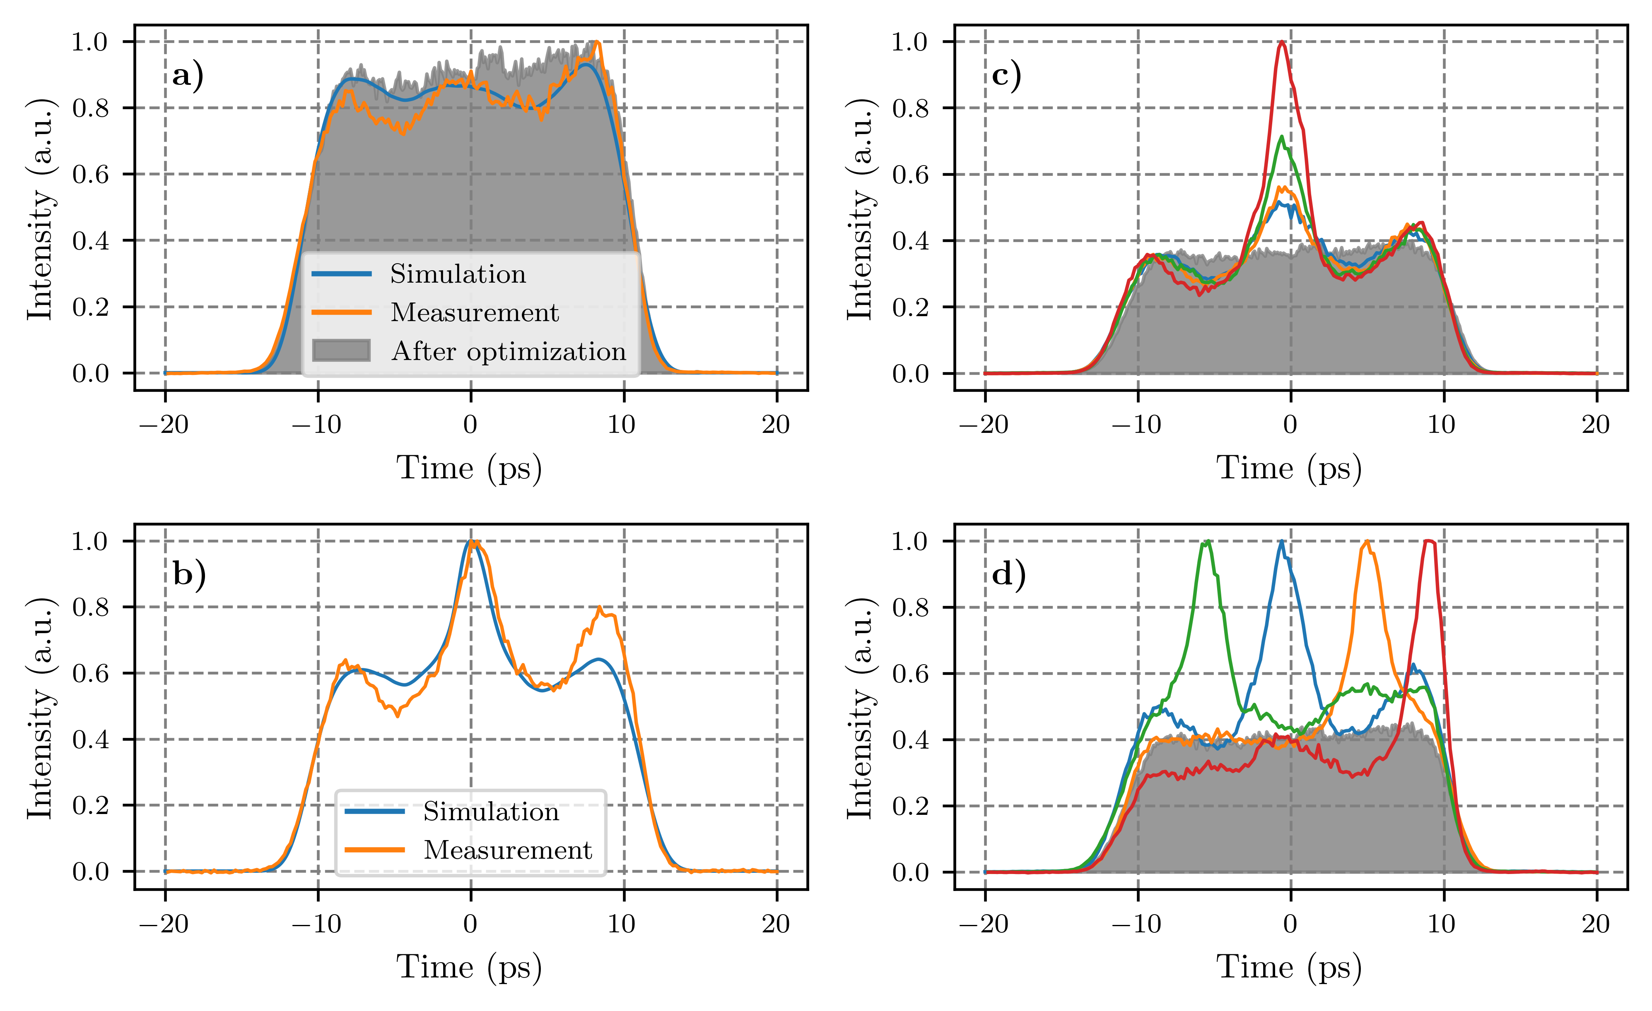
Laser Optimization

Slide 7
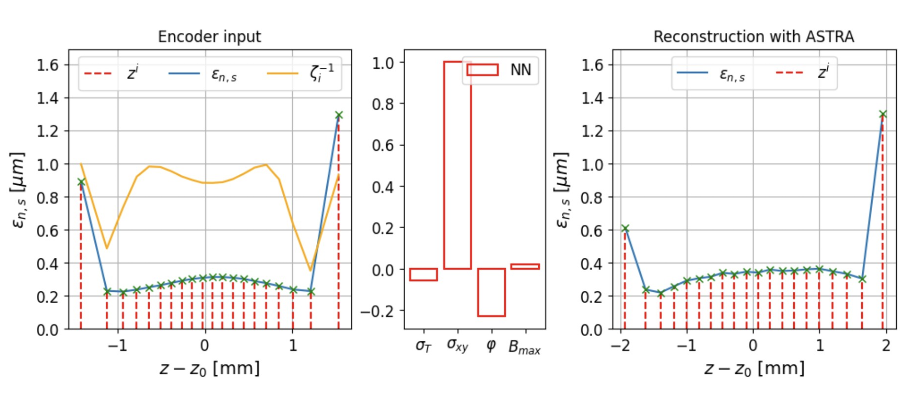
Machine Learning

Slide 8
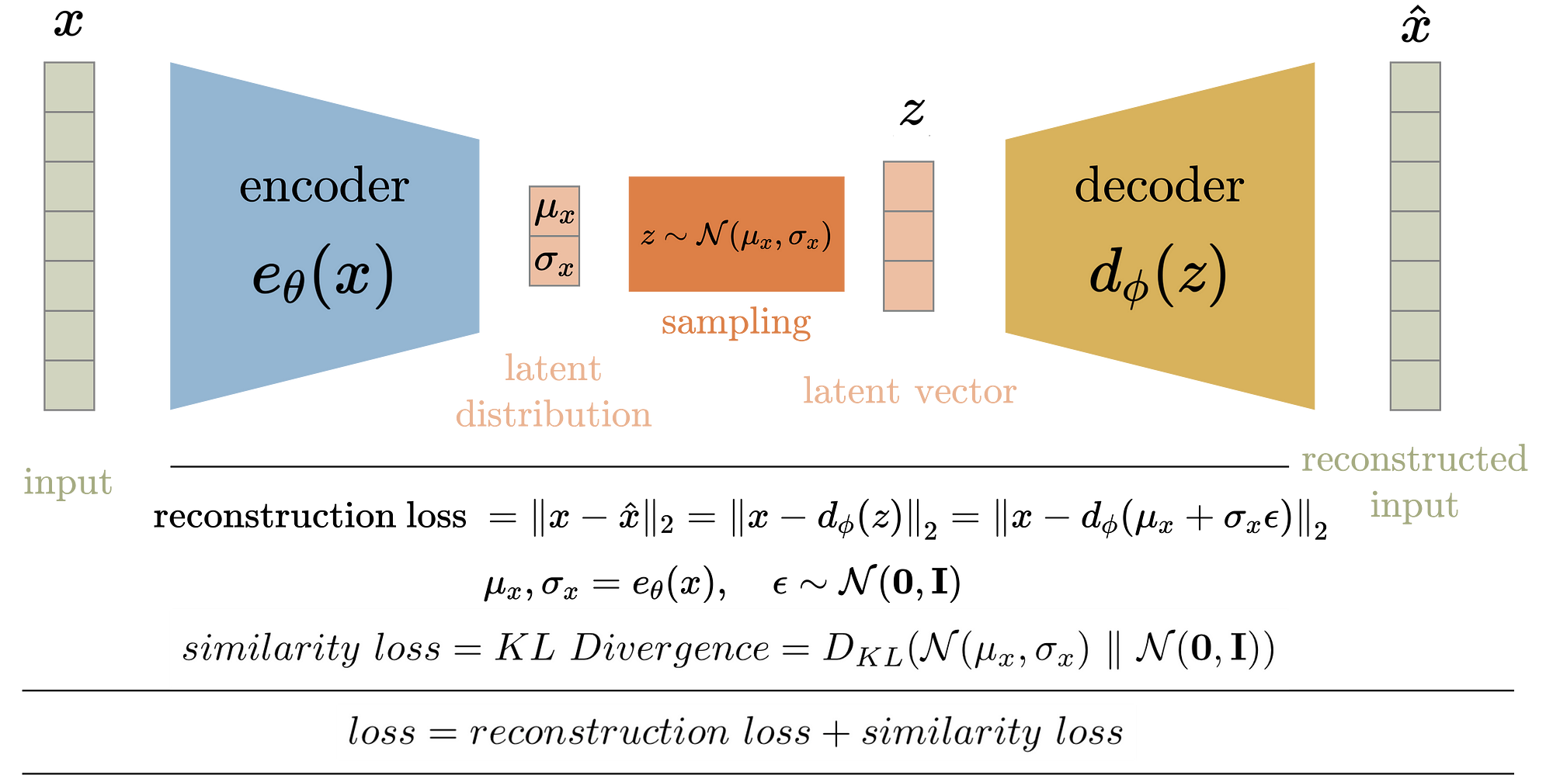
Variational Autoencoder?

Slide 9
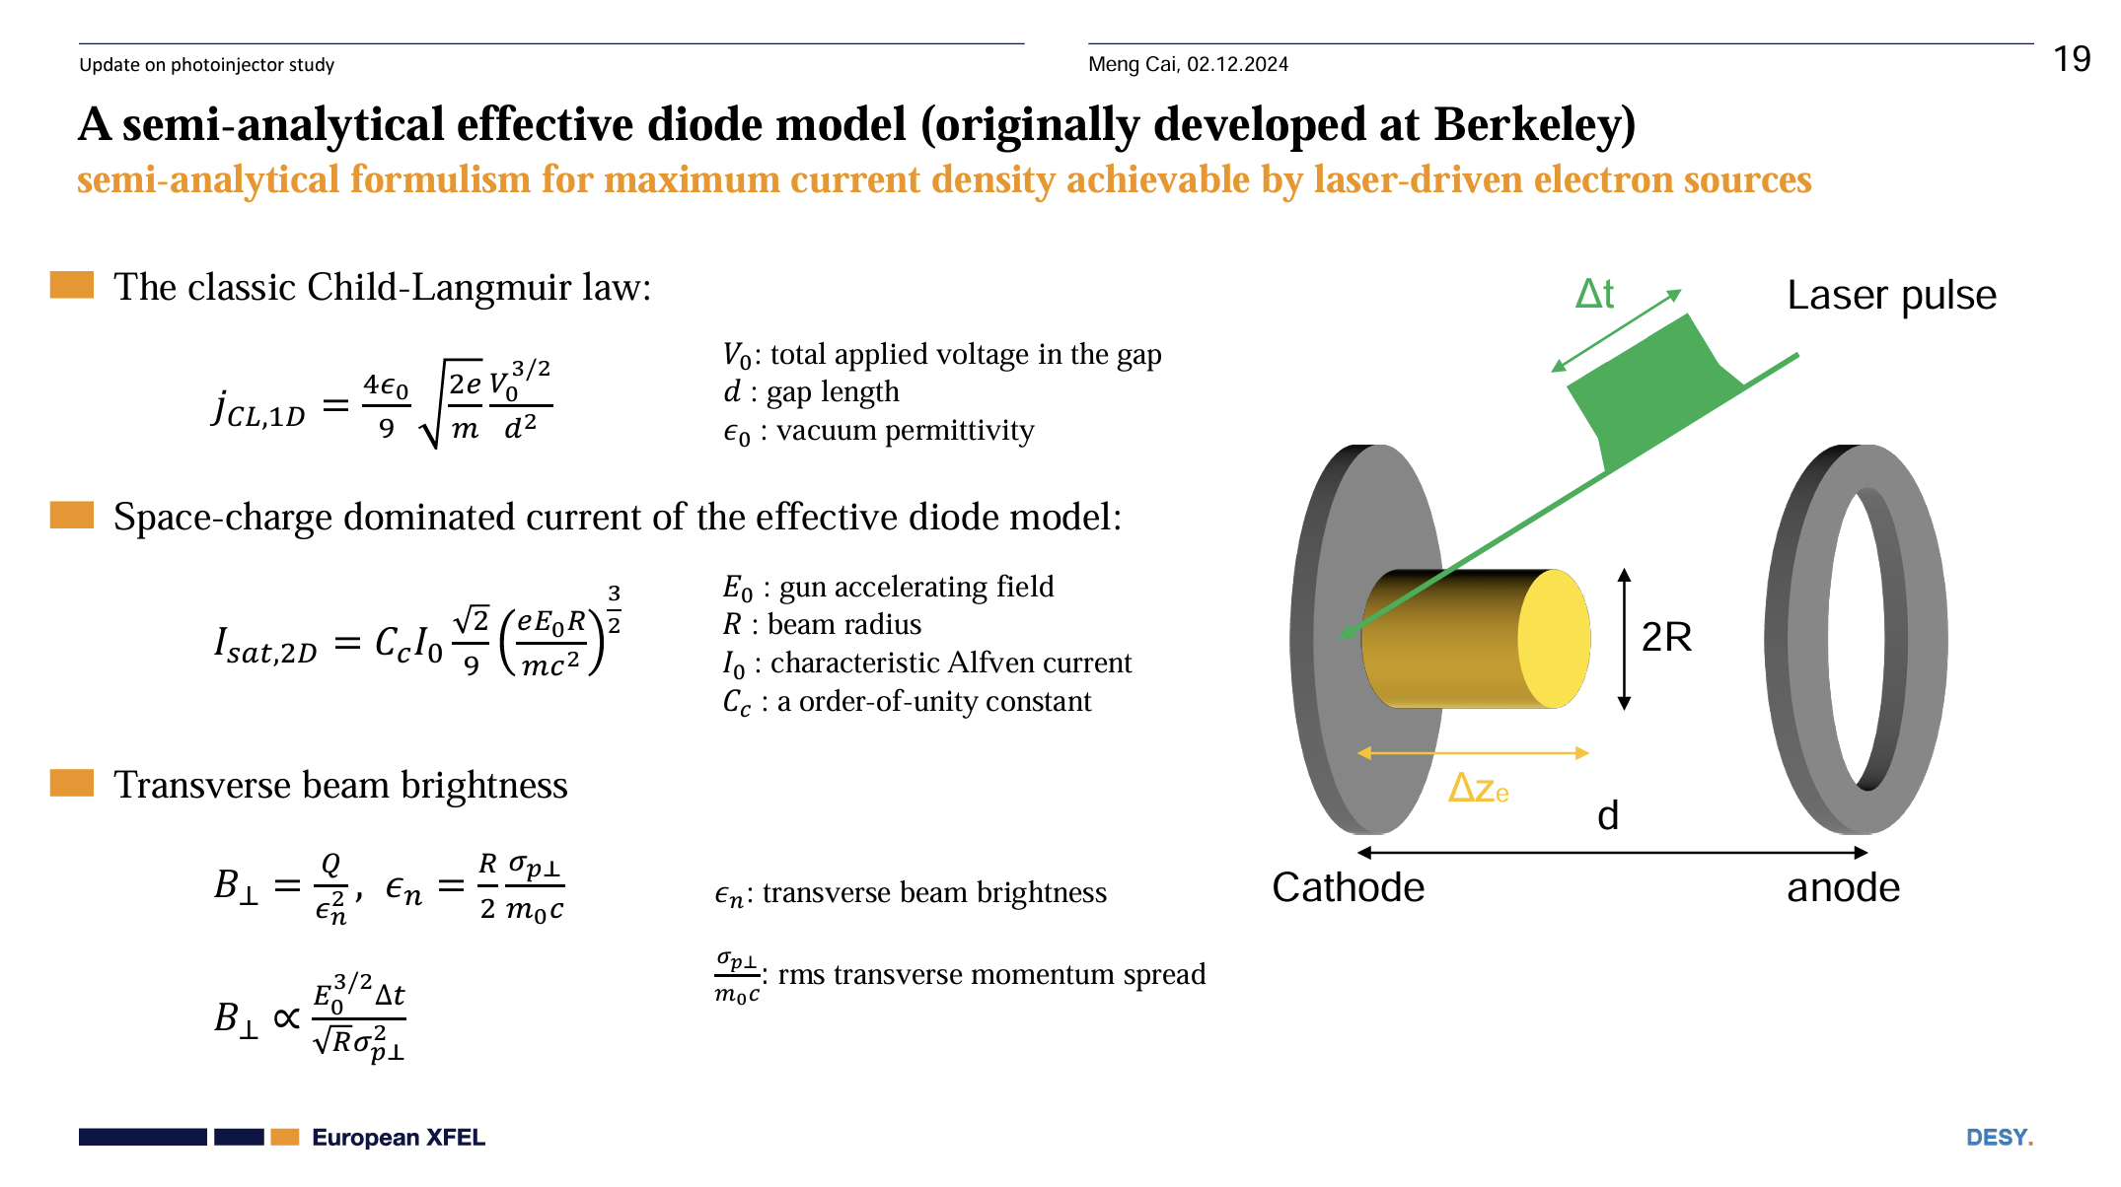
Photoinjector Optimization

Slide 10
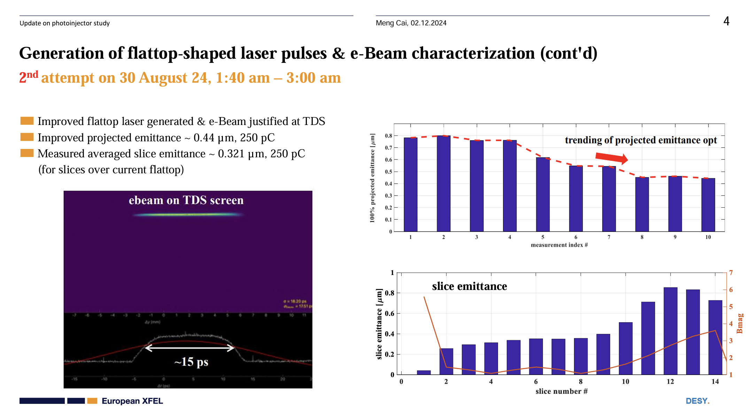
End to End

Slide 11
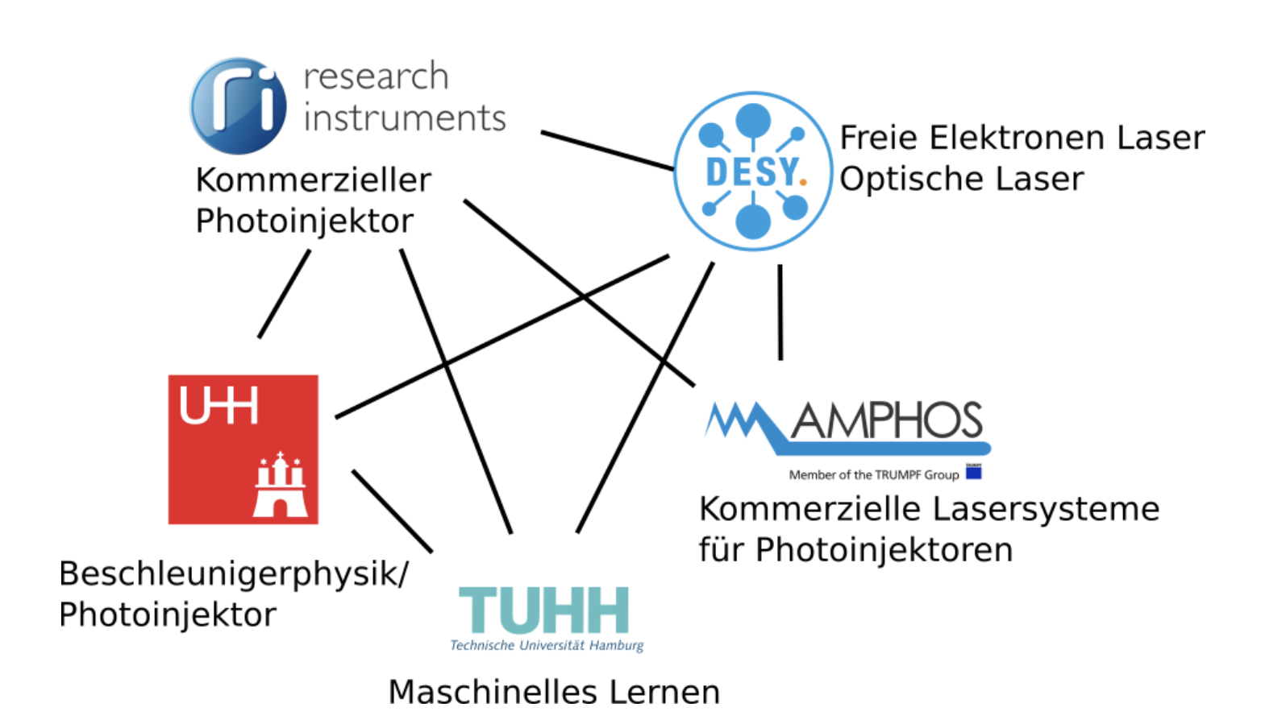
Thank You!

