Slide 1
End-to-End Optimization under OPAL
Application of gained results (shaping capabilities, modeling & simulations, etc.) on emittance optimization (for HDC/CW upgrade) as well as other FEL R&D program(s) in the injector section of the European XFEL
Beamtime summary
1st experiments on 13/17 July 24
particularly for flattop shaping on 18 July 24, 1:00 am – 1:30 am
2nd experiment on 30 August 24, 1:40 am – 3:00 am, flattop shaping
3rd experiment on 10 October 24 for twin-bunch PWFA program
flattop shaping for witness
Main results summarized in the following slides

Slide 2
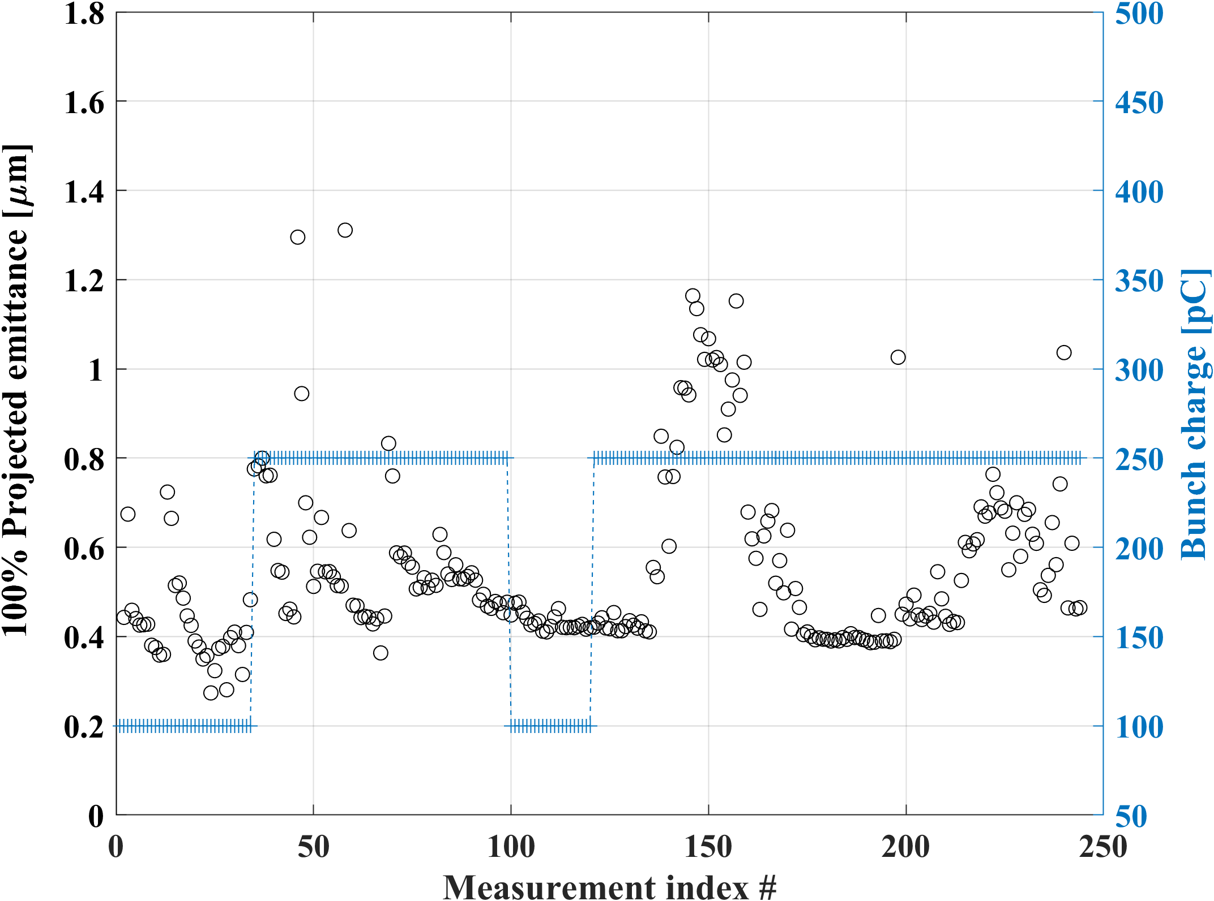
Experimental results on 100% projected emittance optimization
Number of measurements: 244
100% projected emittance about 0.41 µm (XD2) with acceptable mismatch factors, using ~25 ps laser pulses to produce 250 pC
At 100 pC (required for HDC/CW operation), the optimized emittance is about 0.27 µm
If Cs2Te thermal emittance is about 1.1 µm /mm rms (suggested in literatures), then the thermal emittance contributes to about 70% of the best emittance achieved at 250 pC

Slide 3
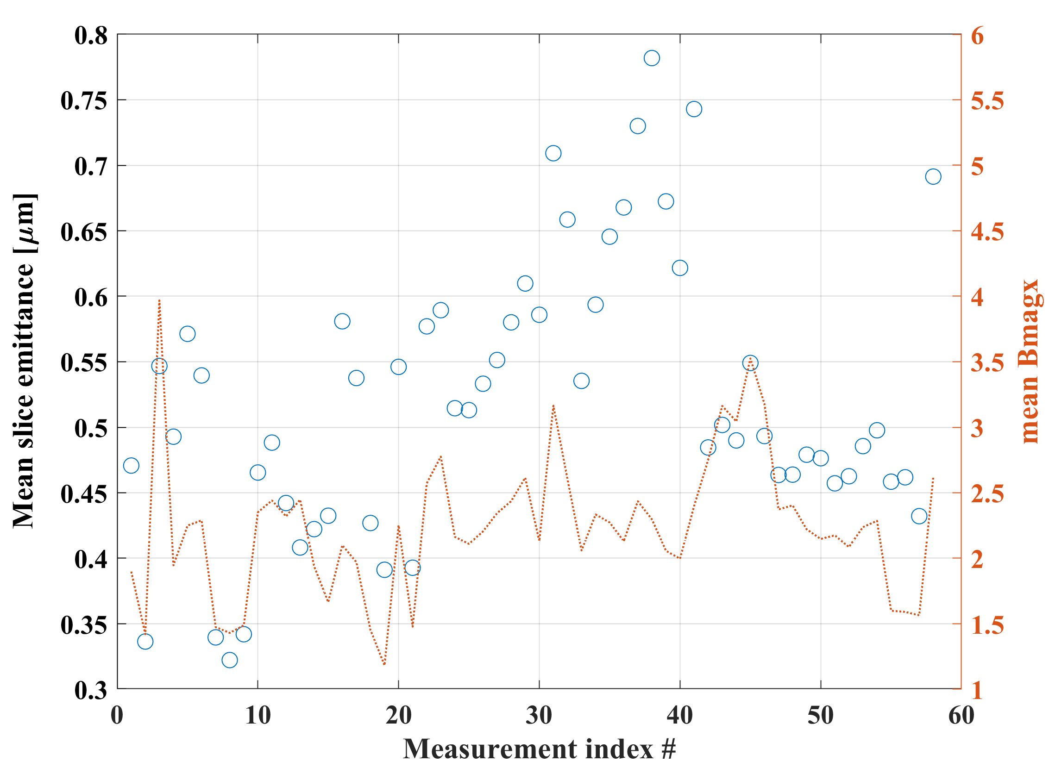
Experimental results on 100% slice emittance optimization
Number of measurements: 58, X2
Matching using X2 not so good overall (status 2024)
Best: mean slice emittance of about 0.32 µm at 250 pC using ~25 ps temporal flattop shaped laser pulses

Slide 4
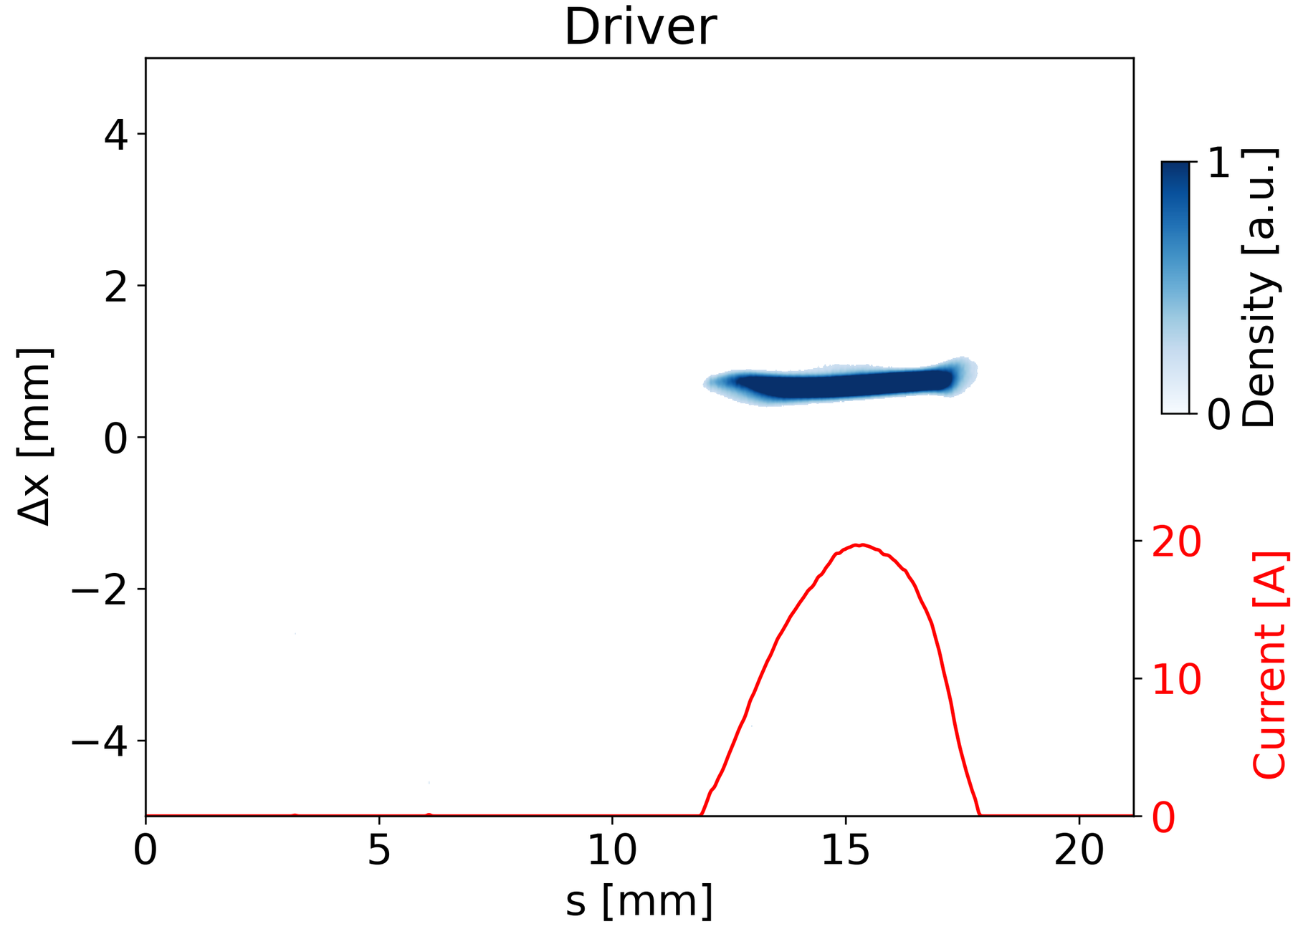
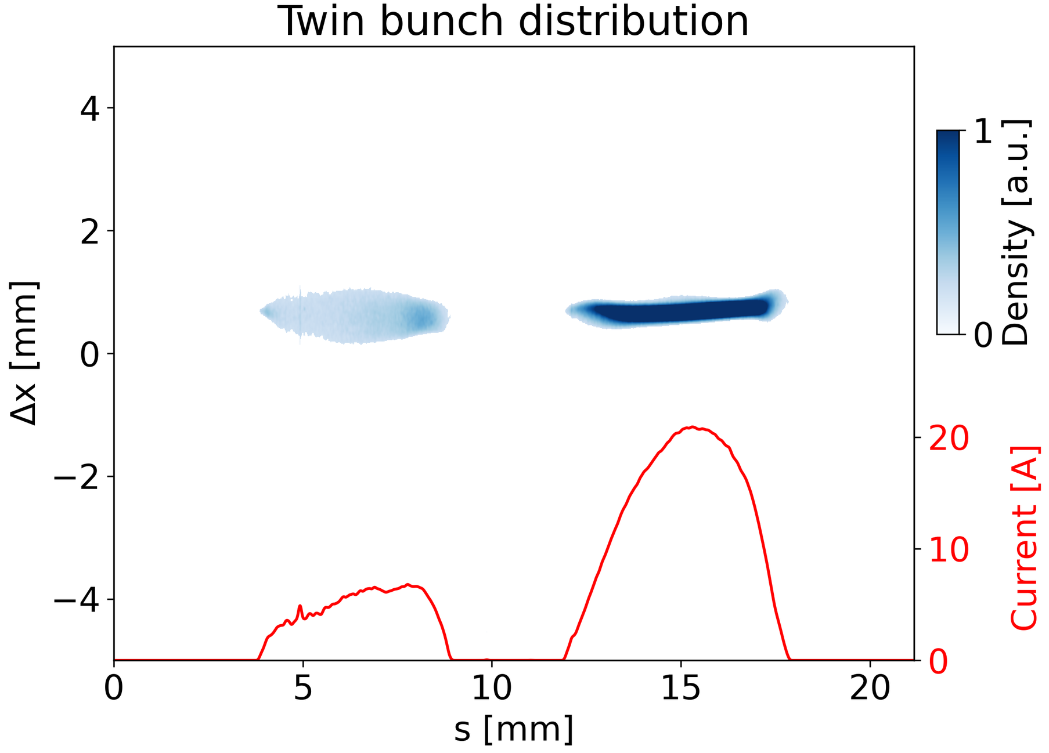
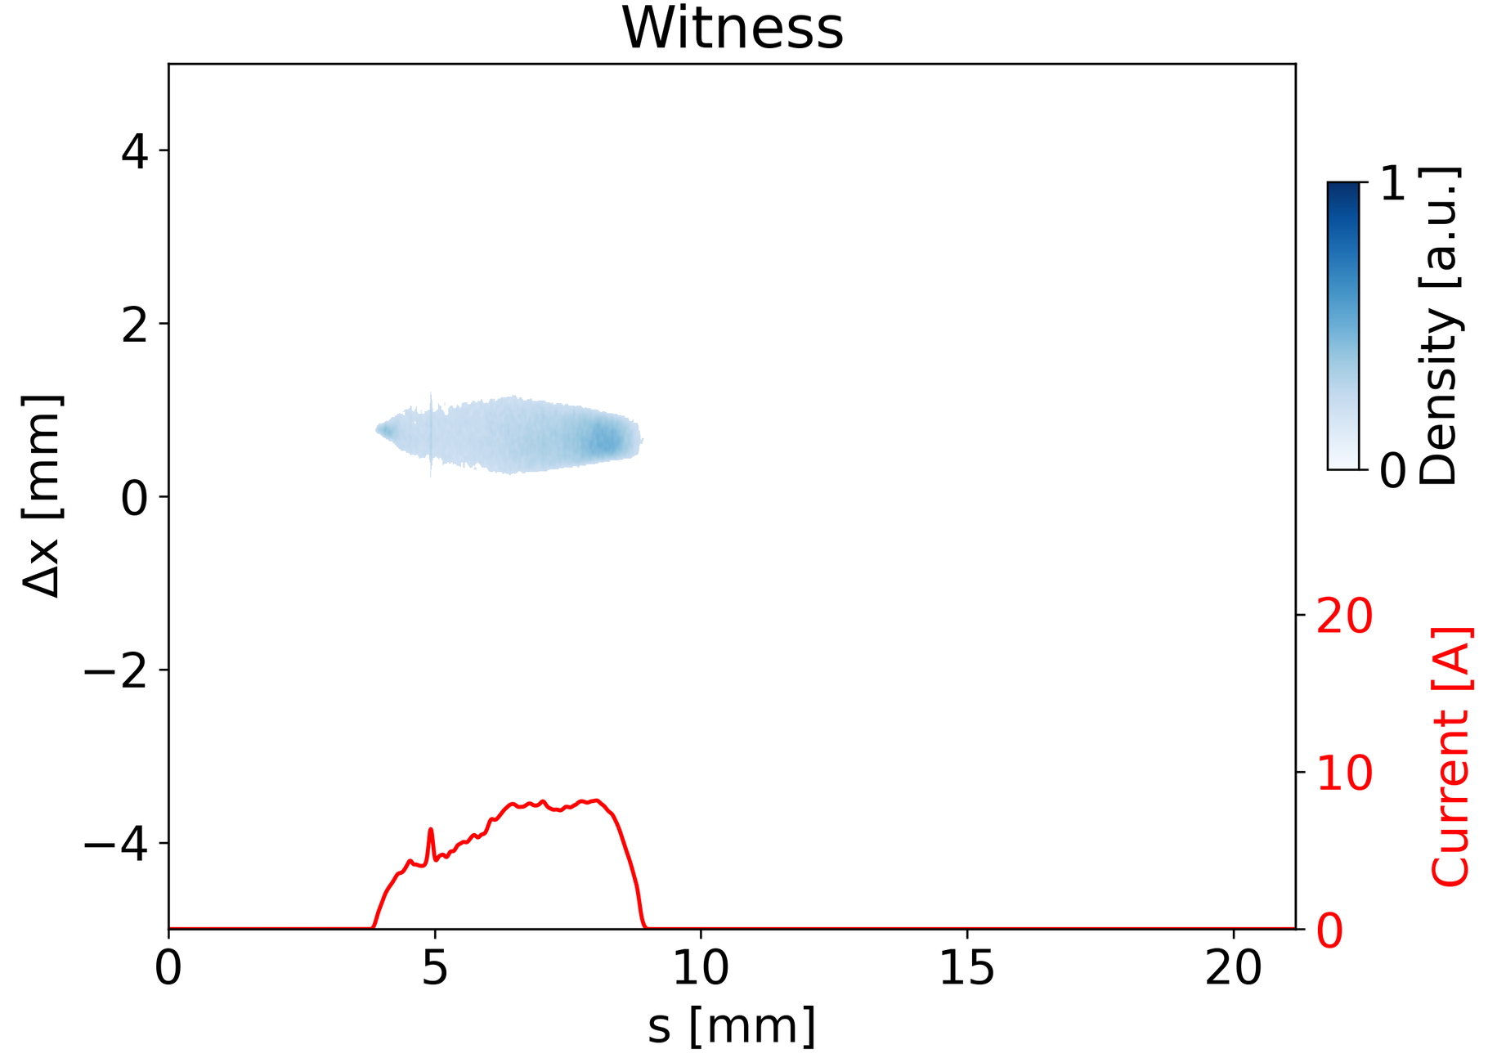
Experimental results on the application of shaped twin-bunches for PWFA
First pulse shaping enabled twin bunch optimization at the XFEL
Twin bunches in the same RF bucket
X1: Gaussian driver 250 pC
X2: flattop-shaped witness 100 pC
Delay ~10 ps

Slide 5
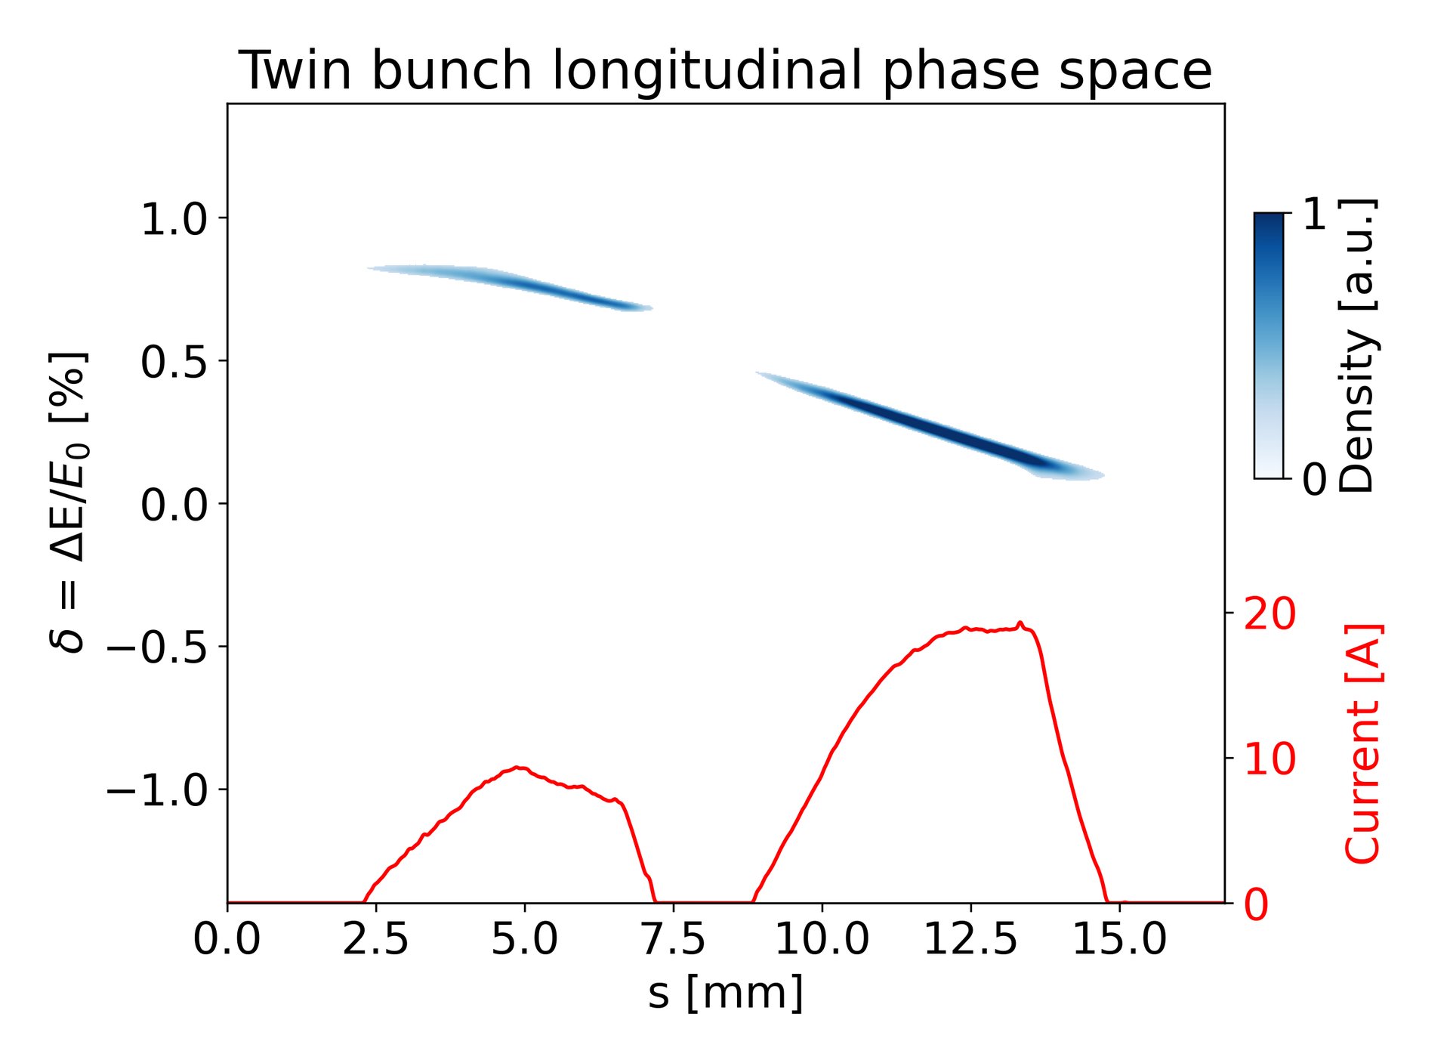
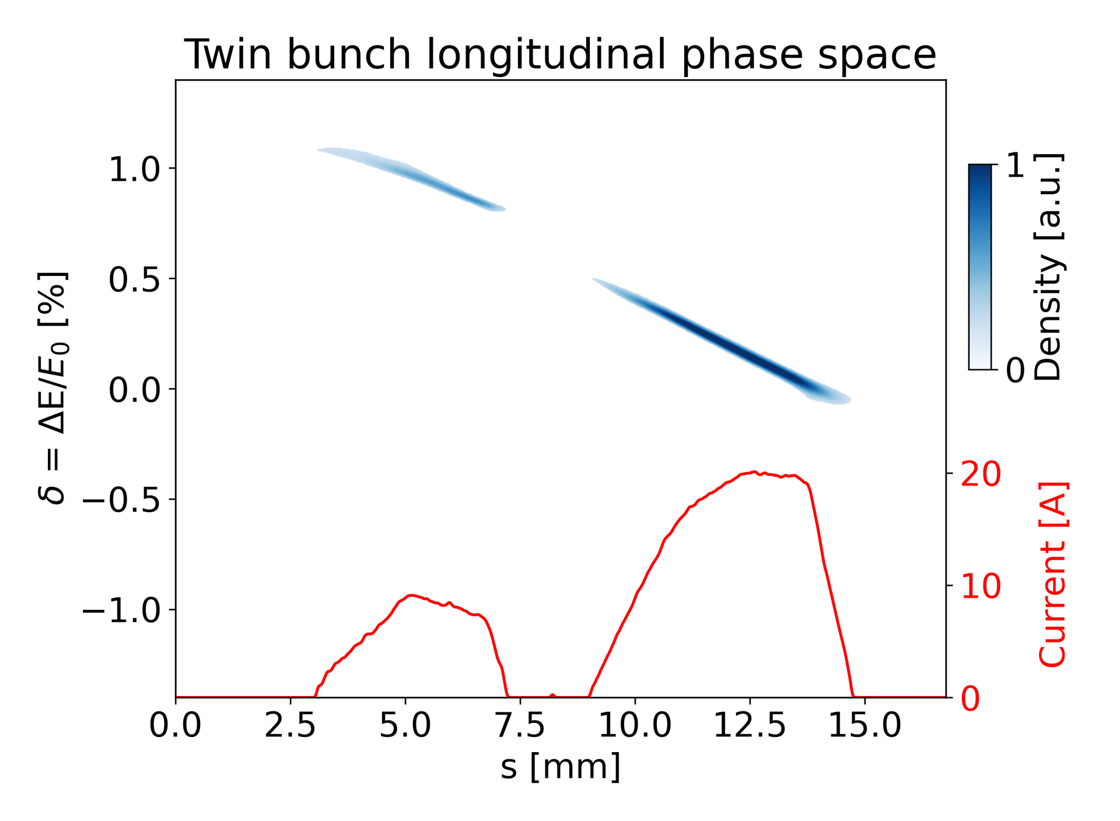
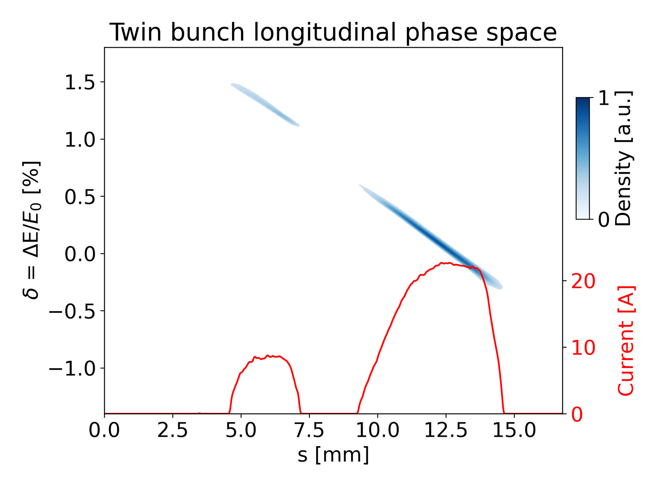
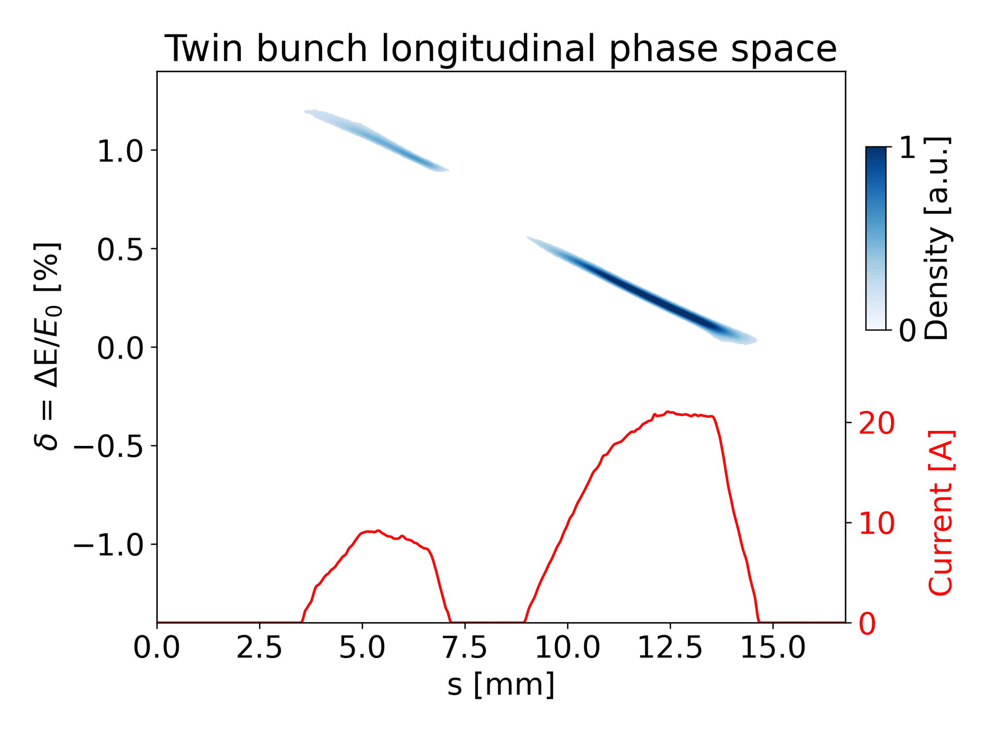
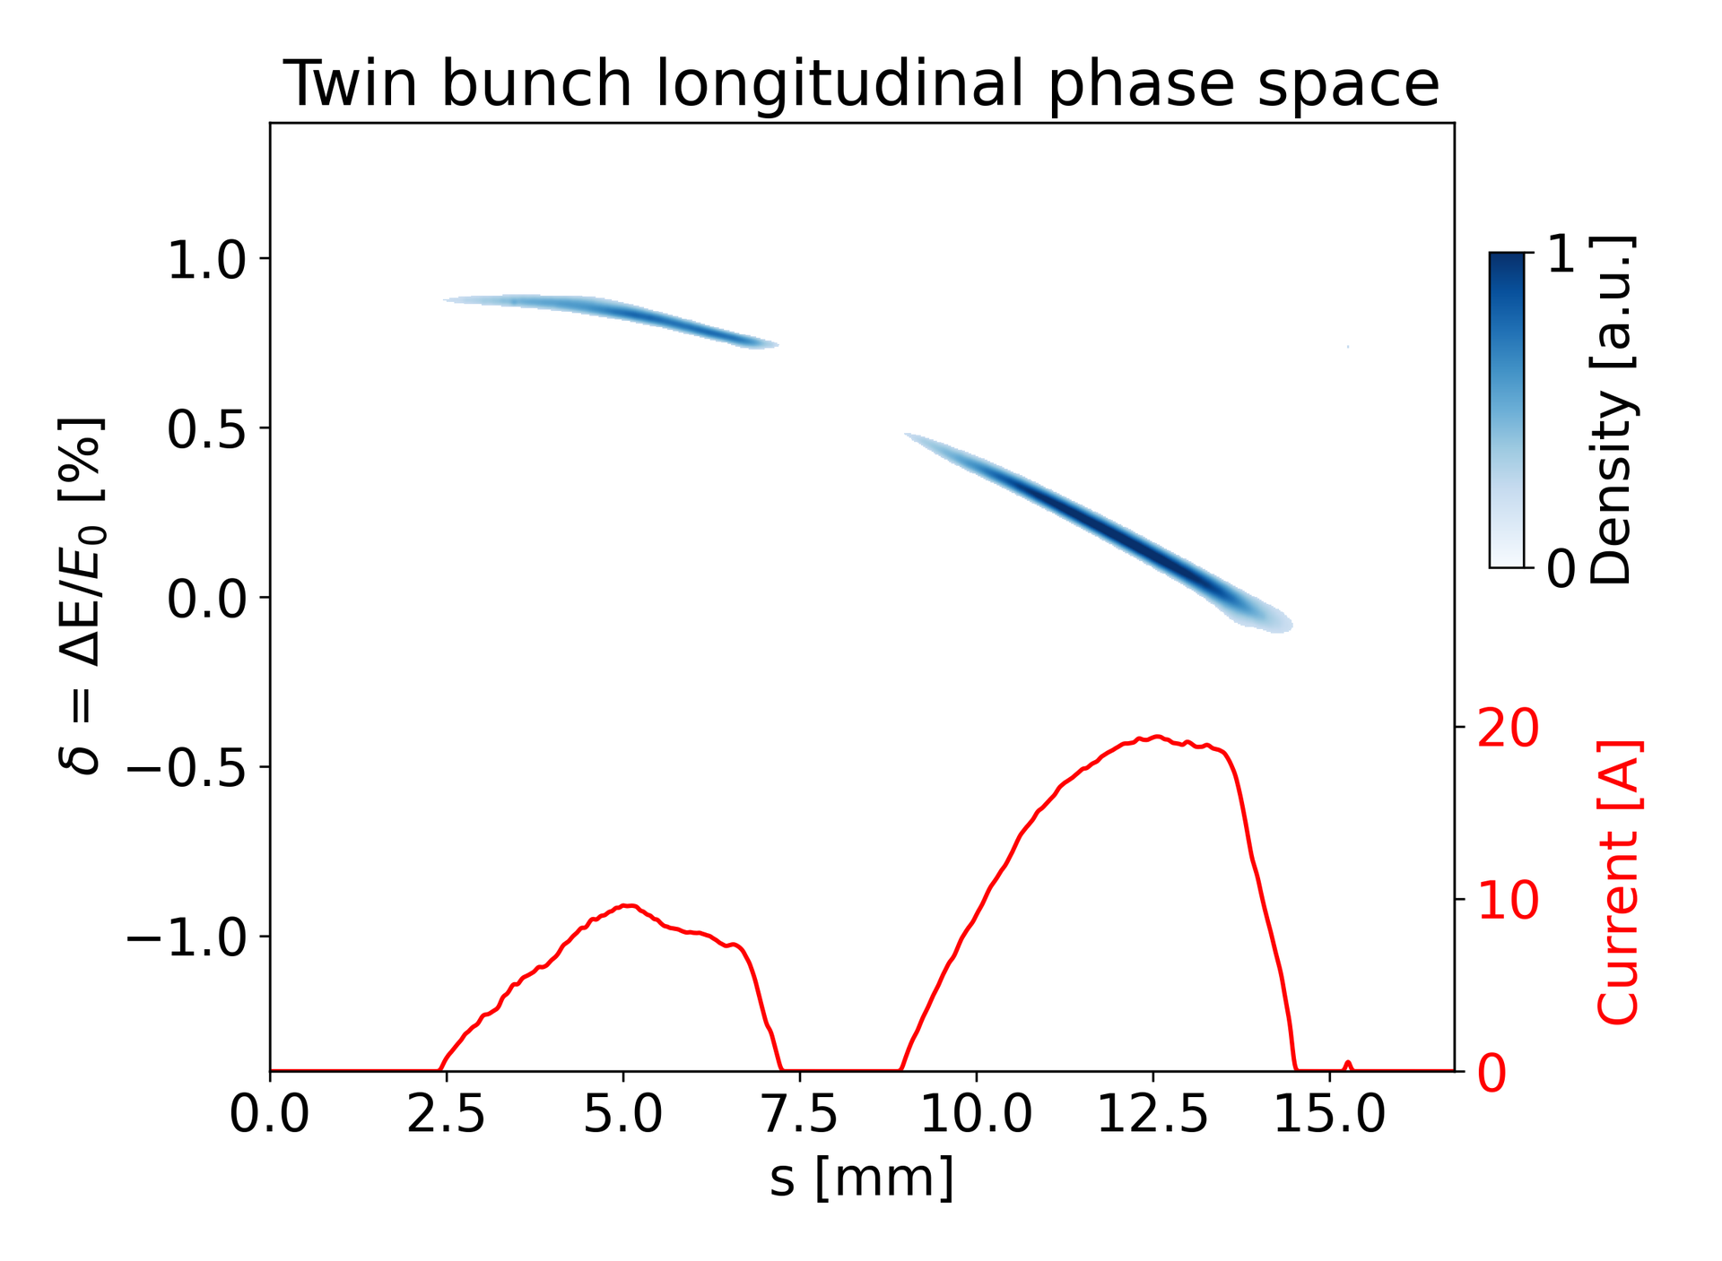
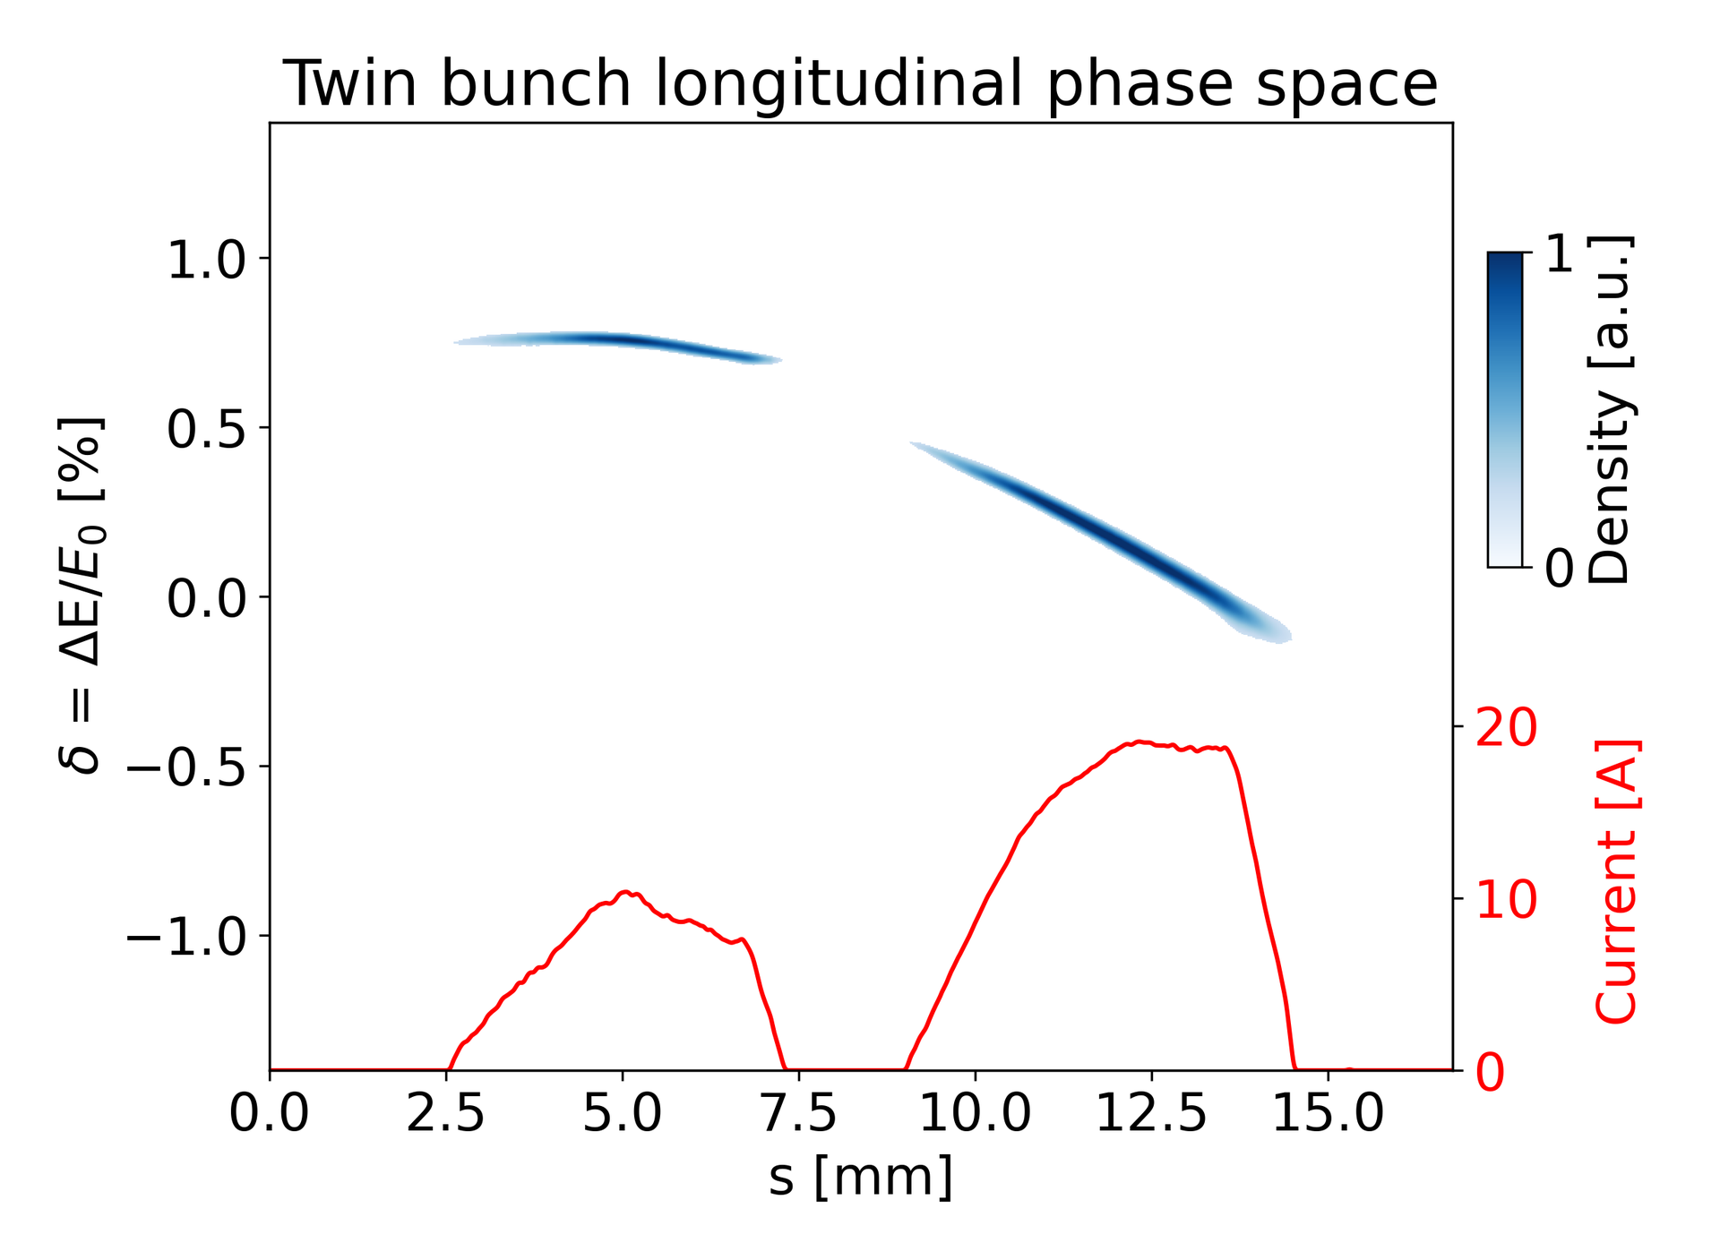
Experimental results on application of shaped twin-bunches for PWFA (contꞌd)
Longitudinal phase space control of twin bunches via A1/AH1 tuning (examples)

Slide 6
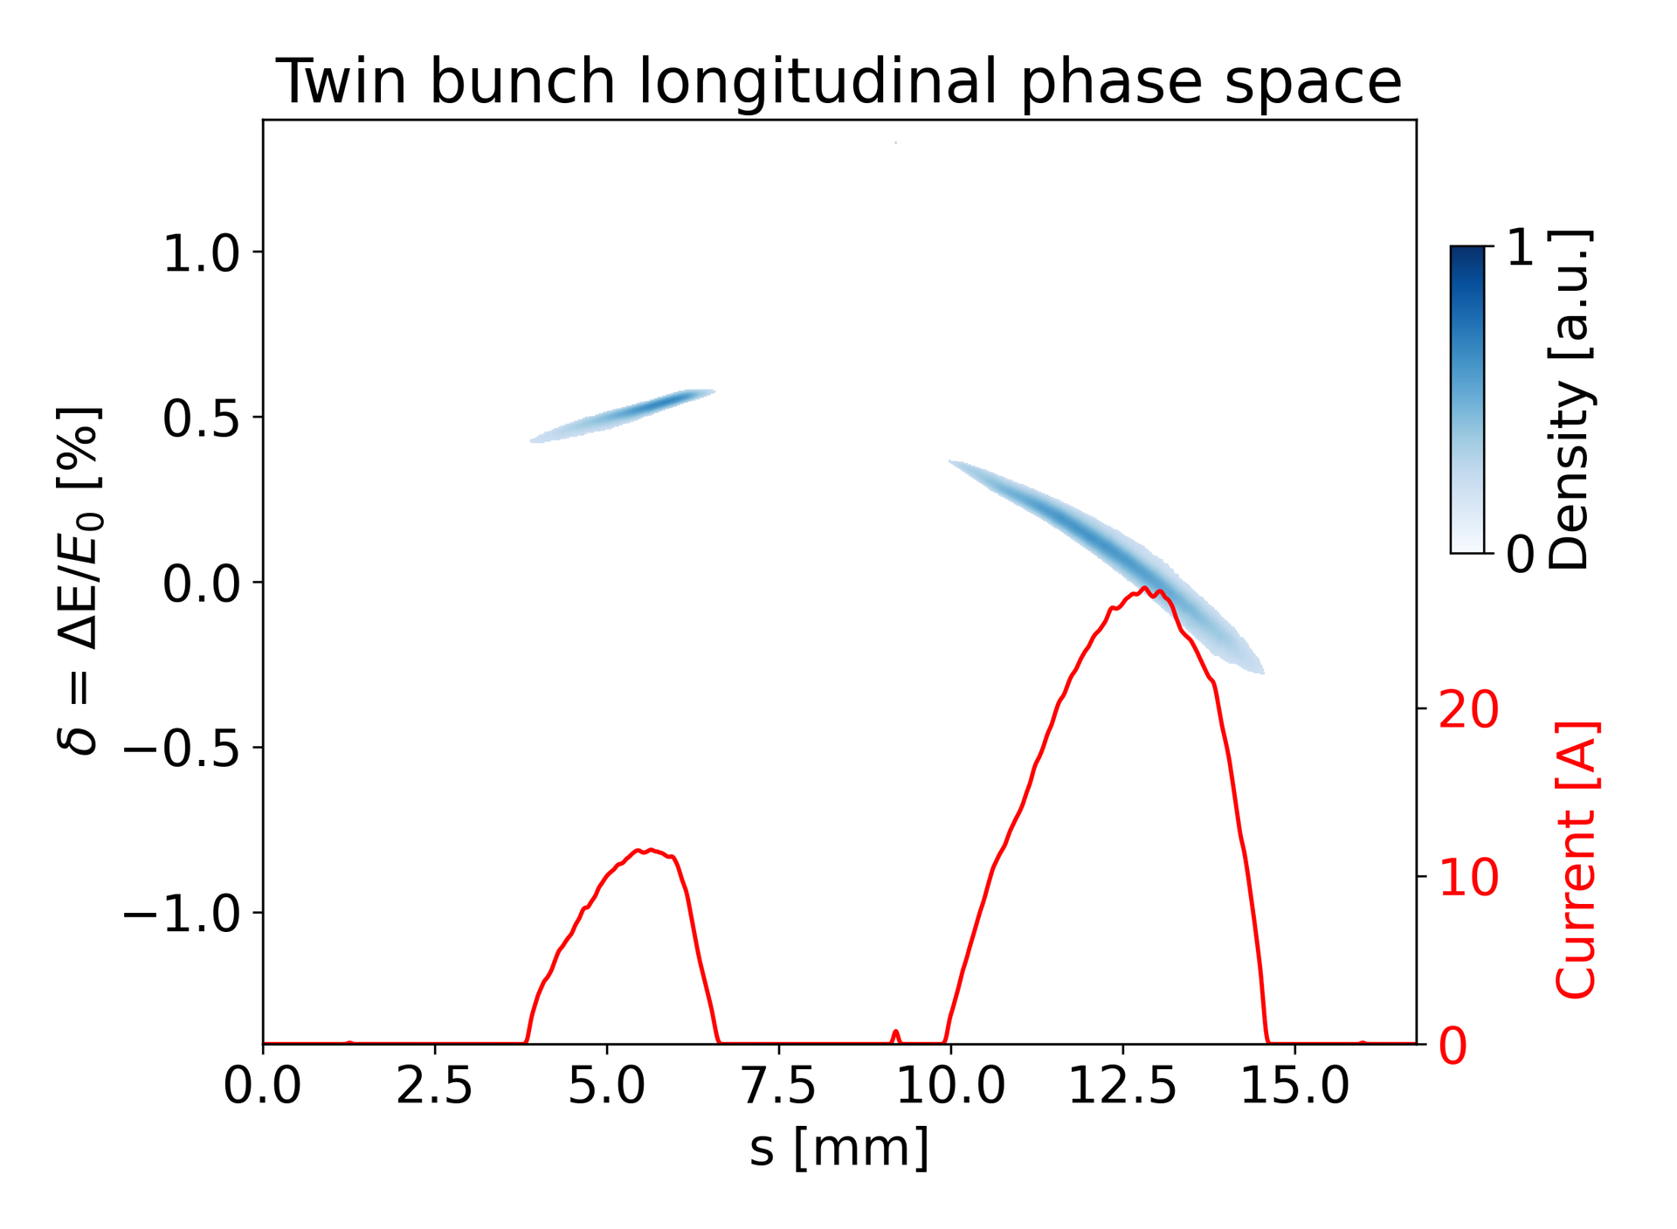
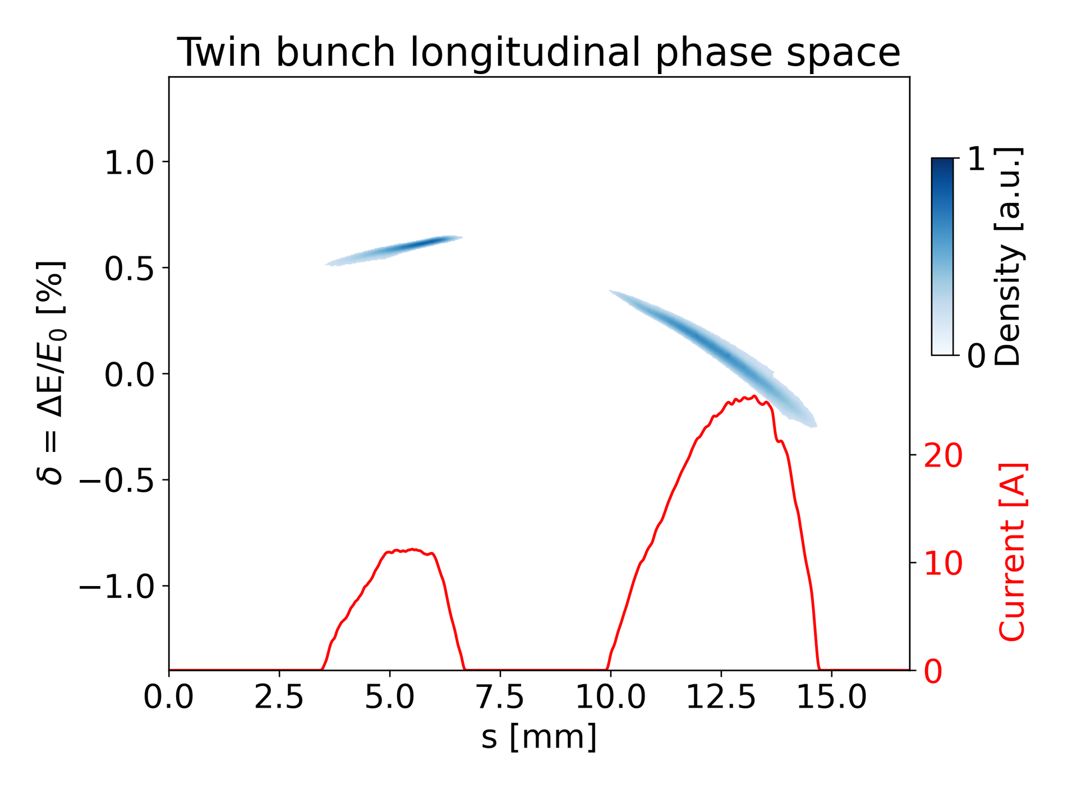
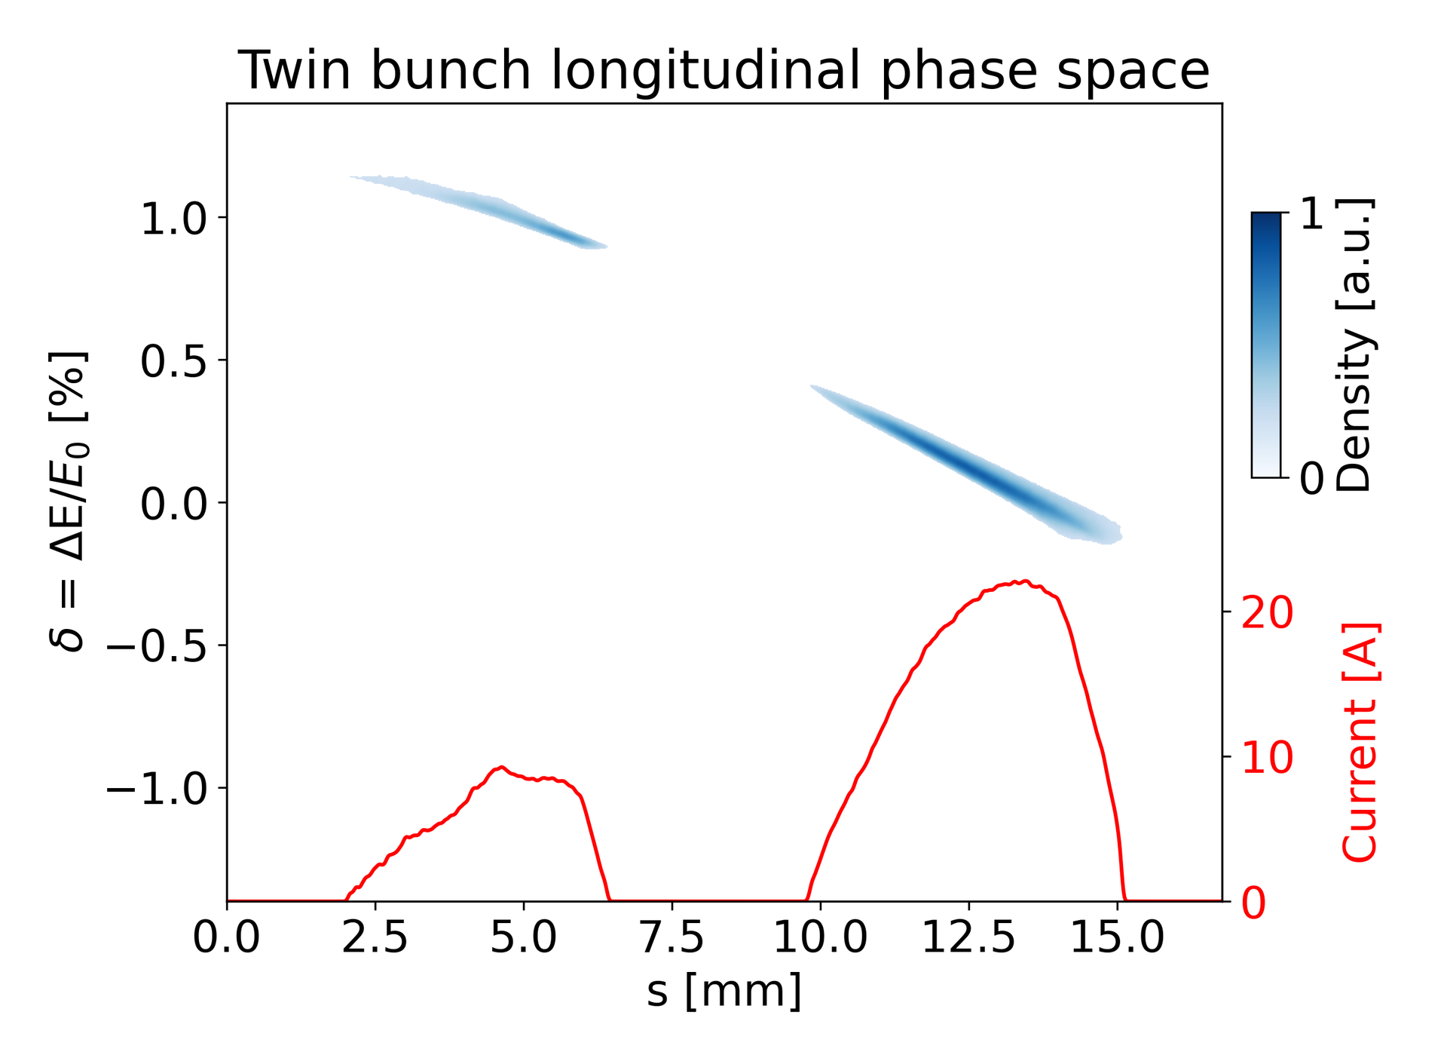
Experimental results on application of shaped twin-bunches for PWFA (contꞌd)
Successful machine tuning of twin bunches in the same RF bucket as preparation of downstream transport studies
Advanced temporal shapes required in the future
Requiring more intelligent control methods for charge, delay, BSA, pulse length, rf phasing, etc.

Slide 7
Near-term Planning till June 23rd 2025
Planned XFEL shutdown from 23rd June
Thermal emittance measurements in the gun section (maybe some Tuesdays?)
Pulse shaping enabled twin-bunch studies (perhaps beamtime in March possible)
Quantitative comparison of X1 and X2 emittance at the same laser pulse length (also in Backups)
Impact of transverse laser distributions
Previously seemed better for X1
If X2 transverse distribution now comparable with X1, further emittance optimization with X2 at longest possible flattop-shaped laser pulses (?)

Slide 8
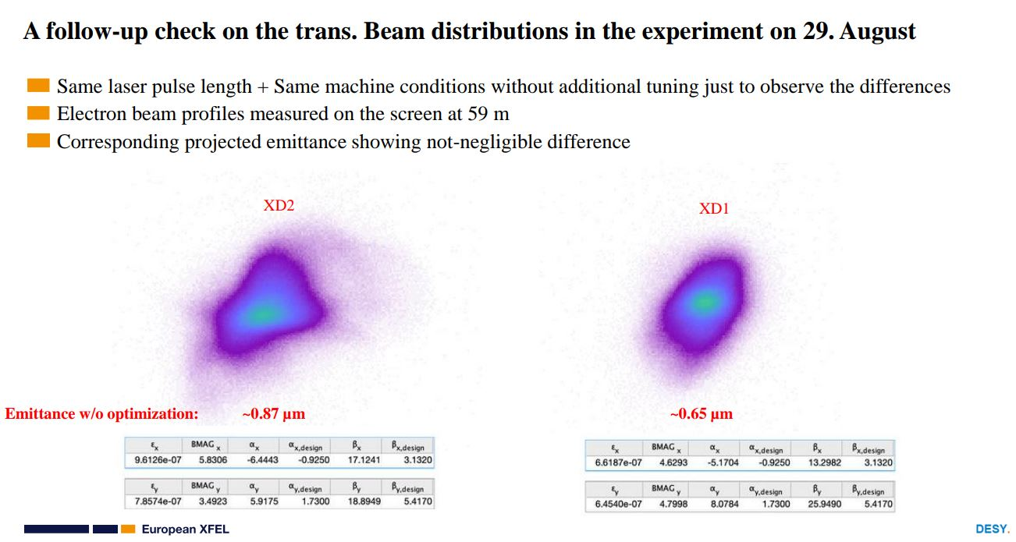
Backups
Remaining issue until end of 2024: direct comparison of X1 and X2 emittance w/o optimization

Slide 9
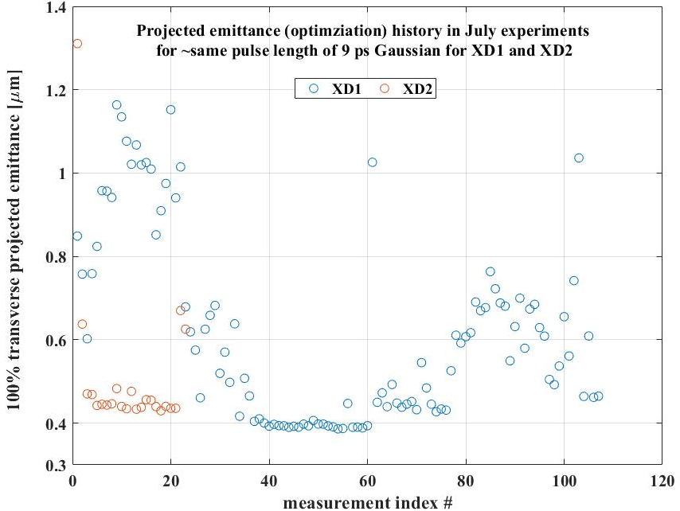
Backups
Remaining issue until end of 2024: direct comparison of X1 and X2 emittance with optimization
~15% deviating

