Slide 1
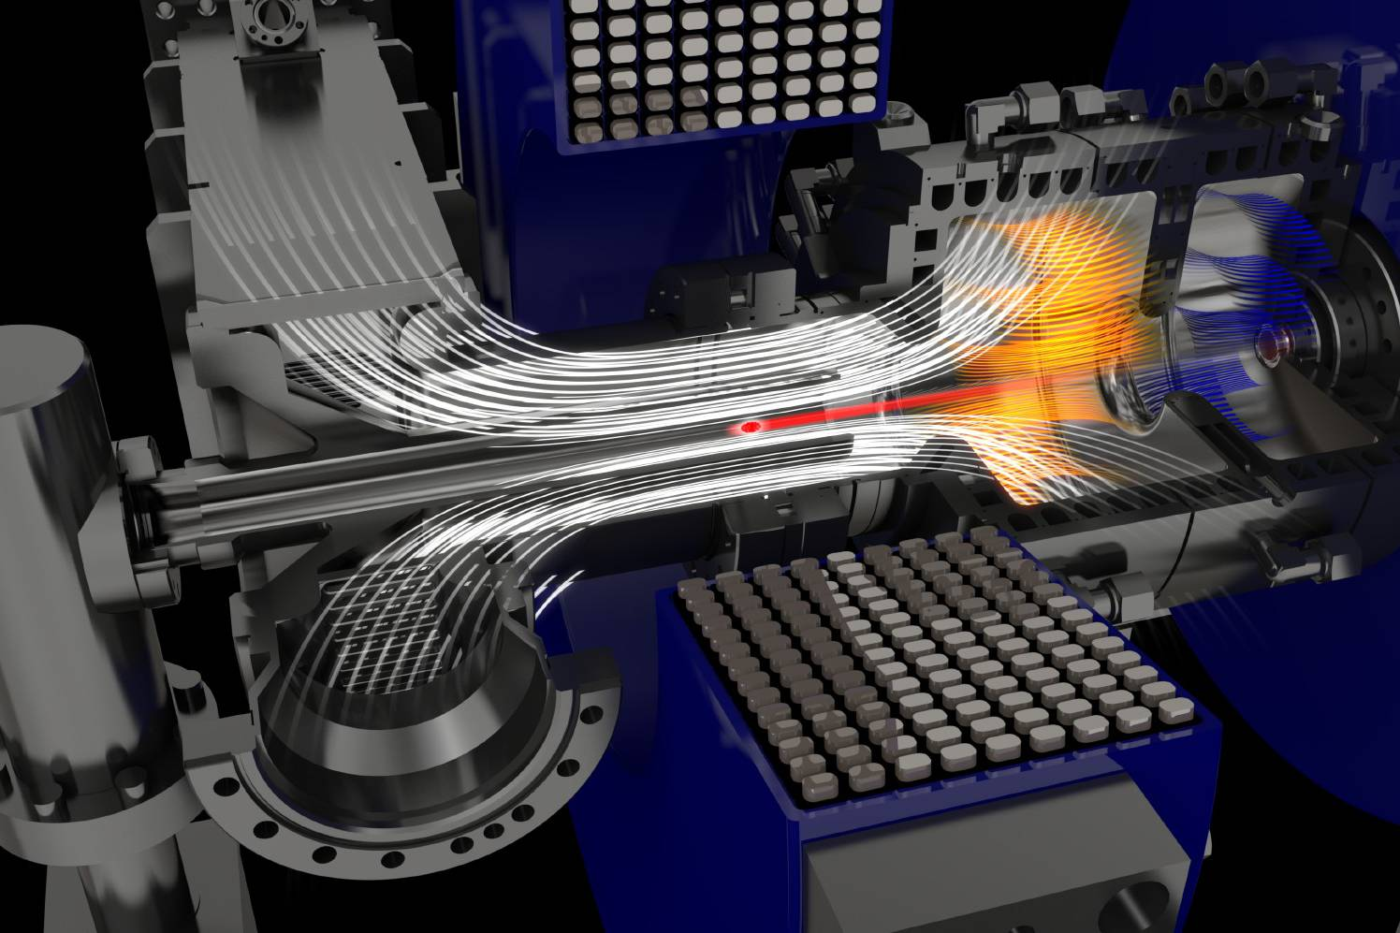
OPAL FEL Meeting
14.01.2025
Workshop 1: Work Package Alignment

Slide 2
Aim for today: You know what to do for the coming year?
What is your plan and what do you want to achieve?
  Let’s look at the milestones and deliverables!
  What has been achieved so far in your work package?
  What could be beneficial for the other work packages?
  What do you need from a partner?
  And in general: How can we help each other?
Also important:
  Please take care of preparing a second annual report by end of April for PT.DESY!

Slide 3
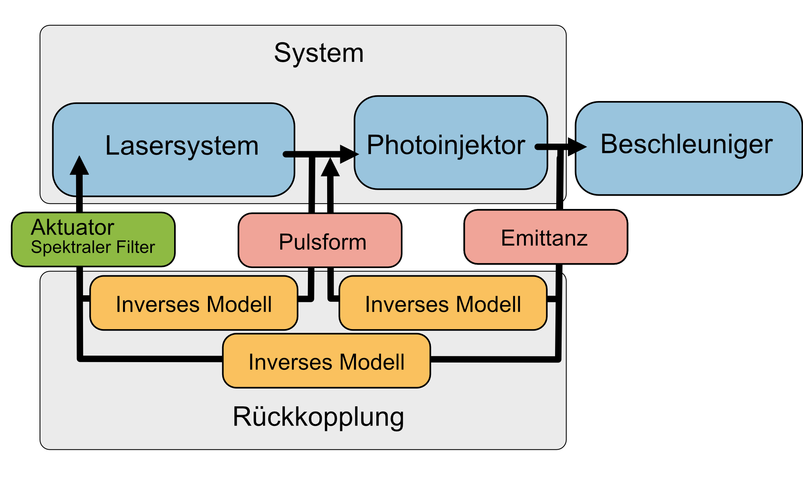
Work Packages
Work Package A:
  Laser Modelling und Optimization
Work Package B:
  Photoinjector Modelling and Optimization
Work Package C:
  Machine Learning for Photo Injectors
Work Package D:
  End to End Optimization

Slide 4
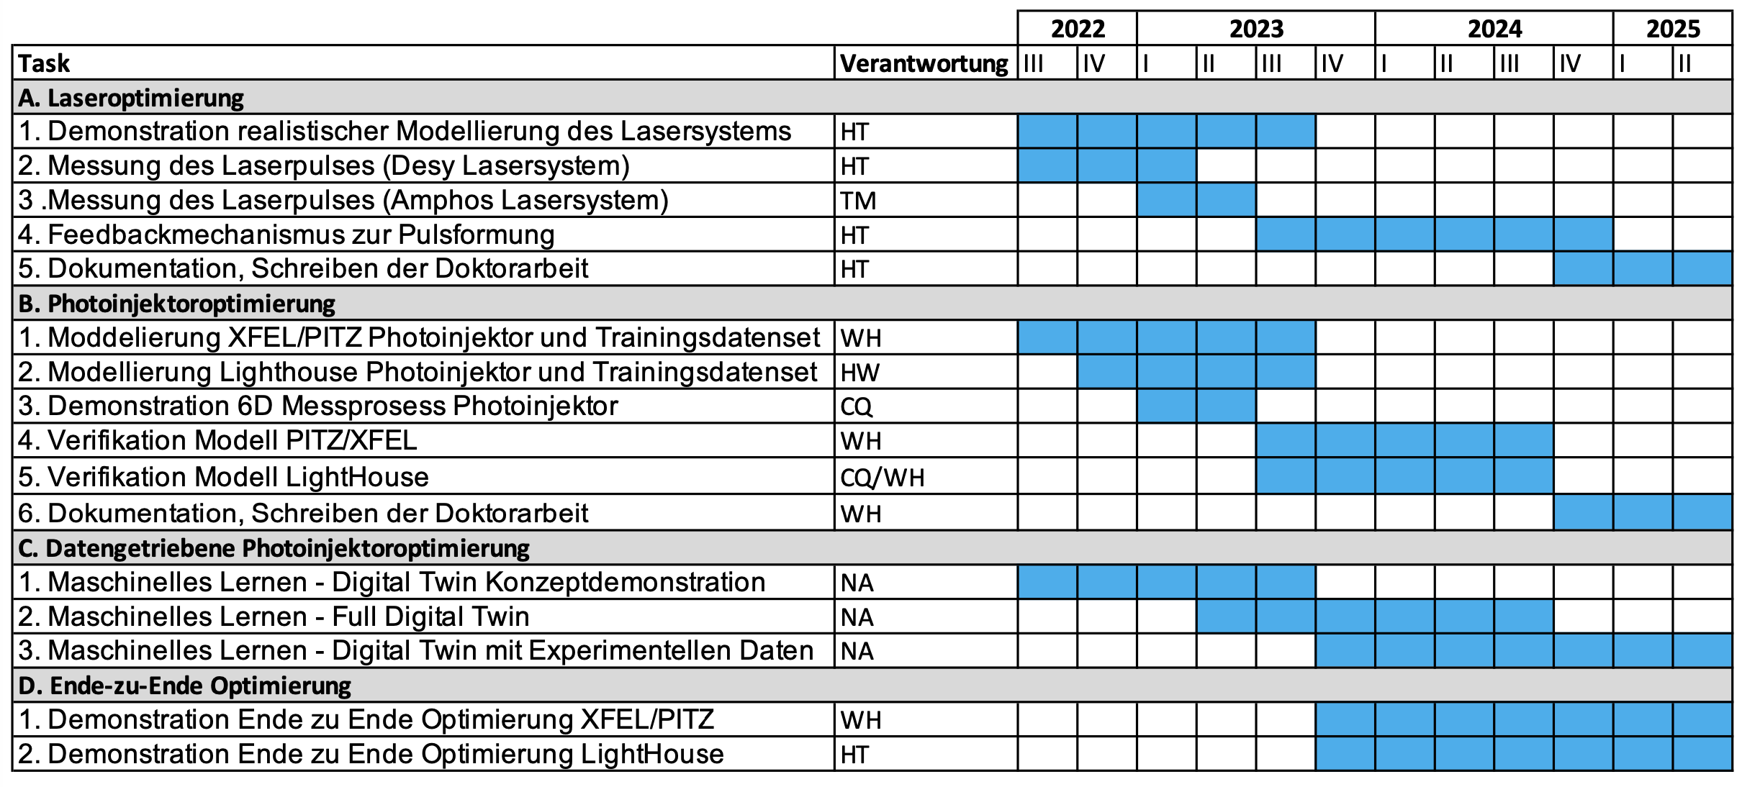
Work Packages Details / Gantt Chart
2023
2024
2025

Slide 5
Milestones (start delayed by 8 months):
?
02/2026
?
02/2026
?
02/2026

Slide 6
WP alignment (Denis inputs)
ML based laser pulse shaping
1) Main achievements :
  Measurement setup to determine pulse intensity profile
  Reduced non-linearities in the NEPAL laser system
  Start-to-end simulation of shaping process (not perfect and can be still improved, but close enough for proof of concept)
  First trials of hand-tailored pulse shaping (Flat-top profile and flat-top with superimposed peak) are promising.
  Simulation tool for data generation is set-up and ready to be used (for ML purposes)
2) Relation to others :
  Alex: I am supposed to receive optimal pulse parameters/shape and reproduce it! Once me and Alex find a common ground for description of pulses and limits of the method, it should be straightforward to incorporate the parts.
  Meng: Output of simulations/ measured pulse profiles can be used by Meng to simulate photoemission process and get the electron bunch distribution later to be used by Alex.

Slide 7
WP alignment (Denis inputs)
ML based laser pulse shaping
3) Main difficulties:
  Find a way to sample uniformly(or close to) in the domain space for learning purposes.
  Find the right parametrization/ NN architecture.
  Mostly need time to properly try things out, but discussion with Alex and Henrik will for sure help.
4) Plan until 02/2026:
  Train a NN which can predict filter settings for a desired shape.
  To have a somewhat functional algorithm for shaping, at least in simulation as a proof of concept first.
  If time allows, to transfer algorithm to the system and see shortcomings.

Slide 8
Key Points for Work Package Alignment (Meng inputs):
Main achievements:​
Numerical optimization using a combined “1D + 2D” laser shaping approach with parameters provided by the laser group.
Brightness model development for Eu-XFEL, integrated with machine learning techniques with Alex.
Collaboratively conducted 3 experiments on the generation of flattop-shaped laser pulses with contributions from all teams.
Single-shot cathode emittance simulations. (will be implemented and validated in future experiments.)
Future plan
Complete ML optimization from laser parameters to injector output.
Validate single-shot thermal emittance simulation with experiments,
Extend brightness model for more injector configurations.

Slide 9
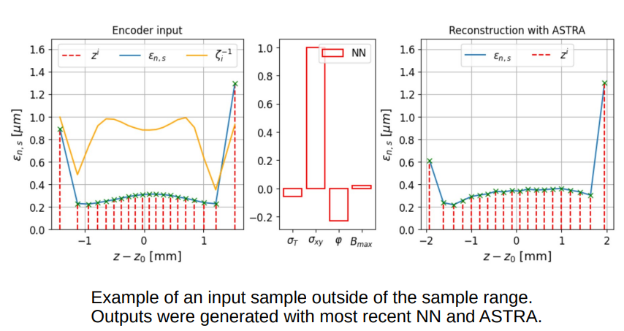
Alex first inputs (more to be added after other duties done)
Different ML architectures have been tried so far for data-driven emittance optimization
Promising results obtained using simulation data (status 2.12.24):
A new Variational Auto Encoder (VAE) approach proposed and to be tried out (probably some new results are available already by now)

Slide 10
Alex first inputs (more to be added after other duties done)
Planning
  Sample pulse shape data
  Try out VAE approach
  Hiring student assistant for analysis for experimental data
  Use experimental data for validation first

Slide 11
End-to-End Optimization under OPAL
Application of gained results (shaping capabilities, modeling & simulations, etc.) on emittance optimization (for HDC/CW upgrade) as well as other FEL R&D program(s) in the injector section of the European XFEL
Beamtime summary
  1st experiments on 13/17 July 24
    particularly for flattop shaping on 18 July 24, 1:00 am – 1:30 am
  2nd experiment on 30 August 24, 1:40 am – 3:00 am, flattop shaping
  3rd experiment on 10 October 24 for twin-bunch PWFA program
    flattop shaping for witness
Main results summarized in the following slides

Slide 12
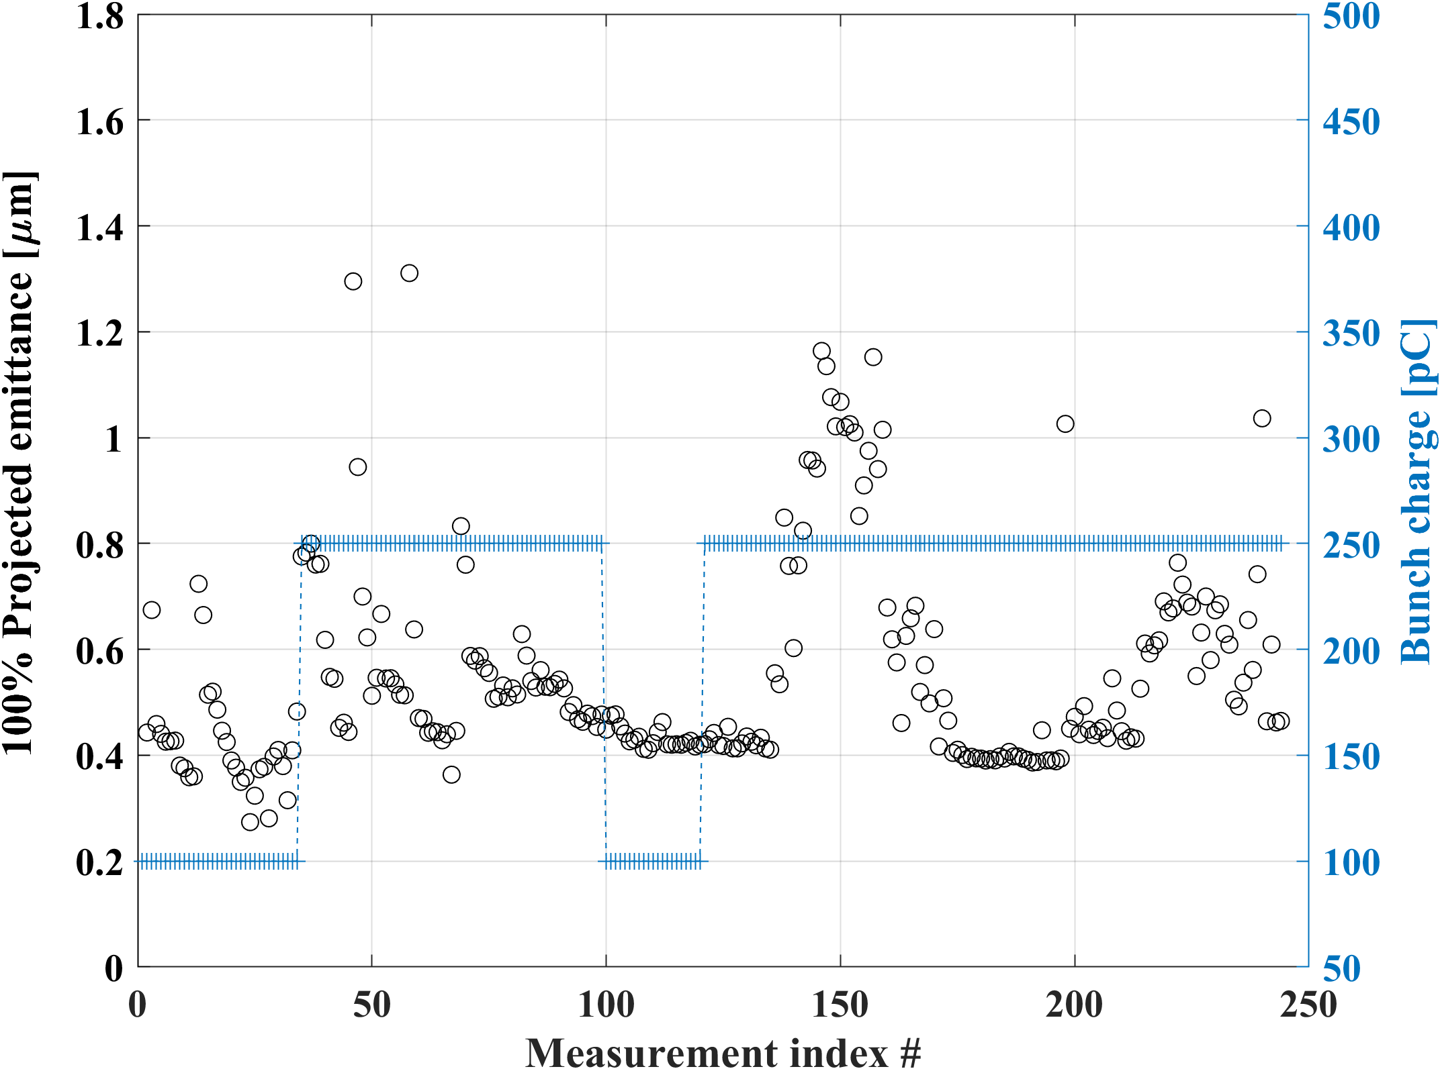
Experimental results on 100% projected emittance optimization
Number of measurements: 244
100% projected emittance about 0.41 µm (XD2) with acceptable mismatch factors, using ~25 ps laser pulses to produce 250 pC
At 100 pC (required for HDC/CW operation), the optimized emittance is about 0.27 µm
If Cs2Te thermal emittance is about 1.1 µm /mm rms (suggested in literatures), then the thermal emittance contributes to about 70% of the best emittance achieved at 250 pC

Slide 13
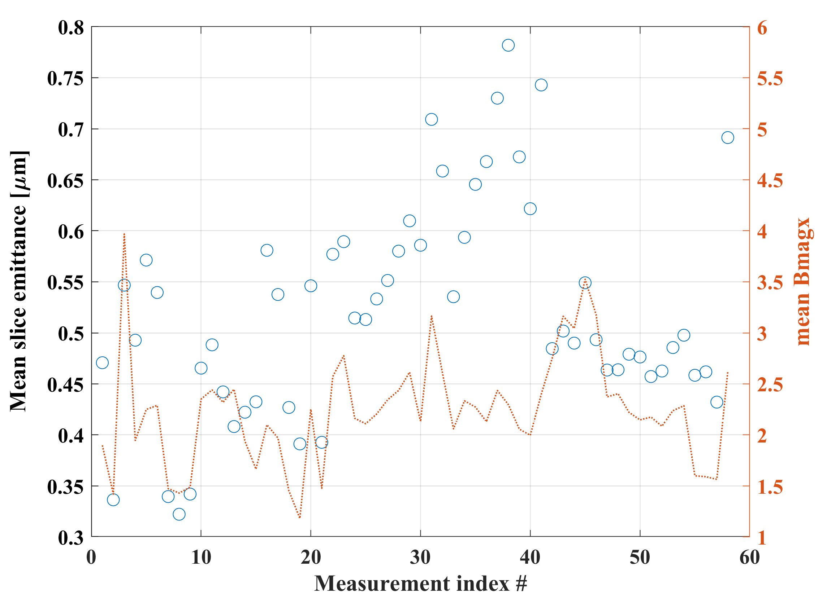
Experimental results on 100% slice emittance optimization
Number of measurements: 58, X2
Matching using X2 not so good overall (status 2024)
Best: mean slice emittance of about 0.32 µm at 250 pC using ~25 ps temporal flattop shaped laser pulses

Slide 14
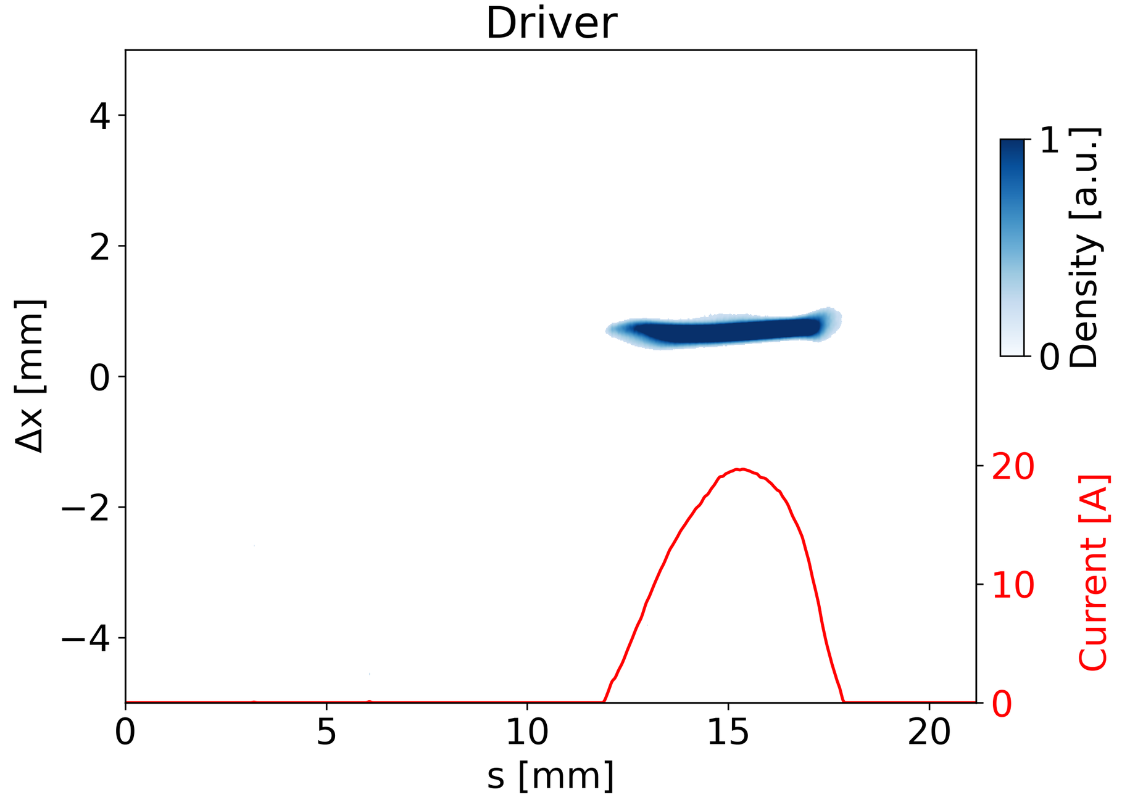
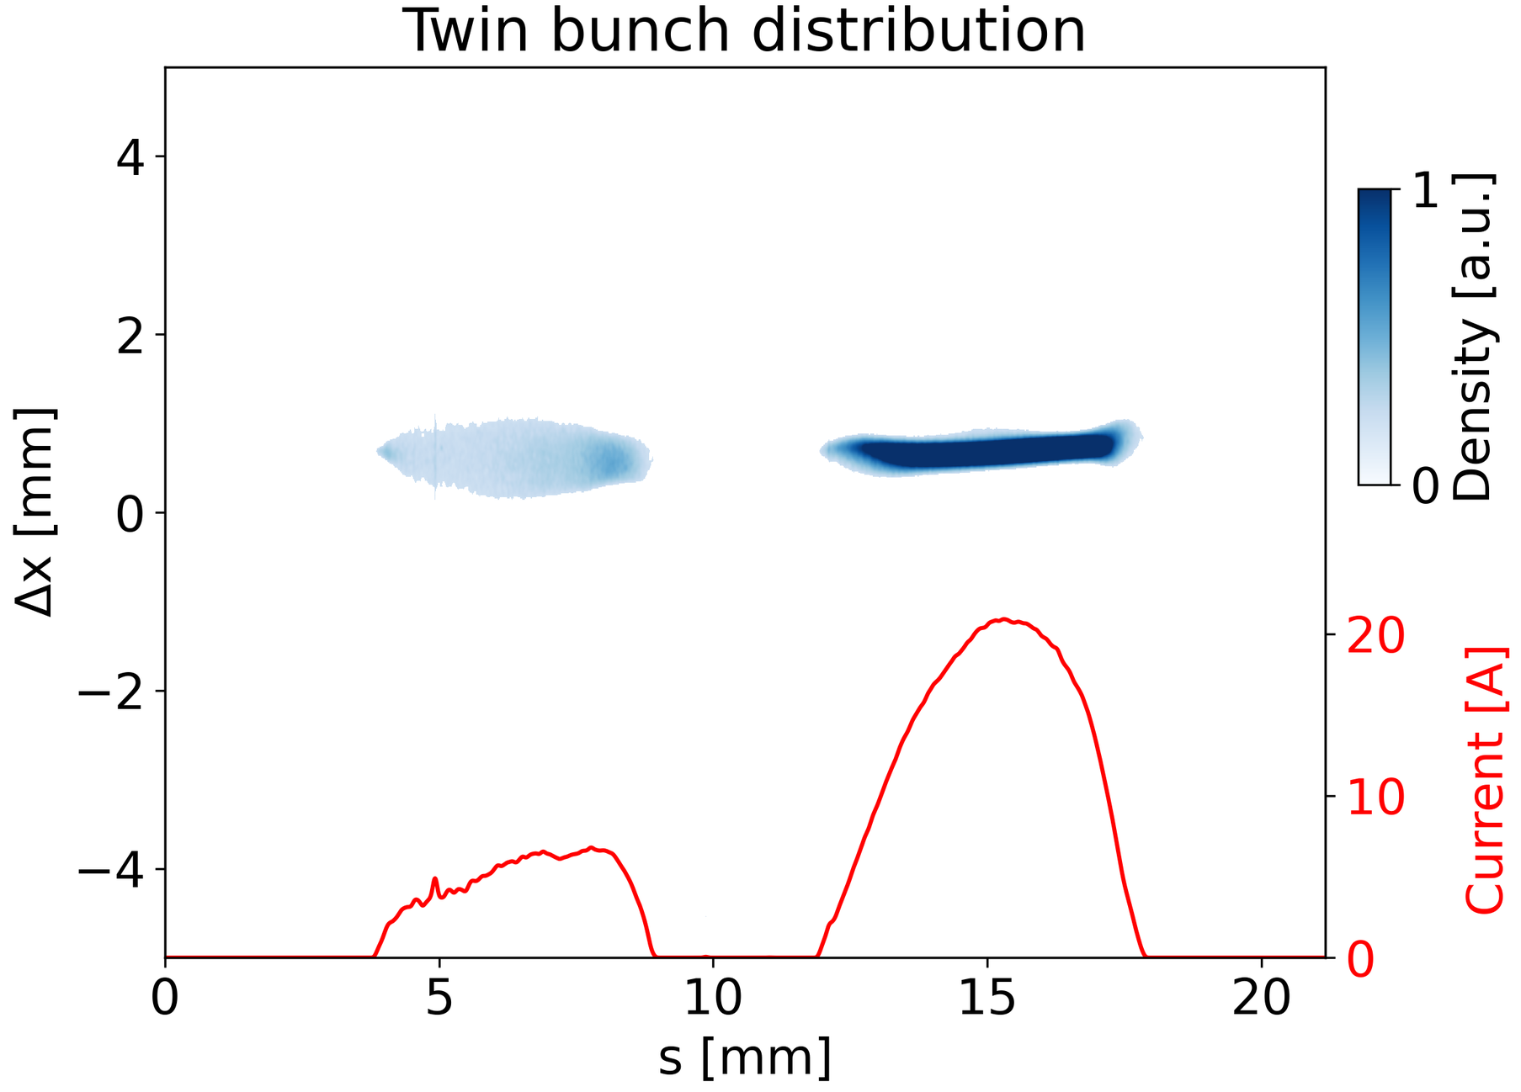
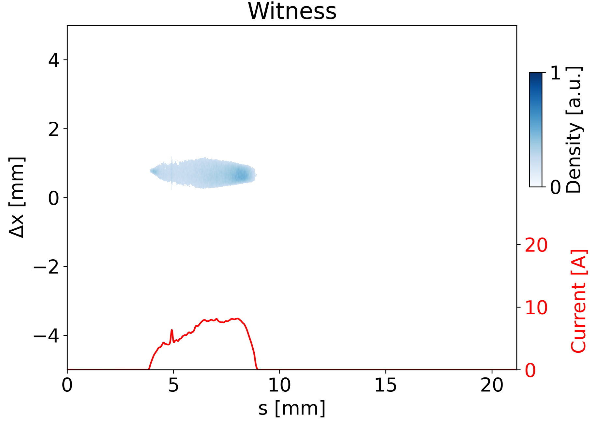
Experimental results on the application of shaped twin-bunches for PWFA
First pulse shaping enabled twin bunch optimization at the XFEL
  Twin bunches in the same RF bucket
  X1: Gaussian driver 250 pC
  X2: flattop-shaped witness 100 pC
  Delay ~10 ps

Slide 15
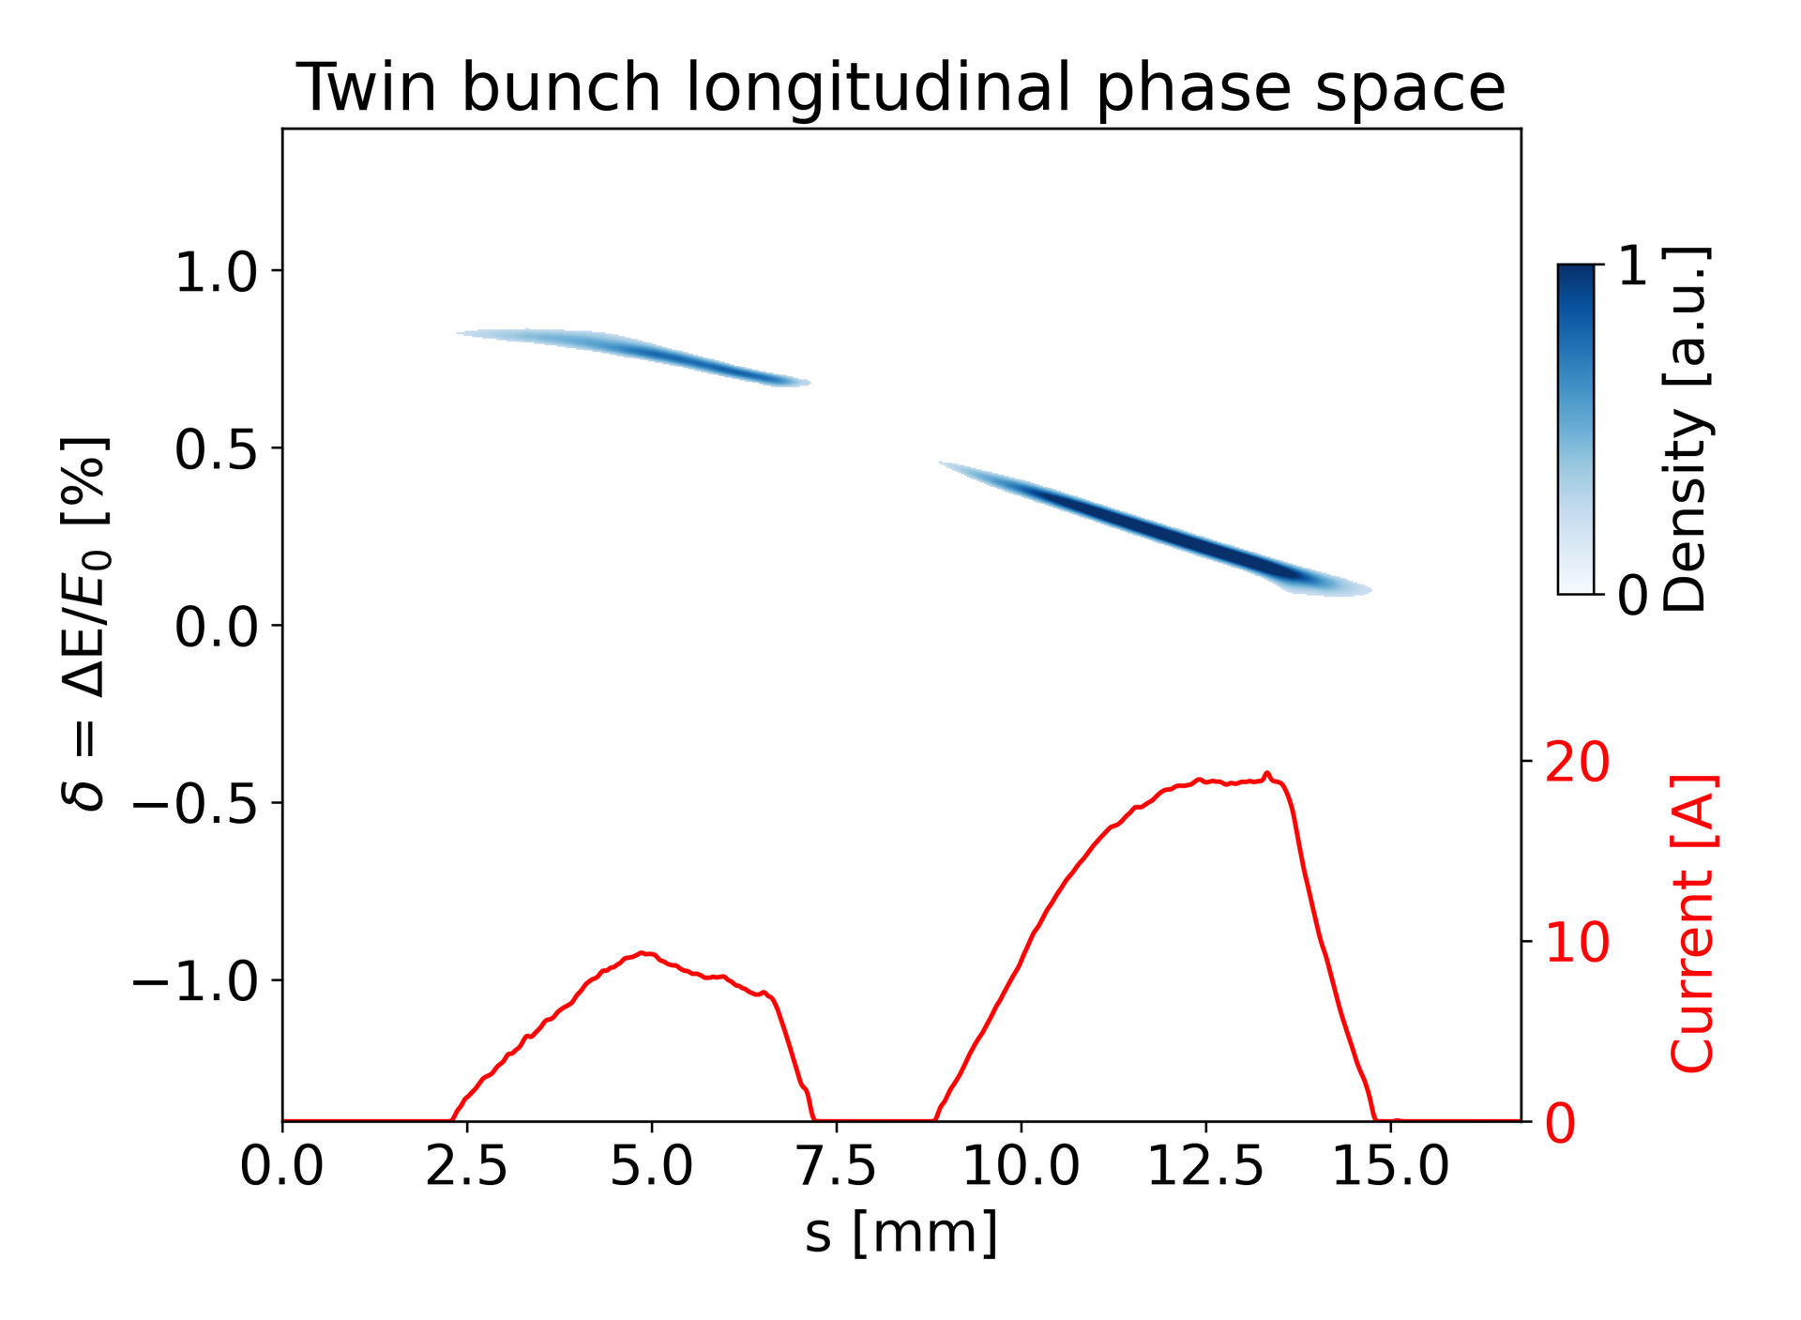
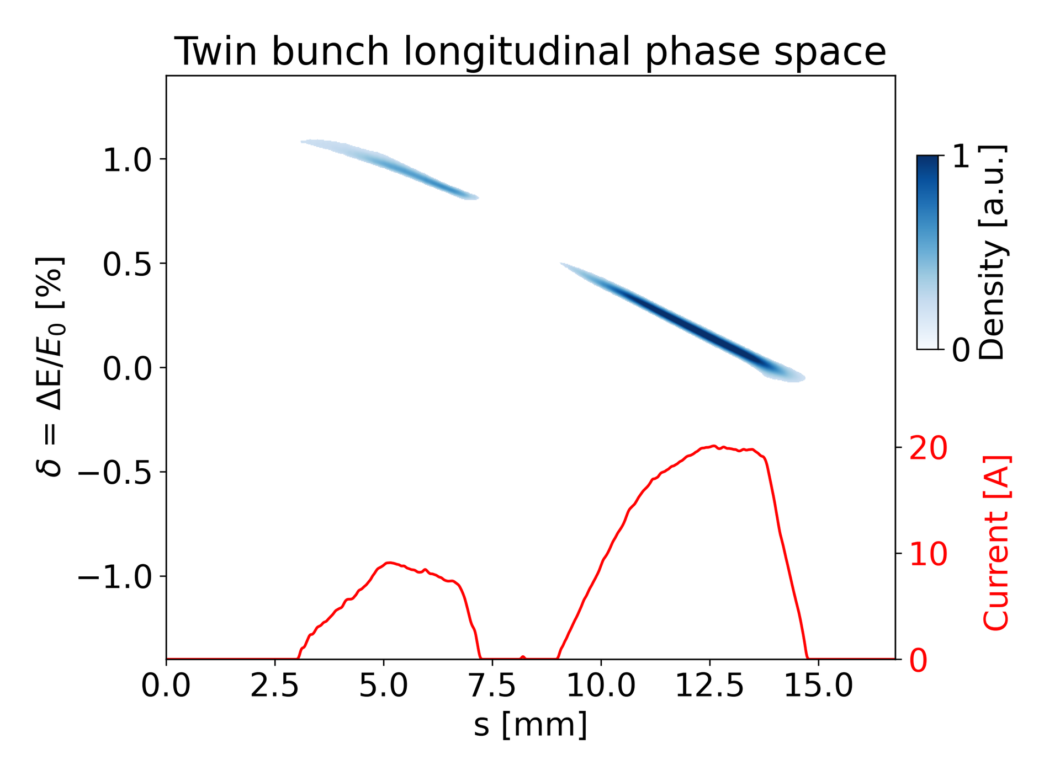
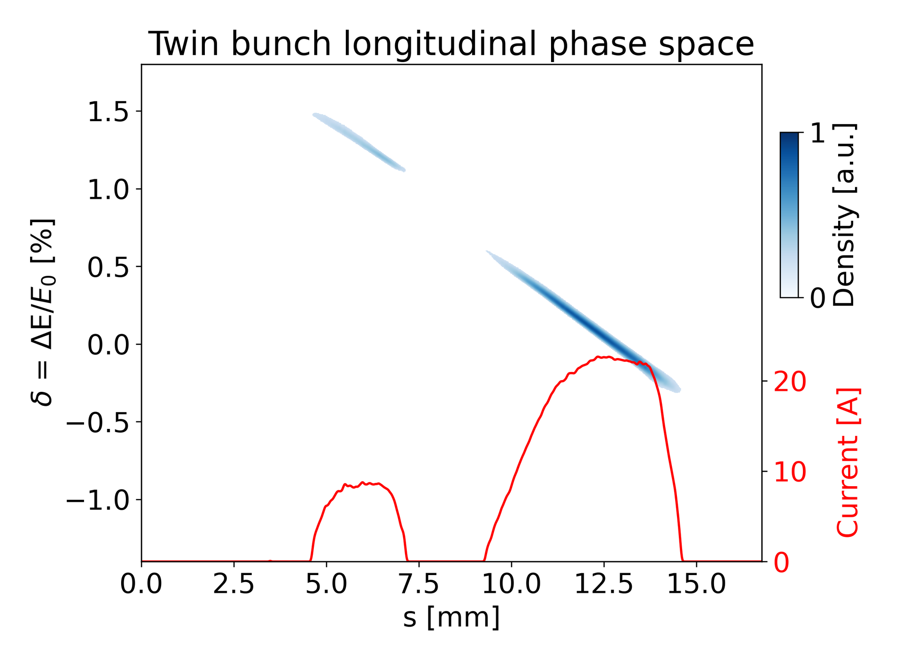
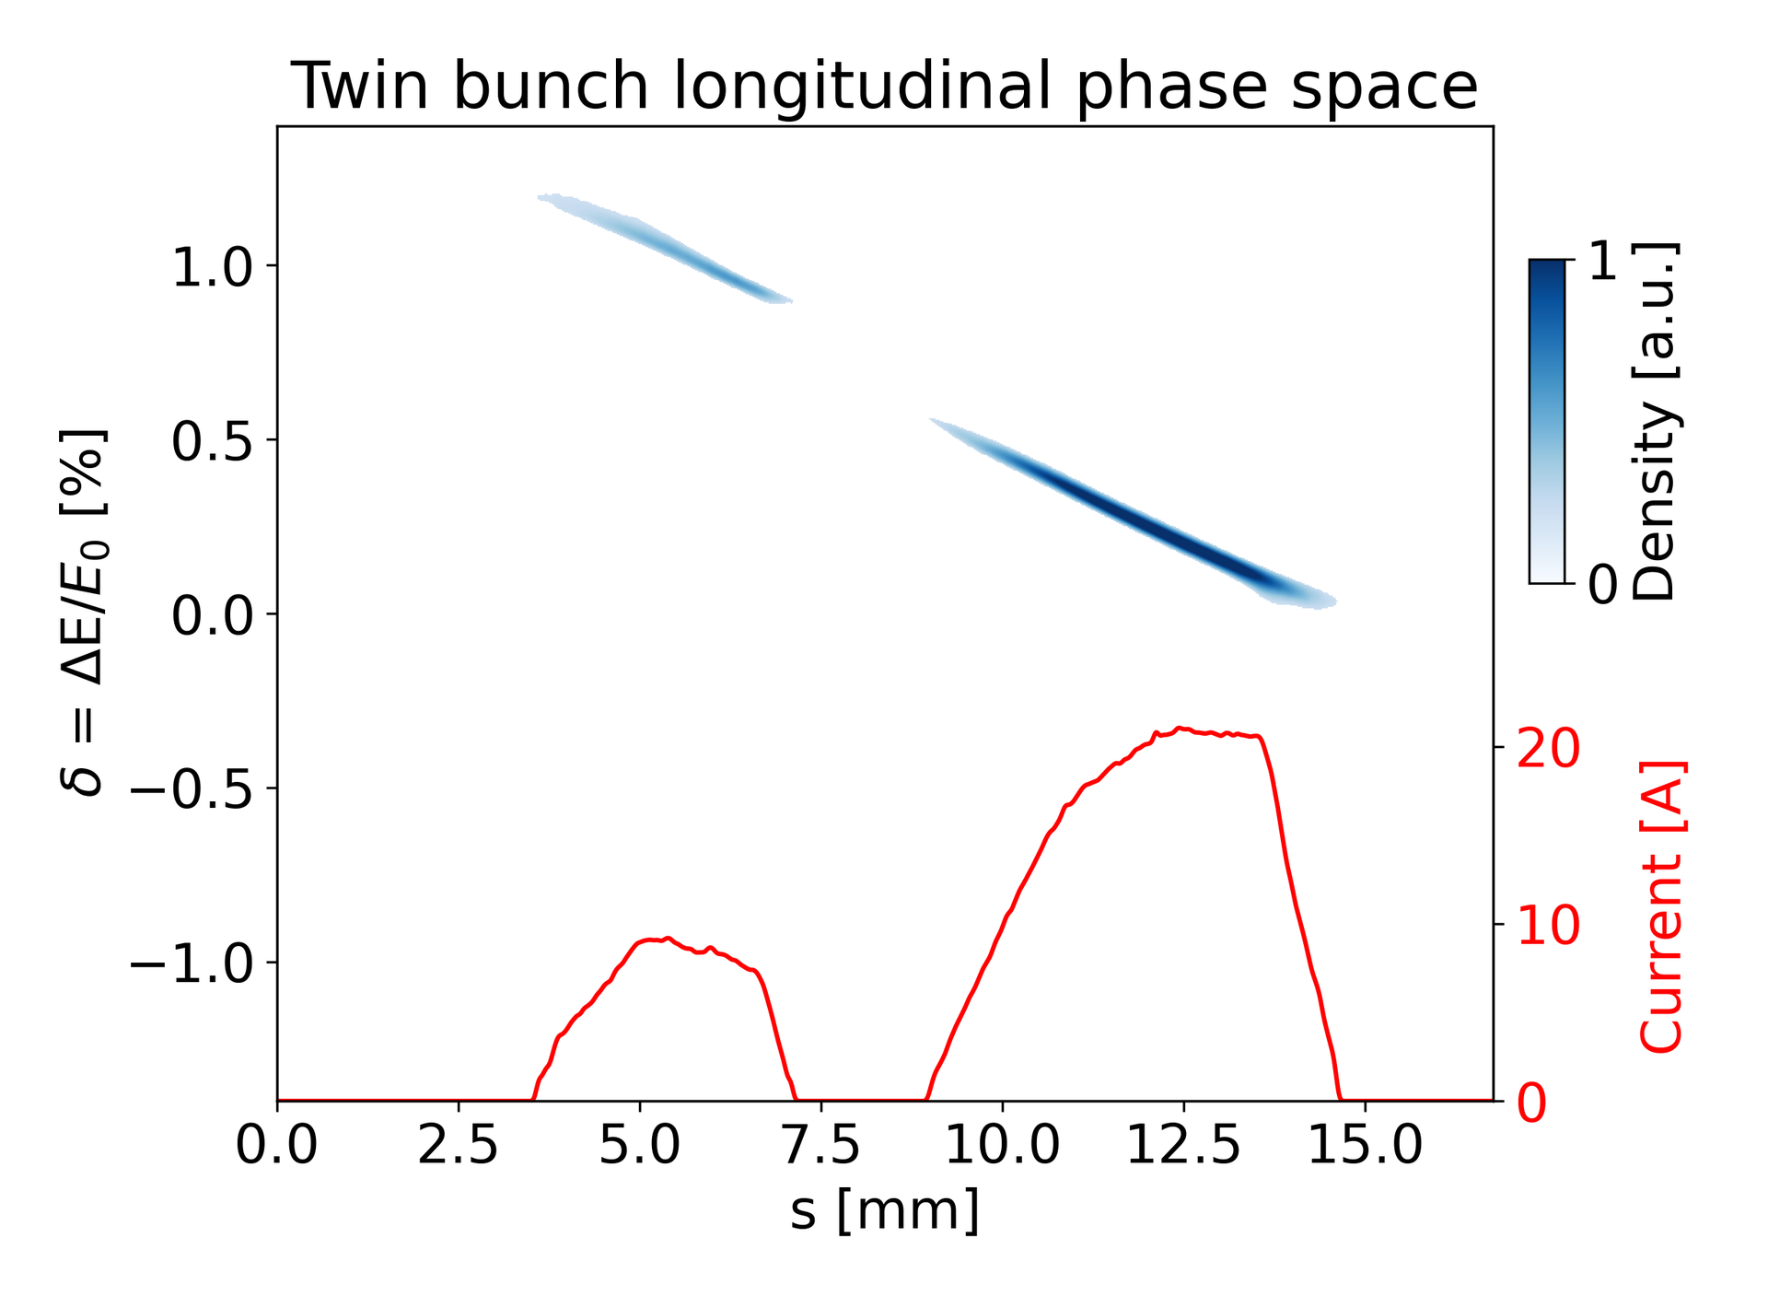
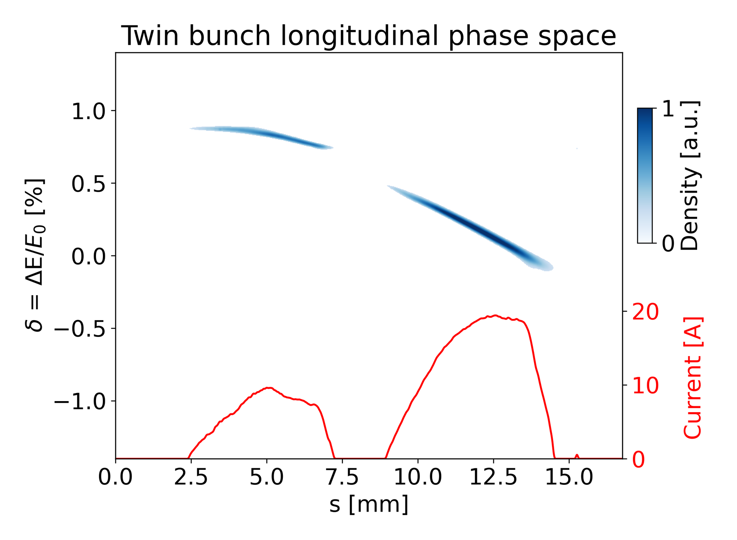
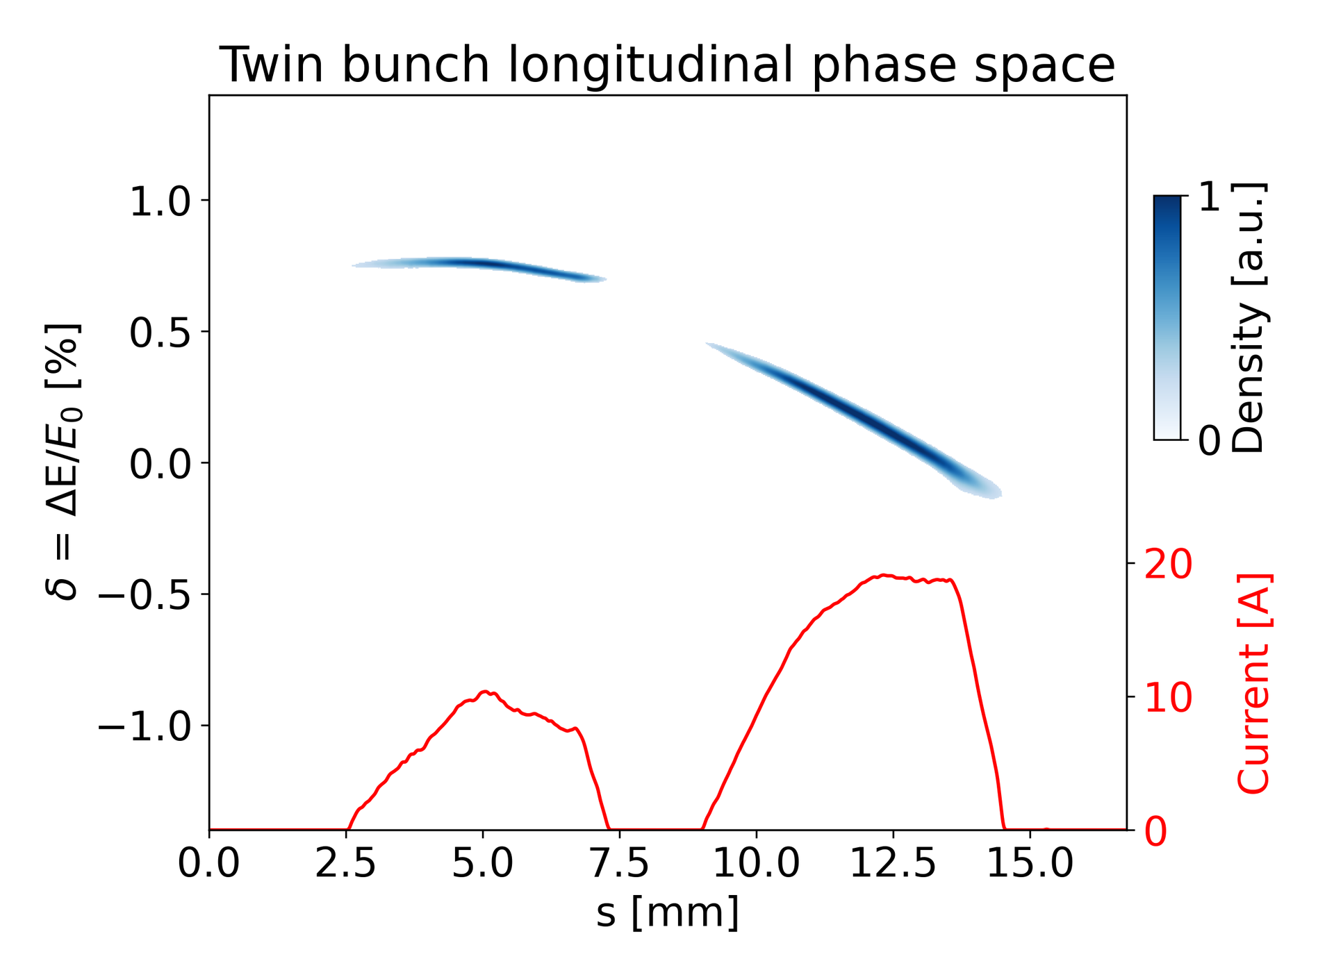
Experimental results on application of shaped twin-bunches for PWFA (contꞌd)
Longitudinal phase space control of twin bunches via A1/AH1 tuning (examples)

Slide 16
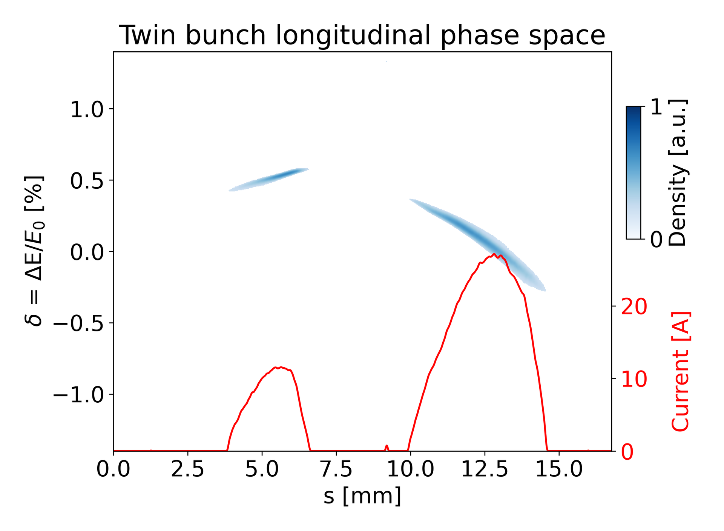
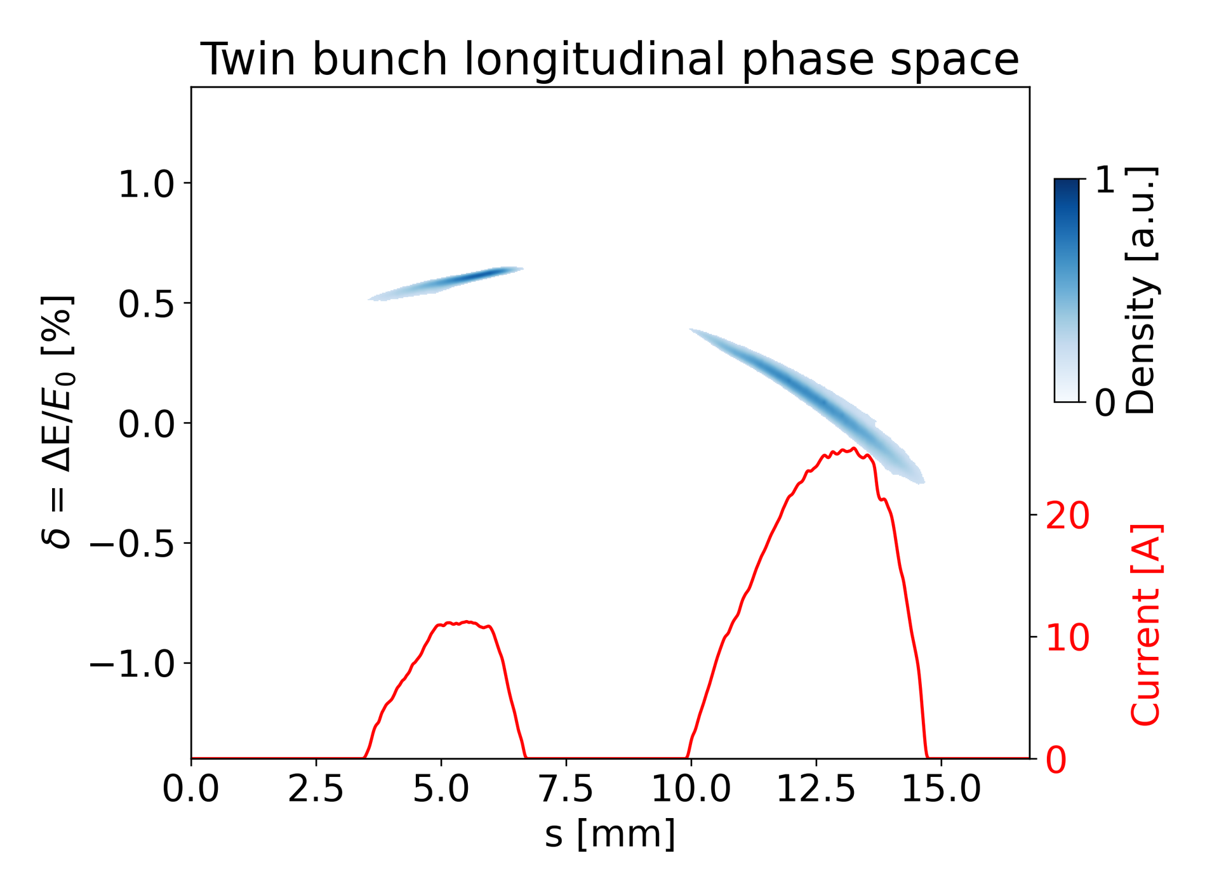
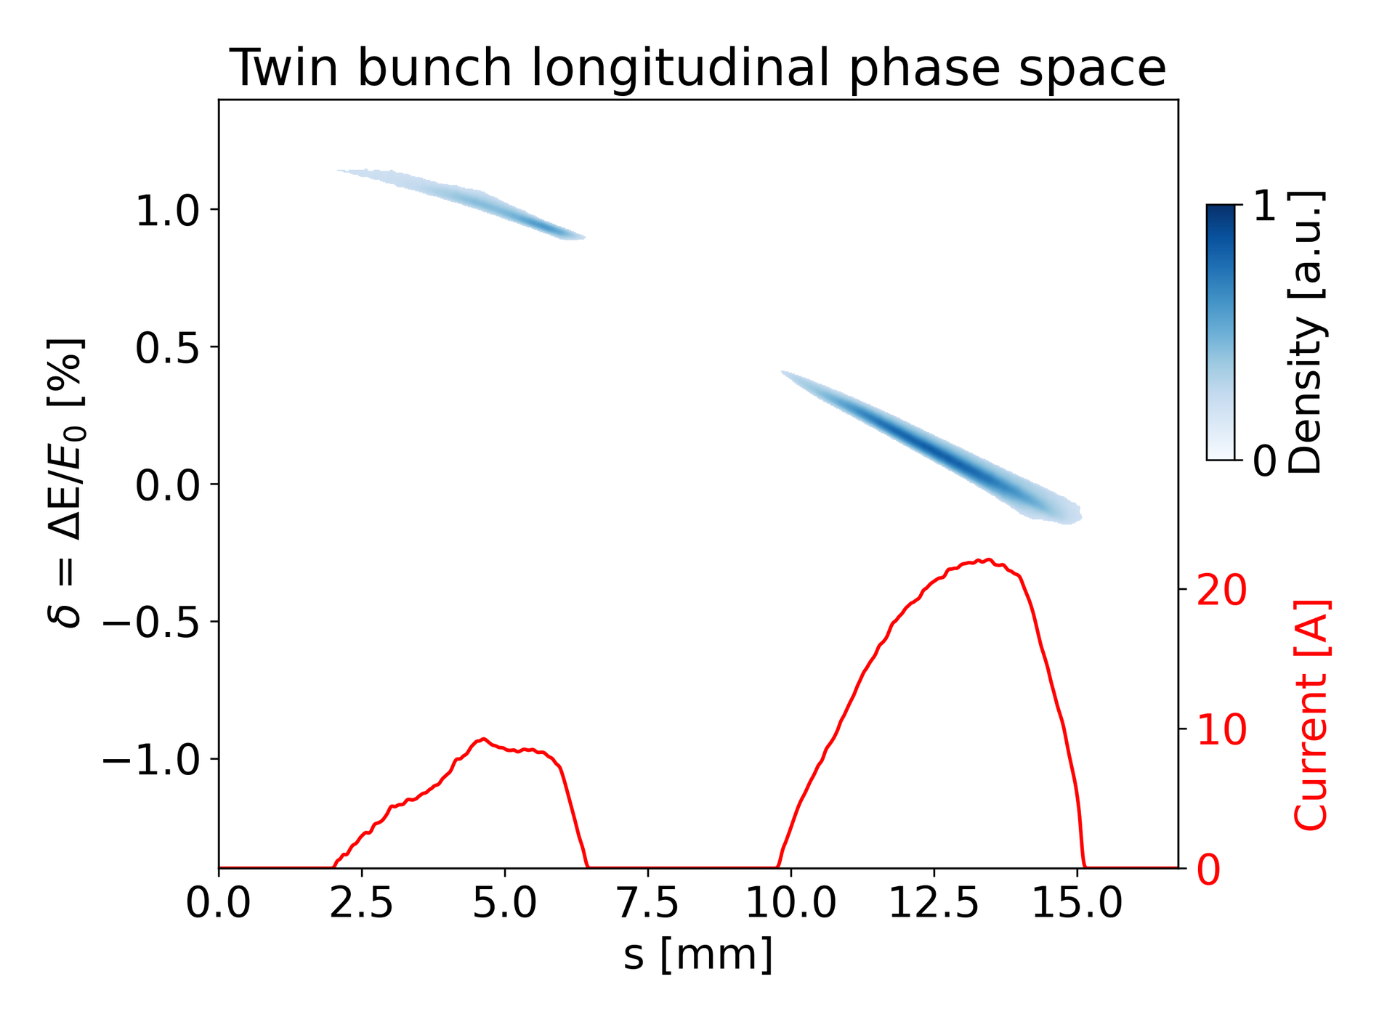
Experimental results on application of shaped twin-bunches for PWFA (contꞌd)
Successful machine tuning of twin bunches in the same RF bucket as preparation of downstream transport studies
  Advanced temporal shapes required in the future
  Requiring more intelligent control methods for charge, delay, BSA, pulse length, rf phasing, etc.

Slide 17
Near-term Planning till June 23rd 2025
Planned XFEL shutdown from 23rd June
Thermal emittance measurements in the gun section (maybe some Tuesdays?)
Pulse shaping enabled twin-bunch studies (perhaps beamtime in March possible)
Quantitative comparison of X1 and X2 emittance at the same laser pulse length (also in Backups)
  Impact of transverse laser distributions
  Previously seemed better for X1
If X2 transverse distribution now comparable with X1, further emittance optimization with X2 at longest possible flattop-shaped laser pulses (?)

Slide 18
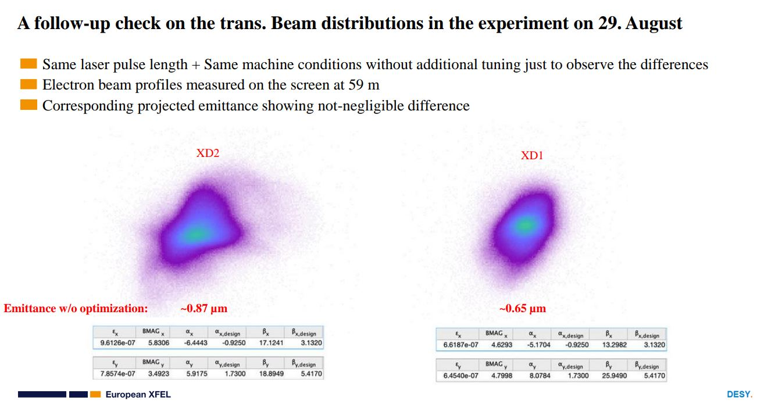
Backups
Remaining issue until end of 2024: direct comparison of X1 and X2 emittance w/o optimization

Slide 19
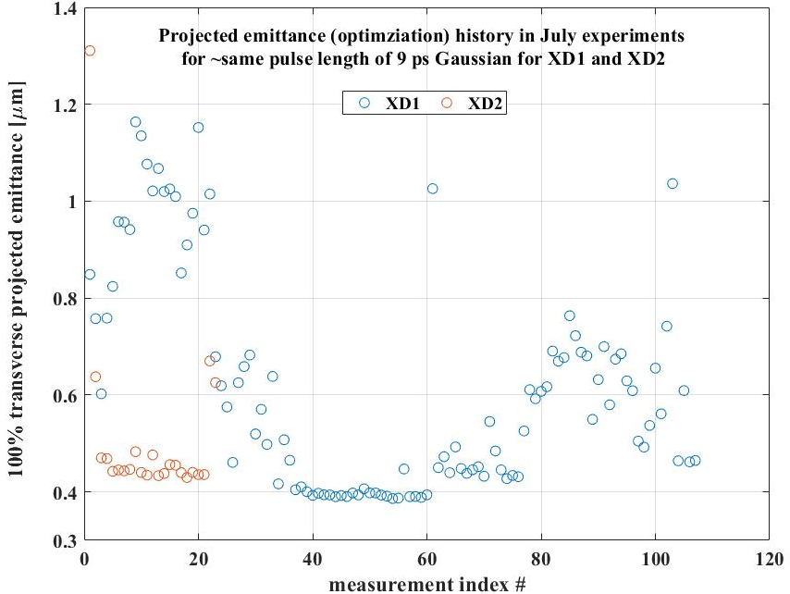
Backups
Remaining issue until end of 2024: direct comparison of X1 and X2 emittance with optimization
~15% deviating

