Slide 1
European XFEL Users’ Meeting 2025
Data Workshop
Data Management Plans
for European XFEL Proposals
Krzysztof Wrona on behalf of the Data Policy and Reduction Working Group
20 January 2025

Slide 2
Examples of Experiment Data Challenges
First-time User Experience It is your first beamtime at European XFEL, and you are responsible for leading data analysis efforts
Complexity and High Data Volume A complex detector setup producing gigabytes per second makes data analysis a significant challenge
Integrating Custom Solutions Specialised equipment or software needs to integrate with facility-provided data services
Publishing Experiment Data Journal require the experiment data to be made publicly available
What if our Data Management Plan addressed these challenges and helped you achieve your experiment goals?

Slide 3
Foundation of Data Management Plan: Scientific Data Policy
comes into effect in 2025
European XFEL updated Scientific Data Policy in November 2023
Updated Scientific Data Policy comes into effect in 2025 for proposal calls which receive beamtime starting from 2026
The implementation phase started, following the SDP approval
https://www.xfel.eu/users/policies/index_eng.html
doi:10.22003/XFEL.EU-TR-2025-001

Slide 4
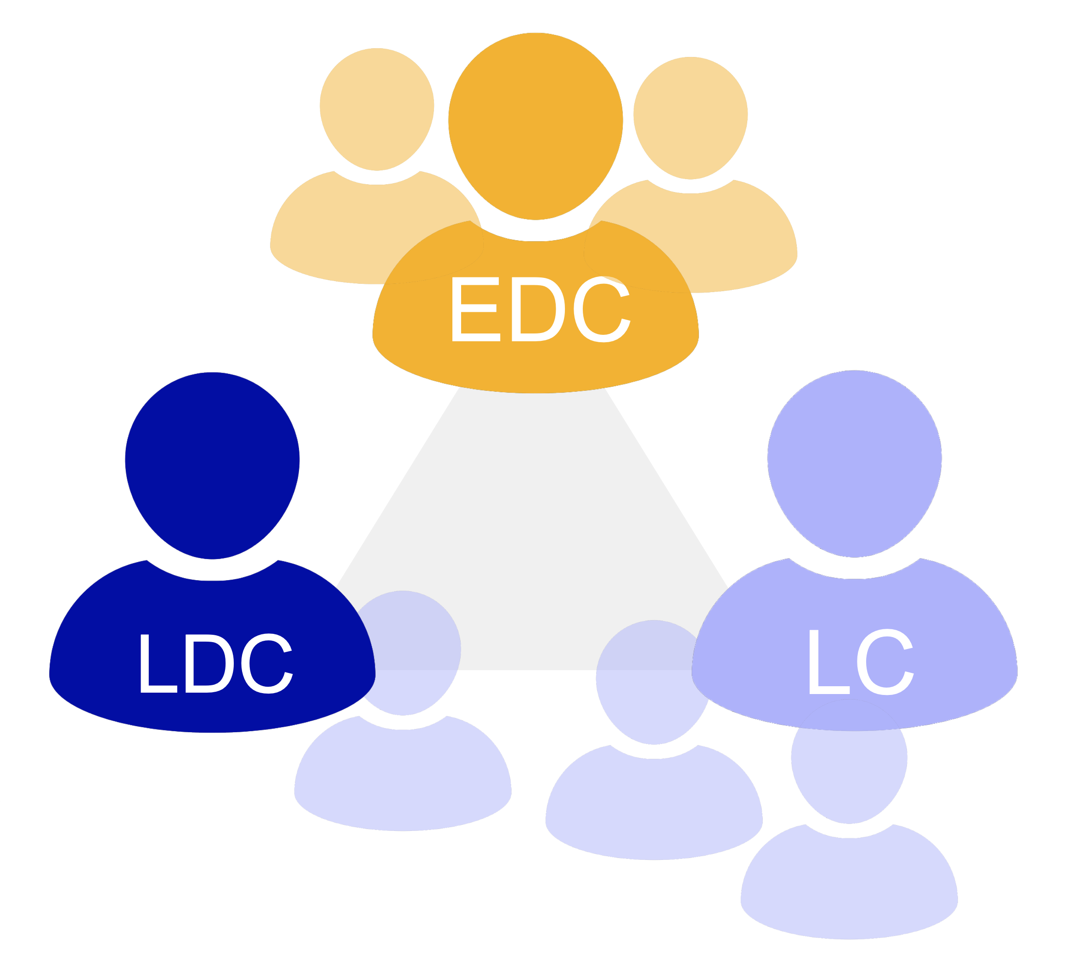
DMPs in the Scientific Data Policy Framework
Scientific
Data Policy
Quality of
Data Services
(QoDS)
Experiment
Team
EuXFEL data
EuXFEL
Instrument
EuXFEL Data Format
(EXDF) Specification
DMP P1234
DMP P2345
Proposal-specific creation and adjustments
DMP P3456
DMP P4567

Slide 5
Data lifecycle and DMP checkpoints
Computing resource allocation
Sample information
Data size estimation
EDC
Team members
Detector used
3
Name of PI
Exp. Technique
Instrument
2
2
…
1
1
…
1
…
Proposal writing / submission
Experiment scheduling
Experiment planning
Experiment and data production
Start of beamtime
Data quality assessment
Data portion selection
RED preparation: ratio known
Publication(s)
OPEN data collection assembly
DOI generation
5
6
1-4
…
1-5
…
Post-experiment data analysis
Apply data reduction
Production of results
Open data phase
6m after beamtime:
RED stage
3y after beamtime:
End of embargo
Notes:
Incremental

Slide 6
Data Management Plan Goals
Facilitating Communication Enhance collaboration between experiment teams and facility experts
Understanding Experiment Needs Capture and document unique requirements of individual experiments
Exploring and Documenting Solutions Provide a structured platform for discussing and recording feasible solutions
Managing Resource Allocation Document and allocate resources needed for successful execution
Defining Analysis Strategies Establish clear strategies for data analysis and management
Managing Data Lifecycle Ensure effective management of data from acquisition to publication

Slide 7
Processes and roles in the DMP concept
We have got
requirement X
DMP 1234
We agreed on
XYZ
We offer software
solution Y
Our instrument can
provide Z
Discussion process
Documentation process

Slide 8
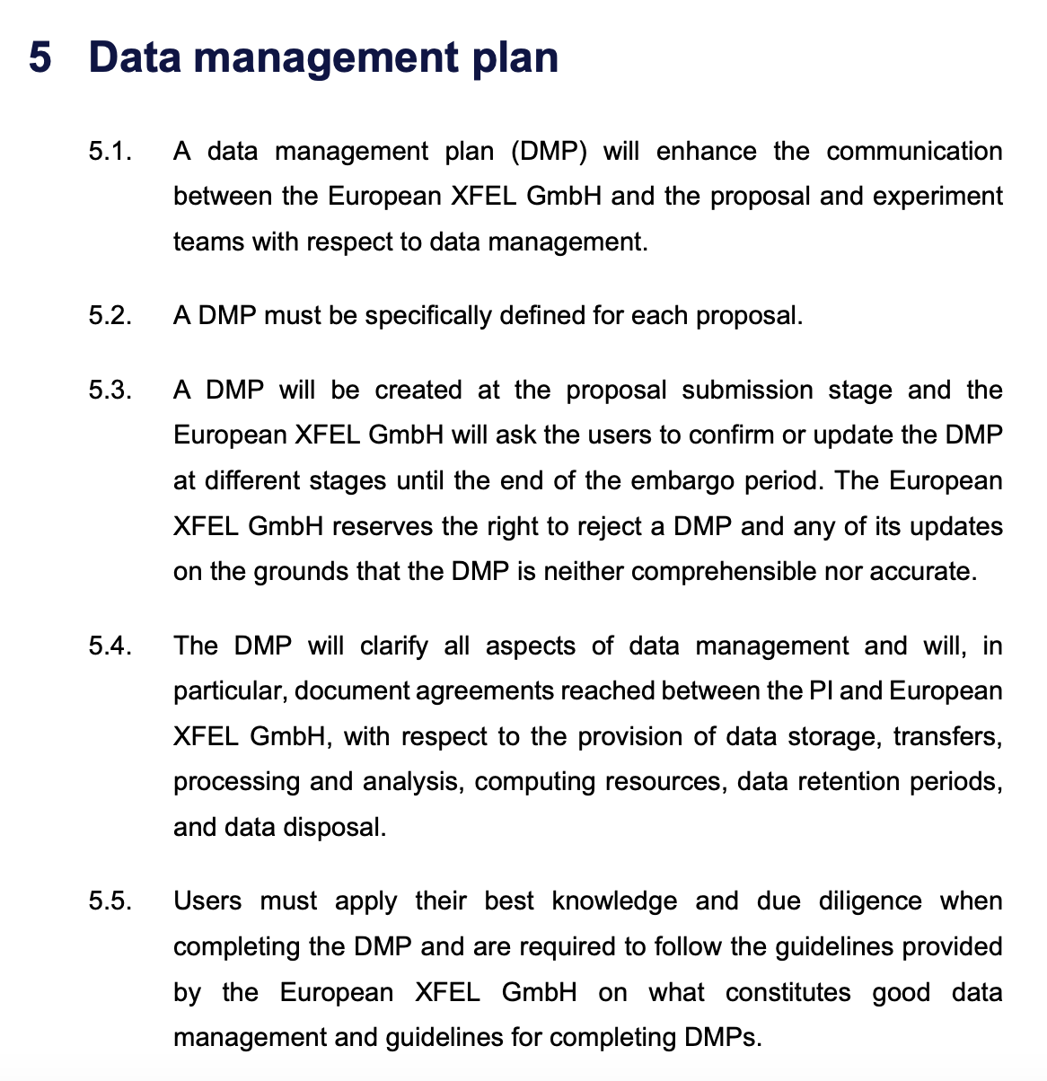
DMP characteristics
DMP will be individual and specific for every proposal
DMP is a dynamic plan adapted at each stage, from proposal acceptance to the open access phase
DMP will formalise the collaborative planning of all data usage requirements and boundary conditions between stakeholders
DMP process will leverage all available information to the fullest extent and will produce statements and agreements as outputs
Covered in SDP Section 5
DOI: 10.22003/XFEL.EU-TR-2025-001

Slide 9
Implementation of the Data Management Plan
Spring 2024: DMP Pilot Project
Conducted with seven proposals from 2024-I to gather a range of data management needs
Focused on gathering data requirements and evaluating the resources necessary for effective data handling during beamtime.
Summer/Autumn 2024: Post-experiment data handling
Archiving of all proposals that passed the embargo period (2017-2021)
Offer the option to store reduced data beyond the embargo period, contingent upon active user engagement
Spring 2025: Next Steps for DMP
Expand the DMP process based on pilot feedback, aiming for wider implementation in the next proposal cycle.
Develop automated workflows to streamline DMP tasks and improve scalability for all beamtimes.

Slide 10
Spring 2024: DMP pilot project
Pilot Scope The pilot project covered selected proposals, one for each instrument, with the following goals:
Gathering Standard Information:
Documented key data-relevant details (e.g., experiment setup, data volume estimates) to ensure completeness and accuracy
Addressing Specific Challenges:
Adopted a collaborative approach to identify and resolve unique data management issues, improving workflows and processes
Testing Communication Channels:
Evaluated various communication methods to understand their strengths and limitations, enhancing user-facility interactions

Slide 11
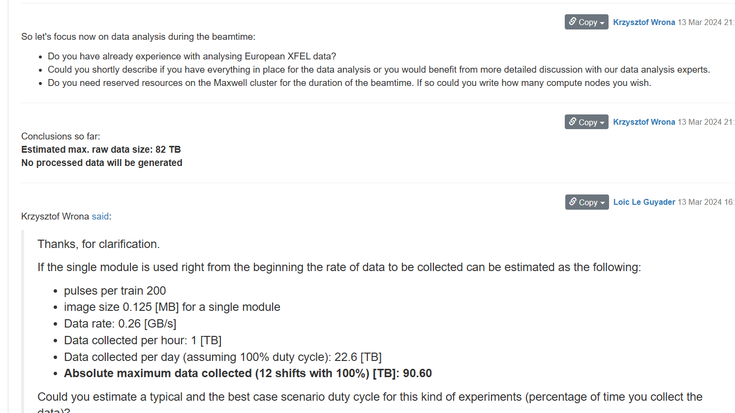
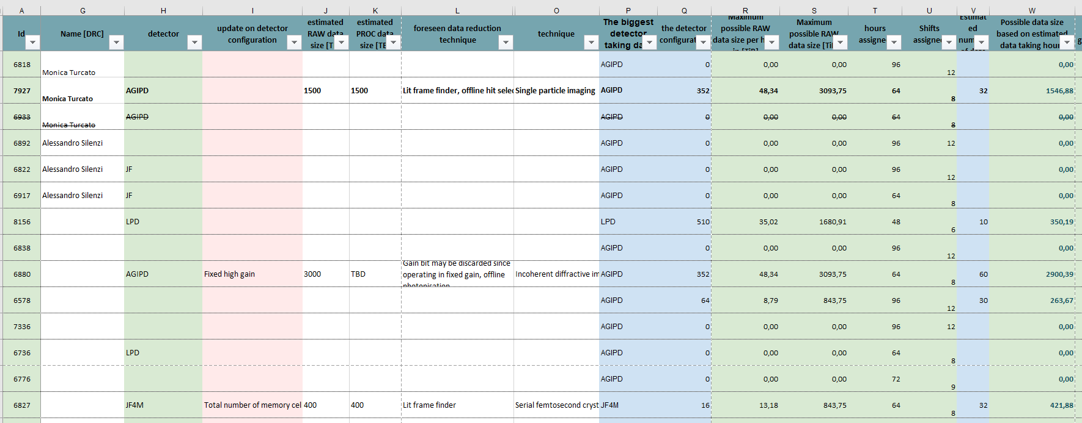
Spring 2024: DMP pilot project
Gathering Standard Information
Identify data-relevant experiment setup, e.g. detectors used and their configurations
Assess the experiment’s duty cycle, including estimated periods when detectors generate data
Determine the level of support needed for data analysis
Obtain details to configure data processing pipelines, e.g. for detector data corrections
Evaluate the computing resources required for data processing and analysis during the beamtime
Estimate the size of RAW and PROC data
Explore the possibility of data reduction, both during and after beamtime

Slide 12
Spring 2024: DMP pilot project
Addressing Specific Challenges:
Collaborative efforts to address non-standard data management challenges
Implementation choices were made through collaborative discussions
Challenge: Large Data Volume Train selection with a slicer device prior to AGIPD1M DAQ reduced raw data by 70% (final dataset: 0.63 PB).
Challenge: New Instrument Camera Adapted an existing solution for online preview using expertise from another instrument.
Challenge: Non-standard Software Deployed custom software on Maxwell to enable non-standard tool usage
Challenge: Non-standard Data Format Converted time-tagged binary shock data to supported formats post-experiment.

Slide 13
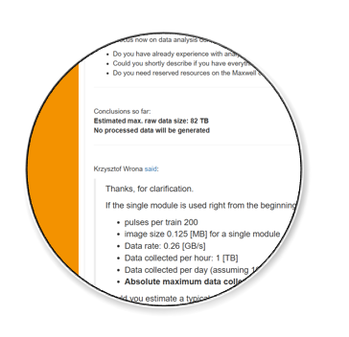
Spring 2024: DMP pilot project
Communication Channels:
Participation in beamtime preparation Kick-Off Meeting
Highly valuable and informative, serving as a critical step in preparation
Occasionally identifies specific data topics, triggering follow-up meetings.
myLog (Electronic Logbook)
Dedicated topic for documenting and discussing DMP
Captures standard agreements during preparation
Could benefit from enhanced features, such as direct messaging for less formal communication

Slide 14
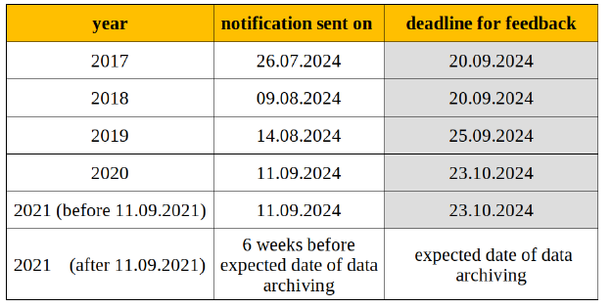
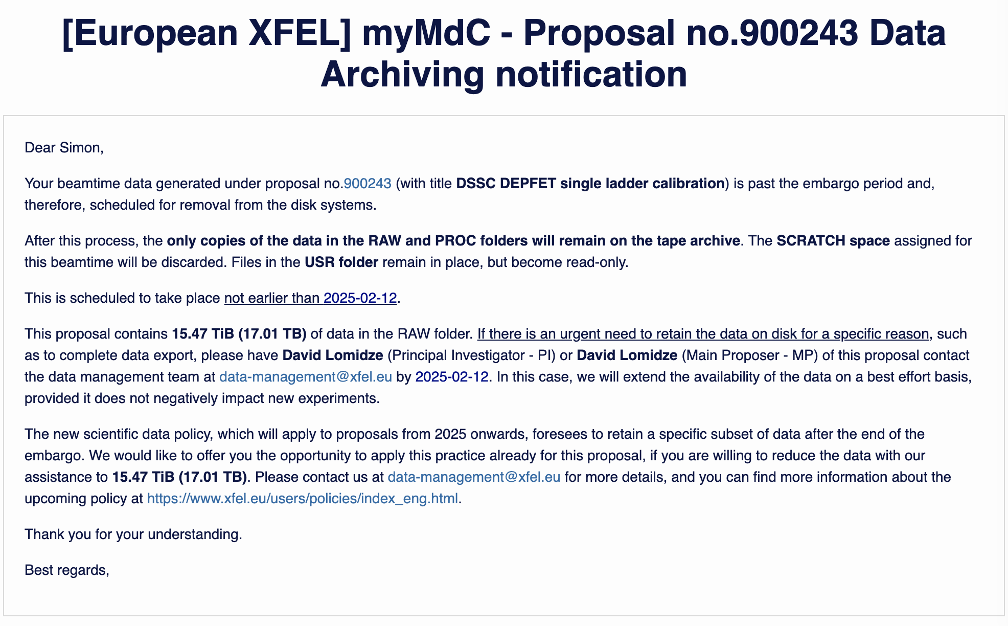
Summer/Autumn 2024: Data Archiving notifications
Introduction of the Archiving Process
Get experience with the DMP post-experiment phase
Define necessary actions to be implemented
Begin with proposals past the embargo period
Introduce the option to create and retain reduced data
Default Actions
RAW Data: Retained only on tape
USR Folder (scripts, auxiliary data, and results): Becomes immutable
SCRATCH and PROC folders: Data removed
Optional Actions (by request):
Data Retention: Extension of the data retention for a specific reason and defined period
Data Download: Enable temporary downloads to finish data analysis
Reduced Data: Create and retain reduced data long-term with the aim of making it open-access

Slide 15
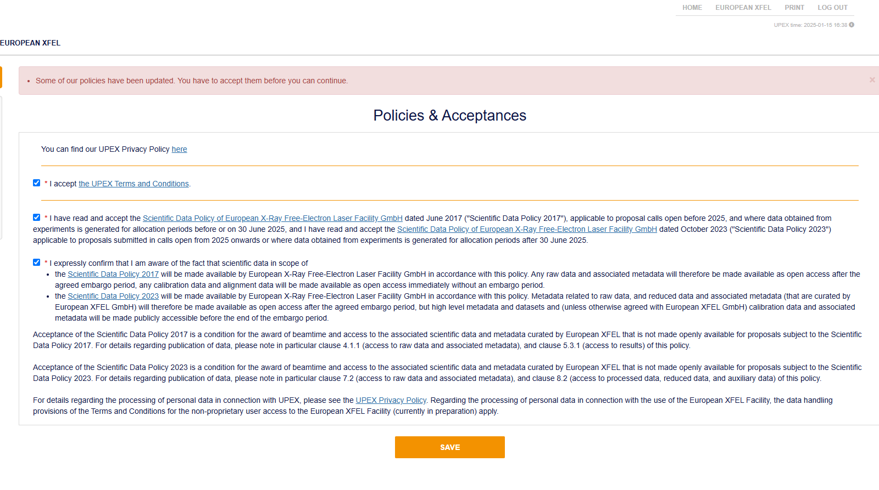
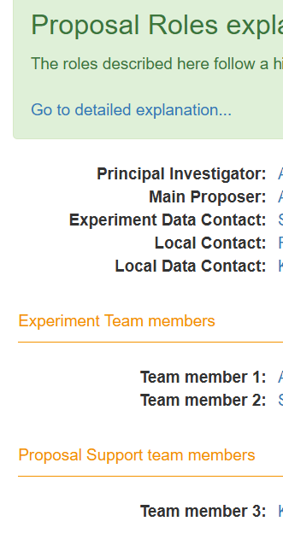
Spring 2025: Next Steps for DMP
Acceptance of the Scientific Data Policy in User Portal
First DMP-related improvements in use:
EDC and LDC defined for each proposal/beamtime
myLog can be created as soon as the beamtime is confirmed
Experiment Support Team
LDC can involve experts in the discussion (myLog), and the follow-up actions can be documented
Getting the first experience in the process scalability
From seven beamtimes chosen for the pilot project to 50+ beamtimes per running period

Slide 16
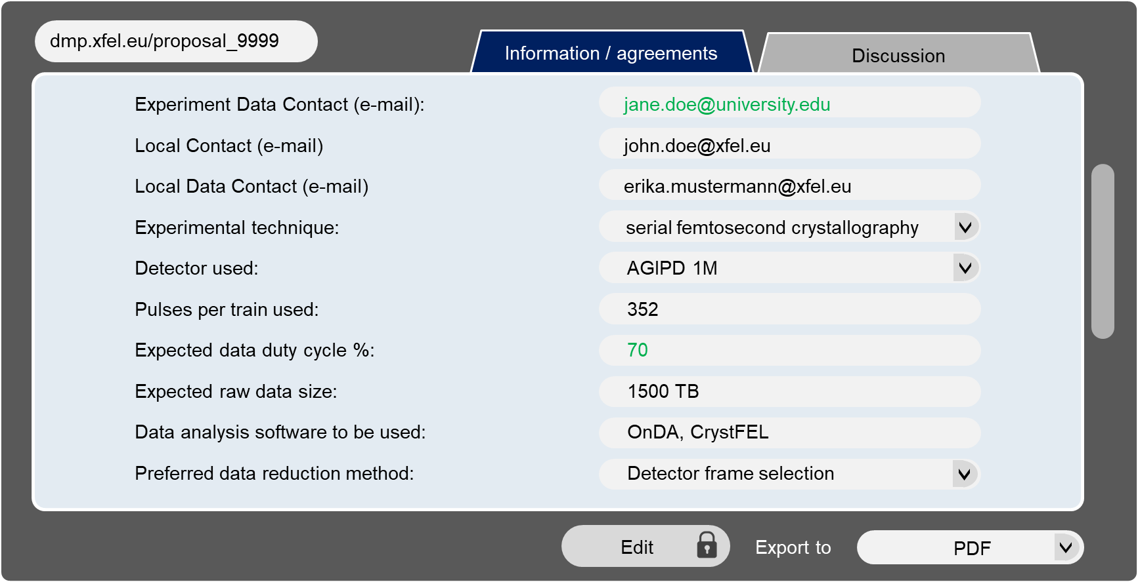
Getting ready for 2026
Prepare for Routine DMP Usage
Adopt Data Management Plans across the entire experiment lifecycle from 2026
Sustain over 50 beamtimes per run period without overburdening staff
Streamlined Processes:
Improve documentation of agreements and make standard steps more straightforward to perform
Continue refining workflows to reduce overhead and complexity
Software Automation:
Develop tools for automated resource allocation, notifications, and standardised data reduction workflows

Slide 17
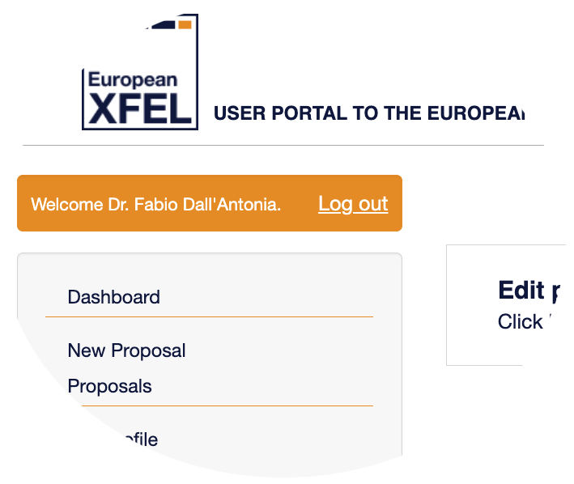
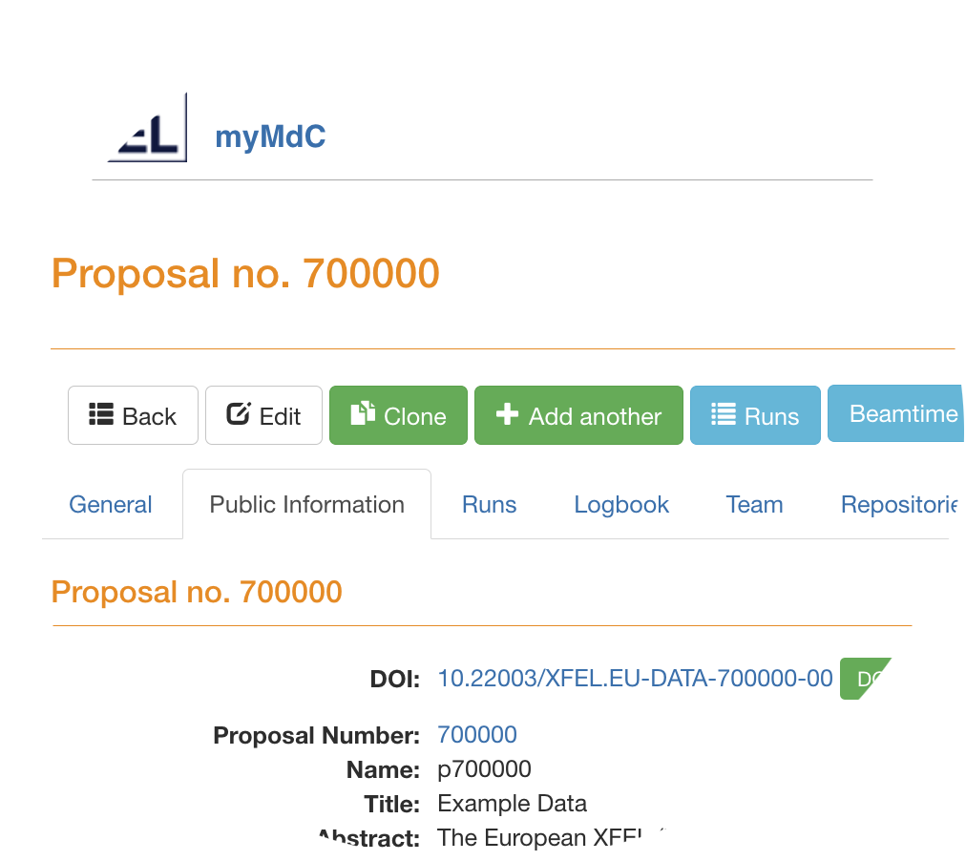
DMP as a service
Scientific
Data Policy
QoDS
Existing components, and some to be developed, serving as:
Sources of DMP information
Tools to streamline processes
Communication tool
Proposal system
DB static facility
information
DMP tool
Metadata catalogue
DB pre-existing
instrument
information
Scheme based on
Sample information
Metadata enrichment
Experts notifications
Triggering actions

Slide 18
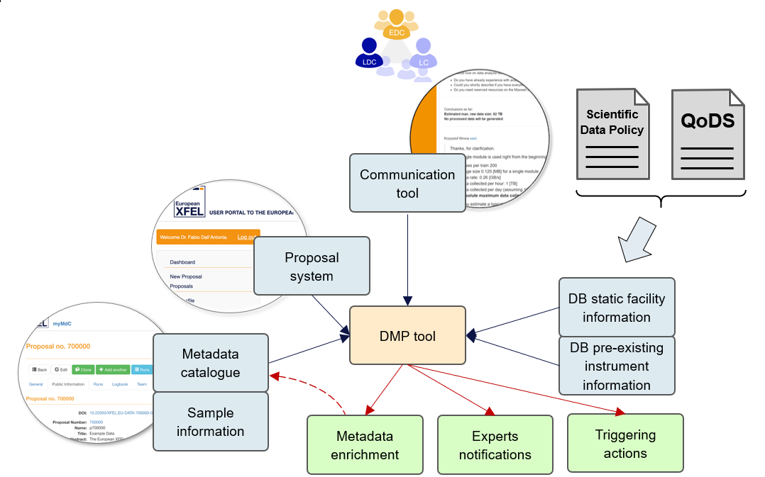
Summary
Data Management Plan is meant to be:
A core component of data services:
Integral to the updated Scientific Data Policy
A mandatory process:
Required for all experiments starting in 2026
An enhancement of the experiment experience
Designed to simplify and improve data-related processes
A collaborative and structured process:
Provides a systematic framework for effective data handling.

