Slide 1
The 2nd fan for the European XFEL V. Balandin (†), W. Decking, N. Golubeva, S. Tomin, S. Walker
Feasibility study for an European XFEL upgrade in the 203?s
Linear accelerator upgrade (HDC)
Addition of FELs
SASE 4/5
2nd Fan (increase number of FELs by order 5 )
New dedicated experiments

Slide 2
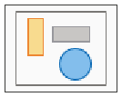
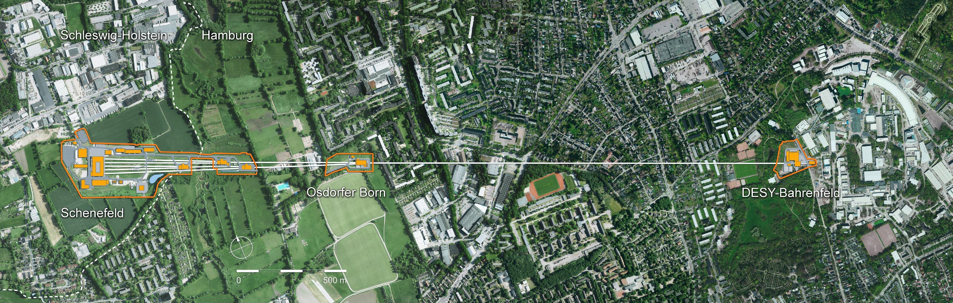

Slide 4
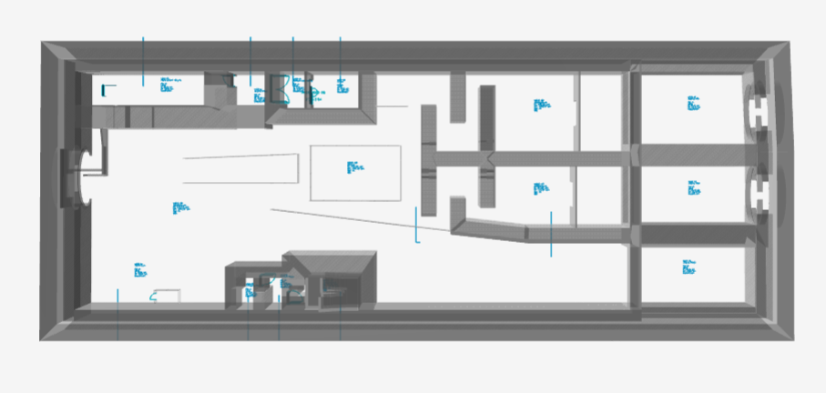
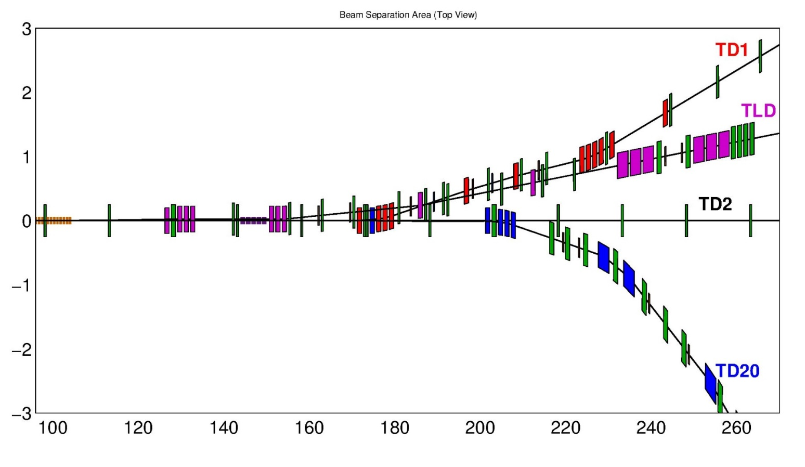
Separation area (Top view): Design in 2011 (Nina Golubeva, Vladimir Balandin)
SASE2
dogleg
KL
BZ
SASE1
Red, magenta and blue
colors mark septa and dipoles
of beamlines to SA2, TLD, TD20
Third beamline TD20 for the future upgrade has been also considered
during the design of the separation area.

Slide 5
Separation area (Top view): Design in 2011 (Nina Golubeva, Vladimir Balandin)
SASE2
dogleg
KL
BZ
SASE1
Red, magenta and blue
colors mark septa and dipoles
of beamlines to SA2, TLD, TD20
Third beamline TD20 for the future upgrade has been also considered
during the design of the separation area.

Slide 6

Design of Extraction sections: Specifications, requirements
Kicker-Lambertson-septum layout
• different bending planes by kickers and septa
• horizontal and vertical dispersions Dx and Dy
Extraction to TLD, Sa2, TD20 - from FODO lattice in the straight line TL
• constraints on possible location of kickers and septa
• Twiss functions at the entrance of deflection sections are fixed
(no matching section in the front)
First-order achromatic beamline (R16, R26, R36, R46 = 0 in the transfer matrix)
Necessary to avoid collisions of magnets from different beamlines
Not done for TD20:
Accept bunches with different energies: up to ±1.5% from nominal energy
First-order isochronous beamline (R56 = 0 in the transfer matrix)
Other effects: due to coherent synchrotron radiation, …

Slide 7
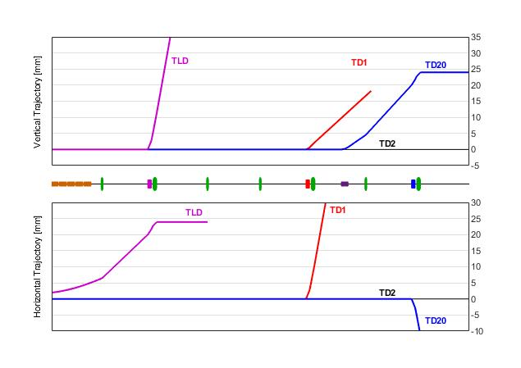
Part 1: Trajectory
Part 1: Joint line for two beams (SA1 and T20).
Kick in vertical plane (2 KL kickers),
≈0.81 mrad kick angle
Additional kick from QF quadrupole
At the entrance of first BZ (H) septum:
20 mm vertical separation
First BZ (H) septum is tilted by ~11°
(slight bend also in Y-plane)
First septum BZ (H) and downstream
QK quadrupole remove the beam slope
Δy ≈ 24 mm
KL
BZ
QF
QK
Beam to T20 is off-axis in this section
No setup for TD1 line for this plot.

Slide 8
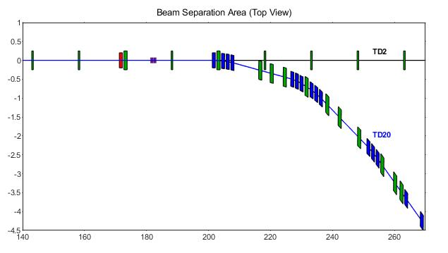
Second part (Part 2): Magnet Lattice
Part 2: Start at the entrance of second BZ septum ̶ Deflection arc T20M
Part 1
Part 2
X-plane: -6.742⁰ (total) deflection
• 4 BZ septa (1st septum is tilted)
• 12 dipoles BD (H)
Y-plane: Dogleg in the end
• closes the linear vertical dispersion • bring the beam back to
the horizontal plane y = 0
• no quads between dipoles
Quadrupoles (10)
Dipoles BD (H)
Dogleg dipoles (V)

Slide 9
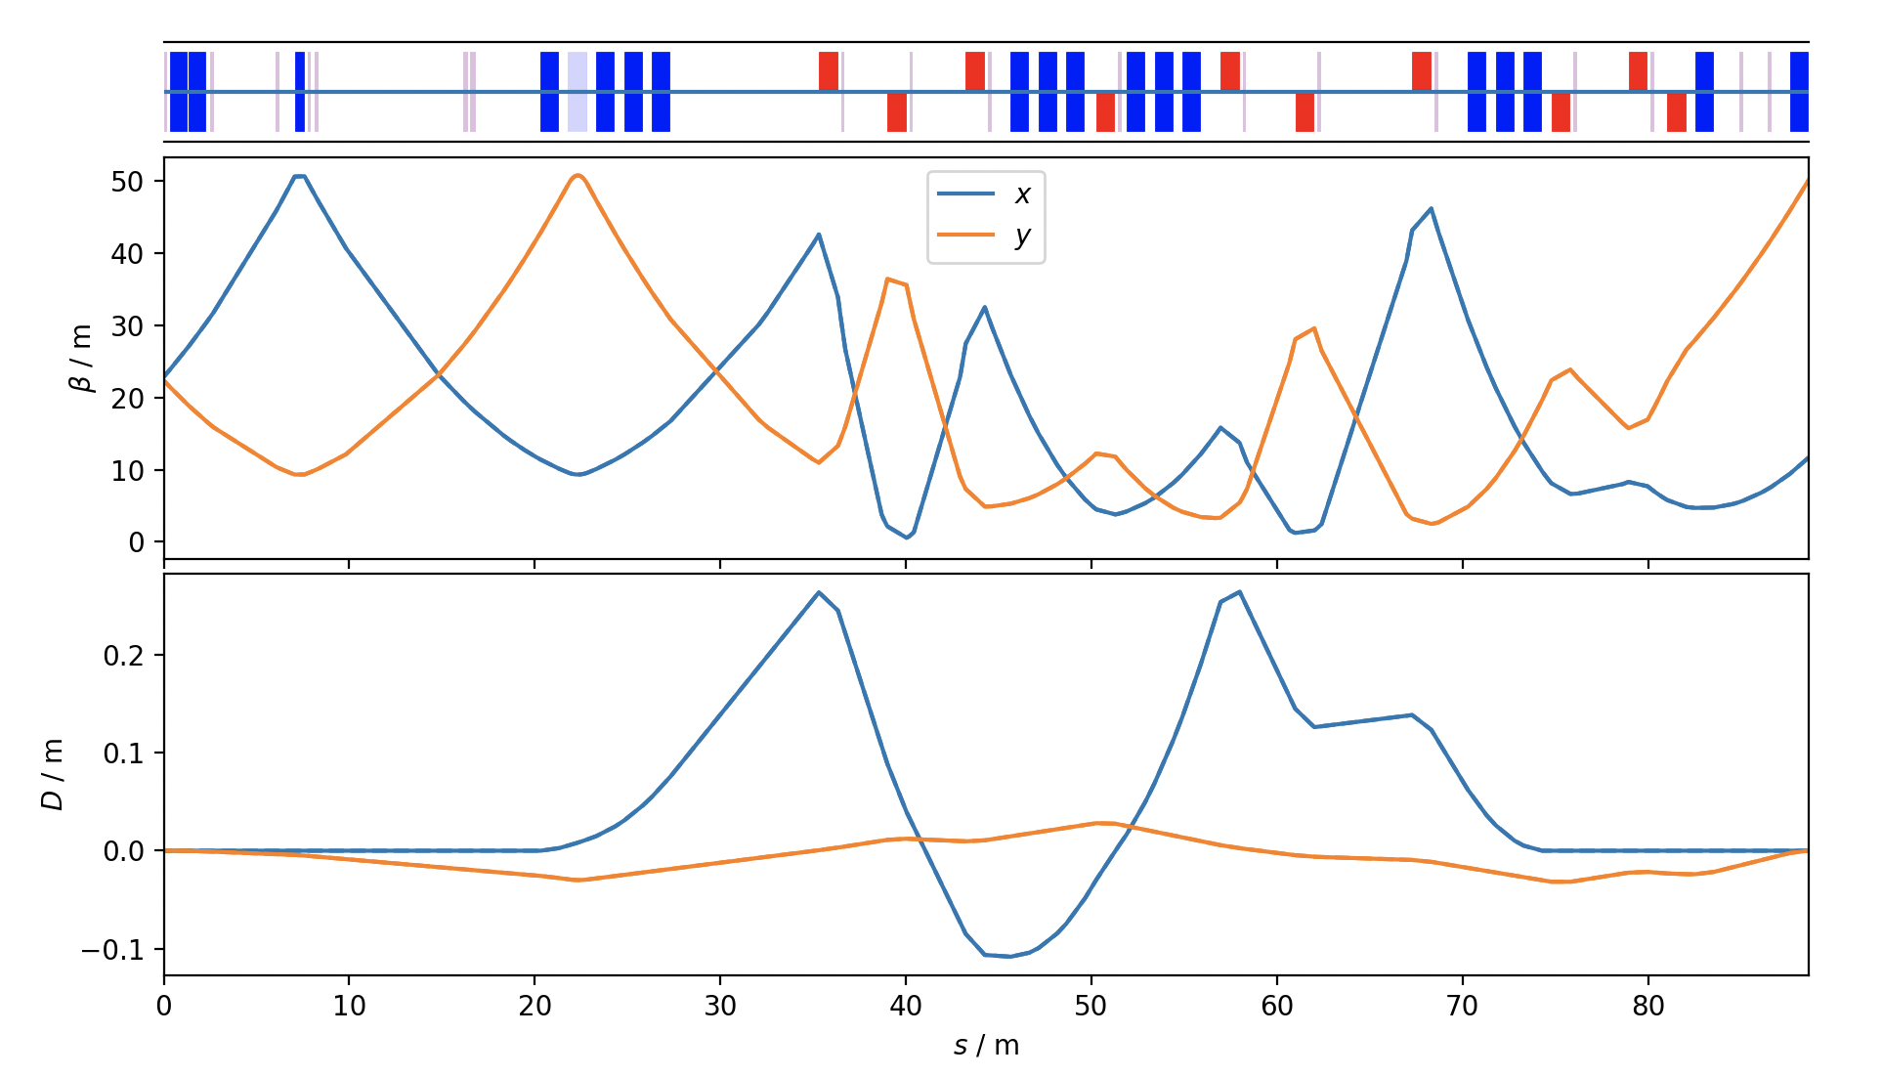
Optics

Slide 10
Questions and Next Steps
What are the limitations coming from the 6 deg bend?
What can be optimised?
Director: What is the highest photon energy I can reasonably expect (or do I have to create an HXR or SXR science case)?
Next Steps:
Create interest (today)
Provide what is already there (next 2 weeks, Sergey and Stuart)
Form a team (over summer)
Make a plan (September)
Anwser the directors question by end of 2026 latest

