Slide 1
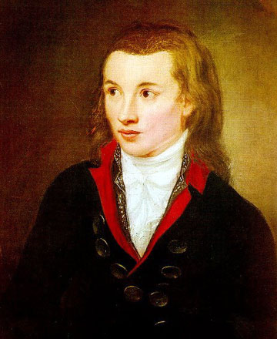
5th NOVALIS Workshop
@ HZDR
W. Hillert
06.03.2025

Slide 2
How to proceed?
Next report is due 30.4.
Sheet about report on collaboration → Marc will send a first draft around
What do we know about SESAME?

