Slide 1
Concatenation Methods
Thomas Flisgen
Workshop on Higher Order Modes in Superconducting Cavities (HOMSC25)
06 - 08 October 2025
DESY, Hamburg, Germany

Slide 2
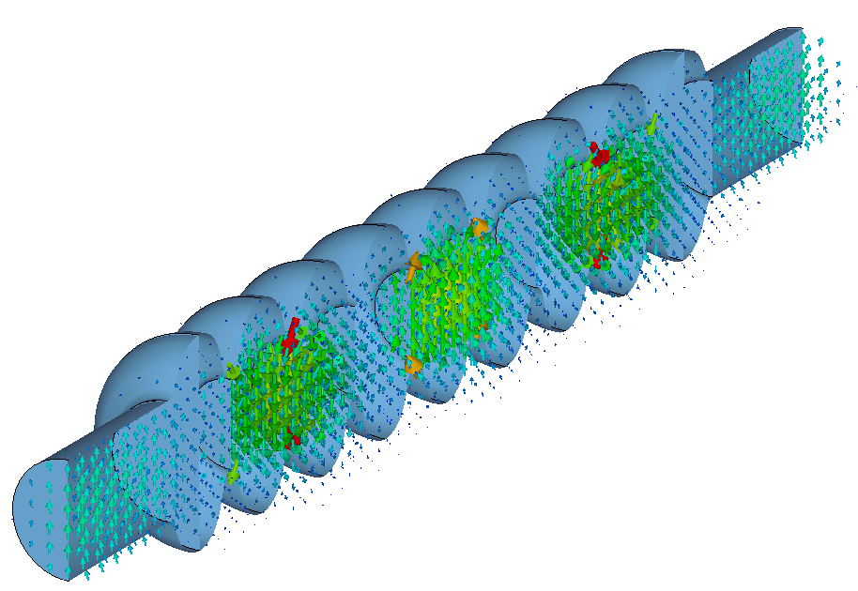

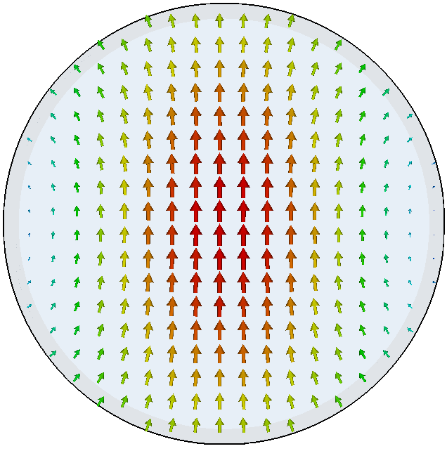
Motivation for concatenation methods: Computation of RF Properties of electrically LARGE structure with tiny features
*
Fundamental waveguide mode
E-Field of third dipole mode in Resonator
Higher modes are not necessarily localized in the individual resonators of the chain
Consideration of the entire chain is necessary for a meaningful determination of its RF properties
*E. Vogel et al.: "Status of the 3rd harmonic systems for FLASH and XFEL in summer 2008", Proc. LINAC 2008

Slide 3


Overview concatenation methods Developed and USED at UROS / HZB / BTU
CSC – A procedure for coupled S-parameter calculations [1]
SCC – State-Space Concatenations [2]
CSC^{BEAM} – Generalization of CSC to compute beam coupling impedances [3]
[1] H. -W. Glock et al., "CSC - A procedure for coupled S-parameter calculations," in IEEE Transactions on Magnetics, vol. 38, no. 2, pp. 1173-1176, 2002
[2] T. Flisgen et al., "Eigenmode compendium of the third harmonic module of the European X-ray Free Electron Laser," in Phys. Rev. Accel. Beams 20, 042002, 2017
[3] T. Flisgen et al., "Generalization of coupled 𝑆-parameter calculation to compute beam impedances in particle accelerators," in Phys. Rev. Accel. Beams 23, 034601, 2020

Slide 4
COMMON FEATURES of THE CONCATENATION METHODS CSC, SSC and CSC^{BEAM}
1. Decomposition of the Structure at Regions of Constant Cross Section
Important advantages:
(numerical) treatment of segments is computationally less demanding
single treatment of identical segments
segments with simple geometry can be treated analytically, which is very fast
employment of (rotational) symmetry of segments is feasible

Slide 5
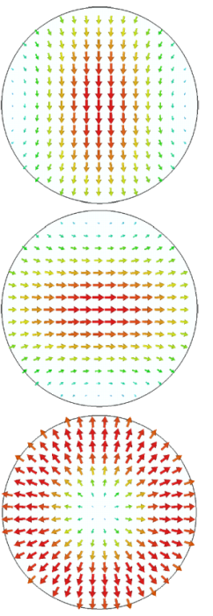
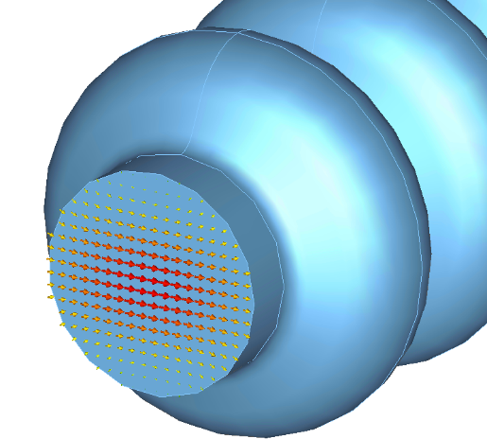






COMMON FEATURES of THE CONCATENATION METHODS CSC, SSC and CSC^{BEAM}
2. Consideration of Segments as Blocks with Terminals and Expansion of Fields on Slice Planes in terms of 2D Port Modes
Segment
E-field of first three 2D port modes
Modal voltages correspond to tangential electric fields of 2D port modes
Modal currents correspond to tangential magnetic fields of 2D port modes

Slide 6





COMMON FEATURES of THE CONCATENATION METHODS CSC, SSC and CSC^{BEAM}
3. Description of RF Properties of Individual Sections
Segment
wave equation (PDE):
Relationship between port quantities (and fields)

Slide 7








COMMON FEATURES of THE CONCATENATION METHODS CSC, SSC and CSC^{BEAM}
4. Concatenation Description of Individual Segments
Segment 1
Segment 2
Coupling equations arising from field continuity constraints
Arbitrary topologies and number of 2D port modes supported
Description of RF properties of full structure available

Slide 8
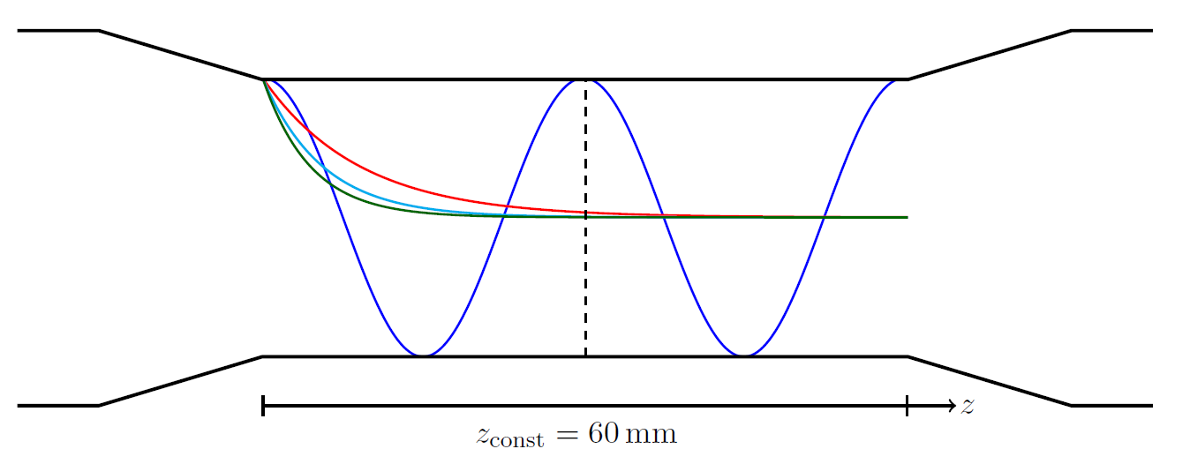
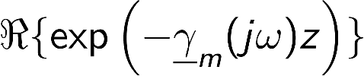

MODAL EXPANSION AT THE SLICE PLANES
How many waveguide modes have to be considered?
Wave amplitudes
Segment 1
Segment 2
Slice plane
Number of waveguide modes required is determined by upper frequency f_{max}
All propagating waveguide modes must be considered (shown in blue here)
Additionally, a finite set of evanescent modes must be taken into account
The longer the region of constant cross section, the fewer waveguide modes need to be considered

Slide 9
Overview concatenation methods Developed and USED at UROS / HZB / BTU
CSC – A procedure for coupled S-parameter calculations [1]
SCC – State-Space Concatenations [2]
CSC^{BEAM} – Generalization of CSC to compute beam coupling impedances [3]
[1] H. -W. Glock et al., "CSC - A procedure for coupled S-parameter calculations," in IEEE Transactions on Magnetics, vol. 38, no. 2, pp. 1173-1176, 2002
[2] T. Flisgen et al., "Eigenmode compendium of the third harmonic module of the European X-ray Free Electron Laser," in Phys. Rev. Accel. Beams 20, 042002, 2017
[3] T. Flisgen et al., "Generalization of coupled 𝑆-parameter calculation to compute beam impedances in particle accelerators," in Phys. Rev. Accel. Beams 23, 034601, 2020

Slide 10
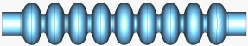


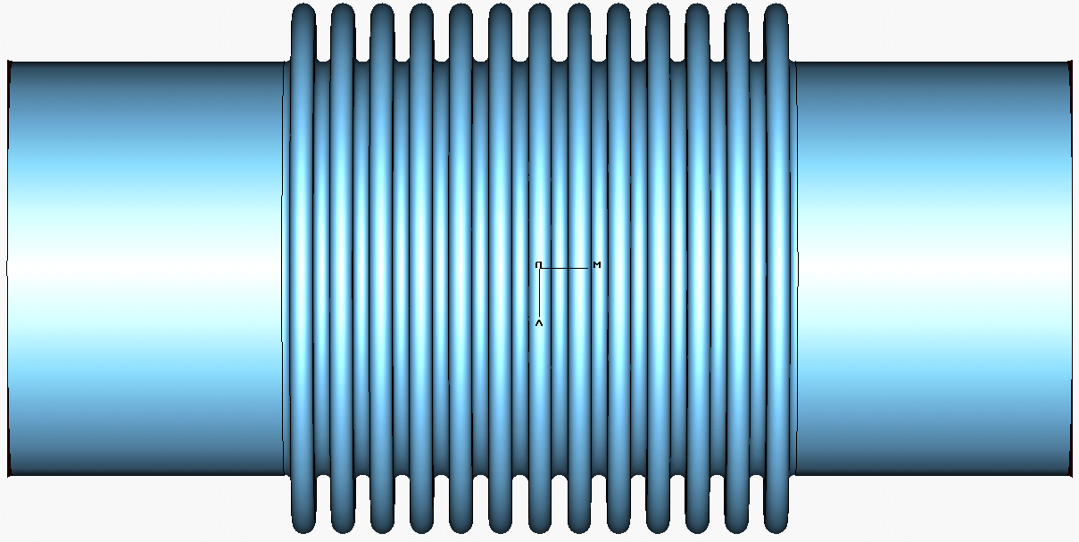

Workflow CSC [1]
Topology Information
Computation of S-Matrices on discrete frequencies
Concatenation
Scattering matrix of full structure and fields on discrete frequencies
[1] H.-W. Glock, K. Rothemund, and U. van Rienen, "CSC - A procedure for coupled S-parameter calculations," in IEEE Trans. on Mag., vol. 38, no. 2, pp. 1173-1176, 2002

Slide 11
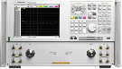



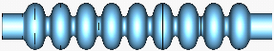


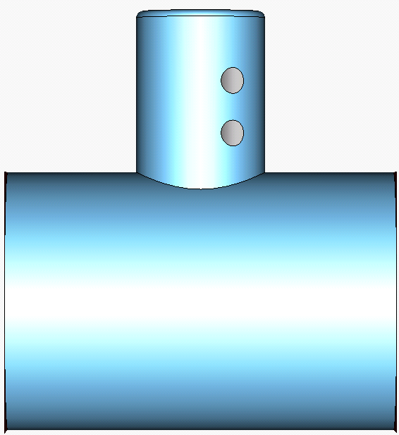

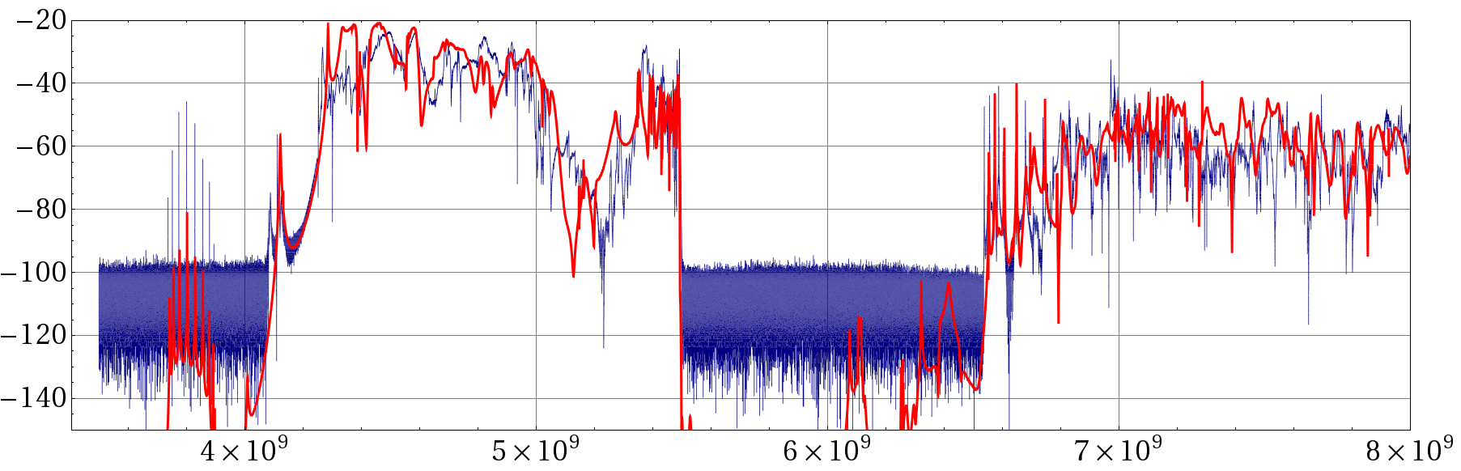
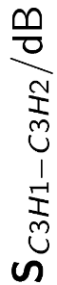
COMPARISON S-PARAMETERS computed with CSC VS. MEASUREMENTS
C1
C2
C3
C4
fundamental band
first two dipole bands
quadrupole modes
Measurement
Simulation
|s_{C3H1,C3H2}| / dB
noise floor
frequency / Hz
T. Flisgen, H.-W. Glock, P. Zhang, I. R. R. Shinton, N. Baboi, R. M. Jones, and U. van Rienen, “Scattering parameters of the 3.9 GHz accelerating module in a free-electron laser linac: A rigorous comparison between simulations and measurements”, Phys. Rev. ST Accel. Beams 17, 022003, 2014

Slide 12
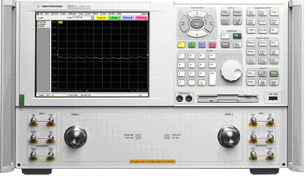
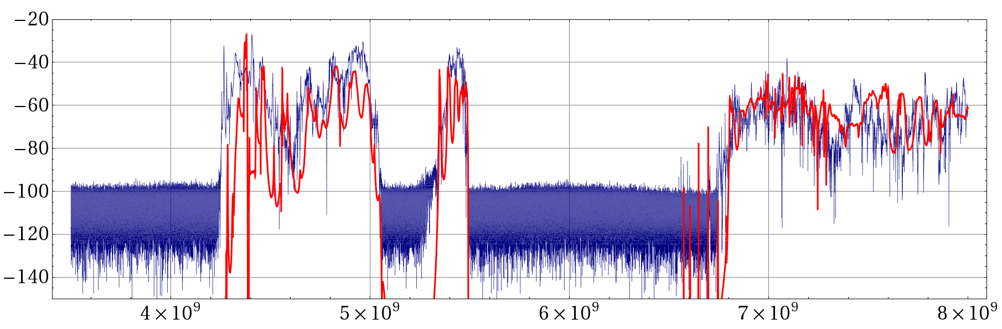
COMPARISON S-PARAMETERS computed with CSC VS. MEASUREMENTS
C1
C2
C3
C4
first two dipole bands
quadrupole modes
Measurement
Simulation
|s_{C1H1,C4H2}| / dB
noise floor
frequency / Hz
T. Flisgen, H.-W. Glock, P. Zhang, I. R. R. Shinton, N. Baboi, R. M. Jones, and U. van Rienen, “Scattering parameters of the 3.9 GHz accelerating module in a free-electron laser linac: A rigorous comparison between simulations and measurements”, Phys. Rev. ST Accel. Beams 17, 022003, 2014

Slide 13
Overview concatenation methods Developed and USED at UROS / HZB / BTU
CSC – A procedure for coupled S-parameter calculations [1]
SCC – State-Space Concatenations [2]
CSC^{BEAM} – Generalization of CSC to compute beam coupling impedances [3]
[1] H. -W. Glock et al., "CSC - A procedure for coupled S-parameter calculations," in IEEE Transactions on Magnetics, vol. 38, no. 2, pp. 1173-1176, 2002
[2] T. Flisgen et al., "Eigenmode compendium of the third harmonic module of the European X-ray Free Electron Laser," in Phys. Rev. Accel. Beams 20, 042002, 2017
[3] T. Flisgen et al., "Generalization of coupled 𝑆-parameter calculation to compute beam impedances in particle accelerators," in Phys. Rev. Accel. Beams 23, 034601, 2020

Slide 14
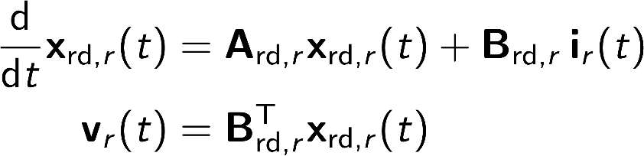
Workflow SCC [2]
Model-Order Reduction
[2] T. Flisgen, J. Heller, T. Galek, L. Shi, N. Joshi, N. Baboi, R. M. Jones, and U. van Rienen, "Eigenmode compendium of the third harmonic module of the European X-ray Free Electron Laser," in Phys. Rev. Accel. Beams 20, 042002, 2017

Slide 15
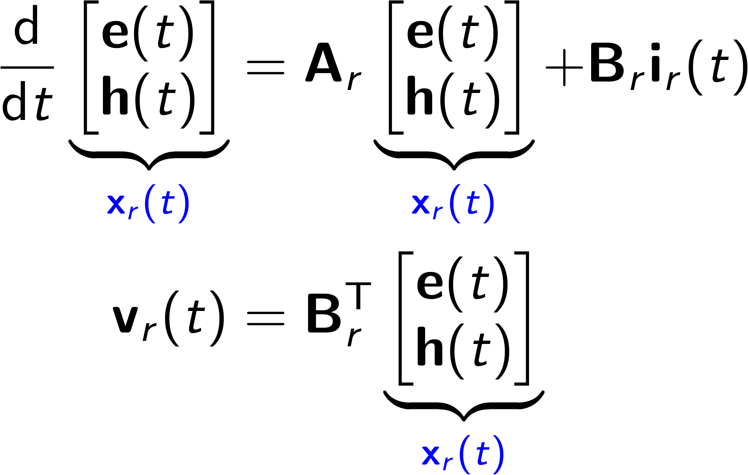
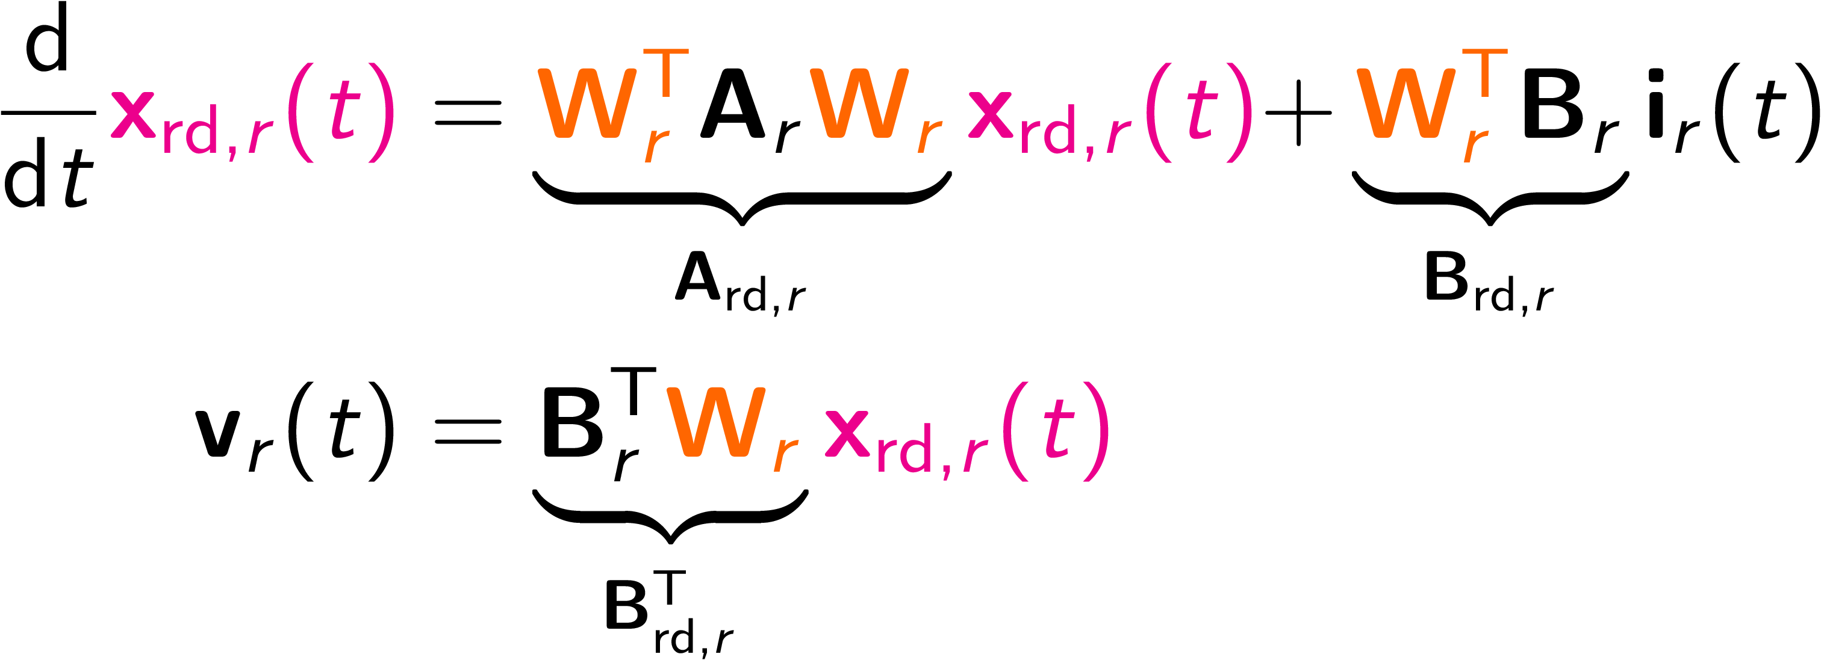
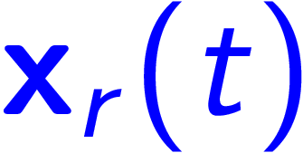


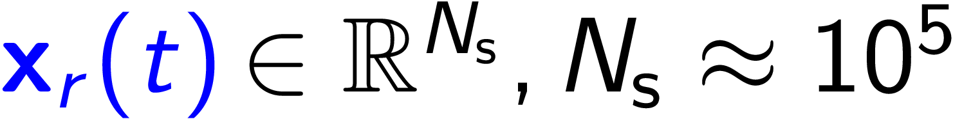


Workflow SCC [2]
Model-Order Reduction
·
=
=
·
state vector:
orthogonal projection matrix:
reduced state vector:

Slide 16
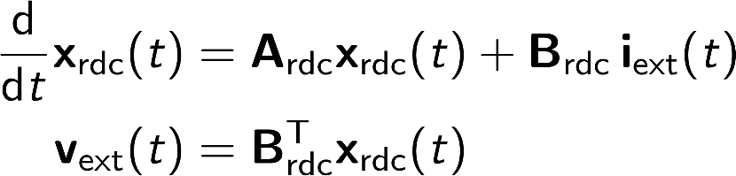
Workflow SCC [2]
Topology Information
Model-Order Reduction
Concatenation
Reduced-Order Model of full structure
Scattering Parameters
…
Field Distributions
Eigenmodes
[2] T. Flisgen, J. Heller, T. Galek, L. Shi, N. Joshi, N. Baboi, R. M. Jones, and U. van Rienen, "Eigenmode compendium of the third harmonic module of the European X-ray Free Electron Laser," in Phys. Rev. Accel. Beams 20, 042002, 2017

Slide 17
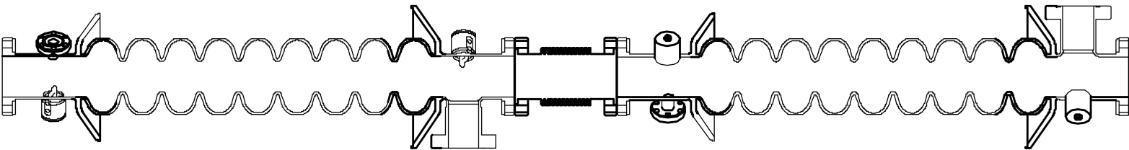
Chain of Eight Superconducting 3rd Harmonic Cavities in XFEL
 | HOM Coupler | Cavity | HOM Coupler with Power Coupler | Bellow | HOM Coupler (rotated) | HOM Coupler with Power Coupler (rotated)
N_{dof} | 411,015 | 1,119,963 | 585,915 | 427,119 | 411,015 | 585,915
N_{dof,red} | 138 | 258 | 164 | 145 | 138 | 164
Full model of eight cavity chain is estimated to have N_{dof} = 20,239,977 degrees of freedom
Reduced-order models of segments concatenated to reduced-order model of full chain with N_{dof,red} = 2,931 degrees of freedom
Figures of cavities E. Vogel et al.: "Status of the 3rd harmonic systems for FLASH and XFEL in summer 2008", Proc. LINAC 2008

Slide 18
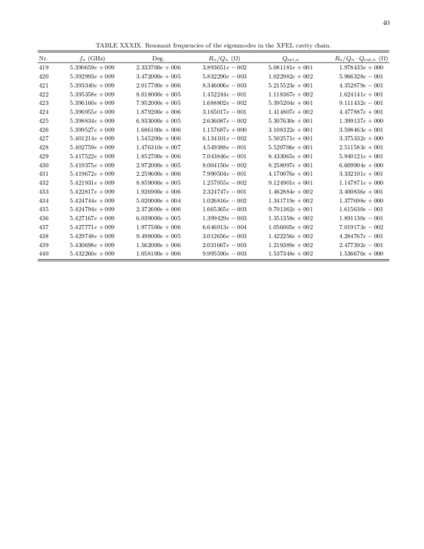
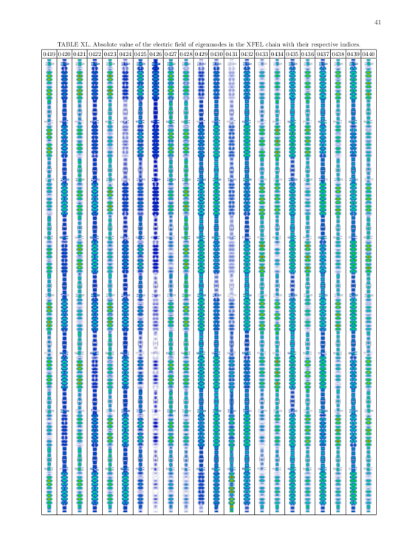
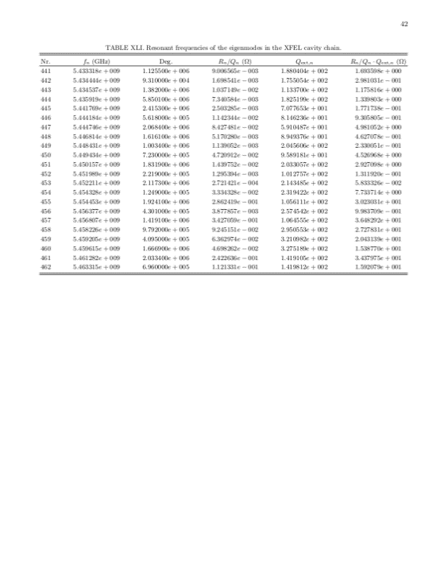
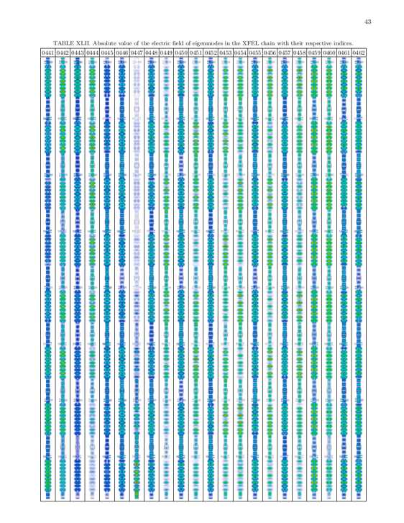
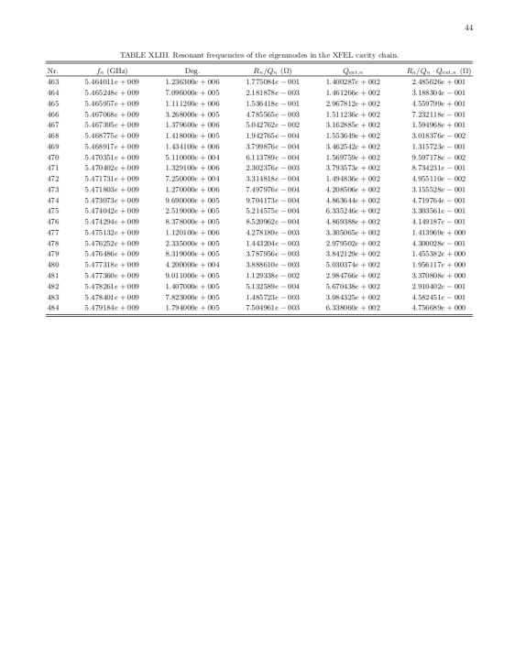
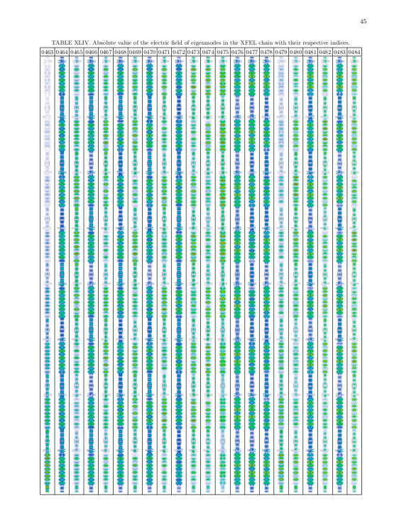
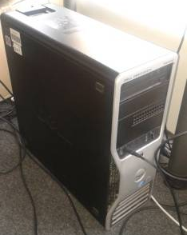
Computation of Eigenmodes based on Reduced-Order Model
Computed 1,479 eigenmodes in the interval 1 GHz to 8 GHz of the chain by means of a standard workstation computer
Assembled a modal compendium for the chain with resonant frequency, external quality factor, R/Q, and electric field distribution of each mode
In total, the compendium consists of 137 pages

Slide 19

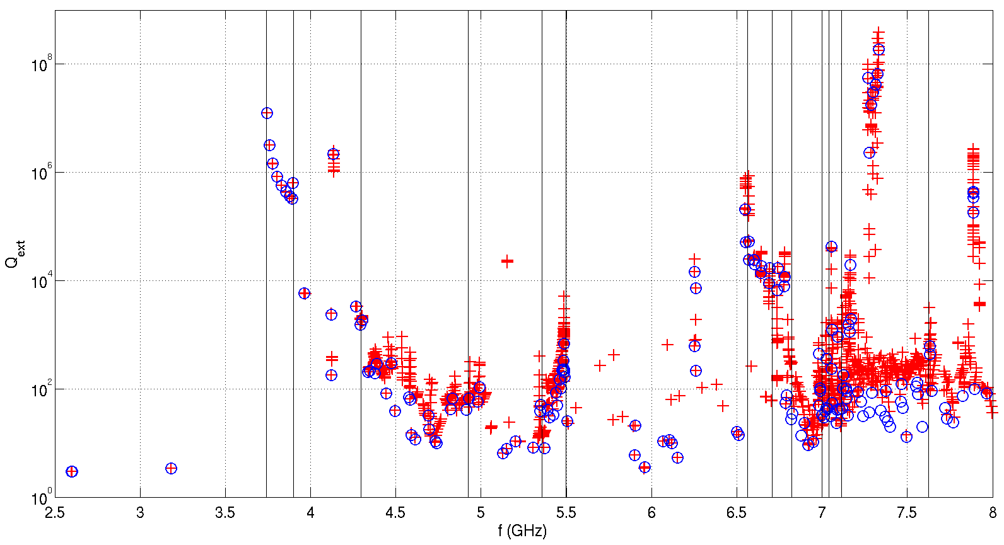
External Quality Factors in Chain of Eight 3rd Harmonic Cavities
monopole bands
dipole bands
quadrupole bands
Figures of cavities courtesy of E. Vogel / DESY

Slide 20
Pure Bellow Modes (Inter-Cavity Modes) at 5.1524 GHz
The plots show the absolute value of the electric field.

Slide 21
Overview concatenation methods Developed and USED at UROS / HZB / BTU
CSC – A procedure for coupled S-parameter calculations [1]
SCC – State-Space Concatenations [2]
CSC^{BEAM} – Generalization of CSC to compute beam coupling impedances [3]
[1] H. -W. Glock et al., "CSC - A procedure for coupled S-parameter calculations," in IEEE Transactions on Magnetics, vol. 38, no. 2, pp. 1173-1176, 2002
[2] T. Flisgen et al., "Eigenmode compendium of the third harmonic module of the European X-ray Free Electron Laser," in Phys. Rev. Accel. Beams 20, 042002, 2017
[3] T. Flisgen et al., "Generalization of coupled 𝑆-parameter calculation to compute beam impedances in particle accelerators," in Phys. Rev. Accel. Beams 23, 034601, 2020

Slide 22
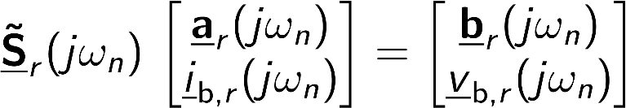
Workflow CSC^{BEAM} [3]
Computation of generalized S-Matrices on discrete frequencies
[3] T. Flisgen, E. Gjonaj, H.-W. Glock, and A. Tsakanian, "Generalization of coupled 𝑆-parameter calculation to compute beam impedances in particle accelerators," in Phys. Rev. Accel. Beams 23, 034601, 2020

Slide 23
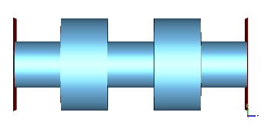
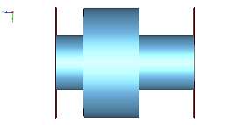





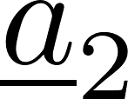





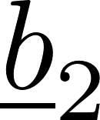
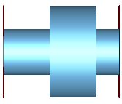
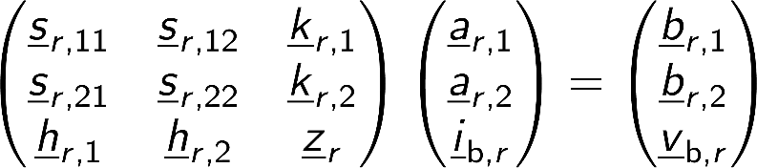
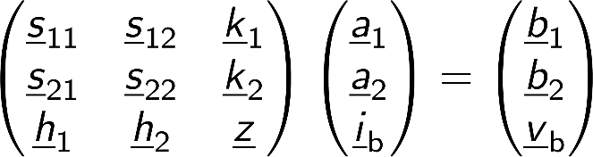




Workflow CSC^{BEAM} [3]
Decomposition
Description of r-th Segment with Generalized Matrix
(Beam is an Additional Port)
Concatenation of Generalized Matrices
commonly known scattering parameters
coupling between scattered waves and beam current
contribution of incident waves to voltage “seen” by beam
commonly know beam coupling impedance
[3] T. Flisgen, E. Gjonaj, H.-W. Glock, and A. Tsakanian, "Generalization of coupled 𝑆-parameter calculation to compute beam impedances in particle accelerators," in Phys. Rev. Accel. Beams 23, 034601, 2020

Slide 24
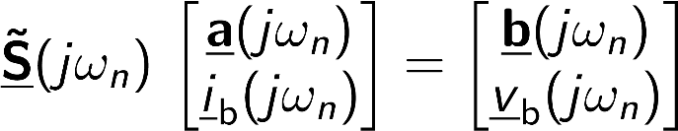
Workflow CSC^{BEAM} [3]
Topology Information
Computation of generalized S-Matrices on discrete frequencies
Concatenation
Generalized S-matrix of full structure (including beam-coupling impedances) on discrete frequencies
[3] T. Flisgen, E. Gjonaj, H.-W. Glock, and A. Tsakanian, "Generalization of coupled 𝑆-parameter calculation to compute beam impedances in particle accelerators," in Phys. Rev. Accel. Beams 23, 034601, 2020

Slide 25
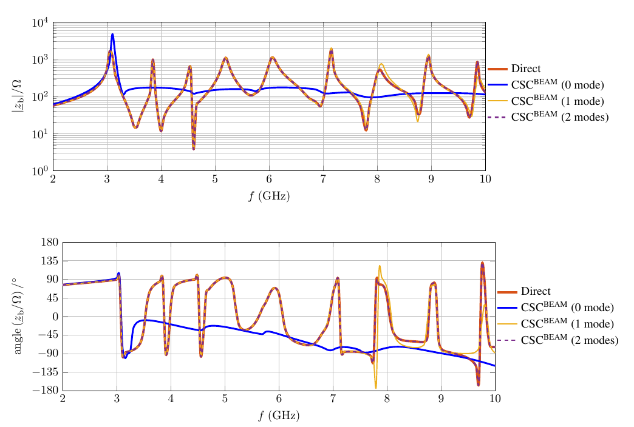
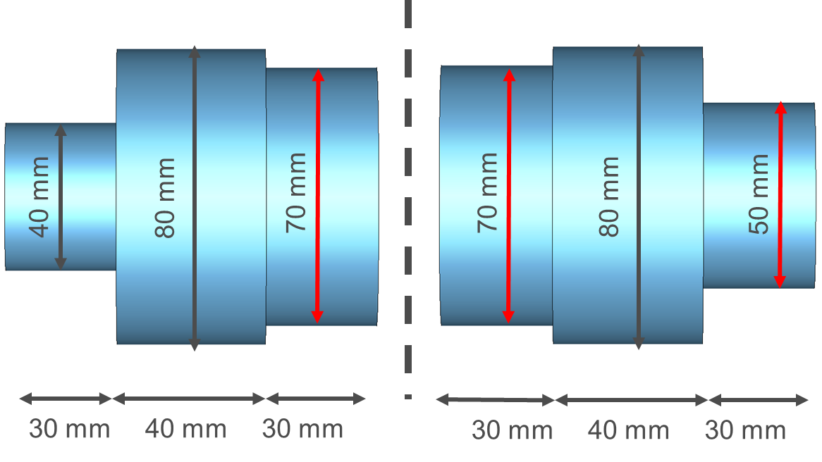
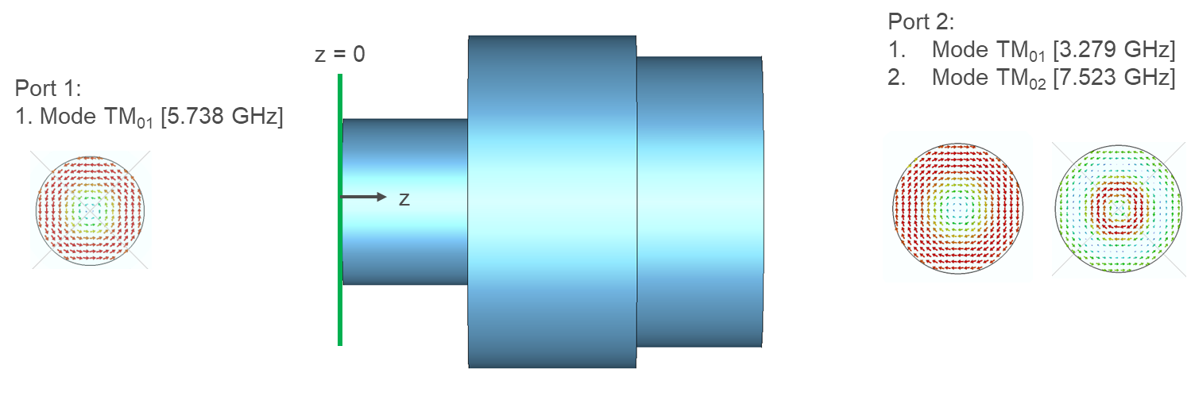
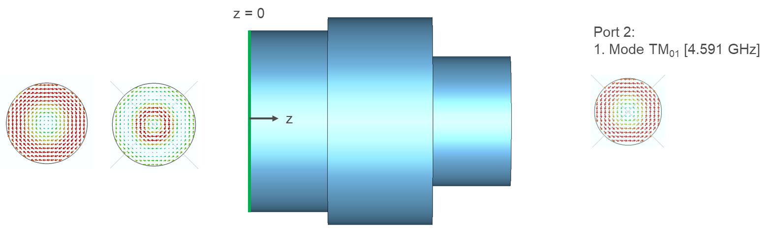
Playground example CSC^{BEAM} [3]
[3] T. Flisgen, E. Gjonaj, H.-W. Glock, and A. Tsakanian, "Generalization of coupled 𝑆-parameter calculation to compute beam impedances in particle accelerators," in Phys. Rev. Accel. Beams 23, 034601, 2020

Slide 26
Summary
Concatenation methods are powerful tools to determine RF properties of (higher-order) modes of complex structures (long chains of cavities with power and HOM couplers) using workstation computers
CSC, SSC and CSC^{BEAM} are based on a non-overlapping domain decomposition and expansion of field at slice planes using waveguide modes
Schemes differ in the way how segments are described and what quantities are delivered
Further research on generalized matrices required, i.e. how they can be effectively determined

Slide 28
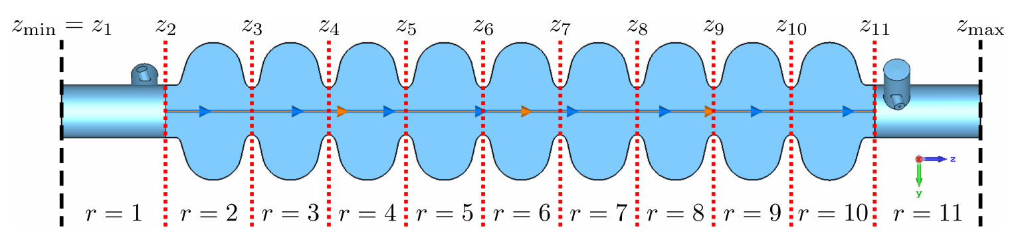
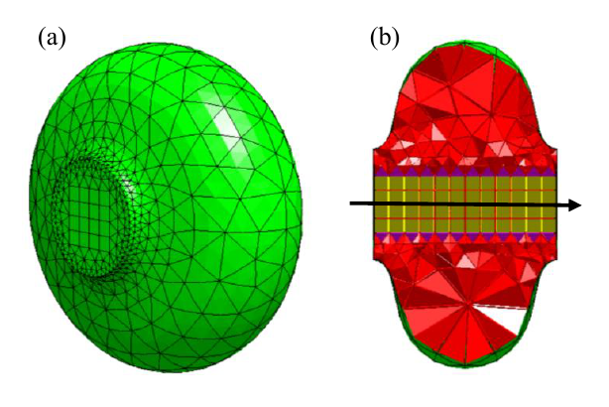
CSC^{BEAM} TESLA CAVITY example [3]
18 port modes used for the field expansion
dimension of generalized matrices for each segment: 37 x 37
Courtesy of Erion Gjonaj
[3] T. Flisgen, E. Gjonaj, H.-W. Glock, and A. Tsakanian, "Generalization of coupled 𝑆-parameter calculation to compute beam impedances in particle accelerators," in Phys. Rev. Accel. Beams 23, 034601, 2020

Slide 29
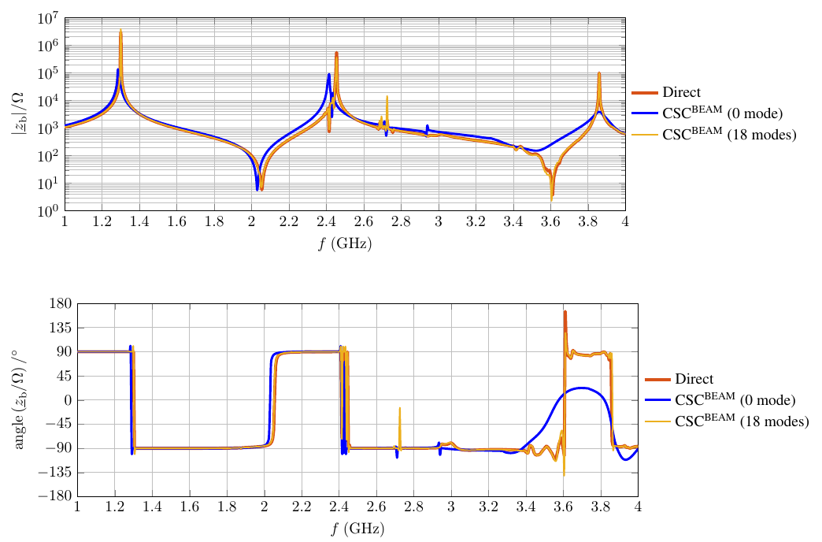
CSC^{BEAM} TESLA CAVITY example [3]
[3] T. Flisgen, E. Gjonaj, H.-W. Glock, and A. Tsakanian, "Generalization of coupled 𝑆-parameter calculation to compute beam impedances in particle accelerators," in Phys. Rev. Accel. Beams 23, 034601, 2020

