Slide 1
Welcome to HOMSC2025.
The International Workshop on Higher Order Modes in Superconducting Cavities
6 – 8 Oct. 2025, DESY Hamburg
Nicoleta Baboi , DESY
6 Oct. 2025

Slide 4
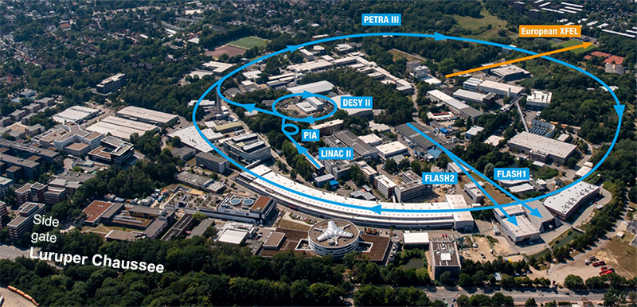
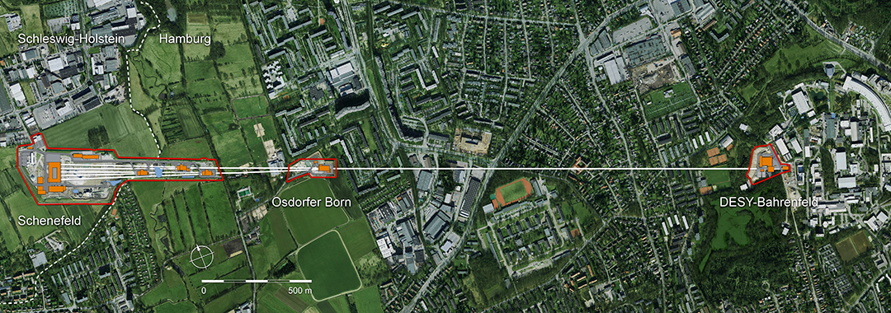
Accelerators at DESY
Further facilities:
ARES, REGAE, KALDERA, LUX etc.

Slide 5
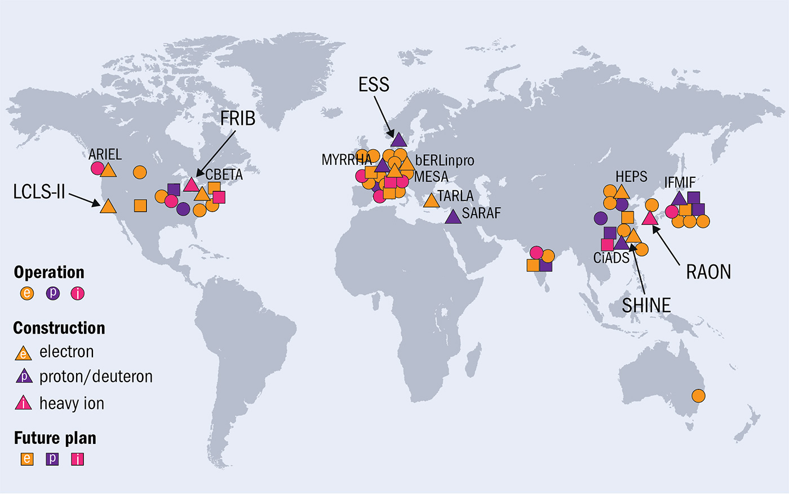
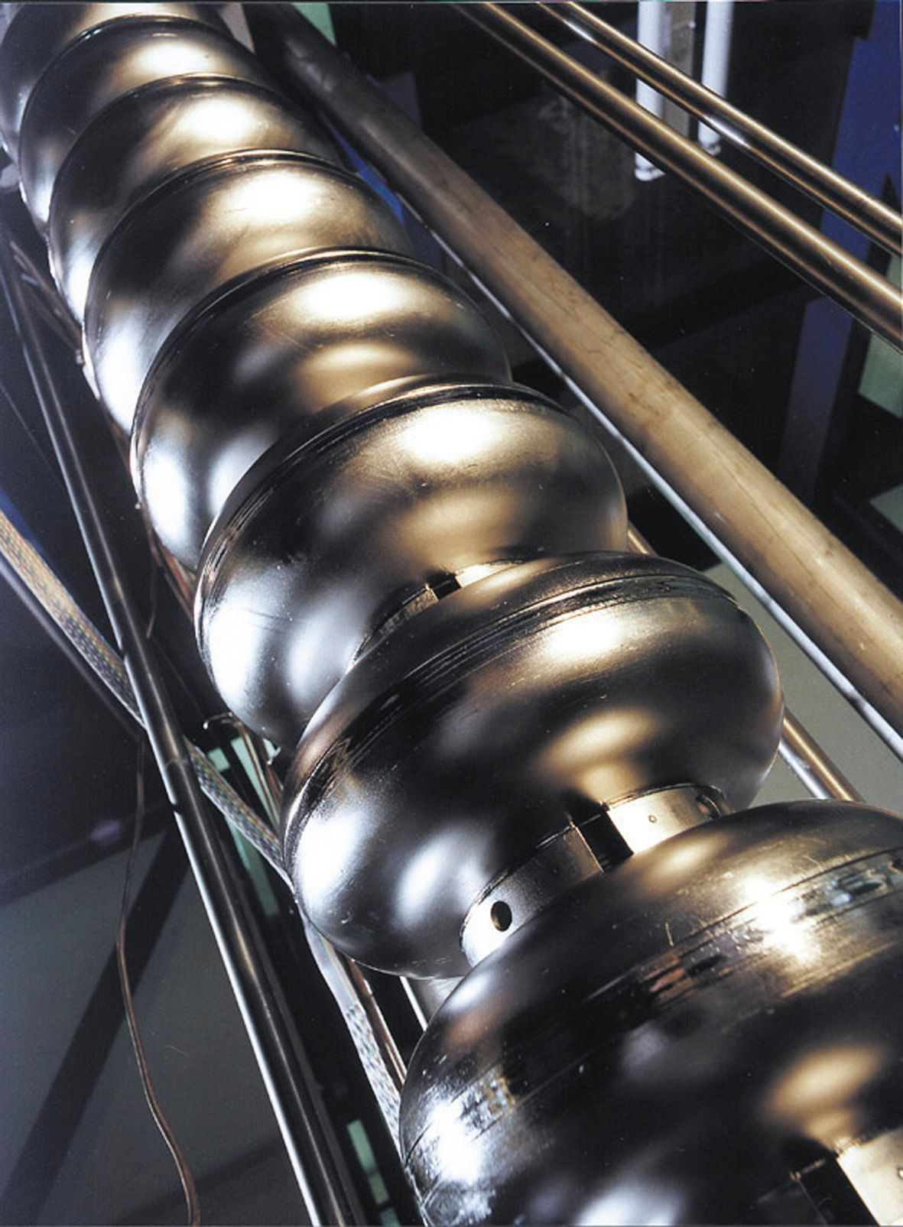
Overview of SRF Facilities
Ref: CERN Courier 10 Nov. 2020 https://cerncourier.com/a/teslas-high-gradient-march

Slide 6
HOMSC Workshop Series
HOMSC2018, Cornell University https://indico.classe.cornell.edu/event/185/
HOMSC16, Warnemunde https://indico.cern.ch/event/465683/
HOMSC14, FNAL https://indico.fnal.gov/event/7942/timetable/#20140714
HOMSC12, Cockcroft Institute https://www.cockcroft.ac.uk/events/HOMSC12/
HOM10, Cornell University https://www.classe.cornell.edu/Events/HOM10/Agenda.html
HOM Measurements 2007, DESY https://indico.desy.de/event/177/

Slide 7
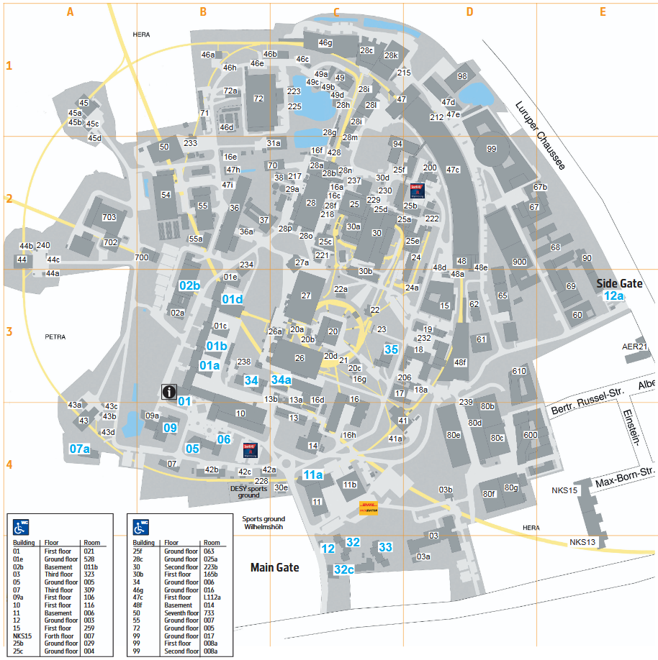
HOMSC2025 at DESY
FLASH Seminar Room
(bld. 28c)
Day 1 & 2
CFEL Seminar Room IV
(bld. 99, first floor)
Day 3
DESY Canteen
(bld. 9): Day 1 & 2

Slide 8
Workshop Programm 4 Working Groups
HOM Damping Requirements for Future Facilities
Organizers: Dmitry Bazyl, Vyacheslav Yakovlev, Pei Zhang
Numerical Simulations for SRF Cavities
Organizers: Thomas Flisgen, Igor Zagorodnov
Design of SRF Cavities and HOM Damping Schemes
Organizers: Sang-hoon Kim, Subashini De Silva, Adolfo Velez, Shahnam Gorgi Zadeh
Operation of SRF Facilities
Organizers: Roger Jones, Matthias Liepe, Michiru Nishiwaki

Slide 9
Participants
,
44 participants
Several online
2 PhD students received financial support
Anthony Gilfellon, University of Manchester
Conor McFarlane, Lancaster University
Support from Deutsche Forschungsgemeinschaft (DFG, German Research Foundation)
https://www.dfg.de/en
We have to decide how to use the funds, apart from the students
It is your responsibility to return the costs that were already supported by your institute, e.g. for the travel

Slide 10
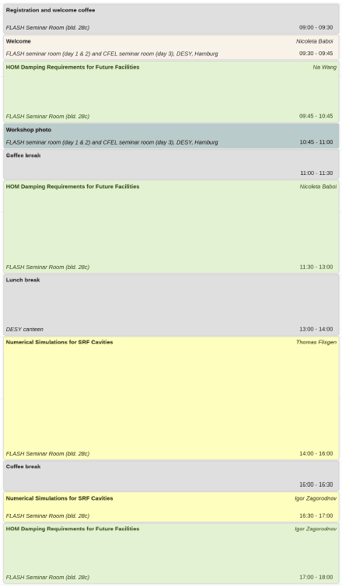
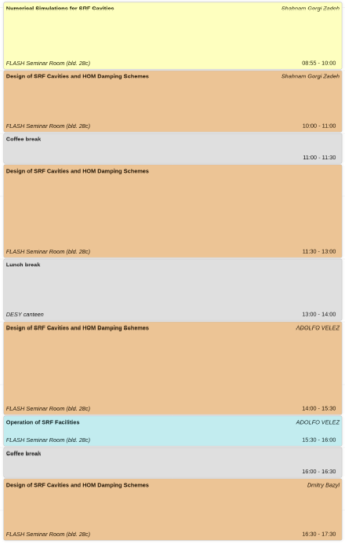
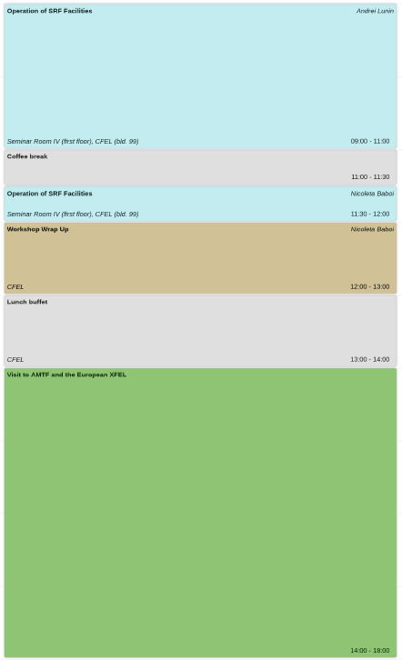
Workshop Programm: Timetable
Mon
Tue
Wed

Slide 11
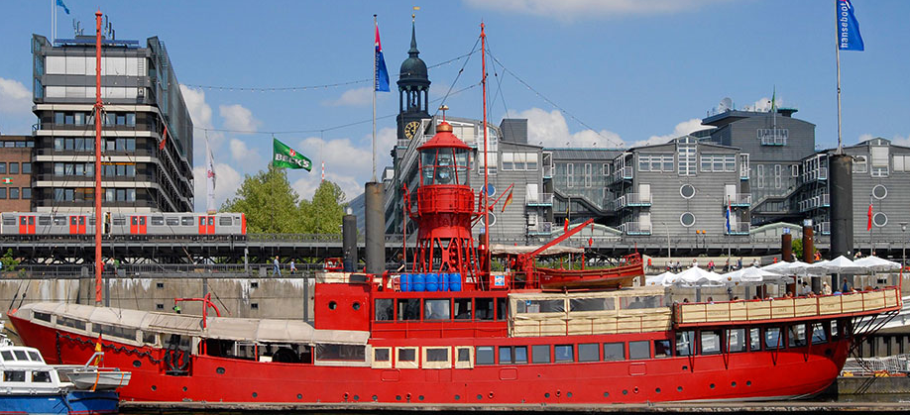
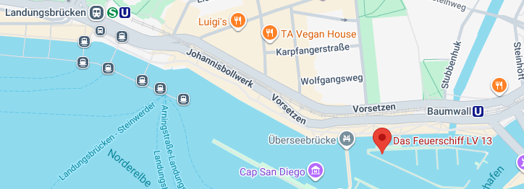
Workshop dinner on Tuesday at 19:00 in Das Feuerschiff
https://www.das-feuerschiff.de/das-feuerschiff /kontakt/anfahrt
Nearby stops:
Baumwall: U3 or Bus 2;
Landungsbrücken: S1/S3 or Bus 112
HVV group tickets will be provided
5 persons per group
Suggest to meet at the main entrance at 17:55
Several options for the menu
Please choose one today at the registration

Slide 12
Practical infos
WiFi:
eduroam
Science-Hotspot (no password)
Dinner options for Monday
The DESY Cafeteria and Bistro on campus offer food until 9 pm: https://desy.myalsterfood.de/
Restaurants: Pizzeria Rolatino, Samarkand, Pandas Küche (vietnameese)
Elbe Einkaufszentrum (EEZ): shopping mall
Workshop Photo
At 10:45
Don’t miss it!

Slide 13
Local Organization Committee
Wai San Lam
Dmitry Bazyl
Igor Zagorodnov
Nicoleta Baboi

Slide 14
Let‘s start!

