Slide 1
Higher Order Mode Damping Requirements for New Circular Accelerators
Na Wang
Institute of High Energy Physics, CAS

Slide 2
Outline
Introduction
Impedance and collective effects
Impact of Higher Order Modes
HOM damping requirements
Summary and outlook

Slide 3
Introduction
High-energy circular electron-positron colliders (CEPC, FCC, …)
Diffraction limited light sources (HEPS, APSU, Petra-IV, EBS, …)
More demanding requirements on beam performances
  High beam energy
  High bunch charge/beam current
  High luminosity/brightness
  High beam stability
The accelerator design has been pushed to a new parameter range
  Large circumference
  Low emittance
  Low momentum compaction
  Short bunch length
Among the various challenges, the management of HOMs in superconducting cavities is of particular concern.

Slide 4
Future circular e-p collider
High intensity effects were evaluated for various energy options (Higgs, Z, W and tt) of the future high energy circular e-p colliders.
The constraints are dictated by the Z operation mode with the lowest beam energy and the highest beam current.
CEPC TDR 30MW
Parameter [unit] | Higgs | Z | W | tt
Beam energy E_{k} [GeV] | 120 | 45.5 | 80 | 180
Circumference [km] | 100 | 100
Emittance (H/V) [nm/pm] | 0.64/1.3 | 0.27/1.4 | 0.87/1.7 | 1.4/4.7
Beam current [mA] | 16.7 | 803.5 | 84.1 | 3.3
Bunch number N_{b} | 268 | 11934 | 1297 | 35
Momentum compaction α_{p} [10⁻⁵] | 0.71 | 1.43 | 1.43 | 0.71
Bunch length σ_{z} (natural/total) [mm] | 2.3/4.1 | 2.5/8.7 | 2.5/4.9 | 2.2/2.9
RF voltage/beam [GV] | 2.2 | 0.12 | 0.7 | 10
Synchrotron tune | 0.049 | 0.035 | 0.062 | 0.078
Radiation damping [ms] | 44/44/22 | 816/816/408 | 150/150/75 | 14/14/7
High energy with wide range
Large circumference, dense beam spectra
High beam current with large N_{b} at Z
Small α_{p}
Short natural σ_{z}
Large cavity number
Slow damping at low E_{k}

Slide 5
Diffraction limited light sources
The design queries of high brightness and low emittance give more demanding requirements on the beam quality and beam stability.
*H.S. Xu, RDTM, 2023
#APSU PDR, 2017
Parameter [unit] | HEPS* | APS-U#
Beam energy E_{k} [GeV] | 6 | 6
Circumference [m] | 1360.4 | 1103.6
Emittance (H) [pm] | 35 | 42
Beam current [mA] | 200 | 200
Bunch number N_{b} | 680/63 | 324/48
Momentum compaction α_{p} [10⁻⁵] | 1.83 | 3.96
Bunch length σ_{z} (natural/total) [mm] | 5.0/29.7 | 4.2/18.6
RF voltage/beam [MV] | 5.0 | 6.6
Synchrotron tune | 8.5E-4/7.8E-5 | 2.3E-3/~
Radiation damping [ms] | 10.9/20.6/18.7 | 7.3/16.1/20.1
Low emittance, more sensitive to perturbs
High beam current with different bunch fill
Small α_{p}
Longer σ_{z}, especially with HRF
Slow longitudinal oscillation, easier to get unstable at longitudinal plane

Slide 6
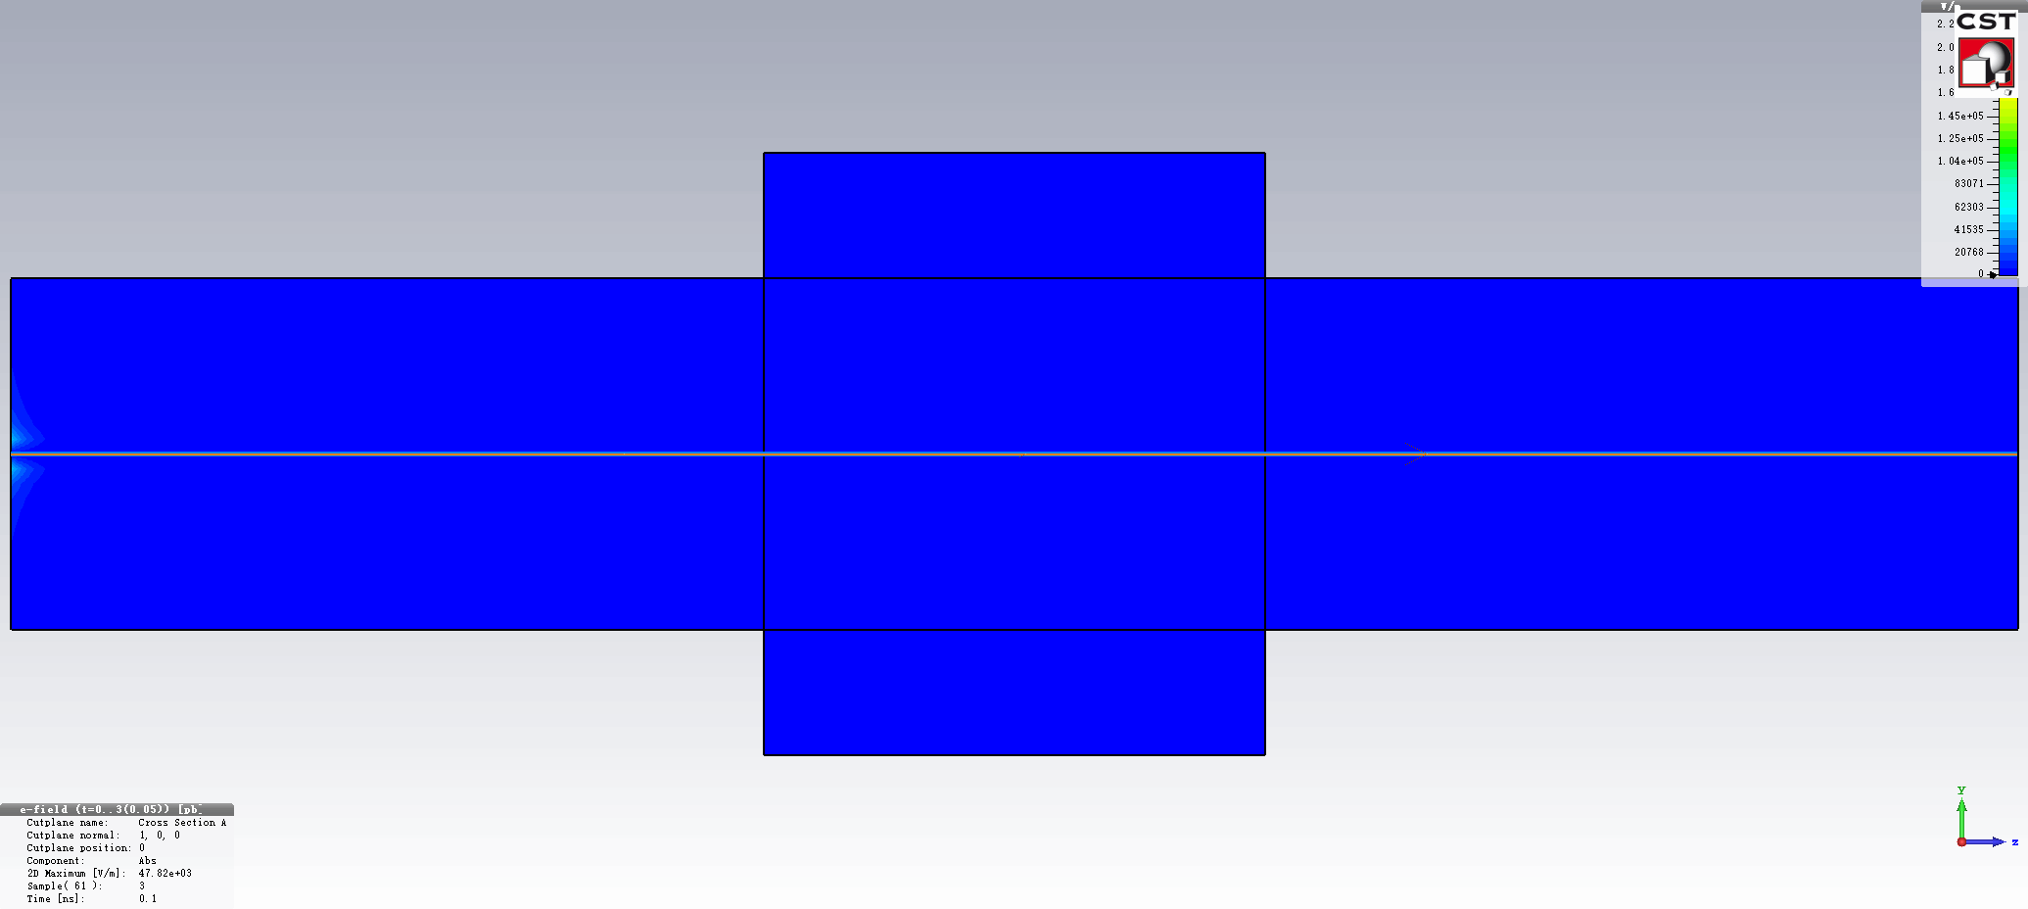
Impedance and collective effects
Why we care impedance?
Relativistic beam radiates electromagnetic field
Device with non-perfect conductor or not smooth
Beam-radiated field is modulated by its surroundings
Evolution of the field radiation of a beam passing through a discontinuous structure.
Energy loss of the beam
Perturb the following particles
Energy loss of beam ⇒ heating of the device ⇒ hardware damage and outgassing
Resonant kicks to following particles ⇒ beam instability ⇒ beam current restriction and beam quality degradation

Slide 7
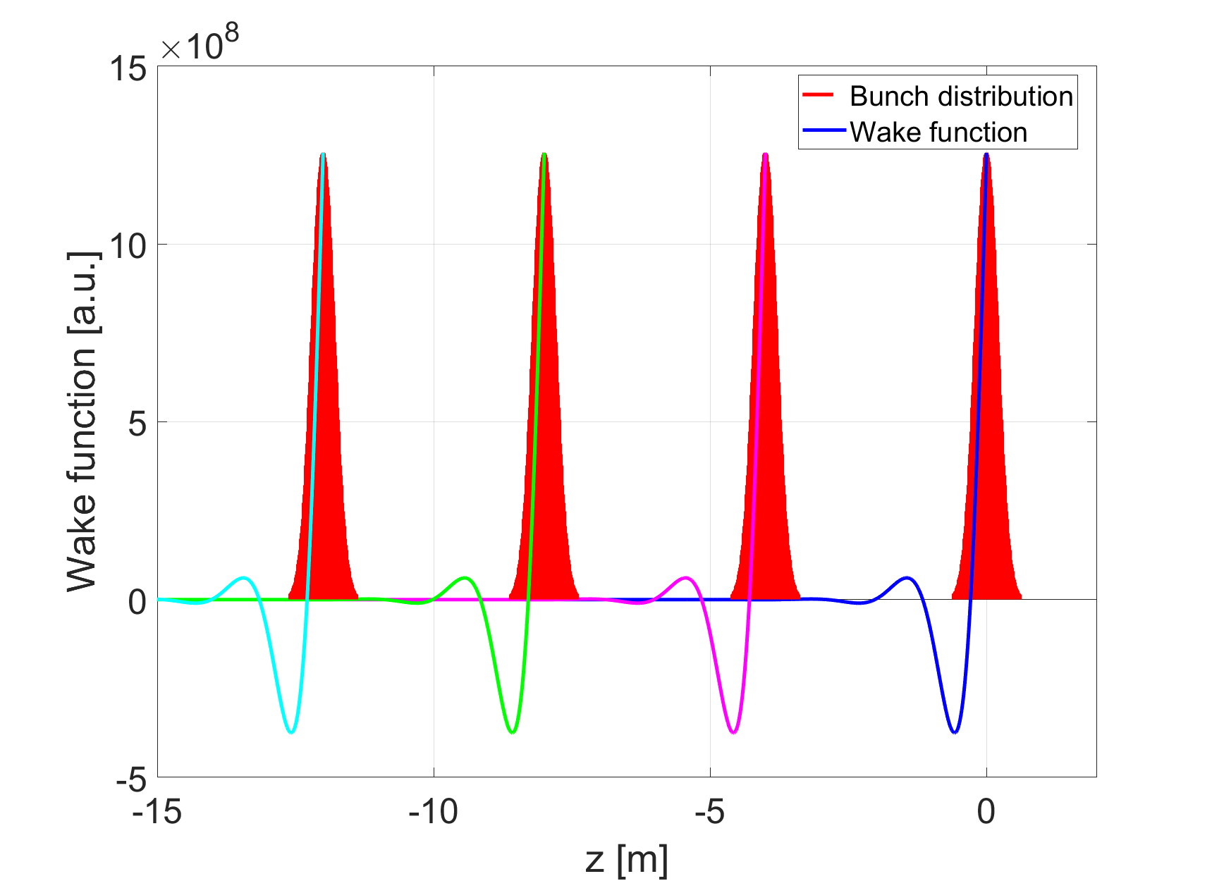
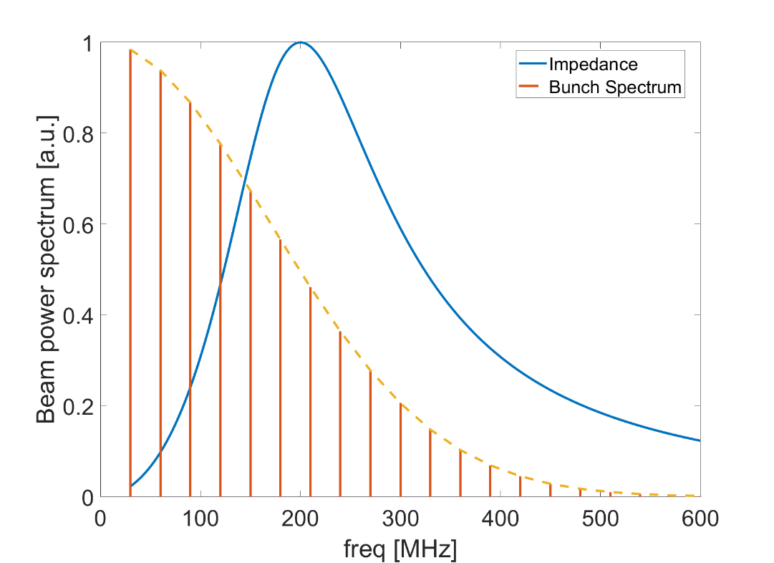
Impedance induced beam instabilities
Single bunch instabilities
  Longitudinal/transverse impedance with low Q (broadband impedance)
  Beam-radiated field vanishes before the arrival of the following bunches
  Bunch deformation/bunch centroid oscillation/single bunch current threshold
1/bunch spacing
bunch spacing
Fourier transform
Bunch profile with wake function
Bunch spectrum with impedance

Slide 8
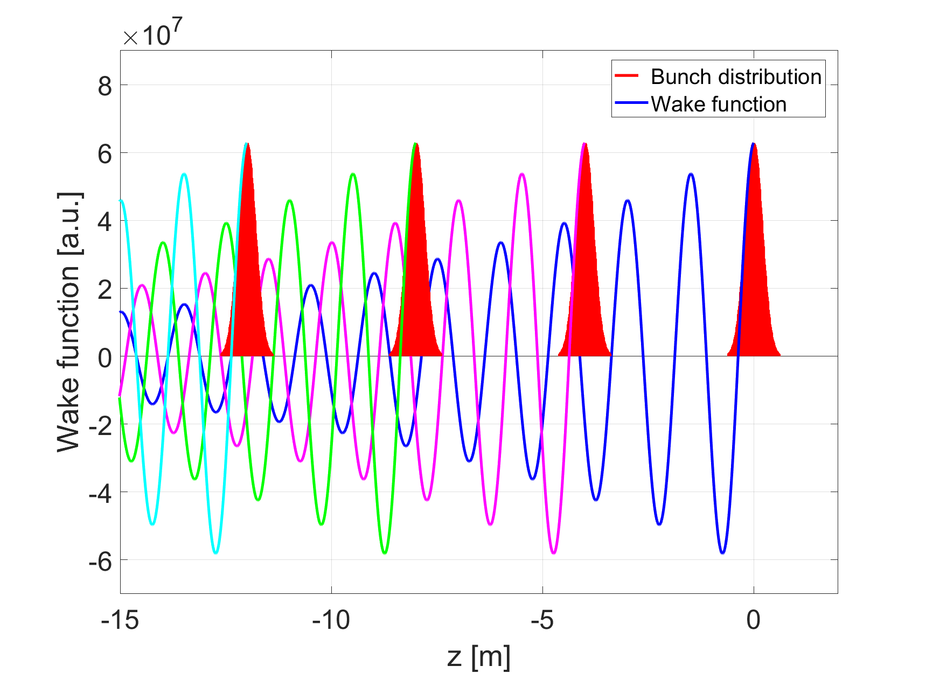
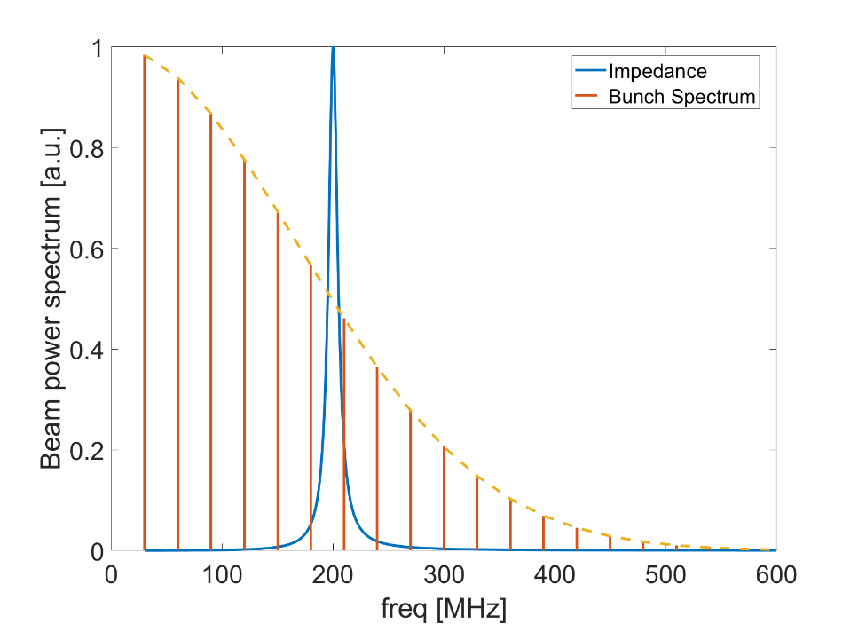
Impedance induced beam instabilities
Single bunch instabilities
Coupled bunch instabilities
  Longitudinal/transverse impedance with high Q (narrowband impedance)
  Beam-radiated field maintains before the arrival of the following bunches
  Field accumulate after the passage of multiple bunches
  Bunch centroid oscillation/beam size blowup/beam current threshold
Fourier transform
Bunch profile with wake function
Bunch spectrum with impedance

Slide 9
Impact of High Order Modes
The HOMs of a RF cavity are high Q narrowband impedances.
Parasitic beam power loss
  Influenced by bunch length
  Influenced by beam filling pattern
  Influenced by HOM frequency
Coupled bunch instabilities
  Influenced by bunch length
  Influenced by beam filling pattern
  Influenced by HOM frequency
  Influenced by damping effects
Short bunch length requires broadband HOM damping scheme
Significant contribute when hitting high-amplitude beam spectrum
HOM damping requirements:
The HOM power loss should be well handled
The HOM impedance should bellow the CBI threshold determined by the synchrotron radiation /Landau damping/feedback

Slide 10

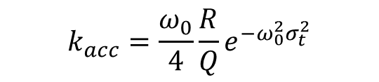
Parasitic beam power loss
Energy loss of electron bunches traversing the cavity -> induce heating and limit the machine performance
The general formula for HOM power extracted into the HOM dampers is given by
$$P_{HOM}=(k_{||}−k_{acc})n_{b}I_{b}^{2}T_{0}$$
Revolution frequency
Total loss factor
Bunch number
Bunch current
Loss factor of the fundamental mode
$$k_{acc}=\frac{ω_{0}}{4}\frac{R}{Q}e^{−ω_{0}^{2}σ_{t}^{2}}$$
The power loss depends both on the beam parameters and the geometry of rf cavities.
Should consider the case when the bunch spacing spectral line hits the HOMs.

Slide 11
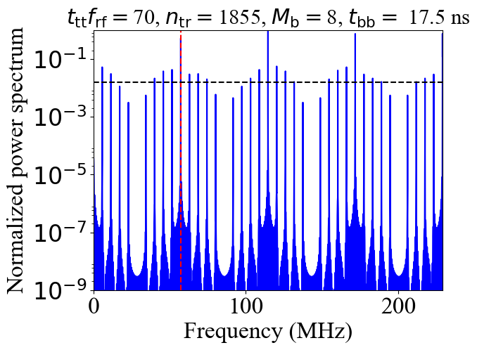
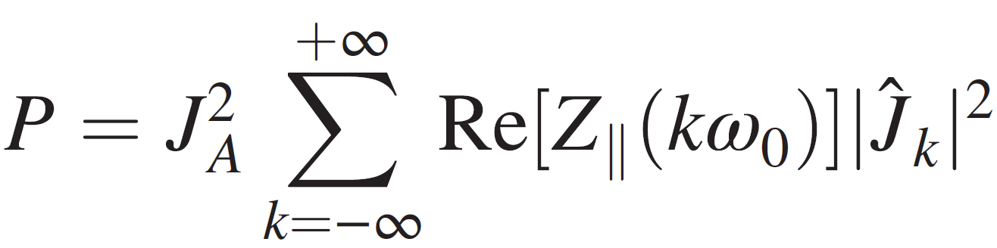
Power loss – influence of filling pattern
I. Karpov, PRAB 21 071001 (2018)
When beam spectral line coincides with a cavity resonance one can expect strong power losses
1/t_{bb}
1/t_{tt}
J_{A}=n_{tr}M_{b}N_{p}ef₀: average beam current
Z||: longitudinal impedance
Ĵ_{k}: normalized Fourier harmonic of beam current
  Bunch spacing
  Bunch train spacing
  Number of bunches in the train
  Number of trains
The beam power spectrum is dominated by the bunch spacing and train spacing

Slide 12
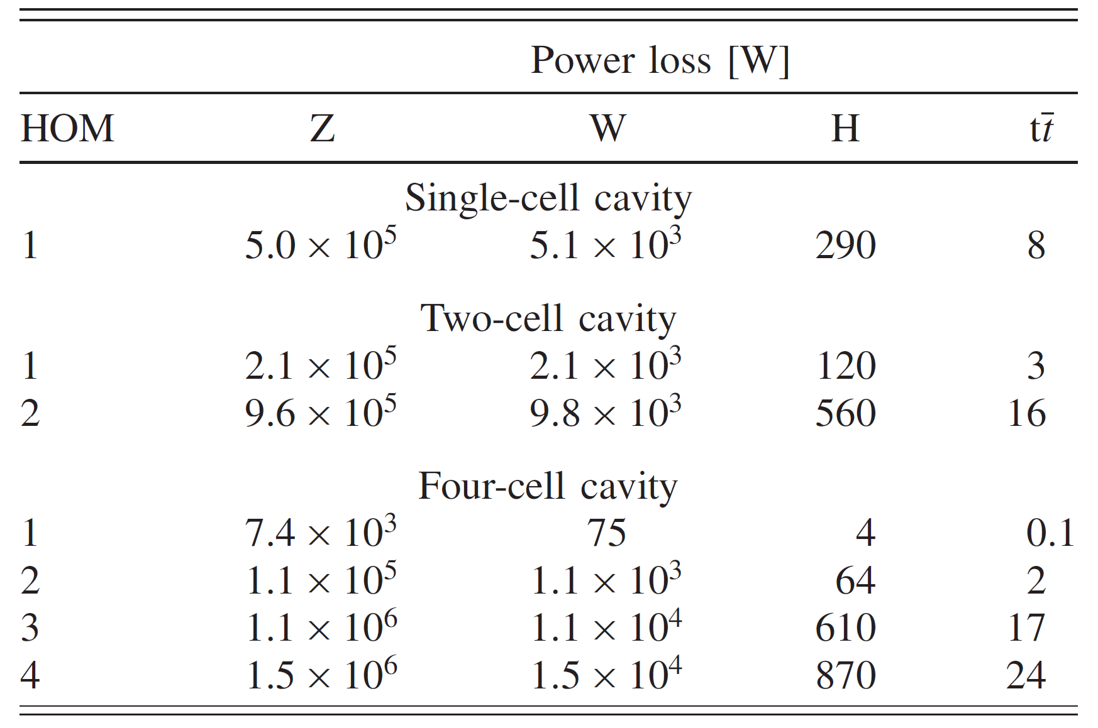
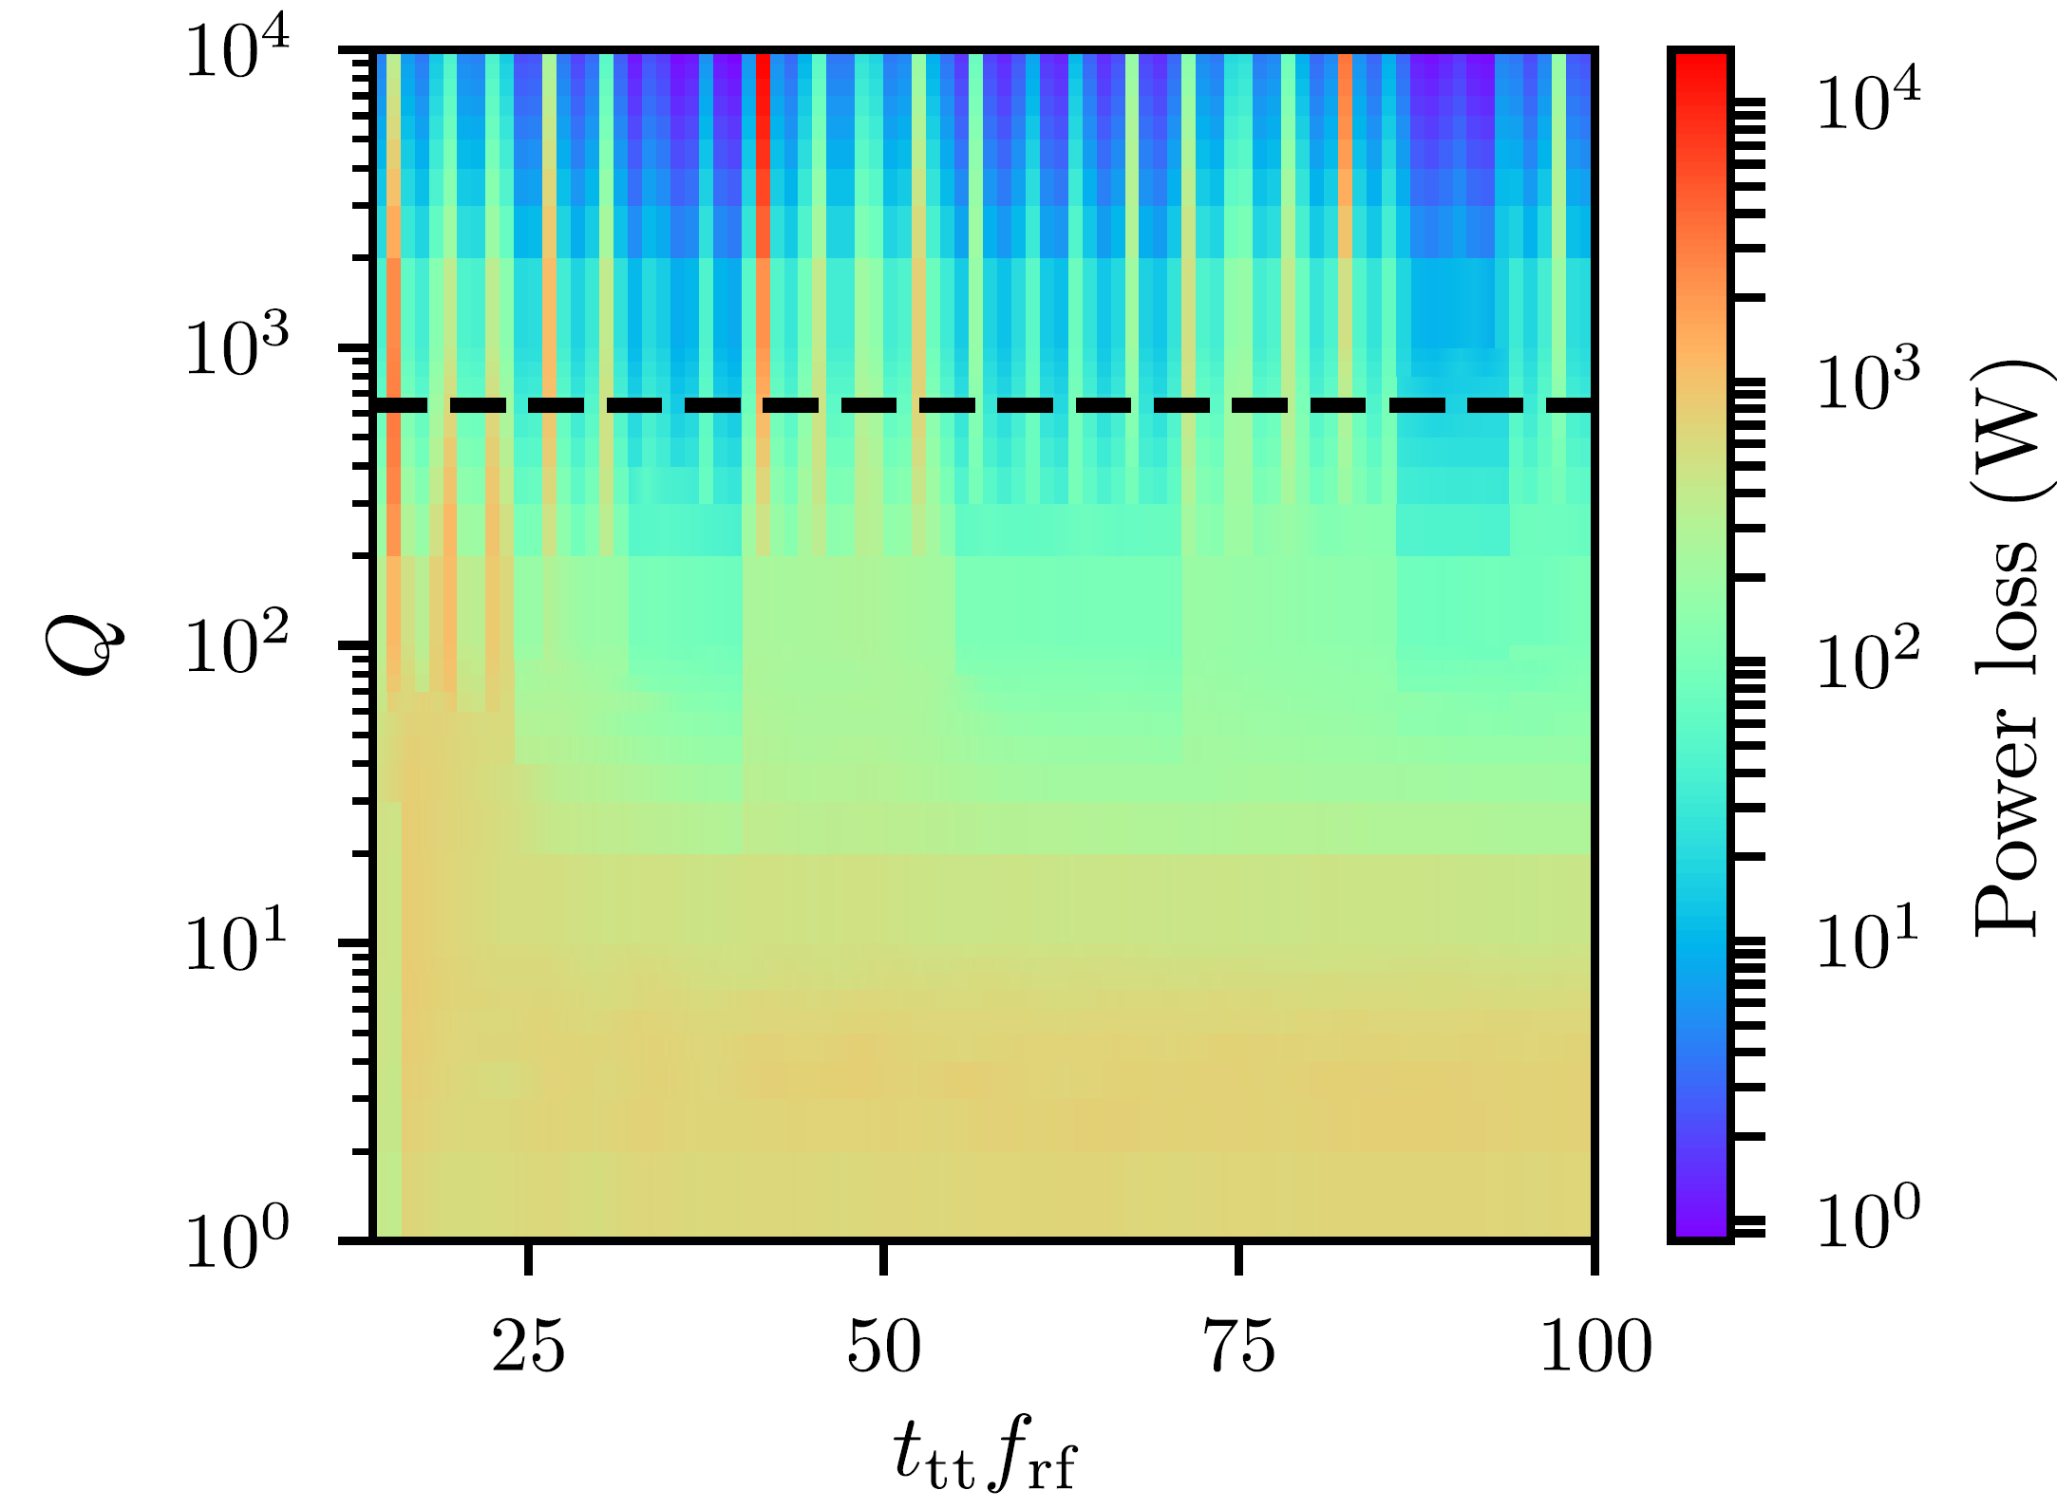
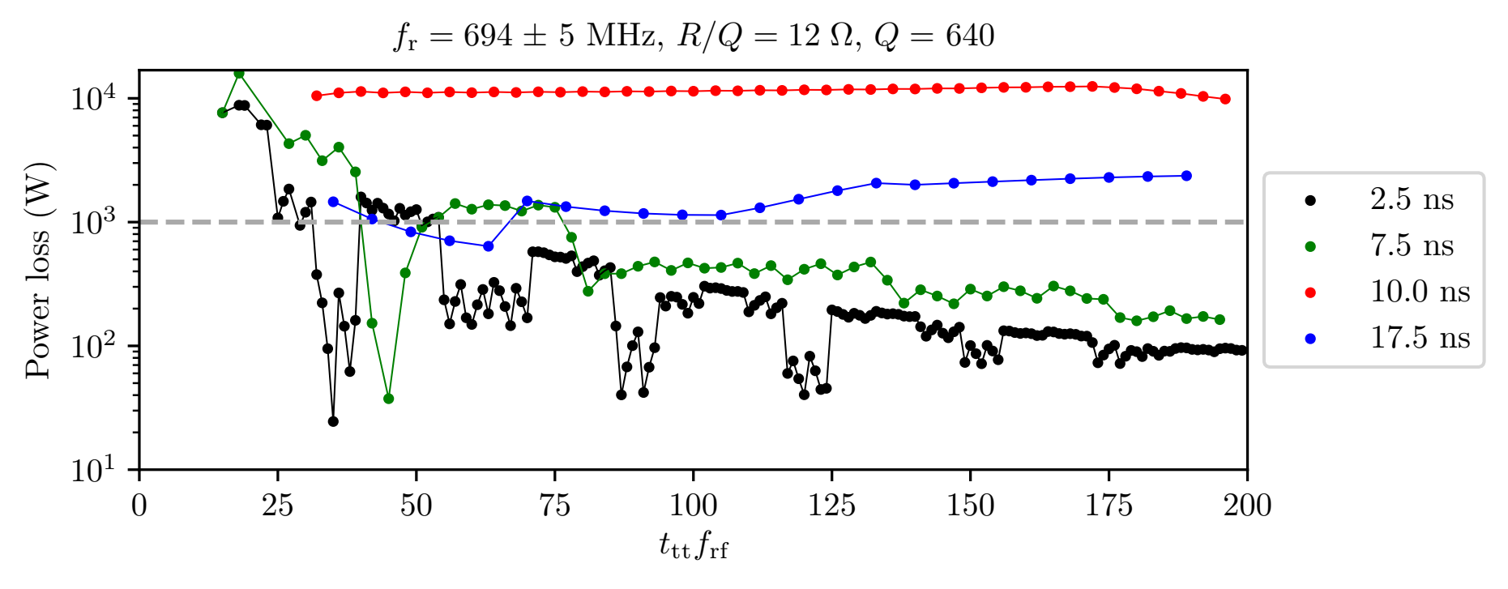
Parasitic beam power loss due to HOMs (FCCee)
I. Karpov, PRAB 21 071001 (2018)
HOM coincides with bunch spectral line
Power loss for different filling pattern
Worst-case scenario with Q=10⁴
Z: P>100kW, should be avoided at design
For small Q, power loss do not depend on train spacing (impedance is broadband and overlaps with many beam spectral lines)
For high Q, there are several values of train spacing with large power losses (when one of the spectral lines hits the resonant impedance)
Some train spacings should be avoided in operation
Dependence of the maximum power loss in resonant case on the train spacing for Z and different bunch spacings.

Slide 13
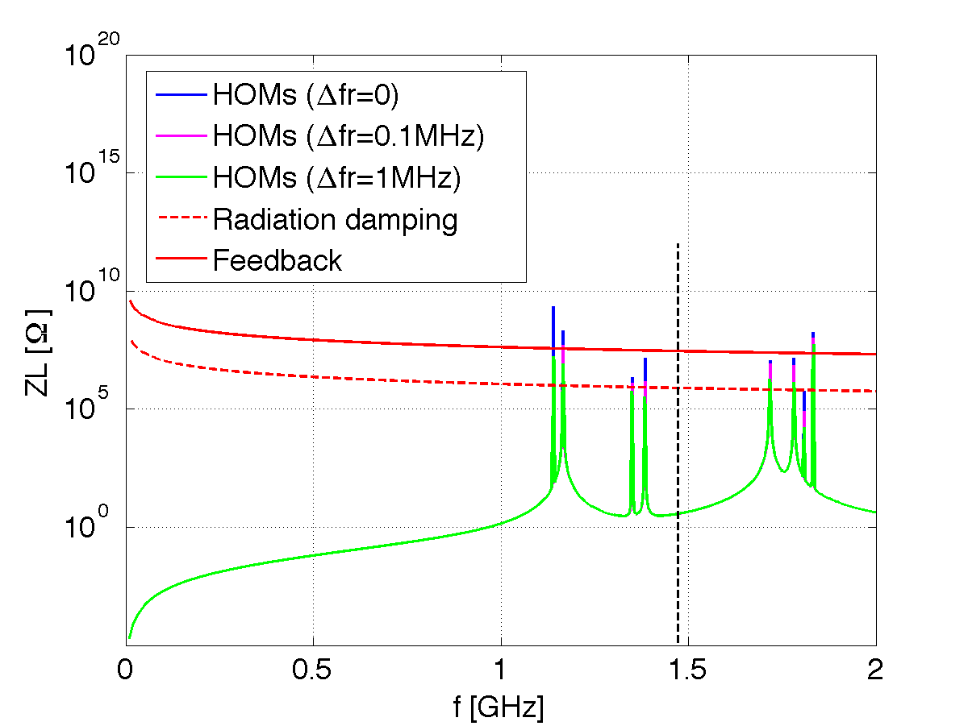
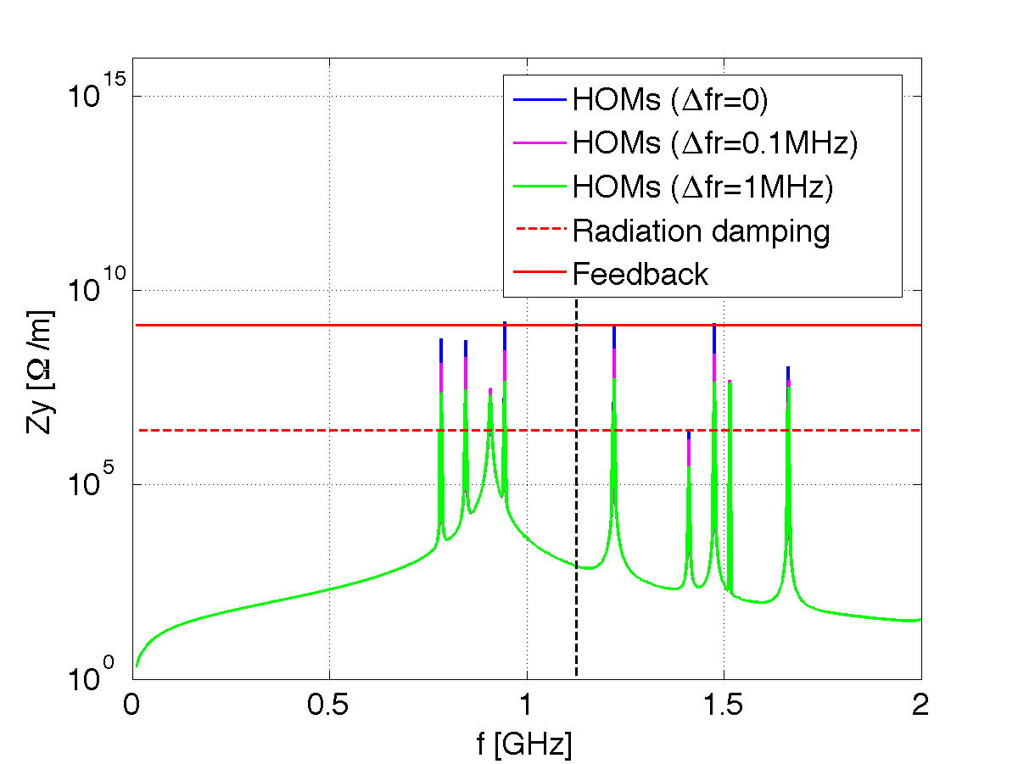
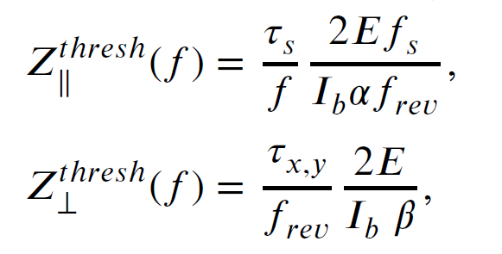
Coupled bunch instabilities
The impedance spectrum for the cavities to be derived and compared to the instability thresholds determined by the synchrotron radiation damping, or with the means to stabilize the beam (feedback, landau damping), above which coupled-bunch instabilities may occur.
Simple rigid-bunch theory:
take each bunch as a point particle
uniform filling pattern
at resonant condition
with zero chromaticity
consider the onset of the instability
Impedance spectrum of the RF HOMs compared to the threshold determined by radiation damping and feedback damping.
For RF system with large number of cavities, HOM frequency spread due to the manufacturing uncertainties can further relax the instability.

Slide 14
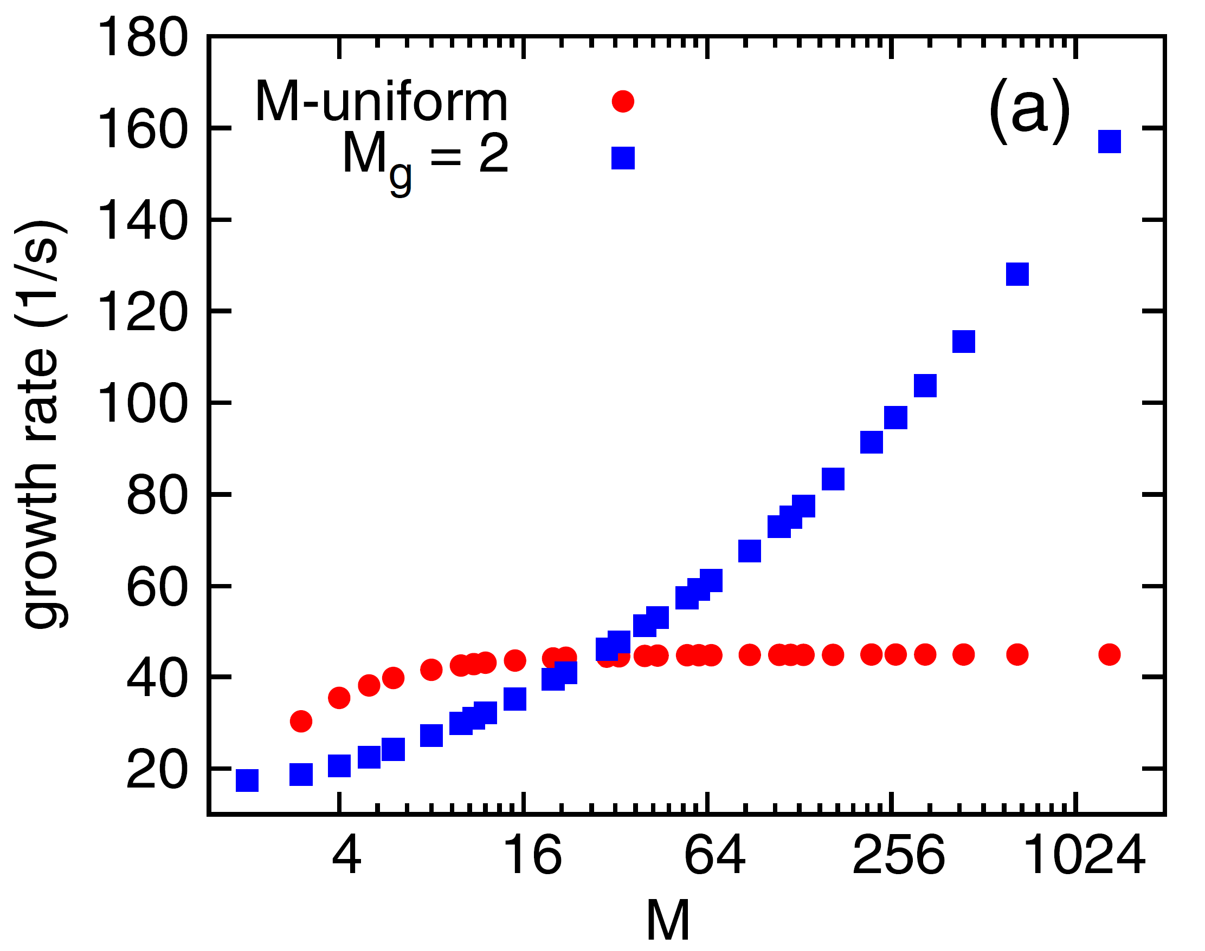
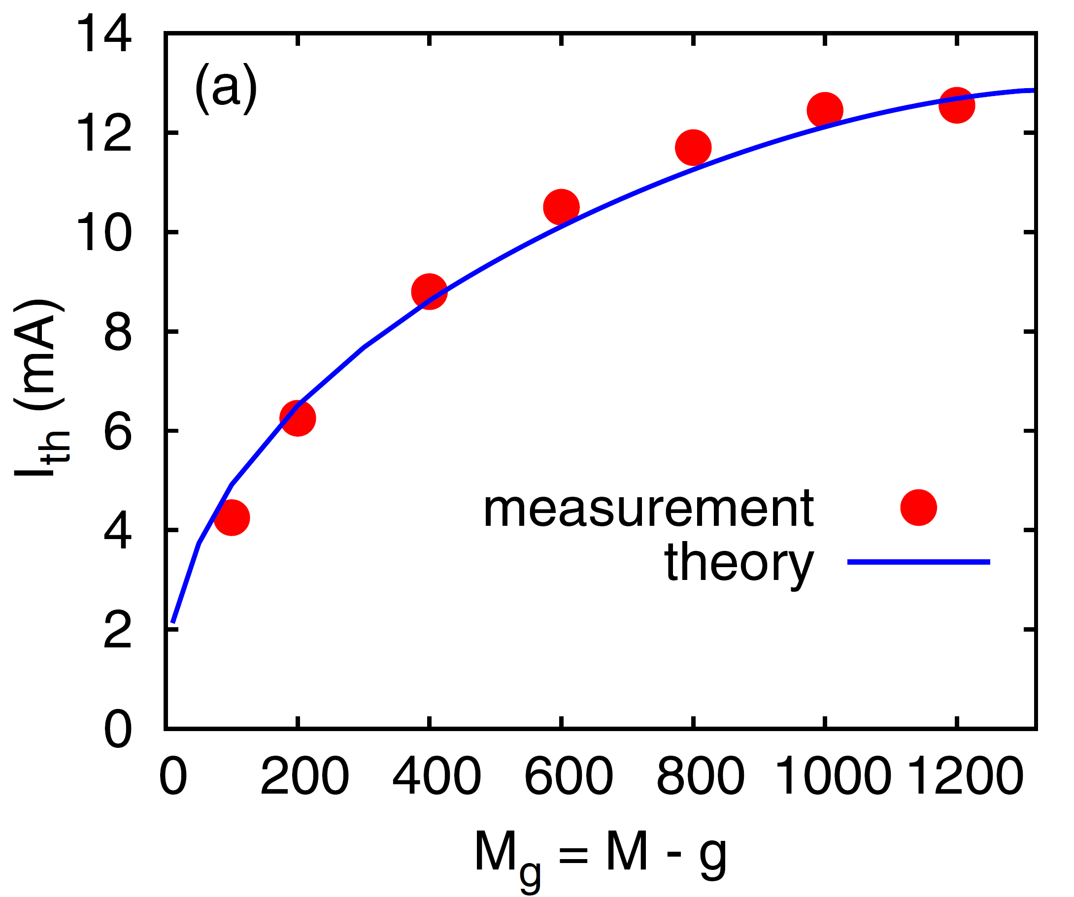
Influence of bunch filling pattern
Circular accelerators operate with a variety of multi-bunch configurations differ from uniform filling, either request by the users or to mitigate beam instabilities (beam ion, electron cloud, …)
The bunch filling pattern plays a key role in the onset of beam instability.
G. Bassi, PRAB 25 014402 (2022)
Uniform filling patterns with large bunch number M (red) is more stable than the case with 2 bunches (blue). I₀=12.7mA
Threshold current increases with maximal uniform filling, good agreement between meas. & theory.

Slide 15
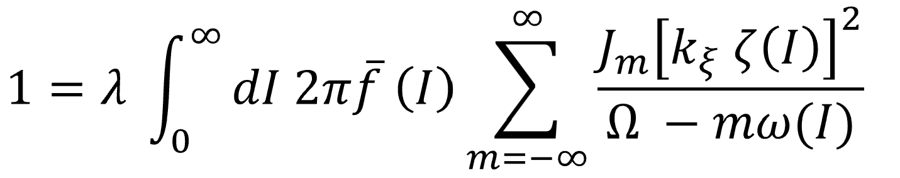
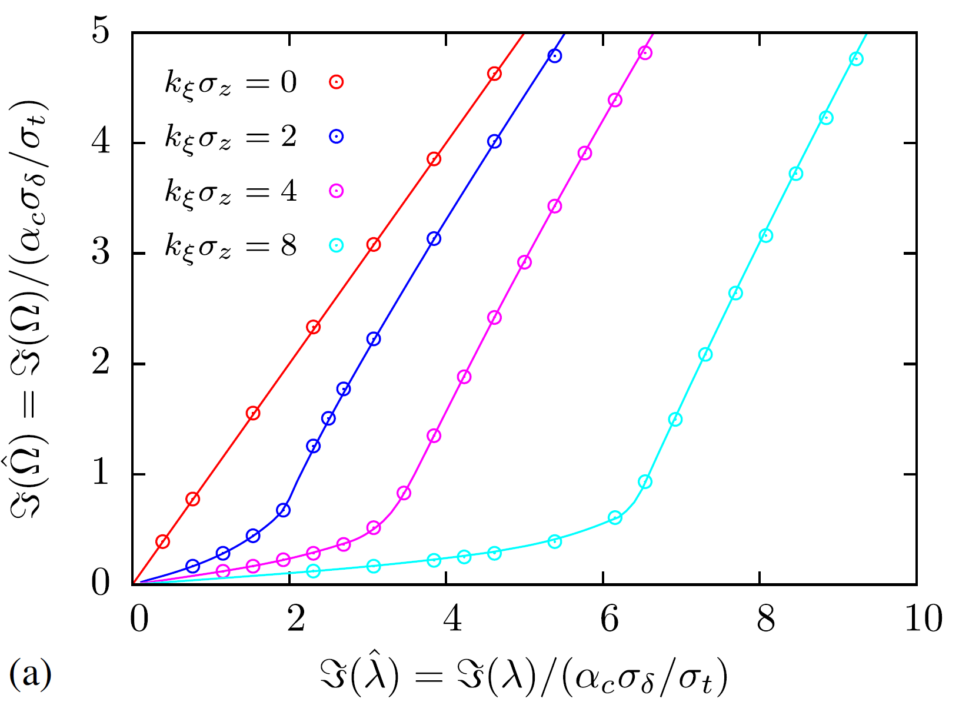
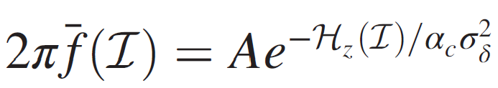
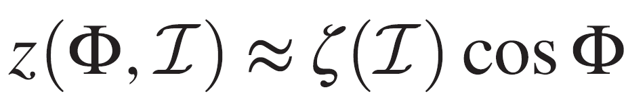




Stabilizing effects of Chromaticity on transverse CBIs
The coupled-bunch growth rates can be significantly reduced when the chromatic betatron tune spread is larger than the growth rate at zero chromaticity.
R. Lindberg, PRAB 24 024402 (2021)
Head-tail (chromatic) phase shift over the bunch
$$k_{ξ}σ_{z}$$
Head-tail (chromatic) frequency
$$ck_{ξ}=ξω_{0}/α_{c}$$
$$k_{ξ}σ_{z}=12.5$$
APSU: σ_{z}=16mm, ξ=5.5, α_{c}=4E-5,
$$k_{ξ}σ_{z}=0.2$$
CEPC-Z: σ_{z}=8.7mm, ξ=5.5, α_{c}=1.4E-5,
Good agreement of the growth rates obtained by tracking (dots) and those of theory (solid lines)
Weak damping mainly due to the large circumference and short bunch length

Slide 16
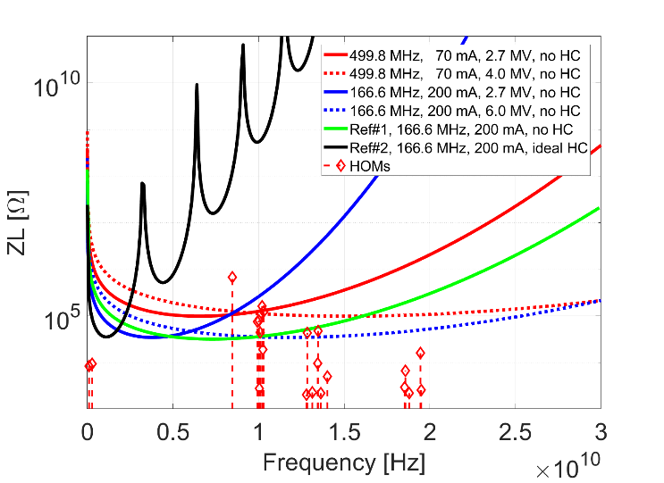
Harmonic RF cavities on CBIs
Harmonic RF cavities are commonly adopted in the synchrotron light sources, mainly for increasing the Tousheck lifetime and mitigating the IBS effects.
Implementing HCs causes several effects:
  Bunch lengthening
  Variations in the longitudinal wake potential well
  Changes in the synchrotron oscillation frequency
  Synchrotron oscillation frequency spread.
N. Wang, IPAC2024 (2024)
Dramatically increase the complexity of beam instabilities.
Comparison of the HOM impedance and the CBI thresholds determined by SR for different RF settings.

Slide 17
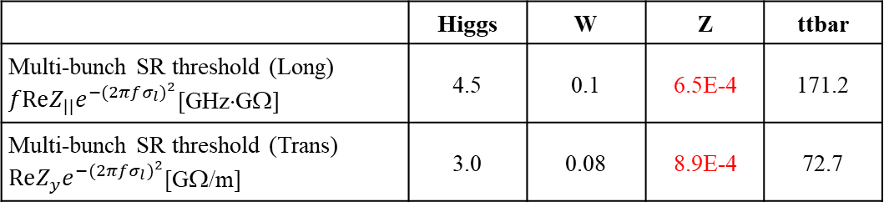
Requirements from different machines
High energy e-p circular colliders
  HOM power and coupled bunch instabilities due to the HOMs are concentrated at Z mode.
  Due to the large circumference, the chromatic phase shift could not provide enough damping to the transverse coupled bunch instability, and the feedback damping is challenging to reach the required damping time within limited number of turns ⇒ The coupled bunch instability induced by the HOMs should be handled by the synchrotron radiation damping.
  The filling pattern is restricted by the HOM power if the Q is not well controlled.
  To meet these requirements, one cell cavities with deep HOM damping are dedicated in both CEPC and FCC-ee Z mode.
 | Higgs | W | Z | ttbar
Multi-bunch SR threshold (Long) $fReZ_{||}e^{−{(2πfσ_{l})}^{2}}$[GHz⋅GΩ] | 4.5 | 0.1 | 6.5E-4 | 171.2
Multi-bunch SR threshold (Trans) $ReZ_{y}e^{−{(2πfσ_{l})}^{2}}$[GΩ/m] | 3.0 | 0.08 | 8.9E-4 | 72.7
Tight narrowband impedance requirements for Z (at least ~two orders lower compare to other energies)

Slide 18
Requirements from different machines
Synchrotron radiation light sources
  As a user facility with many beamlines, beam stability/beam quality is more prominent → HOMs should not dilute emittance or beam energy spread even in resonance.
  Transverse HOMs are normally not dominant in the circular accelerators, either due to the strong feedback damping requirement given by the resistive wall instability or effective landau damping from chromaticity.
  Longitudinal HOMs are not easily to be damped by feedback, especially when interact with harmonic RF cavities, and better take care of during the design stage.
  A more comprehensive consideration can reduce redundancy in hardware design.

Slide 19
Summary and outlook
HOM parasitic power loss and coupled bunch instabilities are the main constraints from SRF HOMs.
Their influence depends on different factors (machine parameters, geometry of rf cavities, damping mechanisms, …).
The goal is to achieve beam stability with less structural complexity that come from an overly aggressive suppression of higher-order modes.
A more comprehensive consideration can reduce redundancy in hardware design and is important for understanding the beam phenomena.
More cross check with beam observations could be beneficial for better understanding and control of the HOMs.

Slide 20
Thank you for your attention

