Slide 1





Dipole mode
wakefields and beam dynamics tracking simulations for the UK XFEL
main accelerating Linacs
Anthony Gilfellon
PhD supervisors: Roger M Jones, Alan E Wheelhouse
Peter H Williams, Bruno Muratori
ASTeC STFC Daresbury Laboratory
University of Manchester
xfel.ac.uk
Notes:
The abstract pattern can be removed or repositioned if required. Be careful to ‘Send to Back’ so that it does not obscure any important information.

Slide 2
Outline
UK XFEL Overview
Benchmarking CST Model
Kick Factors and Wakes
Benchmarking Particle Tracking Codes
Emittance Dilution Results
Conclusions & Future Work

Slide 3
UK XFEL Overview
Benchmarking CST Model
Kick Factors and Wakes
Benchmarking Particle Tracking Codes
Emittance Dilution Results
Conclusions & Future Work

Slide 4

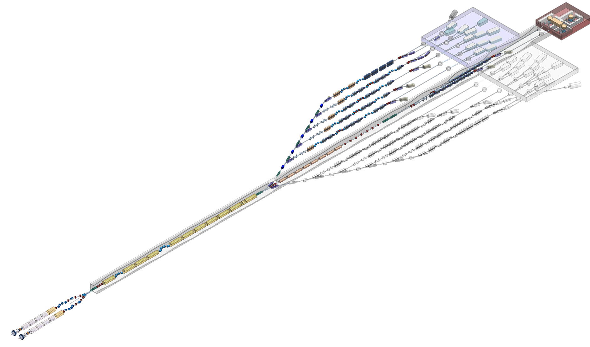
UK XFEL Overview: Facility (not to scale)
UK XFEL is a multi-stage project to pursue ‘next-generation’ XFEL capabilities for the UK
UKXFEL Facility Talk: Wednesday 8th October 10:30 am
Injector section
  Two VHF NC guns
  Varying bunch charge beams interleaved
  Leaves section at 100 MeV
  Maximum bunch repetition rate of 1 MHz
Booster Section
  NC Cu C-band
  ~35 MV/m
  8GeV to 12 GeV
  Matter in extreme conditions
Main Accelerating section
  600 1.3GHz TESLA 9-cell cavities
  Gradient of ~ 14 MV/m
  8 linearising 3.9 GHz
  cavities
  2 bunch
  compressors
12 GeV
FEL lines
  6 to 12 FEL lines
  Independently customisable in terms of bunch charge and repetition rate
8 GeV
Switchyard
  Fast kickers to separate out 1MHz beam to (say) 10 x 100 kHz beams
  Variants are possible
END stations
  Multiple end stations per FEL line
  Full range of pump lasers available
100 MeV

Slide 5
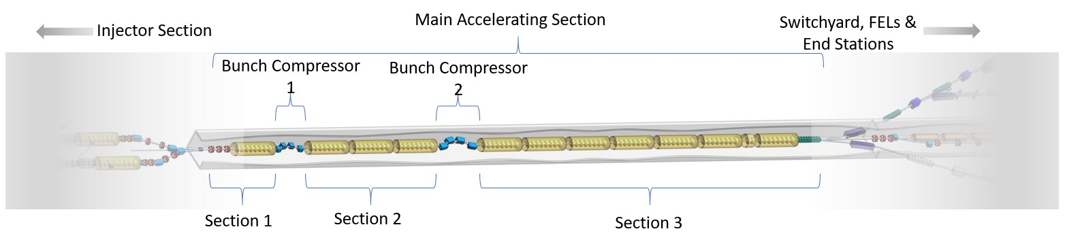
UK XFEL Overview: Main Accelerating Section
2 x 3.9 GHz Cryomodules
100 MeV
290 MeV
2
GeV
8
GeV
100 MeV to 8 GeV
Layout
  3 sections
  2 bunch compressors
  > 1km physical length (CM fill factor dependent)
Accelerating structures
  Most acceleration from section 3
    432 x TESLA 9-cell cavities
    Gradient of ~14 MV/m
    On-crest
Table showing the main parameters for the RF structures present in the UK XFEL’s main accelerating section (90° is on-crest)
 | Cavity Name | Population | Frequency [GHz] | Gradient [MV/m] | Phase [degs]
Section 1 | LIN1 | 16 | 1.3 | 17.686 | 58.0
 | HARM | 16 | 3.9 | 3.094 | -90.0
Section 2 | COMP | 8 | 1.3 | 6.827 | 65.0
 | LIN2 | 152 | 1.3 | 13.593 | 61.1
Section 3 | LIN3 | 432 | 1.3 | 13.657 | 90.0

Slide 6
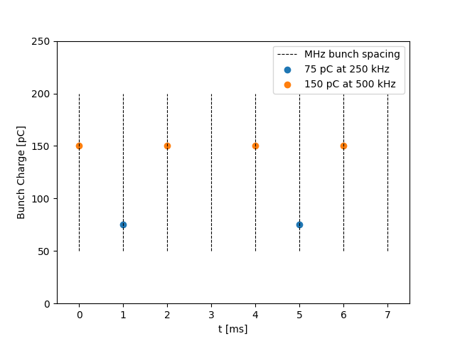
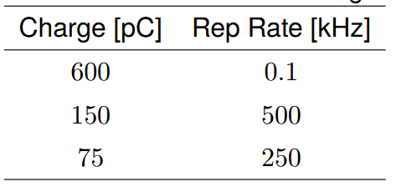
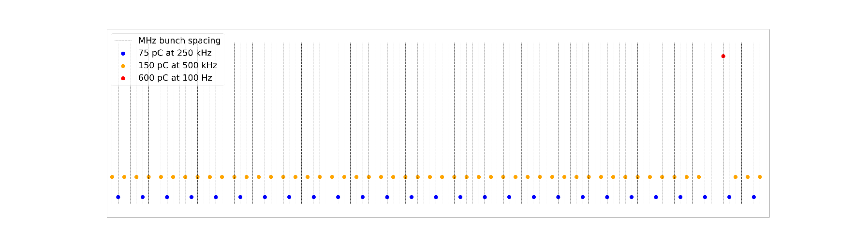
UK XFEL Overview: Composite Beam
Repeat Unit
Feeding 6+ independent FEL lines simultaneously via 1 main accelerating section necessitates a composite beam
There are 3 proposed constituent beams with differing charges and repetition rates
Any constituent beams can be combined to form a composite beam.
The fill pattern is chosen to satisfy end-user requirements.
The long-range wakes created by a composite bunch propagating through the main accelerating section need to be investigated, quantified and mitigated if necessary.
An example fill pattern of the 150 & 75 pC constituent beams
A more complex fill pattern involving the 150, 75 & 600 pC constituent beams
03/10/2025
HOMSC2025
6

Slide 7
UK XFEL Overview
Benchmarking CST Model
Kick Factors and Wakes
Benchmarking Particle Tracking Codes
Emittance Dilution Results
Conclusions & Future Work

Slide 8
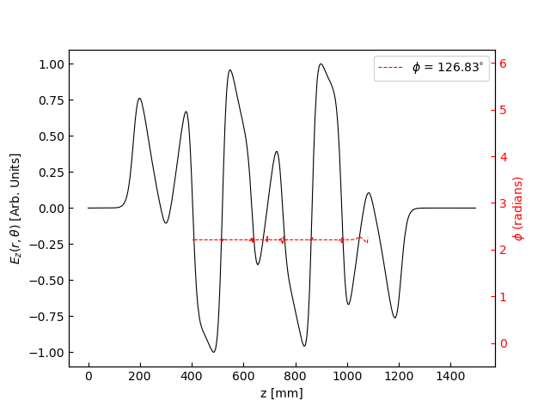
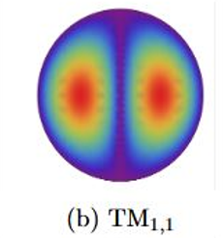
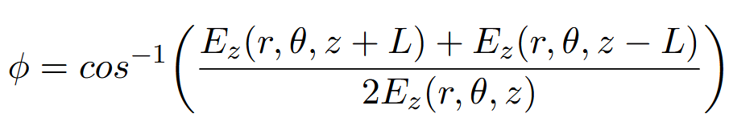
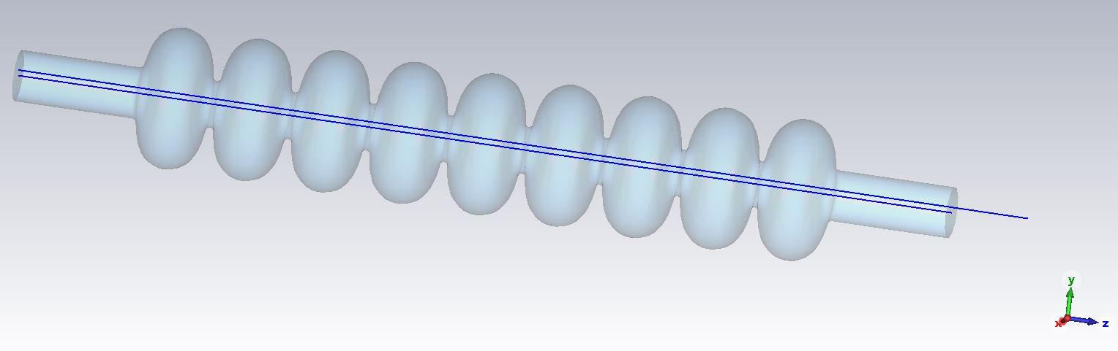
Benchmarking: CST Model
To simulate and probe the EM fields in the cavity a model was constructed using CST and to have confidence our model was accurate enough, it was benchmarked against established results (R. Wanzenberg. (2001) Monopole, dipole and quadrupole passbands of the TESLA 9-cell cavity.)
Concentrating on the dipole modes, the frequency and phase advances of the first 6 dipole passbands were extracted from the simulation by analysing the E_{z} component of the electric field along a line parallel to the axis but offset by 8mm.
Dipole mode
LEFT: The equation to calculate the phase advance of a mode based on the Floquet condition.
8mm radial offset
ABOVE: The normalised z component of the electric field of the 7th TM₁₁₀ dipole mode of the TESLA 9-cell cavity at a radial offset of 8 mm (black), with the phase advance (ϕ = 126.8◦) calculated using the Floquet equation above plotted in red.
CST model showing the axis cavity and the 8mm offset used to calculate the phase advance of the mode
Cavity axis

Slide 9
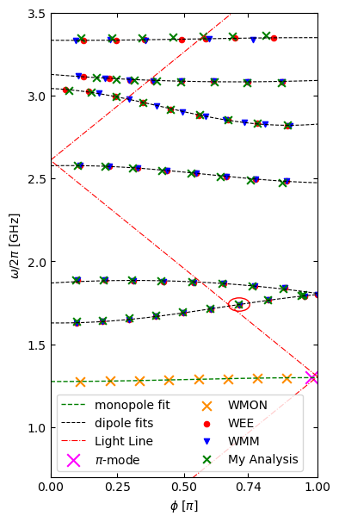
Benchmarking: CST Model
Once the frequencies and phase advances were extracted for the first six dipole mode passbands, a Brillouin diagram showing the dispersion curves of each passband was constructed and compared to trusted, published results, see right.
A mode’s proximity to the light line (shown in red) is an indication of the level of that mode’s excitation within the cavity due to it being near-synchronous.
Dipole mode 7 in the first passband (detailed in the previous slide and highlighted on the right within O) is expected to be a concern.
Also shown in the plot is the first passband of the monopole modes, with the main accelerating TM₀₁₀ π-mode highlighted as X. The mode’s proximity to the light line is a positive in this case as this is the mode that will accelerate the electrons as they transit through the cavity.
5
4
3
1
2
RIGHT: The Brillouin diagram showing the dispersion curves of the first six dipole passbands and the equivalent modes from the Wanzenberg DESY study. Here "W EE" and "W MM" refer to the DESY Wanzenberg study with electric-electric and magnetic-magnetic boundaries in the beampipes respectively. The numbers are referred back to in the Brillouin diagram on slide 11.
(R. Wanzenberg. (2001) Monopole, dipole and quadrupole passbands of the TESLA 9-cell cavity.)

Slide 10
UK XFEL Overview
Benchmarking CST Model
Kick Factors and Wakes
Benchmarking Particle Tracking Codes
Emittance Dilution Results
Conclusions & Future Work

Slide 11
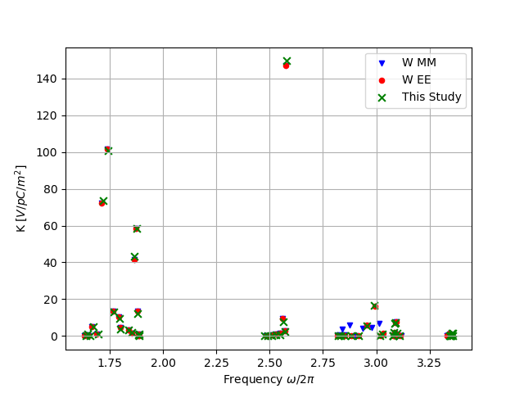
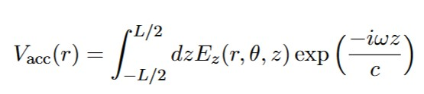
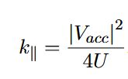

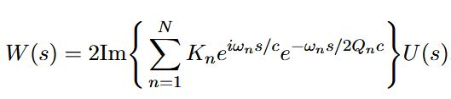
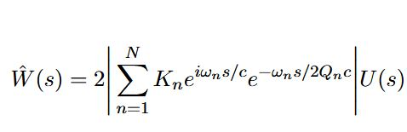

Kick Factors and Transverse Long-Range Wakes
From the E_{z} field profile along the offset trajectory, the envelope wake potential can be calculated as follows
From CST analysis
5
Accelerating voltage from simulated E_{z} field
2
Modal Loss Factor
Stored energy
1
4
Modal Kick Factor
3
Transverse Long-range Wake Potential
$$\frac{ω}{2π}[GHz]$$
Unit Step Function
Envelope Transverse Long-range Wake Potential
Plot comparing derived kick factors to published results
R M Jones and C Glasman. (2005) HIGHER ORDER MODE WAKEFIELD SIMULATIONS AND BEAM DYNAMICS SIMULATIONS IN THE ILC MAIN LINACS. In LINAC 2005 Conference Proceeding.

Slide 12
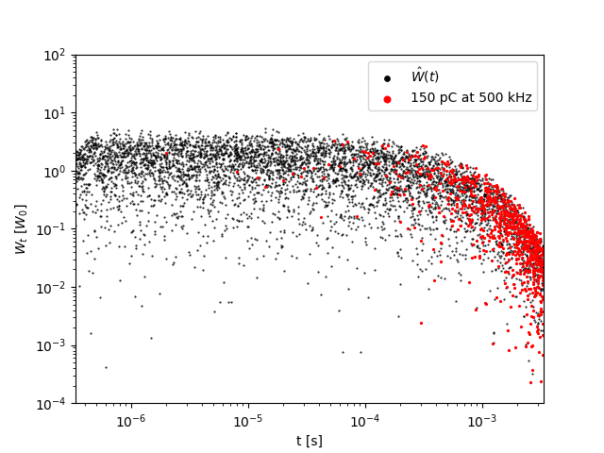
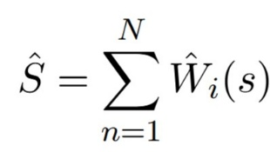

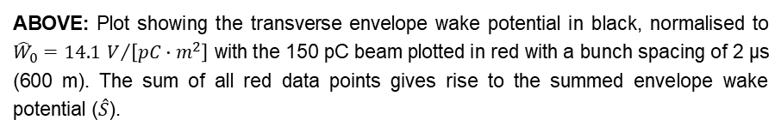
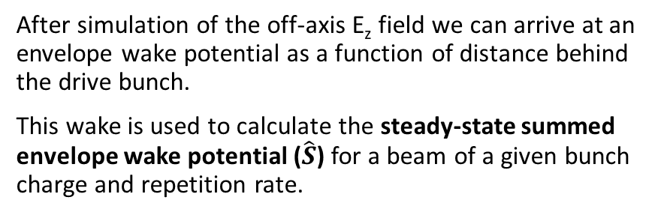
Summed Transverse Long-Range Wake
After simulation of the off-axis E_{z} field we can arrive at an envelope wake potential as a function of distance behind the drive bunch.
This wake is used to calculate the steady-state summed envelope wake potential ($\hat{S}$) for a beam of a given bunch charge and repetition rate.
$${\hat{W}}_{t}[{\hat{W}}_{0}]$$
This represents the worst-case scenario that a new bunch entering a cavity will experience after the steady state is reached for a given beam.
ABOVE: Plot showing the transverse envelope wake potential in black, normalised to ${\hat{W}}_{0}=14.1 V/{\left[pC∙m^{2}\right]}$ with the 150 pC beam plotted in red with a bunch spacing of 2 μs (600 m). The sum of all red data points gives rise to the summed envelope wake potential ($\hat{S}$).

Slide 13
UK XFEL Overview
Benchmarking CST Model
Kick Factors and Wakes
Benchmarking Particle Tracking Codes
Emittance Dilution Results
Conclusions & Future Work

Slide 14
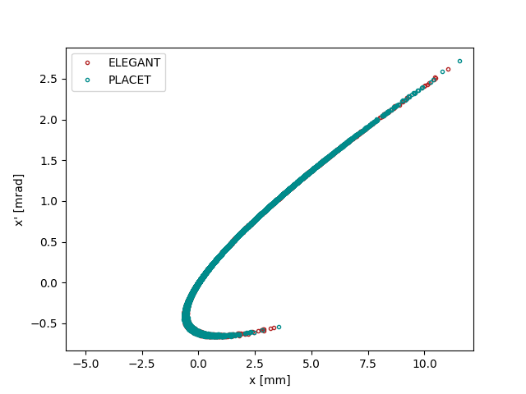
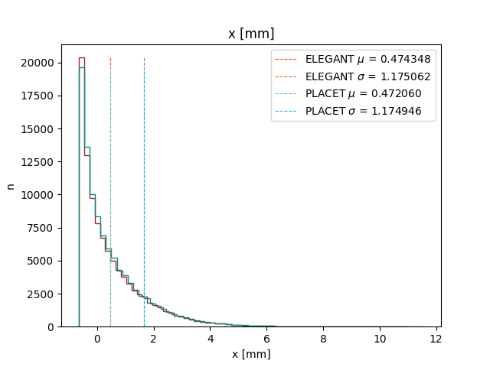
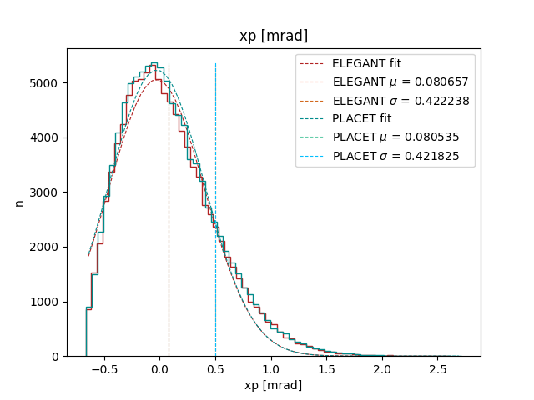
Benchmarking: Particle Tracking Codes
Default particle tracking code for the UK XFEL project is ELEGANT *
Elegant cannot, at present, handle long-range wakes (LRWs)
PLACET ** can track bunches and include effects of LRWs
First job is to benchmark the full lattice in PLACET against trusted ELEGANT results (without LRWs)
* Borland, M. (2000) elegant: A flexible SDDS-compliant code for accelerator simulation. Advanced Photon Source LS-287. Available at: https://www.osti.gov/biblio/761286
* * PLACET Collaboration (2025) PLACET3 particle tracking code (Version 3.1.5) [Computer program]. Available at: https://cern.ch/placet.
BELOW: Plots comparing the results from tracking a 600 pC bunch through the full lattice of the main accelerating section in PLACET and ELEGANT. a) the horizontal phase space of the bunch at the end of the main accelerating section. b) and c) show histograms of the horizontal positions and angles respectively.
a)
b)
c)

Slide 15
UK XFEL Overview
Benchmarking CST Model
Kick Factors and Wakes
Benchmarking Particle Tracking Codes
Emittance Dilution Results
Conclusions & Future Work

Slide 16
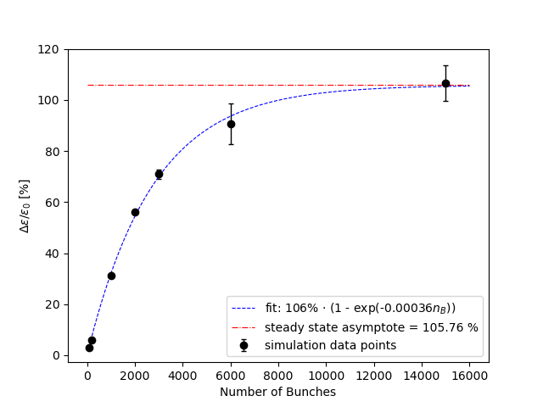
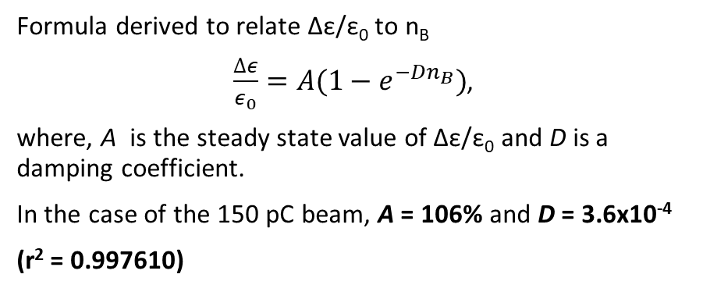
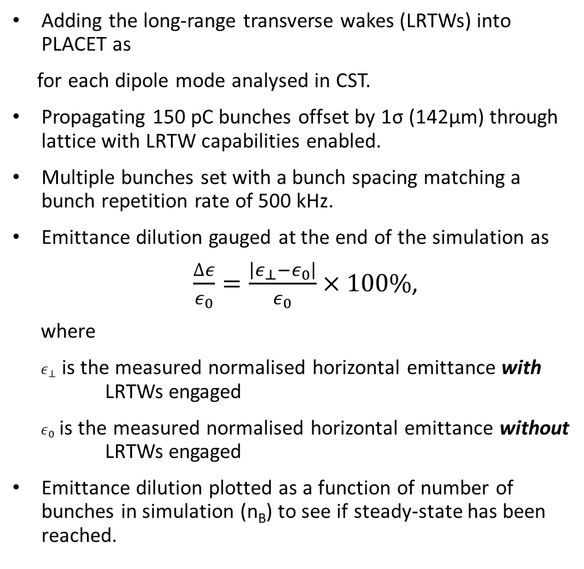
PLACET: Constituent Beam Results
Adding the long-range transverse wakes (LRTWs) into PLACET as
for each dipole mode analysed in CST.
Propagating 150 pC bunches offset by 1σ (142μm) through lattice with LRTW capabilities enabled.
Multiple bunches set with a bunch spacing matching a bunch repetition rate of 500 kHz.
Emittance dilution gauged at the end of the simulation as
$\frac{∆ε}{ε_{0}}=\frac{\left|ε_{⊥}−ε_{0}\right|}{ε_{0}}×100\%$,
where
$ε_{⊥}$ is the measured normalised horizontal emittance with LRTWs engaged
$ε_{0}$ is the measured normalised horizontal emittance without LRTWs engaged
Emittance dilution plotted as a function of number of bunches in simulation (n_{B}) to see if steady-state has been reached.
Frequency [GHz] | Kick [V/pC/m²] | Q₀
(r² = 0.997610)
Formula derived to relate Δε/ε₀ to n_{B}
$\frac{∆ε}{ε_{0}}=A(1−e^{−Dn_{B}})$,
where, A is the steady state value of Δε/ε₀ and D is a damping coefficient.
In the case of the 150 pC beam, A = 106% and D = 3.6x10⁻⁴
(r² = 0.997610)

Slide 17
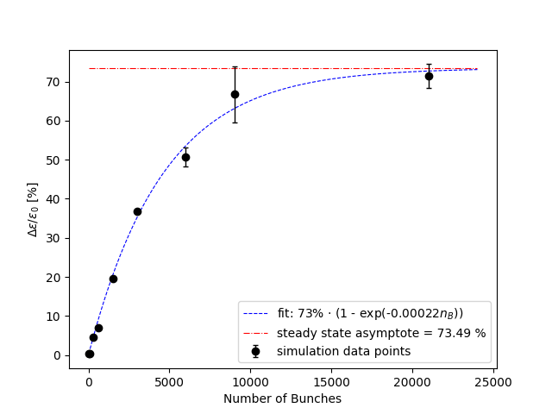
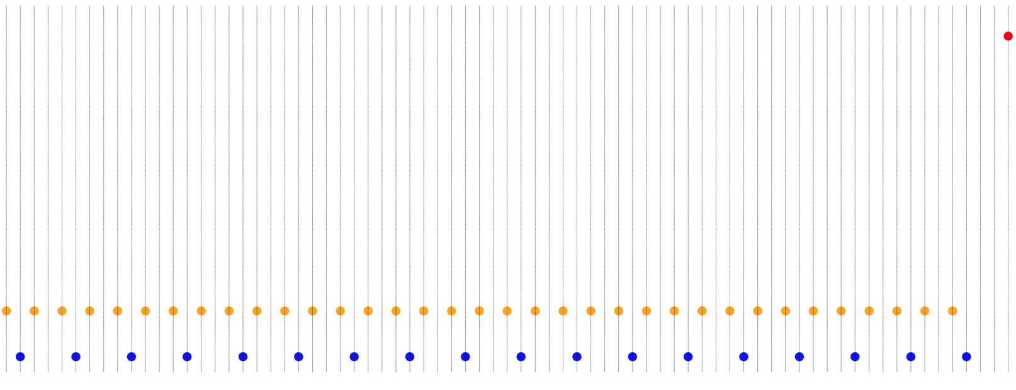
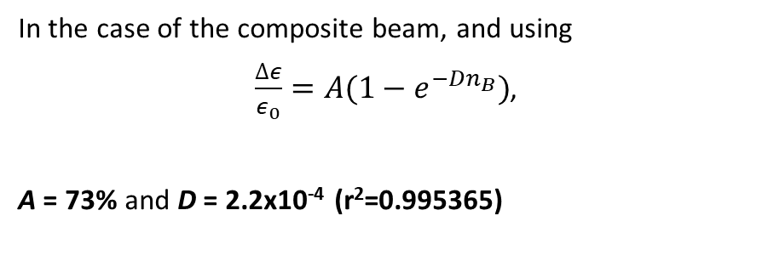
PLACET: Composite Beam Results
We want to judge the effect of the steady-state LRTWs of a composite 75pC and 150pC beam has on a single 600 pC bunch.
600 pC test bunch
(r²=0.995365)
In the case of the composite beam, and using
$\frac{∆ε}{ε_{0}}=A(1−e^{−Dn_{B}})$,
A = 73% and D = 2.2x10⁻⁴ (r²=0.995365)
Steady-state 75 & 150 pC composite beam
in the results shown, one repeat unit of [150-75-150-X ] contains 3 bunches

Slide 18
UK XFEL Overview
Benchmarking CST Model
Kick Factors and Wakes
Benchmarking Particle Tracking Codes
Emittance Dilution Results
Conclusions & Future Work

Slide 19
Conclusions & Future Work
Conclusions
Benchmarking of CST model complete
Kick factors extracted
Particle tracking codes successfully benchmarked (ELEGANT & PLACET)
Results obtained for
  150 pC constituent beam
  600 pC bunch embedded in composite beam
Future Work
HOM Mitigation Strategies (HOM couplers, Beam pipe modification, Photonic band gap (PBG) structures, etc…)
PLACET
  Repeat the analysis with 75 and 600 pC constituent bunches
  Add long-range longitudinal wakes (LRLWs) and judge effect on energy spread
  Add in 3rd harmonic cavity wakes and judge effect of LRTWs on emittance dilution and LRLWs on energy spread
  Add short-range wakes and arrive at an overall wake effect on composite beam.
RF-Track*
  Complete Benchmarking (nearly completed)
  Repeat all analyses done with PLACET to confirm results
  Vary bunch spacing, both systematically and by applying noise- compare to analytical results
* Andrea Latina "RF-Track Reference Manual", CERN, Geneva, Switzerland, 2024 DOI: 10.5281/zenodo.3887085

Slide 20
Acknowledgments
  Roger Jones
  Alan Wheelhouse
    Peter Williams
    Bruno Muratori
    Nirav Joshi
    Aaron Farricker
  and for helping with particle tracking codes…
    Daniel Schulte
    Andrea Latina
    Paula Desiré Valdor
xfel.ac.uk
Notes:
The abstract pattern can be removed or repositioned if required. Be careful to ‘Send to Back’ so that it does not obscure any important information.

Slide 21
Thank you!
Any Questions?
xfel.ac.uk
Notes:
The abstract pattern can be removed or repositioned if required. Be careful to ‘Send to Back’ so that it does not obscure any important information.

