Slide 1
Higher-Order Mode Power Calculation of SHINE LINAC
Yan Wang, ¹ Zhen-Yu Ma,¹ Jin-Fang Chen,¹ Yi-Yong Liu, ¹ Meng Zhang,¹ Bo Liu, ¹ Yu-Bin Zhao,¹
Zhen-Tang Zhao ,¹ Jie-Xi Zhang, ²
¹Shanghai Advanced Research Institute, Chinese Academy of Sciences, Shanghai 201204, China
² ShanghaiTech University
HOMSC2025

Slide 2
OUTLINE
Introduction of SHINE LINAC
HOM power calculation of SHINE LINAC
Preliminary structural design of HOM absorber
Layout plan of the SHINE HOM absorber

Slide 3

Shanghai HIgh repetitioN rate XFEL and Extreme light facility
A Major National Science and Technology Infrastructure Launched in 2016
An 8GeV CW SCRF Linac based hard X-ray free electron laser facility
Co-funded by central and local governments with a ratio of ~20:80
ShanghaiTech, SARI and SIOM are the main designers and constructors
The groundbreaking was made on April 27, 2018.

Slide 4
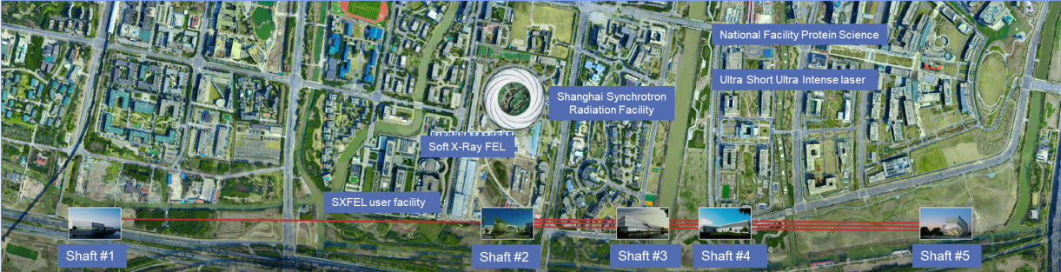
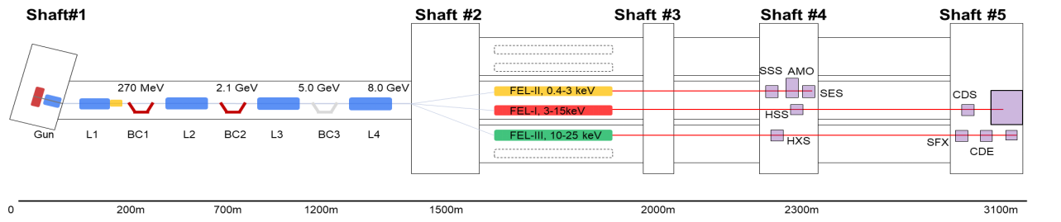

The Main Construction Scope of SHINE
FEL-II 0.2 – 3 keV
FEL-I 3 – 15 keV
An 8GeV SCRF linac, 2 undulator lines to deliver photons from 0.2-15 keV, up to 1 MHz pulse train with pulse duration of 1-100 fs
2 X-ray beamlines and 6 End-stations
100 PW super-intense laser facility
Total length 3.1 km; 29.0 m underground

Slide 5
Main Performance of SHINE
Bypass Line
DCP
FEL-2
0.2-3.0 keV
Injector
DCP
Dump
3.0-15.0 keV
54 CMs
L1
2 CMs
HL
2 CMs
L2
18 CMs
L3
10 CMs
BC3
L4
24 CMs
1.3GHz
FEL-1
XFEL Facility +100 PW Laser Facility
FEL Line | Nominal | Objective
FEL-I
Photon energy/keV | 3-15 | 3-15
Photon number per pulse @12.4keV | >10¹⁰ | >10¹¹
Max pulse repetition rate/MHz | 0.66 | 1
FEL-II
Photon energy/keV | 0.2-3.0 | 0.2-3.0
Photon number per pulse @1.24keV | >10¹² | >10¹³
Max pulse repetition rate/MHz | 0.66 | 1
 | Nominal | Range
Beam energy/GeV | 8.0 | 4-8.6
Bunch charge/pC | 50/100 | 10-300
Max rep-rate/MHz | 1 | up to 1
Photon energy/keV | 0.2-15 | 0.2-15
Pulse length/fs | 20-50 | 5-200
Peak brightness | 5×10³² | 1×10³¹-1×10³³
Average brightness | 5×10²⁵ | 1×10²³-1×10²⁶
2K Cryogenic power/kW | 12 | 12
RF Power/MW | 2.28 | 3.6

Slide 6
The SHINE Linear Accelerator
The SHINE Accelerator consists of
An injector section: 750kV/217MHz photo cathode VHF gun, a two-cell buncher, a single-cavity CM and an eight-cavity CM;
A laser heater section;
Four sections of 1.3GHz standard CMs, and one section of 3.9GHz CMs;
Three magnetic bunch compression sections;
A dechirper section at the end;
In addition, a bypass beam transfer line dedicated to FEL-II
Bypass Line
DCP
FEL-2
0.2-3.0 keV
Injector
DCP
Dump
3.0-15.0 keV
L1
2 CMs
HL
2 CMs
L2
18 CMs
L3
10 CMs
BC3
L4
24 CMs
FEL-1

Slide 7
Performance of SHINE Linac
With a higher gradient (~ 20 MV/m), a total beam energy of 8.0 GeV is expected to deliver by using 54 (+4) 1.3GHz cryomodules at the main linear accelerator;
The beam energy at the bypass line is in the range of 3.5-4.5 GeV, optimizing for seeding schemes.
E_{beam}= 3.5 ~ 4.5 GeV
I_{peak} = 800 A
DCP
FEL-2
0.2-3.0 keV
Injector
DCP
Dump
3.0-13.0 keV
L1
BC1
L2
BC2
L3
BC3
L4
FEL-1
2 CMs
2 CMHs
18 CMs
10 CMs
24 CMs
E_{beam}= 100 MeV
I_{peak} = 10 A
σ_{z} = 1 mm
E_{beam}= 265 MeV
I_{peak} = 80 A
σ_{z} = 0.13 mm
E_{beam}= 2.3 GeV
I_{peak} = 800 A
E_{beam}= 3.5-4.5 GeV
I_{peak} =1.5 kA
E_{beam}= 5.8-8.0 GeV
I_{peak} = 1.5 kA

Slide 8
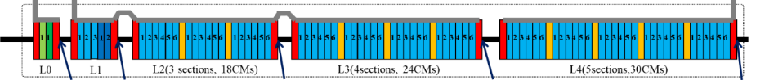
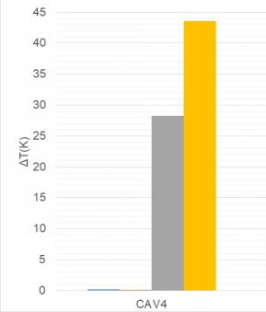
SHINE Linac Parameters
The high-Q Cryomodule (CM) prototype was tested and has reached an average Q₀= 3.0X10¹⁰ at a total voltage of 135 MV, after CM degaussing and fast cooling,
SHINE Linac main parameters | Value
Cavity | TESLA
Operating mode | CW
Operating temp. / K | 2.0
Frequency / MHz | 1300
Eacc / MV/m | 16
Q₀ | 2.7×10¹⁰
Number of cavity | 600
Cryomodule static heat load | 10 W
Cryomodule total heat load | 120 W
Beam energy / GeV | 8.0
CryoPlant / kW | 12
Q₀ measurement of 8 cavities at ~16 MV/m in the high-Q CM prototype
Thermal difference between cell top and bottom during cooling
Flanges loss deducted
Before Degaussing
Degaussing interrupted
After Degaussing

Slide 9
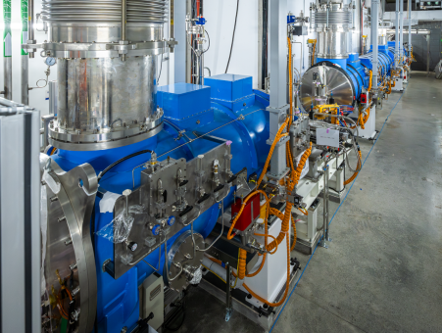
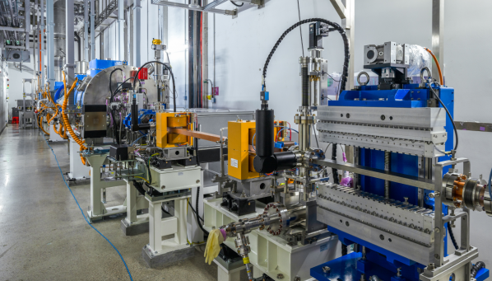
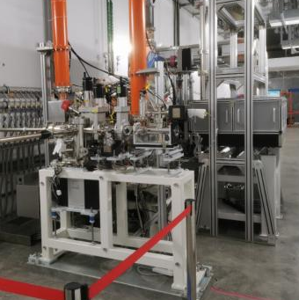
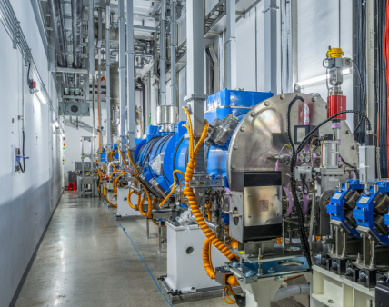
Injector installation and Beam Commissioning
VHF Gun section
i1CM section
i8CM section
Laser heater

Slide 10
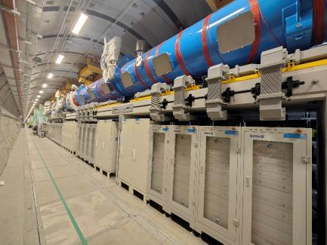
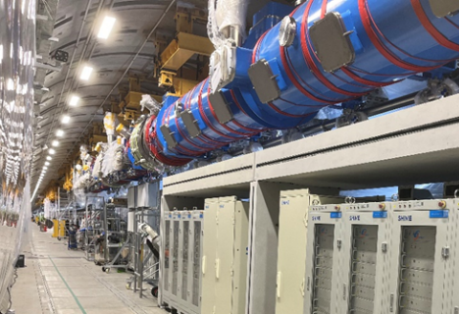
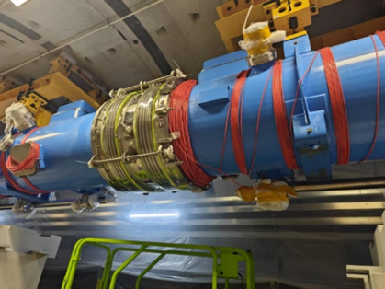
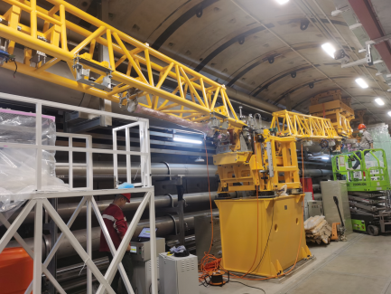
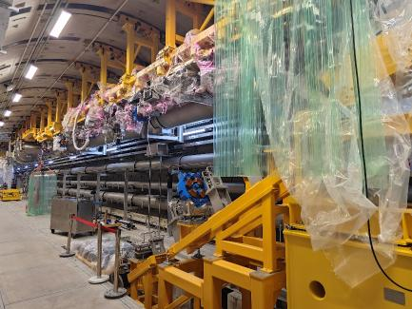
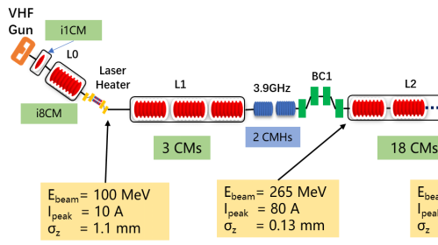
Installation Status of L1-BC1
L1 Section: 1.3GHz CM
3.9 GHz CMX2
HOM Absorber
BC1 Section
Beam Dump1
Notes:
The latest aerial photos of 16th, December, 2023

Slide 11
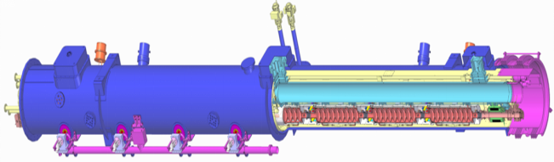
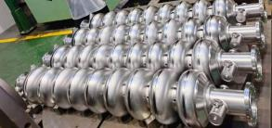
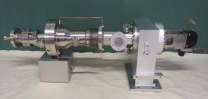
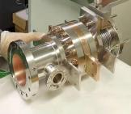
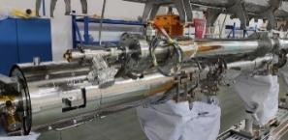
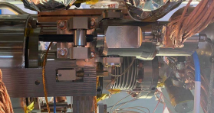
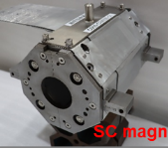
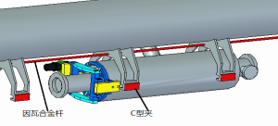
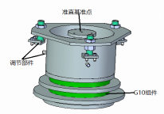
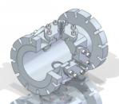
The SHINE Cryomodules
The SHINE linac includes 54 1.3GHz and 3.9GHz CMs, main components are:
8 - 9-cell cavities
8 - Couplers
8 - Tuners
8 - Magnetic shielding
16 - HOM couplers
1 - HOM absorber
1 - SC magnet
1 - BPM
1 - Cryogenic pipe system and thermal shielding
1 - Vacuum components and valves
1 - Cold mass support system
1 – Vacuum vessel
1 - Cryomodule support system
SC cavity
FCP
HOM
Magnetic Shielding
Tunner
SCM
SC supporter
CM supporter
BPM

Slide 12
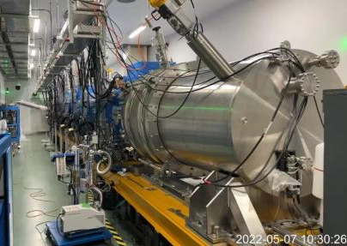
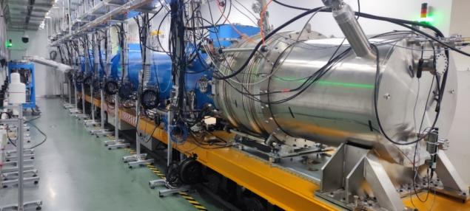
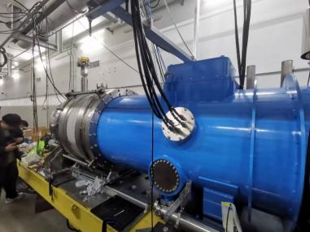
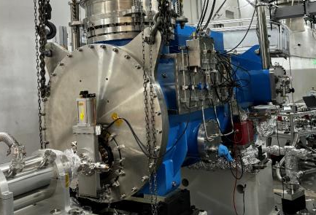
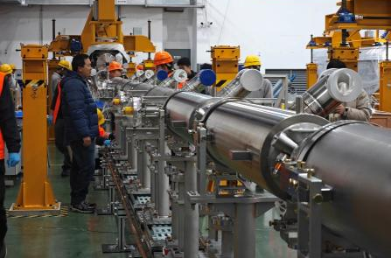
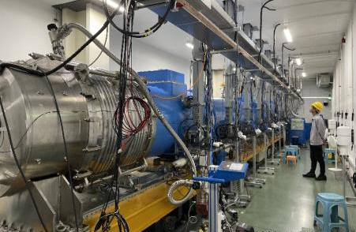
Cryomodules Development and Production
CM prototype with 8 BCPed cavities
CM prototype with 8 high-Q cavities
Test CM for 1.3/3.9GHz single cavity
i1CM for Injector(1 twin-FPC cav.)
i8CM for Injector (8 midT cav.)
sCM01 for L1(8 N-doped cav.)

Slide 13
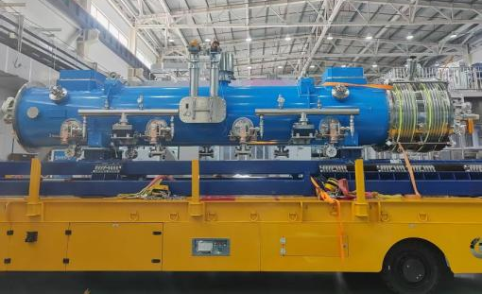
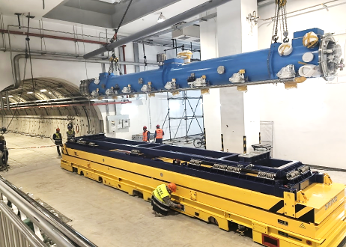
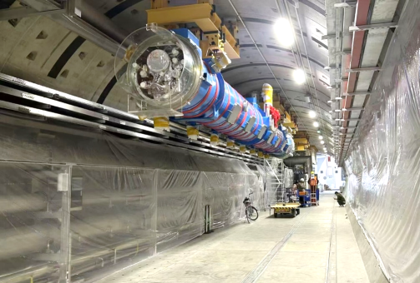
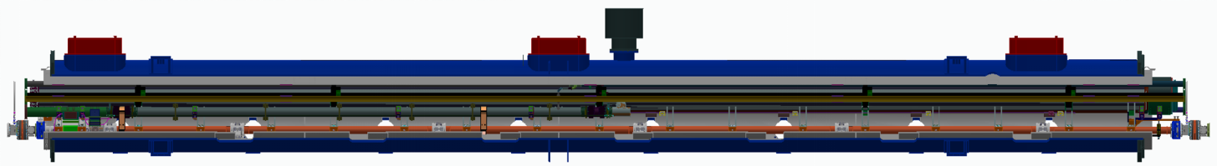
Cryomodule Installation in the Tunnel

Slide 14
Production of Standard 1.3GHz high-Q Cryomodules
1.3 GHz CMs | Goal | Usable Volt.(MV) | Ave. E_{usable} (MV/m) | No. of FE cav. | Ave. Q₀ (E10) | 2K static load（W） | Test time
CM01-ND# | 3E10@166MV | 176.7 | 21.3 | 3 | 3.2 @176 MV | 18.1 | April, 2024
CM02-ND | Ditto | 172.8 | 20.8 | 4 | 2.6 @166 MV | 21.1 | Oct. 2024
CM03-MT* | Ditto | 241.3 | 29.0 | 0 | 4.0 @ 166 MV 3.2 @ 241 MV | 21.7 | Sept,2024
CM04-MT | Ditto | 189.4 | 22.8 | 3 | 3.2 @ 166 MV | 21.7 | Dec, 2024
CM05-ND | Ditto | 172.5 | 20.8 | 2 | 3.1 @ 166 MV | 21.8 | Jan, 2025
CM06-ND | Ditto | 171.8 | 20.7 | 1 (@VT) | 4.0 @ 166 MV | 26.5 | Mar, 2025
CM07-ND | Ditto | 206.6 | 24.9 | 1 | 2.9 @ 166 MV | 22.8 | Mar, 2025
CM08-ND | Ditto | 189.0 | 22.8 | 0 | 4.1 @ 166 MV | 27.9 | Mar, 2025
CM09-ND | Ditto | 200.9 | 24.2 | 2 | 3.1 @ 165 MV | 26.5 | Apr, 2025
CM11-MT | Ditto | 206.6 | 24.9 | 2 | 3.1 @ 166 MV | 26.4 | Apr, 2025
CM12-ND | Ditto | 209.6 | 25.2 | 1 | 3.4 @ 166 MV | 25.6 | May,2025
CM13-ND | Ditto | 180.1 | 21.7 | 0 | 3.8 @ 166 MV | 25.2 | Jun, 2025
CM14-ND | Ditto | 193.7 | 23.3 | 0 | 3.2 @166 MV | 20.7 | Jun, 2025
CM15-22 | CM15-CM16 under horizontal test, CM17-CM22 under assembly
Notes: Admin limit at 26 MV/m since CM04
# ND: Nitrogen-Doping；* MT: Mid-T Baking

Slide 15
OUTLINE
Introduction of SHINE LINAC
HOM power calculation of SHINE LINAC
Preliminary structural design of HOM absorber
Layout plan of the SHINE HOM absorber

Slide 16
SHINE HOM Absorber
SHINE HOM Absorber
SHINE adopted 1.3 GHz 9-cell SC cavities for electron acceleration, with a maximum bunch charge of 300 pC, a maximum repetition frequency of 1 MHz, and a minimum bunch length of 26 μm. The main Linac of SHINE uses 54 1.3 GHz SC modules and 2 3.9 GHz SC third-harmonic cavity cryomodules.
Multiple higher-order modes (HOMs) are excited and coupled outside. HOMs above the cutoff frequency will propagate through the entire cavity chain. Measures must be taken to suppress these modes.
Beam-tube type HOM absorbers are installed between cryomodules, and cooled by 45 K cryogenic pipe to reduce heat leakage to the cryomodule’s 2 K system. The HOM absorbers must have high absorption capacity or efficiency to absorb most of the HOM power, thereby reducing the HOM power shared by other module components.

Slide 17
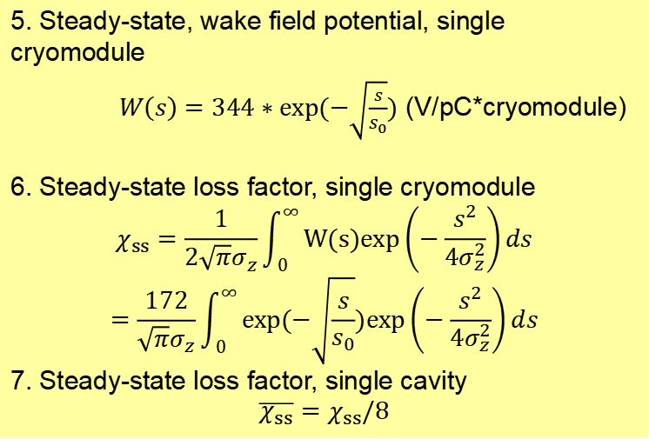
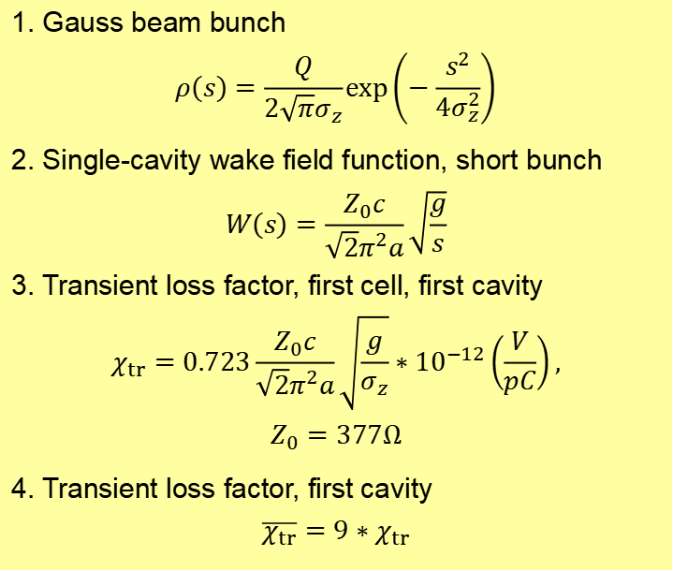
Loss Factor & HOM Power Loss
1. Gauss beam bunch
$$ρ\left(s\right)=\frac{Q}{2\sqrt{π}σ_{z}}\exp\left(−\frac{s^{2}}{4σ_{z}^{2}}\right)$$
2. Single-cavity wake field function, short bunch
$$W\left(s\right)=\frac{Z_{0}c}{\sqrt{2}π^{2}a}\sqrt{\frac{g}{s}}$$
3. Transient loss factor, first cell, first cavity
$$χ_{tr}=0.723\frac{Z_{0}c}{\sqrt{2}π^{2}a}\sqrt{\frac{g}{σ_{z}}}∗{10}^{−12}\left(\frac{V}{pC}\right),$$
$$Z_{0}=377Ω$$
4. Transient loss factor, first cavity
$$\overline{χ_{tr}}=9∗χ_{tr}$$
5. Steady-state, wake field potential, single cryomodule
$W\left(s\right)=344∗exp(−\sqrt{\frac{s}{s_{0}}})$ (V/pC*cryomodule)
6. Steady-state loss factor, single cryomodule
$$χ_{ss}=\frac{1}{2\sqrt{π}σ_{z}}\int_{0}^{∞}{W(s)exp\left(−\frac{s^{2}}{4σ_{z}^{2}}\right)ds}$$
$$=\frac{172}{\sqrt{π}σ_{z}}\int_{0}^{∞}{exp(−\sqrt{\frac{s}{s_{0}}})exp\left(−\frac{s^{2}}{4σ_{z}^{2}}\right)ds}$$
7. Steady-state loss factor, single cavity
$$\overline{χ_{ss}}=χ_{ss}/8$$

Slide 18
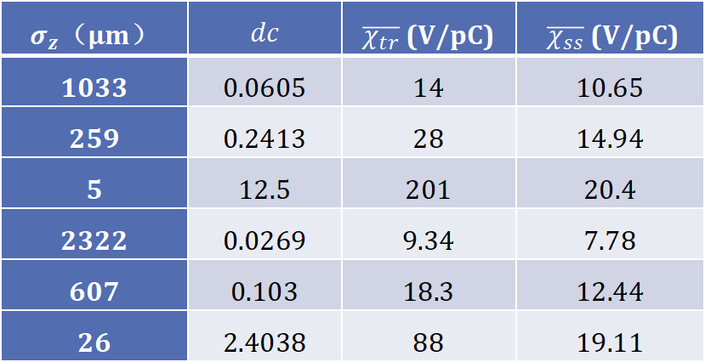
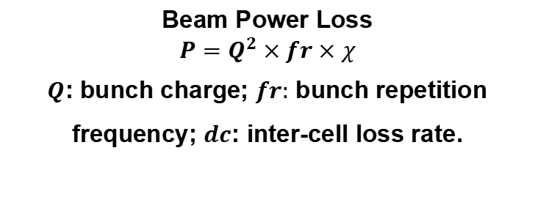
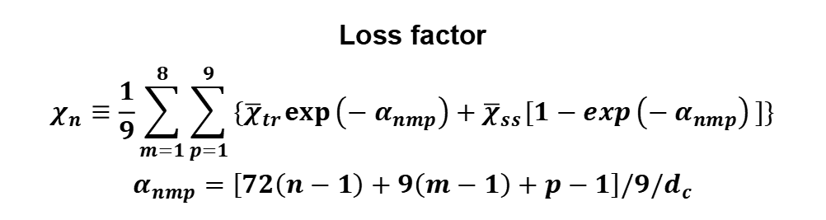
Loss Factor & HOM Power Loss
Loss factor
$$χ_{n}≡\frac{1}{9}\sum_{m=1}^{8}{\sum_{p=1}^{9}{\{{\overline{χ}}_{tr}\exp\left(−α_{nmp}\right)+{\overline{χ}}_{ss}[1−exp\left(−α_{nmp}\right)]\}}}$$
$$α_{nmp}=\left[72\left(n−1\right)+9\left(m−1\right)+p−1\right]/9{/d}_{c}$$
Beam Power Loss
$$P=Q^{2}×fr×χ$$
$Q$: bunch charge; $fr:$ bunch repetition frequency; $dc$: inter-cell loss rate.
$σ_{z}$（μm） | $$dc$$ | $\overline{χ_{tr}}$ (V/pC) | $\overline{χ_{ss}}$ (V/pC)
1033 | 0.0605 | 14 | 10.65
259 | 0.2413 | 28 | 14.94
5 | 12.5 | 201 | 20.4
2322 | 0.0269 | 9.34 | 7.78
607 | 0.103 | 18.3 | 12.44
26 | 2.4038 | 88 | 19.11

Slide 19
HOM power calculation of SHINE cryomodules
100pC，1MHz
Acc Sec, Bunch Length | Loss Factor HOM Power |  |  |  |  |  |  |  |  | CM #
L0，1.033mm | k,V/pC | 85.6 |  |  |  |  |  |  |  | 1
 | P, W | 0.86
L1，1.033mm | k,V/pC | 85.643 | 85.2 |  |  |  |  |  |  | 1-2
 | P, W | 0.85643 | 0.852
L2，0.259mm | k,V/pC | 123.45 | 119.52 | 119.52 | 119.52 | 119.52 | 119.52 | 119.52 | 119.52 | 1-8
 | P, W | 1.2345 | 1.1952 | 1.1952 | 1.1952 | 1.1952 | 1.1952 | 1.1952 | 1.1952
 | k,V/pC | 119.52 | 119.52 | 119.52 | 119.52 | 119.52 | 119.52 | 119.52 | 119.52 | 9-16
 | P, W | 1.1952 | 1.1952 | 1.1952 | 1.1952 | 1.1952 | 1.1952 | 1.1952 | 1.1952
 | k,V/pC | 119.52 | 119.52 |  |  |  |  |  |  | 17-18
 | P, W | 1.1952 | 1.1952

Slide 20
HOM power calculation of SHINE cryomodules
Acc Sec, Bunch Length | Loss Factor HOM Power |  |  |  |  |  |  |  |  | CM #
L3，5μm | k,V/pC | 1235.1 | 728.4 | 461.22 | 320.35 | 246.06 | 206.89 | 186.24 | 175.35 | 1-8
 | P, W | 12.351 | 7.284 | 4.6122 | 3.2035 | 2.4606 | 2.0689 | 1.8624 | 1.7535
 | k,V/pC | 169.61 | 166.58 | 164.98 | 164.14 | 163.7 | 163.46 | 163.34 | 163.27 | 9-16
 | P, W | 1.6961 | 1.6658 | 1.6498 | 1.6414 | 1.637 | 1.6346 | 1.6334 | 1.6327
 | k,V/pC | 163.24 | 163.22 | 163.21 | 163.21 | 163.2 | 163.2 | 163.2 | 163.2 | 17-24
 | P, W | 1.6324 | 1.6322 | 1.6321 | 1.6321 | 1.632 | 1.632 | 1.632 | 1.632
L4，5μm | k,V/pC | 1235.1 | 728.4 | 461.22 | 320.35 | 246.06 | 206.89 | 186.24 | 175.35 | 1-8
 | P, W | 12.351 | 7.284 | 4.6122 | 3.2035 | 2.4606 | 2.0689 | 1.8624 | 1.7535
 | k,V/pC | 169.61 | 166.58 | 164.98 | 164.14 | 163.7 | 163.46 | 163.34 | 163.27 | 9-16
 | P, W | 1.6961 | 1.6658 | 1.6498 | 1.6414 | 1.637 | 1.6346 | 1.6334 | 1.6327
 | k,V/pC | 163.24 | 163.22 | 163.21 | 163.21 | 163.2 | 163.2 | 163.2 | 163.2 | 17-24
 | P, W | 1.6324 | 1.6322 | 1.6321 | 1.6321 | 1.632 | 1.632 | 1.632 | 1.632
 | k,V/pC | 163.2 | 163.2 | 163.2 | 163.2 | 163.2 | 163.2 |  |  | 25-30
 | P, W | 1.632 | 1.632 | 1.632 | 1.632 | 1.632 | 1.632
100pC，1MHz
Notes:
At 1 00pC and 1MHz repetition frequency, the maximum transient HOM power is 12.4W;
At 300pC and 1MHz repetition frequency, the maximum transient HOM power is 28.5W.
The maximum transient HOM power is mainly generated in the first two low temperature superconducting accelerator modules of L3 and L4 straight line segment.

Slide 21
HOM power calculation of SHINE cryomodules
300pC，1MHz
Acc Sec, Bunch Length | Loss Factor HOM Power |  |  |  |  |  |  |  |  | CM #
L0，2.322mm | k,V/pC | 62.416 |  |  |  |  |  |  |  | 1
 | P, W | 5.6175
L1，2.322mm | k,V/pC | 62.416 | 62.24 |  |  |  |  |  |  | 1-2
 | P, W | 5.6175 | 5.6016
L2，0.607mm | k,V/pC | 100.51 | 99.52 | 99.52 | 99.52 | 99.52 | 99.52 | 99.52 | 99.52 | 1-8
 | P, W | 9.0456 | 8.9568 | 8.9568 | 8.9568 | 8.9568 | 8.9568 | 8.9568 | 8.9568
 | k,V/pC | 99.52 | 99.52 | 99.52 | 99.52 | 99.52 | 99.52 | 99.52 | 99.52 | 9-16
 | P, W | 8.9568 | 8.9568 | 8.9568 | 8.9568 | 8.9568 | 8.9568 | 8.9568 | 8.9568
 | k,V/pC | 99.52 | 99.52 |  |  |  |  |  |  | 17-18
 | P, W | 8.9568 | 8.9568
Notes:
At 1 00pC and 1MHz repetition frequency, the maximum transient HOM power is 12.4W;
At 300pC and 1MHz repetition frequency, the maximum transient HOM power is 28.5W.
The maximum transient HOM power is mainly generated in the first two low temperature superconducting accelerator modules of L3 and L4 straight line segment.

Slide 22
HOM power calculation of SHINE cryomodules
Acc Sec, Bunch Length | Loss Factor HOM Power |  |  |  |  |  |  |  |  | CM #
L3，26μm | k,V/pC | 316.26 | 158.74 | 153.09 | 152.89 | 152.88 | 152.88 | 152.88 | 152.88 | 1-8
 | P, W | 28.463 | 14.287 | 13.778 | 13.76 | 13.759 | 13.759 | 13.759 | 13.759
 | k,V/pC | 152.88 | 152.88 | 152.88 | 152.88 | 152.88 | 152.88 | 152.88 | 152.88 | 9-16
 | P, W | 13.759 | 13.759 | 13.759 | 13.759 | 13.759 | 13.759 | 13.759 | 13.759
 | k,V/pC | 152.88 | 152.88 | 152.88 | 152.88 | 152.88 | 152.88 | 152.88 | 152.88 | 17-24
 | P, W | 13.759 | 13.759 | 13.759 | 13.759 | 13.759 | 13.759 | 13.759 | 13.759
L4，26μm | k,V/pC | 316.26 | 158.74 | 153.09 | 152.89 | 152.88 | 152.88 | 152.88 | 152.88 | 1-8
 | P, W | 28.463 | 14.287 | 13.778 | 13.76 | 13.759 | 13.759 | 13.759 | 13.759
 | k,V/pC | 152.88 | 152.88 | 152.88 | 152.88 | 152.88 | 152.88 | 152.88 | 152.88 | 9-16
 | P, W | 13.759 | 13.759 | 13.759 | 13.759 | 13.759 | 13.759 | 13.759 | 13.759
 | k,V/pC | 152.88 | 152.88 | 152.88 | 152.88 | 152.88 | 152.88 | 152.88 | 152.88 | 17-24
 | P, W | 13.759 | 13.759 | 13.759 | 13.759 | 13.759 | 13.759 | 13.759 | 13.759
 | k,V/pC | 152.88 | 152.88 | 152.88 | 152.88 | 152.88 | 152.88 |  |  | 25-30
 | P, W | 13.759 | 13.759 | 13.759 | 13.759 | 13.759 | 13.759
300pC，1MHz
Notes:
At 1 00pC and 1MHz repetition frequency, the maximum transient HOM power is 12.4W;
At 300pC and 1MHz repetition frequency, the maximum transient HOM power is 28.5W.
The maximum transient HOM power is mainly generated in the first two low temperature superconducting accelerator modules of L3 and L4 straight line segment.

Slide 23
HOM power calculation of SHINE cryomodules
100 pC and 1 MHz, the maximum transient HOM power is 12.4 W;
300 pC and 1 MHz, the maximum transient HOM power is 28.5 W;
The maximum transient HOM power is mainly generated by the first two cryomodules at the beginning of the L3 and L4 sections of SHINE Linac;
Absorber Requirements:
Parameter name | Requirements
Overall size | 314 mm (room temperature)
HOM absorbing power | ≥ 100 W
Permeability | ≤ 1.05
Vacuum | ≤ 5×10⁻⁷ Pa
Vacuum leakage rate | ≤ 1×10⁻¹¹Pa·m³/s
Copper film thickness | 15 ±5 μm
RRR value of copper | 30~80
Notes:
When the electron beam is accelerated through the superconducting cavity, it will excite a variety of high-order modes in the cavity. The tail field effect will lead to the instability of the beam and even the collapse of the beam; at the same time, it will cause additional low-temperature power loss and increase the cooling power requirements of the low-temperature system.
Generally, a high-order mode coupler is used to effectively couple the confined mode in the cavity to the outside of the cavity; while the propagation mode above the cutoff frequency will propagate between the whole module cavity chain, and a bunch tube high-order mode absorber is used to effectively suppress it.
A total of 82 sets of tubular high-order mode absorbers were used in the SHINE injector and main linear accelerator.

Slide 24
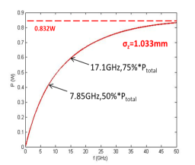
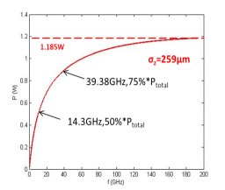
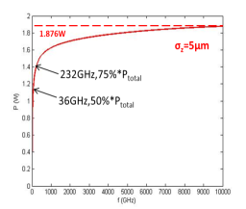
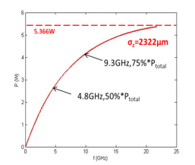
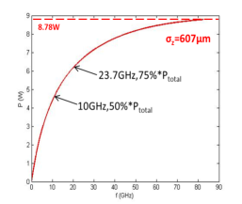
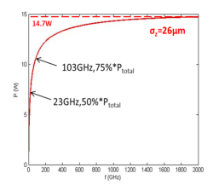
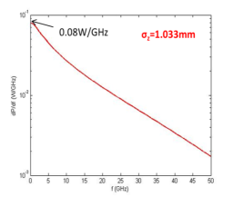
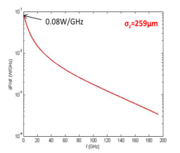
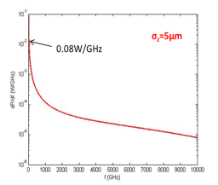
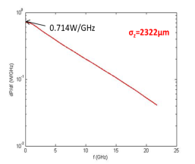
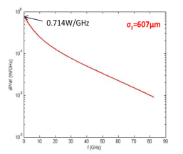




HOM power frequency distribution
$$dP\left(f\right)=\frac{dP}{df}×df$$
100pC, 1MHz | $σ_{z}$=1033μm | $σ_{z}$=259μm | $σ_{z}$=5μm
P_{total} ,W | 0.86，SS | 1.185，SS | 1.876，SS
P_{below f_cutoff} ,W | 0.2 | 0.2 | 0.2
P_{above f_cutoff} ,W | 0.66 | 0.985 | 1.676
f_{50%Ptotal} ,GHz | 7.85 | 14.3 | 36
f_{75%Ptotal} ,GHz | 17.1 | 39.4 | 232
300pC, 1MHz | $σ_{z}$=2322μm | $σ_{z}$=607μm | _{σ_z}=26μm
P_{total} ,W | 5.62 | 8.78 | 14.33
P_{below f_cutoff} ,W | 1.86 | 1.86 | 1.85
P_{above f_cutoff} ,W | 3.76 | 6.92 | 12.48
f_{50%Ptotal} ,GHz | 4.8 | 10 | 23
f_{75%Ptotal} ,GHz | 9.3 | 23.7 | 103
Integral
Differential

Slide 25


HOM Power distribution on vacuum components
absorber
Single Pass Simulation
Diffusion Modal
absorbing power ：
$$P_{k}≈\sum_{n=1}^{N}{\int_{ωc01}^{∞}{\frac{dP_{TM0n}}{dω}\frac{（1−S_{12,k}^{2}−S_{11,k}^{2})}{\sum_{k=1}^{6}{（1−S_{12,k}^{2}−S_{11,k}^{2}）}}dω}}$$
absorption efficiency ：
Ƞ = P ab / P(ω→∞ )
absorbing power ：
$$P_{i}=\int_{0}^{+∞}{\frac{dP\left(ω\right)}{dω}\frac{n_{i}∗S_{i}∗Re\left(𝒵_{i}\left(ω\right)\right)}{\sum_{j=1}^{3}{n_{j}∗S_{j}∗Re(𝒵_{i}\left(ω\right))}}dω}$$
Comp. | number | Surface area (mm²)
BLA | 1 | 1.4E+4
Cavity | 8 | 9E+5
Flanges | 18 | 2.4E+3
Bellows | 9 | 6.4E+4
Gate Valve | 2 | 2E+4
Pi
Vacuum components
Pr
Pt
Notes:
Single Pass * The power absorbed or coupled out by the component after a high-order mode field passes through the component once. It is described by S parameter.
Diffusion Model:
In a uniformly distributed photon gas in a vacuum component, the RF loss on the inner wall of the component is proportional to the number of photons contacting the inner wall.
1. Surface area and number of components;
2. Internal surface impedance of components
Beamline absorber

Slide 26
OUTLINE
Introduction of SHINE LINAC
HOM power calculation of SHINE LINAC
Preliminary structural design of HOM absorber
Layout plan of the SHINE HOM absorber

Slide 27

2. RF design of SHINE high order mode absorber
Calculation of structural design
Influence of geometric dimensions of absorbent material on absorption performance: length, radius, thickness
T ab
R ab
L ab

Slide 28




Length: 50 mm vs 100 mm
Absorption ratio~1: 1.6 @ $ε = 20$，tand = 0.4, single pass)
$$P_{ab/rad}≈\sum_{n=1}^{N}{\int_{ωc01}^{∞}{\frac{dP_{TM0n}}{dω}(1−S_{12}^{2}−S_{11}^{2})dω}}$$
Absorption efficiency of different absorbents at different bunch lengths ($R_{ab}=45$ mm)
$σ_{z}$（μ m） | 50 mm |  |  | 100 mm |  |  | Abs ratio
 | TM₀₁ | TM₀₂ | TM₀₃ | TM₀₁ | TM₀₂ | TM₀₃
1033 | 39.08% | 30.43% | 26.05% | 62.48% | 48.73% | 38.08% | 1： 1.60
259 | 38.87% | 33.18% | 30.40% | 62.53% | 53.54% | 46.30% | 1： 1.61
5 | 38.92% | 35.57% | 33.95% | 62.88% | 57.60% | 53.34% | 1： 1.62
2322 | 40.37% | 26.13% | 18.34% | 63.69% | 40.59% | 25.18% | 1： 1.58
607 | 38.91% | 31.58% | 27.95% | 62.39% | 50.78% | 41.54% | 1： 1.60
26 | 38.90% | 34.86% | 32.89% | 62.77% | 56.40% | 51.25% | 1： 1.61

Slide 29

Length: 50 mm vs 100 mm
Absorption ratio~1: 1.6 @ $ε = 20$，tand = 0.4, single pass
The longer the absorber, the greater the loss factor
For a short beam, the loss factor of 100 mm is 41% more
Loss factor of different absorbers at different bunch lengths
 | 5μm | 26μm
Absorber length, 50mm | 15V/ pC | 6.6V/ pC
Absorber length, 100mm | 21.2V/ pC | 9.3V/ pC
Ratio to module loss factor | 9%，13% | 4.3%，6.1%

Slide 30

Radius
Increase of the radius, decreased slightly of the efficiency
39mm to 45mm, decreased less than 1%
 |  |  | 100pC， 1MHz |  |  | 300pC, 1MHz
 | $σ_{z}$($μm$) |  | 1033 | 259 | 5 | 2322 | 607 | 26
TM₀₁ | Radius (mm) | 39 | 40.08% | 39.66% | 39.38% | 41.22% | 39.87% | 40.10%
 |  | 41 | 39.10% | 38.96% | 38.97% | 39.93% | 38.99% | 38.97%
 |  | 43 | 39.27% | 39.07% | 39.04% | 40.24% | 39.14% | 39.04%
 |  | 45 | 39.08% | 38.87% | 38.92% | 40.37% | 38.91% | 38.90%
TM₀₂ | Radius (mm) | 39 | 30.88% | 33.46% | 35.74% | 26.96% | 31.94% | 35.06%
 |  | 41 | 30.86% | 33.48% | 35.75% | 26.70% | 31.96% | 35.08%
 |  | 43 | 30.92% | 33.54% | 35.79% | 26.62% | 32.02% | 35.12%
 |  | 45 | 30.43% | 33.18% | 35.57% | 26.13% | 31.58% | 34.86%
TM₀₃ | Radius (mm) | 39 | 25.58% | 29.96% | 33.68% | 18.45% | 27.43% | 32.58%
 |  | 41 | 25.66% | 30.08% | 33.76% | 18.17% | 27.56% | 32.67%
 |  | 43 | 26.06% | 30.42% | 33.96% | 18.32% | 27.97% | 32.91%
 |  | 45 | 26.05% | 30.40% | 33.95% | 18.34% | 27.95% | 32.89%
Absorption efficiency of different absorbers with different radii and at different bunch lengths.
Absorbing material: 50mm long, 10mm thick, Re (ε) =20, loss tangent tand=0.4.

Slide 31


Radius
Increase of the radius, decreased slightly of the efficiency
39mm to 45mm, decreased less than 1%
Loss factor varies with different bunch lengths. long bunch (259μm and 607μm), minimum at 43-45mm.
According to the empirical formula of the diffraction model, $Δ=R_{ab}−R_{iris}≥\sqrt{5∗L∗σ_{z}}$, for short beam bunch (5μm and 26μm), radius of the absorber should be greater than 41.5mm.
$σ_{z}$ (μm) | The loss factor (V/pC) varies with the inner diameter absorbed, ε=20
 | $R_{ab}$=39 mm | $R_{ab}$=41 mm | $R_{ab}$=43 mm | $R_{ab}$=45 mm | $R_{ab}$=47 mm
1033 | 0.92993 | 0.87958 | 0.90354 | 0.9332 | 0.94503
259 | 2.6377 | 2.0861 | 1.9865 | 1.9832 | 1.9832
5 | - | 21.2 | 21.2 | 21.2 | 21.2
2322 | 0.45857 | 0.45342 | 0.4940 | 0.53684 | 0.56696
607 | 1.4080 | 1.2746 | 1.2486 | 1.2576 | 1.2613
26 | - | - | 9.3 | 9.3 | 9.3
Loss factor of different absorbers with different radii and at different bunch lengths.
Absorbing material: 50mm long, 10mm thick, Re (ε) =20, loss tangent tand=0.4.
Notes:
According to the empirical formula of the diffraction model, $Δ=R_{ab}−R_{iris}≥\sqrt{5∗L∗σ_{z}}$, for short beam bunch (5μm and 26μm), the difference between the radius of the absorber and the radius of the beam tube is related to the length of the short beam bunch, and the radius of the absorber should be greater than 41.5mm.

Slide 32

Thickness
 |  |  | 100pC， 1MHz |  |  | 300pC, 1MHz
 | $σ_{z}$($μm$) |  | 1033 | 259 | 5 | 2322 | 607 | 26
TM₀₁ | Thickness (mm) | 4 | 25.65% | 29.72% | 33.53% | 20.76% | 27.24% | 32.39%
 |  | 6 | 26.05% | 30.04% | 33.73% | 20.91% | 27.64% | 32.62%
 |  | 8 | 28.17% | 31.50% | 34.58% | 23.91% | 29.49% | 33.66%
 |  | 10 | 29.96% | 32.74% | 35.31% | 26.47% | 31.06% | 34.54%
 |  | 12 | 31.52% | 33.81% | 35.94% | 28.73% | 32.42% | 35.30%
 |  | 14 | 32.16% | 34.24% | 36.20% | 29.65% | 32.98% | 35.61%
 |  | 16 | 32.30% | 34.34% | 36.26% | 29.77% | 33.10% | 35.69%
TM₀₂ | Thickness (mm) | 4 | 21.59% | 26.97% | 31.91% | 14.64% | 23.73% | 30.44%
 |  | 6 | 25.58% | 29.74% | 33.54% | 20.10% | 27.24% | 32.41%
 |  | 8 | 25.02% | 29.38% | 33.34% | 19.10% | 26.77% | 32.15%
 |  | 10 | 27.29% | 30.95% | 34.26% | 22.21% | 28.77% | 33.27%
 |  | 12 | 26.92% | 30.70% | 34.11% | 21.59% | 28.45% | 33.10%
 |  | 14 | 28.16% | 31.56% | 34.62% | 23.33% | 29.55% | 33.71%
 |  | 16 | 28.20% | 31.59% | 34.64% | 23.35% | 29.58% | 33.73%
TM₀₃ | Thickness (mm) | 4 | 23.17% | 28.19% | 32.63% | 15.88% | 25.22% | 31.31%
 |  | 6 | 23.26% | 28.30% | 32.70% | 15.71% | 25.35% | 31.39%
 |  | 8 | 23.16% | 28.23% | 32.66% | 15.60% | 25.26% | 31.34%
 |  | 10 | 24.33% | 29.05% | 33.15% | 17.02% | 26.30% | 31.93%
 |  | 12 | 24.84% | 29.42% | 33.37% | 17.62% | 26.77% | 32.20%
 |  | 14 | 24.63% | 29.27% | 33.28% | 17.33% | 26.58% | 32.08%
 |  | 16 | 24.81% | 29.40% | 33.36% | 17.56% | 26.74% | 32.18%
absorption efficiency increases with thickness, and tends to a stable value;
If the yield depth of the material is smaller, for a certain constant thickness of the material, it is closer to the stable value;
>10mm, the absorption efficiency increases at a lower rate
The ratio of 10mm to 16mm is ~0.93.
The material has maximum yield depth when using Re(ε)=20, loss tangent tand=0.1, inner diameter 78mm and length 50mm

Slide 33


Dielectric constant and loss tangent
Example: 78mm inner diameter, 10mm thickness and 50mm length, single pass, without considering the radiation loss of coupler
Basically, absorption decreases with increase Re(ε), and increases with loss tangent
Re(ε) = 50, tand= 0.1, minimum absorption efficiency
The dielectric constant and loss tangent outside this range will cause the HOM $Q_{ab}> 1E5$in the cavity, which does not meet the beam threshold requirements.
Absorption efficiency calculated by single pass method (considering mode conversion)
Absorbent material parameters | 100pC， 1MHz |  |  | 300pC, 1MHz
 | $$σ_{z} \text{(}μm\text{)}$$ |  |  | $σ_{z}$ ($μm$)
 | 1033 | 259 | 5 | 2322 | 607 | 26
ε=50， tand=0.4 | 31.11% | 30.93% | 30.91% | 31.84% | 30.98% | 30.91%
ε=50，tand=0.3 | 31.26% | 31.07% | 31.06% | 32.03% | 31.13% | 31.06%
ε=50，tand=0.2 | 27.69% | 27.63% | 27.63% | 27.93% | 27.65% | 27.63%
ε=50，tand=0.1 | 24.37% | 24.39% | 24.40% | 24.24% | 24.39% | 24.40%
ε=40，tand=0.1 | 25.42% | 25.47% | 25.48% | 25.20% | 25.46% | 25.48%
ε=30，tand=0.1 | 26.36% | 26.45% | 26.45% | 25.98% | 26.42% | 26.45%
ε=20，tand=0.1 | 27.35% | 27.40% | 27.67% | 26.81% | 27.35% | 27.67%
ε=10，tand=0.1 | 28.63% | 28.95% | 29.05% | 28.52% | 28.93% | 29.05%
Therefore, considering the absorption efficiency and beam threshold, the material characteristic parameters can be determined as: Re（ε）＜ 50， tand ＞ 0.1

Slide 34



HOM power distribution
HOM Coupler
Power Coupler
HOM Absorber, 50 mm
Using the Single Pass Simulation method, the HOM power distribution ratios of beam elements such as HOM absorbers, high-power couplers, and beam elements under two conditions (with and without copper coating on the stainless-steel substrate, with inner diameter of 90mm and thickness of 10mm, and dielectric constant real part Re(ε) = 50, loss tangent value tand = 0.1) were obtained:

Slide 35












HOM power distribution
HOM Absorber, 50 mm
HOM Coupler
Power Coupler
S₂₁, TM₀₁
S₃₁, TM₀₁
S₃₁, TM₀₁
S₂₁, TM₀₂
S₃₁, TM₀₂
S₃₁, TM₀₂
S₂₁, TM₀₃
S₃₁, TM₀₃
S₃₁, TM₀₃

Slide 36

Surface Material
 | Stainless steel vacuum tube wall |  |  |  |  |  | Copper-plated vacuum tube wall
 | 100pC，1MHz |  |  | 300pC，1MHz |  |  | 100pC，1MHz |  |  | 300pC，1MHz
$σ_{z}$（μm） | 1033 | 259 | 5 | 2322 | 607 | 26 | 1033 | 259 | 5 | 2322 | 607 | 26
HOM absorber | 52.31 | 54.00 | 54.12 | 46.48 | 53.48 | 54.12 | 57.98 | 60.14 | 60.30 | 50.77 | 59.47 | 60.29
Power Coupler | 21.77 | 20.10 | 19.98 | 27.03 | 20.62 | 19.98 | 23.22 | 21.47 | 21.35 | 28.72 | 22.02 | 21.35
HOM Coupler | 16.97 | 16.49 | 16.46 | 18.84 | 16.63 | 16.46 | 18.41 | 17.98 | 17.95 | 20.21 | 18.11 | 17.95
Bellow | 7.82 | 8.22 | 8.25 | 6.69 | 8.10 | 8.25 | 0.33 | 0.36 | 0.36 | 0.26 | 0.35 | 0.36
Flange | 0.59 | 0.62 | 0.62 | 0.50 | 0.61 | 0.62 | 0.02 | 0.03 | 0.03 | 0.02 | 0.03 | 0.03
Valve | 0.54 | 0.57 | 0.57 | 0.46 | 0.56 | 0.57 | 0.02 | 0.02 | 0.02 | 0.02 | 0.02 | 0.02
The application of copper plating can significantly reduce the HOM absorption power of components, such as inter-cavity bellows by approximately 23 times compared to pure stainless steel. The copper plating on stainless steel can also greatly reduce the low-temperature load of 2K.

Slide 37


Design of the structure
Based on the simulation, the cost of the material and the difficulty of processing, …
Absorber structure size: inner diameter * outer diameter * length =90*110*50mm
Dielectric parameter of absorbing material: Re (ε) <50, tand> 0.1
Mechanical design of the SHINE HOM absorber

Slide 38


SHINE HOM Absorber
The SHINE HOM Absorber and the Installation

Slide 39
OUTLINE
Introduction of SHINE LINAC
HOM power calculation of SHINE LINAC
Preliminary structural design of HOM absorber
Layout plan of the SHINE HOM absorber

Slide 40

Installation layout
Schematic diagram of main accelerator structure of hard X-ray free electron laser device
Injection tube section:
1.3GHz eight-chamber module tail: 0 sets (no longer installed due to lack of installation space).
Linear accelerator section:
L1: 1 beginning; 2 of 1.3GHz modules and 2 of 3.9GHz modules; 1 end; total 5
L2: 1 beginning; 18 of 1.3GHz modules; 1 end; total 19
L3: 1 beginning; 10 of 1.3GHz modules; 1 end; total 11
L4: 1 beginning; 24 of 1.3GHz modules; 1 end; total 25
A total of 60 sets!

Slide 41

Thank you for your attention！

Slide 42
1.Plan for the next steps
Carry out the development of the first high-order mode absorber of SHINE project:
Absorbent body size:
Inner diameter: 90mm, outer diameter: 110mm, length: 50mm
Two different absorbent materials:
Imported SiC ceramic: Model SC 35
Domestic ALN ceramics: nanocarbon doping
Two high order mode absorber schemes:
SiC scheme high order mode absorber
High order mode absorber for domestic ALN scheme
Manufacturing process plan:
Brazing process
Developed quantity:
There are two sets of absorber scheme.

