Slide 1

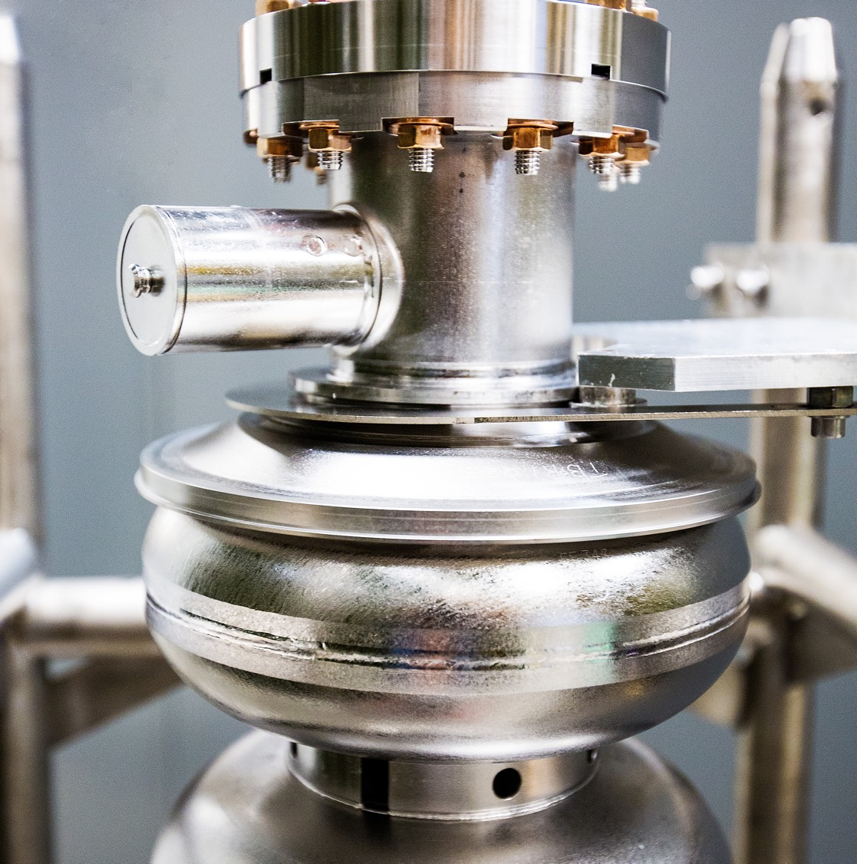
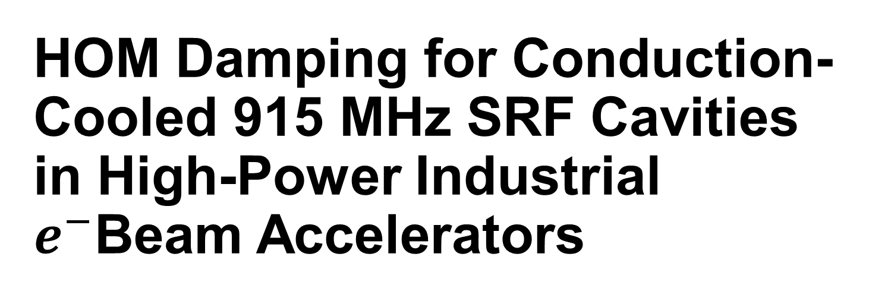
HOM Damping for Conduction-Cooled 915 MHz SRF Cavities in High-Power Industrial $e^{−}$Beam Accelerators
International Workshop on Higher Order Modes in Superconducting Cavities -DESY
Alex Castilla, G. Ciovati, and J. Vennekate

Slide 2
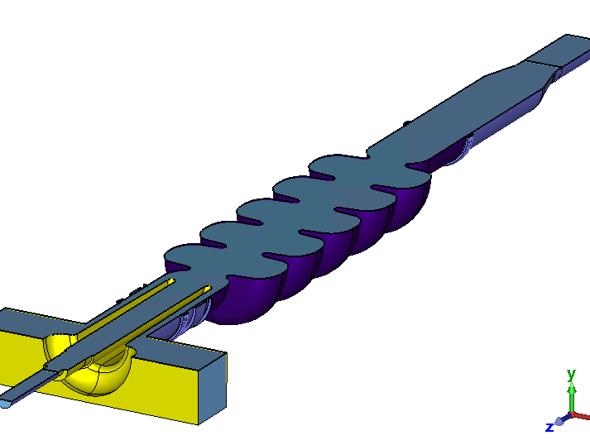
Outline
Motivation
Constraints
Pre-checks
Analysis
Preliminary conclusions*
*Disclaimer: this is a work in progress

Slide 3
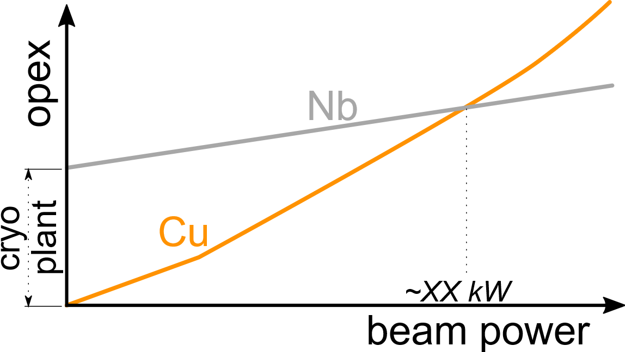
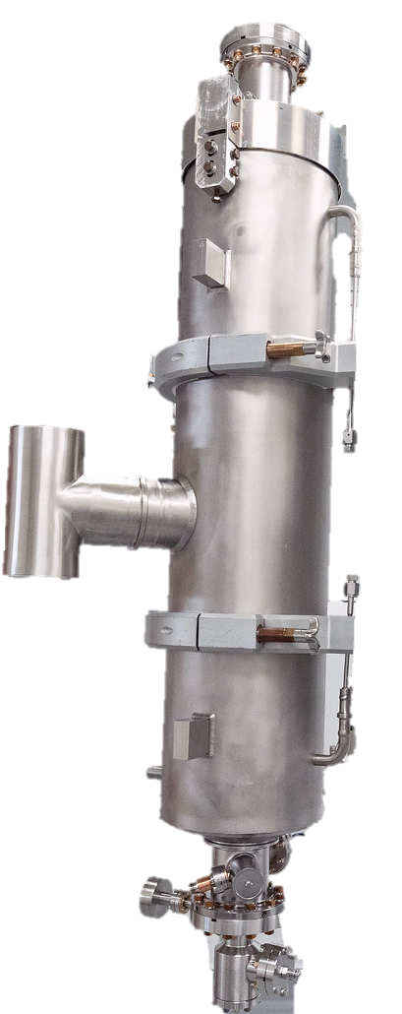
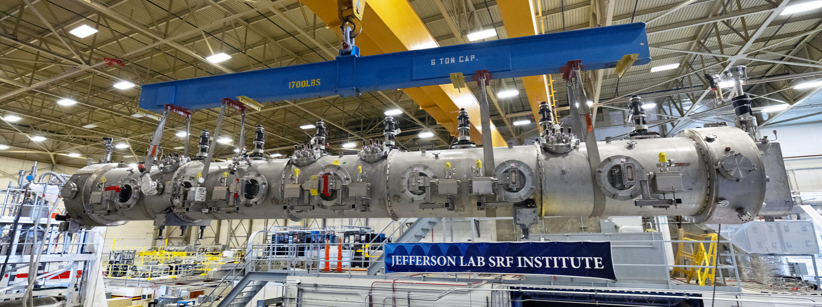
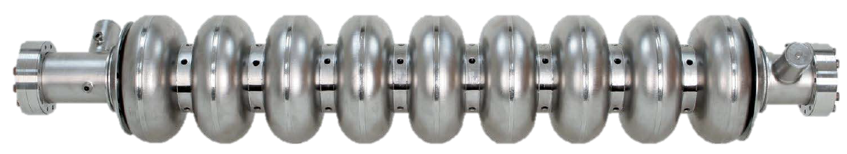
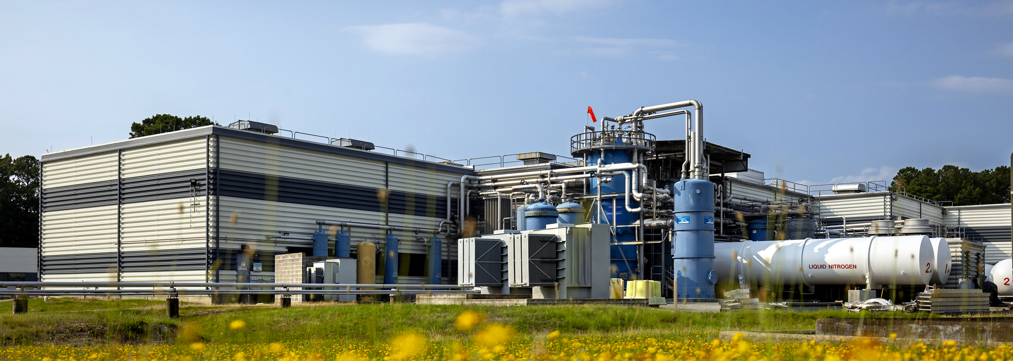
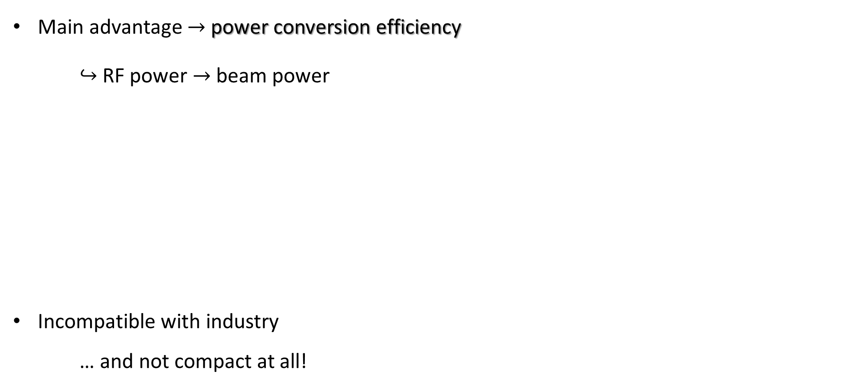
Why SRF and what does it look like
Main advantage $→$ power conversion efficiency
$↪$ RF power $→$ beam power
Incompatible with industry
… and not compact at all!

Slide 4
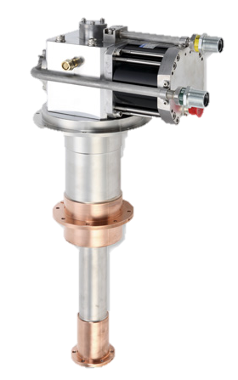
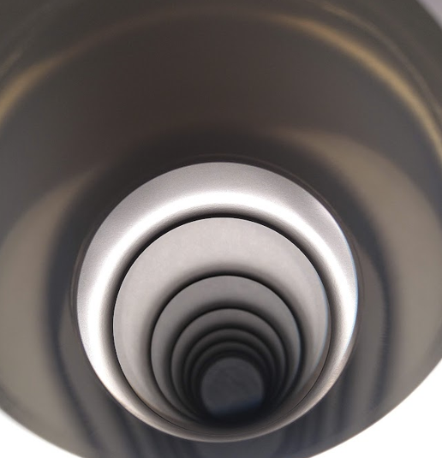
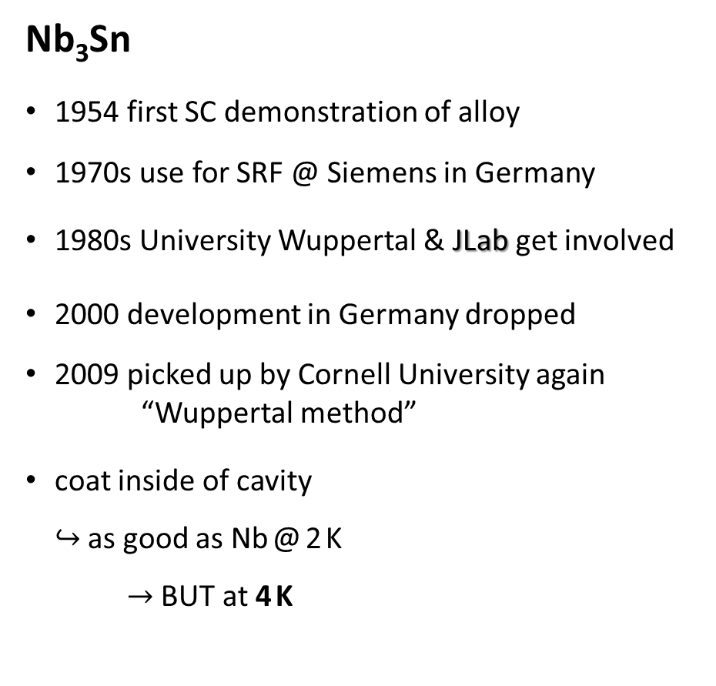
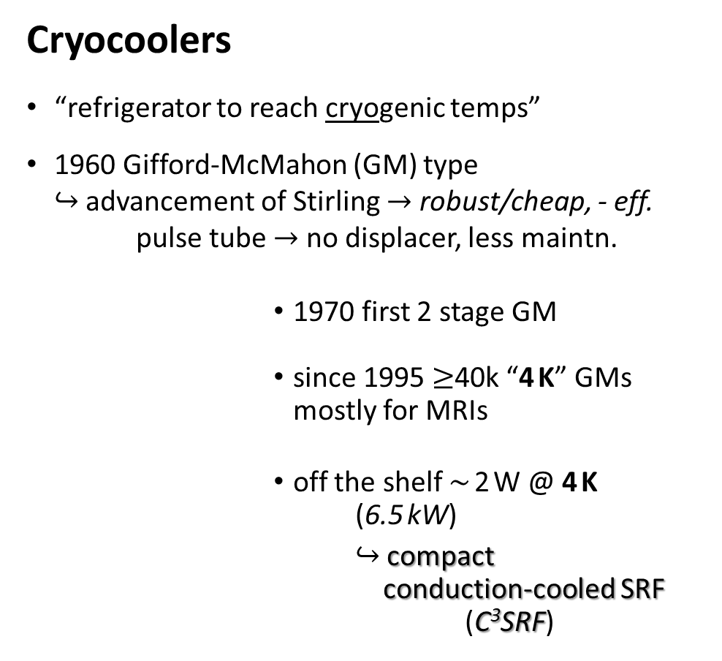
Key Technologies to go “compact”
Nb₃Sn
1954 first SC demonstration of alloy
1970s use for SRF @ Siemens in Germany
1980s University Wuppertal & JLab get involved
2000 development in Germany dropped
2009 picked up by Cornell University again
“Wuppertal method”
coat inside of cavity
$↪$ as good as Nb @ 2 K
$→$ BUT at 4 K
Cryocoolers
“refrigerator to reach cryogenic temps”
1960 Gifford-McMahon (GM) type
$↪$ advancement of Stirling $→$ robust/cheap, - eff.
pulse tube $→$ no displacer, less maintn.
          1970 first 2 stage GM
          since 1995 $≥$40k “4 K” GMs
          mostly for MRIs
          off the shelf $\sim$ 2 W @ 4 K (6.5 kW)
          $↪$ compact
          conduction-cooled SRF (C³SRF)
©Sumitomo Heavy Industries

Slide 5
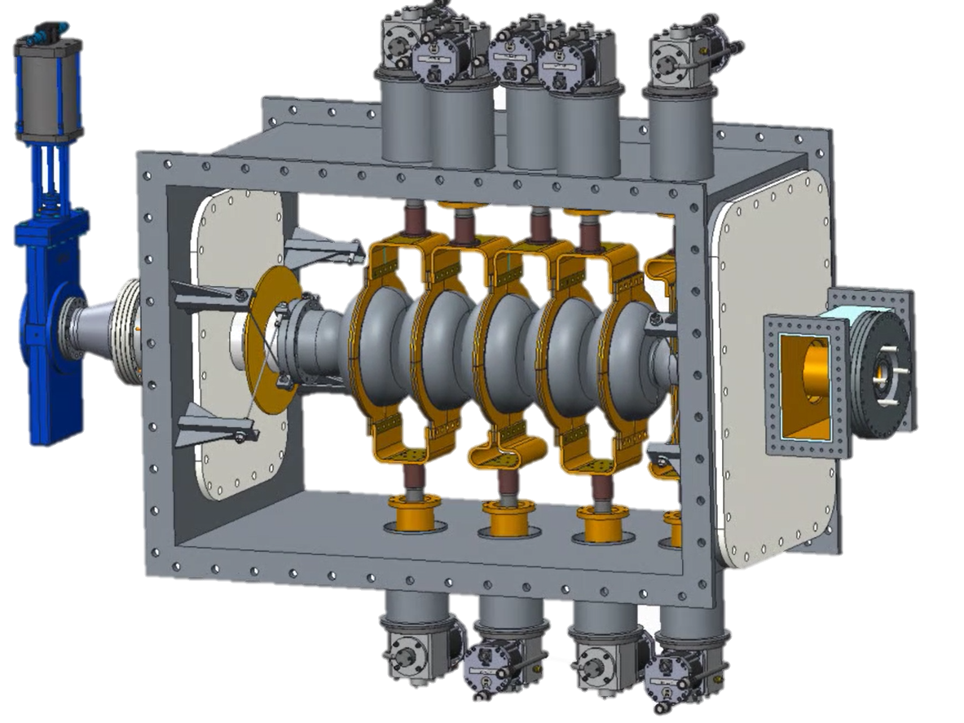
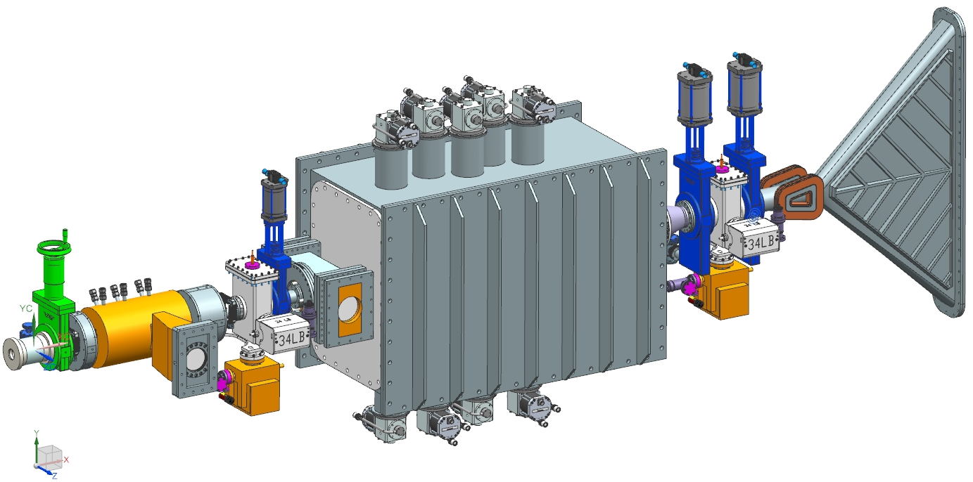
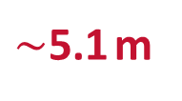
C³ SRF – Conceptual design
Concept for compact 10 MeV & 1 MW irradiation machine
Similar designs under advanced development (e.g. FNAL, Cornell)
Cryomodule
FPC
Solenoids
Beam
Exit
Window
Deflecting
Magnets
Source
Booster
Cryocoolers
$\sim$5.1 m

Slide 6
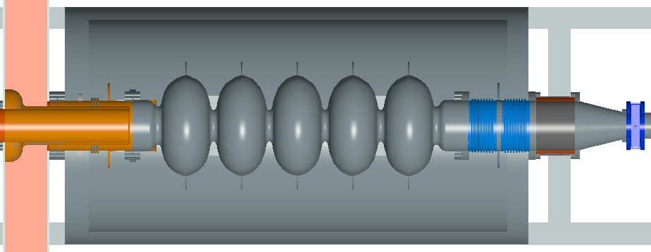
This imposes some constraints…
BLA
Coax FPC
~200mm
<2m
To keep it compact, a BLA can be places right outside the vacuum vessel. Too far?.
Cryo coolers can only handle a couple of Watts of thermal load each at the 4K stage
100 mA and beam requirements for irradiation not as restrictive
Can we then live w/o damping? (see previous talk by A. Lunin)

Slide 7
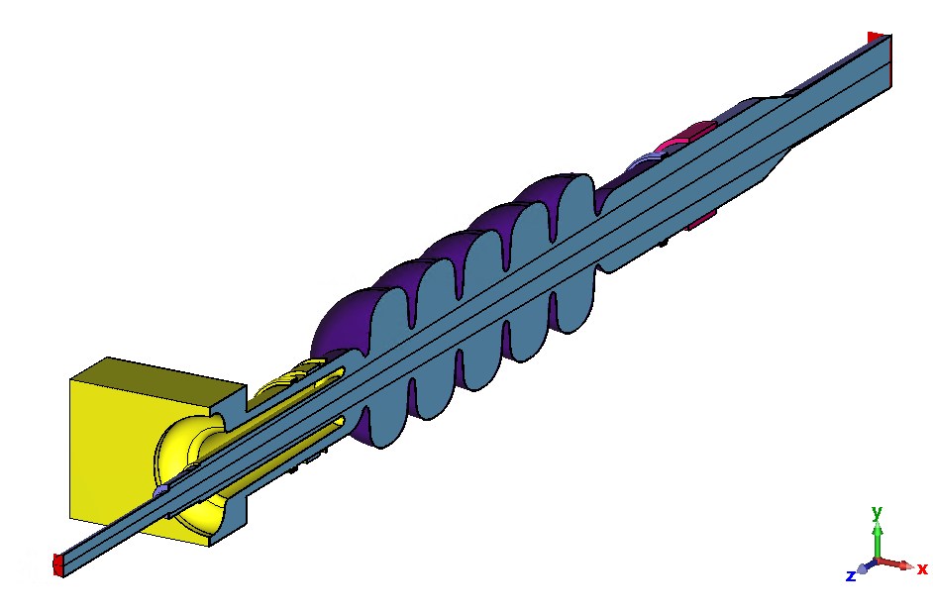
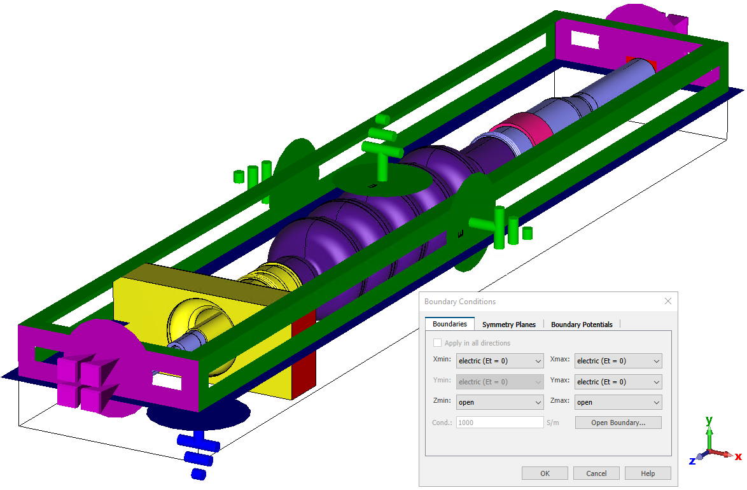
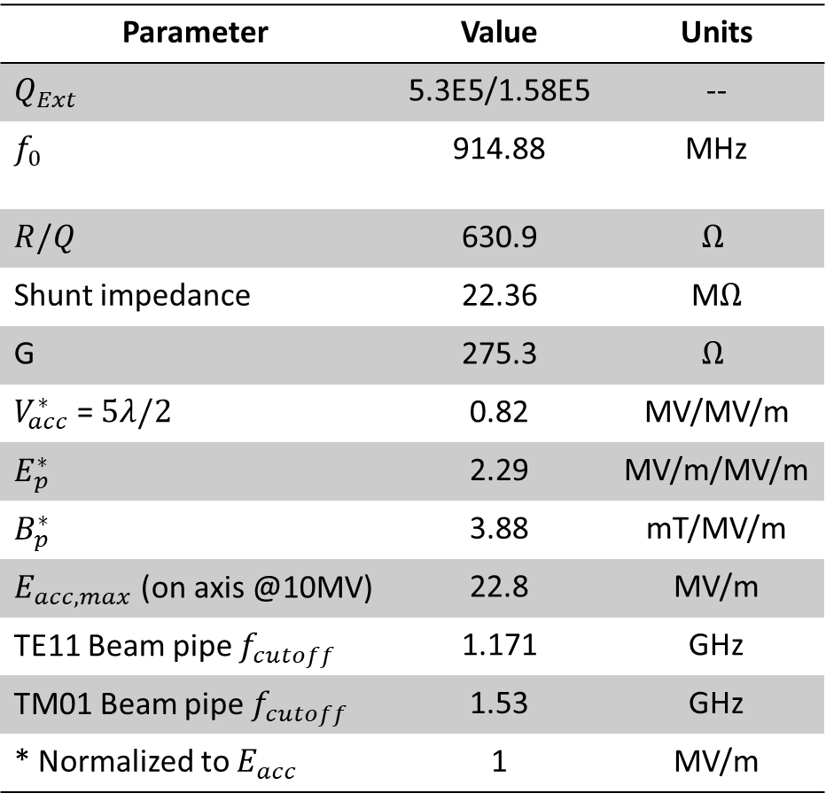
5 cell model
Parameter | Value | Units
$$Q_{Ext}$$ | 5.3E5/1.58E5 | --
$$f_{0}$$ | 914.88 | MHz
$$R/Q$$ | 630.9 | $$Ω$$
Shunt impedance | 22.36 | M$Ω$
G | 275.3 | $$Ω$$
$V_{acc}^{∗}$ = $5λ/2$ | 0.82 | MV/MV/m
$$E_{p}^{∗}$$ | 2.29 | MV/m/MV/m
$$B_{p}^{∗}$$ | 3.88 | mT/MV/m
$$E_{acc,max}\text{ (}\text{on} \text{axis}\text{ @10}\text{MV}\text{)}$$ | 22.8 | MV/m
TE11 Beam pipe $f_{cutoff}$ | 1.171 | GHz
TM01 Beam pipe $f_{cutoff}$ | 1.53 | GHz
* Normalized to $E_{acc}$ | 1 | MV/m

Slide 8
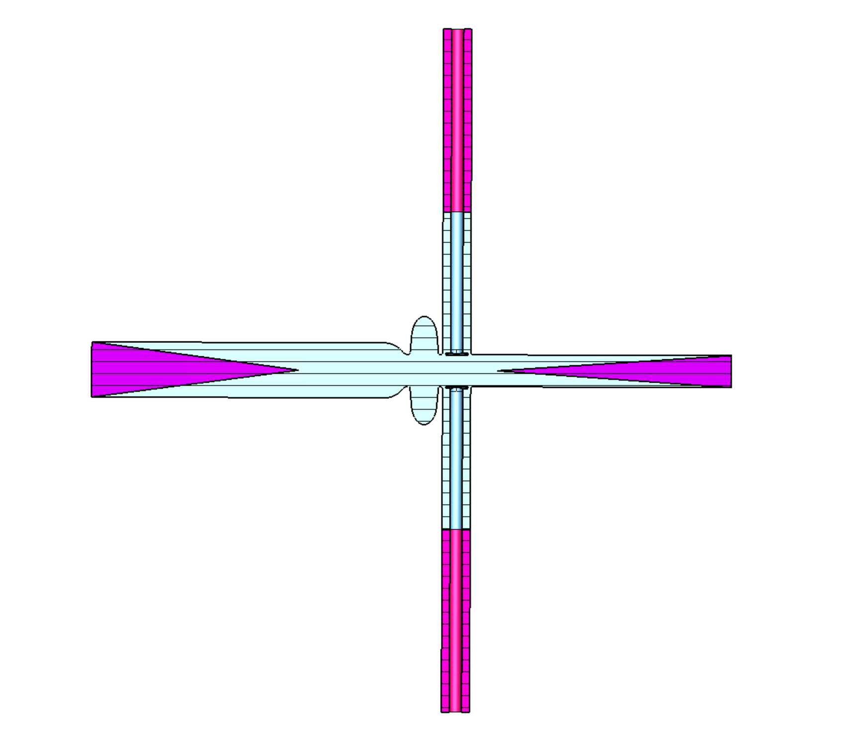
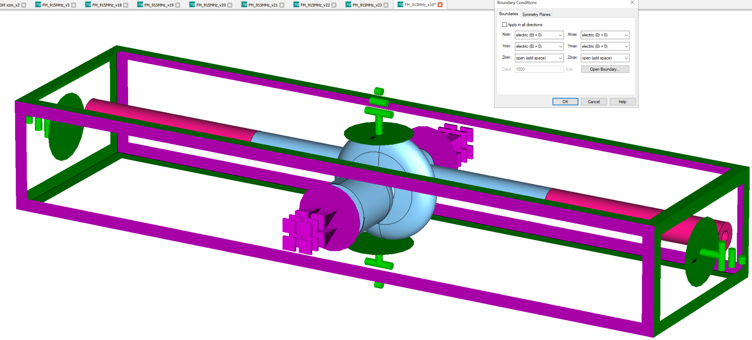
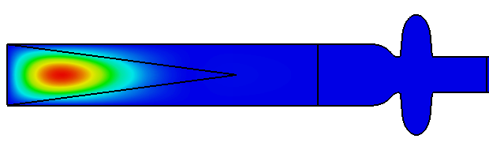
Pre-checks
The use of open boundaries offers similar results (in my experience) when using the lossy Eigen solver in later versions of CST.
Still finicky, can’t handle lossy backgrounds.
WG ports also seem more robust
The use of fake absorbers has proven to be a good method to overcome spurious reflections and other numerical artifacts.
Lots of low-Q unphysical modes

Slide 9
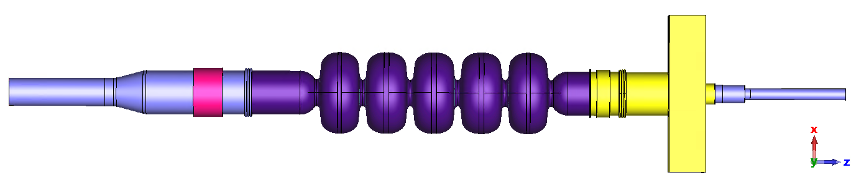
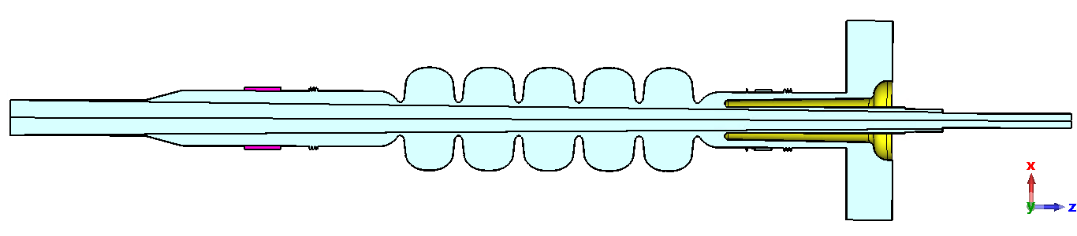
5 cell 3D model
Some technical details:
  Added some extension pipes.
  Added some denser mesh “dummy volumes” near the beam axis.
  Using XZ-symmetry plane (from the beam viewpoint, the structure is virtually axially symmetric).
  Added materials to different sections (wakefield simulations).
  Compared with and w/o a 3 in BLA based on the SiC35 JLab material data.
  Eigenmode simulations are done with all PEC and PEC+BLA, respectively.

Slide 10
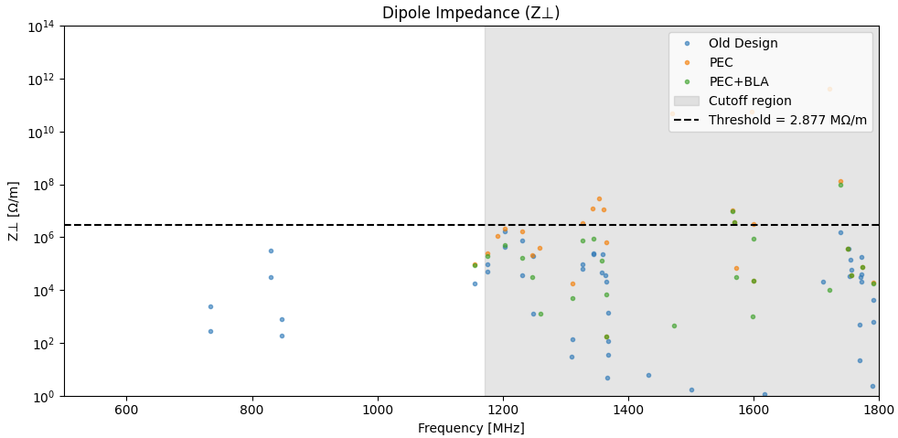
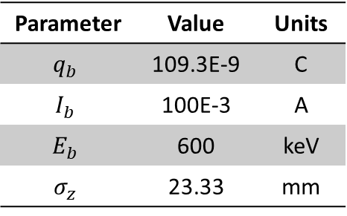
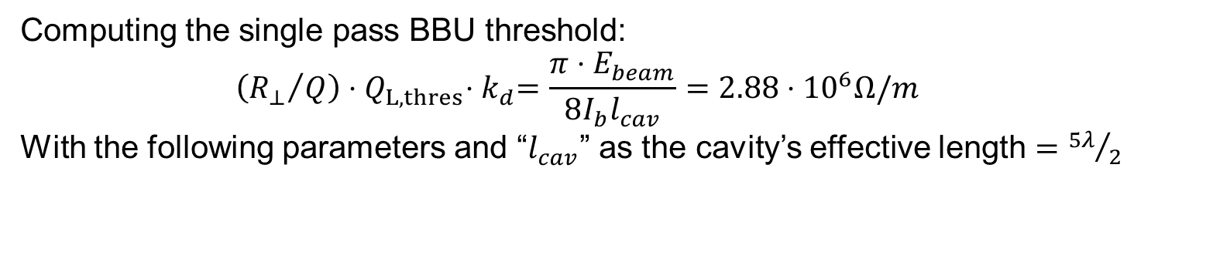
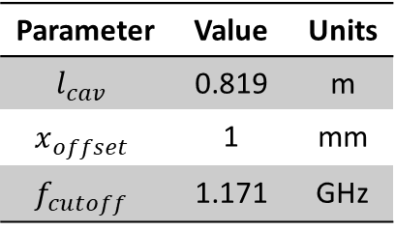
Undamped Dipoles
Computing the single pass BBU threshold:
$$\left({R_{⊥}}/Q\right){⋅Q}_{L,thres}{⋅k}_{d}=\frac{π⋅E_{beam}}{8I_{b}l_{cav}}=2.88⋅{10}^{6}Ω/m$$
With the following parameters and “$l_{cav}$” as the cavity’s effective length $={5λ}/2$
Parameter | Value | Units
$$q_{b}$$ | 109.3E-9 | C
$$I_{b}$$ | 100E-3 | A
$$E_{b}$$ | 600 | keV
$$σ_{z}$$ | 23.33 | mm
Parameter | Value | Units
$$l_{cav}$$ | 0.819 | m
$$x_{offset}$$ | 1 | mm
$$f_{cutoff}$$ | 1.171 | GHz

Slide 11
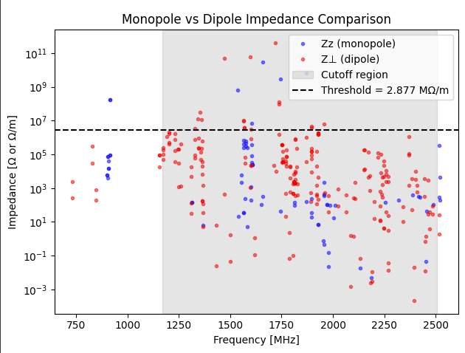
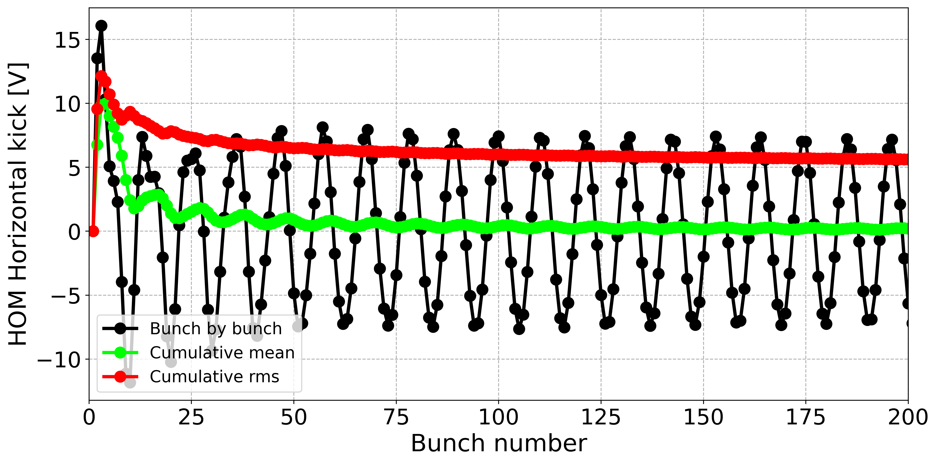
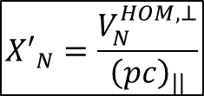
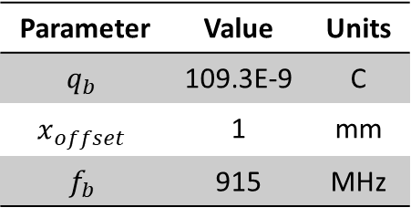

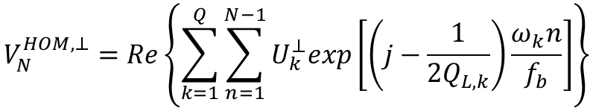
Undamped HOMs
$$V_{N}^{HOM,⊥}=Re\left\{\sum_{k=1}^{Q}{\sum_{n=1}^{N−1}{U_{k}^{⊥}exp\left[\left(j−\frac{1}{2Q_{L,k}}\right)\frac{ω_{k}n}{f_{b}}\right]}}\right\}$$
Parameter | Value | Units
$$q_{b}$$ | 109.3E-9 | C
$$x_{offset}$$ | 1 | mm
$$f_{b}$$ | 915 | MHz
$$U_{k}^{⊥}\left(t\right)=\frac{1}{2}jcq_{b}{\left(r/Q\right)}_{⊥}x_{offset}$$
$${X′}_{N}=\frac{V_{N}^{HOM,⊥}}{{\left(pc\right)}_{||}}$$
Using the method described by R. C. Dhuley, et al., for the analysis of their 650 MHz design with similar constraints [1]. We computed the transverse voltages seen by bunch N due to the previous bunches. Determining that it does not impose a problem for the short linac.
[1] R. C. Dhuley, et al., “Design of a 10 MeV, 1000 kW ave. power electron beam accelerator for wastewater treatment applications”, PRAB 25, 041601 (2022)

Slide 12
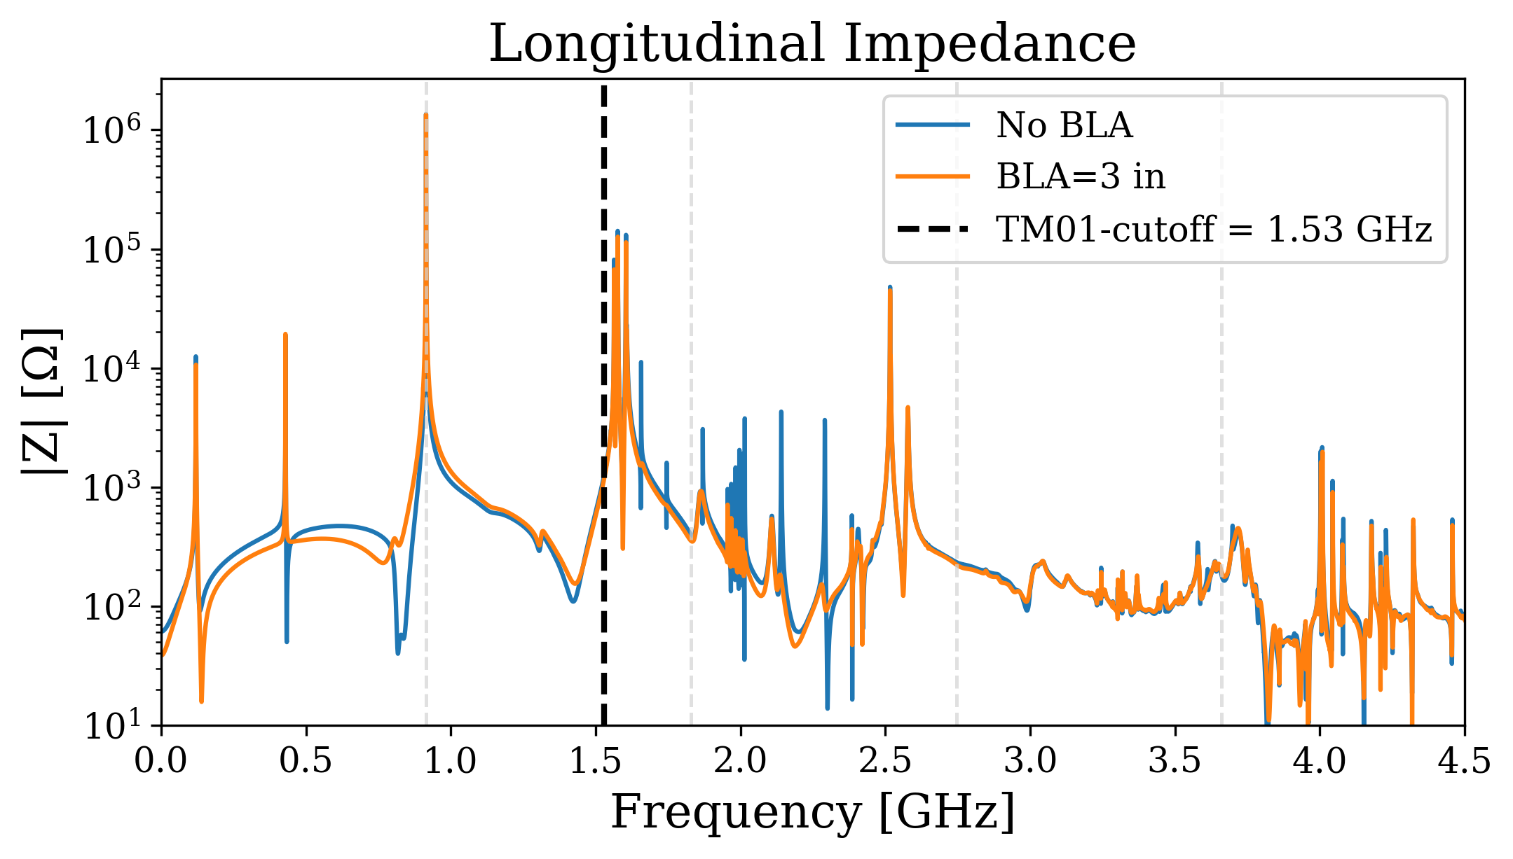
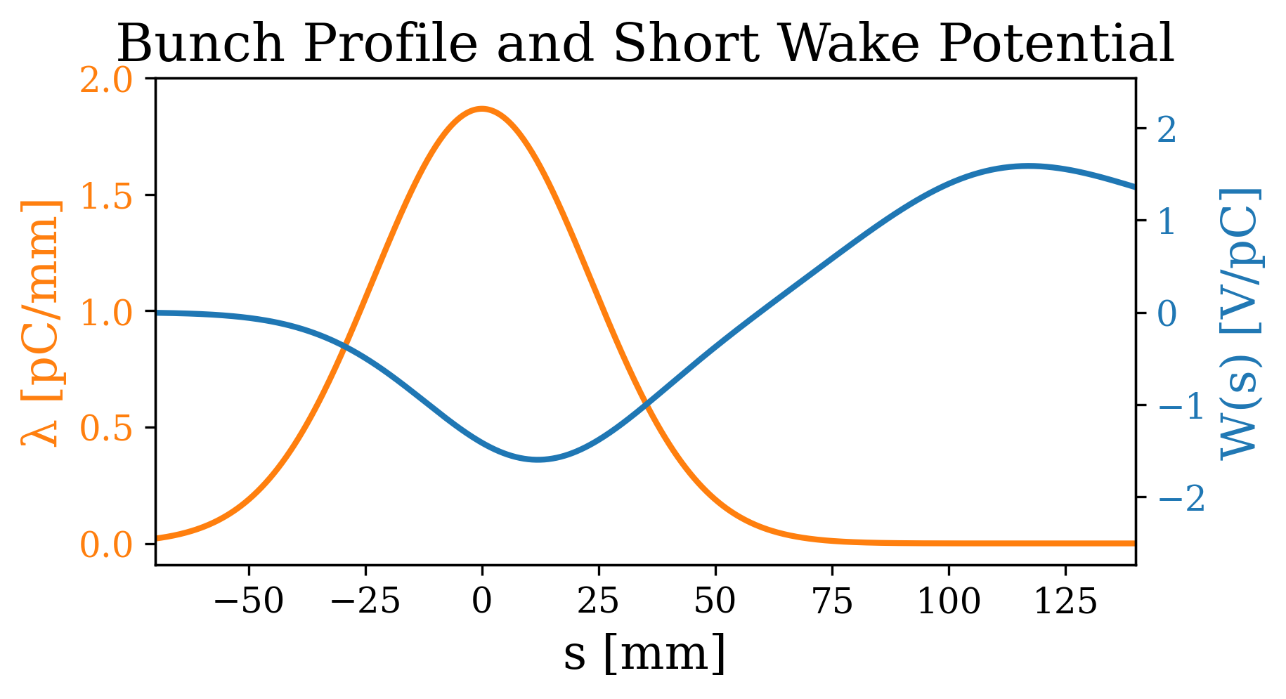
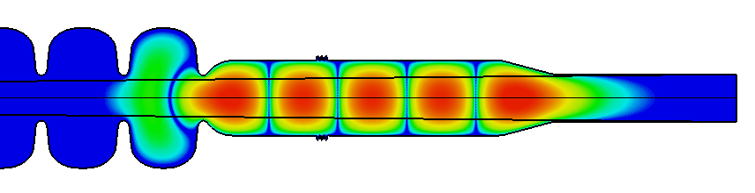
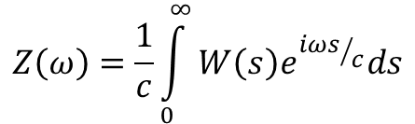
Monopole Wakes
$$Z\left(ω\right)=\frac{1}{c}\int_{0}^{∞}{W\left(s\right)e^{{iωs}/c}ds}$$
Short range wakes similar with & w/o BLA.
Damping of monopoles by the BLA is limited (too far away? But also: so what?)
Beam lines are shown in light dashed vertical lines.
BLA mostly acting on modes trapped in that beampipe section, as expected!

Slide 13
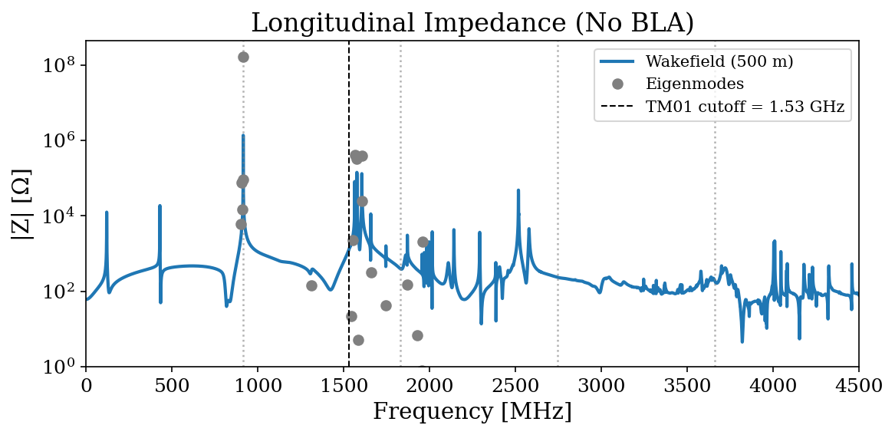
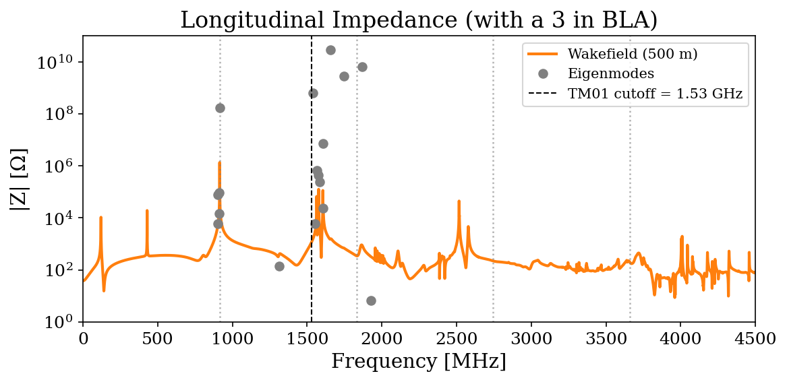

Monopole Impedances
$$Z_{||,i}=\frac{1}{2}{\left(R/Q\right)}_{||,i}Q_{L,i}e^{−{\left({ωσ_{z}}/c\right)}^{2}}$$
The eigenmode impedances (after filtering with bunch shape) are still higher than the impedances computed from the FFT of the CST raw wake potential.
Tried [and failed] to estimate the power exiting the pipes using ports during the wake sims.
Refinement to the analysis may be possible using a hybrid method.
Eigenmode, only takes into account modes with Q>10.

Slide 14
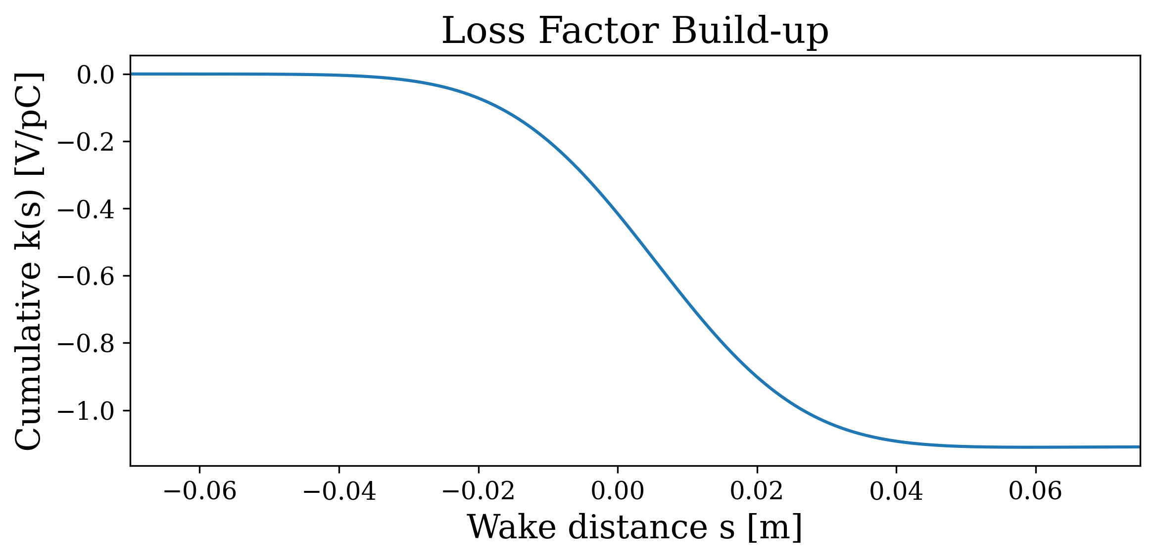
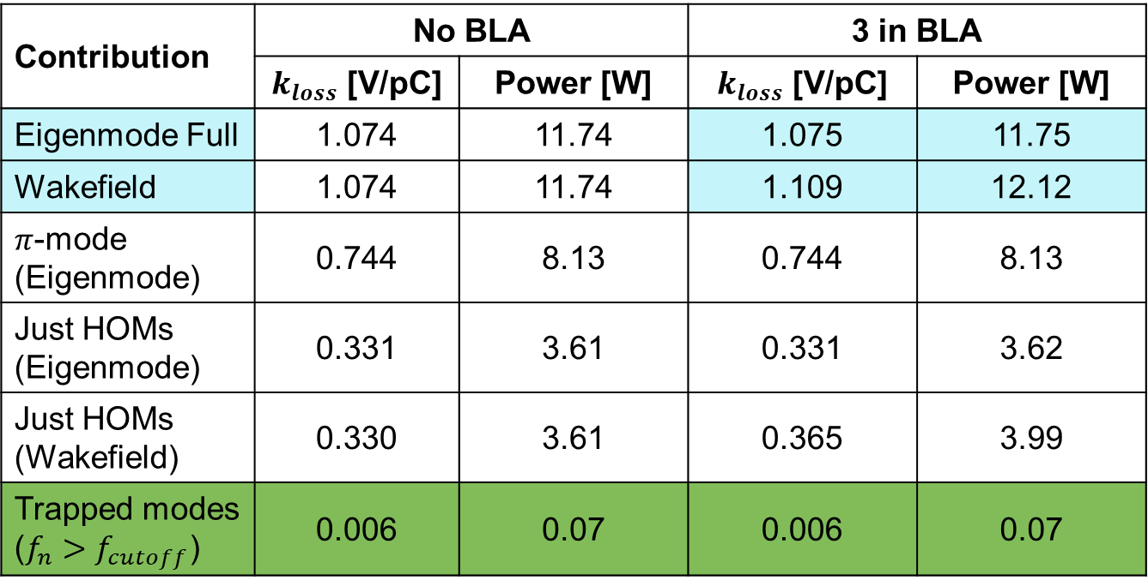

Power deposition
$$k_{loss,i}=\frac{1}{4}ω_{i}{\left(R/Q\right)}_{i}e^{−{\left({ω_{i}σ_{z}}/c\right)}^{2}}$$
Contribution | No BLA |  | 3 in BLA
 | $k_{loss}$ [V/pC] | Power [W] | $k_{loss}$ [V/pC] | Power [W]
Eigenmode Full | 1.074 | 11.74 | 1.075 | 11.75
Wakefield | 1.074 | 11.74 | 1.109 | 12.12
$π$-mode (Eigenmode) | 0.744 | 8.13 | 0.744 | 8.13
Just HOMs (Eigenmode) | 0.331 | 3.61 | 0.331 | 3.62
Just HOMs (Wakefield) | 0.330 | 3.61 | 0.365 | 3.99
Trapped modes ($f_{n}>f_{cutoff}$) | 0.006 | 0.07 | 0.006 | 0.07
It is important to not only make sure that:
We clear the beam resonances
BBU is not an issue for undamped dipoles
The cumulative kicks for the HOMs won’t throw the beams at our beampipes (1 MW beam power) and…
…we don’t overcome the cryocooler’s capacity by heat deposition

Slide 15
Preliminary conclusions
A first look under a lot of simplifications (e.g. assuming axial symmetry, using open boundaries, basic WG port definition).
Undamped dipoles seem under control:
  Dipoles under single pass BBU threshold for frequencies < cutoff
  Cumulative kicks bunch-by-bunch do not seem to pose a threat
Undamped monopoles do not imply a significant added thermal load to the cryocoolers, this is important for reliable and stable operations
A 3in BLA in the “desired” location, doesn’t seem to be neither needed, neither helpful.
Problems to overcome:
  Discrepancy between impedances for the case with BLA
To do:
  HOM statistics to convince ourselves this is not an issue (as A. Lunin mentioned in his talk)
  Other suggestions?

Slide 16

THANK YOU!
A. Castilla

