Slide 1

Beam Stability in the EIC ESR: Contribution of the 591 MHz RF Cavities
Alexei Blednykh
Pre-Operations System Manager
Oct. 6-8, 2025

Slide 2
Outline
Beam Intensity Parameters
Impedance Modeling and Database
Wakefield Simulations of the 2-Cavity String
Total Wakefileds
Instability Threshold Analysis
Summary
International Workshop on Higher Order Modes in Superconducting Cavities (HOMSC2025)
Alexei Blednykh

Slide 3
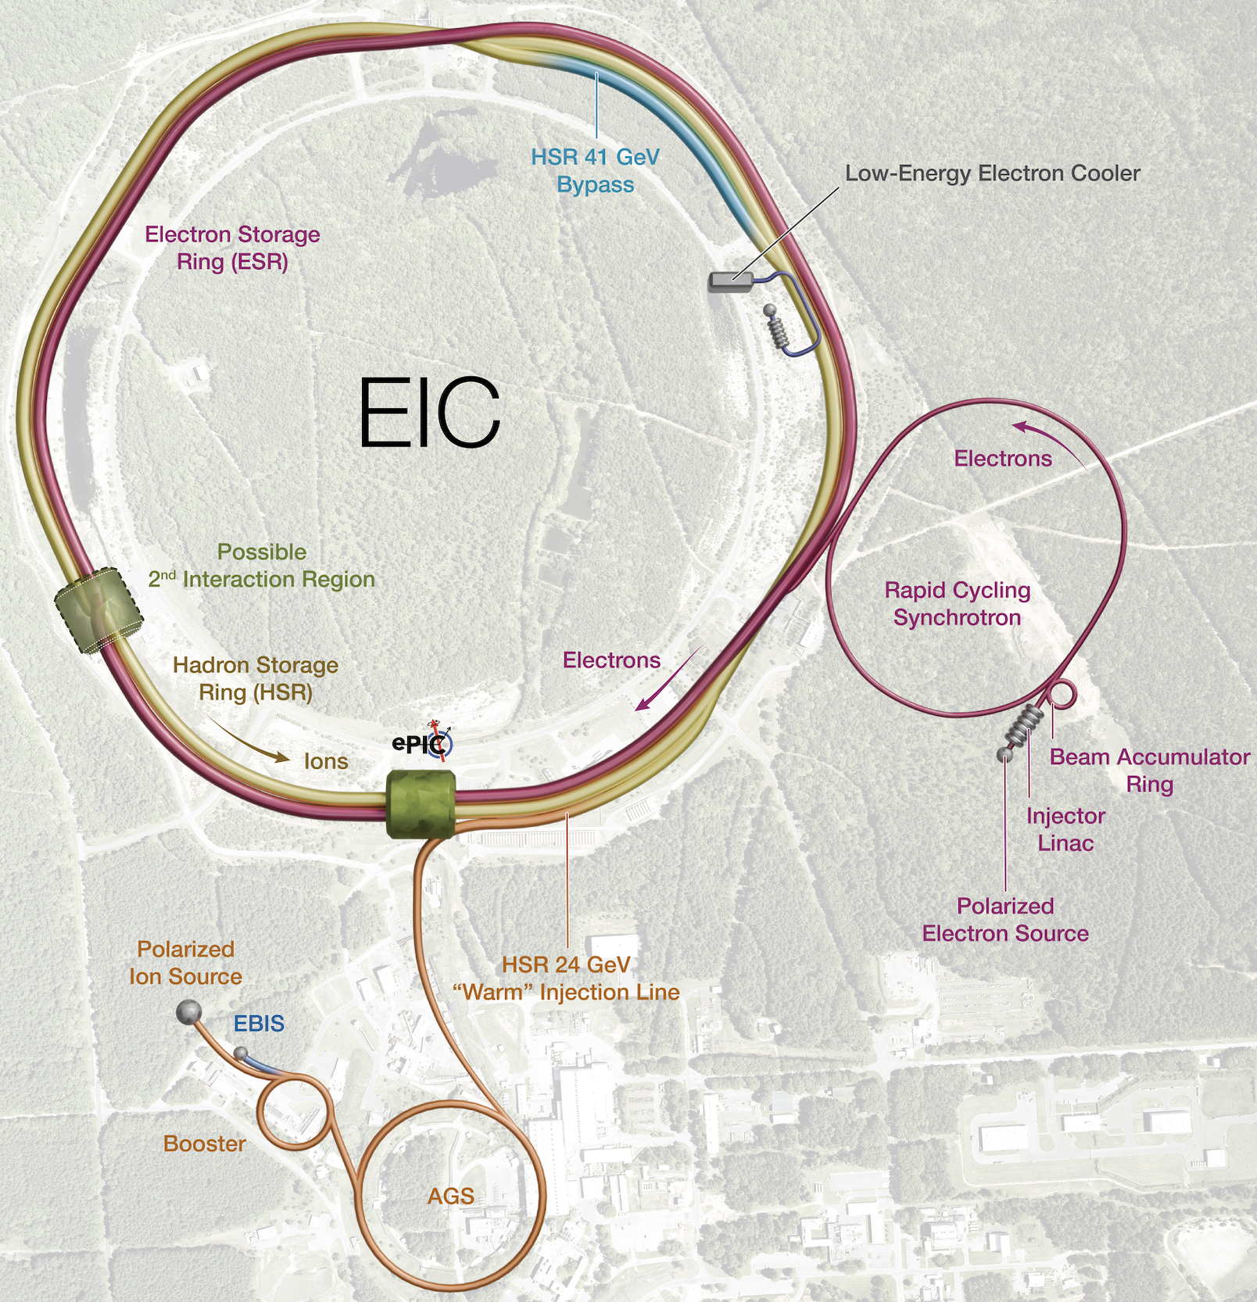

EIC Project Overview
Electron Injection System
  DC Photoelectron Gun
    320 keV, ~85% polarization, 1.5 nC per bunch
  S-band LINAC
    750 MeV energy, normalized emittance: ~80 μm (x), ~50 μm (y)
Beam Accumulator Ring (BAR, C$≈$50 m)
  750 MeV energy, single-bunch accumulation: 28 nC
  Design lead by the NSLS-II team
Rapid Cycling Synchrotron (RCS, C$≈$1.4 km)
  0.750$→$18 GeV in 100 ms, 1 Hz
  Spin-transparent lattice, 28 nC, normalized εₙ: 16-24 nm (x), 1.4-2.4 nm (y)
Electron Storage Ring (ESR, C$≈$3.8 km)
  Beam energy: 5-18 GeV, current : up to 2.5 A, SR power: up to 10 MW
  Polarized bunches, swap-out injection
Hadron Storage Ring (HSR, C$≈$3.8 km)
  Beam energy: Injection at 23.8 GeV, accelerated to 41-275 GeV
  Beam current: up to 1 A / 0.7 A with M = 1160 / 290 bunches
  Crossing angle: 25 mrad with crab cavities
  Spin rotators (longitudinal) for p, d, He³
  Cooler: low-energy electron and stochastic cooling
  Luminosity: up to 10³³-10³⁴ cm⁻²s⁻¹
ESR: 591 MHz
HSR: 24.8 MHz, 49 MHz, 98 MHz, 197 MHz and 591 MHz
International Workshop on Higher Order Modes in Superconducting Cavities (HOMSC2025)
Alexei Blednykh

Slide 4
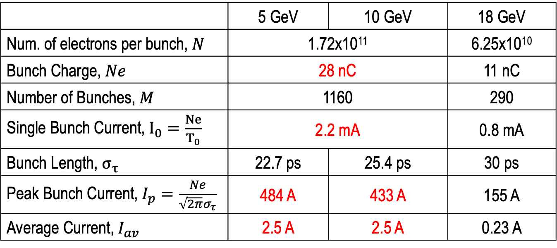
Ultimate Beam Intensity Parameters
 | 5 GeV | 10 GeV | 18 GeV
Num. of electrons per bunch, $N$ | 1.72x10¹¹ |  | 6.25x10¹⁰
Bunch Charge, $Ne$ | 28 nC |  | 11 nC
Number of Bunches, $M$ | 1160 |  | 290
Single Bunch Current, $I_{0}=\frac{Ne}{T_{0}}$ | 2.2 mA |  | 0.8 mA
Bunch Length, $σ_{τ}$ | 22.7 ps | 25.4 ps | 30 ps
Peak Bunch Current, $I_{p}=\frac{Ne}{\sqrt{2π}σ_{τ}}$ | 484 A | 433 A | 155 A
Average Current, $I_{av}$ | 2.5 A | 2.5 A | 0.23 A
High intensity beams at 5 GeV and 10 GeV
International Workshop on Higher Order Modes in Superconducting Cavities (HOMSC2025)
Alexei Blednykh

Slide 5
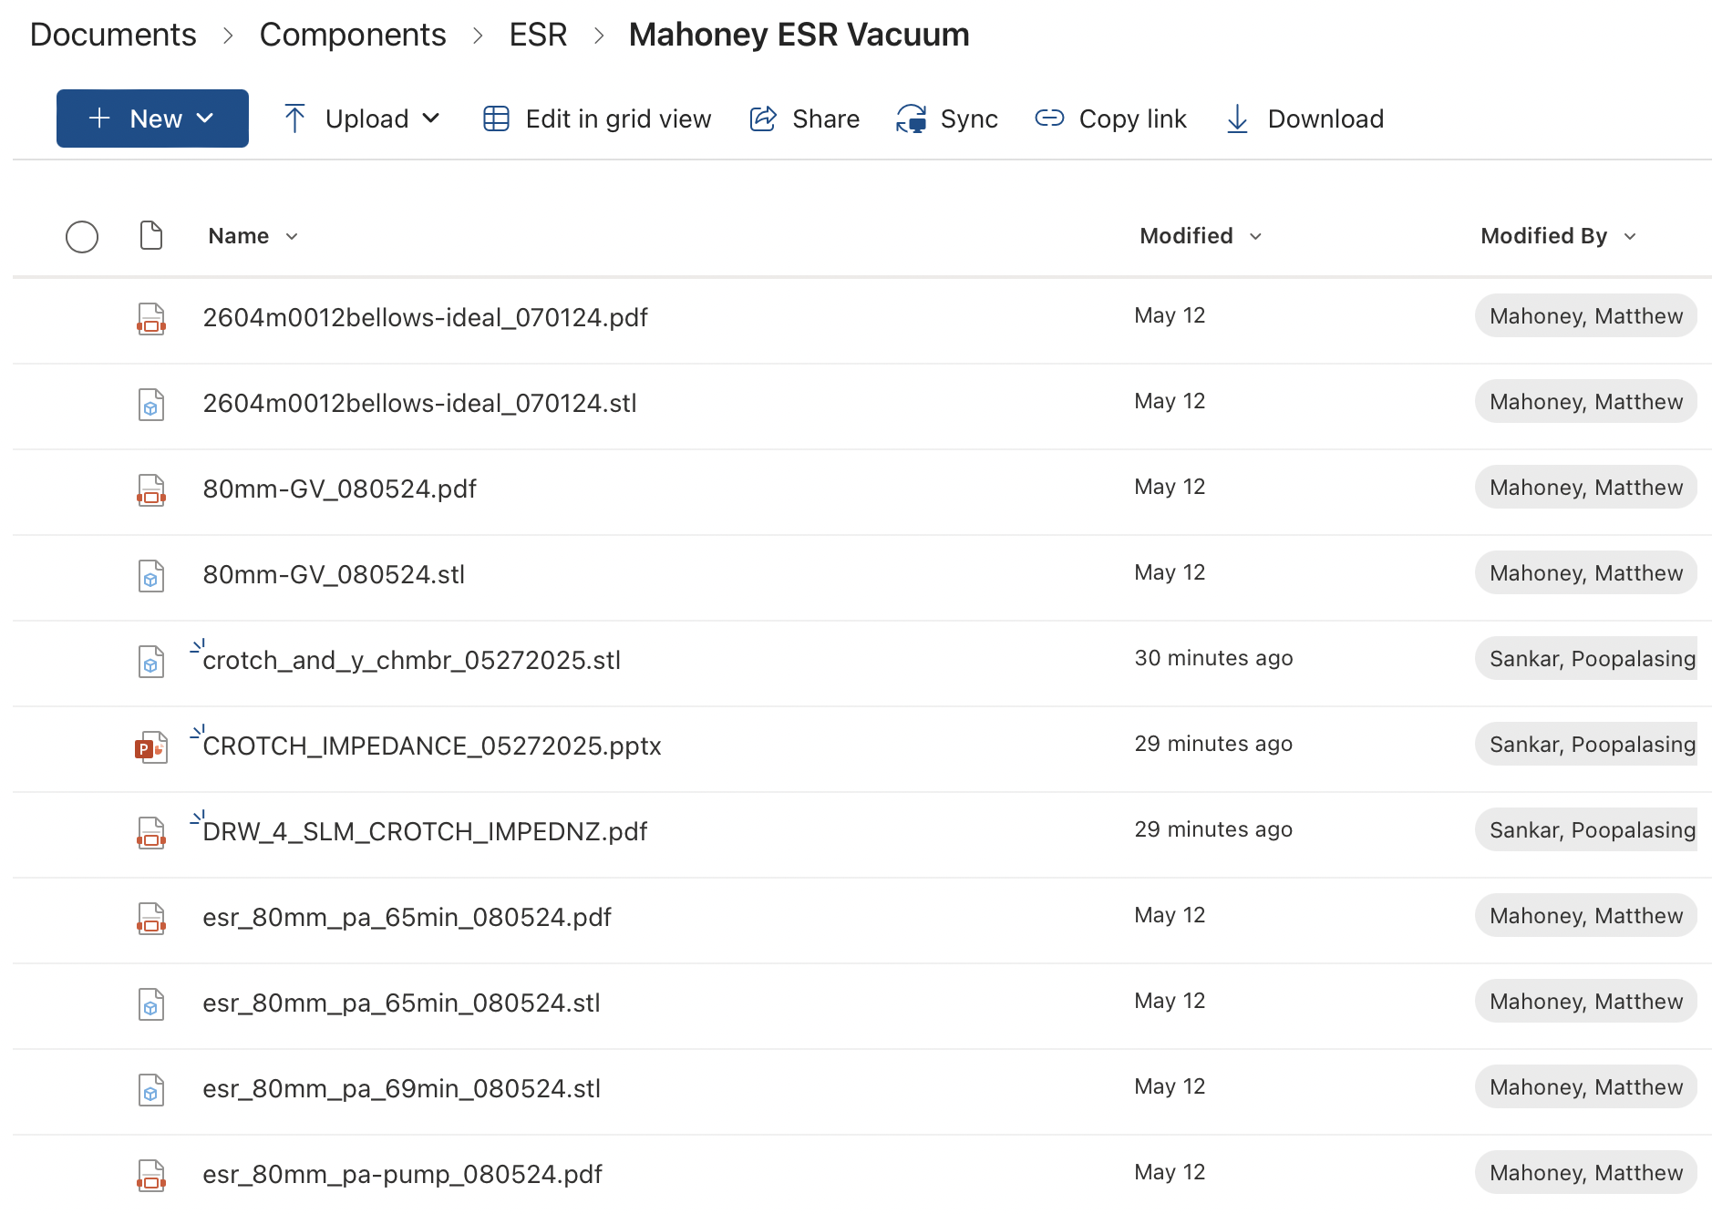
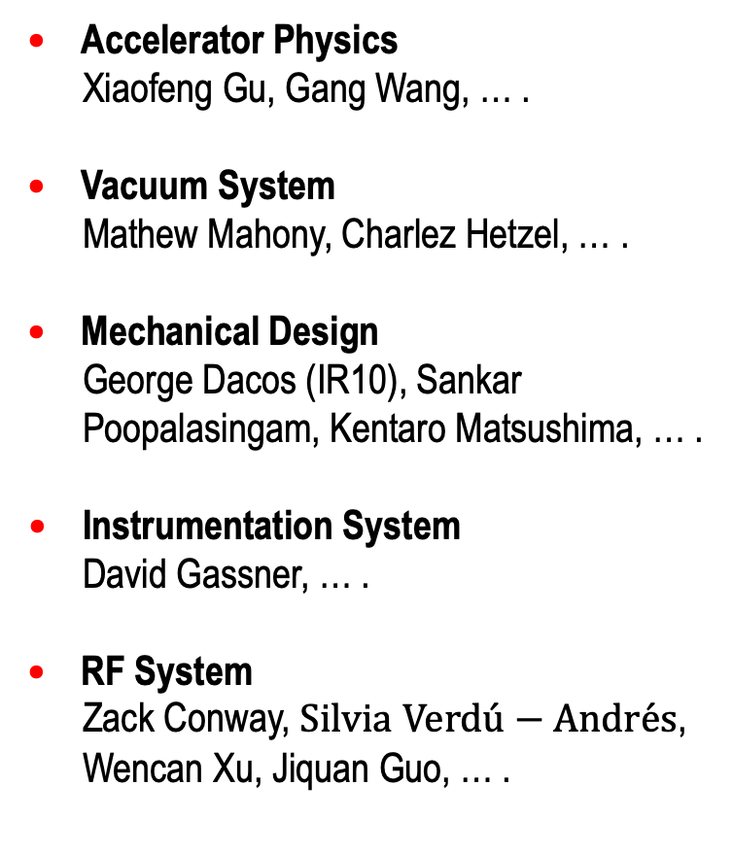
ESR Vacuum System Component Database
Accelerator Physics
Xiaofeng Gu, Gang Wang, … .
Vacuum System
Mathew Mahony, Charlez Hetzel, … .
Mechanical Design
George Dacos (IR10), Sankar Poopalasingam, Kentaro Matsushima, … .
Instrumentation System
David Gassner, … .
RF System
Zack Conway, $Silvia$ $Verd\acute{u}−Andr\acute{e}s$, Wencan Xu, Jiquan Guo, … .
International Workshop on Higher Order Modes in Superconducting Cavities (HOMSC2025)
Alexei Blednykh

Slide 6
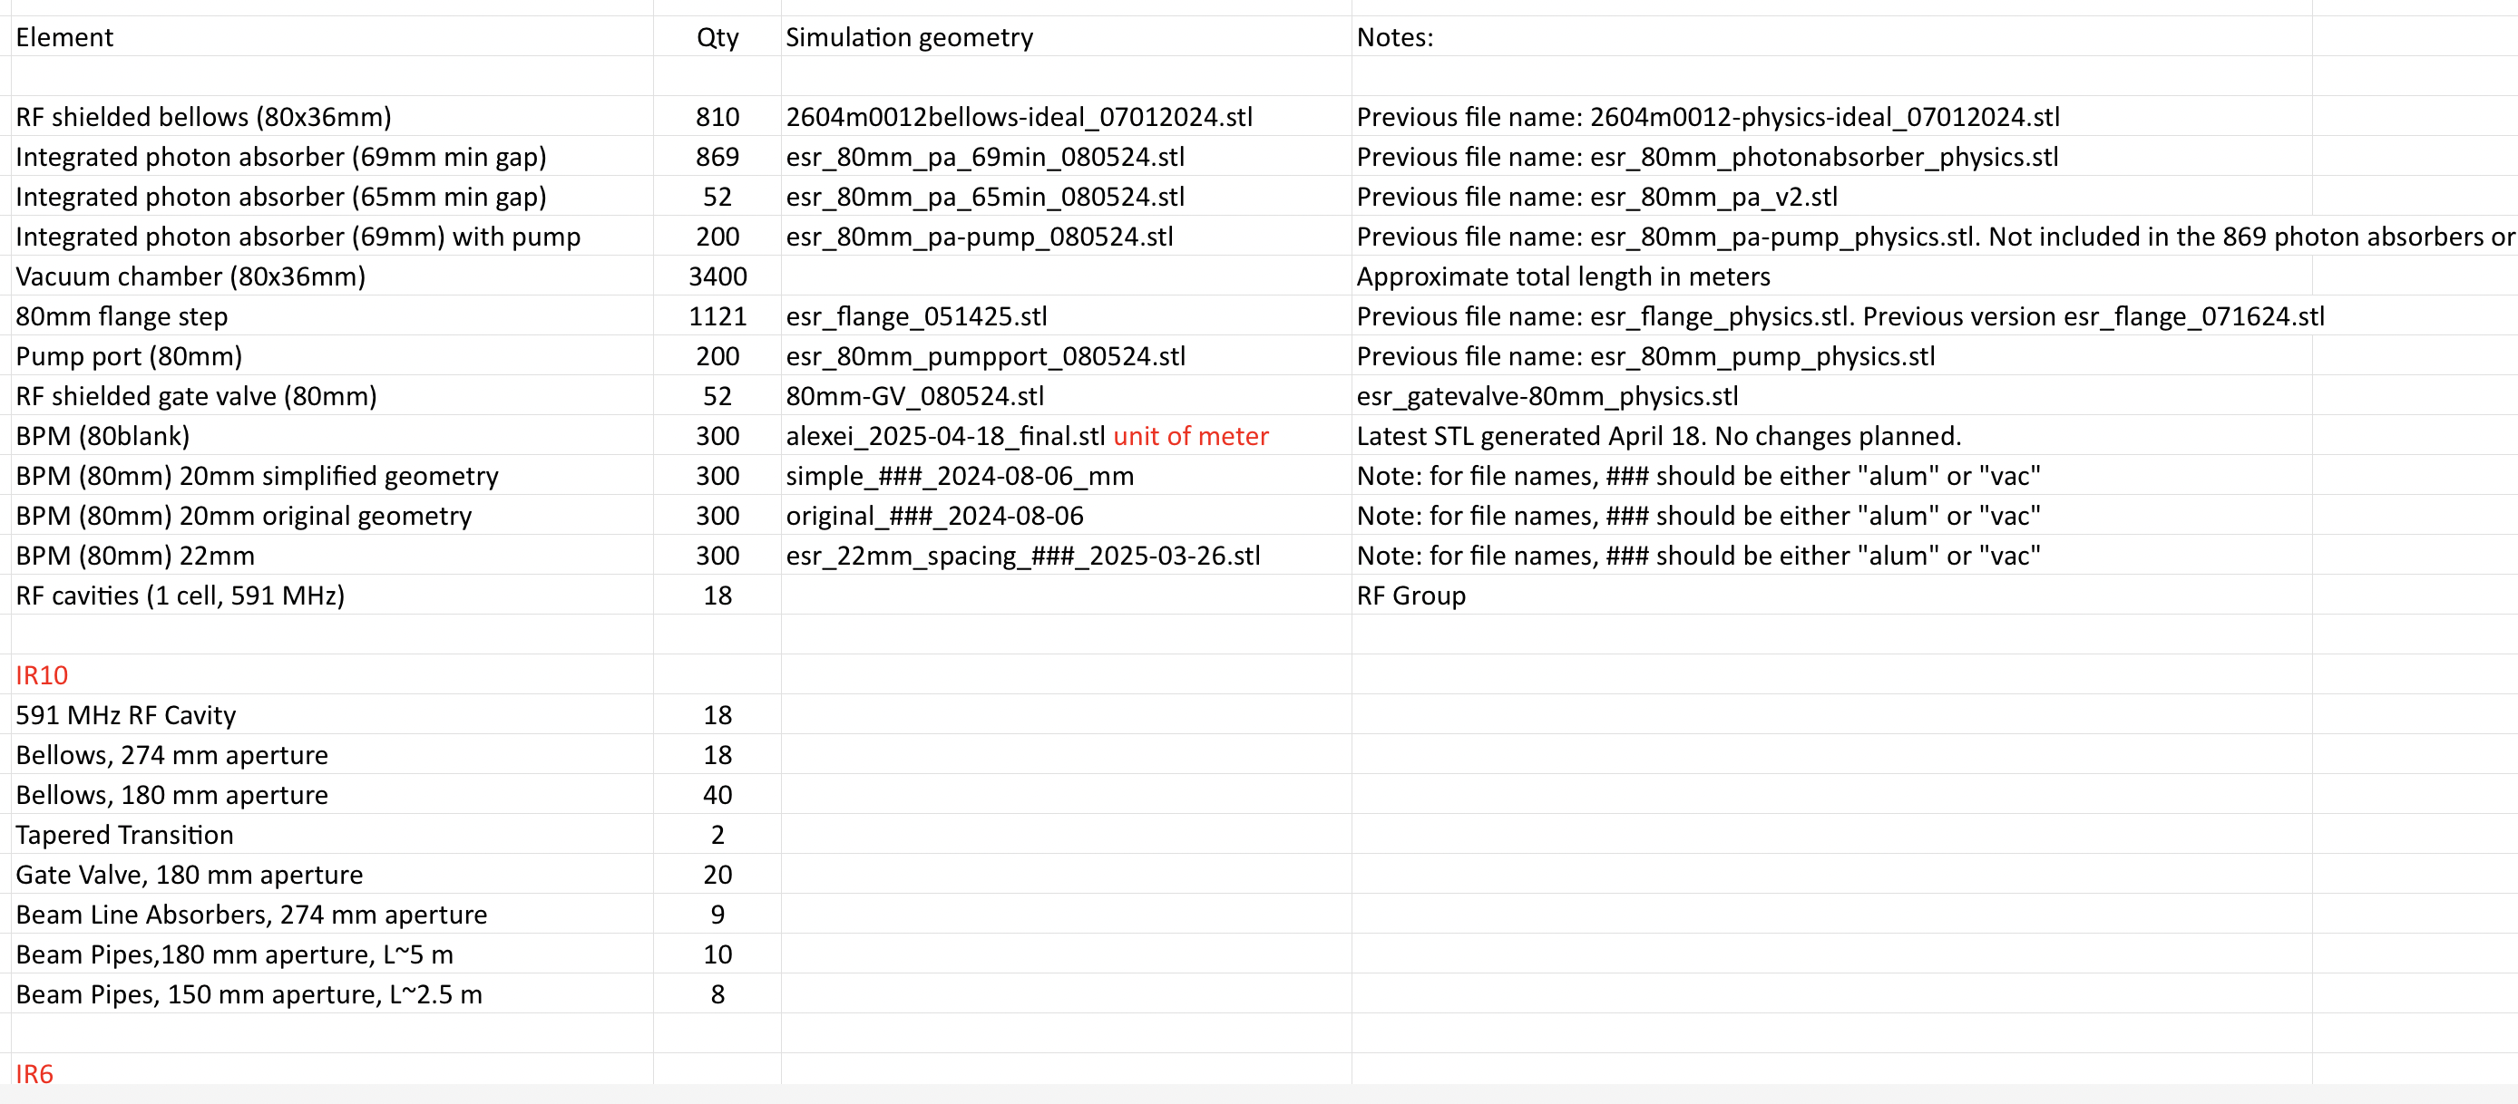
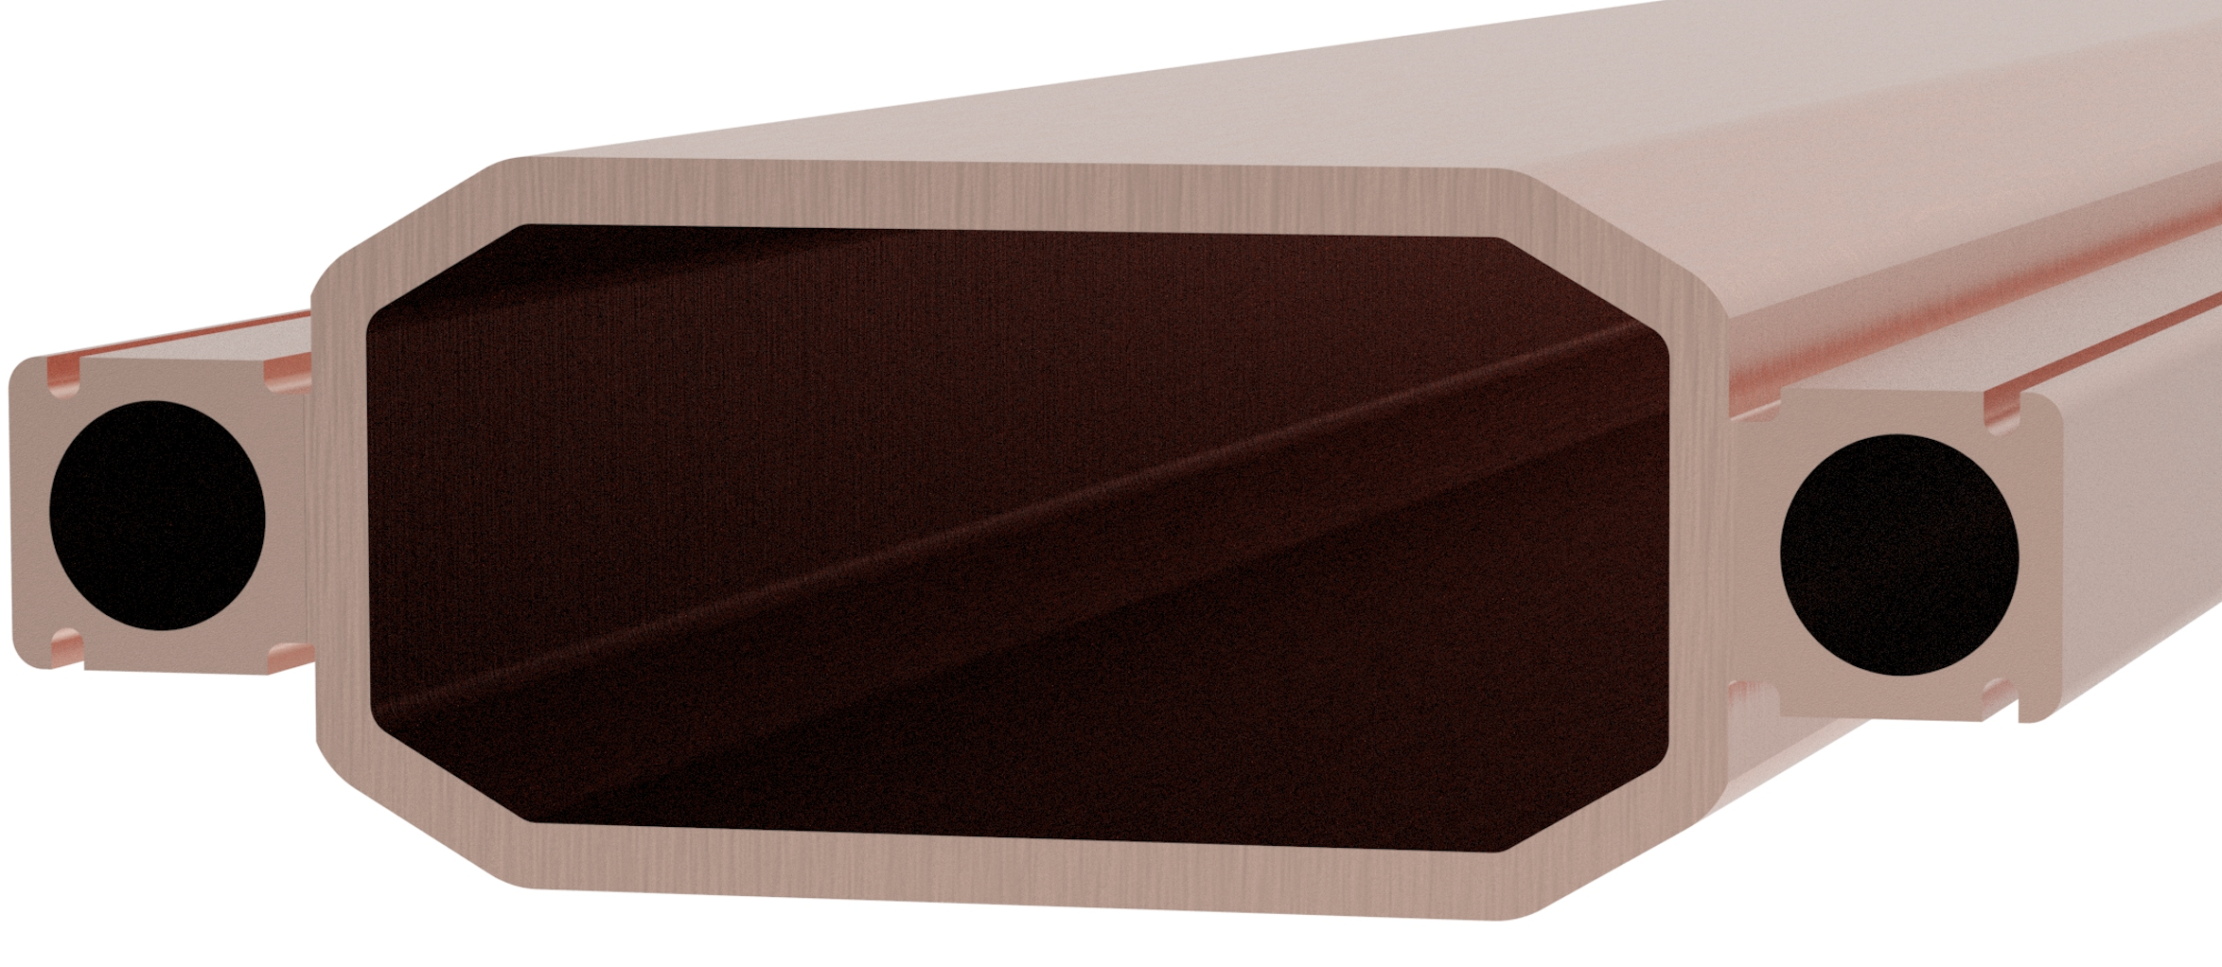
List of Vacuum Components and Their Status
ESR Vacuum Chamber Profile
80 mm
36 mm
Total wakefield simulations for the ESR are in progress.
International Workshop on Higher Order Modes in Superconducting Cavities (HOMSC2025)
Alexei Blednykh

Slide 7
IR10 SRF and Beam Line System
Components | Abbreviation | Previous Number | New Number
IR10
591 MHz RF Cavity | CAV | 17 | 18
Bellows, 274 mm aperture | BLW 274 | 17 | 18
Bellows, 180 mm aperture | BLW 180 | 0 | 40
Bellows, 150 mm aperture | BLW 150 | 17 | 0
Tapered Transition | TPRD | 19 | 2
Gate Valve, 180 mm aperture | GV 180 | 0 | 20
Gate Valve, 150 mm aperture | GV 150 | 17 | 0
Beam Line Absorbers, 274 mm aperture | BLA 274 | 17 | 9
Beam Line Absorbers, 150 mm aperture | BLA 150 | 17 | 0
Beam Pipes,180 mm aperture, L~5 m | BP 180 | 0 | 10
Beam Pipes, 150 mm aperture, L~2.5 m | BP 150 | 18 | 0
International Workshop on Higher Order Modes in Superconducting Cavities (HOMSC2025)
Alexei Blednykh

Slide 8
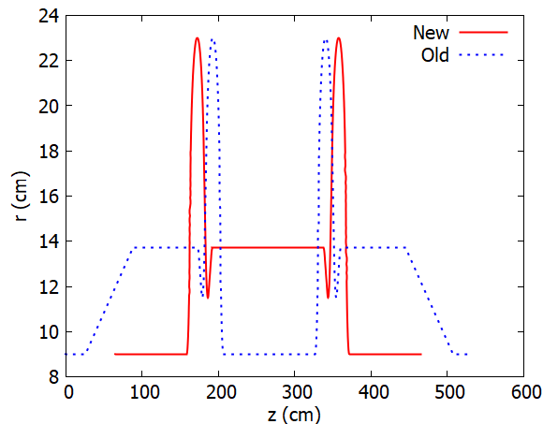
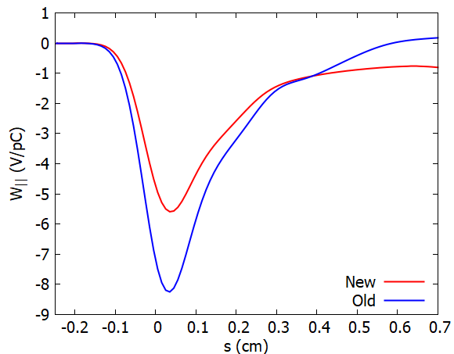
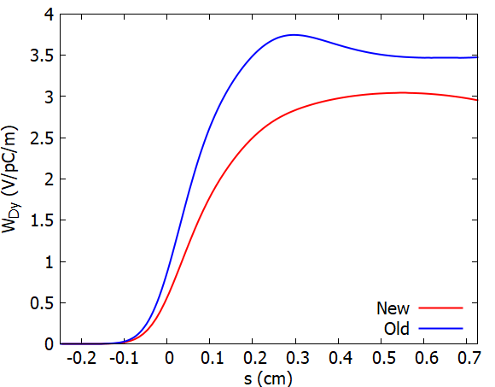
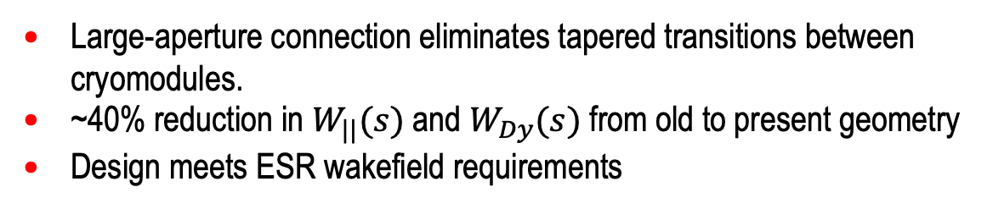
Two Back-to-Back 591 MHz Cavities
Longitudinal Wakefield
Vertical Dipole Wakefield
Large-aperture connection eliminates tapered transitions between cryomodules.
~40% reduction in $W_{||}(s)$and $W_{Dy}(s)$ from old to present geometry
Design meets ESR wakefield requirements
Gang Wang
International Workshop on Higher Order Modes in Superconducting Cavities (HOMSC2025)
Alexei Blednykh

Slide 9
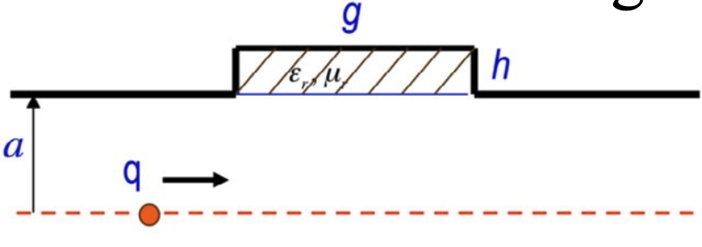
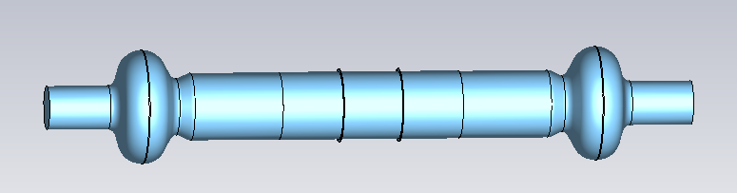
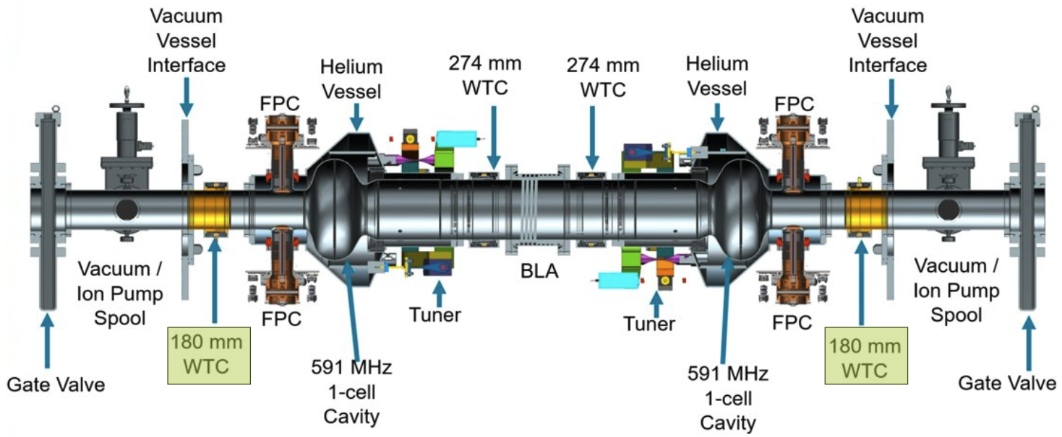
Wakefield Simulations for 2-Cavity String
Beam Line Absorber
Two Back-To-Back Cavities
Simulated Vacuum Components
  Two Back-to-Back 591 MHz RF Cavities
  Beam Line Absorbers, 274 mm aperture
Remaining Components to Simulate
  Bellows, 274 mm aperture
  Tapered Transition (Arc to Straight Section)
  Gate Valve, 180 mm aperture
  Beam Pipes,180 mm aperture, L~5 m
No significant impact is expected from adding $W_{||}(s)$and $W_{Dy}(s)$of the remaining cryomodule components to the total wakefield.
International Workshop on Higher Order Modes in Superconducting Cavities (HOMSC2025)
Alexei Blednykh

Slide 10
Breakdown of Wakefields by Component
Longitudinal Wakefield
Quadrupole Wakefield
Vertical Dipole Wakefield
Wakefields have been simulated for a 0.5 mm bunch length (Pseudo Green Functions).
International Workshop on Higher Order Modes in Superconducting Cavities (HOMSC2025)
Alexei Blednykh

Slide 11
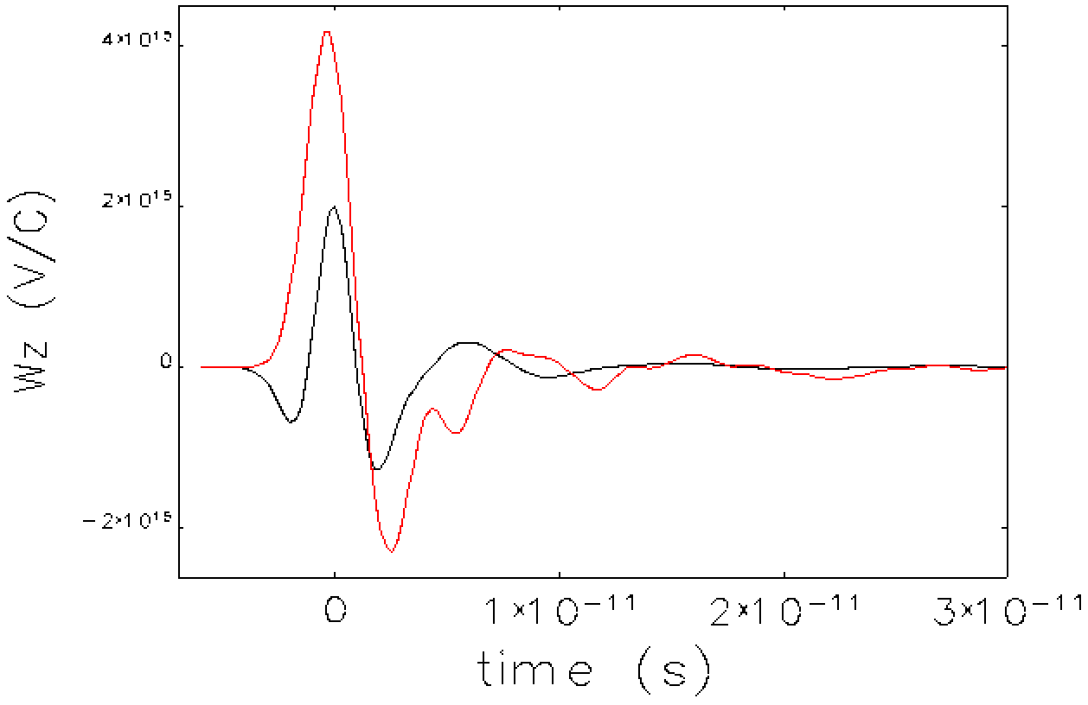
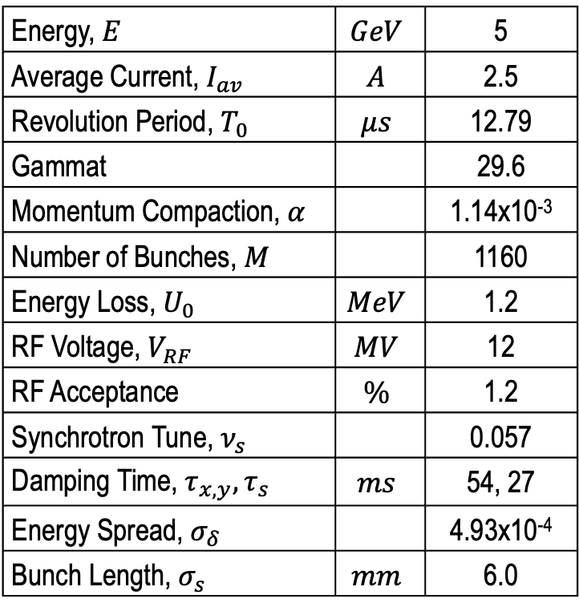
Main Parameters At 5 GeV
Lattice v6.3
Energy, $E$ | $$GeV$$ | 5
Average Current, $I_{av}$ | $$A$$ | 2.5
Revolution Period, $T_{0}$ | $$μs$$ | 12.79
Gammat |  | 29.6
Momentum Compaction, $α$ |  | 1.14x10⁻³
Number of Bunches, $M$ |  | 1160
Energy Loss, $U_{0}$ | $$MeV$$ | 1.2
RF Voltage, $V_{RF}$ | $$MV$$ | 12
RF Acceptance | $$\%$$ | 1.2
Synchrotron Tune, $ν_{s}$ |  | 0.057
Damping Time, $τ_{x,y},τ_{s}$ | $$ms$$ | 54, 27
Energy Spread, $σ_{δ}$ |  | 4.93x10⁻⁴
Bunch Length, $σ_{s}$ | $$mm$$ | 6.0
Geom.+RW
CSR
A safety factor of 2 was applied to the Geom. + RW Wakefield.
International Workshop on Higher Order Modes in Superconducting Cavities (HOMSC2025)
Alexei Blednykh

Slide 12
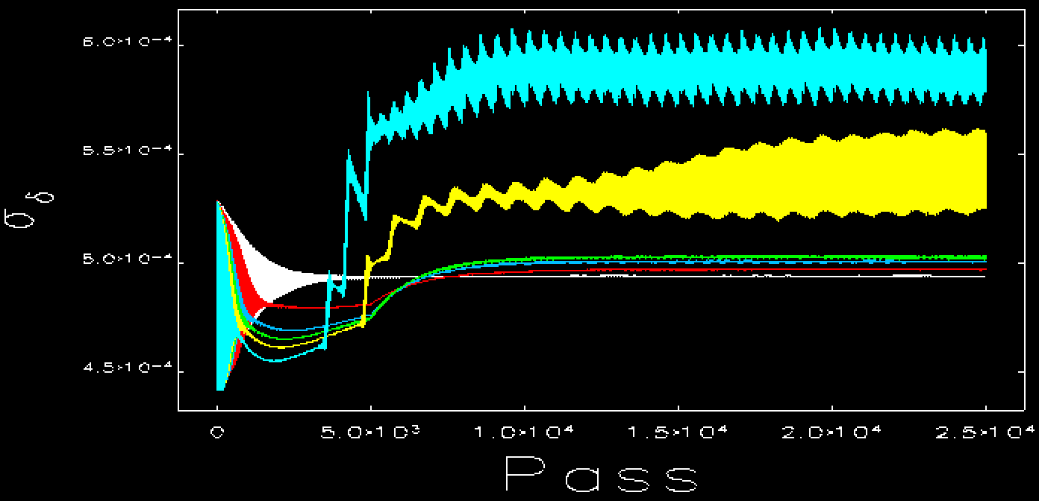
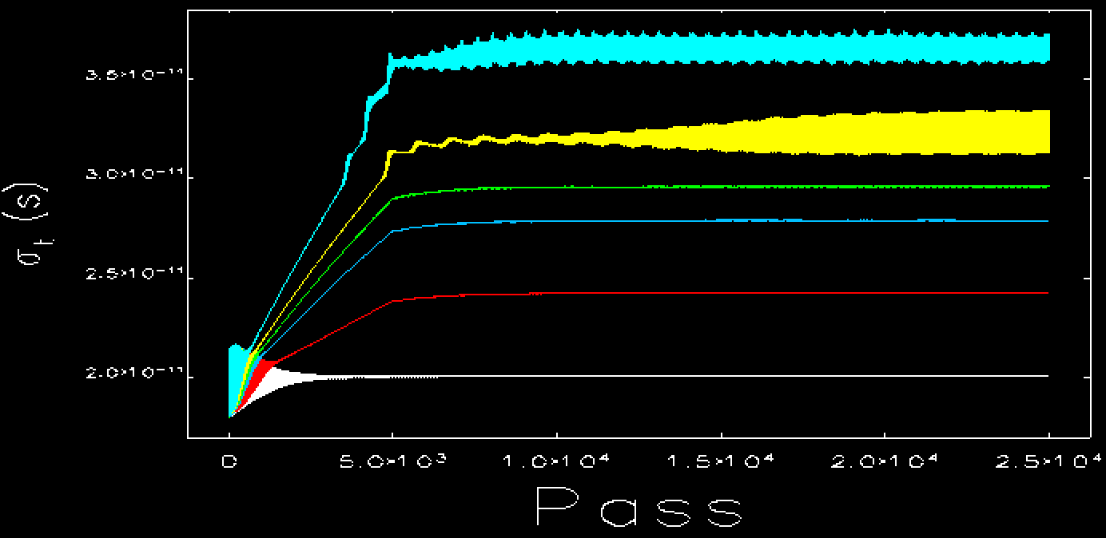
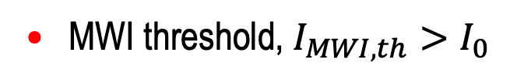


ELEGANT Simulations of MWI
Energy Spread
$$σ_{δ}$$
$$σ_{s} (mm)$$
Bunch Lengthening
mA
mA
MWI threshold, $I_{MWI,th}>I_{0}$
International Workshop on Higher Order Modes in Superconducting Cavities (HOMSC2025)
Alexei Blednykh

Slide 13
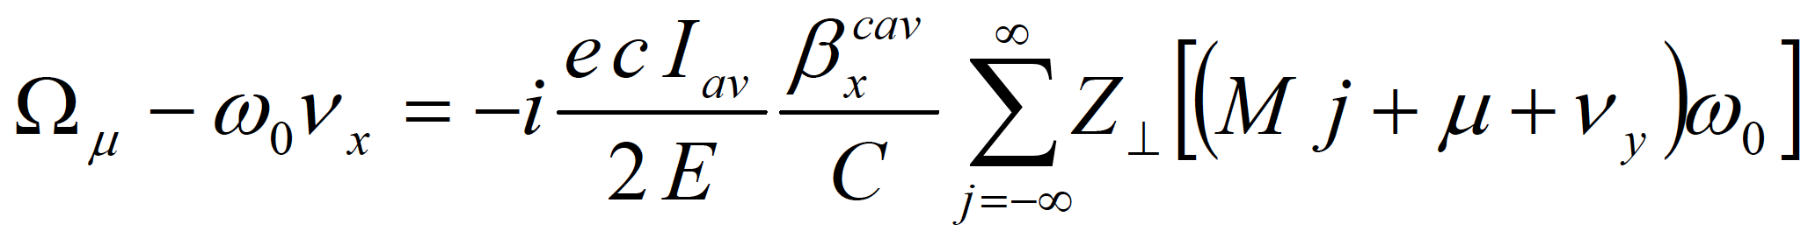
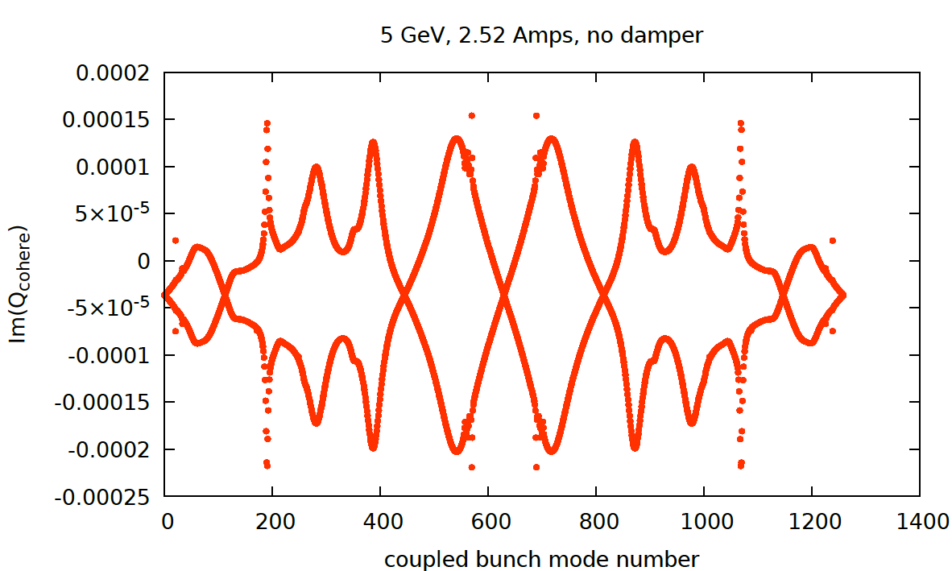
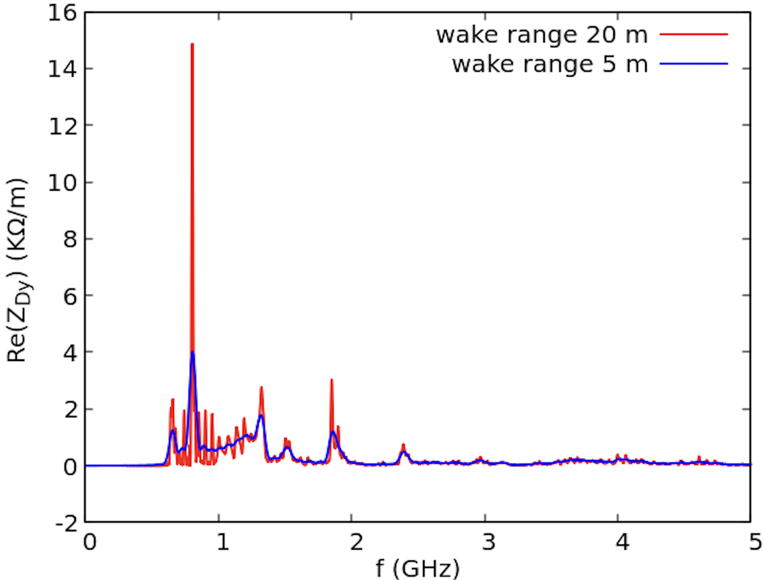
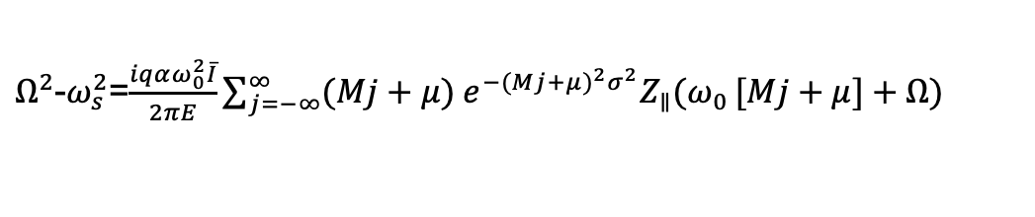
Coupled Bunch Instabilities at 5 GeV
Longitudinal multiple coupled-bunch modes are unstable at 2.5 A average current. The growth time is 20 ms.
The beam is stable against vertical coupled-bunch instabilities during beam-beam collision.
The vertical shunt impedance <12 MΩ/m (Eng. def.).
Cross-checking beam stability, RW+HOM’s w/o beam-beam collision.
$Ω^{2}$-$ω_{s}^{2}$=$\frac{iqαω_{0}^{2}\overline{I}}{2πE}\sum_{j=−∞}^{∞}{(Mj+μ) e^{−(Mj+μ)^{2}σ^{2}}Z_{∥}(ω_{0}}[Mj+μ]+Ω)$
Michael Blaskiewicz
CST (Frequency Domain)
ECHO (Time Domain)
Wencan Xu
Gang Wang
Longitudinal bunch-by-bunch feedback (damper) is required
Vertical bunch-by-bunch feedback is under investigation
International Workshop on Higher Order Modes in Superconducting Cavities (HOMSC2025)
Alexei Blednykh

Slide 14
Summary
2-cavity 591 MHz string contribution analyzed for single-bunch dynamics and HOM-driven effects.
Wakefield and Stability Analysis:
  A longitudinal damper is required to suppress coupled-bunch instabilities driven by HOMs from the 2-cavity string.
  A transverse damper is under investigation to address potential transverse coupled-bunch instabilities (without beam-beam effect)
  The beam is single-bunch stable
Cryomodule impedance meets the requirements
  Remaining components will be incorporated into the impedance budget; No significant impact is expected due to their shielded and standardized designs.
International Workshop on Higher Order Modes in Superconducting Cavities (HOMSC2025)
Alexei Blednykh

