Slide 1
NUMERICAL ANALYSIS OF HIGHER-ORDER MODE COUPLERS
Sosoho-Abasi Udongwo, Thomas Flisgen

Slide 2
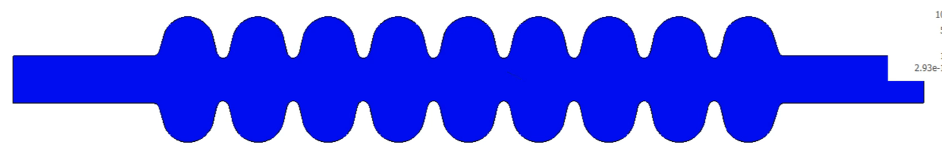
Wakefields
Wakefields
  Generated by the beam as it moves through the cavity structure
  Superposition of several modes
    Lower-Order modes (LOMs)
    Accelerating mode
    Higher-Order modes (HOMs)
Electric field magnitude of fields excited by beam moving through the cavity

Slide 3
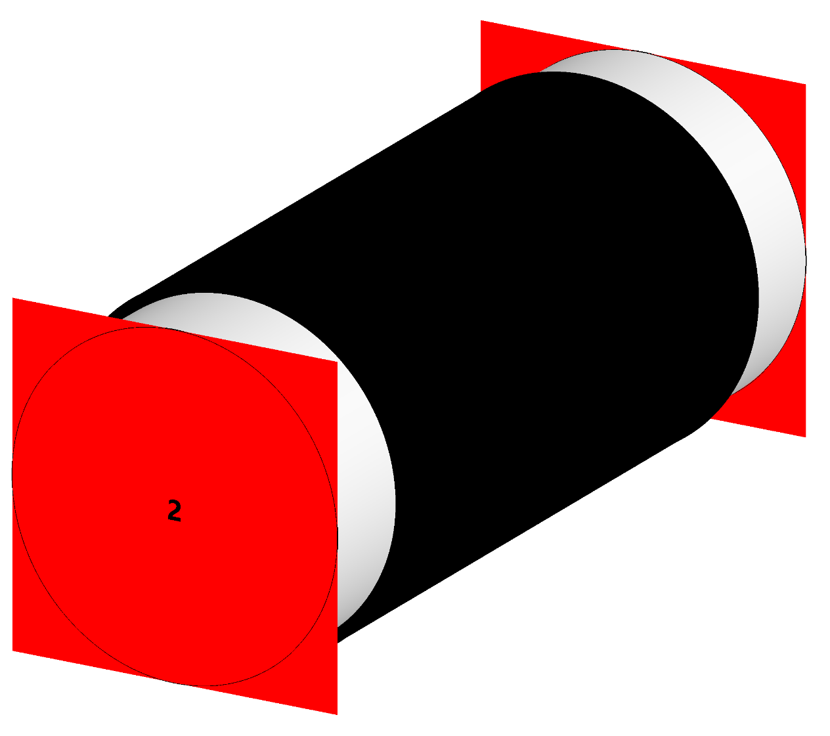
Beamline absorbers
Typically lossy ceramic or ferrite material
Advantages
  Simple, robust and broadband
  Minimal impact on the accelerating mode
  Compact
Disadvantages
  Ineffective for trapped HOMs

Slide 4
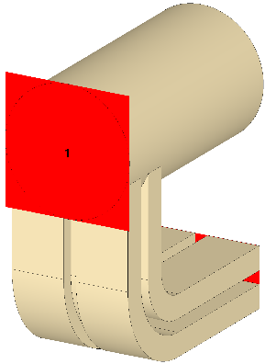
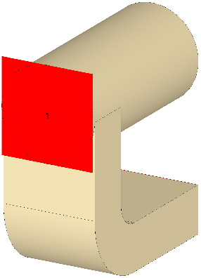
Waveguide couplers
Extract HOM power above waveguide cutoff frequency
Advantages
  Broadband
  Minimal impact on accelerating mode
Disadvantages
  Typically bulky
Rectangular waveguide
Quad-ridged waveguide

Slide 5
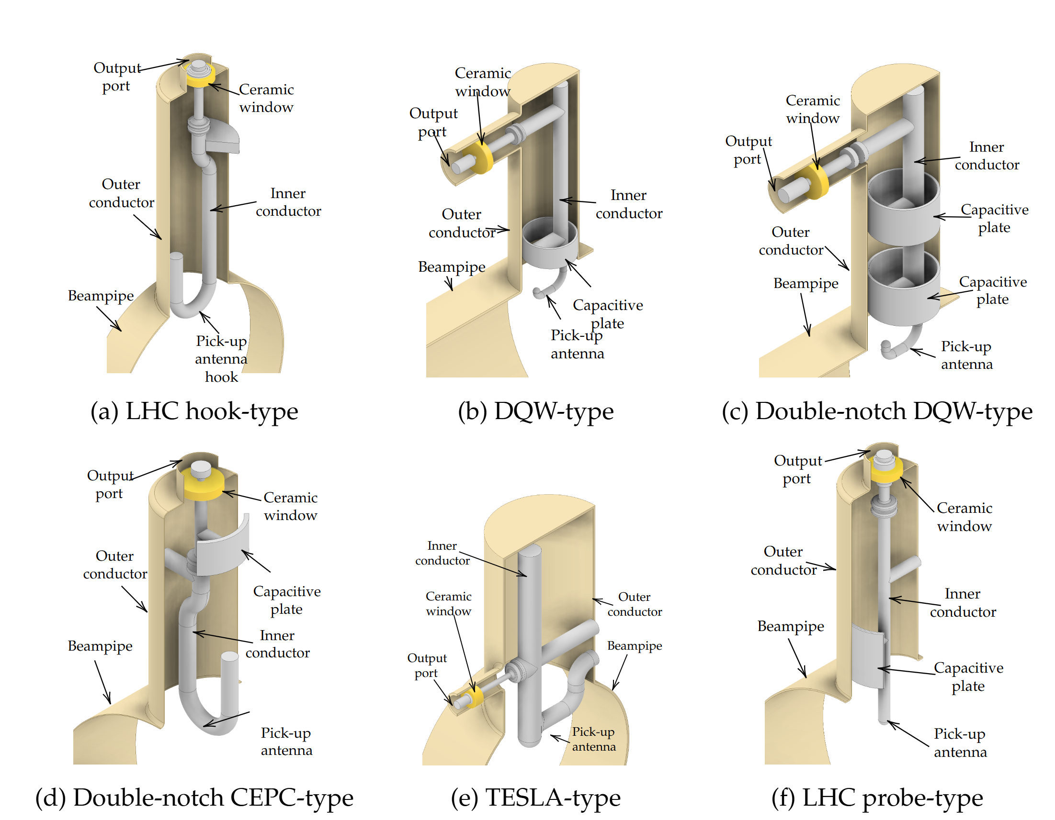
Coaxial hom couplers
Use coaxial line with an antenna or loop near cavity to couple to HOM fields
Advantages
  Can damp trapped modes
Disadvantages
  Usually narrowband
  Complex geometry
  Risk of multipacting
  Usually requires multiple couplers per cavity

Slide 6
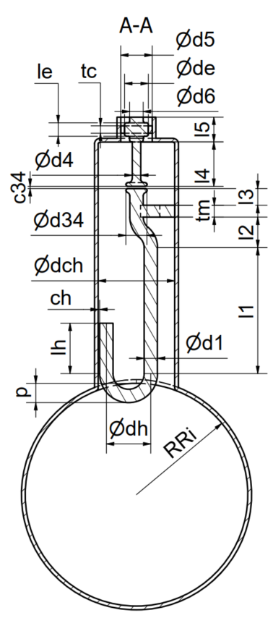
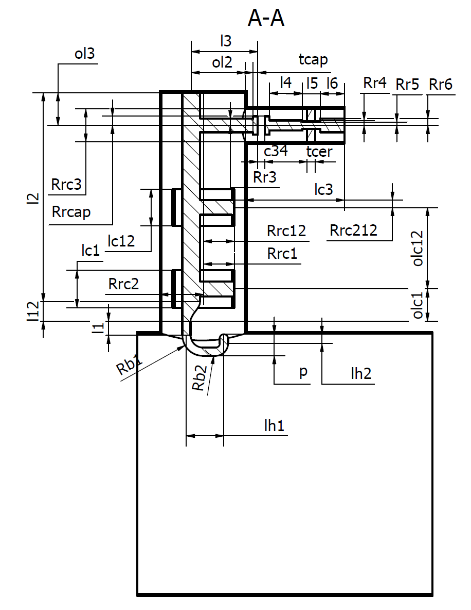
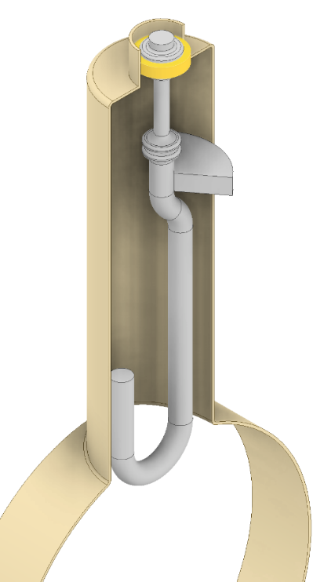
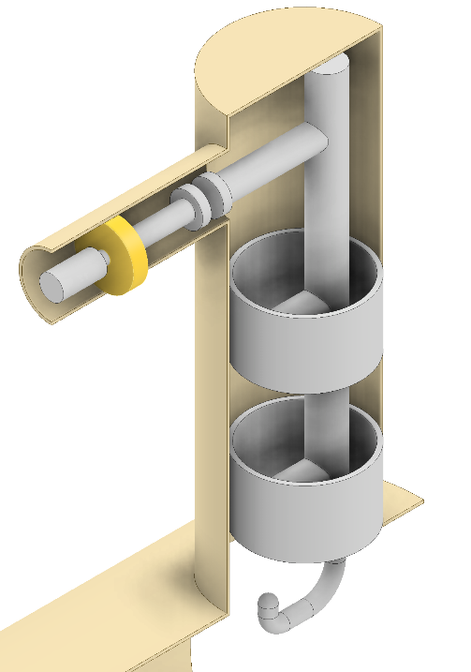
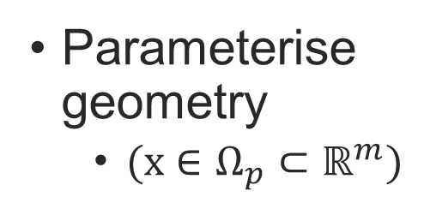
Coaxial HOM Coupler Design
Modelling
Parameterise geometry
  $(x∈Ω_{p}⊂ℝ^{m})$
Parameterisation of some coaxial HOM couplers

Slide 7
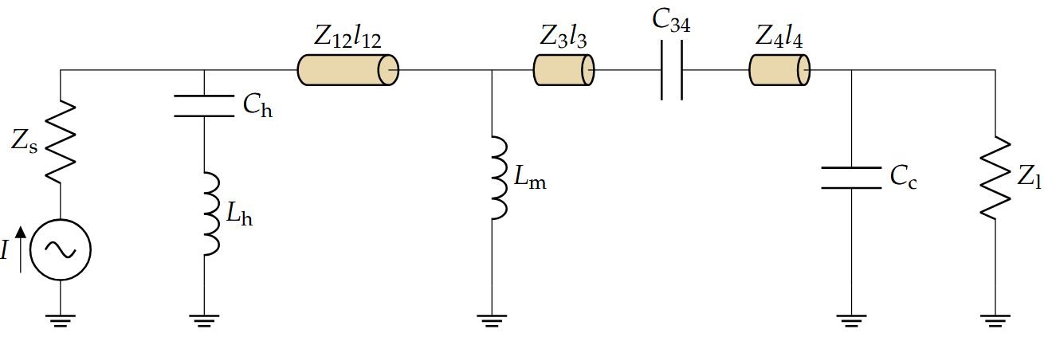

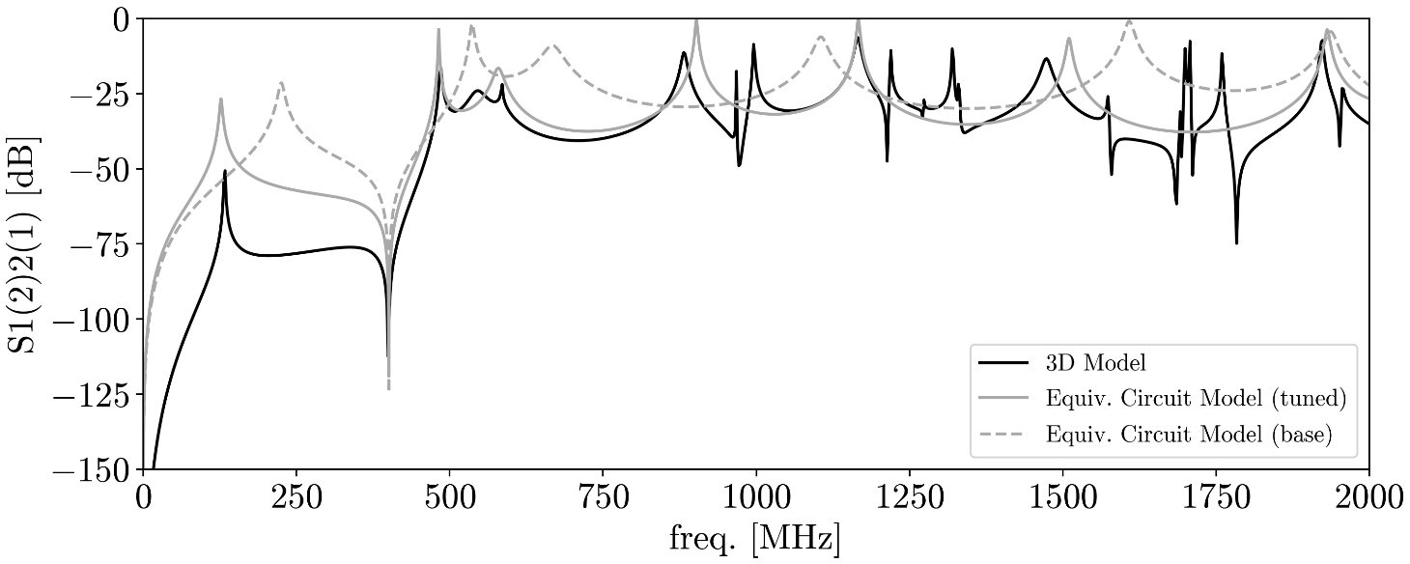
Coaxial HOM Coupler Design
Surrogate Modelling
Roughly synthesise equivalent circuit model
Estimate equivalent circuit element values and bounds from 3D model
Tune equivalent circuit model

Slide 8
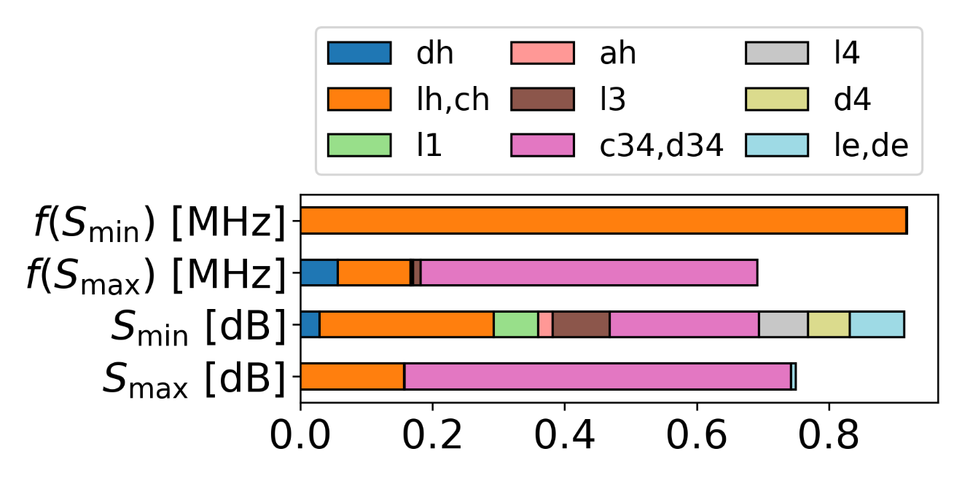
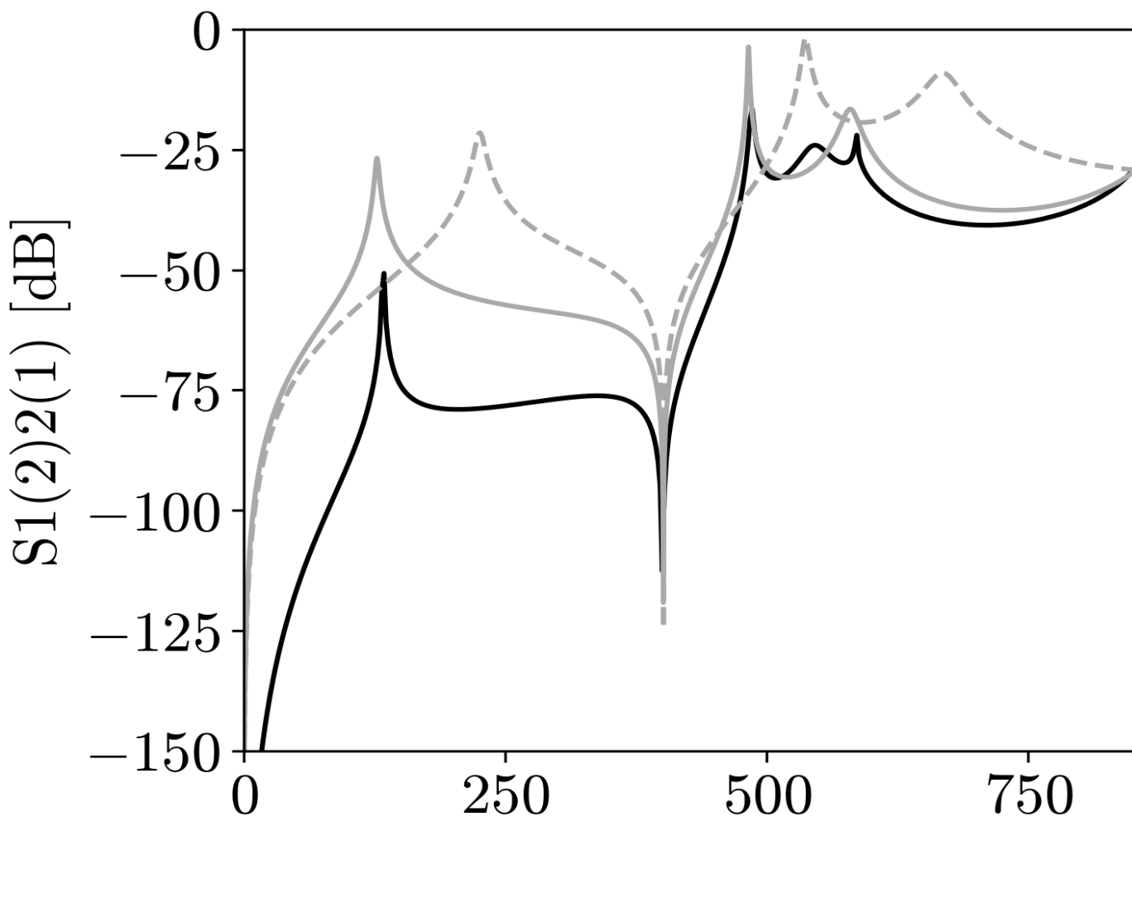
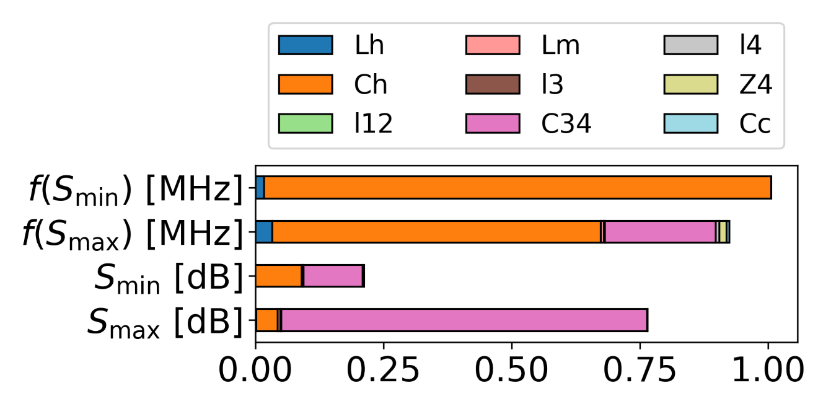


Sensitivity analysis
$$(fmax, Smax)$$
l
l
3D model variable sensitivities
$$(fmin, Smin)$$
l
SALib, UQPy, Dakota Engine, etc
l
Equivalent circuit model variable sensitivities

Slide 9
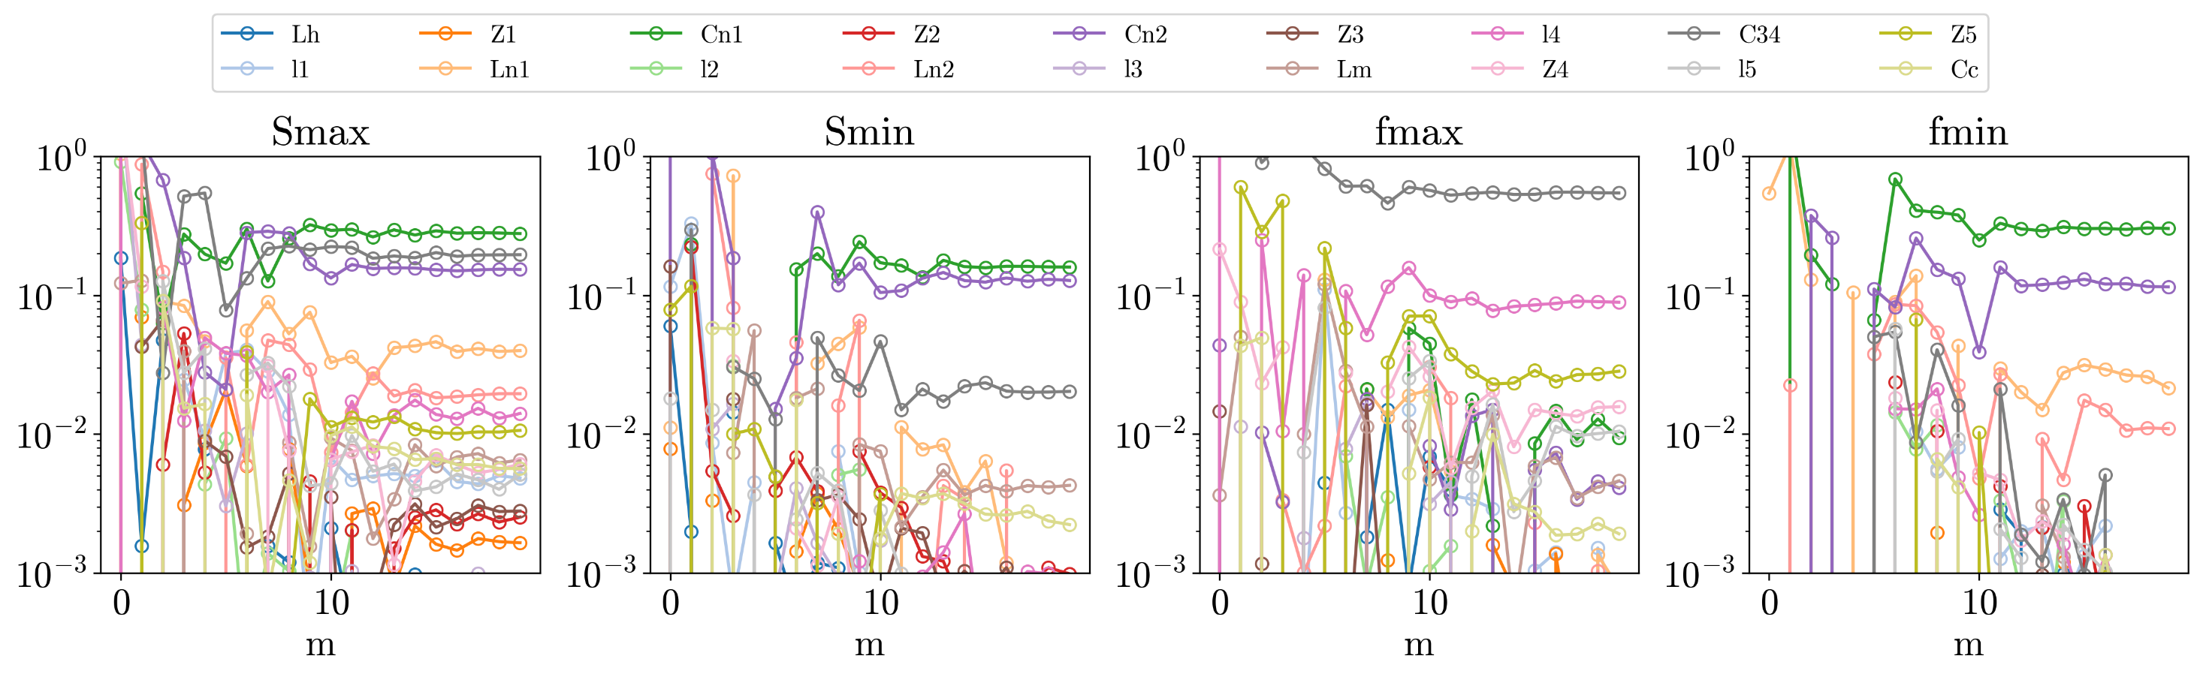
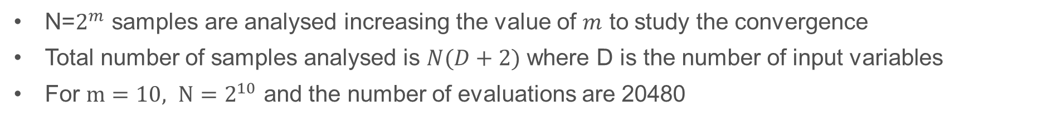
Sobol’ Indices
Convergence of Sobol‘ main indices S1 for equivalent circuit model
S1
N=$2^{m}$ samples are analysed increasing the value of $m$ to study the convergence
Total number of samples analysed is $N(D+2)$ where D is the number of input variables
For $m=10, N=2^{10}$ and the number of evaluations are 20480

Slide 10
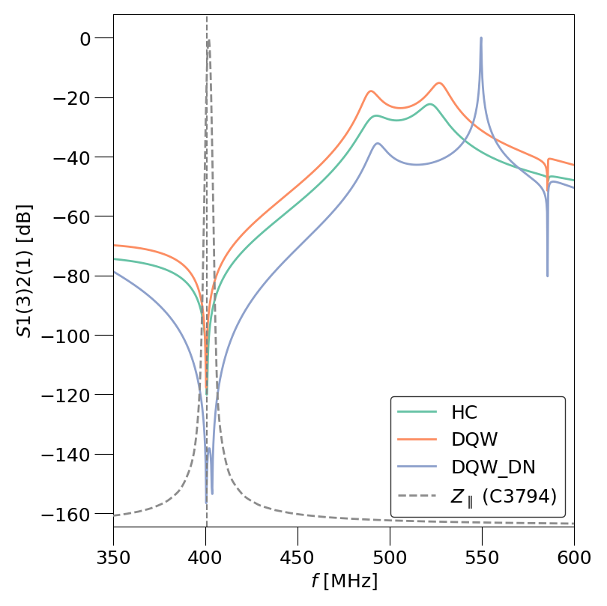
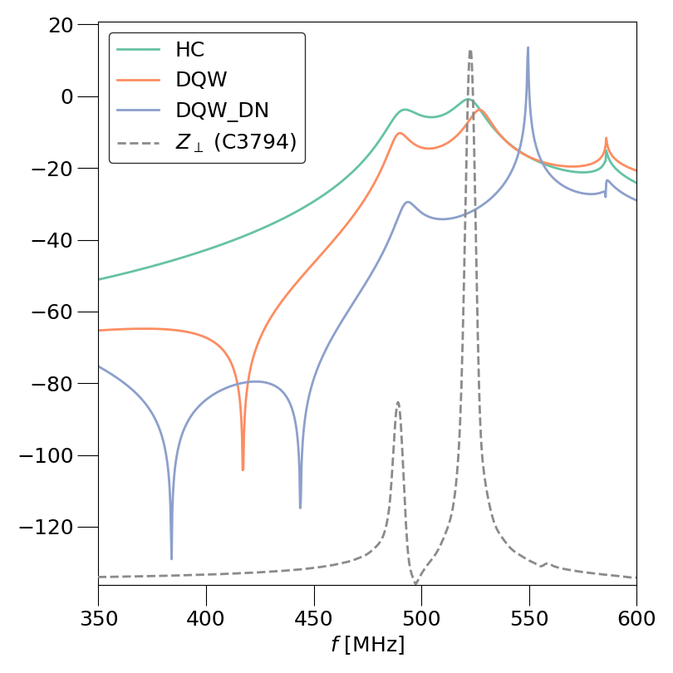
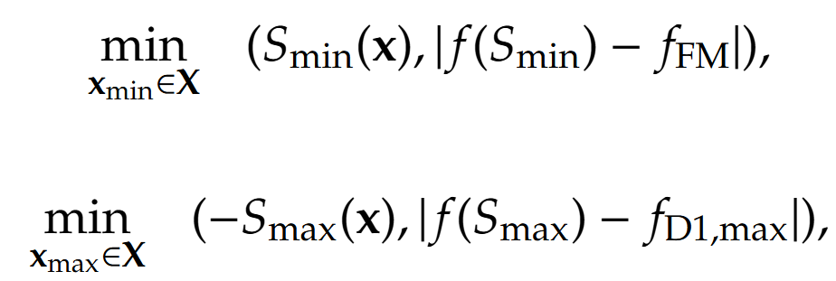
Initial optimisation
Transmission curves for a typical coaxial HOM coupler

Slide 11
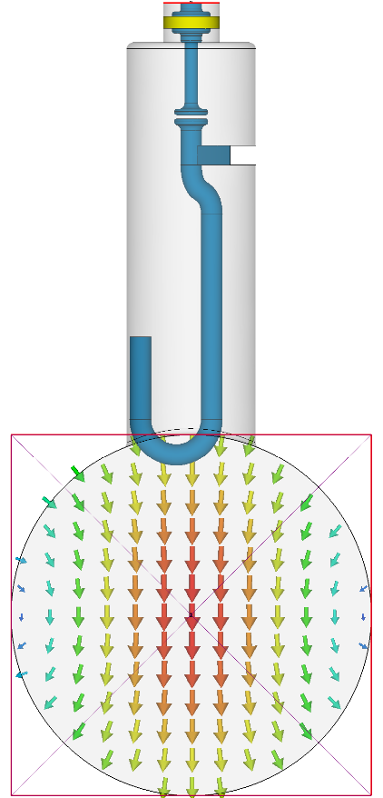
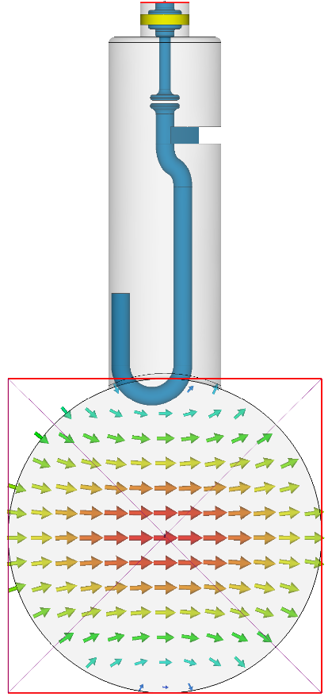
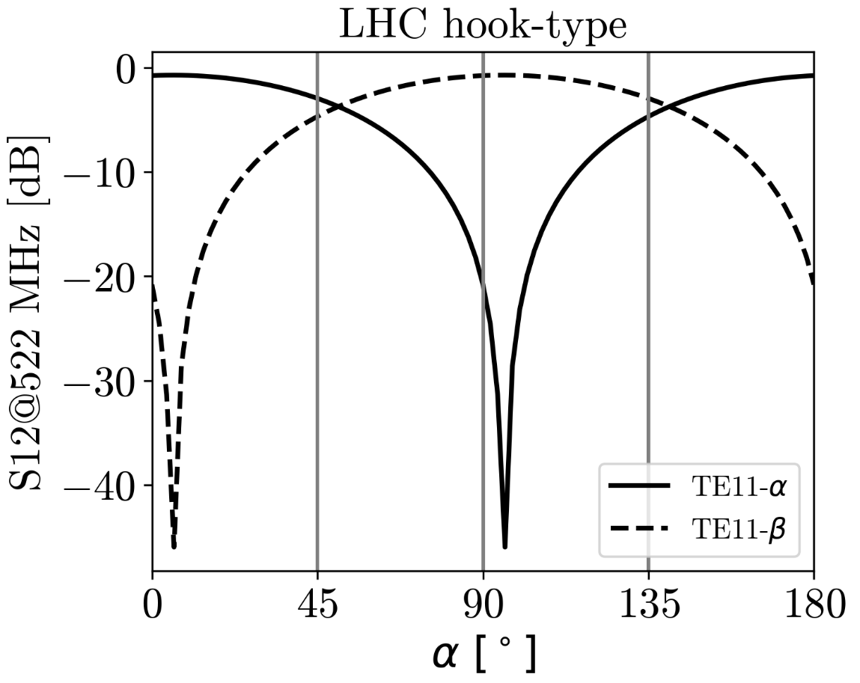
optimisation
Transmission parameter depend on orientation of coaxial HOM coupler
It is therefore necessary to reoptimise the HOM coupler in the cavity-coupler assembly

Slide 12
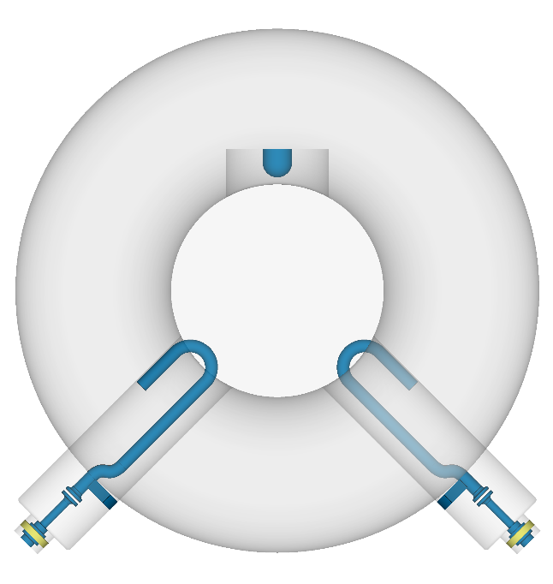
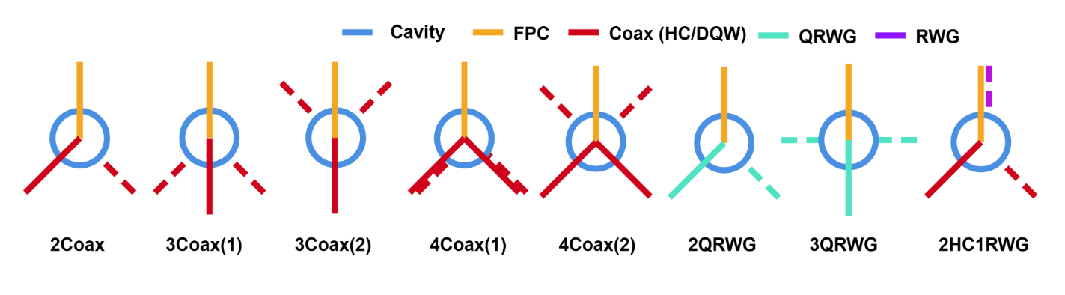
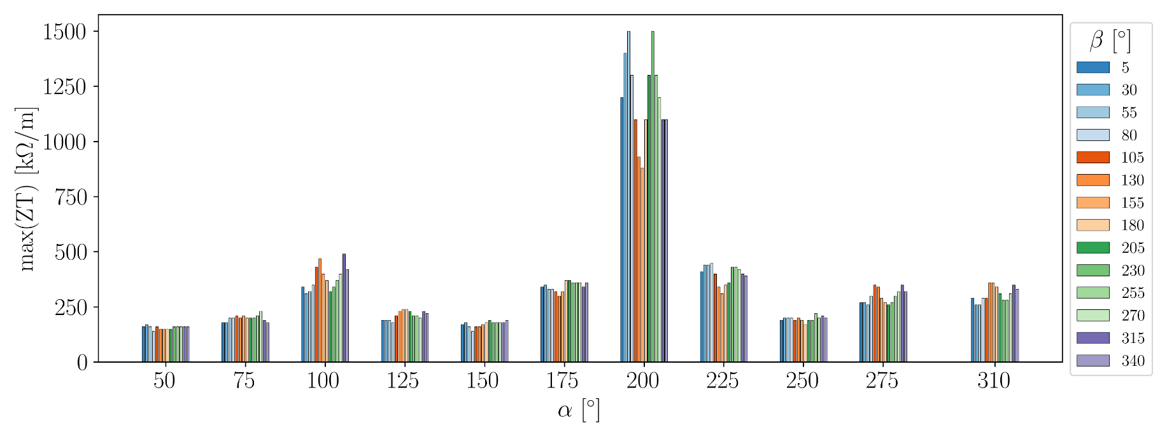
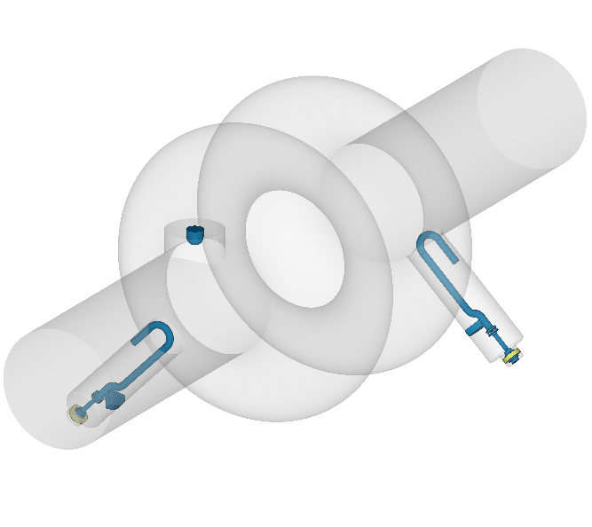



HOM coupler configurations
$$β$$
$$α$$
$$\min_{I_{f}}{Z_{⊥,max}}{.}$$
j

Slide 13
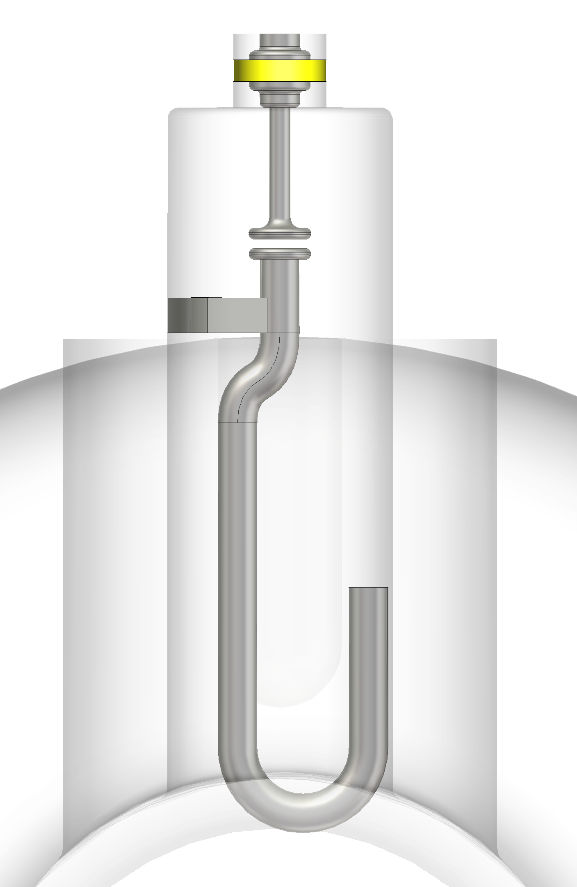
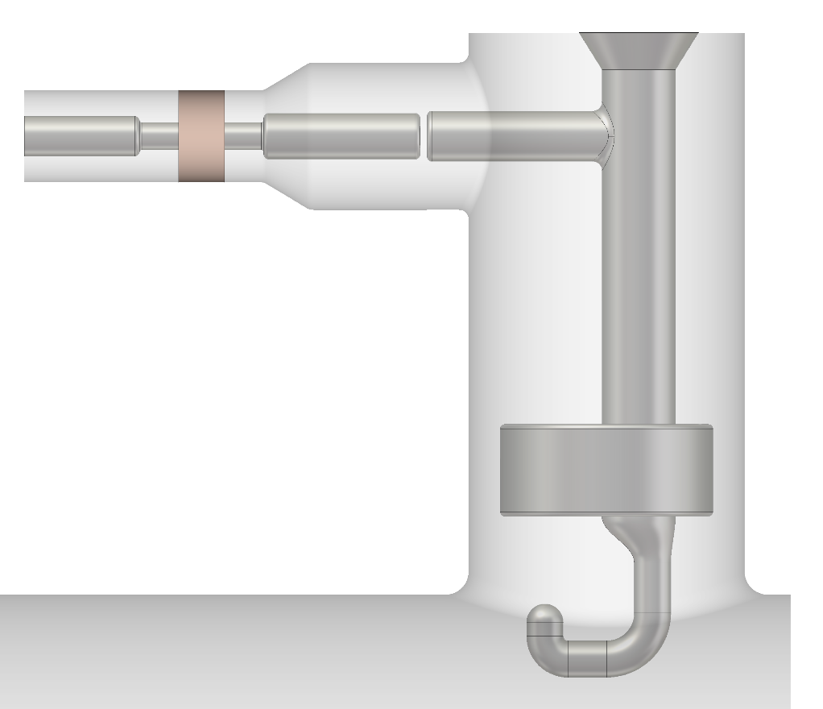
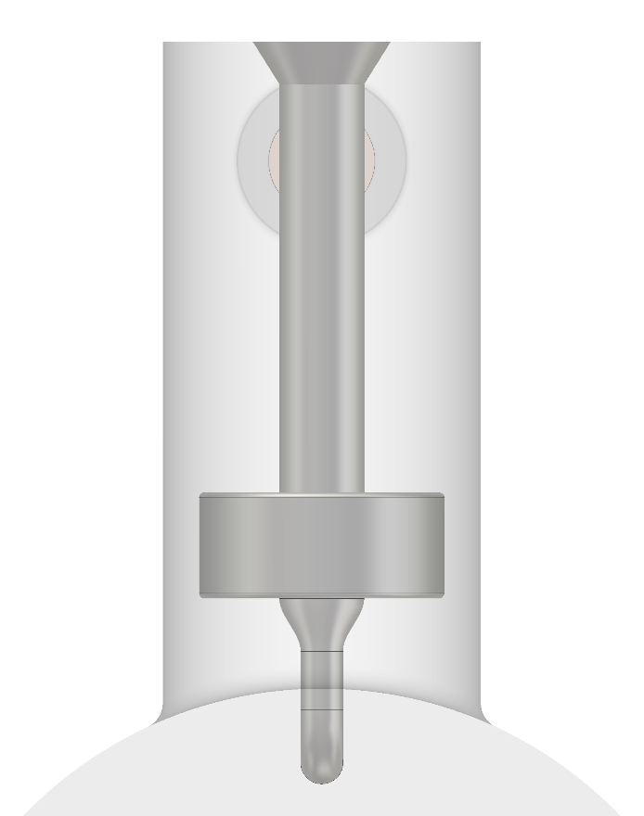



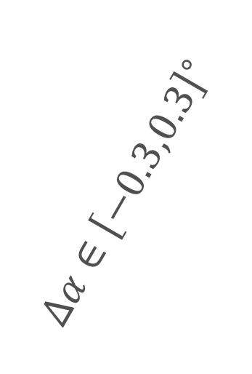


Uncertainty quantification
$$Δch∈\left[−1,1\right]mm$$
$$Δch∈\left[−1,1\right]mm$$
$$Δα∈{\left[−0.3,0.3\right]}^{∘}$$
$$Δp∈\left[−1,1\right]mm$$
$$Δα∈{\left[−0.3,0.3\right]}^{∘}$$
$$Δp∈\left[−1,1\right]mm$$
Double Quarter-Wave HOM Coupler
Hook-Type HOM Coupler

Slide 14
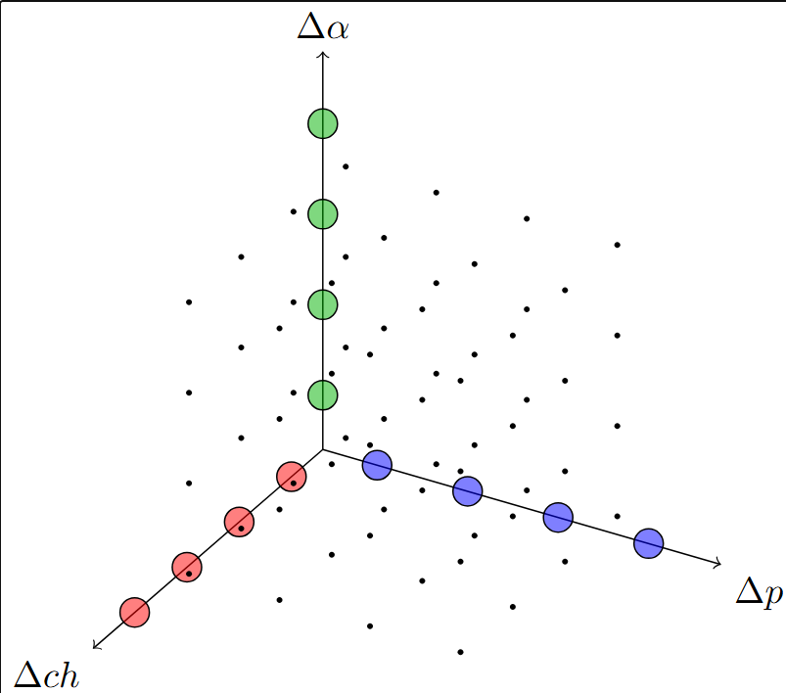
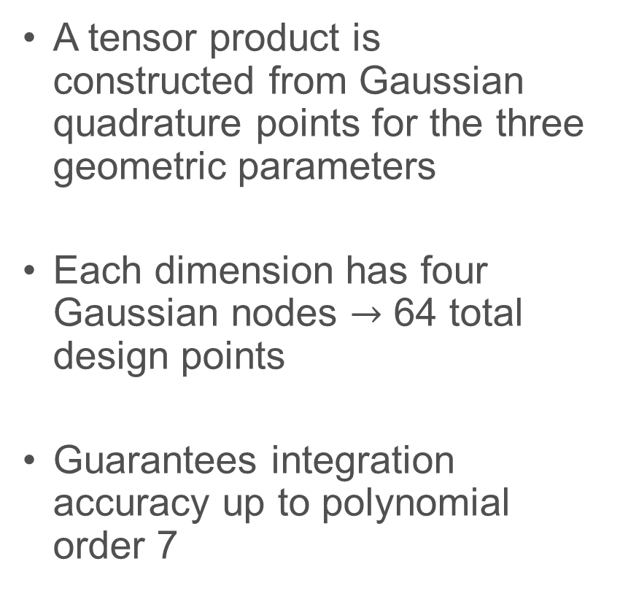
Uncertainty quantification
Method
A tensor product is constructed from Gaussian quadrature points for the three geometric parameters
Each dimension has four Gaussian nodes $→$ 64 total design points
Guarantees integration accuracy up to polynomial order 7

Slide 15
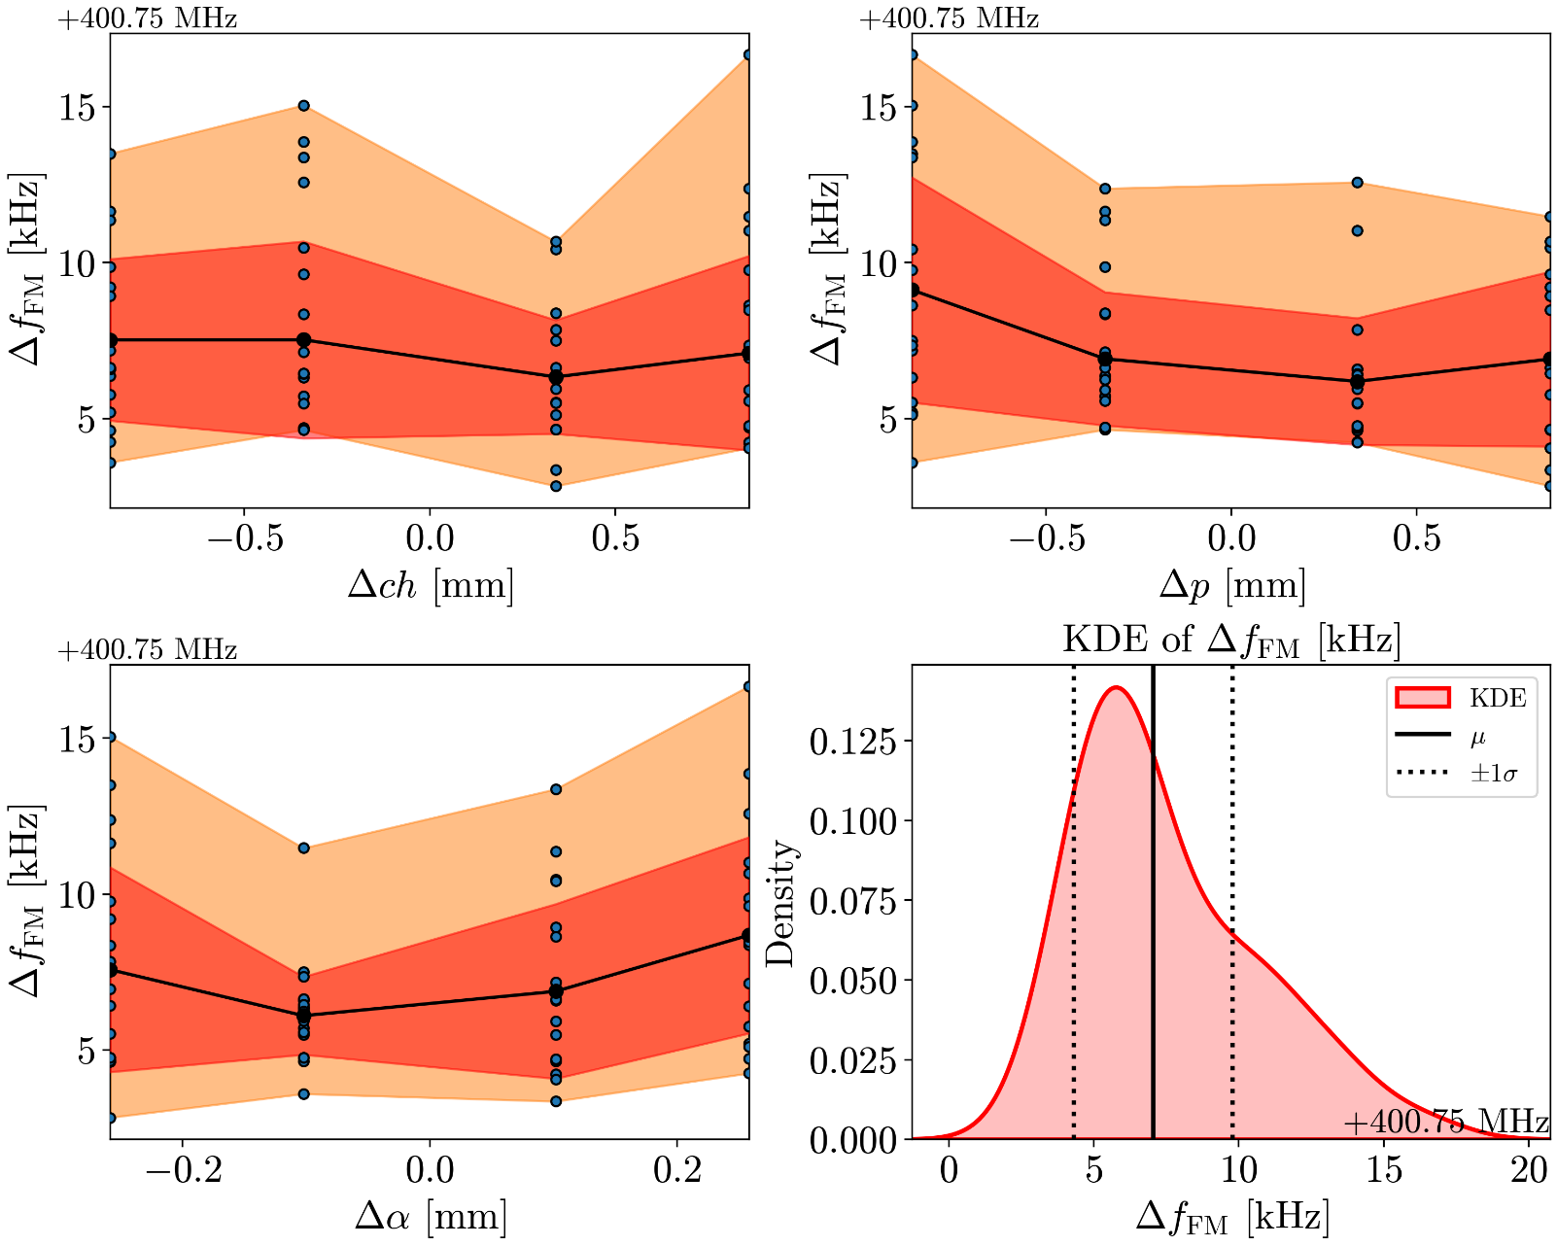
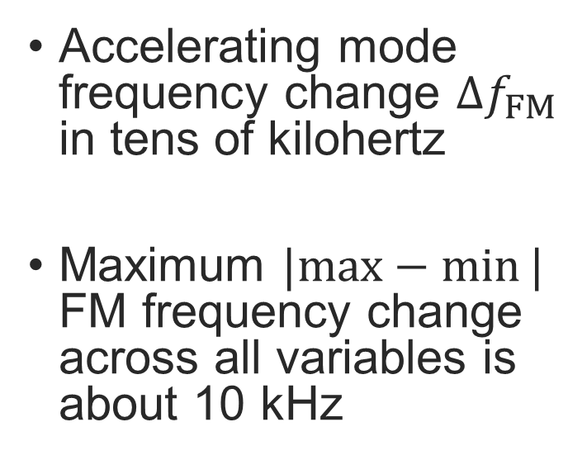
Uncertainty quantification
Accelerating mode frequency
Accelerating mode frequency change $Δf_{FM}$ in tens of kilohertz
Maximum $|max−min⁡|$ FM frequency change across all variables is about 10 kHz

Slide 16
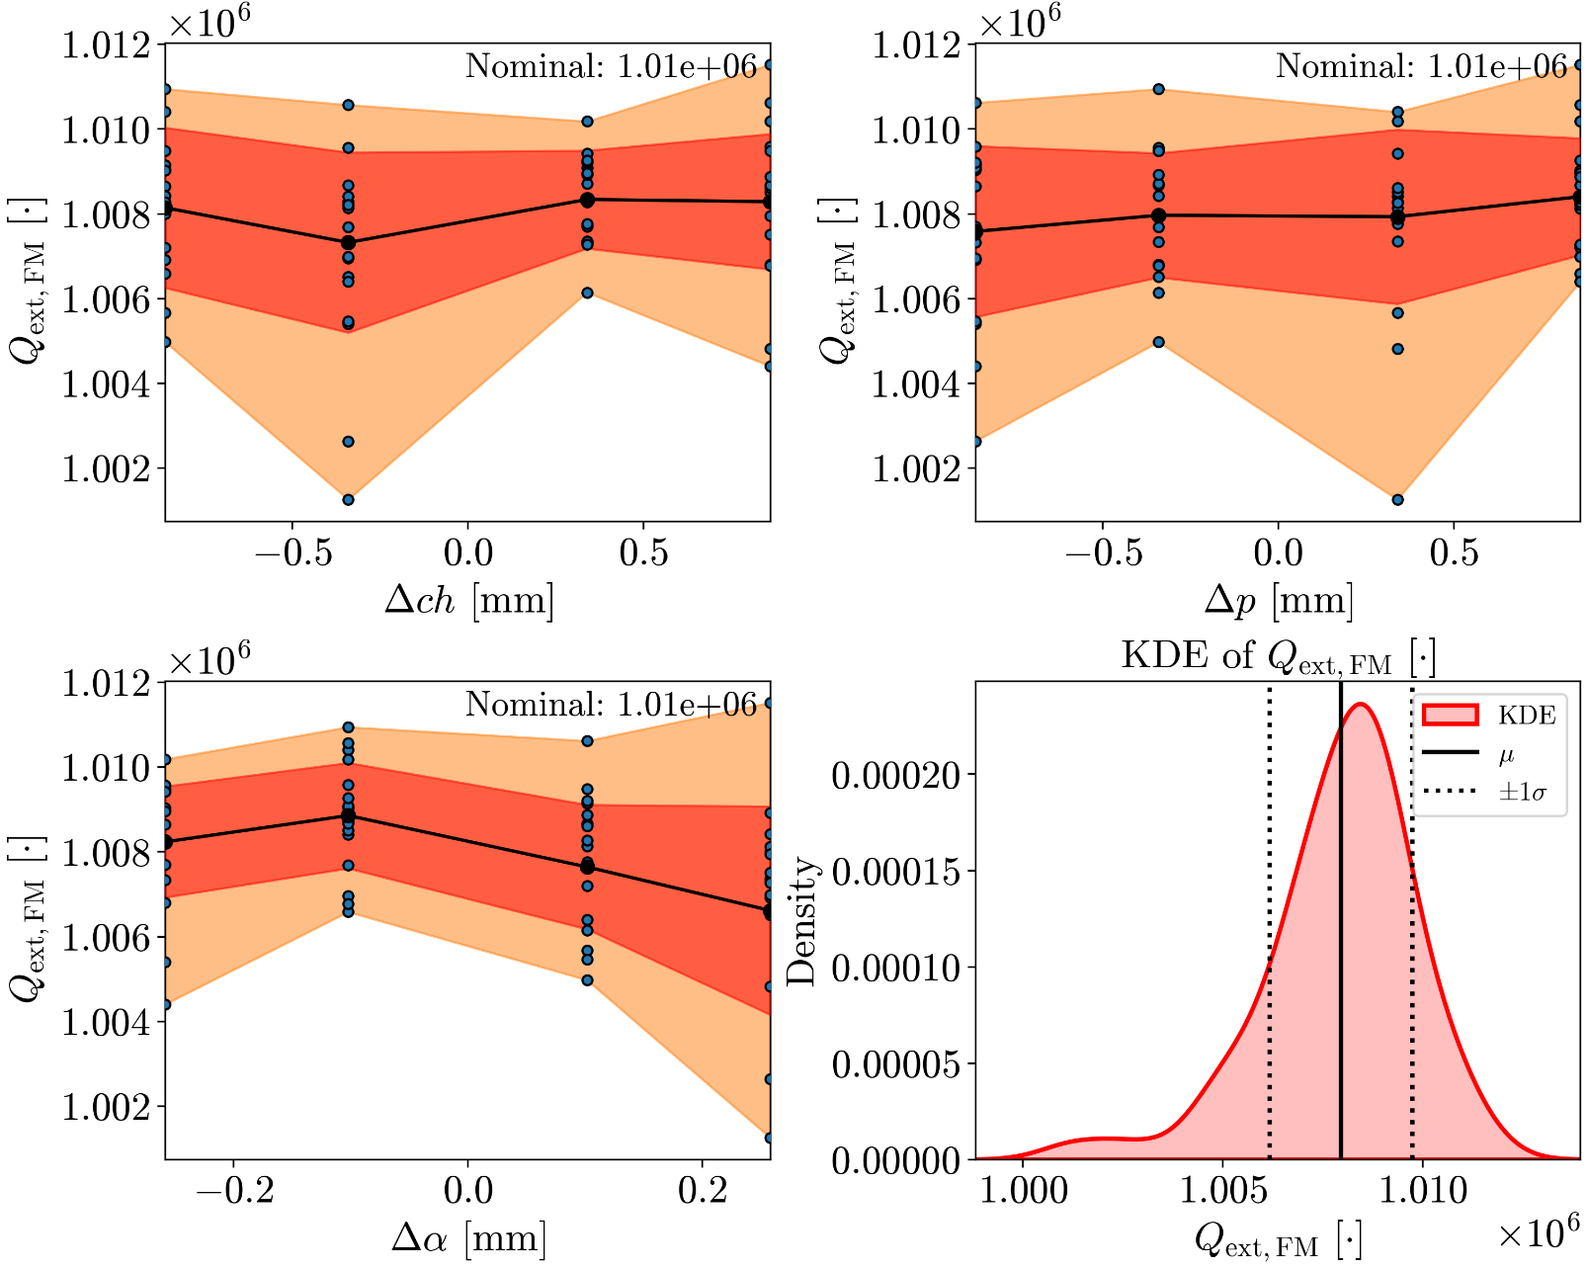

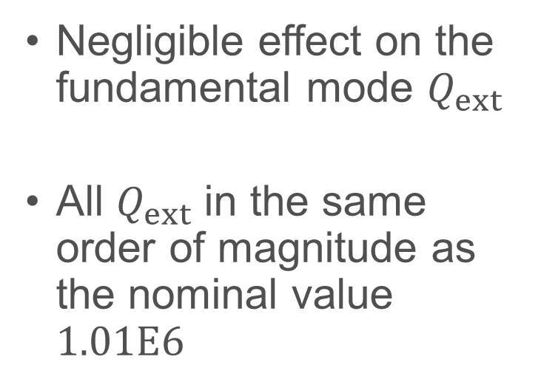
Uncertainty quantification
Accelerating mode external quality factor $Q_{ext}$
Negligible effect on the fundamental mode $Q_{ext}$
All $Q_{ext}$ in the same order of magnitude as the nominal value $1.01E6$

Slide 17
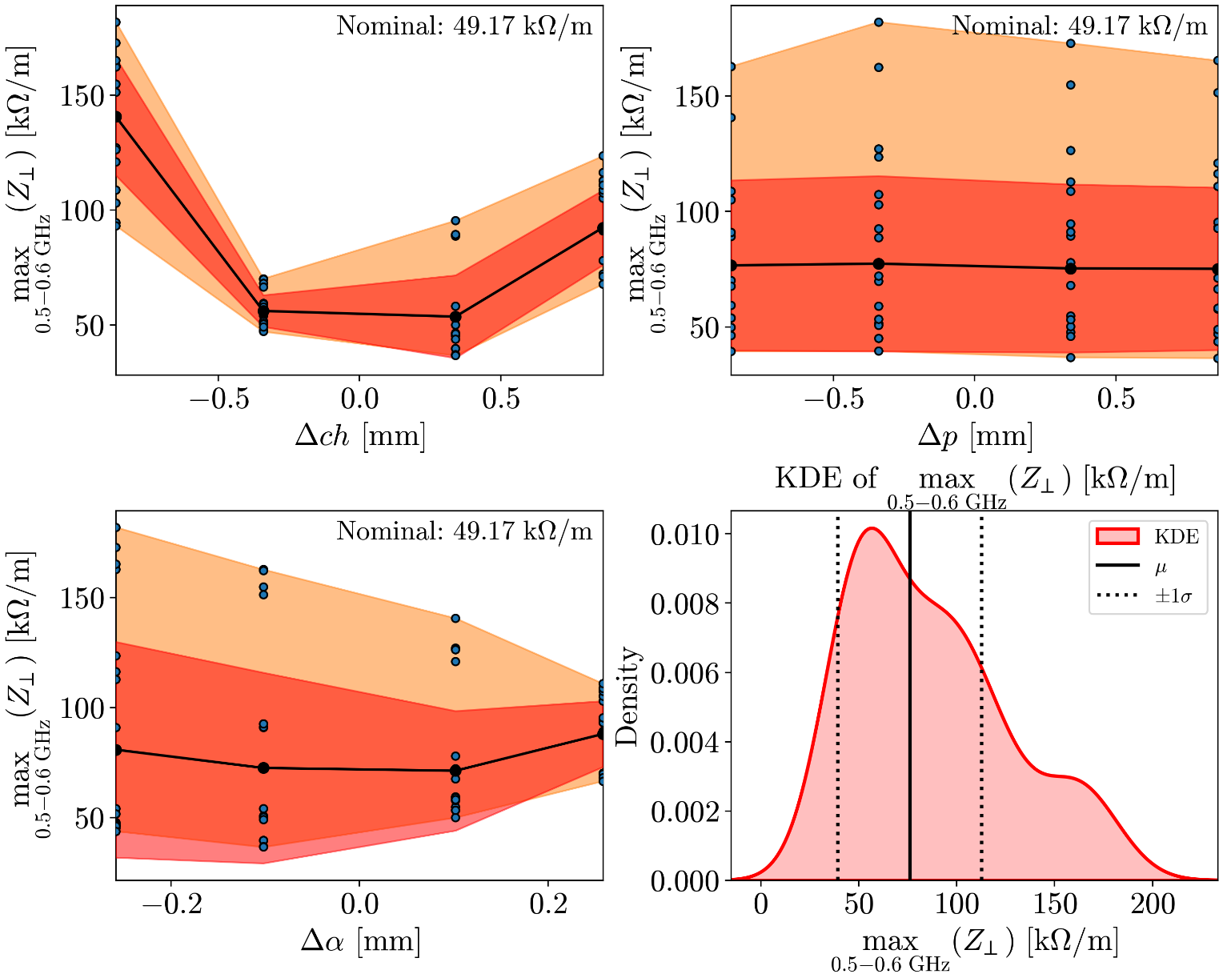

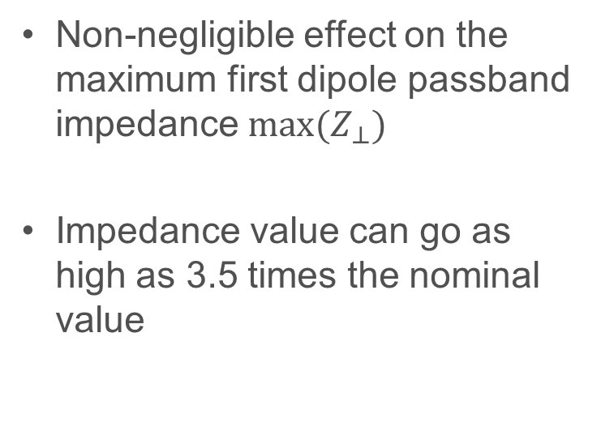
Uncertainty quantification
Max Transverse Impedance – First HOM Dip. Passband
Non-negligible effect on the maximum first dipole passband impedance ${max(Z}_{⊥})$
Impedance value can go as high as 3.5 times the nominal value

Slide 18
Summary
In this presentation I showed
  Equivalent circuit modelling
  Sensitivity analysis and
  Uncertainty quantification of some coaxial HOM couplers
outlook
Development of an efficient procedure for synthesising and tuning equivalent circuit models

Slide 19
Brandenburgische Technische Universität Cottbus – Senftenberg
Fakultät/Institut/Verwaltungsbereich
Fachgebiet/Abteilung
Sosoho-Abasi Udongwo
E udongwo@b-tu.de

