Slide 1

International Workshop
HOMSC2025
Hamburg, Germany @ DESY
October 6-8, 2025
PROGRESS OF HOM COUPLERS FOR PERLE SRF CAVITIES
Patricia Duchesne, Sébastien Blivet, Akira Miyazaki, Gilles Olivier, Guillaume Olry, Hervé Saugnac IJCLab
Yolanda Gomez Martinez LPSC
Carmelo Barbagallo, Karin Canderan CERN
Haipeng Wang JLab
Work supported by funding from the European Union’s program Horizon-INFRA-2023-TECH-01 under GA No 101131435 – iSAS

Slide 2
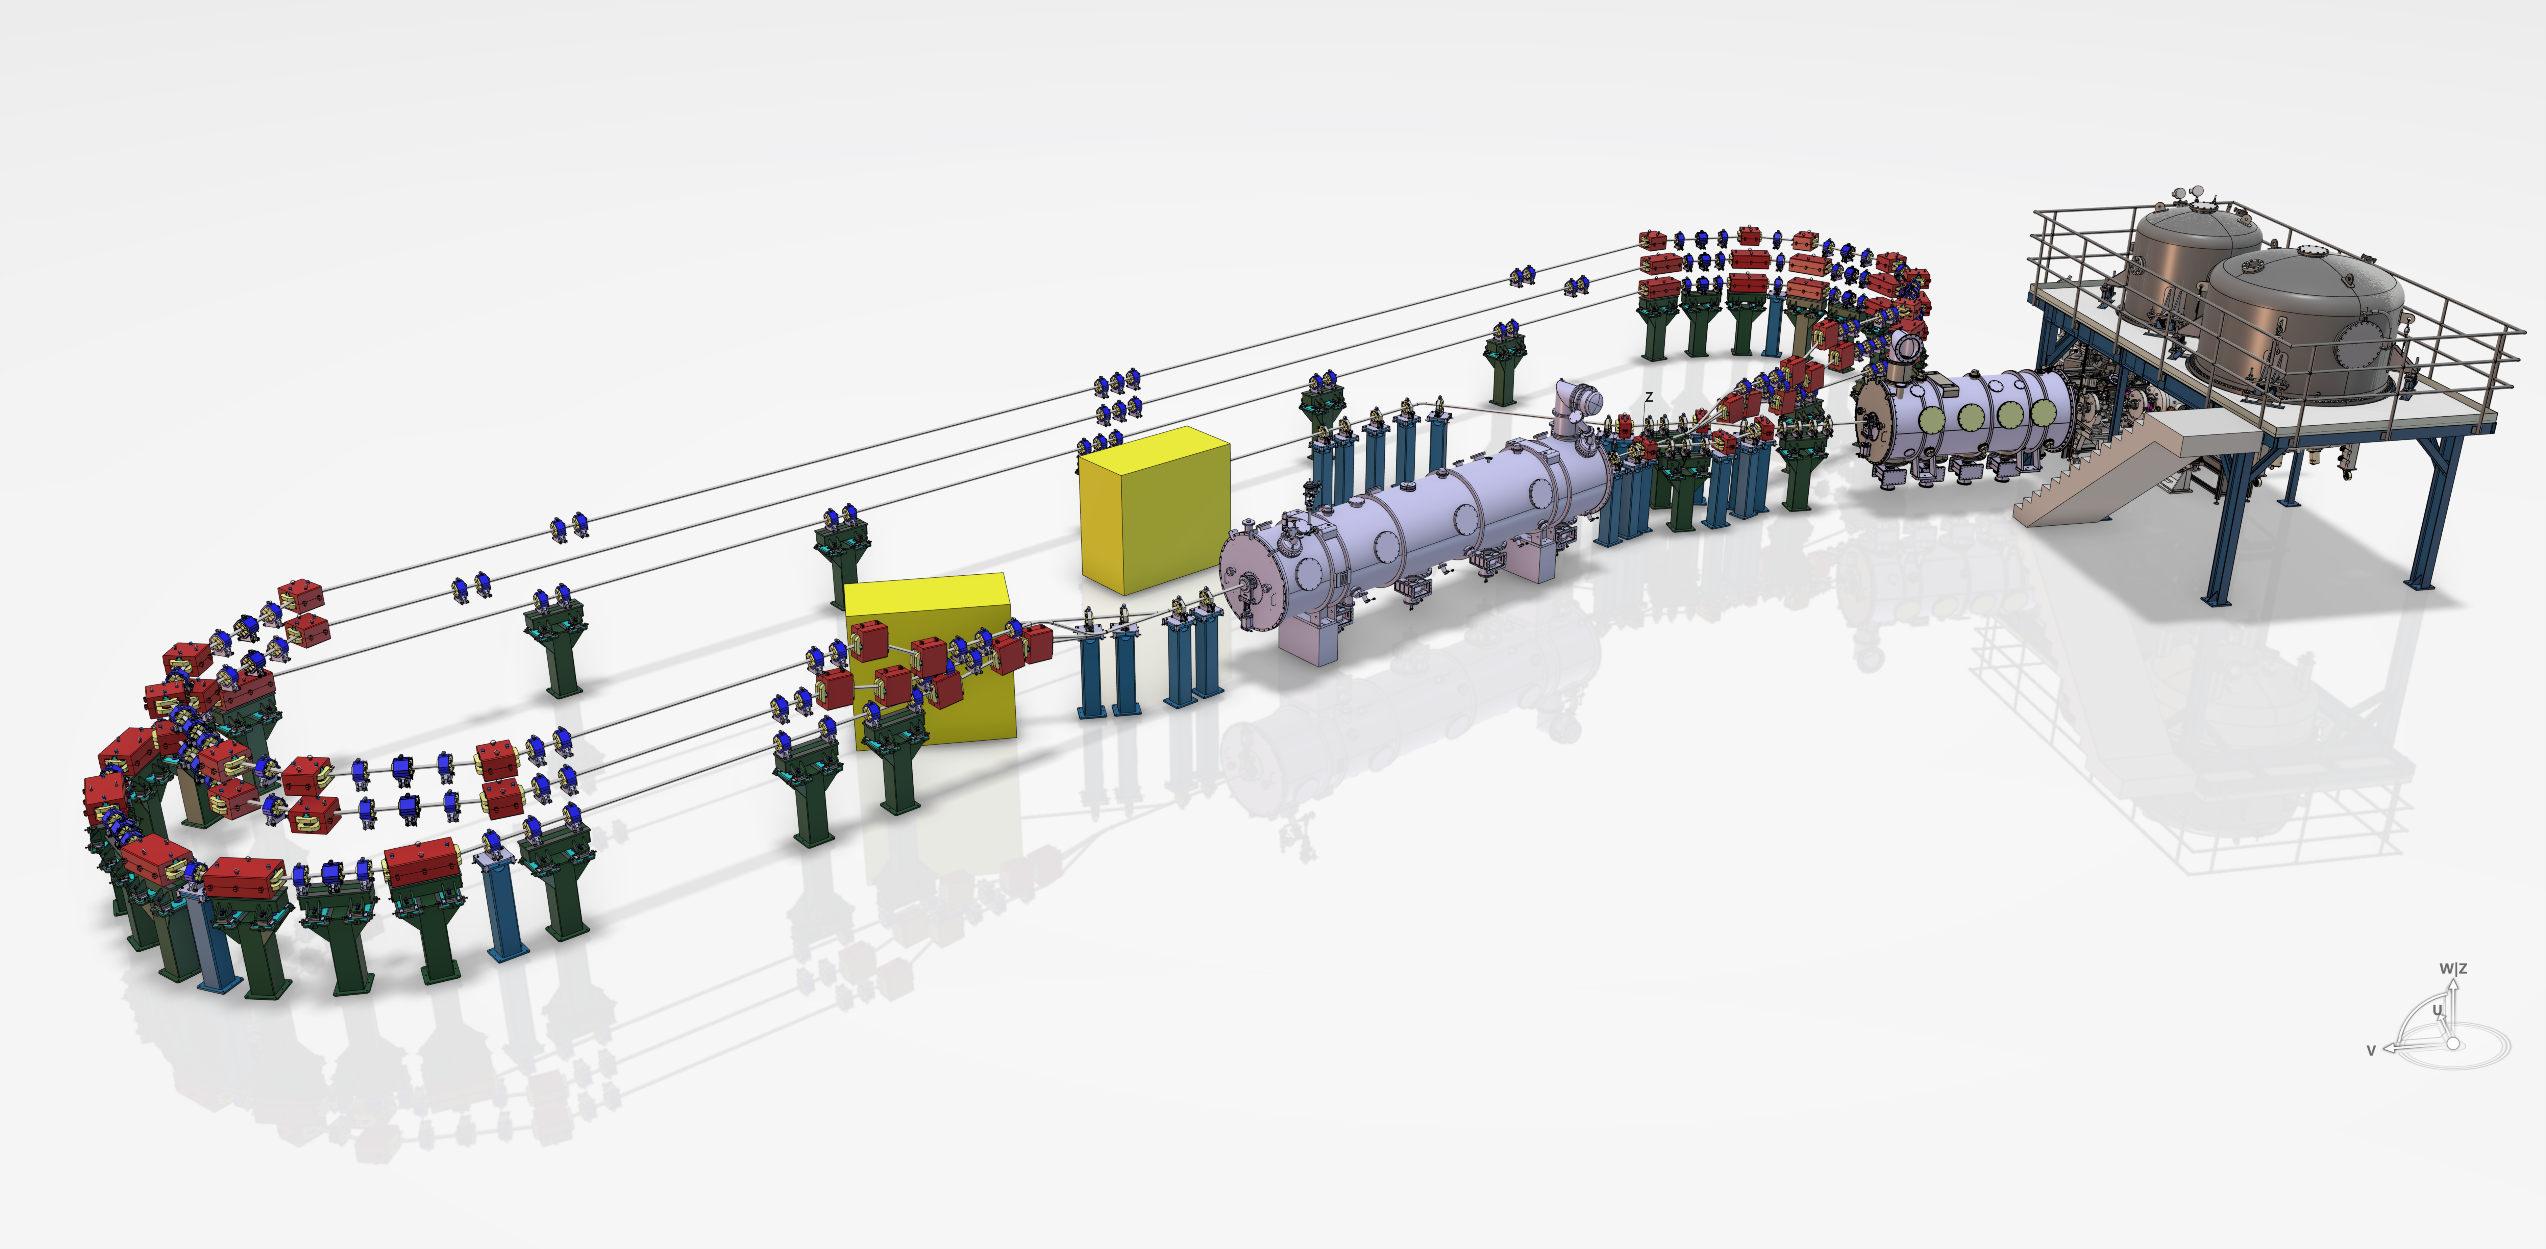
CONTEXT: ERL PERLE
PERLE (Powerful Energy Recovery Linac for Experiments)
PERLE 3 turns @500 MeV
ERL PERLE 250 MeV
PERLE 3 turns @250 MeV
DC Photogun
HV system
PERLE 1 turn @89 MeV
Beam dump
2025
2026
2027
2028
2029
2030
Booster
Linac cryomodule
(Four 5-cell SRF cavities)
Injection line
500
250
Recirculating arc (x3)
Target Parameters (2030) | Unit | Value
Injection energy | MeV | 7
Electron beam energy | MeV | 250
Normalized emittance | mm mrad | 6
Average beam current I_{b,0} | mA | 20
Bunch charge Q_{b} | pC | 500
Longitudinal bunch length σ_{z} | mm | 3
RF frequency | MHz | 801.58
Duty factor | - | CW
20
Demonstrate multi-turn and high current operation
Validate important technical choices
Host experiments of interest for our lab and institute

Slide 3
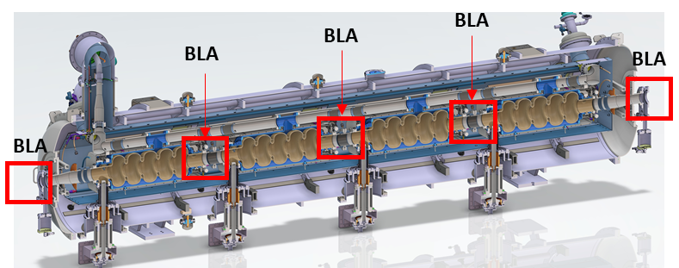
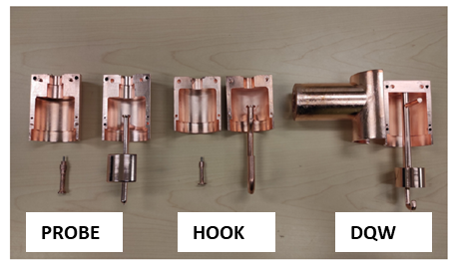
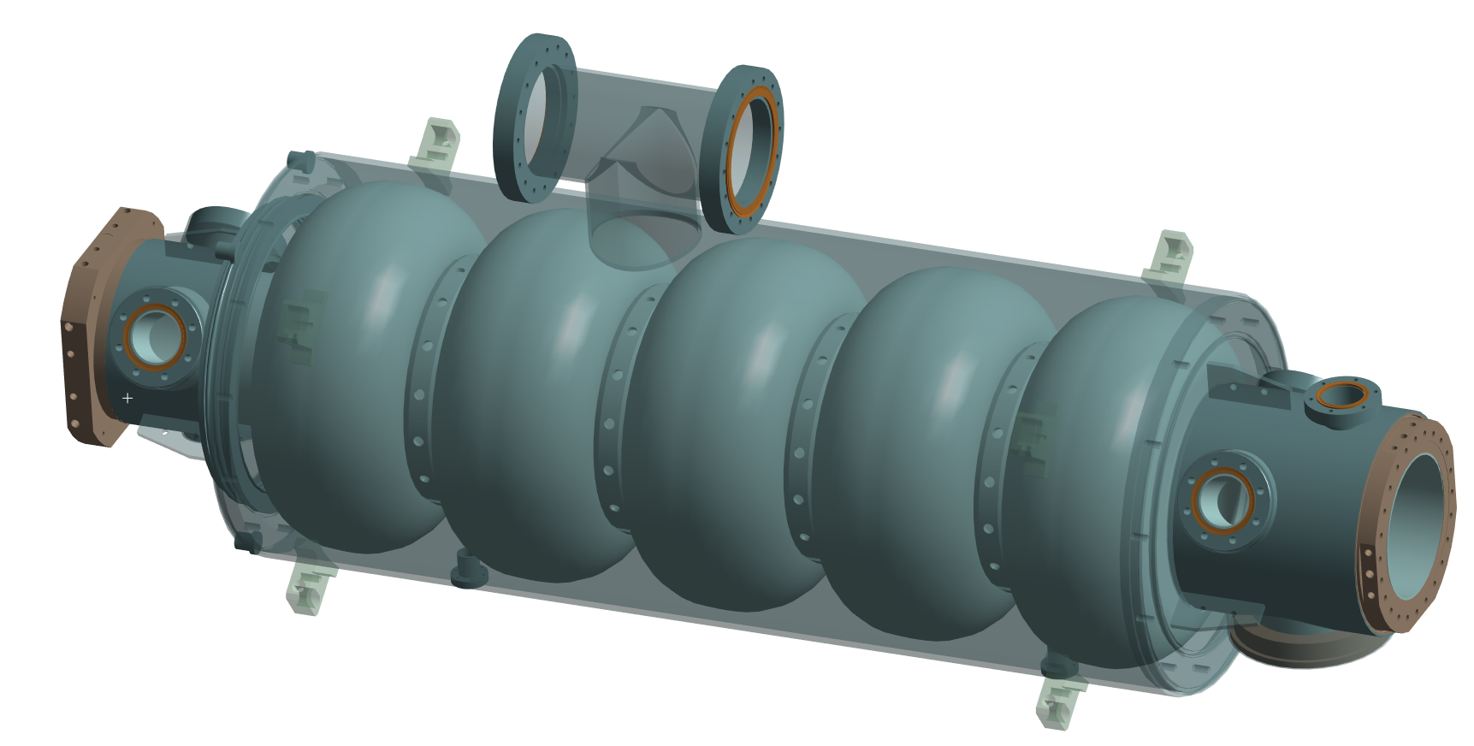
CAVITY AND HOM COUPLER DEVELOPMENT FOR PERLE
PERLE 5-cell CAVITY & HOM COUPLERS
Cavity RF Design by CERN & Jefferson Lab: optimized for an ERL at high beam currents (High Q₀, efficient HOMs extraction), prototype manufactured and tested successfully (Q_{0@2K} = 3e10 @27 MV/m)
HOM Damping scheme for PERLE (C. Barbagallo, PhD Thesis, 2024):
Coaxial couplers to damp the trapped HOMs (4 max / cavity)
Beam-line absorbers to damp the HOMs propagating through the beam pipes (cold / warm BLA)
First Nb 802 MHz 5-cell cavity fabricated @JLab
First PERLE HOM Coupler Prototypes
3D-printed epoxy & copper coated couplers at CERN
Successfully tested on 5-cell copper cavity at Jlab
Linac cryomodule PERLE
HOM port (x4)
Cavity mechanical design: mechanical and RF sensitivity analyses
120°
Cavity made of Niobium RRR250
Titanium He Tank including the beam pipes
4 HOM ports + 1 High Power Coupler port + 1 pickup port
pickup port
Jacketed Nb 802 MHz 5-cell cavity
HPC port

Slide 4

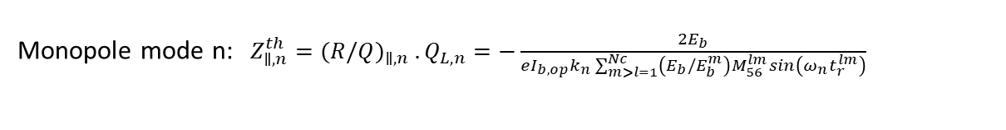
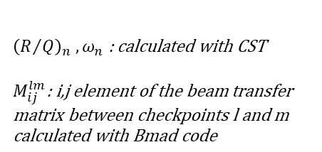
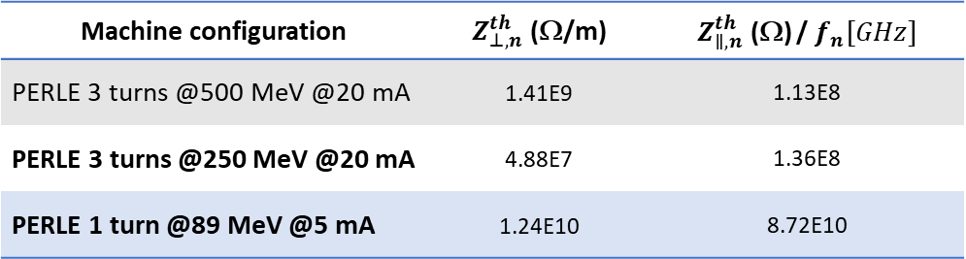
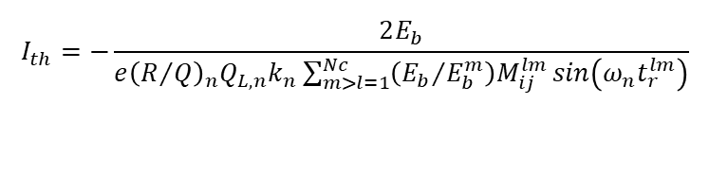
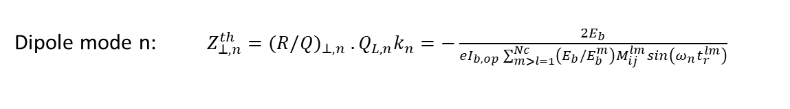
DAMPING SCHEME: REQUIREMENTS
DAMPING REQUIREMENT
BBU (Beam BreakUp instability) studies from an analytical method (C. Barbagallo, PhD Thesis, 2024)
Threshold current I_{th} for a multi-pass machine:
PERLE 500 MeV
$${\left(R/Q\right)}_{n} , ω_{n}\text{ : }\text{calculated} \text{with} \text{CST}$$
$M_{ij}^{lm}\text{: }\text{i}\text{,}\text{j} \text{element} \text{of} \text{the} \text{beam} \text{transfer} \text{matrix} \text{between} \text{checkpoints} \text{l} \text{and} \text{m} \text{calculated} \text{with} \text{Bmad} \text{code}$
CM1_start
Cryomodule 1
CM1_end
$$I_{th}=−\frac{2E_{b}}{e{\left(R/Q\right)}_{n}Q_{L,n}k_{n}\sum_{m>l=1}^{Nc}{\left({E_{b}}/{E_{b}^{m}}\right)M_{ij}^{lm}}sin\left(ω_{n}t_{r}^{lm}\right)}$$
Impedance threshold:
2,4,6
1,3,5
Monopole mode n: $Z_{∥,n}^{th}={(R/Q)}_{∥,n} . Q_{L,n}=−\frac{2E_{b}}{eI_{b, op}k_{n}\sum_{m>l=1}^{Nc}{\left(E_{b}/E_{b}^{m}\right)M_{56}^{lm}}sin\left(ω_{n}t_{r}^{lm}\right)}$
Dipole mode n: $Z_{⊥,n}^{th}={(R/Q)}_{⊥,n} . Q_{L,n}k_{n}=−\frac{2E_{b}}{eI_{b, op}\sum_{m>l=1}^{Nc}{\left(E_{b}/E_{b}^{m}\right)M_{ij}^{lm}}sin\left(ω_{n}t_{r}^{lm}\right)}$
CM2_end
Cryomodule 2
Dump
HOM requirements depending on the machine configuration:
PERLE 250 MeV
Cryo_start
Cryo_end
Dump
Machine configuration | $Z_{⊥,n}^{th}$ (Ω/m) | $Z_{∥,n}^{th}$ (Ω) / $f_{n}[GHz]$
PERLE 3 turns @500 MeV @20 mA | 1.41E9 | 1.13E8
PERLE 3 turns @250 MeV @20 mA | 4.88E7 | 1.36E8
PERLE 1 turn @89 MeV @5 mA | 1.24E10 | 8.72E10
Cryomodule 1
1,2,3

Slide 5
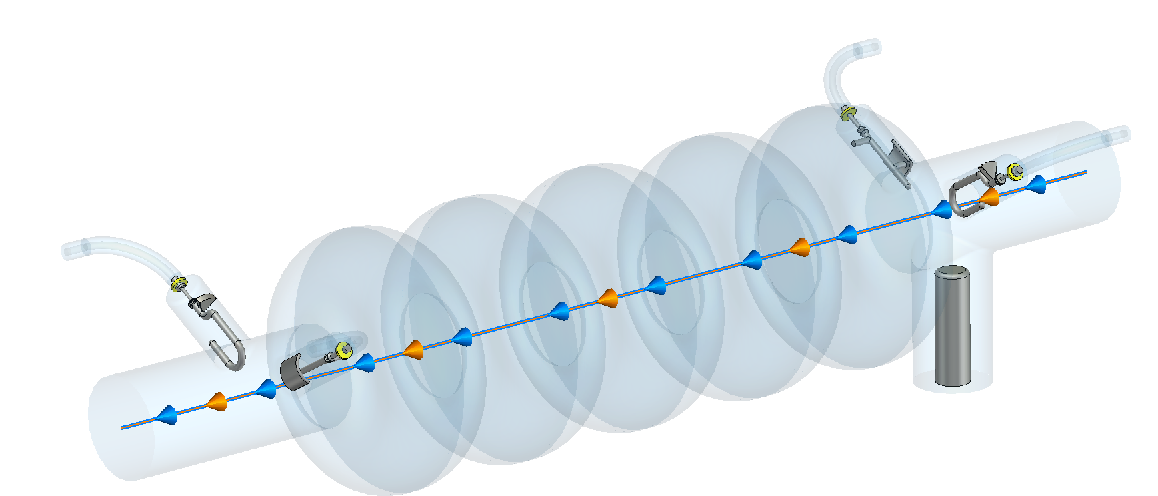
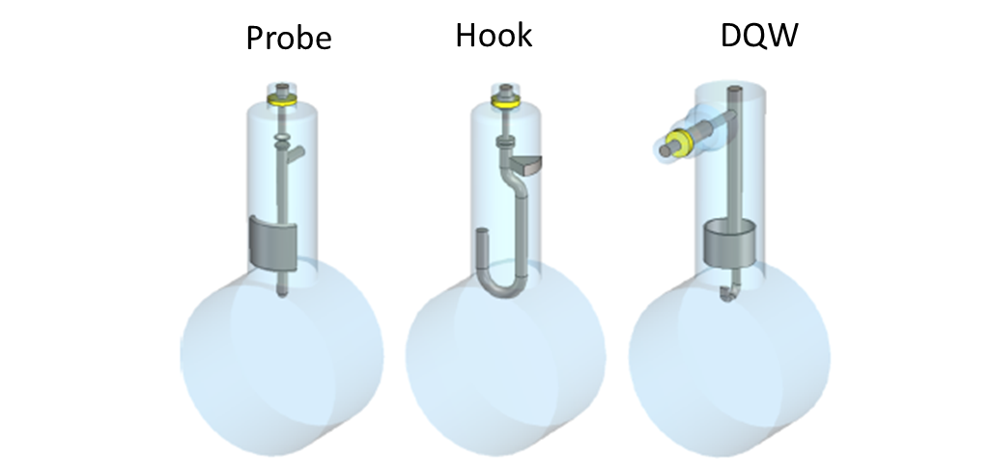


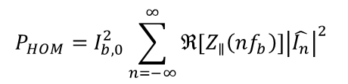
DAMPING SCHEME FOR THE TRAPPED HOMs
CHOICE OF THE HOM DAMPING SCHEME
Example with 2 hook & 2 probe couplers:
Identification of the dangerous HOMs of the 5-cell cavity
with high R/Q values, close to a beam harmonic (a multiple of 40 MHz), confined within the cavity
Several trapped modes: monopoles TM011 and dipoles TE111 & TM110
Monopole modes far from beam harmonics
Dipole modes only 1 to 2 MHz away from beam harmonics
Simulation with CST
(eigenmode + wakefield solvers)
Evaluation of the impedances
with different HOM couplers (HOOK, PROBE, DQW)
Two efficient damping schemes: 4DQW / 2H2P
Evaluation of the HOM power (for one cavity) PERLE 3-turns
Average HOM Power:
$$P_{HOM}=k_{||,HOM}Q_{b}I_{b,op}=\left(k_{||}−k_{||,0}\right){ Q}_{b}I_{b,op}=102W$$
Parameter | Symbol | Value
Longitudinal bunch length | σ_{z} | 3mm
Bunch charge | Q_{b} | 500 pC
Average beam current | I_{b,0} | 20 mA
Operating beam current | I_{b,op} | 120 mA
Total longitudinal loss factor | k∥ | 2.304 V/pC
Loss factor of FM k_{∥,0} | k_{∥,0} | 0.594 V/pC
$$P_{HOM}=I_{b,0}^{2}\sum_{n=−∞}^{∞}{ℜ\left[Z_{∥}\left(nf_{b}\right)\right]{\left|\hat{I_{n}}\right|}^{2}}$$
HOM Power (Wakefield):
$\hat{I_{n} }$= $normalized fourier spectrum$
$$of the beam current$$
Approximation by considering three frequency ranges (Low, Medium, High) (C. Barbagallo):
With 2H2P:
$$P_{HOM}=P_{L}+P_{M}+P_{H}≅P_{L}+P_{M}+\frac{73.7}{7.7}P_{M}=130W$$
P_{L} [0; 2.5 GHz] | P_{M} [2.5; 4 GHz] | P_{H} [4; 40 GHz] | P_{HOM} | 2 Beam pipes | FPC | 2 Hook | 2 Probe
3.5 W | 12 W | 114 W | 130 W | 113 W | 13 W | 1 W | 2.5 W
Almost all of the HOM power goes into the beam pipes (85%). Only several watts are extracted by the HOM couplers

Slide 6
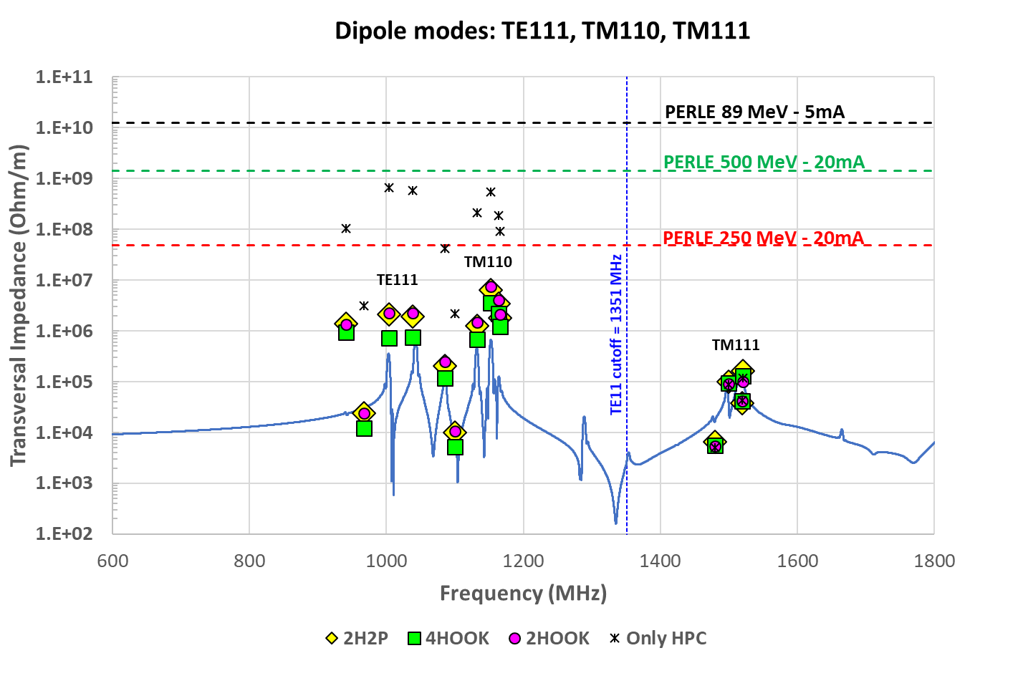
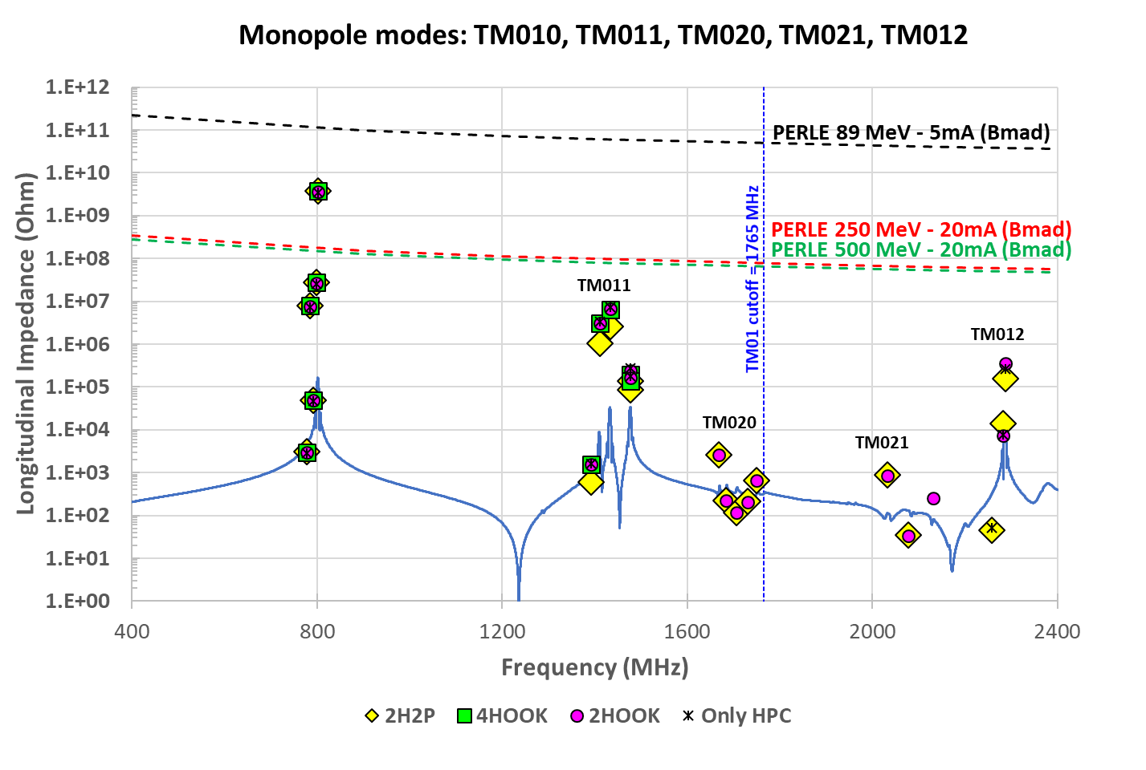
DAMPING SCHEME FOR THE TRAPPED HOMs
HOM DAMPING SCHEME ADOPTED FOR PERLE
Mechanical considerations associated with the integration into the cryomodule
Risk of thermal instability due to dynamic heat loads of the fundamental mode
Integration of the couplers on the cavity equipped with its helium vessel
Only Hook and Probe couplers are possible options
Comparison of the impedances between 2H2P, 4H, 2H
Longitudinal impedance of dangerous monopole modes:
Transversal impedance of dangerous dipole modes:
Ratio = Z_{calc} / Z_{th}
Probe couplers don’t damp enough the monopole modes
Monopole modes are far from beam harmonics
Minimum ratio for 2H > 10
Higher impedances were achieved through more detailed simulations (complete HPC, 2 cavities)
Dipole modes well damped by Hook couplers
Dipole modes are quite close to the beam harmonics
Minimum ratio for 2H > 7
4H damping scheme is the ideal choice (same fabrication, less cost by mass production)
Start PERLE with only 2 HOOK couplers (one on each side of the cavity oriented at 120° to each other), 2 ports left empty for upgrade

Slide 7
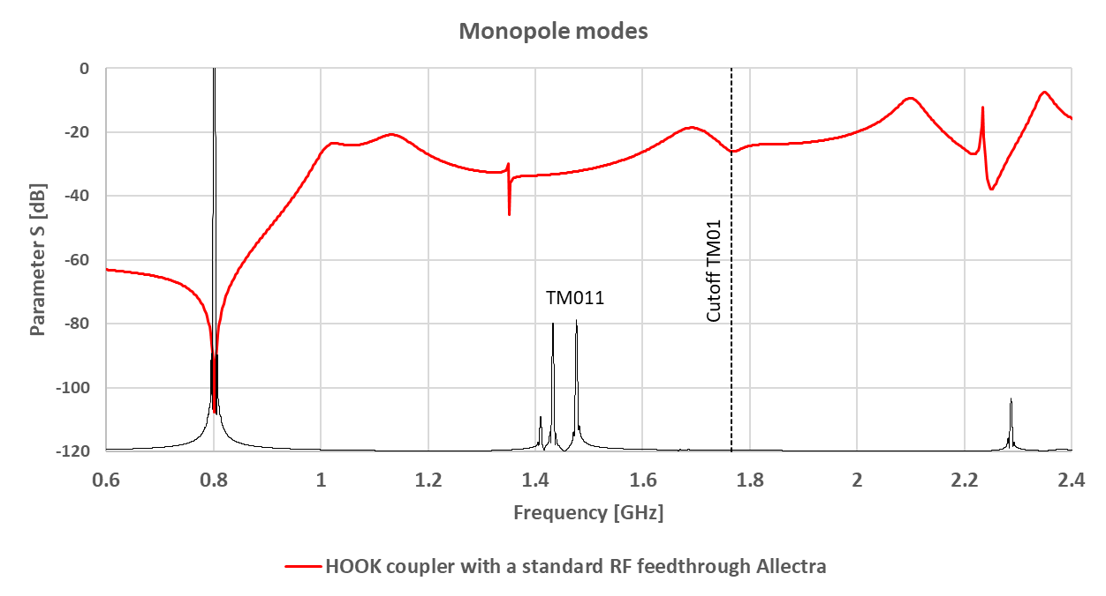
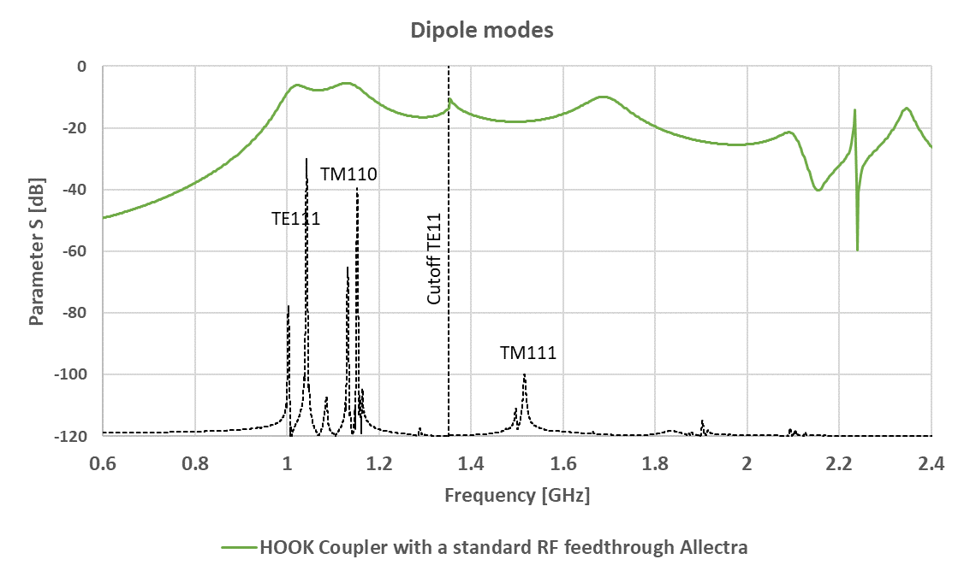
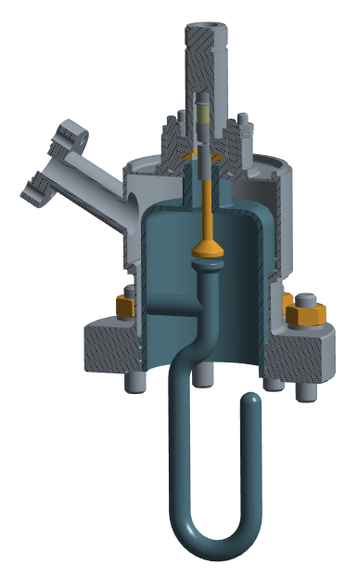
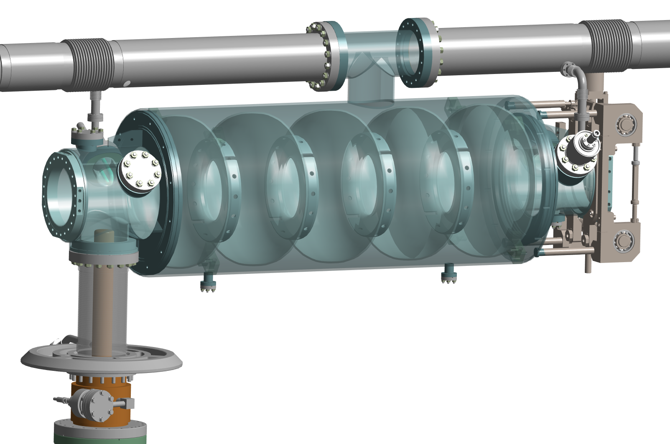
DESIGN OF THE HOM COUPLER
FROM THE RF DESIGN TO THE MECHANICAL DESIGN
Based on 800 MHz Hook coupler for HL-LHC optimized:
The best transmission at TE111 & TM110 passbands
The rejection of the Fundamental mode
Including some geometrical constraints
Hook Coupler for PERLE:
Standard RF feedthrough
Helium Tank
CF16 Flange
Coupler with a High RRR Nb antenna :
A standard RF feedthrough
A Helium tank to provide an active cooling circuit@2K
CF flanges to have a precise positioning
The closest position to the endcell while allowing the integration of the helium vessel of the cavity
Cu top antenna
CF50 Flange
Sensitivity studies performed on geometrical parameters to define requirements on the geometrical tolerances
Validation of the mechanical design: iterative process combining RF, thermal and mechanical analyses
5-cell cavity with 2 Hook couplers in the cryomodule
Nb Outer conductor
Nb antenna

Slide 8

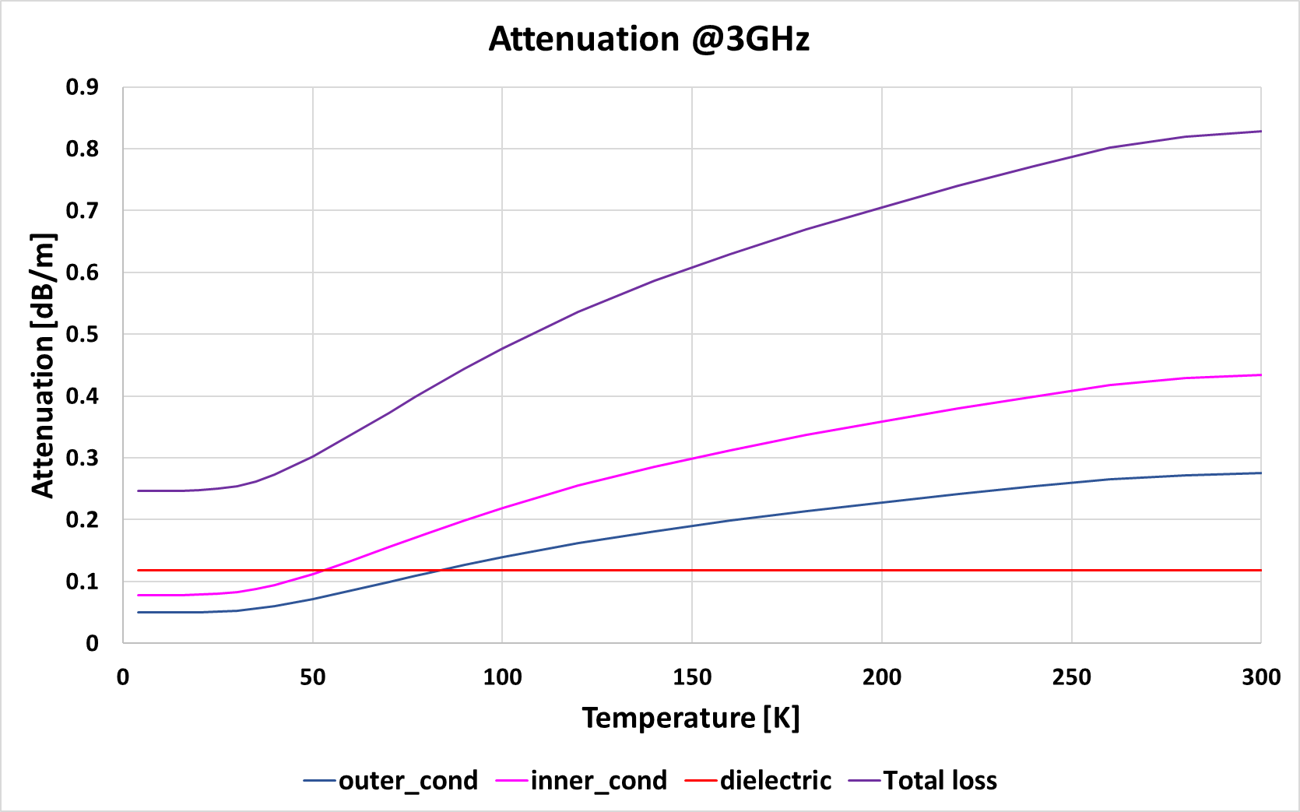
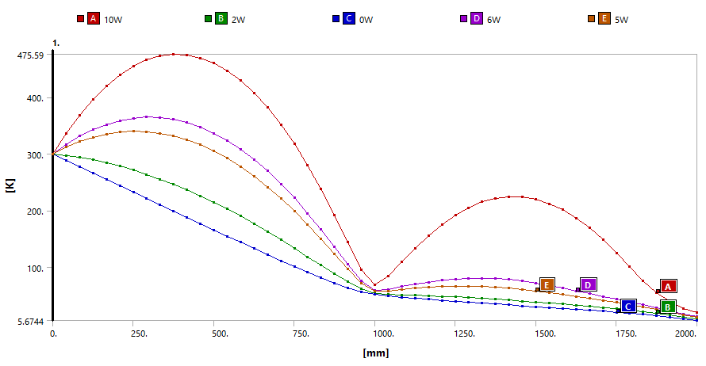
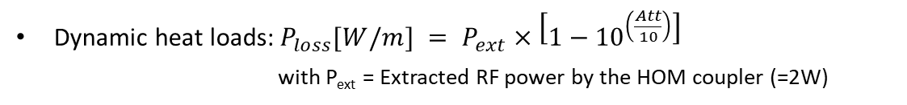
RF CABLE
CHOICE OF THE RF CABLE
As the extracted HOM power by the coupler is evaluated to a few watts, a RF cable type RG142 is being considered:
Its small diameter limits the static heat loads,
Its length is limited to reduce the dynamic heat contribution.
Attenuation @3GHz
Type RG142
0,83 dB/m @RT
Static heat loads: Thermal conduction from the ambient temperature
No thermalization of the RF cable: 145 mW @2K
With a thermalization at 50K: < 100 mW @2K
0,25 dB/m @2K
Dynamic heat loads: RF losses along the RF cable
Evaluation of the attenuation of the RF cable as a function of temperature
Temperature of the cable inside the cryomodule as a function of HOM power extracted
Dynamic heat loads:$P_{loss}[W/m] = P_{ext}×\left[1−{10}^{\left(\frac{Att}{10}\right)}\right]$
with P_{ext} = Extracted RF power by the HOM coupler (=2W)
T = 476K = 203°C
T = 364K
Thermalization at the centre
T = 337K
No thermalization of the RF cable: 420 mW @2K, T°_{max} = 380K
With a thermalization at 50K: < 150 mW @2K, T°_{max} = 300K
Thermal. 50K
Extremity on the HOM coupler side
Measurements will be realized in cryostat to validate the choice of RF cables
Thermal straps @2K will be also added to reduce heat loads on the HOM coupler
Extremity on the Cryomodule side

Slide 9
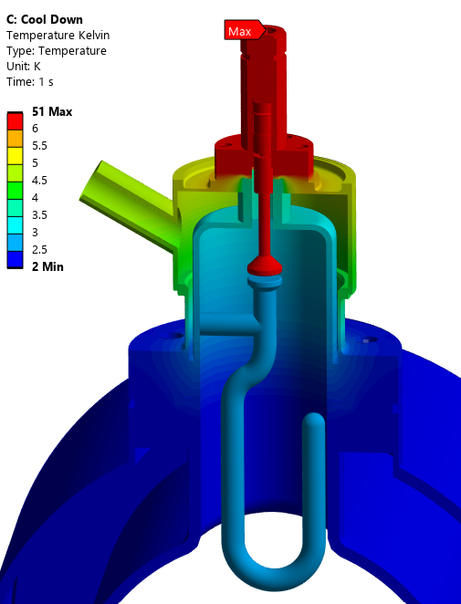
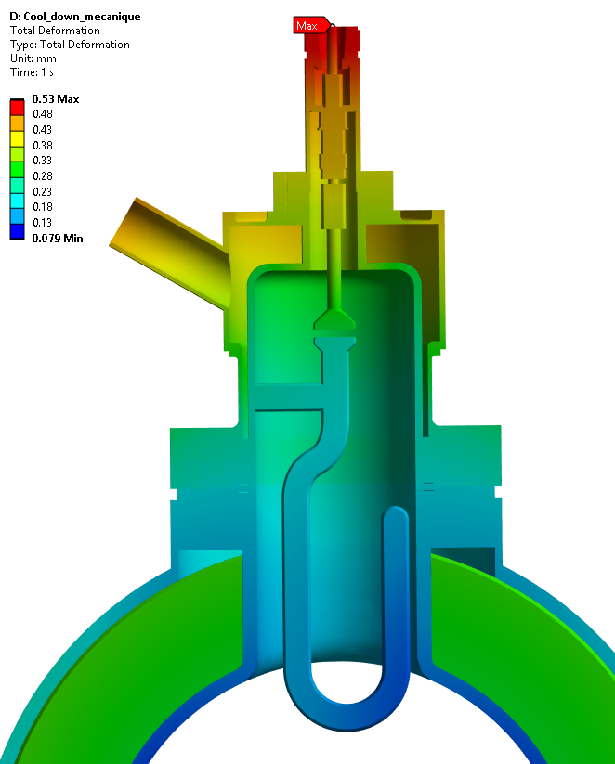
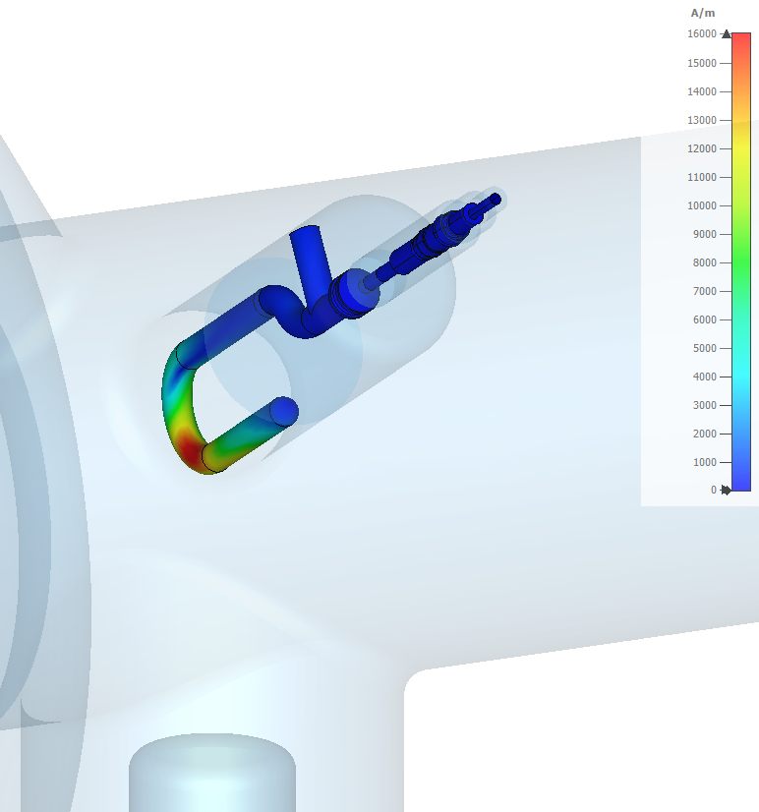
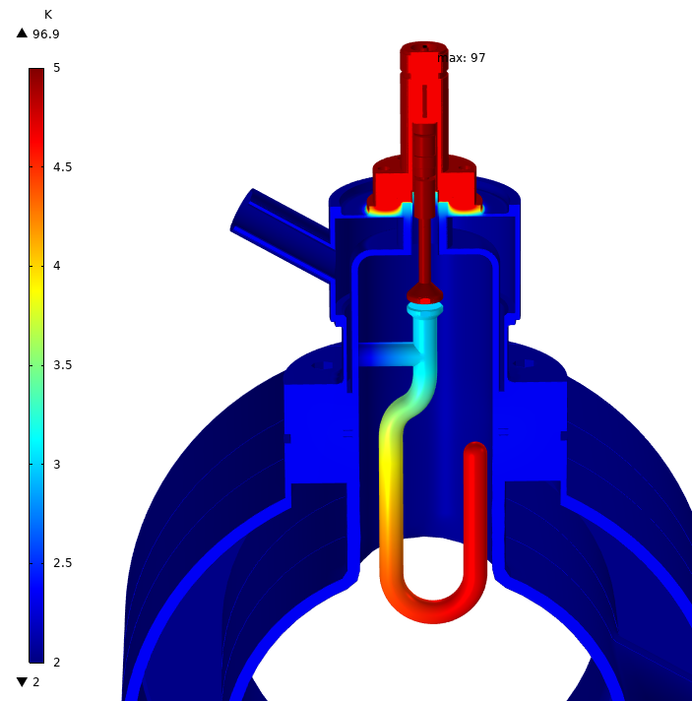
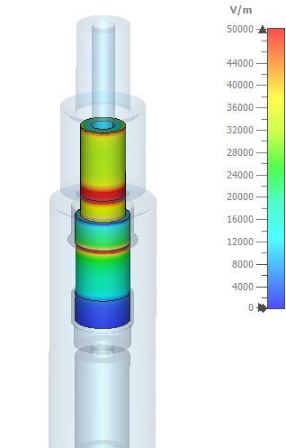


MECHANICAL DESIGN OF THE HOM COUPLER
T° achieved after cooling down
Thermal contractions
Thermal and Mechanical analyses
Static heat loads
= 100 mW
Cooling down (static heat loads, no LHe in the coupler tank):
4.8 K
Gap reduction 0.05mm
No liquid helium
Resistance to the helium bath pressure (MAWP=1,5 barg)
Low temperature range achieved
Acceptable thermal contractions and stresses
30K
Gap reduction 0.04mm
Cavity @2K
Nominal condition (all heat loads, LHe in the coupler tank):
Heat loads from the RF cable: 100 mW + 150 mW
Dynamic heat loads due to fundamental mode (FM) on walls and dielectrics (strongly depend on the Niobium T°)
Gap reduction 0.06mm
2.8K
H field & E field @Eacc = 22.4 MV/m
T° in nominal condition
$$P_{Joule}=\frac{1}{2}R_{surf}\left(T\right)\iint_{S}{H_{S}^{2}dS}$$
all heat loads
= 100 mW + 150 mW
In the ceramic
E_{max} = 0.05 MV/m
Static heat loads [mW] | 100
Dynamic heat loads [mW] | 490+150
➔ Total heat loads [mW] | 740
Dissipated by:
Cavity LHe@2K [mW] | 5
Coupler LHe@2K [mW] | 735
$$P_{cer}=πfε_{0}ε_{r}tanδ\iiint_{V}{E^{2}dV}$$
Liquid helium
H_{max} = 1.6x10⁴A/m
B_{max} = 21mT
Cavity @2K
4.8K
Niobium parts remain superconducting
Dynamic heat loads due to FM: 490 mW (including 40mW on hook antenna)
Heat loads dissipated in LHe tank: 735 mW

Slide 10
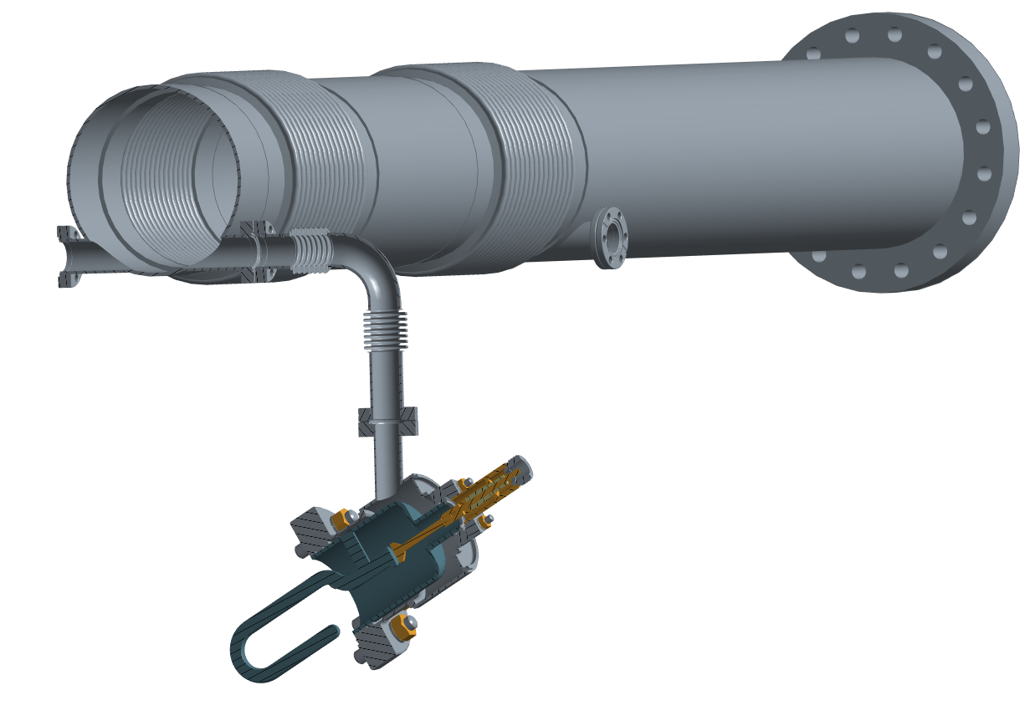
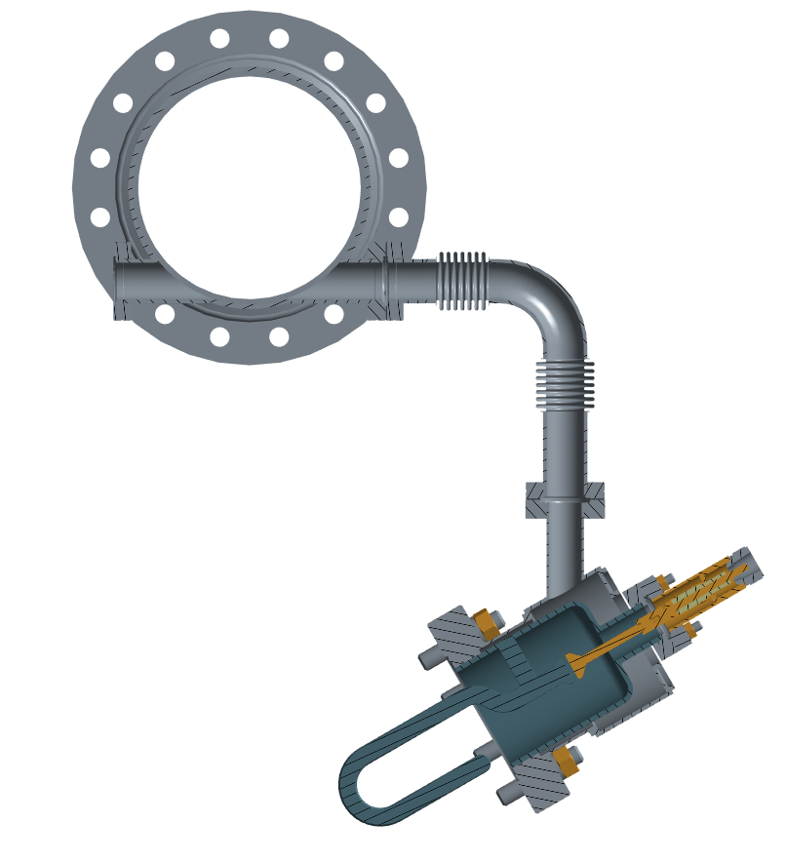



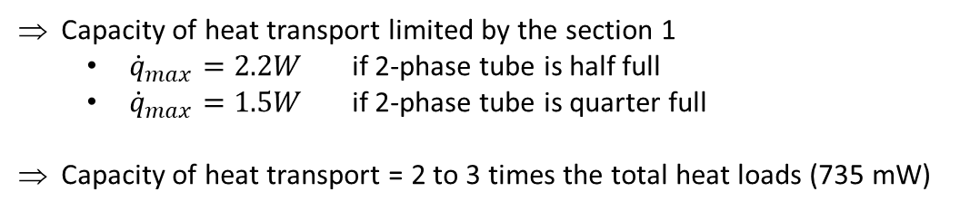

COOLING CIRCUIT
COOLING CIRCUIT @2K
Cooling circuit for HOM coupler
Single pipe connecting the coupler helium vessel to the 2-phase tube (saturated helium bath)
Heat extraction capacity
Evaluation of the maximum heat flux extracted before boiling:
2-phase tube
Pipe ∅16
Use of the equivalent thermal conductivity of Superfluid Helium in a channel:
T_{w}
T_{c}
$${\dot{q}}^{3.4}=f^{−1}\frac{dT}{dX}$$
$$\dot{q}$$
Gorter-Mellink law:
He II
∅100
L
H1
Section 1
Hydrostatic pressure gives the maximum variation of temperature ΔT
H2
Section 2
He I
Capacity of heat transport limited by the section 1
${\dot{q}}_{max}=2.2W$ if 2-phase tube is half full
${\dot{q}}_{max}=1.5W$ if 2-phase tube is quarter full
Capacity of heat transport = 2 to 3 times the total heat loads (735 mW)
He II
P_{sat} + ρgh
ΔT
H3
Section 3
P_{sat}
Vapor
T_{sat}

Slide 11
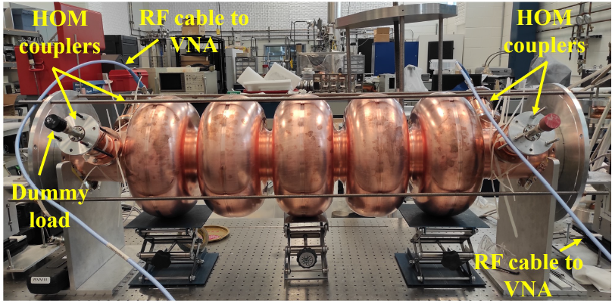
CONCLUSION and OUTLOOK
A damping scheme with only 2 Hook couplers is selected to start PERLE
A mechanical design of Hook coupler equipped with a helium tank is proposed
The heat extraction capacity of the cooling circuit is compatible with the estimated static and dynamic heat loads
Fabrication of 4 HOM Couplers by CERN:
Detailed manufacturing studies in progress
Manufacturing in 2026
Test of HOM couplers at IJCLab scheduled for the end of 2026:
Measurement campaign on the copper 5-cell cavity at room T°, based on
the experimental setup proposed by C. Barbagallo and H. Wang (2023)
Fabrication of a mock-up helium tank and its circuit to validate the cooling system (Beginning of 2026)
Integration on the cavity string (End of 2027)
Copper 5-cell cavity fabricated at Jlab (2023)

Slide 12
Thank you for your attention

