Slide 1
Evanescent mode coupling in coaxial HOM filters
Kai Papke
DESY
Acknowledgments:
Thomas Flisgen¹, Frank Gerigk², Graeme Burt³, Ursula van Rienen⁴, Hermann Pommerenke²
ICFA Workshop on High Order Modes in Superconducting Cavities 2025
DESY, Hamburg, Germany - 6-8.10.2025
¹BTU Cottbus and FBH, ²CERN, ³Lancaster University, ⁴University of Rostock

Slide 2
Introduction

Slide 3
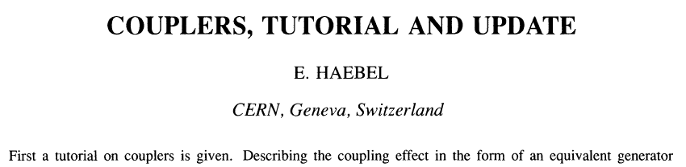
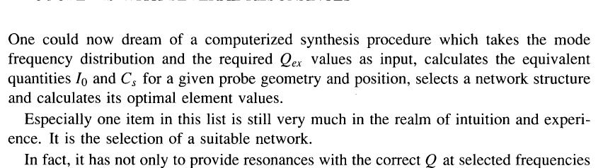
Introduction
Some thoughts on the course of history
[E. Haebel, Part. Accel. 40, 141 (1992)]

Slide 4
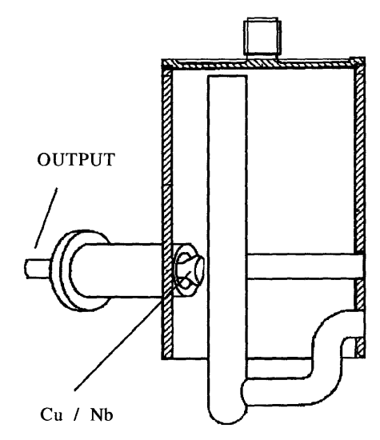
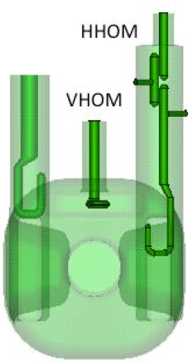
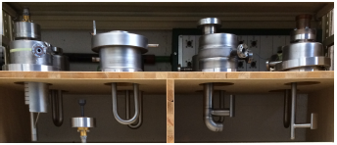
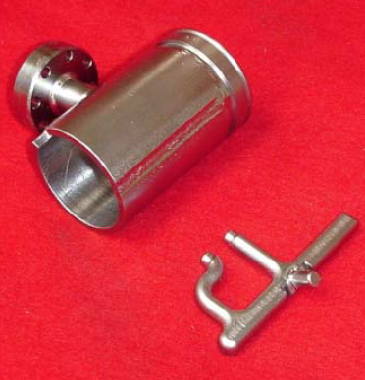
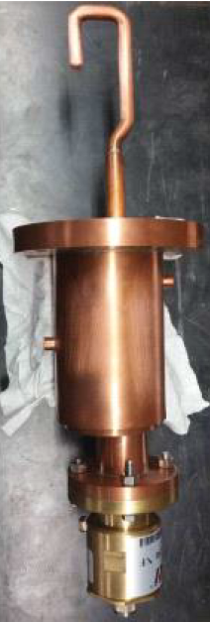
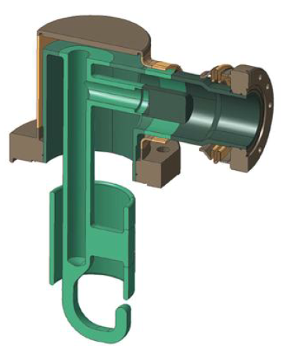
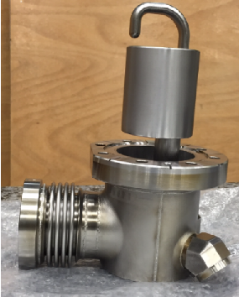
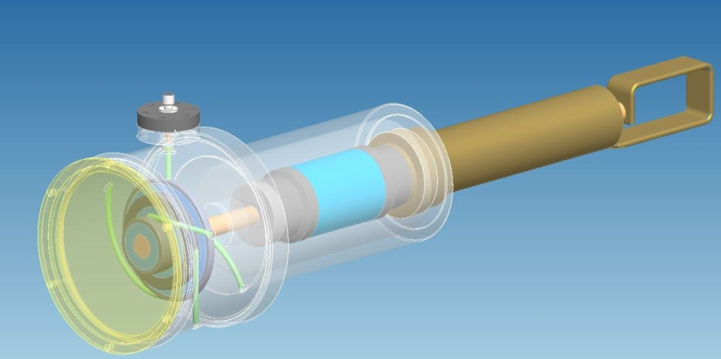
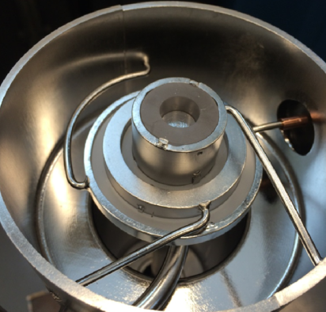
Introduction
Some thoughts on the course of history
Era of Numerical simulations tools yield a zoo of coaxial HOM couplers but ...
  Choice a suitable topology remains doubtful
  Systematic design typically based on exhaustive parameter variations
  Black box behavior hinder in understanding the origin of particular filter characteristics (parasitic and non-parasitic phenomena)
LHC HOM couplers [CERN]
J. Sekutowicz, et. al. , HERA, TESLA, ...
Q. Wu, et. al., HOM Damper for 56MHz SRF Cavity for RHIC
B. P. Xiao, et al. DQW-CC HOM Coupler,
De Silvia, et al., RFD-CC HHOM Coupler
Notes:
no conclusions on topology or topological improvements
Most designs quite similar from from the equivalent circuit
Basic equivalent elements are shunt L, series C and shunt LC (shunt = connection inner and outer conductor, series = along the inner conductor)
Some combinations cause parasitic intersection of stop eventually narrowing the notch filter (TESLA and DQWCC HOM couplers)
Coupling of evanescent modes is another phenomenon but non-parasitic
New Class of coaxial filters with canonical topology and elaborated design procedures given complete understanding

Slide 5
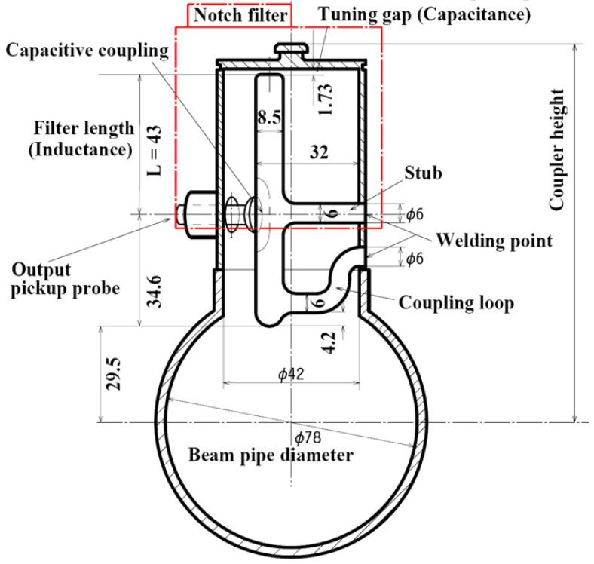
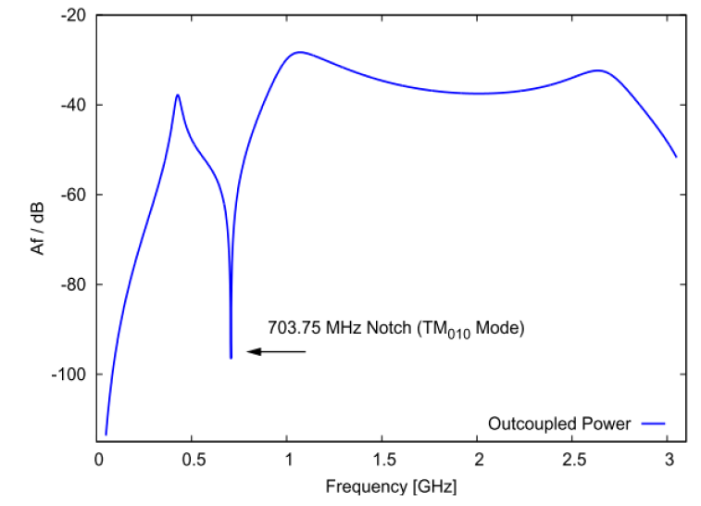
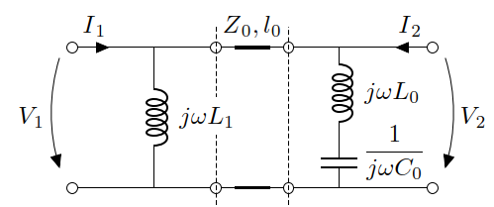
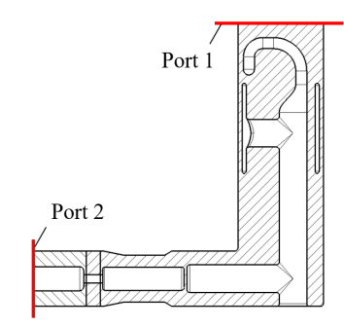
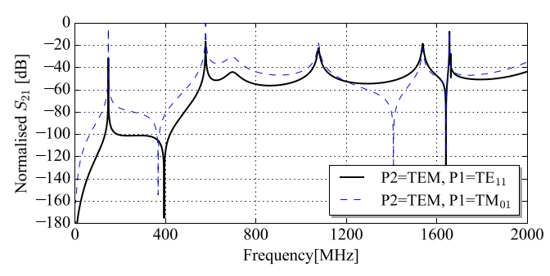
Introduction
Motivation
Common to many HOM couplers is a parasitic behavior below notch
Notch filter seem to be placed within the pass-band of a high-pass filter
Intrinsic property given by combination series notch filter (L₀C₀) and fixing of inner conductor (L₁)
RF Transmission of modified TESLA Coupler
K. Watanabe, et. al., NIM Sec. A, 2008
W. Xu, et. al., in Proc. PAC 2011 , TUP060
RF Transmission of DQWCC HOM Coupler
How to avoid this combination?
J. Mitchel, PhD thesis 2019
Notes:
rf transmission by means of the examples on the left
Some words on equivalent elements:
Fixing of inner conductor equivalent to inductance
Notch filter in most designs equivalent to Series LC circuit connecting inner and outer conductor
How to avoid this combination?
Fixing strictly necessary to hold inner conductor
Abandon notch filter makes coaxial HOM couplers useless; other damping schemes more preferable (e.g. rect. or ridged wg)

Slide 6
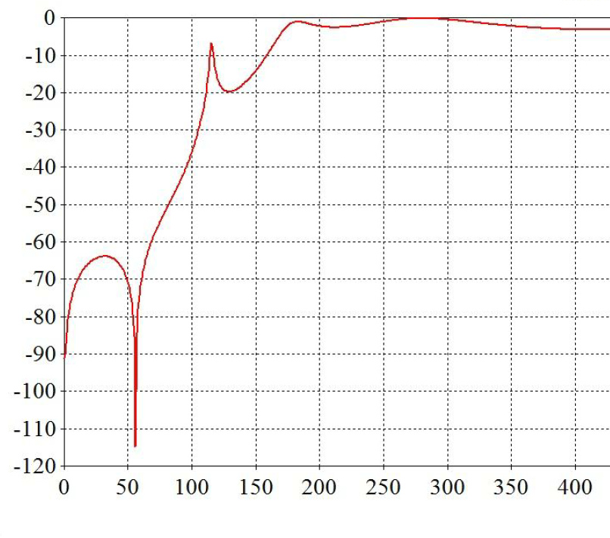
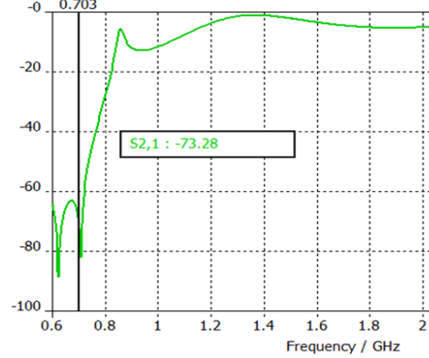
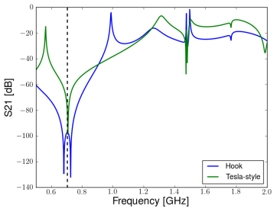
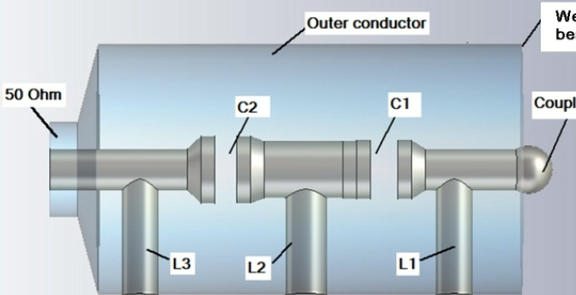
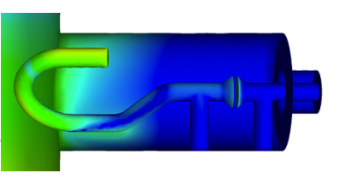
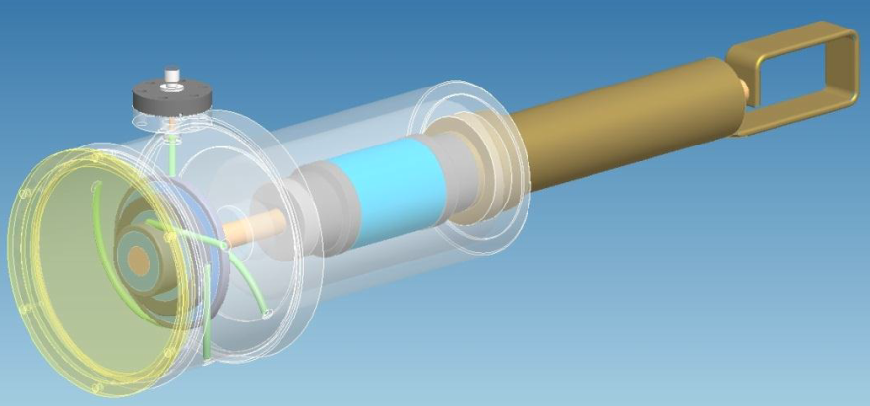

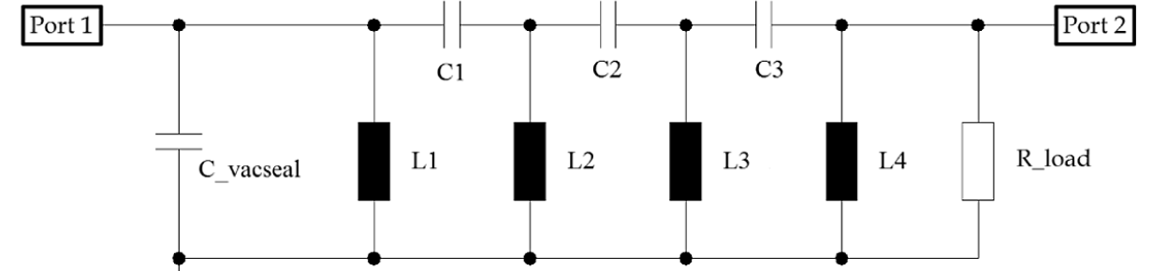
Introduction
Motivation
Some HOM couplers reveal an “unusual” notch characteristic
Q. Wu, et. al., HOM Damper Design ..., BNL, 2010
W. Xu, in Proc. PAC2011, TUP060
R. Ainsworth, in Proc. IPAC2012, WEEPPB008
In contradiction to equivalent circuits based on alternating shunt inductance and series capacitance (only notch at f = 0 Hz possible)
Q. Wu, et. al., Operation of the 56 MHz superconducting rf cavity in RHIC with higher order mode damper, PRAB 22, 102001 (2019)
What is the origin of the notch(es)?
Notes:
Couplers 1 and 2 do NOT suffer from parasitic behavior of previous slide

Slide 7
Phenomenological investigations
Towards an understanding of the “unusual” notch in coaxial lines

Slide 8
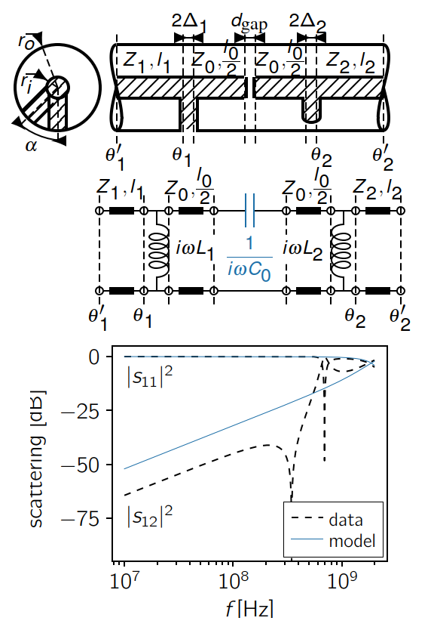
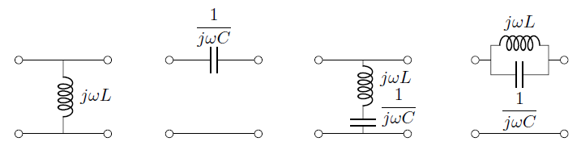
Phenomenological investigations
Topology, filter components, and equivalent circuits
Analysis of waveguide obstacles and discontinuities by numerous model fits
Focus on elements that are appropriate for high-pass filters, i.e. equivalent behavior of:
Ladder of shunt inductance and series capacitance will NOT introduce a notch at a frequency > 0
Coaxial guide with capacitive gap between two inductive posts
f₀ = 0
f₀ = 0
f₀ > 0
f₀ > 0
Notes:
Simplest microwave structure common to previous designs on primary focus
Angle variation not present in Wu’s and Ainsworth’s designs
Fit by intuitive equivalent circuit fails -> assumption by previous authors definitely wrong

Slide 9
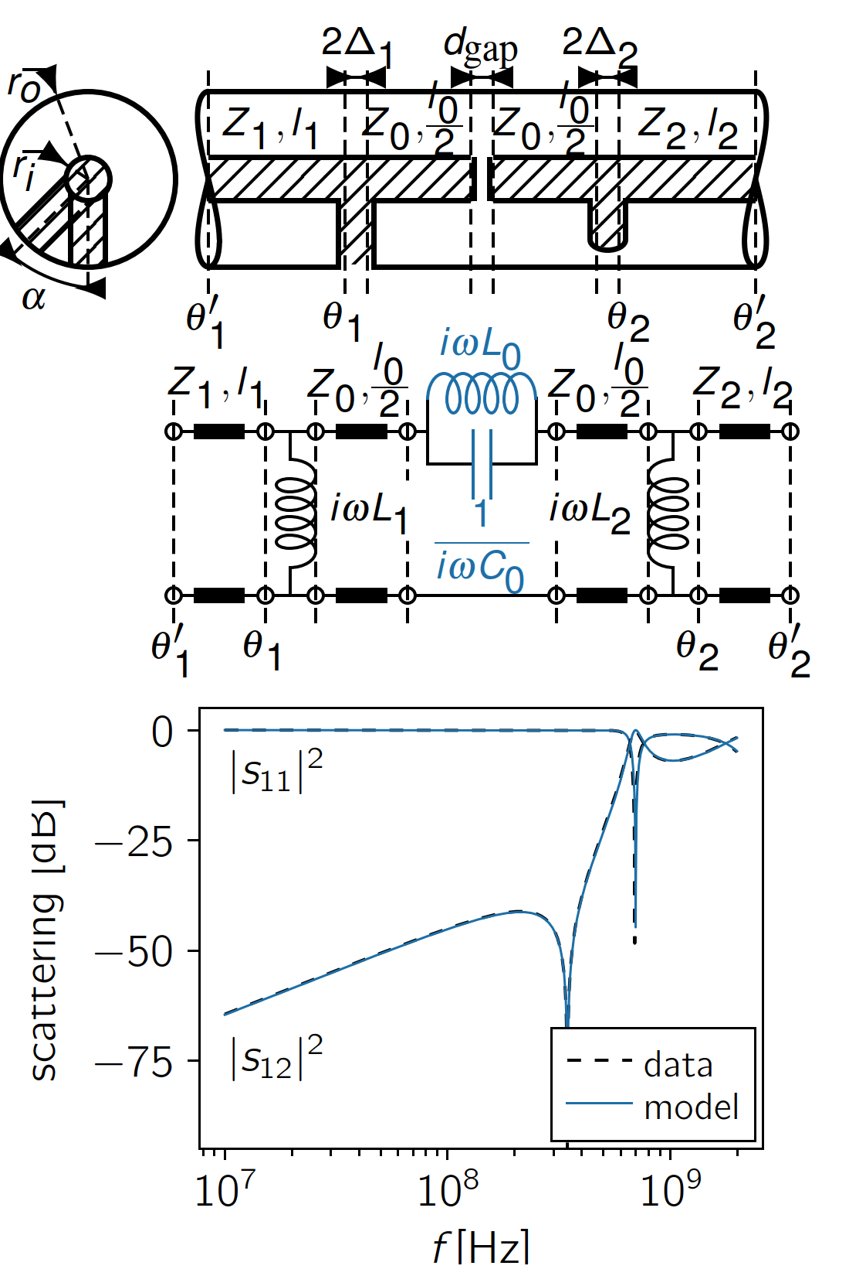
Phenomenological investigations
Topology, filter components, and equivalent circuits
Analysis of waveguide obstacles and discontinuities by numerous model fits
Focus on elements that are appropriate for high-pass filters, i.e. equivalent behavior of:
Parallel LC resonator yield perfect match between equivalent circuit model and simulation data over large frequency range
Coaxial guide with capacitive gap between two inductive posts
f₀ = 0
f₀ = 0
f₀ > 0
f₀ > 0
Notes:
Perfect match of parallel LC applies of course only up to a certain frequency as shown later
Hovever, below that frequency, the fit appears to be exact

Slide 10
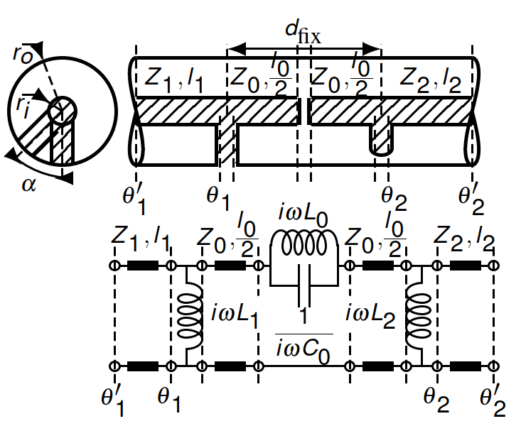
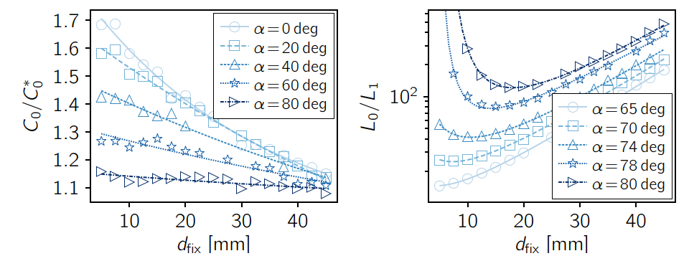
Phenomenological investigations
Equivalent circuit and element characteristics
Canonical 3rd-order high-pass filter with finite transmission zero at f₀ >= 0
Remarkable variation of $$L_{0}$$ by orders of magnitude with d_{fix} and α
L0 nearly constant over large frequency well above notch frequency -> broad band character
Indicators for coupled evanescent modes
Coaxial guide with capacitive gap between two inductive posts
Dependency of notch filter elements
Notes:
Actually sub-canonical since microwave structure has less physical elements than equivalent circuit
3rd order filter extendable by feed through capacitance to 4th order -> already comparable or superior to TESLA, LHC, and most other couplers
Transmission zero at f=0 if alpha = 90deg
constant L0 allows for broad band character (L1, L2, C0 are anyway constant but Tlines are the limiting factor)
small distance dﬁx favorable to reduce impact of transmission lines
Broad band matching is limited by the frequency band over with equivalent circuit elements behave constant

Slide 11
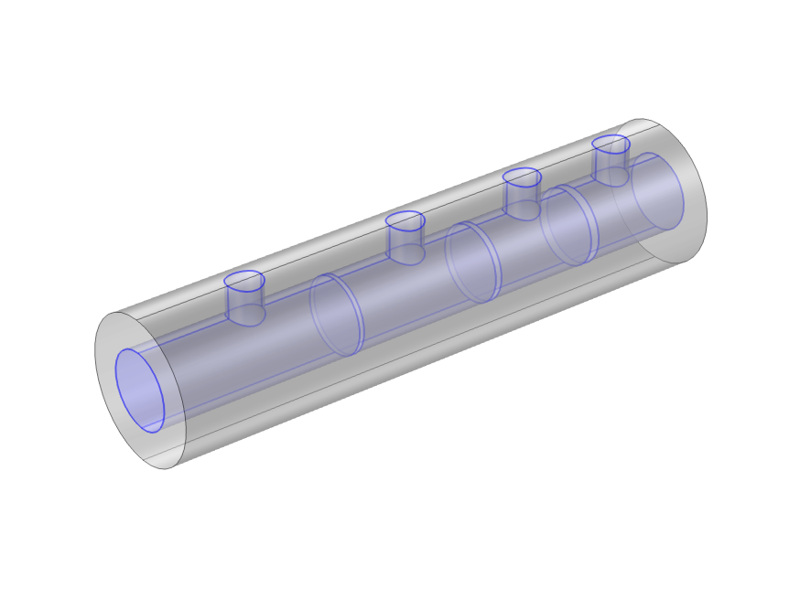
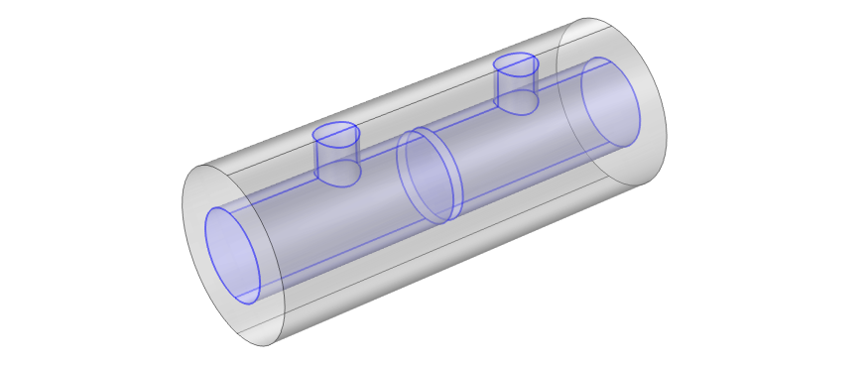
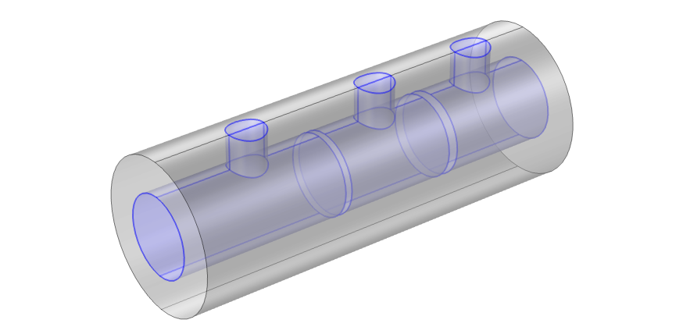
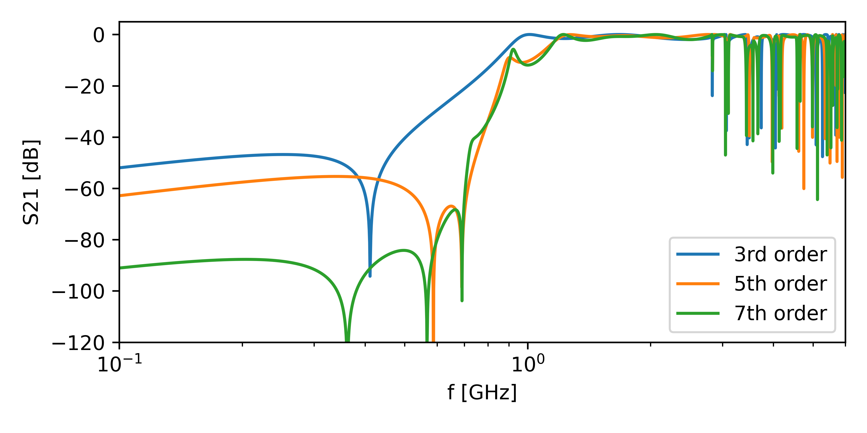
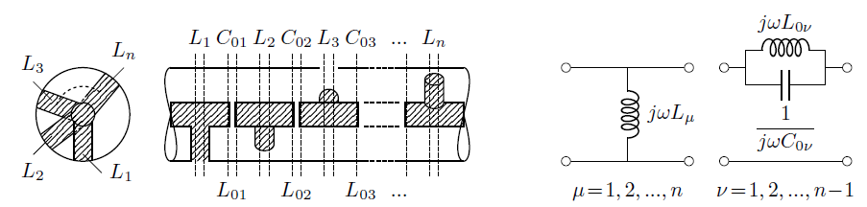
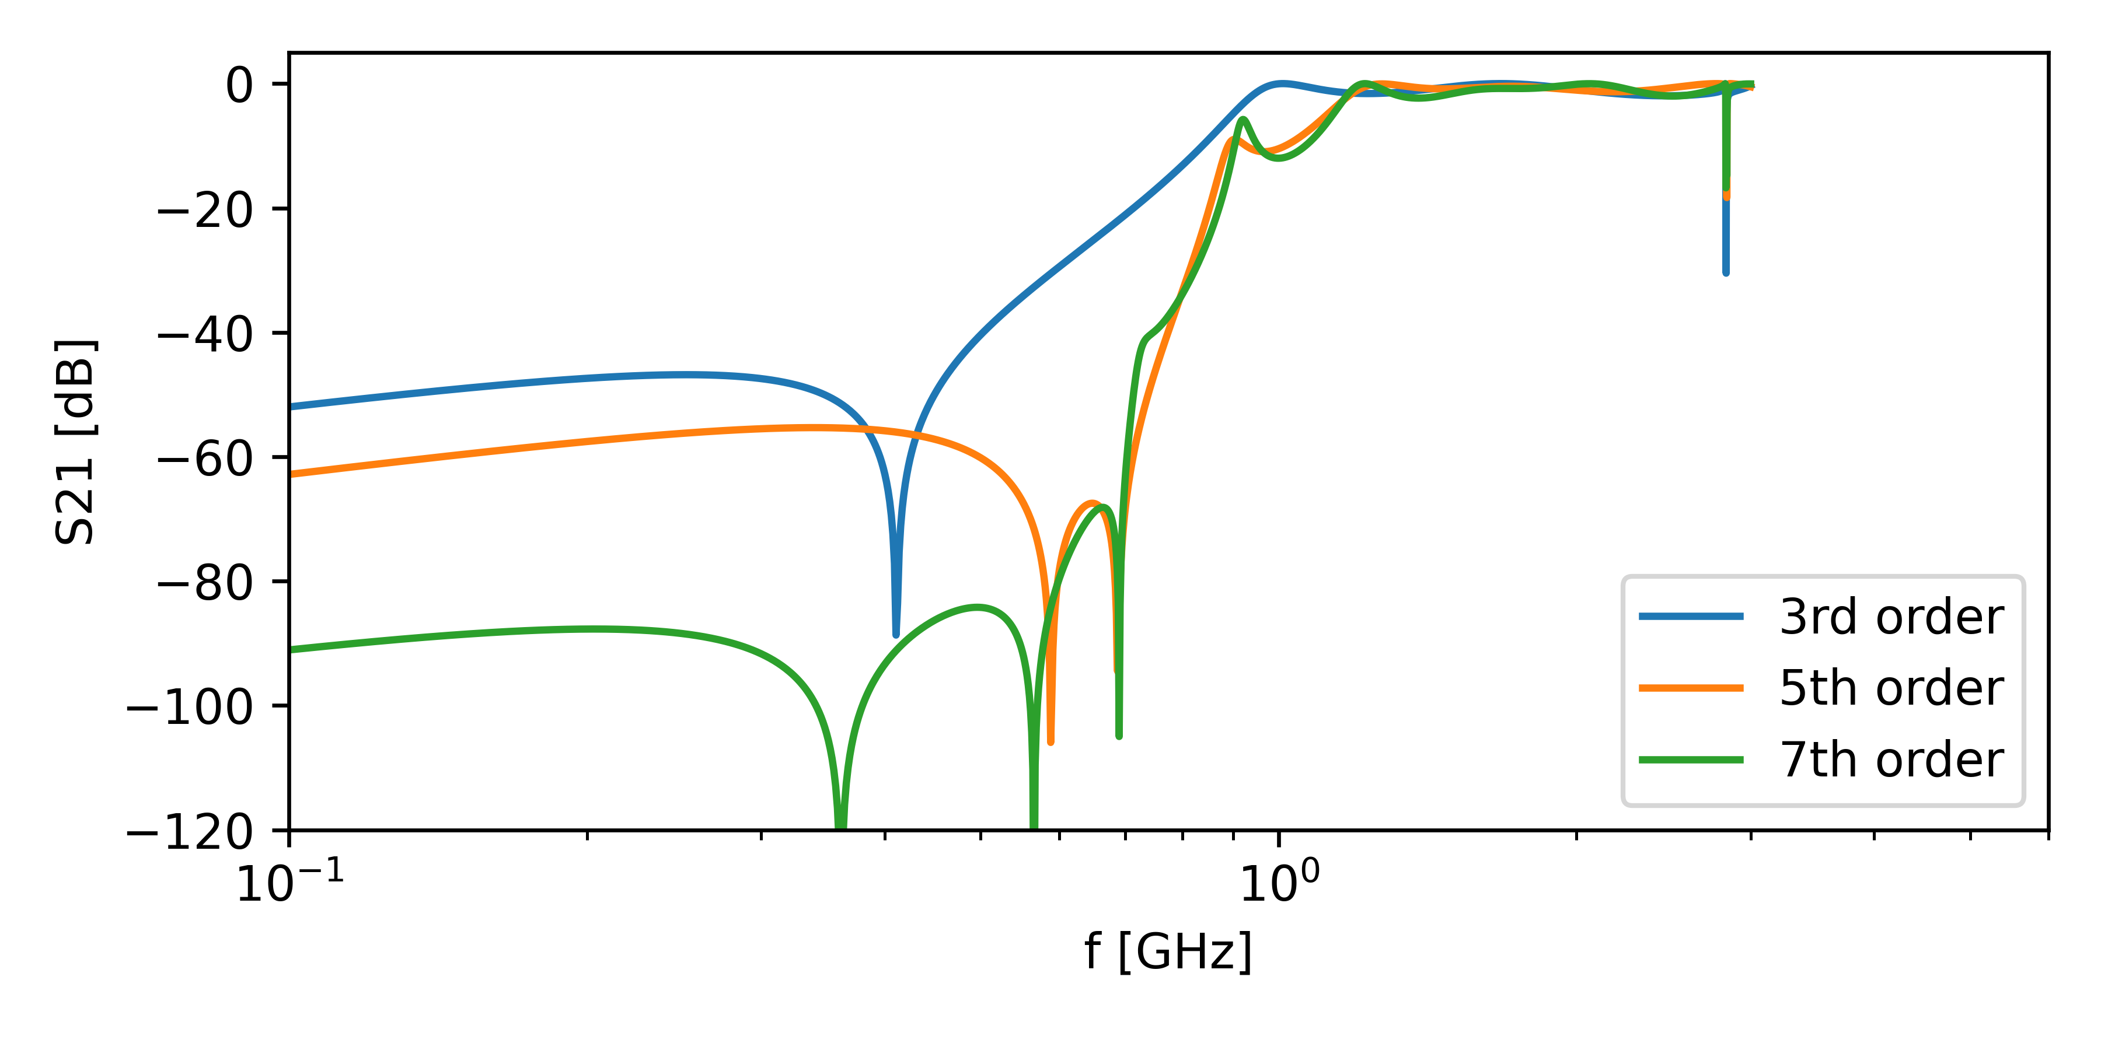
Phenomenological investigations
Scalability of the filter order
Repetition of “T”-element in part analog to repetition of alternating shunt inductance and parallel LC resonator in series
3rd order filter
5th order filter
7th order filter
Propagation of 1st HOM
Notes:
In general evanescent modes coupling occurs also between non-neighboring fixings (inductive posts)
Equivalent circuit must be reassessed but ...
There is evidence of equivalence: 3 examples indicate similar scaling behavior as alternating shunt inductance and parallel LC circuit
Bandwidth is limited by cutoff of the first HOMs

Slide 12
Phenomenological investigations
Scalability of the filter order
Repetition of “T”-element in part analog to repetition of alternating shunt inductance and parallel LC resonator in series
3rd order filter
5th order filter
7th order filter
Notes:
In general evanescent modes coupling occurs also between non-neighboring fixings (inductive posts)
Equivalent circuit must be reassessed but ...
There is evidence of equivalence: 3 examples indicate similar scaling behavior as alternating shunt inductance and parallel LC circuit
Bandwidth is limited by cutoff of the first HOMs

Slide 13
Field Analyses
On the interference of evanescent modes in coaxial wave guides

Slide 14
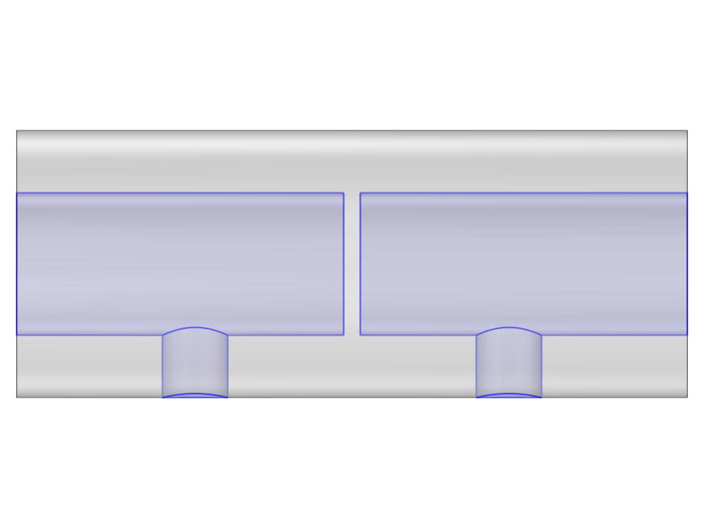
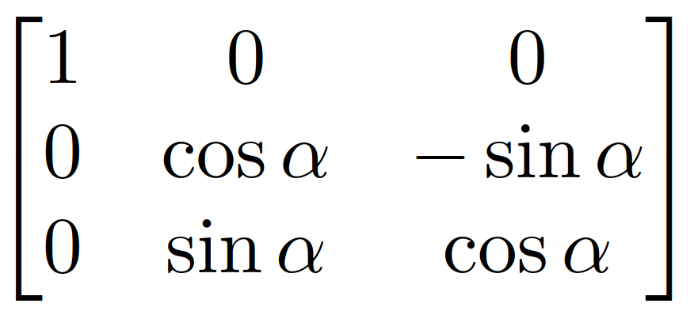
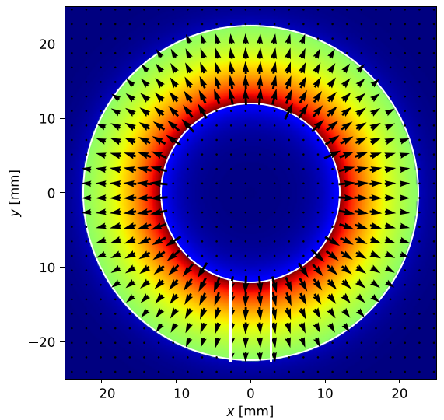
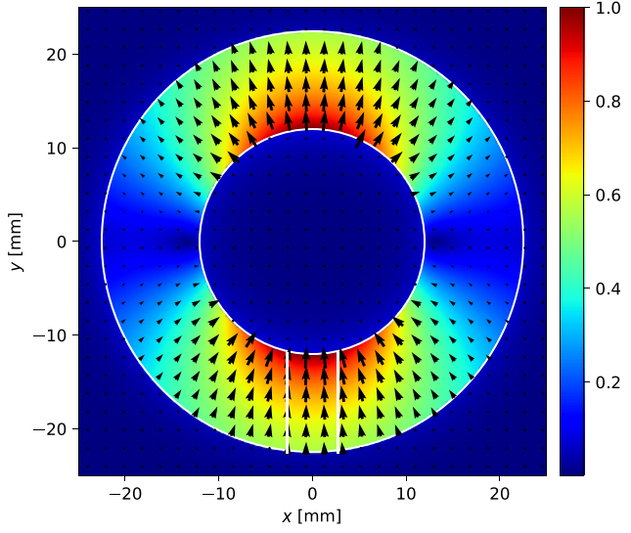
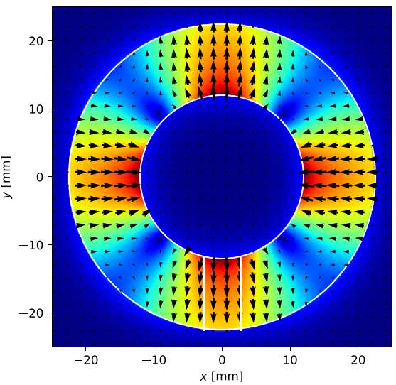
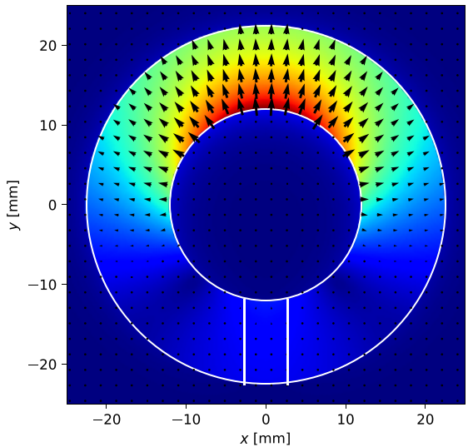
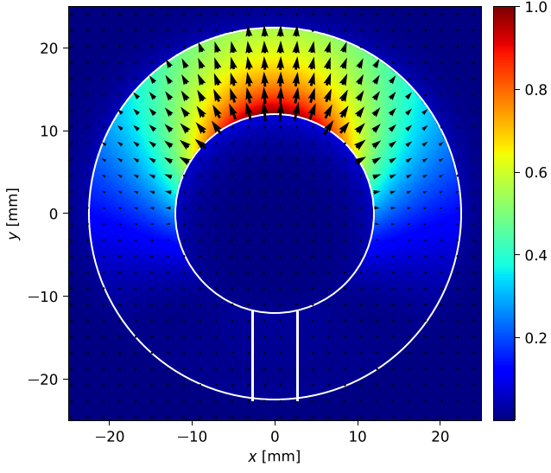
Field analyses
Exploration of contributing modes
Concatenation procedure based on scattering properties (CSC)¹
Excited modes and their superposition at a single inductive post
Inductive post defines polarization angle of the excited TEmn mode
TEM mode
N modes
N modes
Rotation
N modes
TEM mode
...
...
...
TEM
TE11
TE21
TEM+TE11
TEM+TE11+TE21
¹H.-W. Glock, et. al., CSC—A Procedure for Coupled S-Parameter Calculations, IEEE Transaction on Magnetics, Vol. 38, No. 2, 2002
Notes:
Comparison of complete and concatenated structure with varying number of modes (N) in between the segments
Rotation matrix is analytical incorporates impact of the rotation angle alpha (only a characteristic part of the matrix is shown)

Slide 15
Field analyses
Properties related to the coupling of evanescent modes
Presence of modes depends on filter order
Coupling of evanescent modes vanishes if orthogonality applies
  @ α=45deg, Inference of TE21 disappears below its cutoff
  @ α=90deg, Inference of TE11 disappears below its cutoff
3rd order filter
5th order filter
7th order filter
TEM
TE11
TEM
TE11
TE21
TEM
TE11
TE21
  -> Parallel LC resonator reduces C in equivalent circuit
Notes:
In general evanescent modes coupling occurs also between non-neighboring fixings (inductive posts)
Equivalent circuit must be reassessed but ...
There is evidence of equivalence: 3 examples indicate similar scaling behavior as alternating shunt inductance and parallel LC circuit
Bandwidth is limited by cutoff of the first HOMs

Slide 16
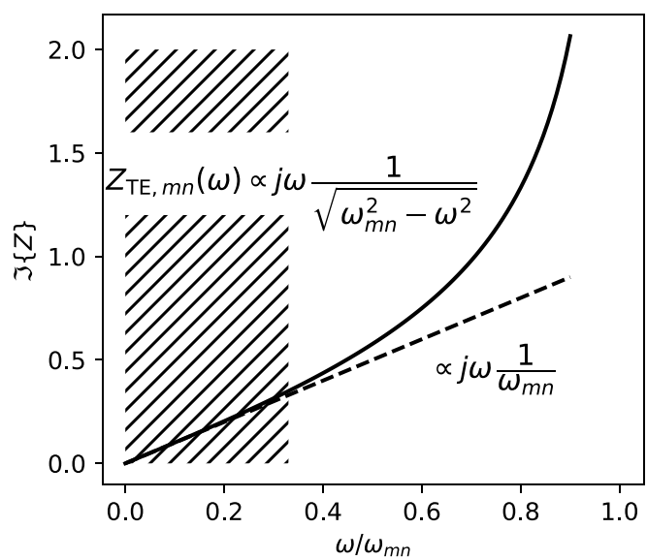
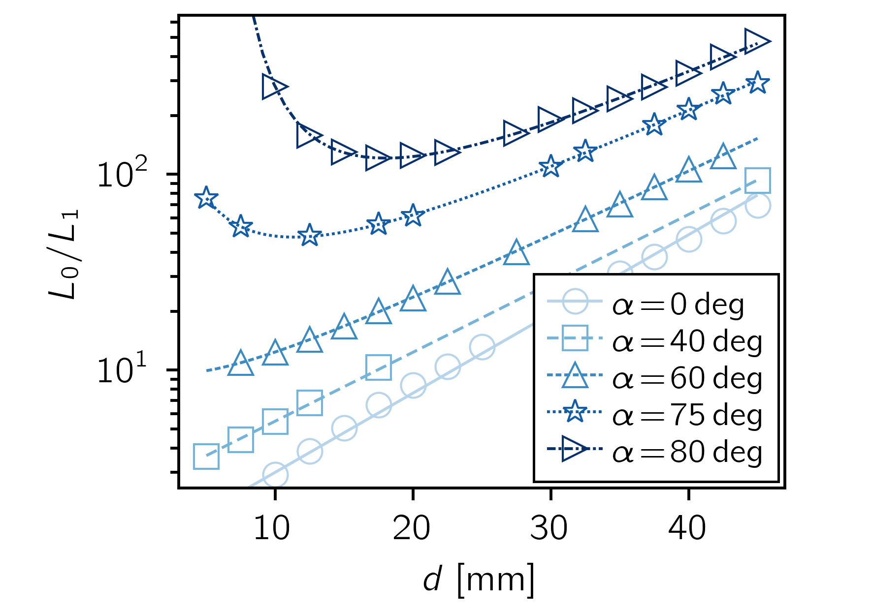
Field analyses
Properties related to the coupling of evanescent modes
Consistency of L₀ over notably large frequency range results from dependency of the TE11 cutoff frequency
Large adjustment range of L₀ results from the nearly inverse dependency of the coupling factor between evanescent modes
L₀ ∝ k⁻¹ (coupling factor k ∝ cosα)
L0 Consistency and Cutoff dependency
Coupling factor dependency
microwave structure and equivalent circuit
Notes:
These properties are verified for the 3rd order realization

Slide 17
Filter design
Some thoughts on rudimentary approaches

Slide 18

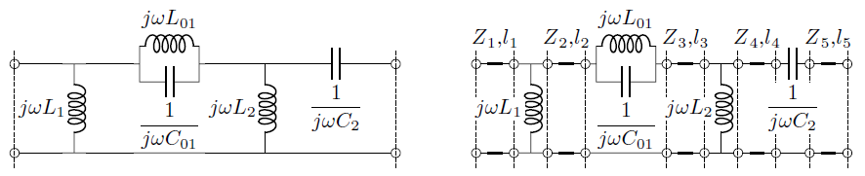
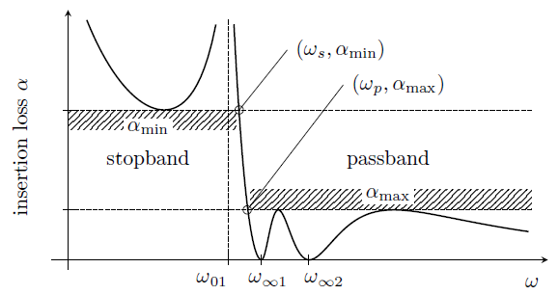
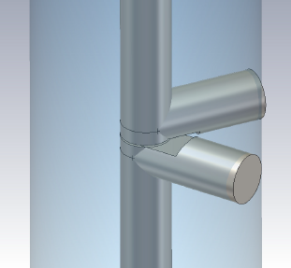
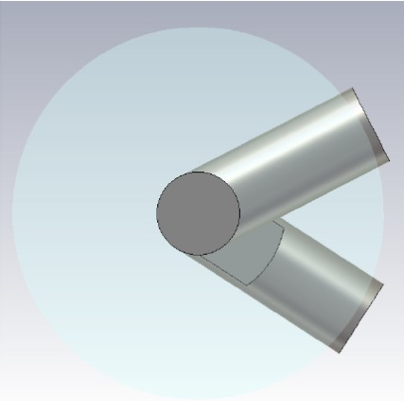
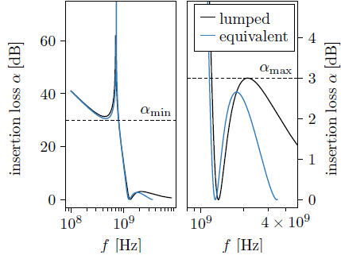
Filter design
Synthesis based on fitting equivalent circuits
If equivalent circuits exists, methods of network synthesis can be applied, particularly by means of ladder networks
Example of a third-order elliptic high-pass filter (704 MHz SPL)
Approximation problem
Network synthesis
Model fitting
Notes:
Transmission lines must be includes
Equivalent circuits for filter order >=5 mus be revealed
First approach for the synthesis of transfer functions by means of coaxial microwave structures
still rudimentary but the principle has been proven

Slide 19
Filter design
Synthesis based on concatenation of scattering matrices
Numerical optimization of parameterized segments using CSC
Fully consistent to complete structure provided the necessary modes are involved
3D field simulations replaced by matrix multiplications and solving small linear matrix equations given the minimal order representation of the problem
TEM mode
N modes
N modes
Rotation
N modes
TEM mode
...
...
...
Notes:
Method resulting from the angle analyses of the various structures (3rd, 5th, and 7th order)

Slide 20
Conclusion

Slide 21
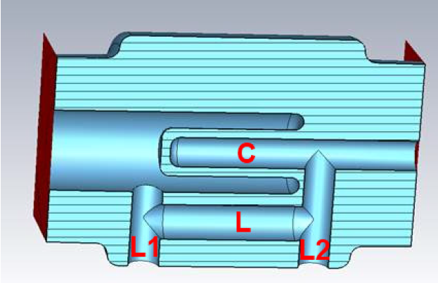
Conclusion
Evanescent mode coupling in coaxial HOM couplers allow for ...
Canonical topology -> Filter realization with minimal effort
High-pass realization without parasitic effects below TE11 cutoff
No need of large notch filter capacitance or series LC resonator
Remarkable larger adjustment range of filter functions (equivalent circuit elements) in comparison to existing coupler designs
In general compact design due to evanescent character
Independent treatment of beam pipe/ cavity coupling and notch
Broad band character -> matching focus: beam pipe/ cavity coupling
Dismountable coupler designs
Systematic design in principle without 3D numerical simulations
W. Xu, et. al., in Proc. PAC 2011 , TUP060
B. P. Xiao, et al. DQW-CC HOM Coupler,
B. P. Xiao, et al., in Proc. SRF2013
Notes:
Below TE11 cutoff can be a very large frequency range
Most existing couplers require 3D simulations

Slide 22
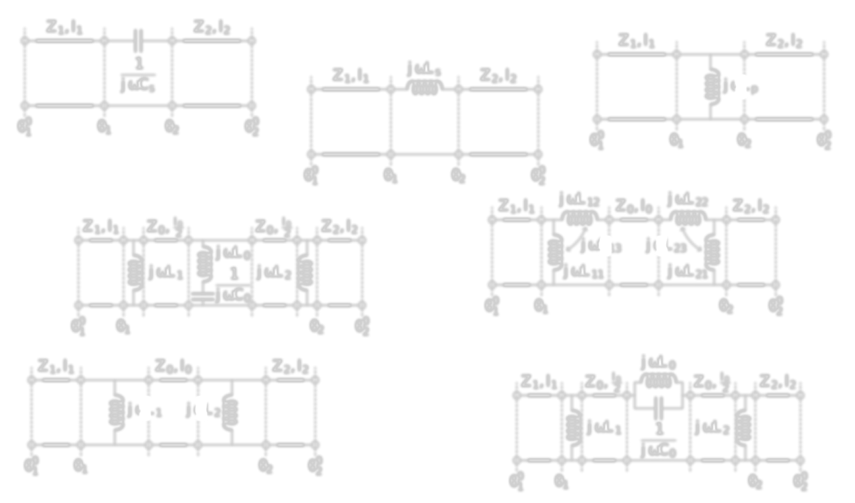
Outlook
Still a lot of work to do ...
Equivalent circuits including quadrupole modes and simplifications for filter synthesis
Investigate the scalability of the filter order and limits in more detail
Refine and automatize design processes from filter function to microwave structure
Experimental studies and application in real facilities
Thank you very much

Slide 23
Extra slides

Slide 24


Introduction
RF Filter Components, Equivalent Circuits, and Topology
Analysis of numerous obstacles and discontinuities by model fitting
Focus on elements that are appropriate for high-pass filters, i.e. equivalent behavior of
Ex: Capacitive gap in coaxial guide
  analytical or empirical approximation:
Coaxial line with capacitive gap
d_{gap}
L_{P} [nH]
$$C_{s}^{}={C_{s}^{∗}+1.965ε}_{0}r_{i}ln2\frac{r_{o}−r_{i}}{d_{gap}}$$
$$C_{s}^{∗}=ε_{0}\frac{πr_{i}^{2}}{d_{gap}}$$
[Matthaei et. al, “Microwave Filters, Impedance-Matching Networks, and Coupling Structures”]
dgap [mm]

Slide 25


Introduction
Some thoughts on Filter theory and coaxial lines
Analysis of numerous obstacles and discontinuities by model fitting
Focus on elements that are appropriate for high-pass filters, i.e. equivalent behavior of
Ex: Inductive post in coaxial guide
  analytical or empirical approximation:
Coaxial line with inductive post
L_{P} [nH]
$$L_{P}^{}={0.367µ}_{0}(r_{o}−r_{i}) \log_{10}2\frac{r_{o}−r_{i}}{r_{fix}}$$
[Matthaei et. al, “Microwave Filters, Impedance-Matching Networks, and Coupling Structures”]

Slide 26



Coaxial Couplers and Synthesis
Transmission Zeros in Cutoff Tubes
No coupling due to vanishing fields at coupler location (resonance in cutoff tube)
Independent of coupler design
Influenced by waveguide, taper and coupler location
Ensure distance from HOMs
Transmission zeros of the high- SPL cutoff tubes
Cavity side | r₁ [mm] | r₂ [mm] | l_{t} [mm] | l₀ [mm] | f₁ [GHz]
Tuner | 65 | 40 | 28 | 30 | 1.85-1.96
FMC | 70 | 40 | 34 | 59 | 1.68-1.74
TEM-TE₁₁ transmission
TEM-TM₀₁ transmission
Probe antenna mounted on cutoff tube

Slide 27
Coaxial Couplers and Synthesis
Summary and Conclusions
Analysis of numerous obstacles and discontinuities by model fitting
  understanding of individual components of HOM couplers
  basis for topological choice, synthesis, and numerical optimizations
  equivalent behavior of capacitive gap between two inductive posts as a mid-shunt ladder possibly not documented so far
First approach for the synthesis of transfer functions by means of coaxial microwave structures
  still rudimentary but the principle has been proven
Understanding of transmission zeros in cutoff tubes
  transmission zeros of SPL cutoff tubes not harmful

Slide 28





Coaxial Couplers and Synthesis
Equivalent Circuit Parameter Characterization of RF Filter Components
Example coaxial guide with capacitive gap between two inductive posts
freq. domain simulation
$$S^{′}(ω_{k})$$
$$T_{model}(ω)$$
phase shift
$$S=wS^{′}w$$
2-port parameter transformation
$$S(ω_{k})→T(ω_{k})$$
non-linear least square problem
scattering [dB]
$$L_{0},C_{0},L_{1}, L_{2},Z_{0},λ_{1},λ_{2}$$

