Slide 1
Notes:
Slide 1: Company Logo Full Page
Before you start editing the slides of your talk change to the Master Slide view:
Microsoft Office :Menu: View > Slide Master;
Macintosh – View > Master > Slide Master
Edit the following items:
On the Slide Master (first master slide) – lower area
a) On the left Delete the text and write the title of the event/Conference, Location
b) On the right delete the text and write the name and surname of the speaker and the date (day, month , year)
Close Master View

Slide 2
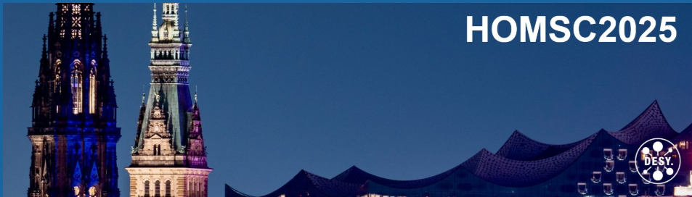
QMiR Cavities RF Analysis
Nuaman Shafqat
On behalf of
Elettra team
Elettra Sincrotrone Trieste
Notes:
Slide 2: Title of the Presentation
Before you start editing the slides of your talk change to the Master Slide view:
Microsoft Office :Menu: View > Slide Master;
Macintosh – View > Master > Slide Master
Edit the following items:
On the Slide Master (first master slide) – lower area
a) On the left Delete the text and write the title of the event/Conference, Location
b) On the right delete the text and write the name and surname of the speaker and the date (day, month , year)
Close Master View
To start adding slides insert a new slide and select a Layout:
For Title & Subtitle
For text with bullet points
For Text
For Picture, graphs, visuals
Two columns
Blank

Slide 3
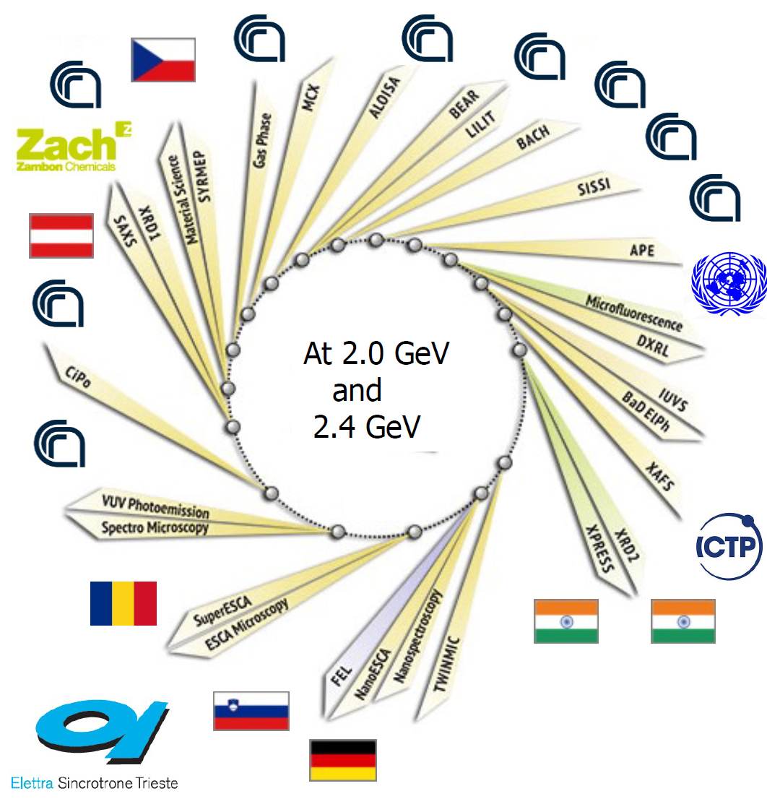
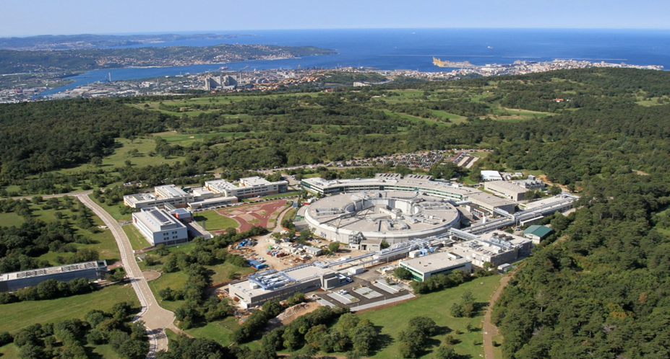
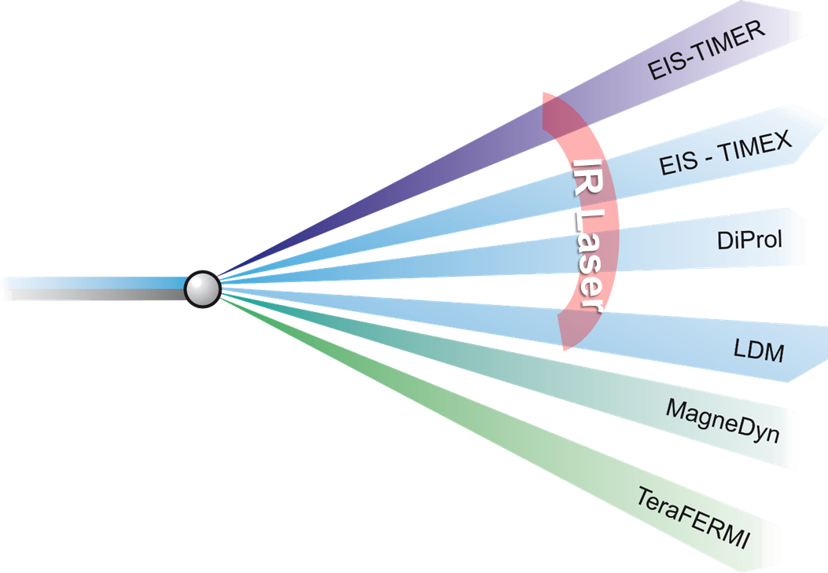
Elettra Sincrotrone Trieste
Elettra Sincrotrone Trieste is an international multidisciplinary research centre of excellence, open to the international research community, featuring a 2.0/2.4 GeV, third-generation synchrotron light source (Elettra), a free-electron laser light source (FERMI) and a variety of support laboratories.
Shut down in July for major upgrade
ELETTRA, 2-2.4 GeV SRLS:
in operation since 1994
FERMI, 1.5 GeV FEL:
in operation since 2010

Slide 4
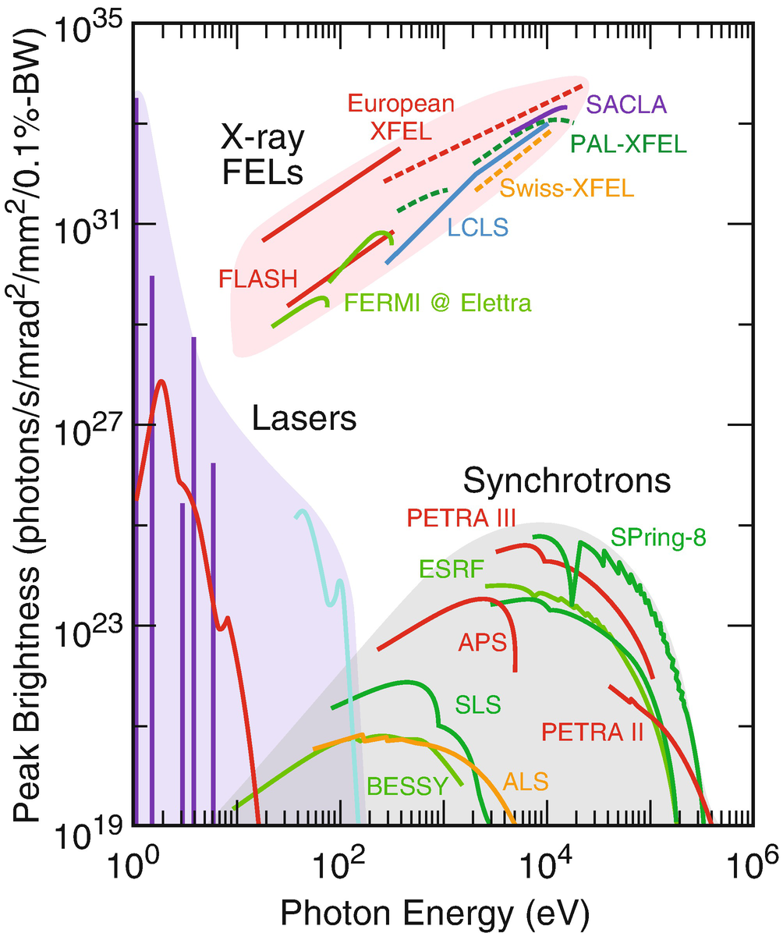

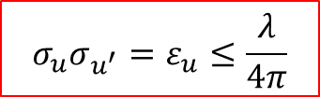

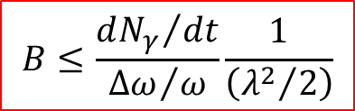

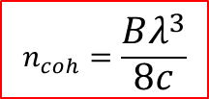
Elettra 2,0
Diffraction Limit
$$n_{coh}≫ 1$$
Almost all experimental techniques gain from either a large 6-D photon density (brilliance) or a large coherent flux (degeneracy parameter):
$$n_{coh}=\frac{Bλ^{3}}{8c}$$
and
$$B≤\frac{{dN_{γ}}/{dt}}{{Δω}/ω}\frac{1}{\left({λ^{2}}/2\right)}$$
$$n_{coh}≈ 1$$
4GSR
Diffraction Limit
for
$$σ_{u}σ_{u^{′}}=ε_{u}≤\frac{λ}{4π}$$
ICS
More flux at the sample, for any given λ-range
Higher λ-harmonics by means of low-gap IDs
Shorter integrated time of measurement
Micro- and nano-focusing
Transverse x&y coherence up to 1 keV
$$n_{coh}≪ 1$$

Slide 5
Elettra 2,0
Timing Mode
Parameter | Elettra 2.0 | Crab Cavities | FERMI | Units
Spectral range | 0.02 - 50 | 0.1 - 10 | 0.01 – 0.7 | keV
Rep. rate | 1 – 400 | 0.1 – 1 | 0.05 | MHz
Pulse duration, rms | 30 | 0.5 – 2 | 0.005 – 0.1 | ps
Flux at sample, ave | 10⁶ – 10¹³ | 10⁵ – 10⁹ | 10⁹ – 10¹³ | ph/sec
Spectral resolution | 10⁻⁵ – 10⁻⁴ | 10⁻⁴ | 10⁻⁴ – 10⁻³ (w/o mono)
Polarization | all | all | all
Coherence | Hor. ≤ 1 keV | Hor. < 0.5 keV | full
# Beamlines / Run | 31 | < 10 | < 2

Slide 6
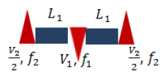
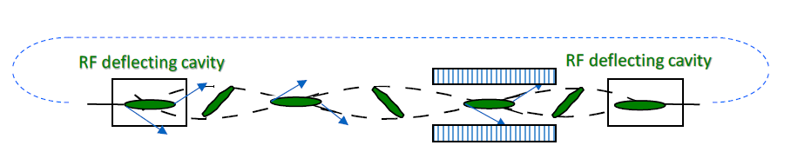
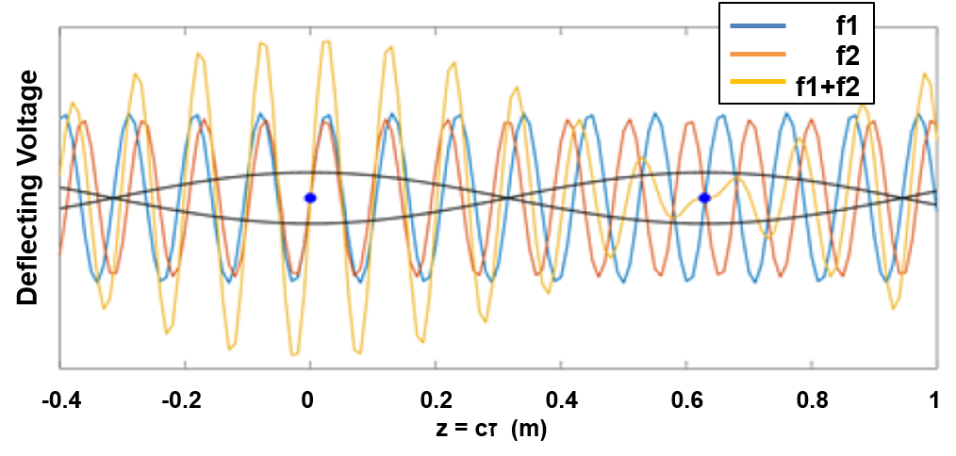
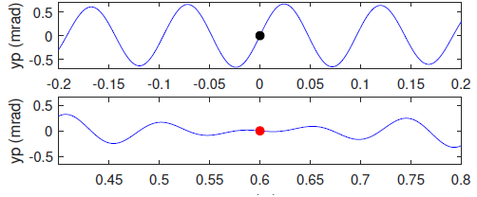
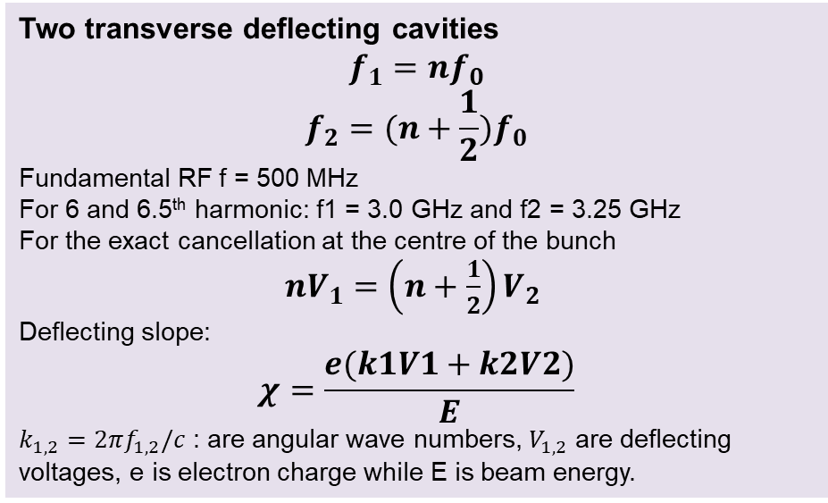
Elettra 2.0
1- frequency tilt & cancel
The bunch is crabbed at it passes through zero-crossing of transverse deflecting cavities
Two transverse deflecting cavities
$$f_{1}=nf_{0}$$
$$f_{2}=(n+\frac{1}{2})f_{0}$$
Fundamental RF f = 500 MHz
For 6 and 6.5th harmonic: f1 = 3.0 GHz and f2 = 3.25 GHz
For the exact cancellation at the centre of the bunch
${nV}_{1}=\left(n+\frac{1}{2}\right)V_{2}$
Deflecting slope:
$$χ=\frac{e(k1V1+k2V2)}{E}$$
$k_{1,2}=2πf_{1,2}/c$ : are angular wave numbers, $V_{1,2}$ are deflecting voltages, e is electron charge while E is beam energy.

Slide 7
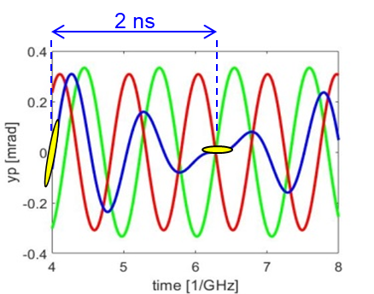
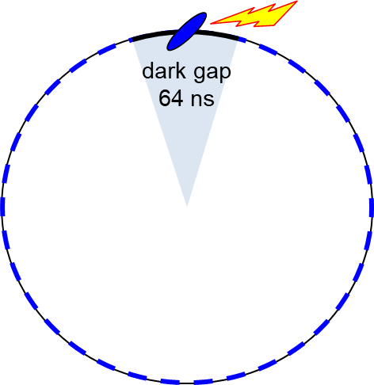
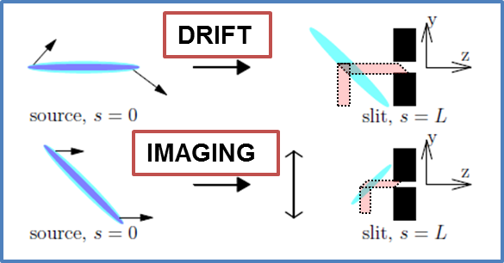
Crab Cavities:
Working Principle
Fill pattern:
200 regular bunches, 2 mA/bunch, 4 ns-time sep.
1 tilted bunch, 2 mA , ±32 ns time sep., 1.157 MHz
Pulse selection:
Temporal gating
distorted orbit
chopper
A. Lunin et al., Phys. Proc. 79 (2015) 54.
A. Lunin, T. Khabiboulline, V. Yakovlev , “A White Paper on Design and Fabrication of SRF Deflecting Cavities for Elettra 2.0”, FNAL note.
A. Zholents, NIM A 798 (2015) 111
See also: X. Huang, PRAB 2016, 2019, 2023

Slide 8
Project Evaluation
Ref. A. Fabris
Elettra 2.0 team
SLAC
NC
Project planning
(AF, SDM)
Elettra
ANL
(A. Zholents, X. Huang)
Panel Review
(A. Fabris chair)
FERMILAB
SC
SC
Beam physics
(SDM, KM & al.)
Strategic Project Agreement
Strategic Project Agreement
white papers
Requirements
Voltages, frequencies
Length, size
Apertures
Material
Temperature
Loss factor, kick factor
RF design
(NS)
SC & Cryogenics
(MM, PZ)
 | Voltage (MV) | f (GHz)
Cavity 1 | < 1.5 (2.0) | 3.0
Cavity 2 | < 1.2 (1.8) | 3.25
Decision of SC technology
feasibility of achieving the performance
duration of the design work
cost of the design work
anticipated cost of operation and maintenance
identify risks
Shunt impedance HOMs below cutoff frequency
Vertical plane | <1.5 (MΩ/m)
Horizental plane | <4.0 (MΩ/m)
Longitudinal plane | <0.4 (MΩ/m*GHz)

Slide 9
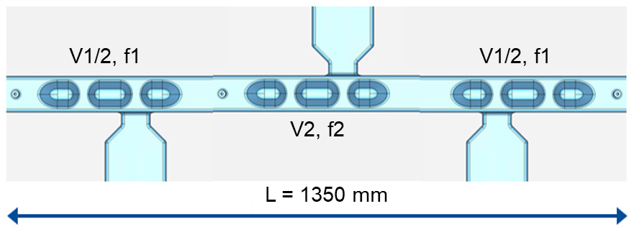
QMiR Design:
FNAL-Elettra-CERN
Quasi-waveguide Multicell Resonator (QMiR) designed for 2.815 GHz frequency for APS-U@ANL. Cavity successfully tested @2K in a vertical cryostat, demonstrated a 2.6 MV transverse voltage.
A. Lunin, T. Khabiboulline, V. Yakovlev , “A White Paper on Design and Fabrication of SRF Deflecting Cavities for Elettra 2.0”, FNAL
Optimization of the FermiLab/ANL prototype to 3.0 GHz and 3.25 GHz, larger apertures, lower HOMs, and weaker multipoles.
RF source input power < 500 W per cavity.
3 pure-Nb cavities @ 4,5 K (extension of the Elettra 3HC cryogenic system).
Best cancellation of residual kicks for standard bunches
Notes:
Slide 3 – (..) : Content of the presentation
Insert a new slide: Home > “New Slide” and choose a slide Layout:
For Title & Subtitle
For text with bullet points
For Text
For Picture, graphs, visuals
Two columns
Blank
If you want Copy & paste an element from the Clip Board to the particular slide: 1. Click on a box to mark it.
2. Position the mouse pointer on the box frame: Copy! 3. Click on the particular slide: Paste!
How you intend to use the elements is your choice. You can combine the text block style with the background colour in different manner.

Slide 10
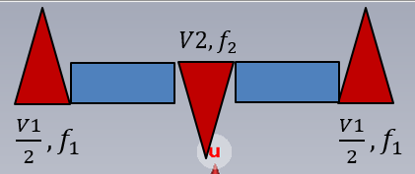
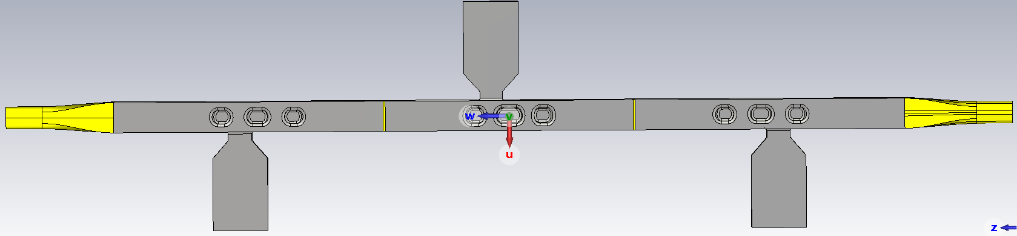
Explanation of The Model Proposed Configuration
Available space = 2.5 m
 | f [GHz] | D.V. [MV] | % change in D.V. @ 5.0 mm offset
Cav. 1 | f1: 3.0 | V1: 1,5 | ≤10 %
Cav. 2 | f2: 3.25 | V2: 1.2 | ≤10 %
Shunt impedances HOMs below cutoff
Vertical | <1.5 | (MΩ/m)
Horizontal | <4.5 | (MΩ/m)
Longitudinal | <5,0 | (MΩ*GHz)
Short range wakefields
Loss factor | 4 | (V/pC)
Horizontal kick factor | 1.3 | (V/pC/mm)
Vertical kick factor | 1.3 | (V/pC/mm)
Notes:
Slide 3 – (..) : Content of the presentation
Insert a new slide: Home > “New Slide” and choose a slide Layout:
For Title & Subtitle
For text with bullet points
For Text
For Picture, graphs, visuals
Two columns
Blank
If you want Copy & paste an element from the Clip Board to the particular slide: 1. Click on a box to mark it.
2. Position the mouse pointer on the box frame: Copy! 3. Click on the particular slide: Paste!
How you intend to use the elements is your choice. You can combine the text block style with the background colour in different manner.

Slide 11
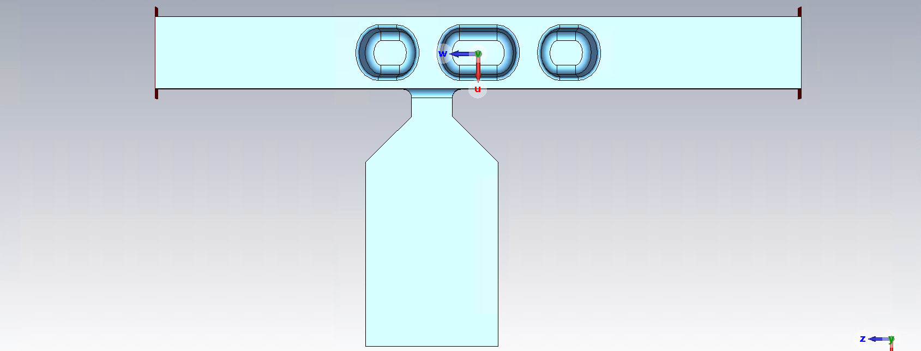
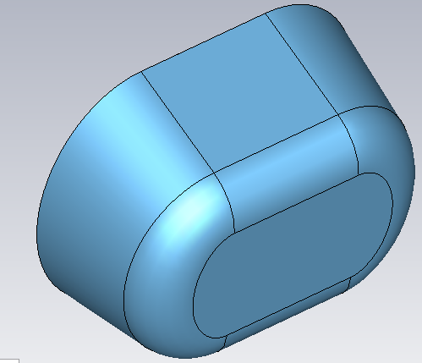
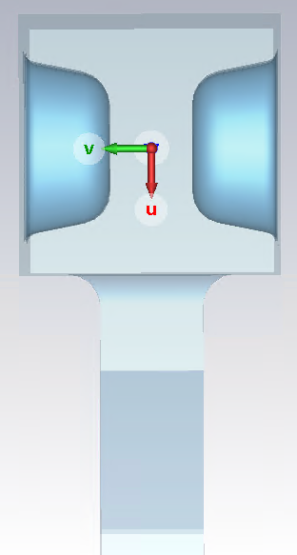
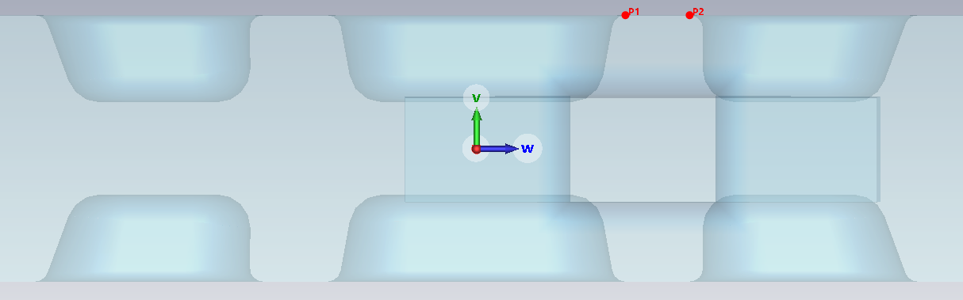
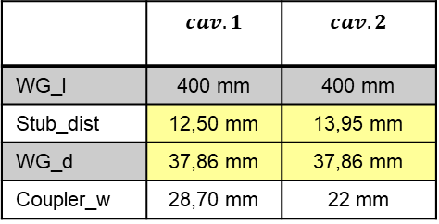
QMiR Elettra Geometry
WG_l
Stub shape
 | $$cav.1$$ | $$cav.2$$
WG_l | 400 mm | 400 mm
Stub_dist | 12,50 mm | 13,95 mm
WG_d | 37,86 mm | 37,86 mm
Coupler_w | 28,70 mm | 22 mm
72.136 mm
WG_d
Stub_dist
Stub_dist
Stub_dist
WG_d
18 mm
Notes:
Slide 3 – (..) : Content of the presentation
Insert a new slide: Home > “New Slide” and choose a slide Layout:
For Title & Subtitle
For text with bullet points
For Text
For Picture, graphs, visuals
Two columns
Blank
If you want Copy & paste an element from the Clip Board to the particular slide: 1. Click on a box to mark it.
2. Position the mouse pointer on the box frame: Copy! 3. Click on the particular slide: Paste!
How you intend to use the elements is your choice. You can combine the text block style with the background colour in different manner.

Slide 12
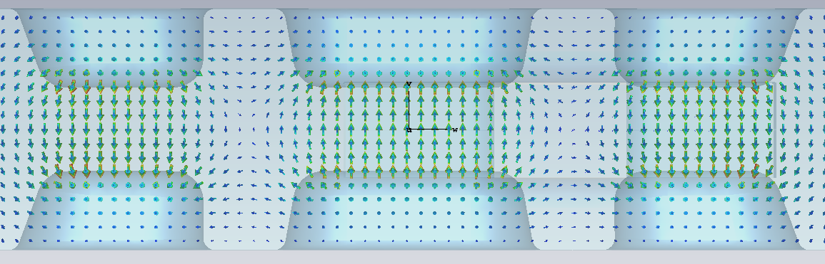
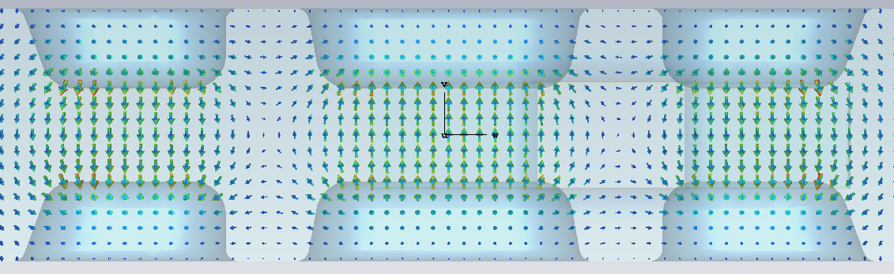
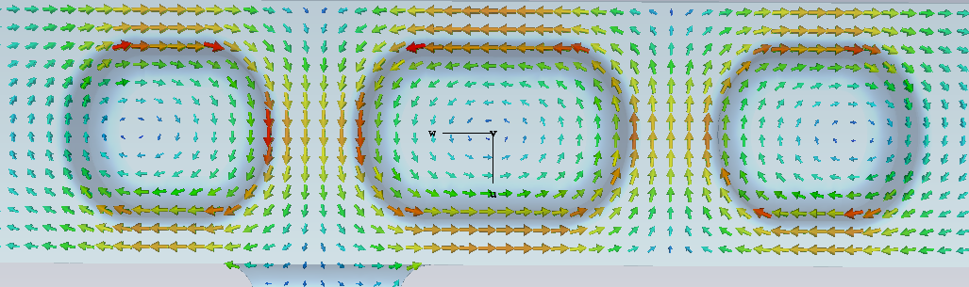
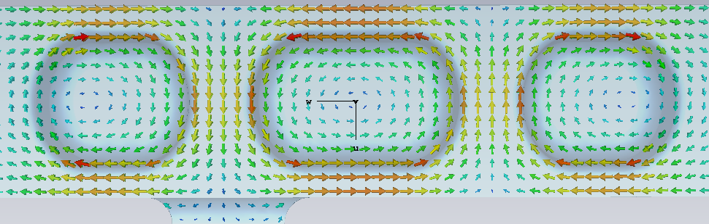
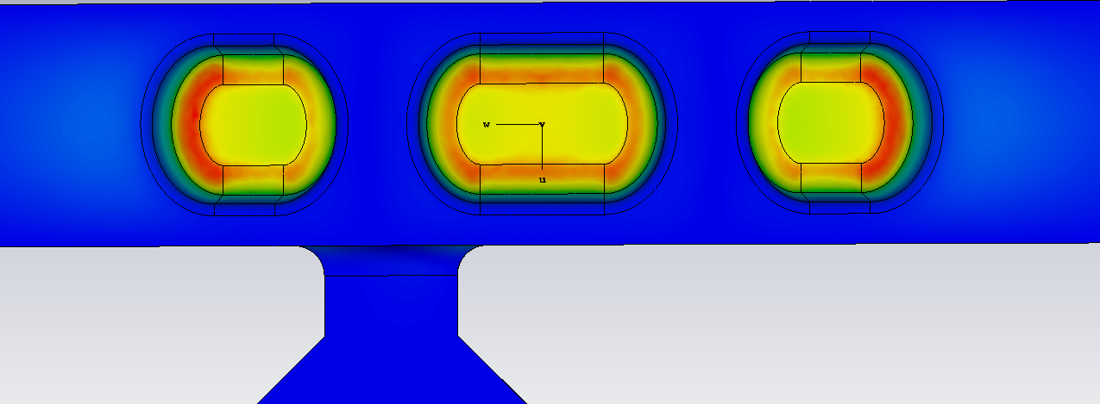
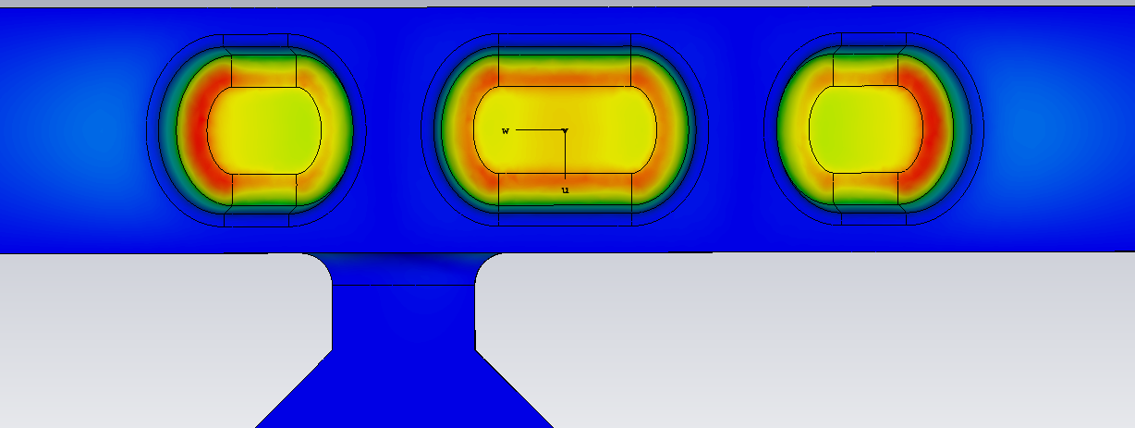
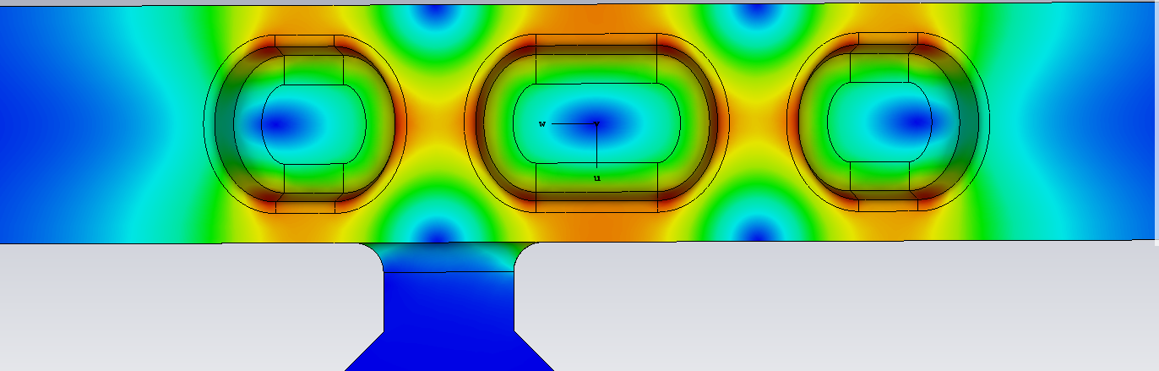
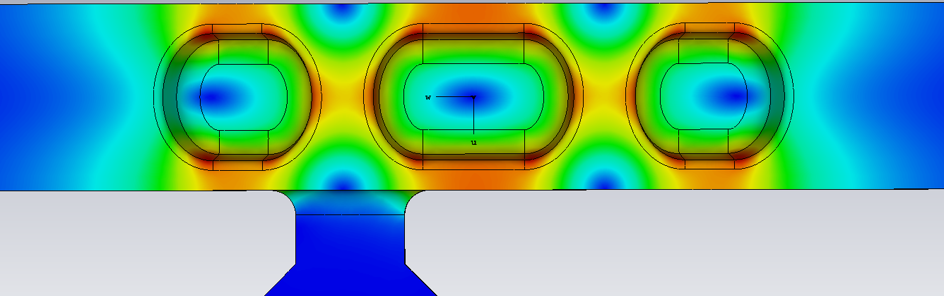


QMiR Elettra
Fundamental Mode
Cav.1
$$Feq. = 2.99866 GHz \\ Q_ext ={1,26e}^{05}$$
Cav.2
$$Feq. =3.24835 GHz \\ Q_ext ={3,25e}^{05}$$
E field (side view)
E field (side view)
H field (top view)
H field (top view)
E field (contour)
E field (contour)
H field (contour)
H field (contour)
Notes:
Slide 3 – (..) : Content of the presentation
Insert a new slide: Home > “New Slide” and choose a slide Layout:
For Title & Subtitle
For text with bullet points
For Text
For Picture, graphs, visuals
Two columns
Blank
If you want Copy & paste an element from the Clip Board to the particular slide: 1. Click on a box to mark it.
2. Position the mouse pointer on the box frame: Copy! 3. Click on the particular slide: Paste!
How you intend to use the elements is your choice. You can combine the text block style with the background colour in different manner.

Slide 13
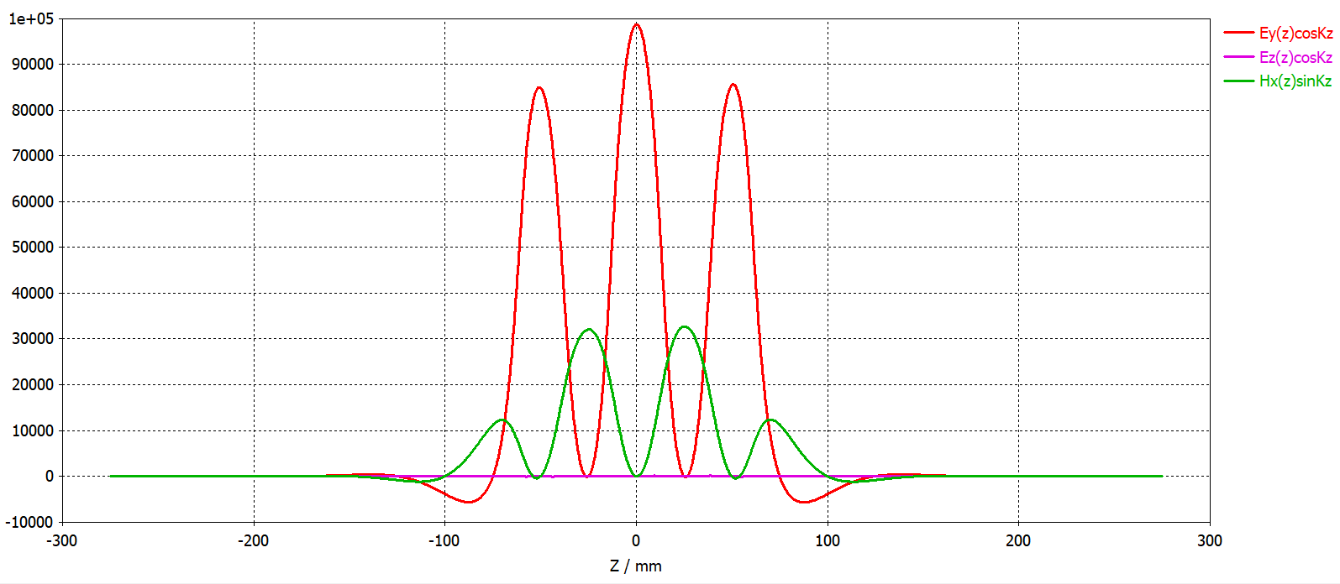
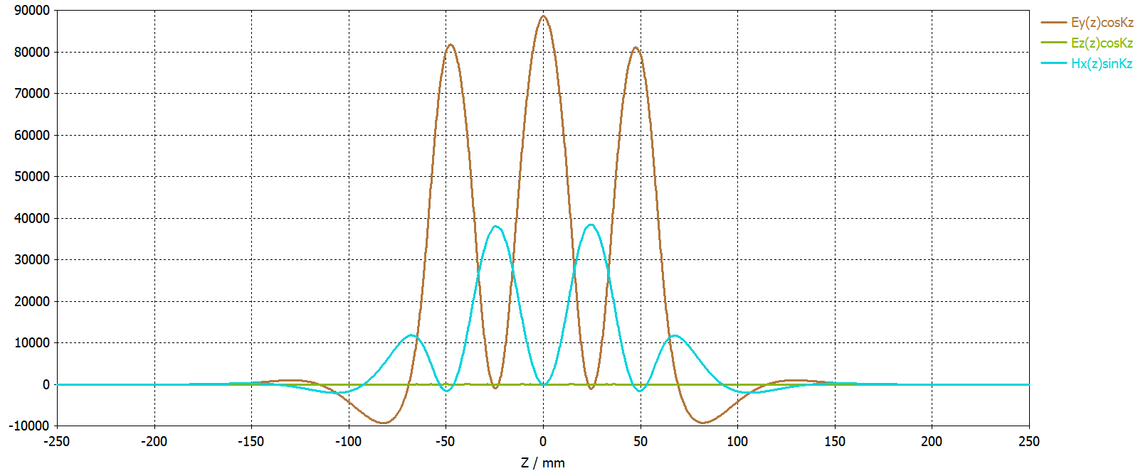


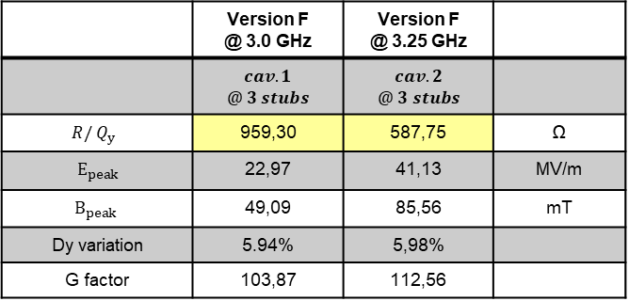
QMiR Elettra Geometry cav1 n cav2
Cav.1
$$Feq. = 2.99866 GHz \\ Q_ext ={1,26e}^{05}$$
Cav.2
$$Feq. =3.24835 GHz \\ Q_ext ={3,25e}^{05}$$
 | Version F @ 3.0 GHz | Version F @ 3.25 GHz
 | $$cav.1$$ $$@ 3 stubs$$ | $$cav.2$$ $$@ 3 stubs$$
$$R/{ Q}_{y }$$ | 959,30 | 587,75 | Ω
$$E_{peak}$$ | 22,97 | 41,13 | MV/m
$$B_{peak}$$ | 49,09 | 85,56 | mT
Dy variation | 5.94% | 5,98%
G factor | 103,87 | 112,56
E_peak & B_peak are scaled for 0,75 MV for Cav.1 & 1,2 MV for Cav.2
Notes:
Slide 3 – (..) : Content of the presentation
Insert a new slide: Home > “New Slide” and choose a slide Layout:
For Title & Subtitle
For text with bullet points
For Text
For Picture, graphs, visuals
Two columns
Blank
If you want Copy & paste an element from the Clip Board to the particular slide: 1. Click on a box to mark it.
2. Position the mouse pointer on the box frame: Copy! 3. Click on the particular slide: Paste!
How you intend to use the elements is your choice. You can combine the text block style with the background colour in different manner.

Slide 14

QMiR Elettra Geometry cav1 n cav2
Cav.1
$$Feq. = 2.99866 GHz \\ Q_ext ={1,26e}^{05}$$
Cav.2
$$Feq. =3.24835 GHz \\ Q_ext ={3,25e}^{05}$$
Notes:
Slide 3 – (..) : Content of the presentation
Insert a new slide: Home > “New Slide” and choose a slide Layout:
For Title & Subtitle
For text with bullet points
For Text
For Picture, graphs, visuals
Two columns
Blank
If you want Copy & paste an element from the Clip Board to the particular slide: 1. Click on a box to mark it.
2. Position the mouse pointer on the box frame: Copy! 3. Click on the particular slide: Paste!
How you intend to use the elements is your choice. You can combine the text block style with the background colour in different manner.

Slide 15
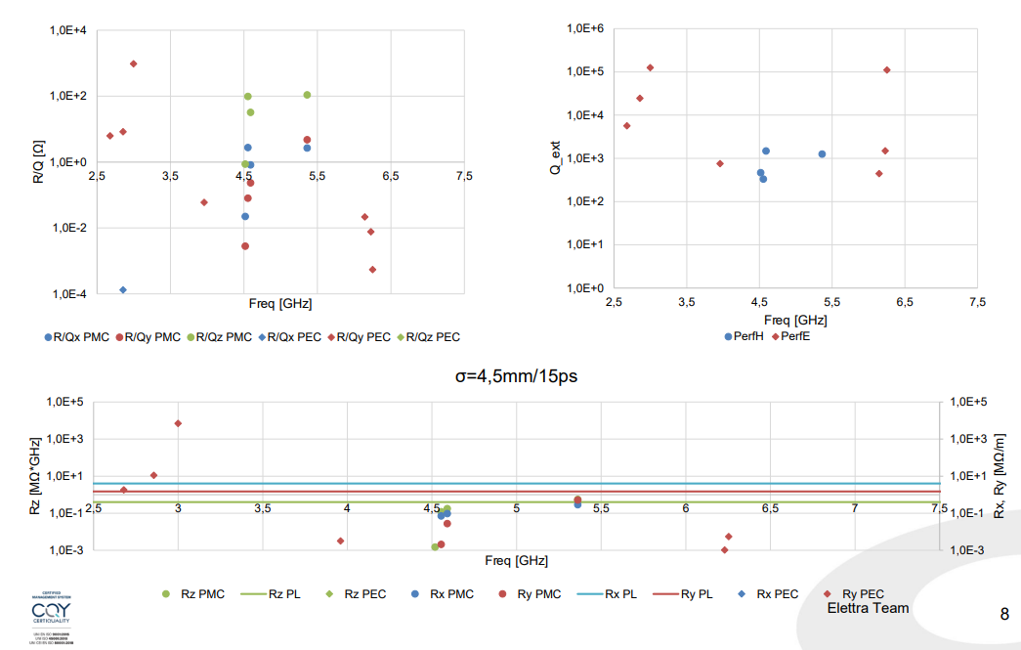

QMiR Elettra Geometry (Cav.1)
Cav.1
$$Feq. = 2.99866 GHz \\ Q_ext ={1,26e}^{05}$$
Notes:
Slide 3 – (..) : Content of the presentation
Insert a new slide: Home > “New Slide” and choose a slide Layout:
For Title & Subtitle
For text with bullet points
For Text
For Picture, graphs, visuals
Two columns
Blank
If you want Copy & paste an element from the Clip Board to the particular slide: 1. Click on a box to mark it.
2. Position the mouse pointer on the box frame: Copy! 3. Click on the particular slide: Paste!
How you intend to use the elements is your choice. You can combine the text block style with the background colour in different manner.

Slide 16

QMiR Elettra Geometry (Cav.2)
Cav.2
$$Feq. =3.24763 GHz \\ Q_ext ={3,25e}^{05}$$
Notes:
Slide 3 – (..) : Content of the presentation
Insert a new slide: Home > “New Slide” and choose a slide Layout:
For Title & Subtitle
For text with bullet points
For Text
For Picture, graphs, visuals
Two columns
Blank
If you want Copy & paste an element from the Clip Board to the particular slide: 1. Click on a box to mark it.
2. Position the mouse pointer on the box frame: Copy! 3. Click on the particular slide: Paste!
How you intend to use the elements is your choice. You can combine the text block style with the background colour in different manner.

Slide 17
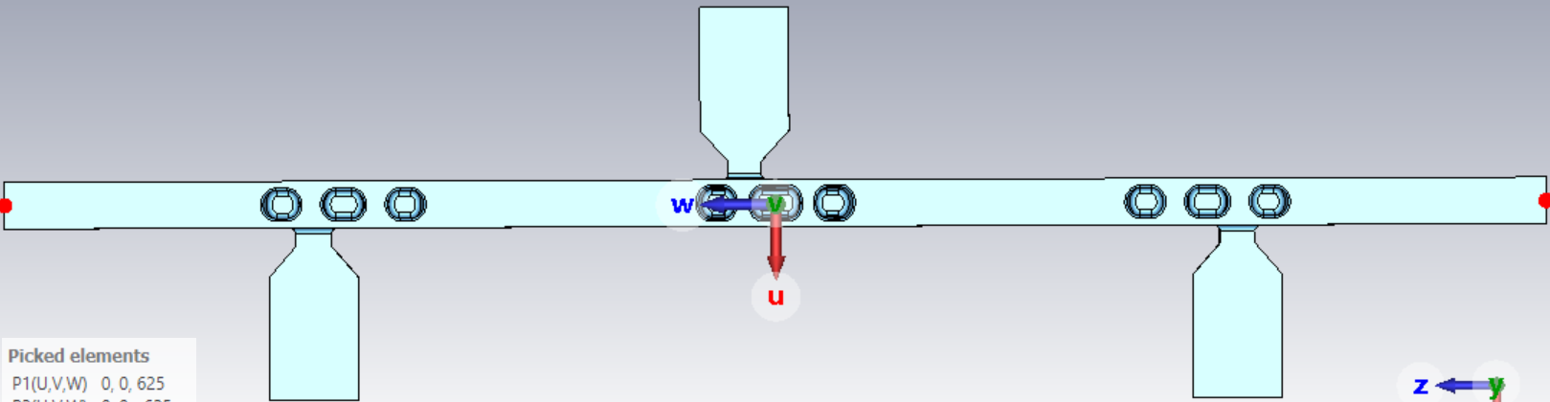
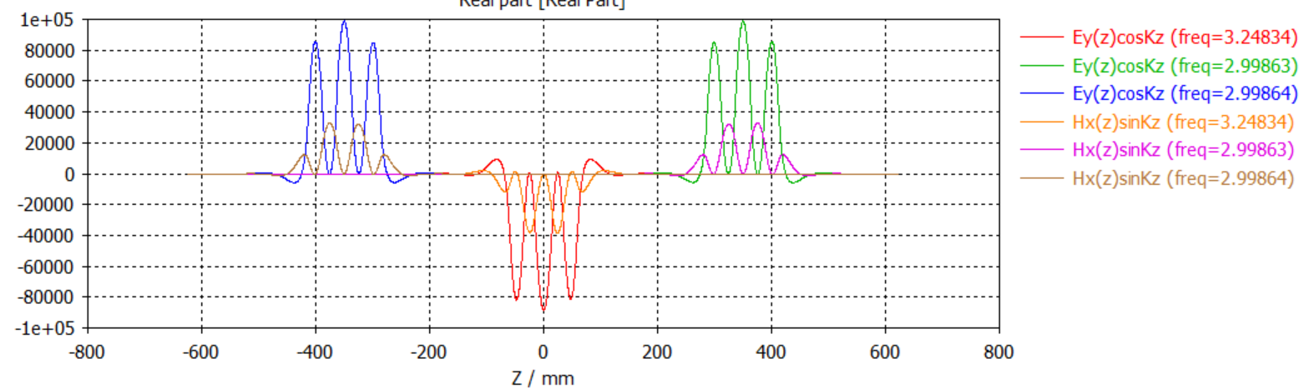


QMiR Elettra 3 cav System
1$250 mm$
cav1
cav1
cav2
Cav.2
$$Feq. =3.24763 GHz \\ Q_ext ={3,25e}^{05}$$
Cav.1
$$Feq. = 2.99866 GHz \\ Q_ext ={1,26e}^{05}$$
Cav.1
$$Feq. = 2.99866 GHz \\ Q_ext ={1,26e}^{05}$$

Slide 18

QMiR Elettra 3 cav System (HOMs)
Cav.1
$$Feq. = 2.99866 GHz \\ Q_ext ={1,26e}^{05}$$
Cav.2
$$Feq. =3.24763 GHz \\ Q_ext ={3,25e}^{05}$$

Slide 19
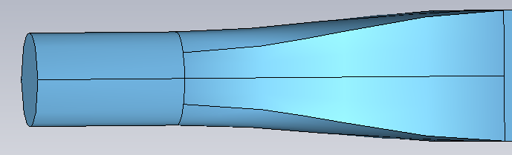
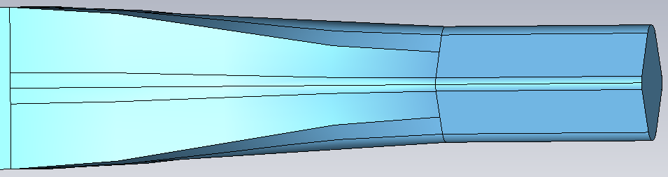
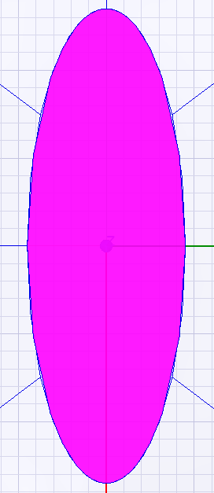
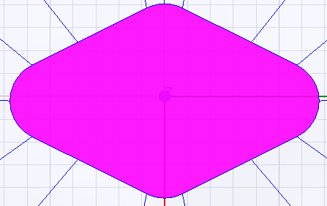
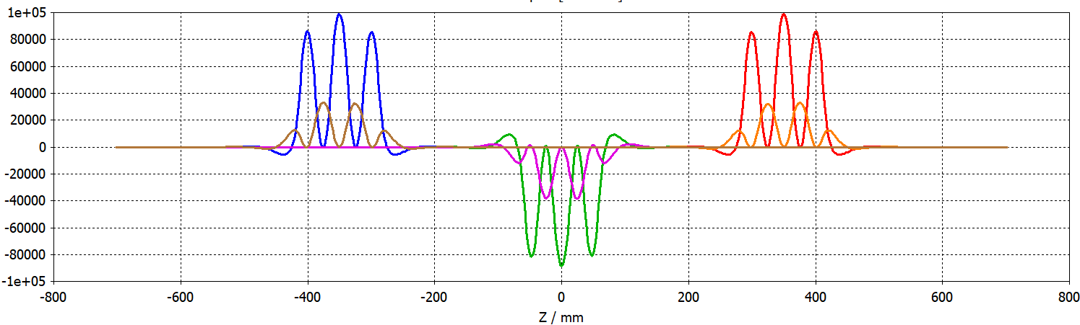
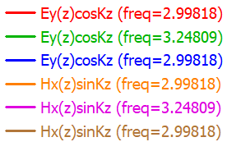
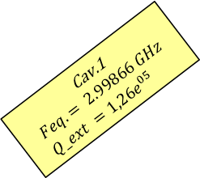
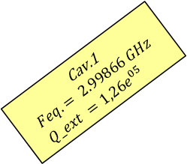
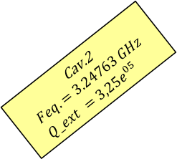

QMiR Elettra 3 cav System + CPR Tapers
Eliptical Profile
RhombiodalProfile
1$350 mm$
Copper
cav1
Copper
Copper
cav1
Copper
PEC
PEC
PEC
PEC
PEC
PEC
cav2
27mm
27mm
Cav.1
$$Feq. = 2.99866 GHz \\ Q_ext ={1,26e}^{05}$$
Cav.2
$$Feq. =3.24763 GHz \\ Q_ext ={3,25e}^{05}$$
Cav.1
$$Feq. = 2.99866 GHz \\ Q_ext ={1,26e}^{05}$$
9mm
17mm

Slide 20
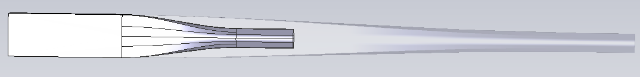
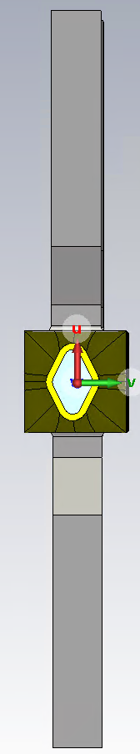
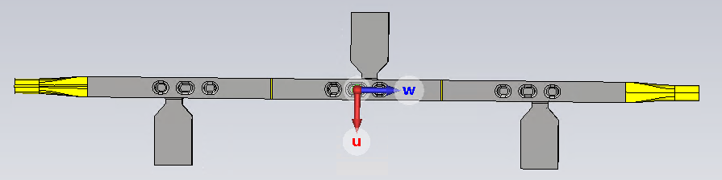


QMiR Elettra 3 cav System + CPR Tapers
450 mm
cav1
150 mm
1350 mm
Copper tapers (150 mm)+2 rings
1750 mm
Copper tapers (350 mm)+2 rings
1950 mm
Copper tapers (450 mm)+2 rings

Slide 21
QMiR Elettra 3 cav System + Tapers + CR
Cav.1
$$Feq. = 2.99866 GHz \\ Q_ext ={1,26e}^{05}$$
Cav.2
$$Feq. =3.24763 GHz \\ Q_ext ={3,25e}^{05}$$
Copper tapers (150 mm)+2 rings
Copper tapers (350 mm)+2 rings
Copper tapers (450 mm)+2 rings

Slide 22
QMiR Elettra 3 cav System: R/Q Comparison
Cav.1
$$Feq. = 2.99866 GHz \\ Q_ext ={1,26e}^{05}$$
Cav.2
$$Feq. =3.24763 GHz \\ Q_ext ={3,25e}^{05}$$
Copper tapers (150 mm)+2 rings
Copper tapers (350 mm)+2 rings
Copper tapers (450 mm)+2 rings

Slide 23
QMiR Elettra 3 cav System: QL Comparison
Cav.1
$$Feq. = 2.99866 GHz \\ Q_ext ={1,26e}^{05}$$
Cav.2
$$Feq. =3.24763 GHz \\ Q_ext ={3,25e}^{05}$$

Slide 24





QMiR Elettra 3 cav System + Tapers
Eliptical Profile
RhombiodalProfile
1$350 mm$
Copper ring
Copper ring
cav1
cav1
cav2
Cav.1
$$Feq. = 2.99866 GHz \\ Q_ext ={1,26e}^{05}$$
Cav.2
$$Feq. =3.24763 GHz \\ Q_ext ={3,25e}^{05}$$
Cav.1
$$Feq. = 2.99866 GHz \\ Q_ext ={1,26e}^{05}$$
Setup
$HFSS$
$Default PML Boundary on all ports$
$Full model simulation, no symmetry planes are used.$
$CST$
$Eigen solver, type Genral \left(Lossy\right)$
$Full model simulation, no symmetry planes are used.$
$Qlossy of CST matched with Q of HFSS.$
$Remarks$
$Introduction of symmetry planes create some non$
$standard modes.$
Quality factor Q
Freq CST | Q CST | Freq HFSS | Q HFSS
4,00339 | 6,45 E05 | 4,00347 | 5,45 E05
4,00341 | 6,45 E05 | 4,00349 | 5,46 E05
4,01279 | 2,33 E05 | 4,01318 | 2,08 E05
4,01345 | 5,14 E05 | 4,01384 | 3,87 E05
4,04 | 3,84 E08 | 4,03997 | 6,54 E08

Slide 25





QMiR Elettra Wakefields (Cav.1)
Cav.1
$$Feq. = 2.99866 GHz \\ Q_ext ={1,26e}^{05}$$
Notes:
Slide 3 – (..) : Content of the presentation
Insert a new slide: Home > “New Slide” and choose a slide Layout:
For Title & Subtitle
For text with bullet points
For Text
For Picture, graphs, visuals
Two columns
Blank
If you want Copy & paste an element from the Clip Board to the particular slide: 1. Click on a box to mark it.
2. Position the mouse pointer on the box frame: Copy! 3. Click on the particular slide: Paste!
How you intend to use the elements is your choice. You can combine the text block style with the background colour in different manner.

Slide 26




QMiR Elettra Wakefields (Cav.2)
Cav.2
$$Feq. =3.24763 GHz \\ Q_ext ={3,25e}^{05}$$
Notes:
Slide 3 – (..) : Content of the presentation
Insert a new slide: Home > “New Slide” and choose a slide Layout:
For Title & Subtitle
For text with bullet points
For Text
For Picture, graphs, visuals
Two columns
Blank
If you want Copy & paste an element from the Clip Board to the particular slide: 1. Click on a box to mark it.
2. Position the mouse pointer on the box frame: Copy! 3. Click on the particular slide: Paste!
How you intend to use the elements is your choice. You can combine the text block style with the background colour in different manner.

Slide 27


QMiR Elettra WakeImpedance from Wakefields
Cav.2
$$Feq. =3.24763 GHz \\ Q_ext ={3,25e}^{05}$$
Cav.1
$$Feq. = 2.99866 GHz \\ Q_ext ={1,26e}^{05}$$
Notes:
Slide 3 – (..) : Content of the presentation
Insert a new slide: Home > “New Slide” and choose a slide Layout:
For Title & Subtitle
For text with bullet points
For Text
For Picture, graphs, visuals
Two columns
Blank
If you want Copy & paste an element from the Clip Board to the particular slide: 1. Click on a box to mark it.
2. Position the mouse pointer on the box frame: Copy! 3. Click on the particular slide: Paste!
How you intend to use the elements is your choice. You can combine the text block style with the background colour in different manner.

Slide 28

QMiR Elettra WakeImpedance from Wakefields
Cav.2
$$Feq. =3.24763 GHz \\ Q_ext ={3,25e}^{05}$$
Cav.1
$$Feq. = 2.99866 GHz \\ Q_ext ={1,26e}^{05}$$
Notes:
Slide 3 – (..) : Content of the presentation
Insert a new slide: Home > “New Slide” and choose a slide Layout:
For Title & Subtitle
For text with bullet points
For Text
For Picture, graphs, visuals
Two columns
Blank
If you want Copy & paste an element from the Clip Board to the particular slide: 1. Click on a box to mark it.
2. Position the mouse pointer on the box frame: Copy! 3. Click on the particular slide: Paste!
How you intend to use the elements is your choice. You can combine the text block style with the background colour in different manner.

Slide 29

QMiR Elettra WakeImpedance from Wakefields
Cav.2
$$Feq. =3.24763 GHz \\ Q_ext ={3,25e}^{05}$$
Cav.1
$$Feq. = 2.99866 GHz \\ Q_ext ={1,26e}^{05}$$
Notes:
Slide 3 – (..) : Content of the presentation
Insert a new slide: Home > “New Slide” and choose a slide Layout:
For Title & Subtitle
For text with bullet points
For Text
For Picture, graphs, visuals
Two columns
Blank
If you want Copy & paste an element from the Clip Board to the particular slide: 1. Click on a box to mark it.
2. Position the mouse pointer on the box frame: Copy! 3. Click on the particular slide: Paste!
How you intend to use the elements is your choice. You can combine the text block style with the background colour in different manner.

Slide 30

QMiR Elettra WakeImpedance from Wakefields
Cav.2
$$Feq. =3.24763 GHz \\ Q_ext ={3,25e}^{05}$$
Cav.1
$$Feq. = 2.99866 GHz \\ Q_ext ={1,26e}^{05}$$
Notes:
Slide 3 – (..) : Content of the presentation
Insert a new slide: Home > “New Slide” and choose a slide Layout:
For Title & Subtitle
For text with bullet points
For Text
For Picture, graphs, visuals
Two columns
Blank
If you want Copy & paste an element from the Clip Board to the particular slide: 1. Click on a box to mark it.
2. Position the mouse pointer on the box frame: Copy! 3. Click on the particular slide: Paste!
How you intend to use the elements is your choice. You can combine the text block style with the background colour in different manner.

Slide 31


QMiR Elettra WakeImpedance from Wakefields
Cav.2
$$Feq. =3.24763 GHz \\ Q_ext ={3,25e}^{05}$$
Cav.1
$$Feq. = 2.99866 GHz \\ Q_ext ={1,26e}^{05}$$
Notes:
Slide 3 – (..) : Content of the presentation
Insert a new slide: Home > “New Slide” and choose a slide Layout:
For Title & Subtitle
For text with bullet points
For Text
For Picture, graphs, visuals
Two columns
Blank
If you want Copy & paste an element from the Clip Board to the particular slide: 1. Click on a box to mark it.
2. Position the mouse pointer on the box frame: Copy! 3. Click on the particular slide: Paste!
How you intend to use the elements is your choice. You can combine the text block style with the background colour in different manner.

Slide 32


QMiR Elettra WakeImpedance from Wakefields
Cav.2
$$Feq. =3.24763 GHz \\ Q_ext ={3,25e}^{05}$$
Cav.1
$$Feq. = 2.99866 GHz \\ Q_ext ={1,26e}^{05}$$
Zoomed (4,25-6,0 GHz)
Notes:
Slide 3 – (..) : Content of the presentation
Insert a new slide: Home > “New Slide” and choose a slide Layout:
For Title & Subtitle
For text with bullet points
For Text
For Picture, graphs, visuals
Two columns
Blank
If you want Copy & paste an element from the Clip Board to the particular slide: 1. Click on a box to mark it.
2. Position the mouse pointer on the box frame: Copy! 3. Click on the particular slide: Paste!
How you intend to use the elements is your choice. You can combine the text block style with the background colour in different manner.

Slide 33




Q₀, R_{SF} & Dynamic Thermal load for NB cavity @ 4K
Below the critical temperature or $T<T_{c}/2$, with $T_{c}$ the critical temperature, the BCS contribution to the surface resistance $R_{sf}$ dominates. The product ${G=Q}_{0}R_{sf}$ results a characteristic of the geometry of the cavity, and only dependent from the operational temperature of the device.
$$G=Q_{0}R_{sf}=Q_{0}ω^{2}λ_{L}^{3}μ_{0}^{2}σ\left(T\right)\exp\left(−\frac{Δ}{K_{B}T}\right)$$
$$R_{sf}[Ω]≈α×{10}^{−4}\frac{{\left(f\left[GHz\right]\right)}^{2}}{T} \exp\left(−\frac{17.67}{T}\right)$$
$$P_{th}=\frac{ω_{0}U_{0}R_{sf}}{G}$$

Slide 34


Q₀, R_{SF} & Dynamic Thermal load for NB₃Sn cavity @ 4K
Q₀versus T at 1.3 GHz from calculations based on BCS theory for Nb₃Sn compared to measurement of a Nb3Sn cavity.
Scaling the BCS part $∝f^{2}$from 1.3 $⇒$3.0 and 3,25 GHz and adding the reported ~5 nΩ residual resistence

Slide 35
Static Thermal Load
The static thermal load depends only on the cryomodule cryogenic design and not on the cavity material.
Here below a rough estimation of the thermal budget @ 4K and @ thermal screen stage

Slide 36




Conclusions
Pure Nb cavities
$No possibility to use cryocooler system$
$For 180 W consumption @ 4K a cryo plant$
$capable of 250{lt}/h LHe is needed.$
$Electricty consumption:300 KWh.$
Nb3Sn cavities
$Possibility to use cryocooler system$
$even below 4K.$
$Electricty consumption:20 KWh.$
Vs
The current Elettra liquefaction plant, which will also supply LHe to Elettra 2.0, does not have sufficient power to supply liquid helium to the pure Nb cavities, so it would be necessary to install a dedicated plant. The Nb3Sn cavity solution requires more time from a research and development point of view for the construction of the cavities themselves, but would have less impact on the Elettra 2.0 facility. In the long term, the cryogen-free Nb3Sn solution is more sustainable, also due to the uncertainty of the He market.

Slide 37











Acknowledgements
Elettra Team
External Collaborator
RF Group CERN
A. Fabris
S. Di Mitri
F. Gerigk
G.Scrimali
M. Modica
K. Manukyan
S. Dastan
M. Zamolo
R. Calaga
A. Grudiev
Special thanks to...
A. Zholents – ANL USA
A. Lunin, T. Khabiboulline, V. Yokovlev– FNAL USA

Slide 38
QMiR Elettra Review Pannel Comments
Verification should be done to make sure the reasonable isolation of operating mode and no-interaction of HOMs.
Multi-pole components should be further studied and optimized
Further optimization of design should be done from wakefields point of view.
Additional reduction of both normal and skew sextuple components should be considered by poles (electrodes) shaping.
More complex HOM damping is needed as the number of on-cell waveguides increases.
Further analysis should be preformed to ensure effective damping of SOM as gaps in a bunch pattern will generate sub-harmonic.
Solely relying on R/Q of SOMs may not provide adequate solution to control the parasitic impedance. Fundamental rejection in the waveguide incorporating rejection/notch filters should be investigated.
The HOM resonant RF losses must be carefully analyzed considering the actual geometry of the adjacent sections of the vacuum chamber.
The cavity slow frequency tuner with a range of about few 100 kHz should be integrated into the CM design.
The procedure for safely parking the cavities be carefully studied. Preliminary assumption is that the system should be warmed up to room temperature when not in use. A proper mechanism of absorbing SOM/HOM power, if necessary, should be analyzed and developed.
Notes:
Slide 3 – (..) : Content of the presentation
Insert a new slide: Home > “New Slide” and choose a slide Layout:
For Title & Subtitle
For text with bullet points
For Text
For Picture, graphs, visuals
Two columns
Blank
If you want Copy & paste an element from the Clip Board to the particular slide: 1. Click on a box to mark it.
2. Position the mouse pointer on the box frame: Copy! 3. Click on the particular slide: Paste!
How you intend to use the elements is your choice. You can combine the text block style with the background colour in different manner.

Slide 39
Notes:
Last Slide 1: Thanks to the audience

Slide 40
Notes:
Last Slide 2: Aerial Photo of Elettra

Slide 41

QMiR Elettra
Post Processing
Fundamental mode @ 3.0 GHz |  | Symmetric | units
Acc. Voltage | $$V_{z}=\int{E_{z}e^{jkz}dz}$$ |  | V
Deflecting Voltage | $$V_{x}=\int{E_{x}cos\frac{2πf}{c}z+\int{μ_{0}cH_{y}sin\frac{2πf}{c}z}}$$ |  | V
 | $$V_{y}=\int{E_{y}cos\frac{2πf}{c}z+\int{μ_{0}cH_{x}sin\frac{2πf}{c}z}}$$
R over Q | $${\left(\frac{R}{Q}\right)}_{x}=\frac{{\left(V_{x}\right)}^{2}}{2πfU}$$ |  | Ω
 | $${\left(\frac{R}{Q}\right)}_{y}=\frac{{\left(V_{y}\right)}^{2}}{2πfU}$$
 | $${\left(\frac{R}{Q}\right)}_{z}=\frac{{\left( V_{z}\right)}^{2}}{2πfU}$$
PW voltage | $${PW V}_{x}=−\frac{c}{ωr}\left(\int{E_{z(x=0)}\sin\left(\frac{2πf}{c}z\right)−\int{E_{z(x=r)}\sin\left(\frac{2πf}{c}z\right)}}\right)$$ |  | V
 | $${PW V}_{y}=−\frac{c}{ωr}\left(\int{E_{z(y=0)}\sin\left(\frac{2πf}{c}z\right)−\int{E_{z(y=r)}\sin\left(\frac{2πf}{c}z\right)}}\right)$$
PW R over Q | $${PW \left(\frac{R}{Q}\right)}_{x}=\frac{{\left({PW V}_{x}\right)}^{2}}{2πfU}$$ |  | Ω
 | $${PW \left(\frac{R}{Q}\right)}_{y}=\frac{{\left({PW V}_{y}\right)}^{2}}{2πfU}$$
$$E_{peak}$$ | Peak of E field |  | V/m
$$H_{peak}$$ | Peak of H field |  | T
Q factor
G factor | $$Q×\sqrt{\frac{2πfμ_{0}}{2σ}}$$
Notes:
Slide 3 – (..) : Content of the presentation
Insert a new slide: Home > “New Slide” and choose a slide Layout:
For Title & Subtitle
For text with bullet points
For Text
For Picture, graphs, visuals
Two columns
Blank
If you want Copy & paste an element from the Clip Board to the particular slide: 1. Click on a box to mark it.
2. Position the mouse pointer on the box frame: Copy! 3. Click on the particular slide: Paste!
How you intend to use the elements is your choice. You can combine the text block style with the background colour in different manner.

Slide 42


Literature Survey
Generation of Short Pulses in SPEAR3
1- frequency tilt & cancel
The bunch is crabbed at it passes through zero-crossing of transverse deflecting cavities
Two transverse deflecting cavities
$$f_{1}=nf_{0}$$
$$f_{2}=(n+\frac{1}{2})f_{0}$$
6th & 6.5th harmonic of 476.3 MHz to produce “beat frequency” kick waveform that crab-kick every other bucket with a combined voltage of 2-3 MV
For the exact cancellation at the centre of bunch ${nV}_{1}=\left(n+\frac{1}{2}\right)V_{2}$. The slight over-compensation with V2 helps minimizing the perturbation to the whole bunch.
Coupling strength of crab cavity is proportional to product of its frequency & deflecting voltage ($∈ = \frac{ekV}{E_{0}}$)
f1
f2
f1+f2
Deflecting Voltage
-0.4 -0.2 0 0.2 0.4 0.6 0.8 1
z = cז (m)
APS-SPX
Crab cavity frequency: 2815 MHz
Transverse kick: 2 MV
SPEAR3
Crab cavity frequency: 2858 MHz
Transverse kick: 1.93 MV

Slide 43



QMiR Elettra 3 cav System + Tapers
Eliptical Profile
RhombiodalProfile
1$250 mm$
cav1
cav1
cav2
Cav.1
$$Feq. = 2.99866 GHz \\ Q_ext ={1,26e}^{05}$$
Cav.2
$$Feq. =3.24763 GHz \\ Q_ext ={3,25e}^{05}$$
Cav.1
$$Feq. = 2.99866 GHz \\ Q_ext ={1,26e}^{05}$$

Slide 44
QMiR Elettra 3 cav System + Tapers (HOMs)
Cav.1
$$Feq. = 2.99866 GHz \\ Q_ext ={1,26e}^{05}$$
Cav.2
$$Feq. =3.24763 GHz \\ Q_ext ={3,25e}^{05}$$

Slide 45
QMiR Elettra 3 cav System + Tapers + 2CR
Cav.1
$$Feq. = 2.99866 GHz \\ Q_ext ={1,26e}^{05}$$
Cav.2
$$Feq. =3.24763 GHz \\ Q_ext ={3,25e}^{05}$$

Slide 46


QMiR Elettra 3 cav System + Tapers
Eliptical Profile
RhombiodalProfile
1$350 mm$
Copper ring
Copper ring
cav1
cav1
cav2
Cav.1
$$Feq. = 2.99866 GHz \\ Q_ext ={1,26e}^{05}$$
Cav.2
$$Feq. =3.24763 GHz \\ Q_ext ={3,25e}^{05}$$
Cav.1
$$Feq. = 2.99866 GHz \\ Q_ext ={1,26e}^{05}$$
Copper ring
Copper ring
Copper ring
Copper ring
cav1
cav1
cav2

Slide 47
QMiR Elettra 3 cav System + Tapers + 4CR
Cav.1
$$Feq. = 2.99866 GHz \\ Q_ext ={1,26e}^{05}$$
Cav.2
$$Feq. =3.24763 GHz \\ Q_ext ={3,25e}^{05}$$
2- copper ring system
4- copper ring system
2- copper ring system
4- copper ring system

Slide 48
QMiR Elettra 3 cav System + Tapers + 4CR
Cav.1
$$Feq. = 2.99866 GHz \\ Q_ext ={1,26e}^{05}$$
Cav.2
$$Feq. =3.24763 GHz \\ Q_ext ={3,25e}^{05}$$
2- copper ring system
4- copper ring system

Slide 49
QMiR Elettra 3 cav System: QL Comparison
Cav.1
$$Feq. = 2.99866 GHz \\ Q_ext ={1,26e}^{05}$$
Cav.2
$$Feq. =3.24763 GHz \\ Q_ext ={3,25e}^{05}$$

Slide 50
QMiR Elettra 3 cav System + Tapers + CR Steel
Cav.1
$$Feq. = 2.99866 GHz \\ Q_ext ={1,26e}^{05}$$
Cav.2
$$Feq. =3.24763 GHz \\ Q_ext ={3,25e}^{05}$$
Copper tapers (150 mm)+2 rings
Steel tapers (150 mm)+2 rings

Slide 51
QMiR Elettra 3 cav System + Tapers + CR Steel
Cav.1
$$Feq. = 2.99866 GHz \\ Q_ext ={1,26e}^{05}$$
Cav.2
$$Feq. =3.24763 GHz \\ Q_ext ={3,25e}^{05}$$
Copper tapers (350 mm)+2 rings
Steel tapers (350 mm)+2 rings

Slide 52
QMiR Elettra 3 cav System + Tapers + CR Steel
Cav.1
$$Feq. = 2.99866 GHz \\ Q_ext ={1,26e}^{05}$$
Cav.2
$$Feq. =3.24763 GHz \\ Q_ext ={3,25e}^{05}$$
Copper tapers (450 mm)+2 rings
Steel tapers (450 mm)+2 rings

