Slide 1



The UK XFEL project: conceptual design
Anthony Gilfellon, STFC Daresbury Laboratory
On behalf of the UK XFEL project team
8th October 2025
xfel.ac.uk
Notes:
The abstract pattern can be removed or repositioned if required. Be careful to ‘Send to Back’ so that it does not obscure any important information.

Slide 2
Outline
Concept principles
User communities’ requirements
Conceptual design for a next-generation XFEL
Summary and next steps

Slide 3
Concept principles
user communities’ requirements
Conceptual design for a next-generation XFEL
Summary and next steps

Slide 4

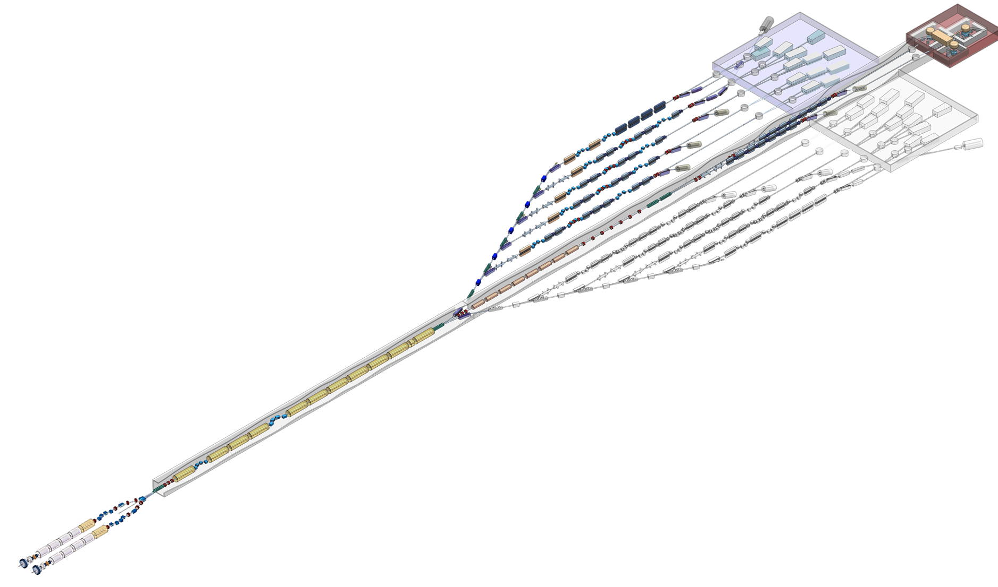



UK XFEL: Conceptual Design & Options Analysis
UK XFEL is a multi-stage project to pursue ‘next-generation’ XFEL capabilities for the UK
Conceptual Design
Ambitious ‘international-scale’ scope
Robust and technically feasible
Scalable to a range of investment options
Options Analysis (vs the status quo):
A new facility in the UK
Investment at existing XFELs
A combined approach
Science and Technology Case
Access to the ultrafast domain: the intrinsic timescales for physical, chemical and biological changes of matter
Impacts for society and industry: biotech, batteries, energy and catalysis, defence etc.
xfel.ac.uk

Slide 5
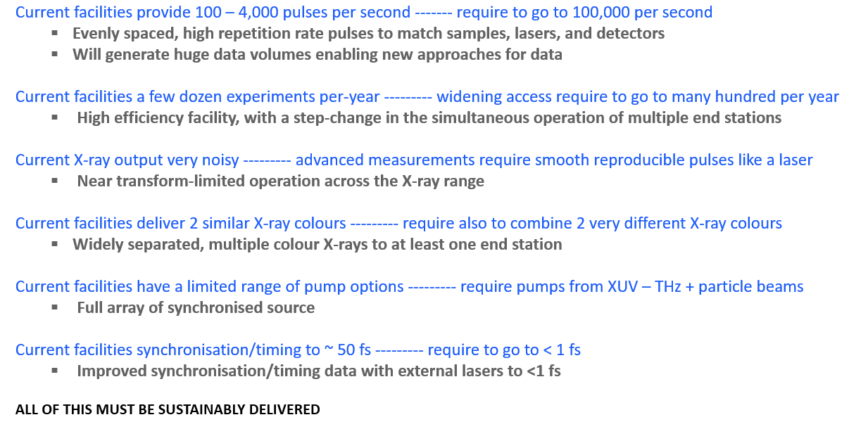
UK XFEL next generation capabilities
The Science Case calls for an ambitious, internationally-competitive machine, with ‘next-generation’ capabilities
Extremely high
pulse rep. rate
+ data and AI
Significantly increased capacity
Enhanced X-ray pulse qualities
A suite of laser-based synchronous sources
Environmentally Sustainable

Slide 6
Concept principles
User communities’ requirements
Conceptual design for a next-generation XFEL
Summary and next steps

Slide 7
The UK’s XFEL user community
Non-domestic users of LCLS and Eu XFEL:
The UK has a very strong XFEL user community: over 500 UK scientists with active involvement in XFEL science in the past decade (from the 2020 Science Case)
LCLS (2024)
Eu XFEL (2023)
Notes:
To give you a sense of scale for the user community in the UK I’ve charted the 2024 data for two of the major facilities, (we have more data coming soon from the others, but it’s a similar story). The UK is the second largest non domestic user at both facilities. With use increasing from 6% in 2018 to 11% in 2024.

Slide 8


UK XFEL Science Case
The UK XFEL Science Case (2019–2020) demonstrated the scientific need for ‘next-generation’ XFEL capability
Presently being updated and expanded to a Science and Technology Case (2022-2025)
xfel.ac.uk
Demonstrated
scientific
‘mission need’

Slide 9
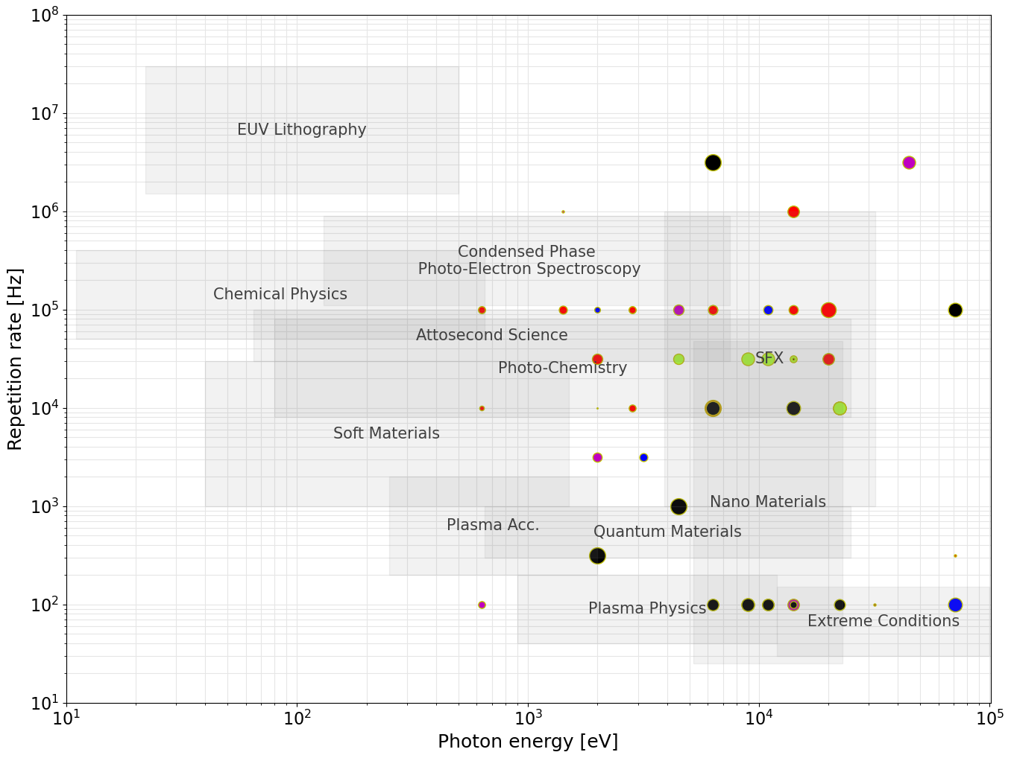

Top-level
facility design
choices
Acceleration Technology:
User Requirements from the Science Case & Survey
ERLs
Important to recognise continuous vs bursts
Max. photon energy strongly influences the required electron beam energy
Repetition rate largely dictates the type of acceleration technology
Always aiming for most efficient way to cover this parameter space
Requirements suggest ~8 GeV superconducting RF linac
SRF
(CW)
~1 MHz to allow many simultaneous experiments at ~100 kHz
LCLS-II-HE, SHINE, UK XFEL:
~8 GeV SRF CW
Pulses/sec
SRF
(Pulsed)
HRR NC
-> extra capability for a subset of users
Physics and X-ray Photonics
Matter in Extreme Conditions
Quantum and Nanomaterials
Chemical Sciences and Energy
Life Sciences
Industry
Booster
NC
Electron Beam Energy:
~1-1.5 GeV
~2-3 GeV
~6-8 GeV
≥10 GeV

Slide 10
Top-level
facility design
choices
Acceleration Technology:
User Requirements from the Science Case & Survey
HXR 10 to 20 KeV
100 kHz
X-ray diffraction
Biological processes
SXR 1 to 5 KeV
100 kHz
Atomic / Molecular Chemistry
ERLs
Max. photon energy strongly influences the required electron beam energy
Repetition rate largely dictates the type of acceleration technology
Always aiming for most efficient way to cover this parameter space
Requirements suggest ~8 GeV superconducting RF linac
SRF
(CW)
Pulses/sec
SRF
(Pulsed)
HRR NC
HXR 20 to 45 KeV
100 Hz
Matter in extreme conditions
Physics and X-ray Photonics
Matter in Extreme Conditions
Quantum and Nanomaterials
Chemical Sciences and Energy
Life Sciences
Industry
NC
Electron Beam Energy:
~1-1.5 GeV
~2-3 GeV
~6-8 GeV
≥10 GeV

Slide 11
Concept principles
User communities’ requirements
Conceptual design for a next-generation XFEL
Summary and next steps

Slide 12
Facility concept
A step change in the simultaneous operation of multiple end stations
The aim is for ~10 FELs in simultaneous operation
Growing international consensus around this direction for superconducting XFELs
~10 FELs independently tuneable in terms of photon energy, pulse duration etc.
+ potential direct uses of electron beam
Kickers to split MHz bunch train to ~100 kHz per line
8GeV Beam Utilisation
FEL 6
FEL 5
Electron bunch properties tailored per FEL
FEL 4
FEL 3
Gun
FEL 5B
Injector 1
FEL 1a
FEL 2
MEC
SCRF 8GeV Linac
Cu Linac
Cu Linac
Injector 2
8GeV
~12 GeV
FEL 1b
FEL 2X
Fixed accelerator energy ~8 GeV, electron bunches at ~1 MHz
Energy boost for higher pulse energy/high photon energy
FEL 5Bx
FEL 3X
FEL 4X
FEL 5X
FEL 6X
Expansion
Injector
Linac
Spreader
FELs
Photon Transports
Experimental Halls

Slide 13
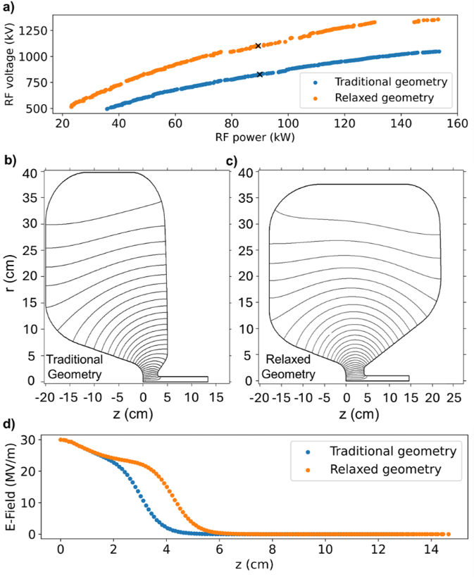
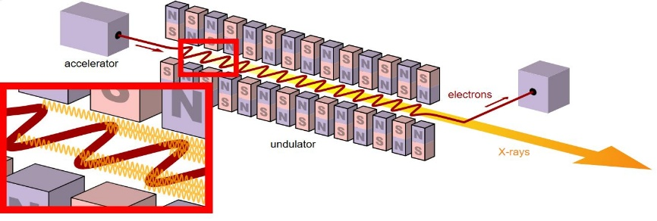
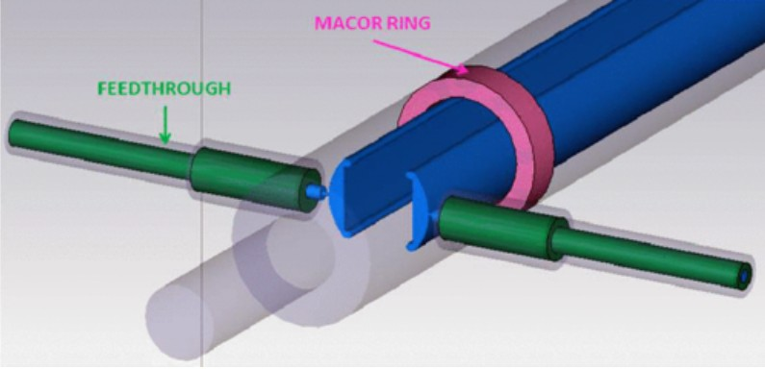
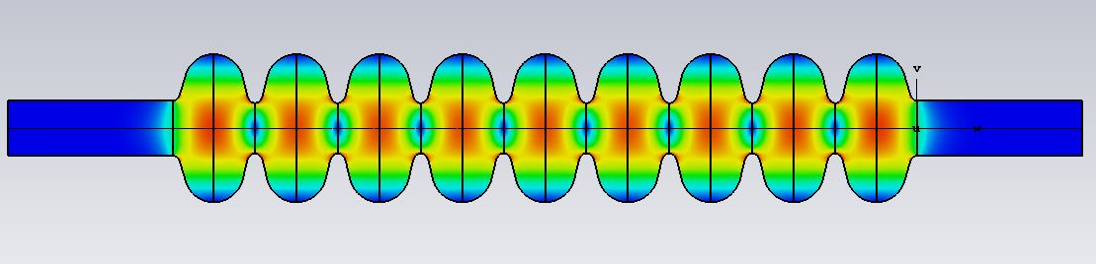
UK XFEL Facility (not to scale)
Injector section
Two VHF NC guns
Varying bunch charge beams interleaved
Leaves section at 100 MeV
Maximum bunch repetition rate of 1 MHz
Booster Section
NC Cu C-band, 100 Hz, ~35 MV/m
8GeV to 12 GeV
Matter in extreme conditions
Main Accelerating section (initial design)
100 MeV to 8 GeV
600 1.3GHz TESLA 9-cell cavities
Gradient of ~ 14 MV/m
8 linearising 3.9 GHz
cavities
2 bunch
compressors
12 GeV
FEL lines
6 to 12 FEL lines
Independently customisable in terms of bunch charge and repetition rate
8 GeV
Above: Illustration of the mechanism in an optical device used to create free-electron laser light.
Left: (a) Pareto fronts for each gun design. The selected design is marked with a black cross. b) Optimized traditional gun geometry. c) Optimized relaxed gun geometry. d) Peak electric field on axis for each gun design.
END stations
Multiple end stations per FEL line
Full range of pump lasers available
Switchyard
Fast kickers to separate out 1MHz beam to (say) 10 x 100 kHz beams
Variants are possible
Above: Example of a stripline kicker.
Belver-Aguilar, C. et al. (2014) ‘Stripline design for the extraction kicker of Compact Linear Collider damping rings’, Phys. Rev. ST Accel. Beams, 17, p. 071003. Available at: https://doi.org/10.1103/PhysRevSTAB.17.071003.
~ 1km
Above: The TM₀₁₀ π-mode E-field distribution in A 9-cell L-band TESLA cavity.
100 MeV

Slide 14
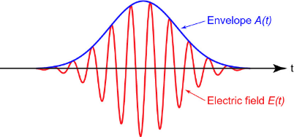
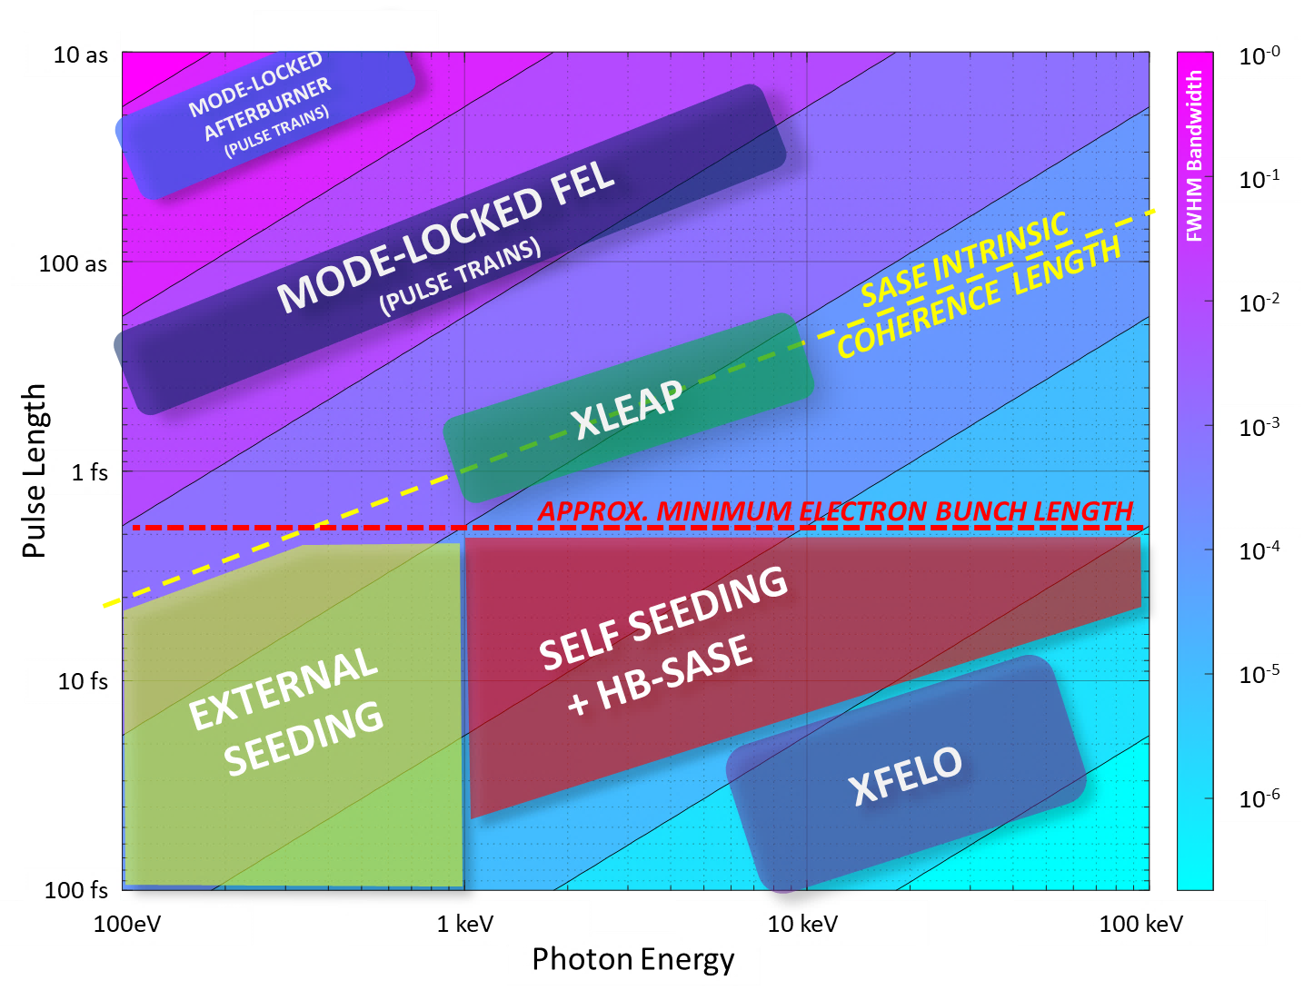
Near transform-limited pulses (8 GeV)
Each FEL has 1-3 primary operating modes, covering both short-pulse and long-pulse options
Generating laser-like pulses across a wide range of energies and pulse lengths requires a variety of techniques
FEL | Tuning | Mode | Technique | Transform Limited Pulse Duration
FEL-6 | 0.05 – 1.0 keV | Seeded | EEHG | 5 – 100 fs
FEL-5 | 0.25 – 3.0 keV | Long pulse | EEHG/HB | 100 fs – 20 fs
 |  | Short Pulse | XLEAP | 2 fs – 350 as
FEL- 4 | 1.0 – 5.0 keV | Long Pulse | HB-SASE | 40 fs – 15 fs
 |  | Short Pulse | XLEAP | 800 as – 275 as
FEL-3 | 3.0 – 13.0 keV | Long Pulse | HB-SASE | 20 fs – 10 fs
 |  | Short Pulse | XLEAP | 400 as – 200 as
FEL-2 | 5.0 – 20.0 keV | Long Pulse | HB-SASE | 16 fs - 12 fs
 |  | Short Pulse | XLEAP | 300 as – 200 as
 |  | Cavity | XFELO | ~ 100 fs
FEL-1 | 9 – 20 keV | High Power | SASE | ~ 30 fs (not TL)
 | 13 – 30keV* | High Energy
 | 20 – 40keV* | High Energy
100 eV – 20 keV
100 as to 100 fs
Short Pulse Modes
FEL-4
FEL-3
FEL-2
FEL-5
FEL-6
Seeded
Long Pulse Modes
FEL-1
High Energy
Cavity
14
*via booster, possibly at lower rep. rate
Pulse durations estimated from simulations/scaling, intermediates between short and long pulse modes also accessible.
Notes:
Single-cycle undulator light with carrier-envelope phase control

Slide 15
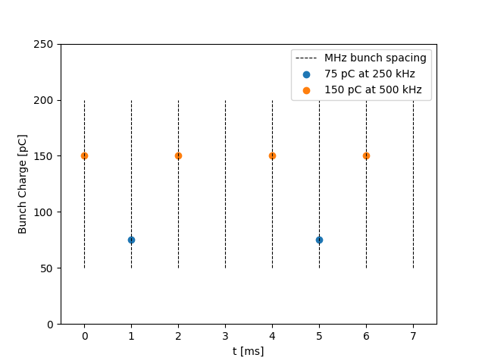
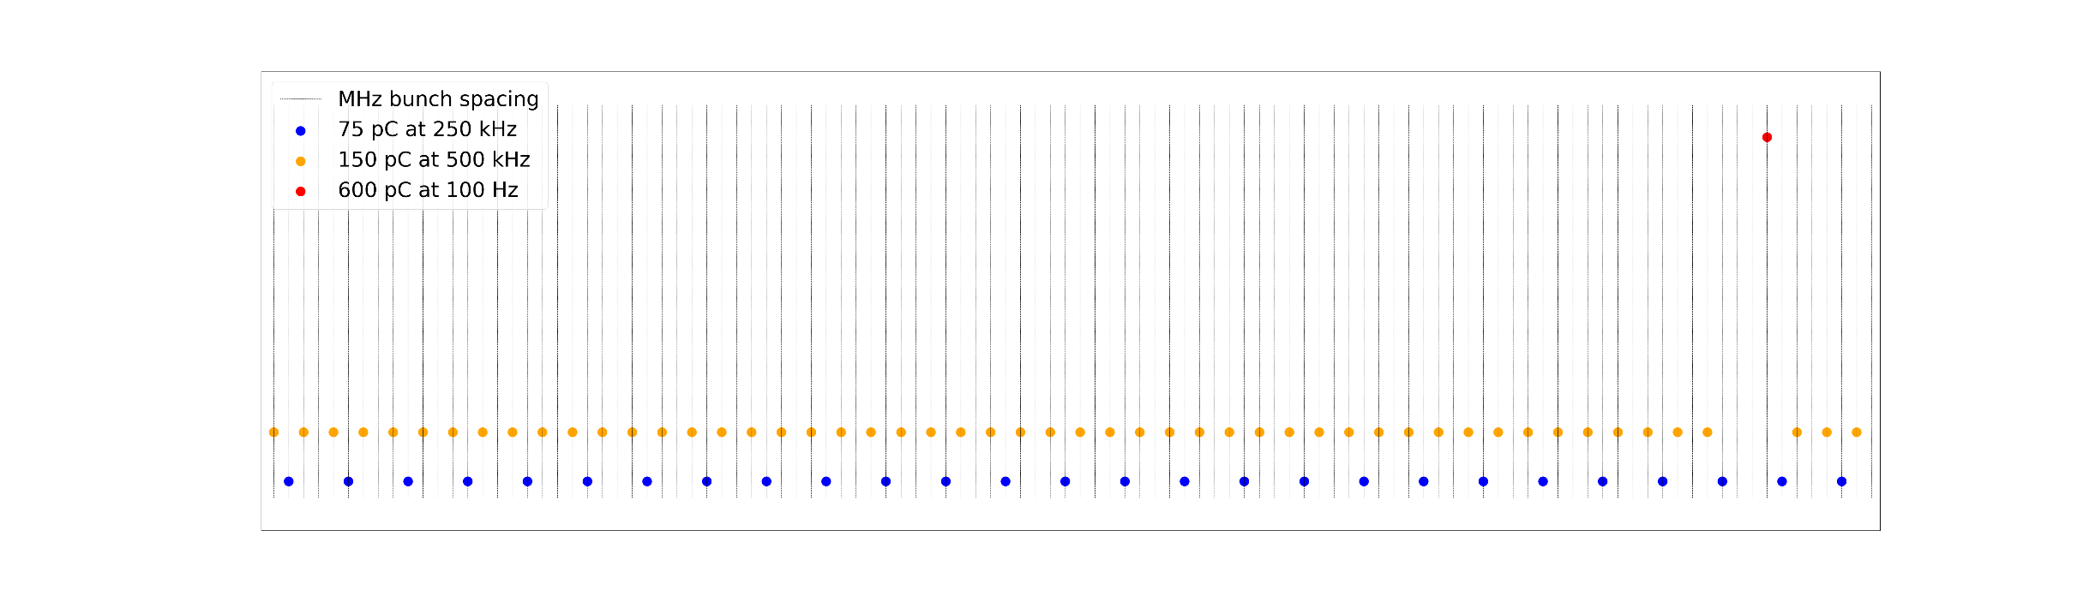
Example Composite Beam
Repeat Unit
Feeding 6+ independent FEL lines simultaneously via 1 main accelerating section necessitates a composite beam
1MHz beat - - - - - - -
75 pC bunches at 250 kHz
150 pC bunches at 500 kHz
600 pC bunches at 100 Hz (→ NC booster)
Switchyard distributes bunches to end stations at required bunch repetition rates and charges.
Previous Presentation (21):
“Dipole mode wakefields and beam dynamics tracking simulations for the UK XFEL main accelerating Linacs”

Slide 16
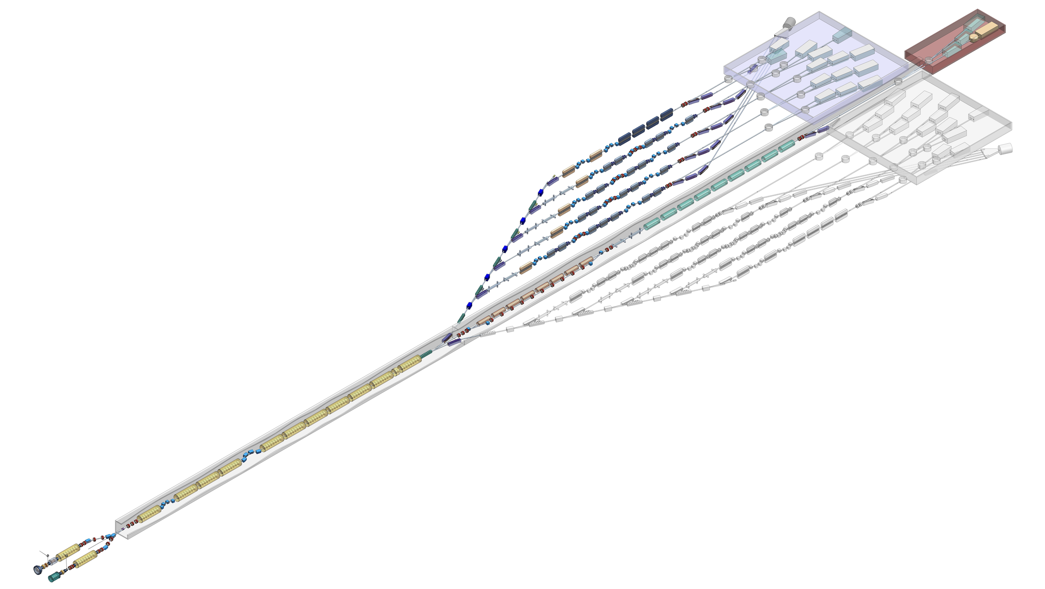
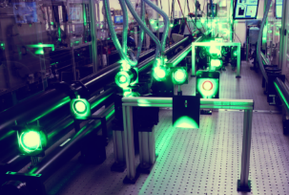
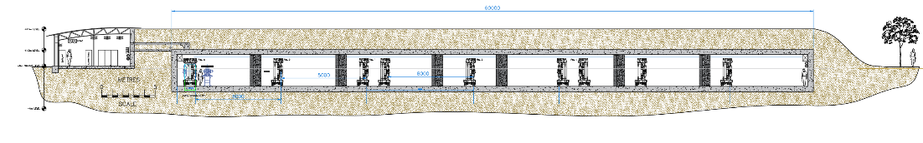
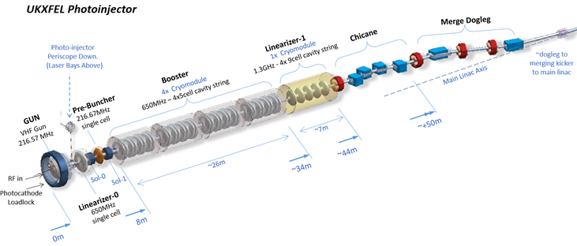
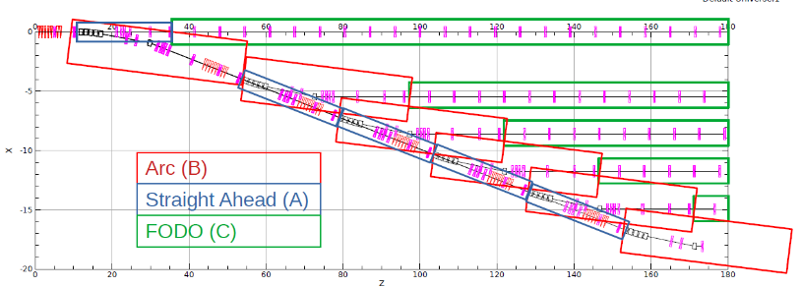
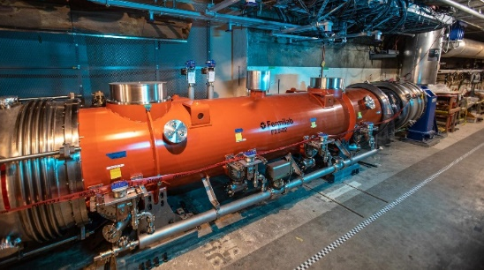
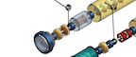
Facility design features
A world-class array of independently operable instruments
We have developed a self-consistent conceptual design that is:
Robust and technically feasible
Highly modular in terms of design and civil engineering
Highly and independently customisable for each experimental line
Individually shielded undulator lines for independent operation
Specialised undulator features per line
12 GeV
A laser facility as well as an accelerator facility
8 GeV
Modular beam distribution
Two photo-injectors, with multiple lasers each - for flexibility and redundancy – a key R&D technology
Making use of established acceleration technology
100 MeV

Slide 17
Technology readiness
Generally the required technology is well developed – MHz XFELs are already in commissioning
Some R&D areas and capability-building (for a UK option) would be essential e.g. MHz electron injector programme, fast kickers
There are some trade-offs between technology readiness and more sustainable technologies, e.g. thin-film SRF
Key R&D technologies can have many benefits independently of a UK XFEL
12 GeV
8 GeV
Modular beam distribution
Making use of established acceleration technology
Two photo-injectors, with multiple lasers each - for flexibility and redundancy – a key R&D technology
100 MeV

Slide 18
Concept principles
User communities’ requirements
Conceptual design for a next-generation XFEL
Summary and next steps

Slide 19
Summary
XFELs are an extraordinary technology that still have great potential to be improved: they are well positioned to be leading scientific facilities for decades
There is considerable domestic (UK) demand for XFEL capabilities
We have developed a conceptual design for a next-generation XFEL to meet the Science Case requirements:
Ambitious ‘international-scale’ scope
Robust and technically feasible
Aspects of this design can be mapped to a range of options presently being analysed
This is a major opportunity for the UK to develop a new facility or to help significantly enhance international facilities
Key Parameters
8 GeV e⁻ machine
2 VHF NC Guns
Interleaved beams of irregular fill pattern comprised of varying bunch charges
600 L-band TESLA 9-cell cavities ~14MV/m
12 GeV
8 GeV
Next Steps
Publish the “Conceptual Design and Options Analysis” document Q1 2026.
Present to both internal (UKRI) and external advisory boards.
NC Cu Booster to take beam to 12 GeV.
6 – 12 FEL lines (scalable)
100 MeV

Slide 20

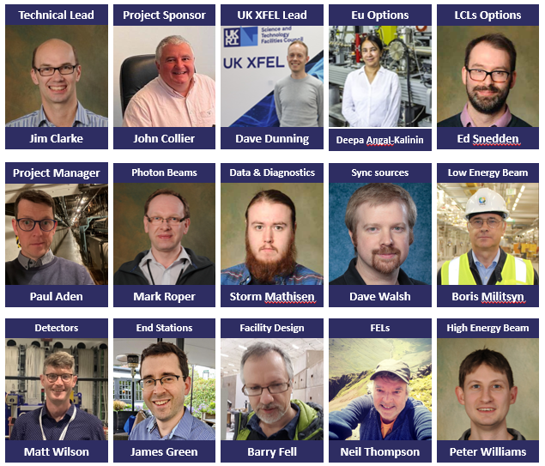
Acknowledgements
Science Team
Facility design and support
Matter in extreme conditions
Andy Higginbotham (York), Andy Comley (AWE), Emma McBride (QUB), Sam Vinko (Oxford), Marco Borghesi (QUB), Malcolm McMahon (Edinburgh), Justin Wark (Oxford)
Nano/Quantum materials
Anna Regoutz (UCL), Marcus Newton (Soton), Ian Robinson (UCL/Brookhaven), Mark Dean (Brookhaven), Shakil Awan (Plymouth), Paolo Raedelli (Oxford), Simon Wall (Aarhus), Sarnjeet Dhesi (Diamond),
Engineering/Materials/Applications
David Rugg (RR), Sven Schroeder (Leeds), David Dye (IC) Dan Eakins (Oxford), Mike Fitzpatrick (Coventry)
Life sciences:
Allen Orville (Diamond), Jasper van Thor (IC), Xiaodong Zhang (IC), Shakil Awan (Plymouth), Adrian Mancuso (Diamond), Tian Geng (Heptares)
Chemical sciences:
Öznur Apsimon, Can Davut, Ben Hounsell, Suzanna Percival, Julian McKenzie, Lee Jones, Louise Cowie, Hywel Owen, Andy Wolski, Andrew Potter, Adam Dixon, Frank Jackson, Joe Crone, Ian Bailey, Peter McIntosh, Alan Wheelhouse, Anthony Gilfellon, Aaron Farricker, Anisullah Baig, Fahim Habib, Lily Berman, Alan Mak, Alex Hinton, Brian McNeil, Katie Morrow, Amelia Pollard, Matt King, Alex Aiken, Patrick Sterling, Chris Armstrong, Matthew Veale, Sion Richards, Ben Shepherd, Andrew Vick, James Bourne, Emily Baker, Sonja Scott-Jones, Lynn Caddick, Lauren Hamblett
Julia Weinstein (Sheffield), Russell Minns (Soton), Sofia Diaz-Moreno (Diamond), Alex Baidak (Manchester), Andrew Burnett (Leeds), Tom Penfold (Newcastle), Rebecca Ingle (UCL), Mark Brouard, Claire Vallance (Oxford)
Physical sciences:
Amelle Zair (KCL), Adam Kirrander (Edinburgh), Jason Greenwood (QUB), Jon Marangos (IC), Elaine Seddon (Cockcroft)
+ around 100 additional experts from around the world contributing to Science Case
20

Slide 21






































UK XFEL
Science Team
UK Research Councils & Government
Other XFELs
And Others….
Notes:
Uk-xfel misnomer?

Slide 22
Thank you!
Any Questions?
xfel.ac.uk
Notes:
The abstract pattern can be removed or repositioned if required. Be careful to ‘Send to Back’ so that it does not obscure any important information.

Slide 23
Additional Slide….

Slide 24
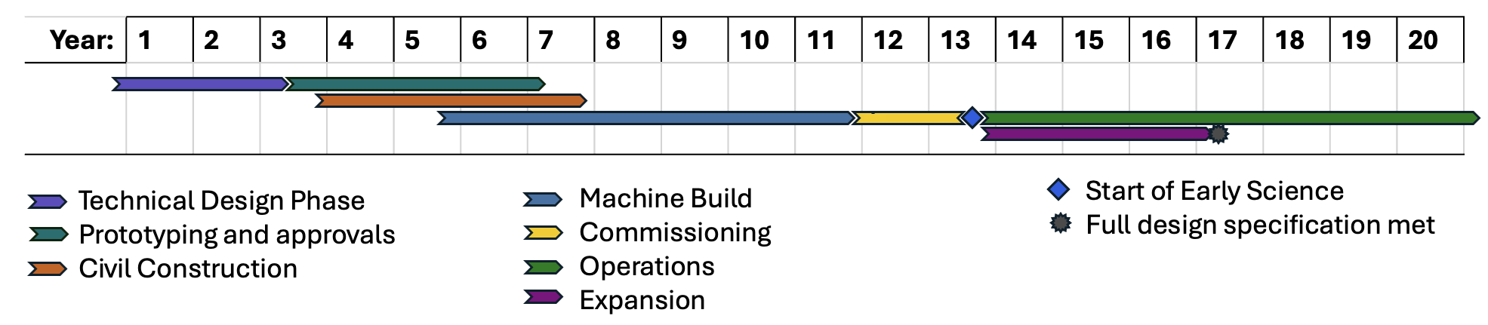
UK XFEL Next Steps
It’s a major decision for the UK to set its direction between the options presented in the CDOA
Options review will take place over the coming year, whilst preparations for a TDR process begin.
Expected bid into the 2027 UKRI Infrastructure Funding window for the next phase.
Investing in existing FELs will have timelines dependent upon the various levels of investment and their own strategic roadmaps.
Building a UK based XFEL will be a decade long endeavour;

