Slide 1


Welcome and Introduction
PUNCH4NFDI-2.0 Preparation
Hamburg, 4 March 2025

Slide 2
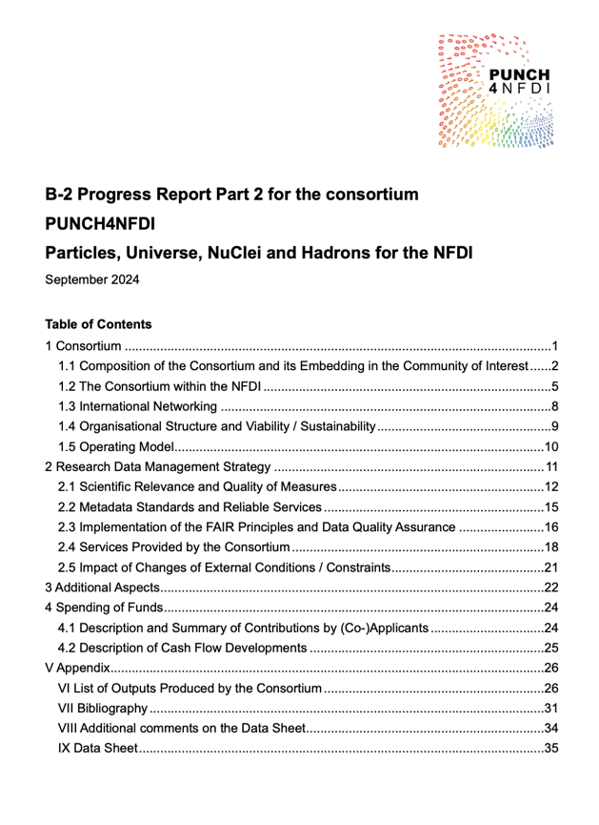
Oct 2021
PUNCH begins
Sep 2024
Report
Feb 2025
Today
Oct 2026
End / begin
27-29 Nov ‘24
Annual meeting
18 Feb / 4 Mar ‘25
In-person meetings
18 June ‘25
letter of intent
Composition of
consortium
11 Feb ‘25
Evaluation
April ‘25
Concept fixed
6 Aug ‘25
Proposal deadline
A long way to go in PUNCH-1.0
PUNCH-2.0 Planning | Kassel 18 February 2025

Slide 3





PUNCH4NFDI in a Nutshell
Science Data Platform
Curation
Selection, combination
MD catalogues
REANA
AAI
Portal
DRPs and registry
RDMO
Preparation
Retrieval
Analysis
Compute/Storage4PUNCH
REANA
Statistical / ML / simulation tools
Analysis tools, benchmarks
github & gitlab
Storage4PUNCH
DRPs and registry
MD catalogues
Portal
Publication
Archival
PUNCH-2.0 Planning | Kassel 18 February 2025

Slide 4
Conclusions
Tool-
box
Federated
Infrastructures
Data
Management
SDP &
DRP
Manage-
ment
Federated Infrastructures
Data Management
SDP & DRP
NFDI &
the world
Training
Service
Development
PUNCH-2.0 Planning | Kassel 18 February 2025

Slide 5
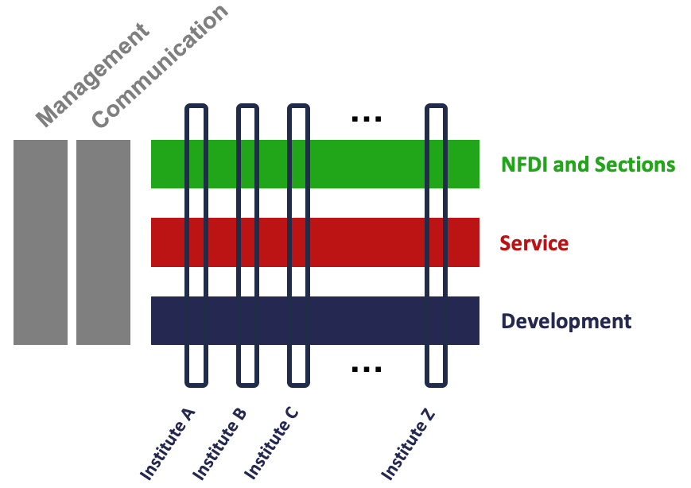
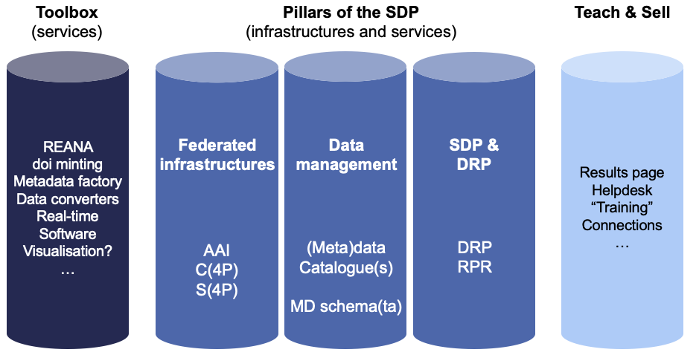
PUNCH-2.0 – Planning for the Future
PUNCH-2.0 Planning | Kassel 18 February 2025

Slide 6
PUNCH4NFDI in a Nutshell
Science Data Platform
Curation
Selection, combination
MD catalogues
REANA
AAI
Portal
DRPs and registry
RDMO
Preparation
Retrieval
Analysis
Compute/Storage4PUNCH
REANA
Statistical / ML / simulation tools
Analysis tools, benchmarks
github & gitlab
Storage4PUNCH
DRPs and registry
MD catalogues
Portal
Publication
Archival
PUNCH-2.0 Planning | Kassel 18 February 2025

Slide 7
PUNCH-2.0 Planning | Kassel 18 February 2025

Slide 8

Thank you!
The PUNCH4NFDI Consortium
Spokespersons
PD Dr. Thomas Schörner (BLV, DESY, thomas.schoerner@desy.de)
Dr. Andreas Haungs (Satzung, KIT, andreas.haungs@kit.edu)
Dr. Christiane Schneide (deputy Satzung, DESY, christiane.schneide@desy.de)
Contact
Mail: punch4nfdi@desy.de
Web: www.punch4nfdi.de
Mastodon: @punch4nfdi@nfdi.social

Slide 9




Acknowledgements
Funded in parts by the Deutsche Forschungsgemeinschaft (DFG, German Research Foundation) – project number 460248186 (PUNCH4NFDI).

