Slide 1
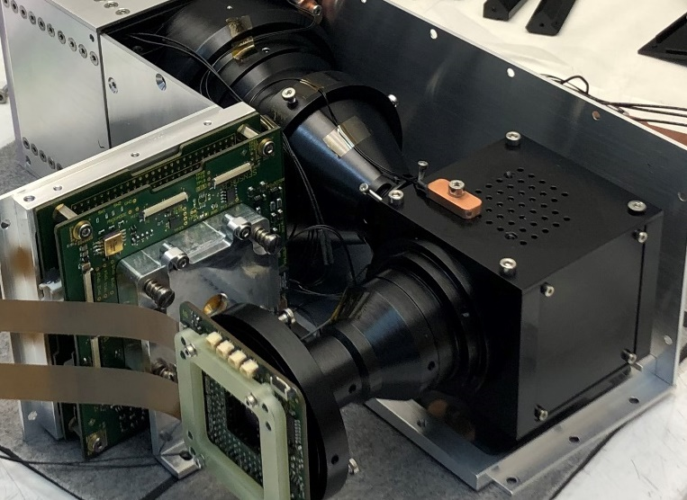
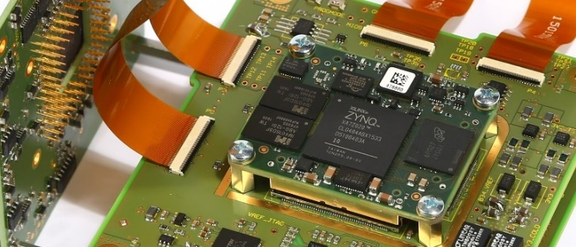

Fault-tolerant modular sensor electronics to perform long‐term measurements with small satellite remote sensing instruments
Tom Neubert, Elektronische Messsysteme
SEI-Tagung 2025, HZDR Helmholtz-Zentrum Dresden Rossendorf, March 24 – 26, 2025

Slide 2
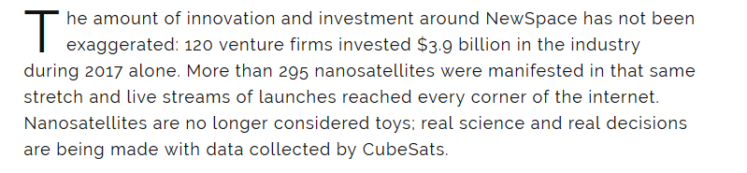
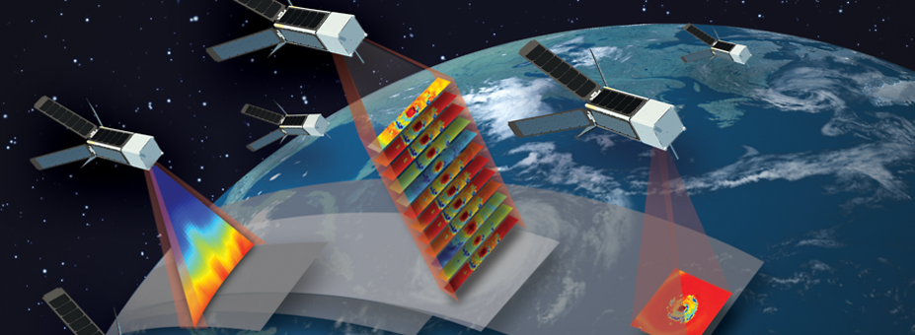
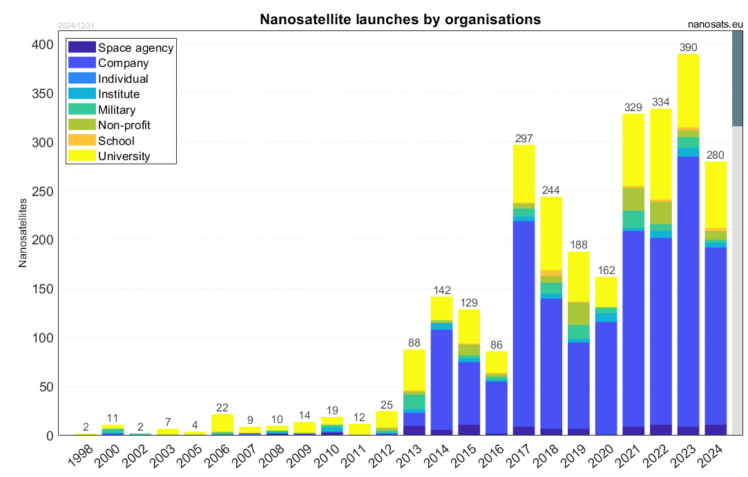
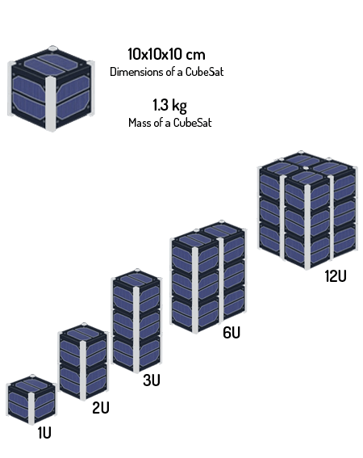
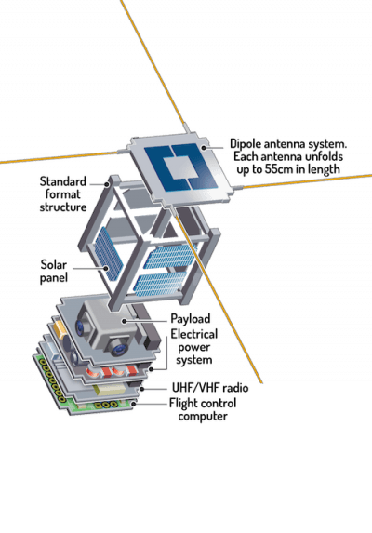
NEW SPACE: next generation of miniaturized climate research instruments
(2024)
Credit: MIT Lincoln Laboratory
Source Erik Kulu. Nanosats Database. https://www.nanosats.eu/, May 2024.

Slide 3
MINIATURIZED SCIENCE INSTR. ELECTRONICS
Motivation and Objectives
go for small and highly focused instruments and missions
use latest industry-level technology and prepare it for space
multi-mission approach, continous improvement
standardized sublevel modules are available (power, solar panels, communication, obc, antennas, adcs, …)
customize science payload electronics needed
SHI spectrometer for atmospheric temperature measurements (AtmoLITE)
flexibility, (re)programmability, modularity, reusability
design a “standardized“ science payload electronics with heritage from precursor instruments (AtmoHIT & AtmoSHINE) on sounding rocket and in space
long-term measurements with custom mitigation techniques using COTS components
focus is on imaging sensors in combination with integrated System-on-Chip (SoC) solutions

Slide 4
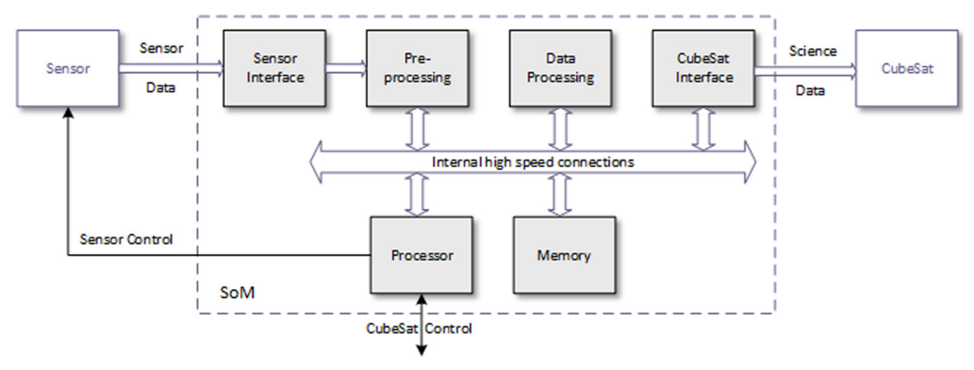


SYSTEM-ON-MODULE APPROACH
Features
Pin compatible modules with processing units, memory and power conversion
Several processing capabilities (CPLD, FPGAs, µC, SoC, MPSoC, RFSoC)
Short development time, ‘low’ design expertise needed (ideal for student projects)
Challenge
Radiation environment, system reliability
Size, power consumption, limited data bandwidth
Solution approach
SRAM-based XILINX System-on-Chip (SoC) architectures contains processing units (PS) and reconfigurable logic (PL)
Mitigation techniques, protection circuits and reconfiguration for long-term measurements
Source: https://shop.trenz-electronic.de

Slide 5
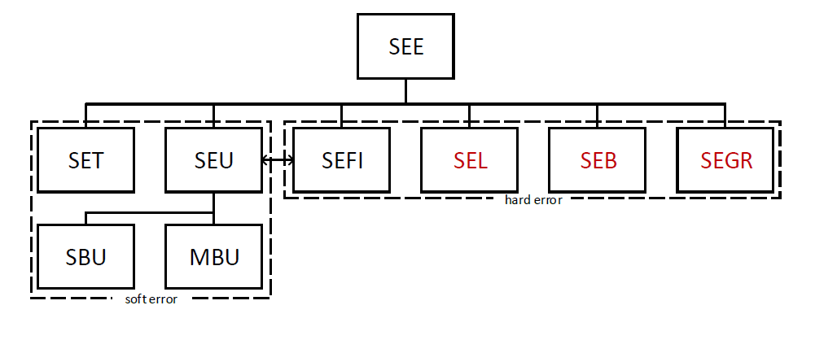
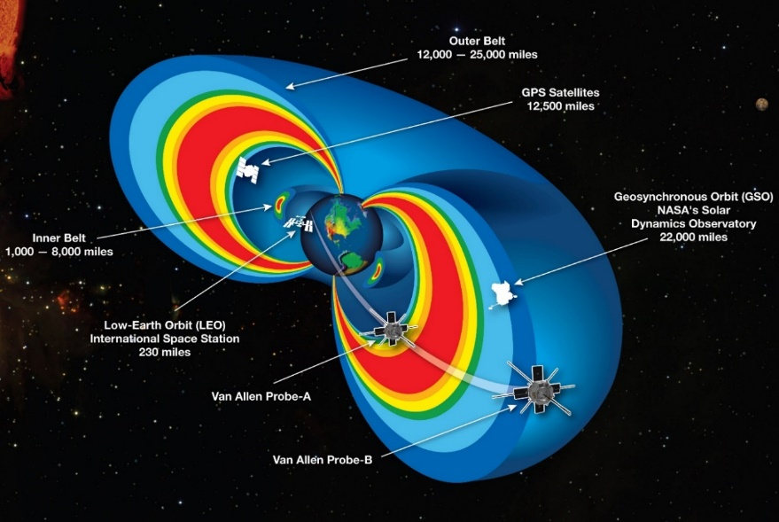


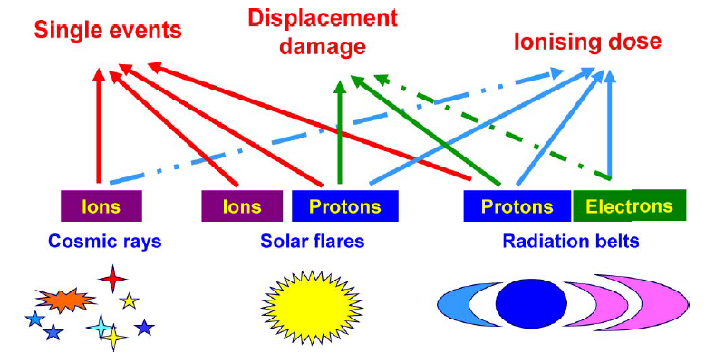

Radiation Hardeness Assurance (RHA)
definition of mission
requirements
specification of radiation environment …
radiation design margins
protection measures
implementation
evaluation

Slide 6
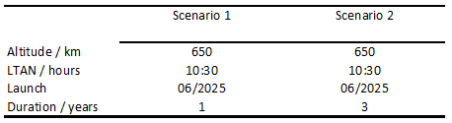
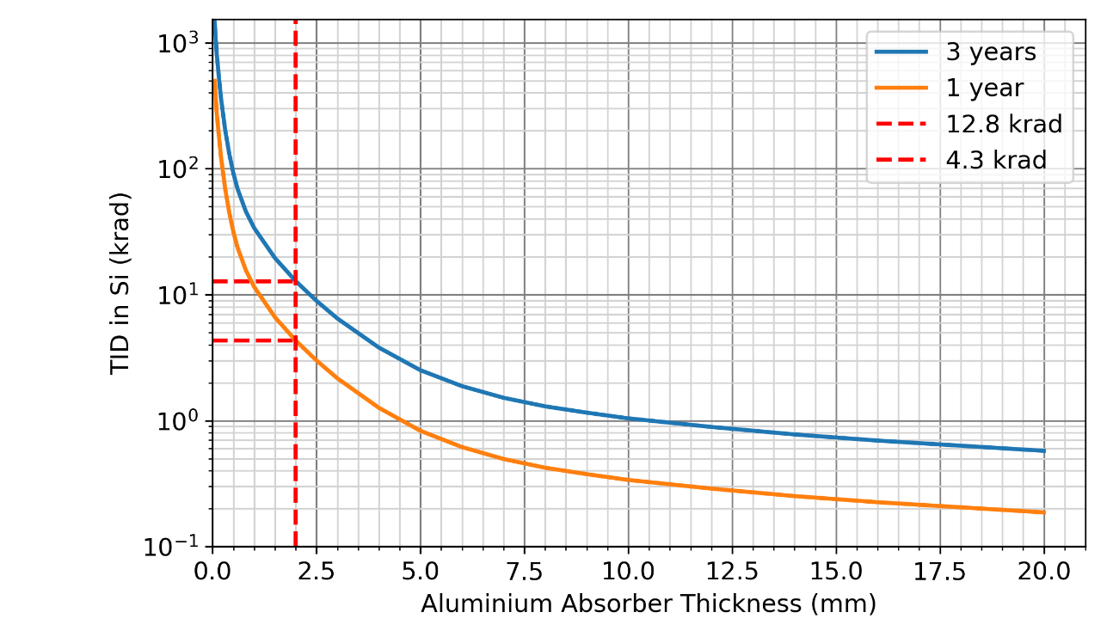
RADIATION ENVIRONMENT AND SHIELDING
Model parameters
Satellite orbit | Sun-synchronous orbit 650km
Mission time | 1 or 3 years
Trapped proton and electron fluxes | IRENE (AP9/AE9/SPM) model
Solar particle model | ESP-PSYCHIC (worst event fluence)
Galactic cosmic ray fluxes | GCR model ISO 15390
Ionizing dose models | SHIELDOSE-2
Ionizing dose shielding configuration | Centre of AL spheres, aluminium
The total ionizing dose (TID) for 3 years and
with effective shielding using sectoring analysis will be approx. 13 krad.
Source: https://www.spenvis.oma.be/ecss/frame.php/e_st_10_12c/09_04_01

Slide 7
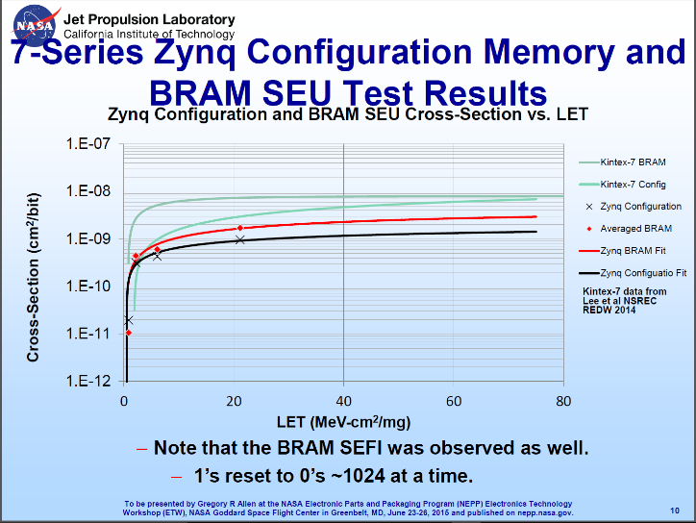
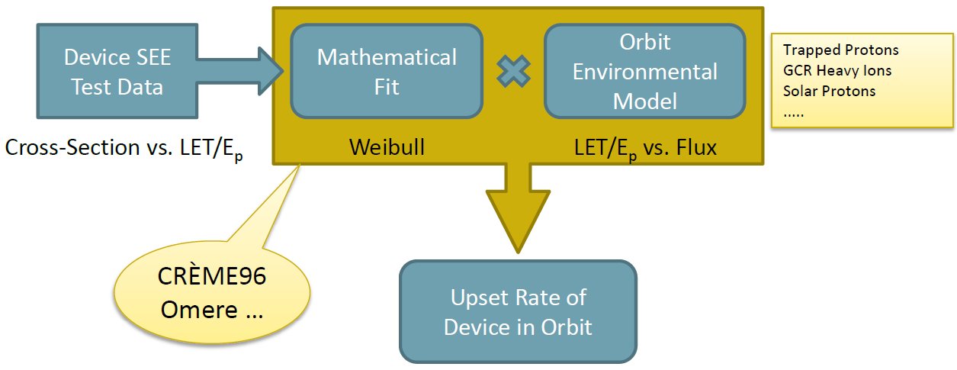
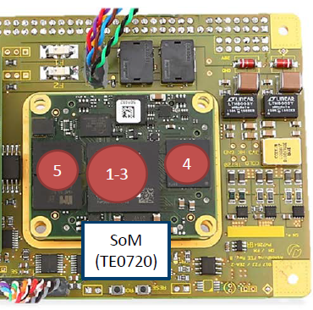
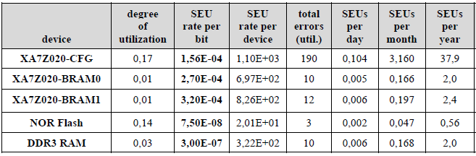
COMPONENT RADIATION SENSITIVITY ANALYSIS
(Source: Space Science and Engineering SOUTHWEST RESEARCH INSTITUTE )
1
2
3
4
5
The results indicate an SEU rate for the flash memory of less than 2 events during mission (0,56 per year) in contrast to the configuration memory (CFG), which will have around 3 events per month.

Slide 8
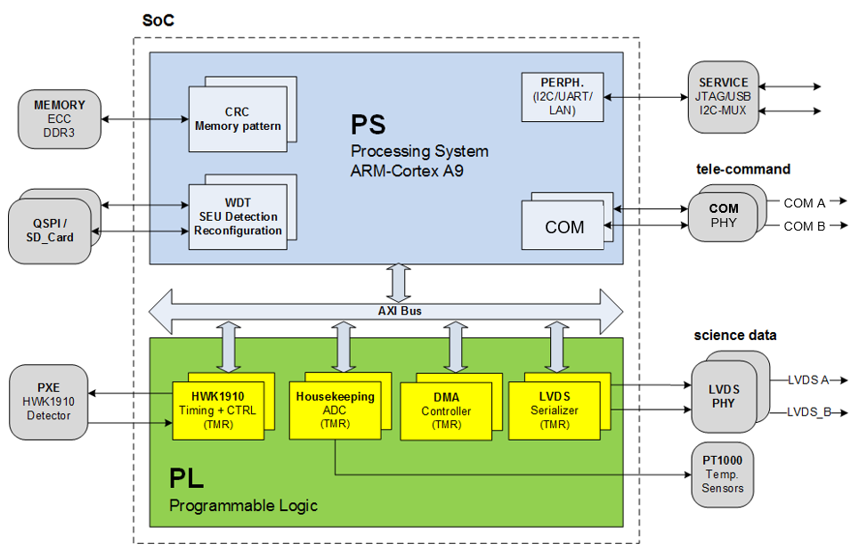
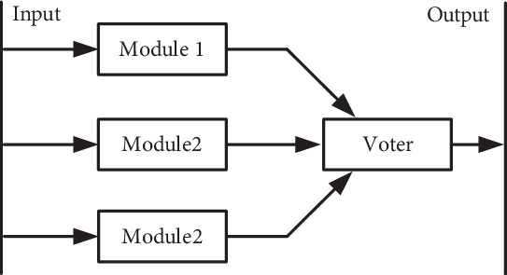
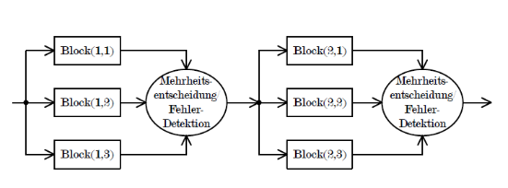

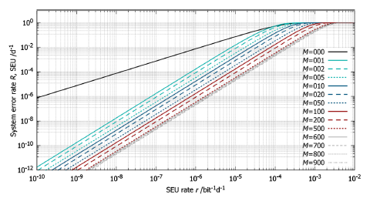
MITIGATION MEASURES OVERVIEW
class | type of measures | Mitigation effect | devices / functionality
Component selection | part classification | Degradation | Automotive COTS (AEC-Q 100)
 | Hi-Rel | TID, SEE | Radiation tolerant @ single strain
Redundancy | standby “cold” | SEE | SD-card with reference boot image
 | circuit “warm” | SEE | power conversion, communication circuits
 | TMR | SEU | FPGA logic slices
Protection circuits | Watchdog timer | SEE | Supervisor / Reset / Reconfiguration
 | Over current /voltage | SEL, SET | SoM, image sensors
Memory Protection | ECC | SEU | volatile DDR-3 single bit protection
 | CRC | SEU | In-orbit reprogramming verification
 | Scrubbing / Reconfiguration | SEU | FPGA configuration memory
System Error Rate Analysis for TMR designs
M=001:
M=002:
(Allen et. al. 2011)
The SEU rate the logical configuration memory (CFG), which will have around 3 events per month can be reduced by using TMR to once every 2.5 years.
Notes:
N number of configuration bits
M number of groups (TMR granularity)
r SEU rate per bit
Tc configuration time (scrubbing intervall)

Slide 9
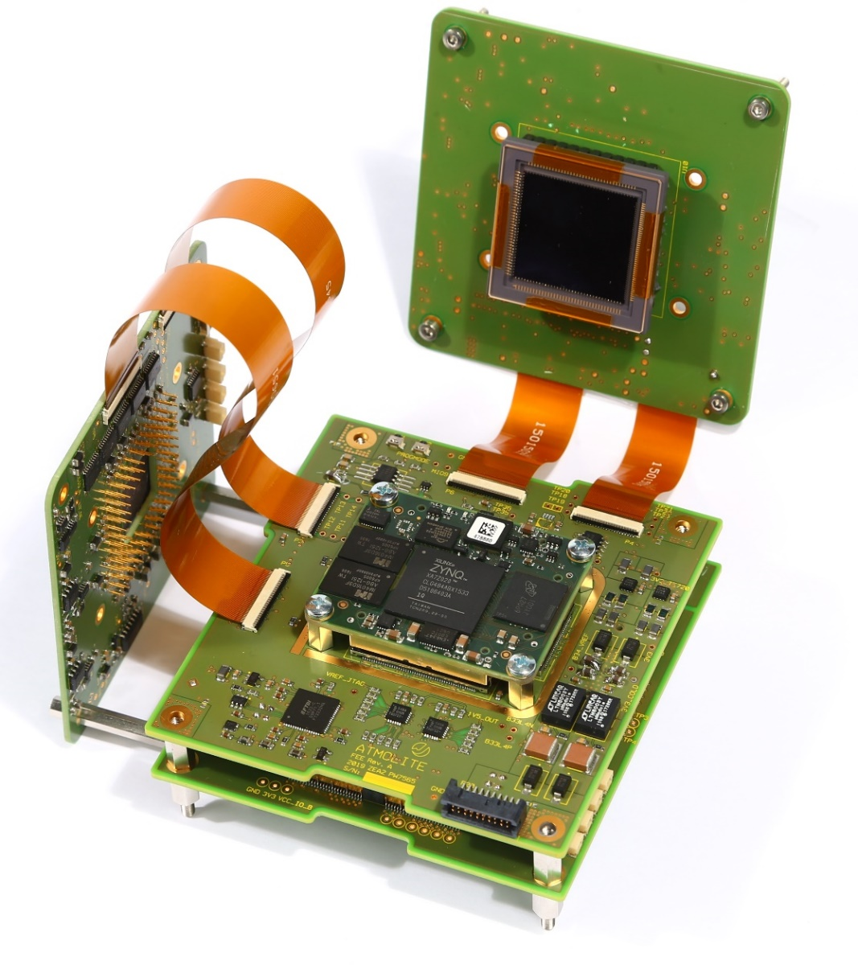
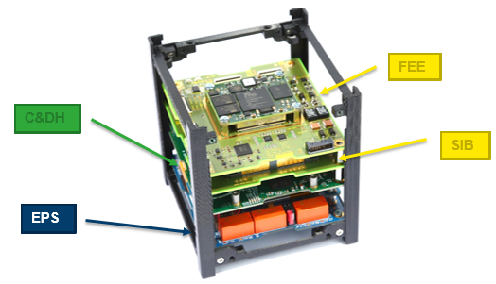
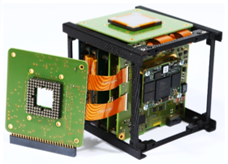
DUAL IMAGING SENSOR ELECTRONICS
Hardware specifications
Processor: Xilinx ZYNQ XA7Z020 with 666 MHz
ARM dual-core Cortex-A9 processor
Memory: 512 MB SDRAM with ECC
Storage: 32 MB QSPI Flash
(for Boot Config / User-Data)
4 GB eMMC
2 x 4 GB high reliability Mini SD-cards for fail safe data storage
Sensors: 2D-sensors (UV, Vis, NIR)
Interfaces: SPI, UART, USB, LVDS, SpW, Ethernet
Power Supply: 10 to 28 Volt
Power Consumption: 5 W (average)
Operating Temperature: -40 °C to +80 °C
Dimensions: 96 x 90 x 12.4 mm
Mass: 100g mainboard only / 200g with SIB
Shock/ Vibration: acc. MIL-STD-810F
EMC: acc. MIL-STD 461F (rad.+ cond. emissions)
PXE = ProXimity Electronics:
servers several detectors
FEE = FrontEnd Electronics:
data acquisition, data processing and communication unit
Satellite Interface Board (SIB) interfacing to power and communication lines with filtering

Slide 10
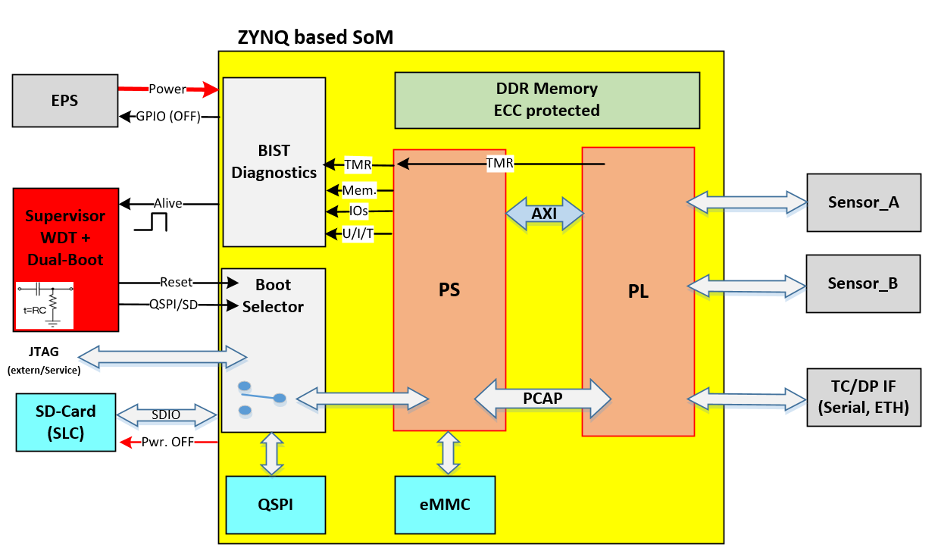
MITIGATION STRATEGY
Blockdiagram Security strategy
BIST: Detection and monitoring of failure
Diagnostics for all vital functions
Classification in
  Minor → Warning
  Major errors → Reconfiguration
  Critical situations → Shutdown
Reconfiguration process initiated
on Software crash
compensate for SEU and SEFI induced errors
safe shutdown at SEL events
ICAP
Highly secured boot process
Redundant boot devices
  Automatic switch between Nominal/Redundant
‘Golden Image’ in third device
BIST and automatic correction of invalid FW image
Triple Firmware storage devices:
QSPI nominal (primary) boot device
SD-Card redundant (secondary) boot device
eMMC Transfer memory and ‘Golden image’

Slide 11
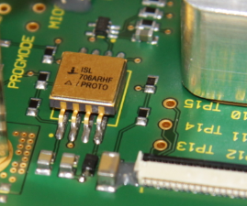
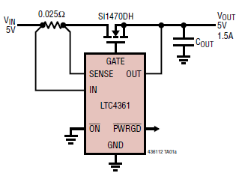
DUAL-BOOT SUPERVISOR AND SEL PROTECTION
Radiation hard µC Supervisor SEL overcurrent protection
WDT resets the system due to the following events:
SEU caused error of the PL configuration
Software crash of PS
SEFI introduced functional interrupt
overvoltage/overcurrent protection controller
On SEL: turns off the MOSFET within 10 μs
automatically restarts (130ms start-up delay)
ISL706ARH (5962R1121304VXC)
QML qualified per MIL-PRF-38535
High dose rate 100krad(Si)
SEL LETTH 86MeV•cm²/mg
Notes:
The first block is a power voltage monitor with POR circuitry and a watchdog timer block (WDT) which generates a reset after 1.6 s in case of missing alive pulse. During normal operation, the POR generates a stable power-up reset signal. The WDT input is driven by a trigger signal, which is suppressed by the BIST diagnostics block in case of major risks. It is a combined signal produced by a separate software task in the processing system (PS) and an independent logic part inside the FPGA fabric (PL). Inside the PL a digital counter generates the periodically trigger alive signal. In addition, this counter is stimulated with a command from the BIST in the PS. In both case that the processor or the fabric stops working, the trigger signal fails and a reset is generated by the WDT.
Therefore, the WDT starts the reconfiguration procedure triggered by the following BIST diagnostics events of:
programmable logic (PL); in case one of the TMR majority voters detects a mismatch in a triplicated block.
processing system (PS); a cyclic memory pattern checks on random bit pattern fails, TC/DP- and housekeeping data packages are inconsistent by CRC, status flags and error states occur of peripheral interfaces such as I2C, SPI and DMA and configuration memory checks detects discrepancies.
The second block of the supervisor is mainly used as an early power fail indicator (PFI). We are using the PFI circuit to generate a signal to select between the nominal and secondary boot memory device. It is based on a comparator (or Schmitt-trigger), which generates a digital output signal based on an analog input voltage. The RC components are used to switch from nominal to redundant boot device after a defined time constant. At power-up, the 'BootSelect' signal is active high and indicates the SoM to boot from the nominal boot device. The reset signal from the POR block starts the booting process. In case the PS and PL starts nominal, the system begins sending out the alive signal, which triggers the WDT. In case of a corrupted boot memory the SoM will not generate an alive signal. With a time delay the WDT generates a second reset pulse. In the meantime, the 'BootSelect' signal is active low due to the RC charging circuit and selects the redundant boot memory.

Slide 12
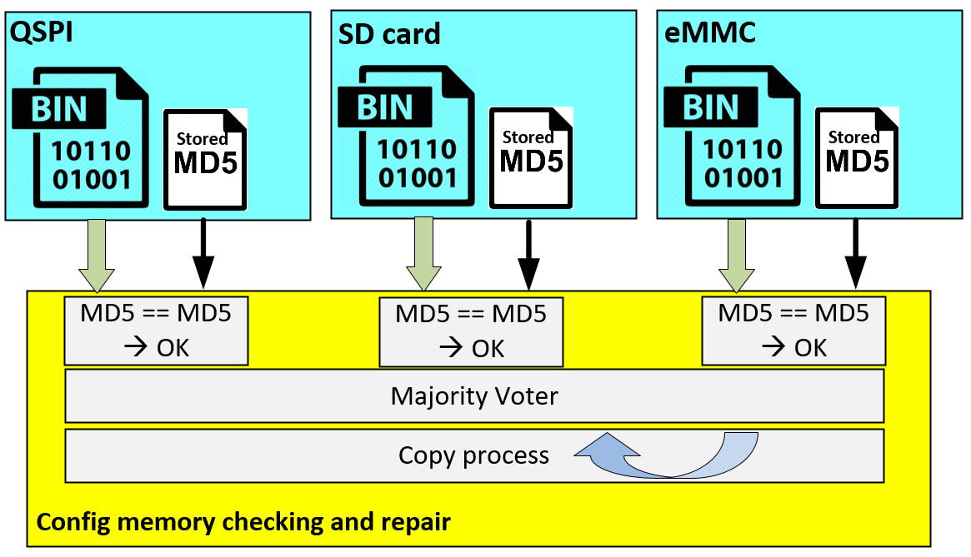
BIST: Firmware check and ‚Self-repair‘
TMR like behavior of the three configuration memories
Nominal/Primary
Boot device
Redundant/Sec.
in Cold-Spare
‚Golden Image‘
Each configuration memory holds the binary boot image and the correct MD5 hash tag in a separate file.
STEP 1: BIST
At power-up time ‘System-checker’ process
Firmware and stored MD5# are checked
  → FW OK marker for each device
MD5# tags are compared to each other’s
  Discrepancy of memory content
STEP 2: Repair, in case of a discrepancy
consistent memory is copied to the faulty one
Firmware consists of three parts:
First-Stage-Bootloader (fsbl) ~ 100 KB
PL configuration bit stream (.bit) 1.8 … 4 MB
PS application code (.elf). ~ 1 MB (FreeRTOS)

Slide 13
In-flight reconfiguration image upload
Groundsation <-> Satellite Upload process
Initialization informations - Total size of Configuration
Upload Data blocks: - block size in parameters - Data-CRC secured - Reply ACK/NAK - on NAK: resend block
Finalize - Send MD5# - Generate local MD5# - Compare MD5’s# - Reply ACK / NAK
Program Operation
Poll Status and wait for programming finished

Slide 14
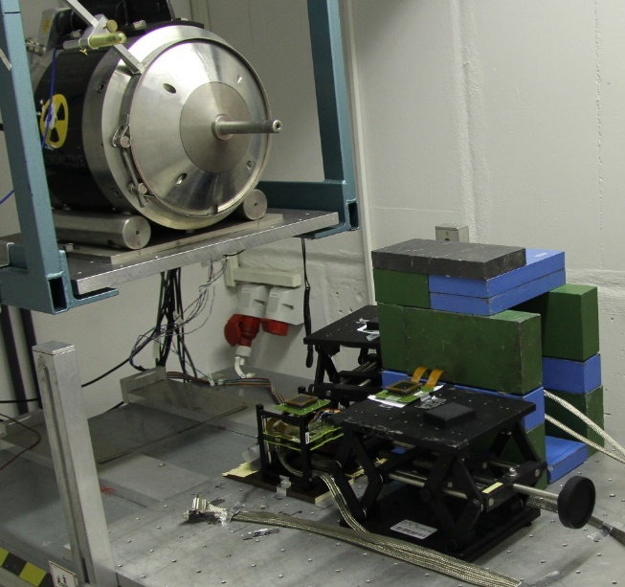
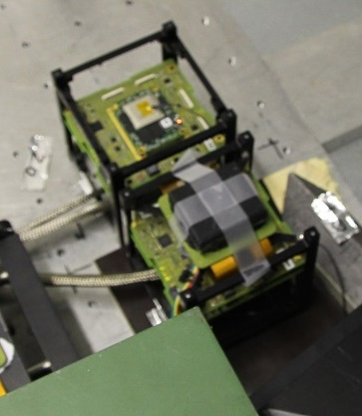
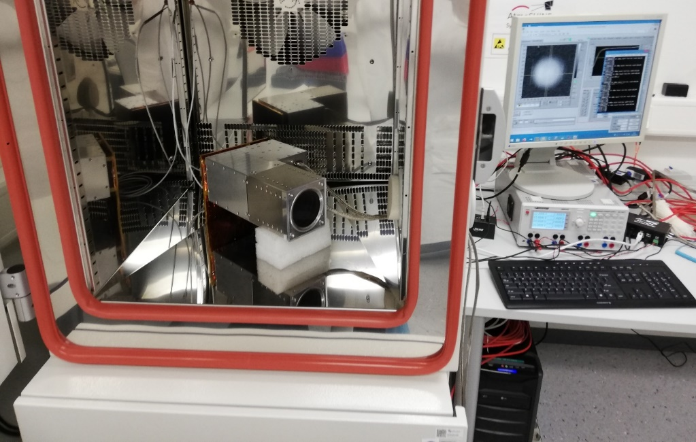
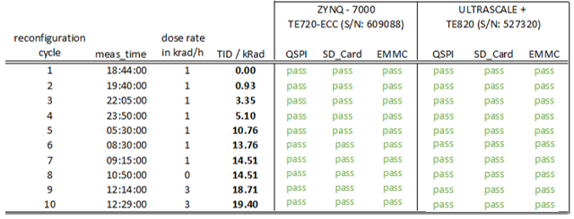
ENVIRONMENTAL TESTS
Radiation Test
Thermal Cycling Test
2
1
1
2
Test compliant @ 20krad (Si)
QSPI reprogramming

Slide 15


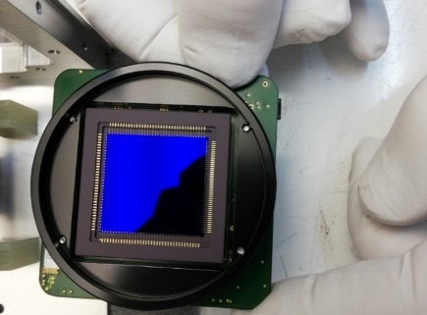
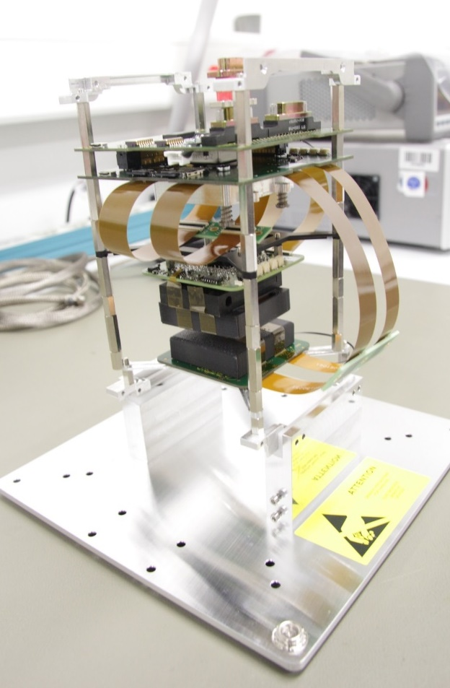
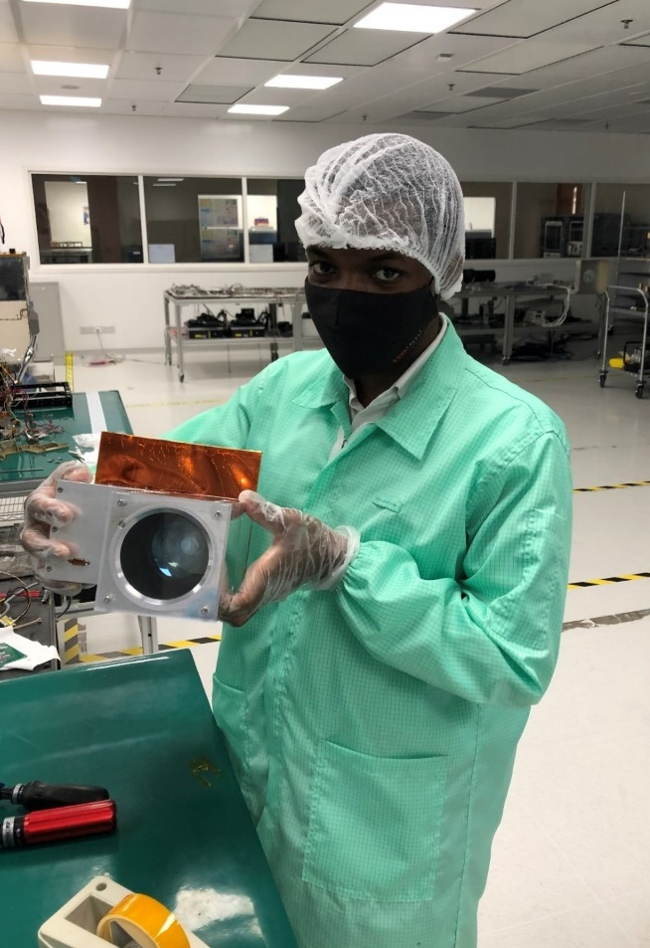
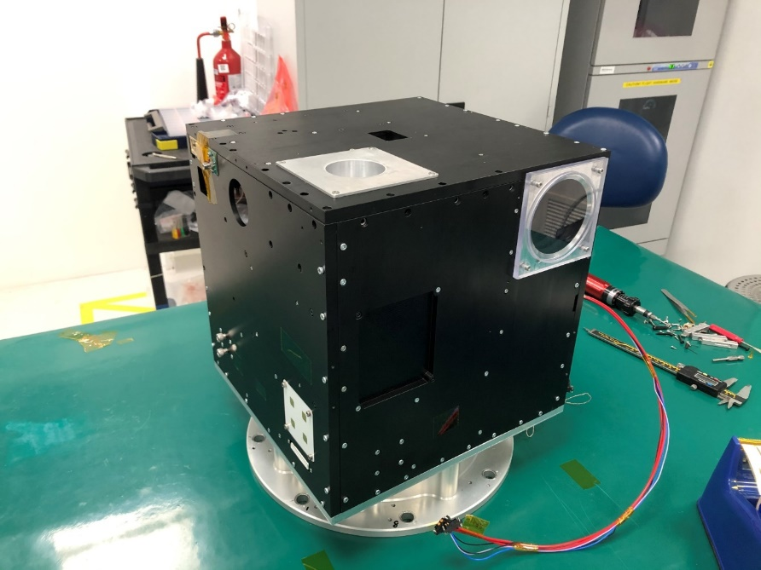
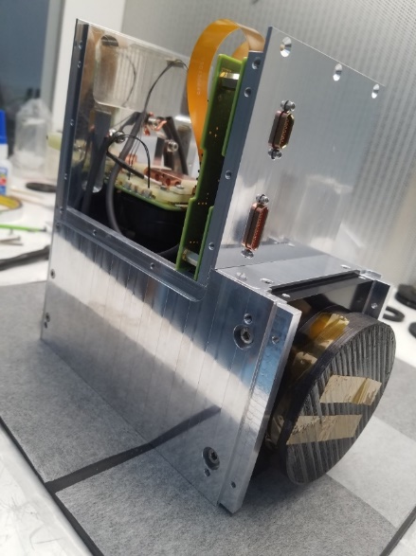
ATMOLITE INTEGRATION INTO INSPIRESAT-3/4
Integration into EM satellite structure
INSPIRE – 3
05/2021
Compliance Test in Jülich, ITE
Integration, Wuppertal
Satellite Integration in Singapore

Slide 16

Thank you for your attention !
More information:

