Slide 1
Enhancing coherent flux by using two-step X-ray focusing
By Jirayoot Srisakunkan
Supervisor: Michael Sprung
Notes:
Hello, everybody. My name is Jirayoot Srisakunkan. Today I would like to present my mini-project during DESY Summer Student Program . The topic is Enhancing coherent flux by using two-step X-ray focusing. And, my project is about making a program to calculate in the case of two steps X-ray focusing for enhancing coherent flux to use in the coherent experiment at P10 beam line which located in PETRAIII.

Slide 2
Outline
Introduction
Infrastructure
Program
Result
Acknowledgement
Notes:
In my talk, I will separate it in 5 main topics, Introduction, Infrastructure, Program, Result, and Acknowledgement, respectively.

Slide 3
Introduction – Motivation
Since P10 at the new synchrotron PETRA III has the low-beta source (G)…
So, the transverse coherent length will be...
G_{v} = 14.1 µm
G_{h} = 84.6 µm = 6G_{v}
Notes:
Let’s start at the introduction, P10 beam line at the new synchrotron PETRA III has the low-beta source (G) which has the asymmetric beam looks like this. P10 is a coherent beam line, and one of the important value in the coherent technique is the transverse coherent length of the source which is equal to wavelength of the monochromatic source plus source to sample distance over source size. Because the horizontal size of the source is 6 times larger than the vertical size, and via this formula, the transverse coherent length at the sample will have the vertical size 6 times larger than the horizontal size as shown.

Slide 4
Introduction – Motivation (continued)
By the way, the speckle size on the detector…
If solve by use the slit, many loss of coherent beam occur…
To reduce loss of the coherent beam…
To enhance the coherent flux…
To make a round shape of the coherent beam matching the speckle …
…Two-step focusing will be used!!!
Notes:
In addition, the speckle size on the detector will also be mentioned in the coherent technique which is equal to wavelength of the monochromatic source plus source to sample distance over slit size , that gives the speckle a square shape. So the coherent beam must be made to a square one to match the speckle. And the easiest way is using the slit, but many loss of the coherent beam will be occurred since the slit blocked them. Therefore, two-step focusing will be used to reduce loss of the coherent beam, also enhance the coherent flux. Furthermore, it can make a round shape of the coherent beam which mostly match to the square shape of the speckle on the detector.

Slide 5
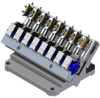
Introduction – Two-step X-ray focusing
by Two Compound Refractive Lenses
(Michael Spung, DESY)
CRL2
g_{2h}
Non-focused coherent beam
b_{2h}
G_{h}
B_{2h}
Best focused coherent beam
horizontal direction
CRL1
a
CRL2
g_{1v}
b_{1v}
g_{2v}
b_{2v}
G_{v}
B_{1v}
B_{2v}
vertical direction
Notes:
The goal of the two-step focusing is to make the round-shape coherent beam at the sample. Since the vertical size of the coherent beam at the sample is 6 times larger than the horizontal one, So there must be a pre-focusing lens in the vertical direction as shown to focus the primary source in vertical direction to be the secondary source of the next lens. With this way, the round coherent beam can be made, and a relation between two focusing lenses is achieved as shown. g_{2v} is the secondary source to second lens distance, M₁ is Magnification power of the pre-focusing lens, G_{h} is horizontal source size, G_{v} is vertical source size, a is primary to secondary source size, and b_{2v} is second lens to sample distance. In addition, the lenses which be used in this focusing are Compound Refractive Lenses or CRL. And then, I will call the first & the second lens as CRL1 & CRL2, respectively.

Slide 6
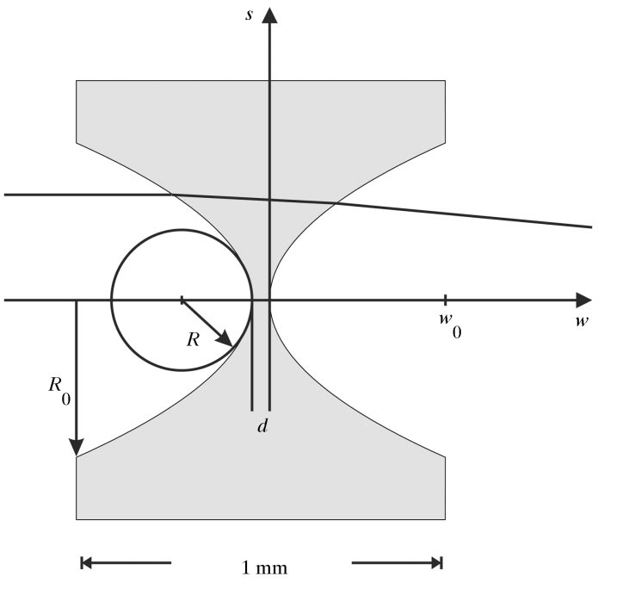
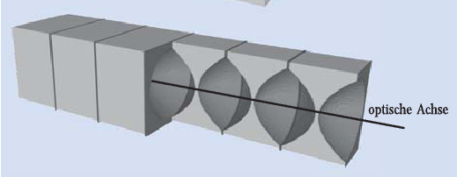
Introduction - Parabolic CRL
The fabrication technique has been improved
Concave form (n of X-ray in matter < 1)
Parabolic shape, no spherical aberration
Lengeler et al, 1999
Bruno Lengeler et al.
Schmahl et all, 2001
Notes:
Furthermore, CRL consist of the refractive lenses aligned in a row as shown here, and they are parabolic ones which can be created with different radii of curvature because the fabrication technique has been improved enough now. Since the refractive index of the X-ray in matter is below 1 via its formula, CRL must be concave form to be able to focus the X-ray. Moreover, with Parabolic shape, no spherical aberration will occur like the cylindrical CRL which have the circle shape and strong spherical aberration. The focal distance of CRL depend on number of their lens and the absorption of the material which is Be as shown in this formula. To calculate some optics values, CRL will use the formula same as the basic optics.

Slide 7
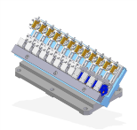
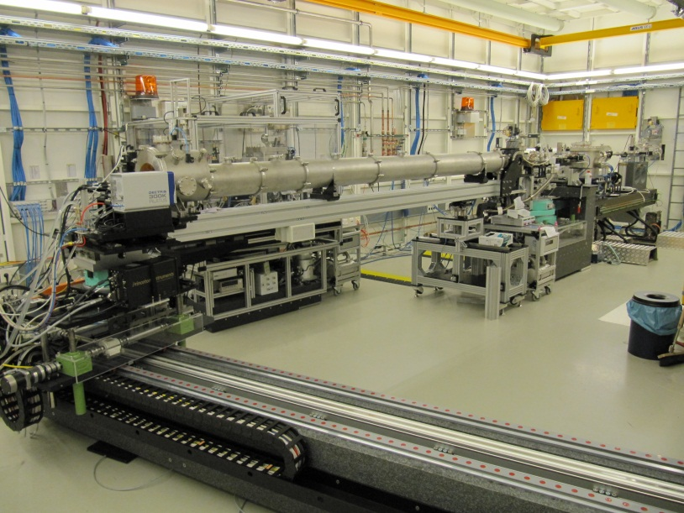
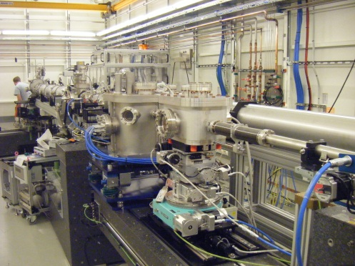
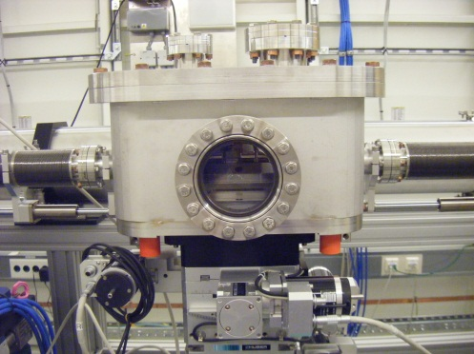
Infrastructure - Two CRL in P10
85.5 m
43.0 m
CRL2
CRL1

Slide 8
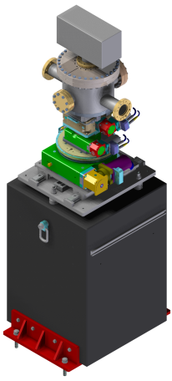
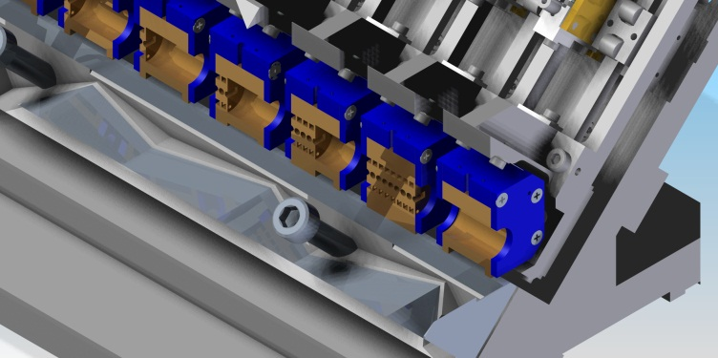
Infrastructure – Two CRL Profiles
CRL1 (64 Combinations)
CRL2 (4,096 Combinations)
Stack | N | R [µm]
1 (1D) | 1 | 1,500
2 (1D) | 2 | 1,500
3 (1D) | 1 | 500
4 (1D) | 2 | 500
5 (1D) | 4 | 500
6 (1D) | 8 | 500
Stack | N | R [µm]
1 (1D) | 1 | 500
2 (1D) | 2 | 500
3 (1D) | 4 | 500
4 (1D) | 8 | 500
5 (2D) | 1 | 1,000
6 (2D) | 1 | 500
7 (2D) | 1 | 200
8 (2D) | 1 | 200
9 (2D) | 1 | 50
10 (2D) | 2 | 50
11 (2D) | 4 | 50
12 (2D) | 8 | 50

Slide 9
Program – CRL1
www.pythonxy.com
Start
1
E_{X-ray} & Primary to Secondary source distance
Calculate Secondary source profile
Secondary source is in the supposed position?
Read Absorption Coefficient & Calculate necessary constant
+
no
Create each combination profile
yes
+
Correct Secondary source profile & Calculate Transmission & Gain
1
2

Slide 10
Program – CRL1 (continued)
www.pythonxy.com
2
- More transmission
- More Gain
- Less used stacks
3
Better combination?
Last Combination?
+
+
no
no
yes
yes
Keep the combination profile
Best combination profile
3
End

Slide 11
Program – CRL2
www.pythonxy.com
Start
1
E_{X-ray} , Primary to Secondary source distance & Goal CRL2 to sample distance
Calculate Final beam profile
Final beam is in the supposed position?
Read Absorption Coefficient & Calculate necessary constant
+
no
Create each combination profile
yes
+
Correct Final beam profile & Calculate Transmission & Gain
1
2

Slide 12
Program – CRL2 (continued)
www.pythonxy.com
2
- More transmission
- More Gain
- Less used stacks
3
Better combination?
Last Combination?
3
+
no
no
yes
yes
Keep the combination data
Best combination profile
3
End

Slide 13
Result – Example (before correction)
E_{X-ray} = 10.0 keV
Primary to Secondary source distance, a = 75.0 m
CRL2 to sample distance , b_{2goal} = 2.2 m
Binary
1 : used stack
0 : unused stack
CRL1 combination | binary representation | b_{1v} distance difference [cm]
15 | 111100 | 1.5
16 | 000010 | 1.4
≤ 50 cm
1D (Vertical)
CRL2 combination | binary representation | b_{2goal} distance difference [cm]
841 | 100100101100 | 12
842 | 010100101100 | 2.1
843 | 110100101100 | 7.8
844 | 001100101100 | 7.1
2D
≤ 15 cm

Slide 14
Result – Example (CRL1)
E_{X-ray} = 10.0 keV, and a = 75.0 m
Best combination Number: 16
Number of used stacks: 1
Binary representation of best combination : 0 0 0 0 1 0
Distance correction for the best CRL combination: 1.2 cm
Vertical focused beam size: 26.4 µm
Transmission of CRL : 96.5%
Gain of flux density of CRL: 160

Slide 15
Result – Example (CRL2)
E_{X-ray} = 10.0 keV, a = 75.0 m, and CRL2 to sample distance = 2.2 m
Best combination Number: 841
Number of used stacks: 5
Binary representation of best CRL combination : 1 0 0 1 0 0 1 0 1 1 0 0
Distance correction for the best CRL combination: 9.8 mm
Vertical focused beam size: 3.38 µm
Horizontal focused beam size: 1.77 µm
Transmission of CRL : 82.5%
Gain of flux density of CRL: 2.80e+5

Slide 16
Acknowledgement
Thank you to my supervisor, Michael Sprung ,for giving opportunity to do this work, and his advice/help/patience during the program
Thank you to my advisor, Alexey Zozulya and Fabian Westermeier, for his advice/help/patience during the program
Thank you to everyone who help me during the program

Slide 17
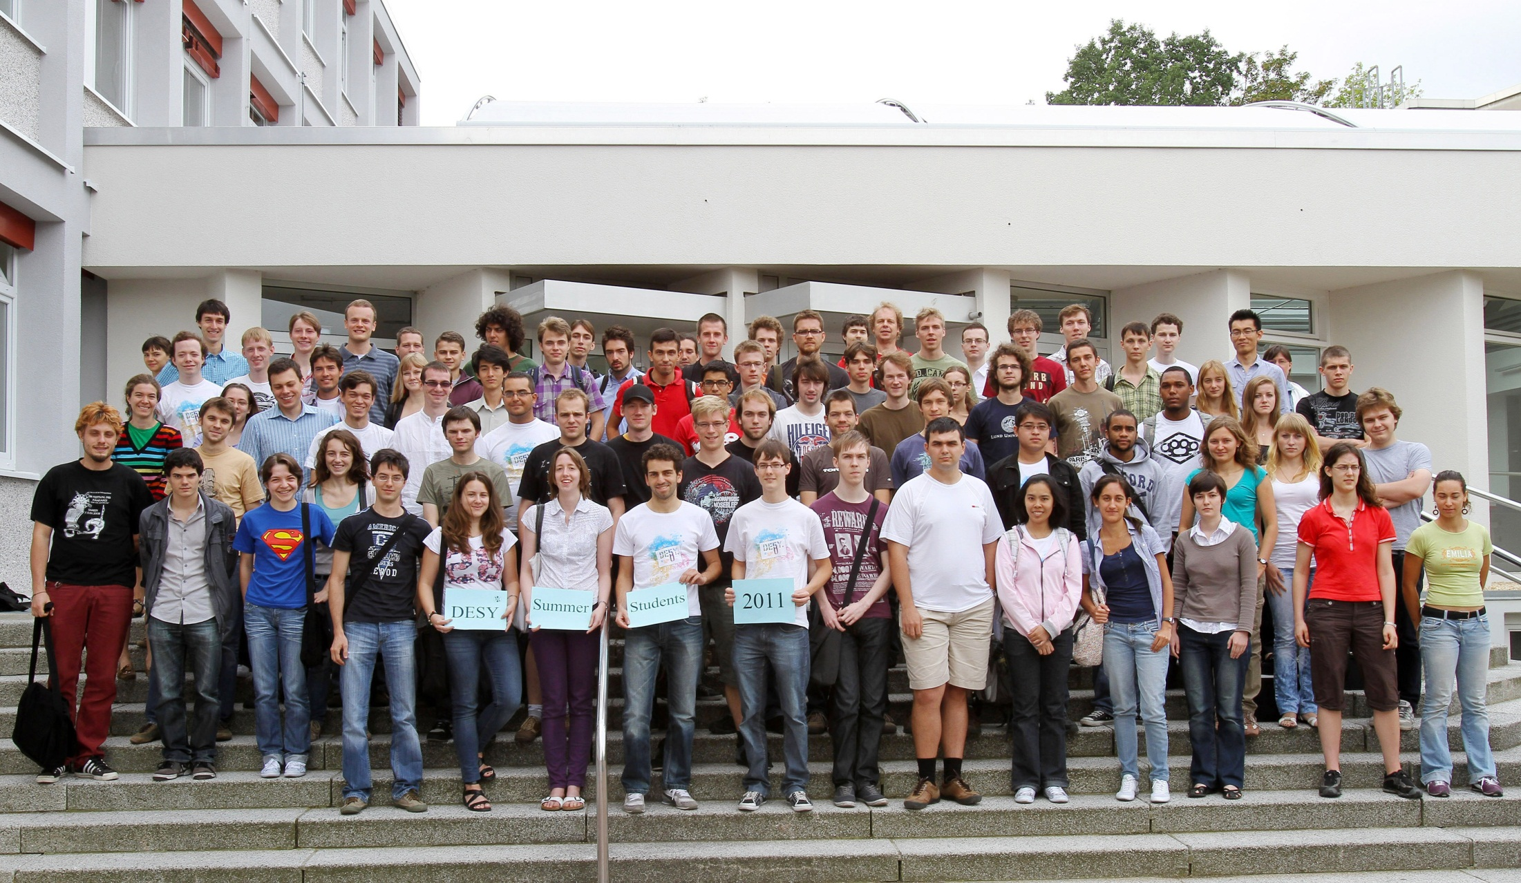
Thank you for your attentions

