Slide 1




Status and Plans for the HALHF BDS
Vera Cilento, Lewis Kennedy, Rogelio Tomás and Richard D’Arcy

Slide 2
Outline
Motivation
Introduction to the BDS
Status of the HALHF BDS
  Comparison with CLIC and ILC BDS designs
  BDS scaling with Length
  BDS scaling with Emittance
Dual BDS option
  Development of the model to construct the Dual BDS in CLIC
  CLIC Dual BDS Design at 380 GeV and 3 TeV
  HALHF dual BDS (scaled from CLIC Design)
Conclusion for the ESPPU Document
Future Plans for HALHF BDS

Slide 3
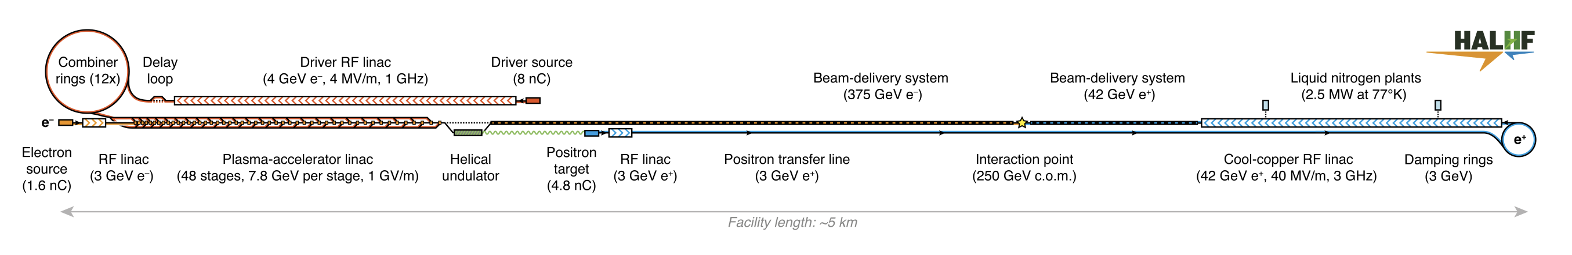
Motivation
What are we investigating?

Slide 4
Motivation
What are we investigating?
What statements we want to do for the ESPPU document?
  What would be the minimum BDS length we aim?
  How short we can make the BDS in reality?
What are we going to study after this 6 weeks, for the pre-CDR?
  Try to reach a first optimised BDS design for plasma collider

Slide 5
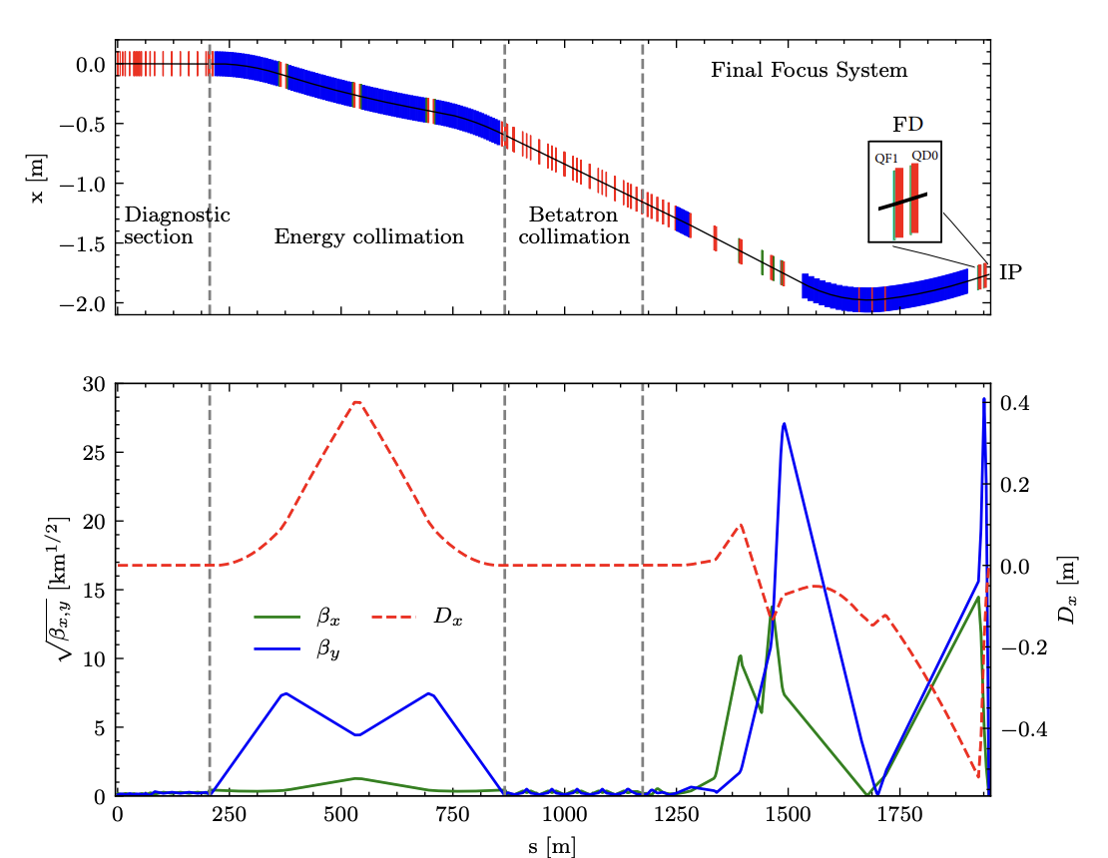
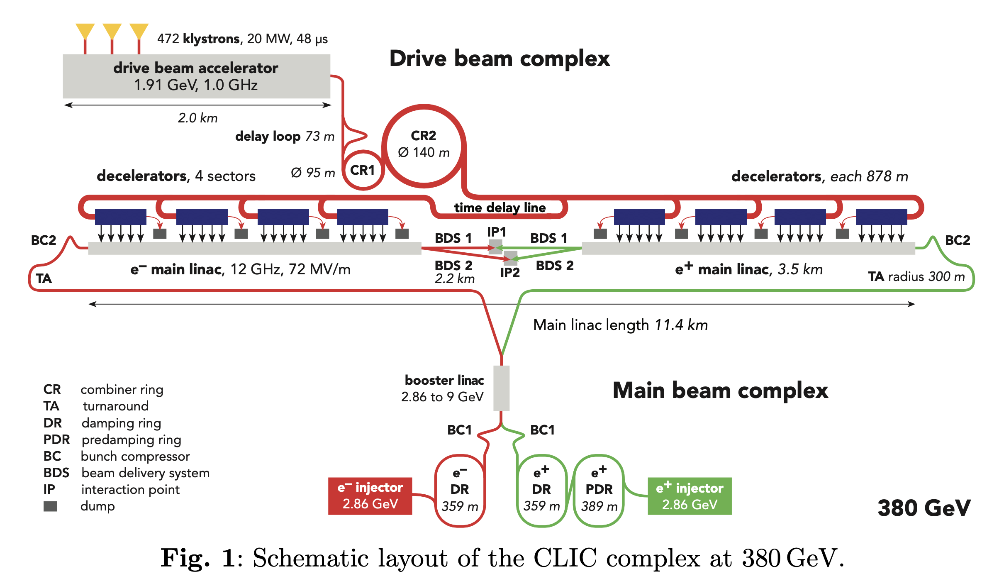
Introduction to the BDS
The BDS is composed by:
  Diagnostic Section (end of ML to collimation section)
  Collimation Section (protects the downstream beamline and detector against mis-steered beams from ML and removes beam halo)
  Final Focus System (focus the beam to nanometer level and correct the chromaticity)

Slide 6
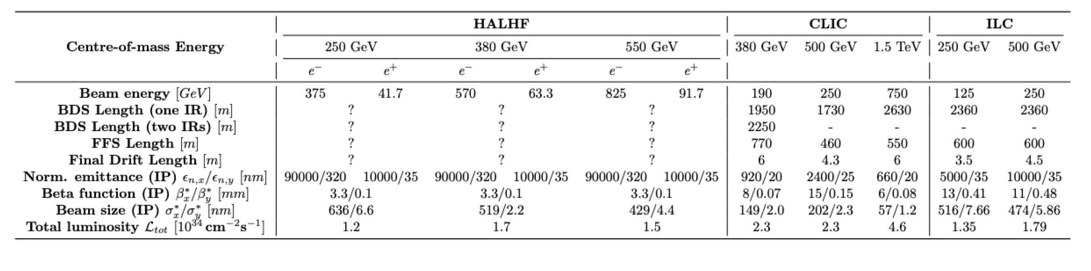
Comparison with CLIC and ILC BDS Designs
ILC BDS keeps the same length for the energy upgrades (approx. 2.4 km)
CLIC BDS Design goes from 1.9 km at 380 GeV to 2.6 km at 1.5 TeV (only one BDS)
For the two IPs option for CLIC the BDS length would be 300 m longer for the version at low energy → 2.2 km
Fundamental is the choice of the L* (distance from the last magnet to the IP) in the design
27/02/2025

Slide 7
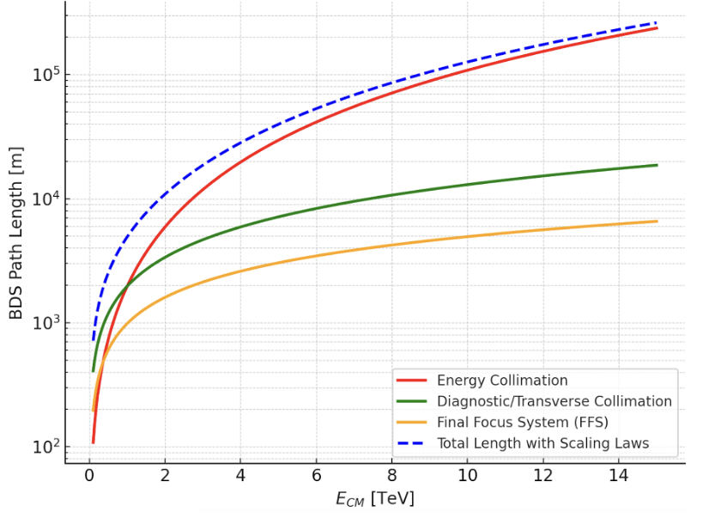
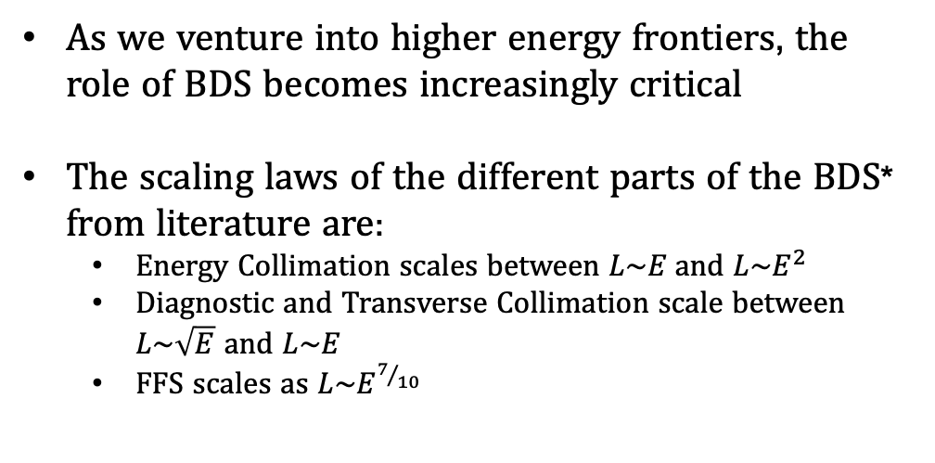
BDS Scaling with Length
As we venture into higher energy frontiers, the role of BDS becomes increasingly critical
The scaling laws of the different parts of the BDS* from literature are:
  Energy Collimation scales between $L\sim E$and ${L\sim E}^{2}$
  Diagnostic and Transverse Collimation scale between $L\sim \sqrt{E}$ and $L\sim E$
  FFS scales as $L\sim E^{7/{10}}$
*White, G., et al. "Beam delivery and final focus systems for multi-TeV advanced linear colliders." Journal of Instrumentation 17.05 (2022): P05042.
HALHF Workshop

Slide 8
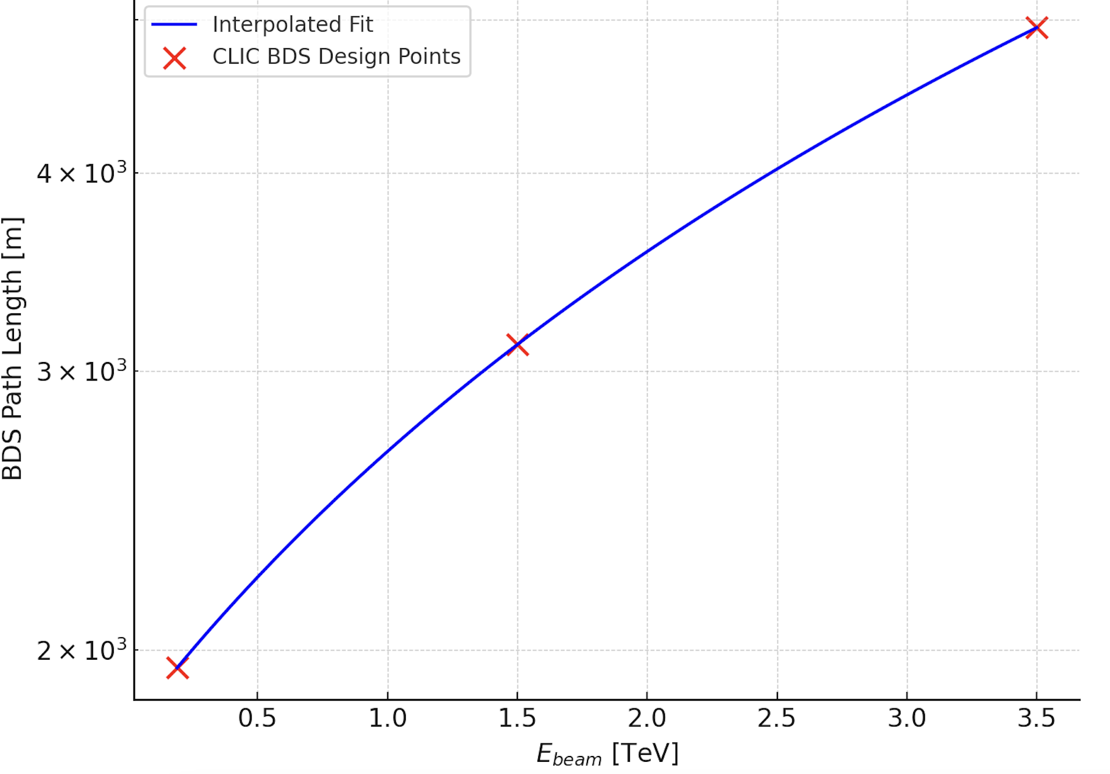
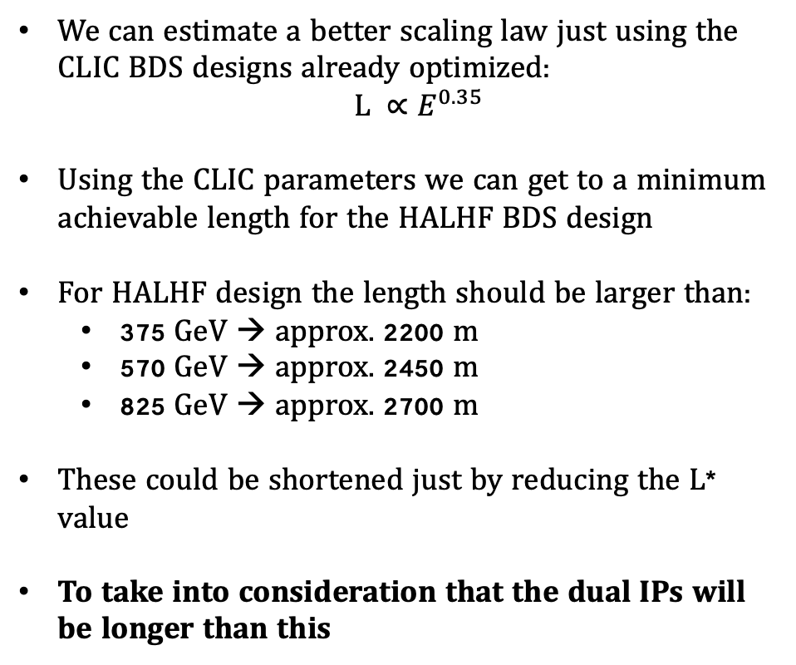
BDS Scaling with Length
We can estimate a better scaling law just using the CLIC BDS designs already optimized:
$L ∝E^{0.35}$
Using the CLIC parameters we can get to a minimum achievable length for the HALHF BDS design
For HALHF design the length should be larger than:
  375 GeV → approx. 2200 m
  570 GeV → approx. 2450 m
  825 GeV → approx. 2700 m
These could be shortened just by reducing the L* value
To take into consideration that the dual IPs will be longer than this
HALHF Workshop

Slide 9
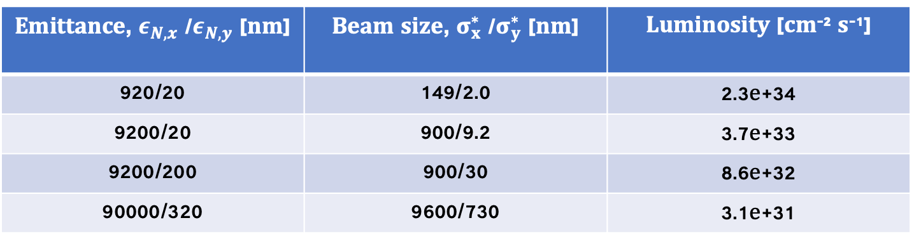
BDS scaling with emittance
Unfortunately, the length will be significantly different in HALHF because of the very large emittance
To try to get a first estimate, a simulation with PLACET and GUINEA-PIG of the CLIC BDS (380 GeV) with an increasing emittance has been done (values not optimized):
Emittance, $ε_{N,x}$ /$ε_{N,y}$ [nm] | Beam size, $σ_{x}^{∗}$ /$σ_{y}^{∗}$ [nm] | Luminosity [cm⁻² s⁻¹]
920/20 | 149/2.0 | 2.3e+34
9200/20 | 900/9.2 | 3.7e+33
9200/200 | 900/30 | 8.6e+32
90000/320 | 9600/730 | 3.1e+31
27/02/2025

Slide 10
BDS scaling with emittance
Unfortunately, the length will be significantly different in HALHF because of the very large emittance
To try to get a first estimate, a simulation with PLACET and GUINEA-PIG of the CLIC BDS (380 GeV) with an increasing emittance has been done (values not optimized):
Emittance, $ε_{N,x}$ /$ε_{N,y}$ [nm] | Beam size, $σ_{x}^{∗}$ /$σ_{y}^{∗}$ [nm] | Luminosity [cm⁻² s⁻¹]
920/20 | 149/2.0 | 2.3e+34
9200/20 | 900/9.2 | 3.7e+33
9200/200 | 900/30 | 8.6e+32
90000/320 | 9600/730 | 3.1e+31
CLIC emittancevalues
HALHF emittance target values
27/02/2025

Slide 11
BDS scaling with emittance
The larger emittance cause a luminosity degradation at the IP
To deal with that we would need to optimize the lattice:
  Increasing Dx via larger bending angles (next slide)
  Strong aberrations → possibly go back to the traditional chromaticy correction scheme
  Larger collimation sections
  Magnet aperture and technology → normal conducting would not work, limiting beta*, requiring a longer system or needing Nb3Sn
How do we address these issues?
  Simulations to optimize the HALHF BDS
    First approach is optimizing the linear and non-linear optics, targeting the CLIC betas with HALHF emittance (simulations in next slide) → bending strengths scans in the FFS
27/02/2025

Slide 12
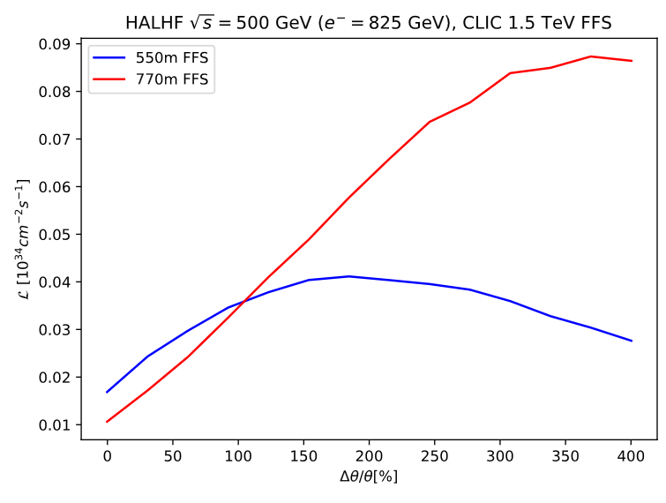
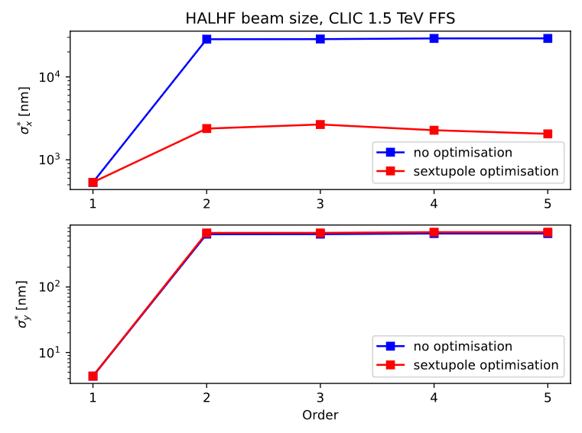
BDS scaling with emittance
A simulation to understand if the CLIC scheme could be used is shown
  Bending magnets strengths scan for the FFS and beam size size optimization
FFS Length = 770 m
Beta x/y = 6/0.08 mm
Beam size x/y (1st order) = 535/4.3 nm
We are quite far from the luminosity goals and from the beam size optimization we also do not gain anything → the aberrations are too large
We need a longer system or decrease the emittance values
27/02/2025

Slide 13
  Development of the Model to construct the Dual BDS for CLIC
The BDS is composed by:
  Diagnostic Section
  Collimation Section
  Final Focus System
The starting point to make the dual BDS design is to split the beamline from the DS

Slide 14
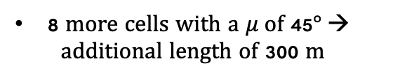
  Development of the Model to construct the Dual BDS for CLIC
DS for the single IR (baseline design with long L*)
New DS for the dual IRs in the case of the longer DS (BDS2 e+)
The FODO cells have been filled with Dipoles + Dispersion Suppressor for the separation of the two BDS
New DS for the dual IRs in the case of the shorter DS (BDS2 e-)
We have different lengths of the DS → the new layout involves four different beamlines in order to provide the desired longitudinal and transverse separation
8 more cells with a $μ$of 45$°$→
additional length of 300 m
27/02/2025

Slide 15
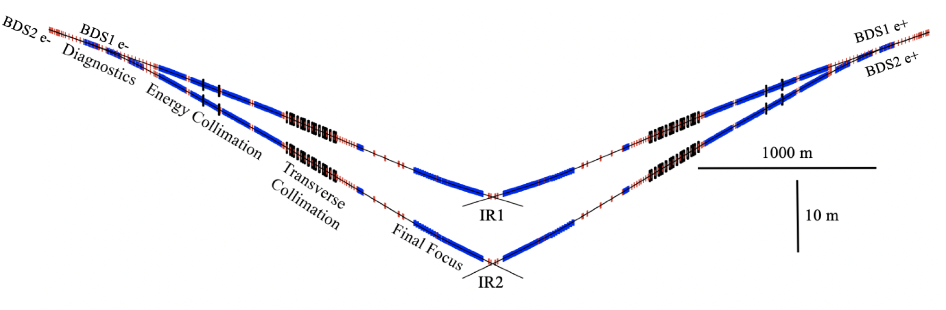
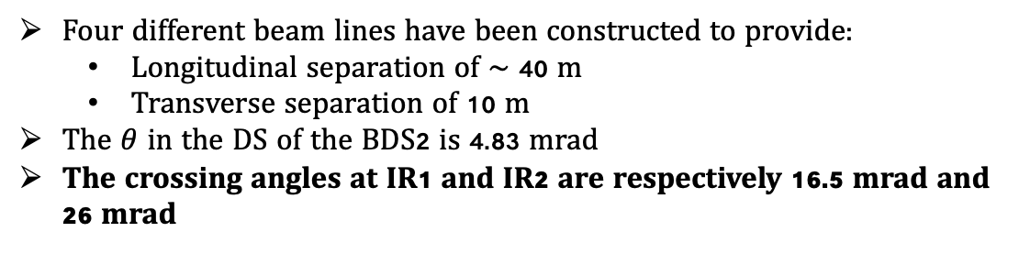
Dual BDS for CLIC
Four different beam lines have been constructed to provide:
  Longitudinal separation of $\sim$ 40 m
  Transverse separation of 10 m
The $θ$ in the DS of the BDS2 is 4.83 mrad
The crossing angles at IR1 and IR2 are respectively 16.5 mrad and 26 mrad
27/02/2025

Slide 16
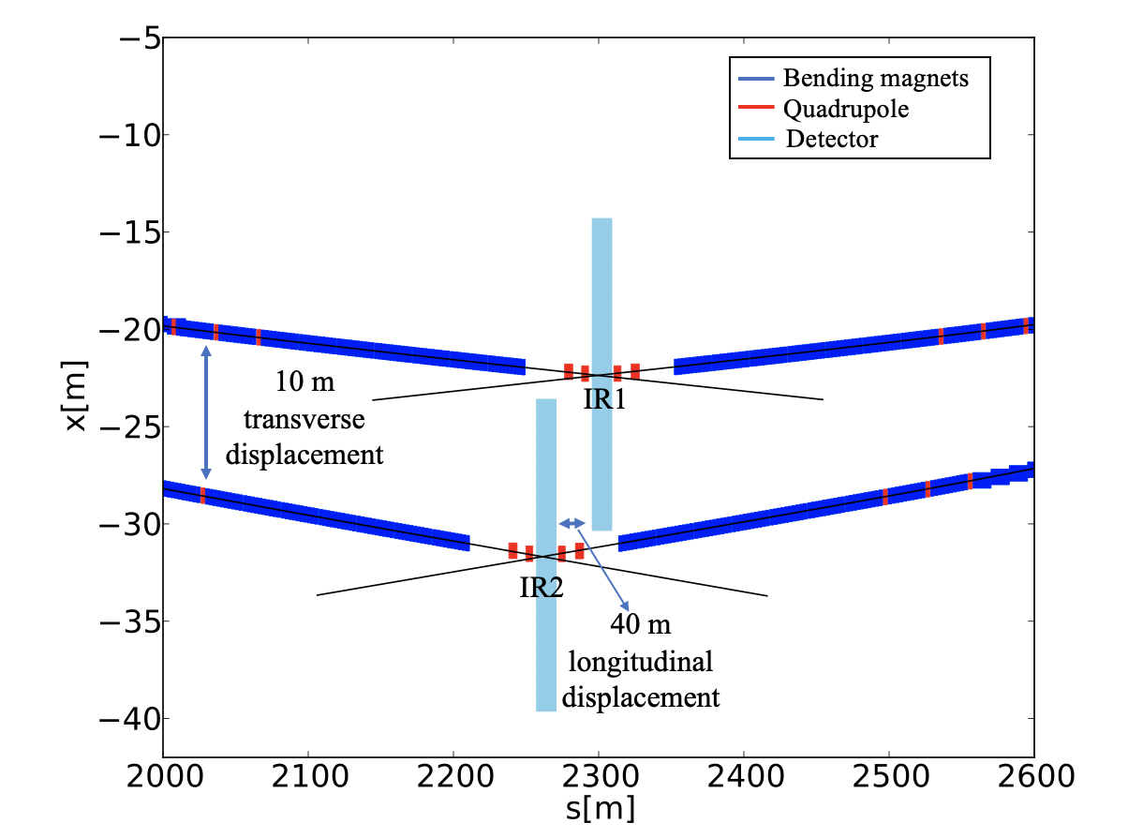
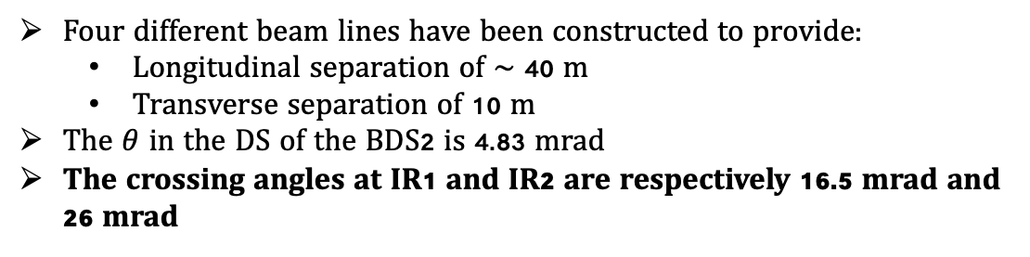
Dual BDS for CLIC
Four different beam lines have been constructed to provide:
  Longitudinal separation of $\sim$ 40 m
  Transverse separation of 10 m
The $θ$ in the DS of the BDS2 is 4.83 mrad
The crossing angles at IR1 and IR2 are respectively 16.5 mrad and 26 mrad
27/02/2025

Slide 17
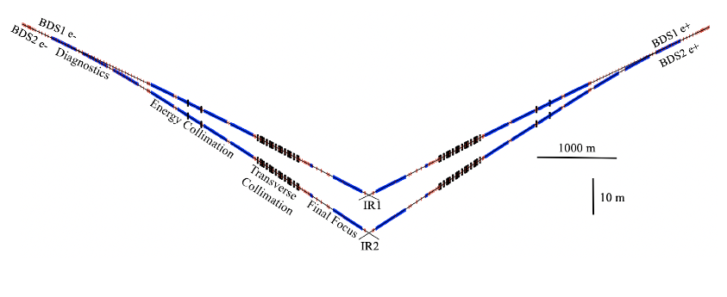
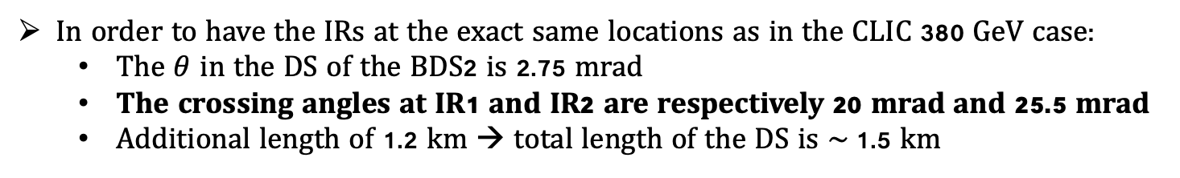
Dual BDS for CLIC at 3 TeV
In order to have the IRs at the exact same locations as in the CLIC 380 GeV case:
  The $θ$ in the DS of the BDS2 is 2.75 mrad
  The crossing angles at IR1 and IR2 are respectively 20 mrad and 25.5 mrad
  Additional length of 1.2 km → total length of the DS is $\sim$1.5 km
27/02/2025

Slide 18
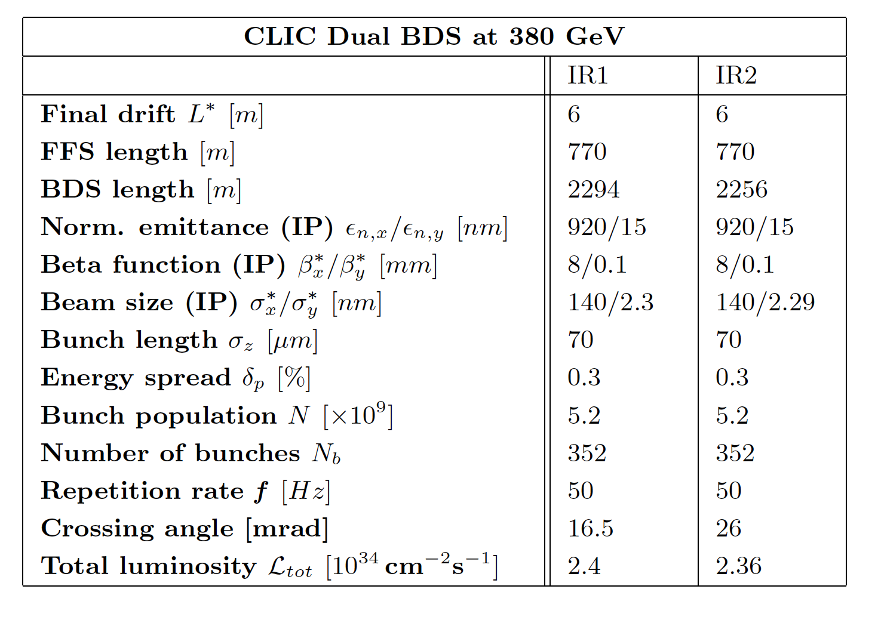
Dual BDS for CLIC
The luminosity loss can be considered negligible (1.5%) for the CLIC 380 GeV case
Increasing the energy (3 TeV) will cause a percentage of luminosity loss from the new bending magnet of approx. 10%
Working with the civil engineering team to develop a feasible design, including the placement of the beam dumps
Possible solutions for insufficient space include adding shielding or incorporating a vertical bending magnet in BDS2. This option still requires further optimization but appears feasible, with a luminosity loss of 7% for a 0.4 m vertical offset
Other solution proposed is to increase the transverse separation of 10 m
27/02/2025

Slide 19
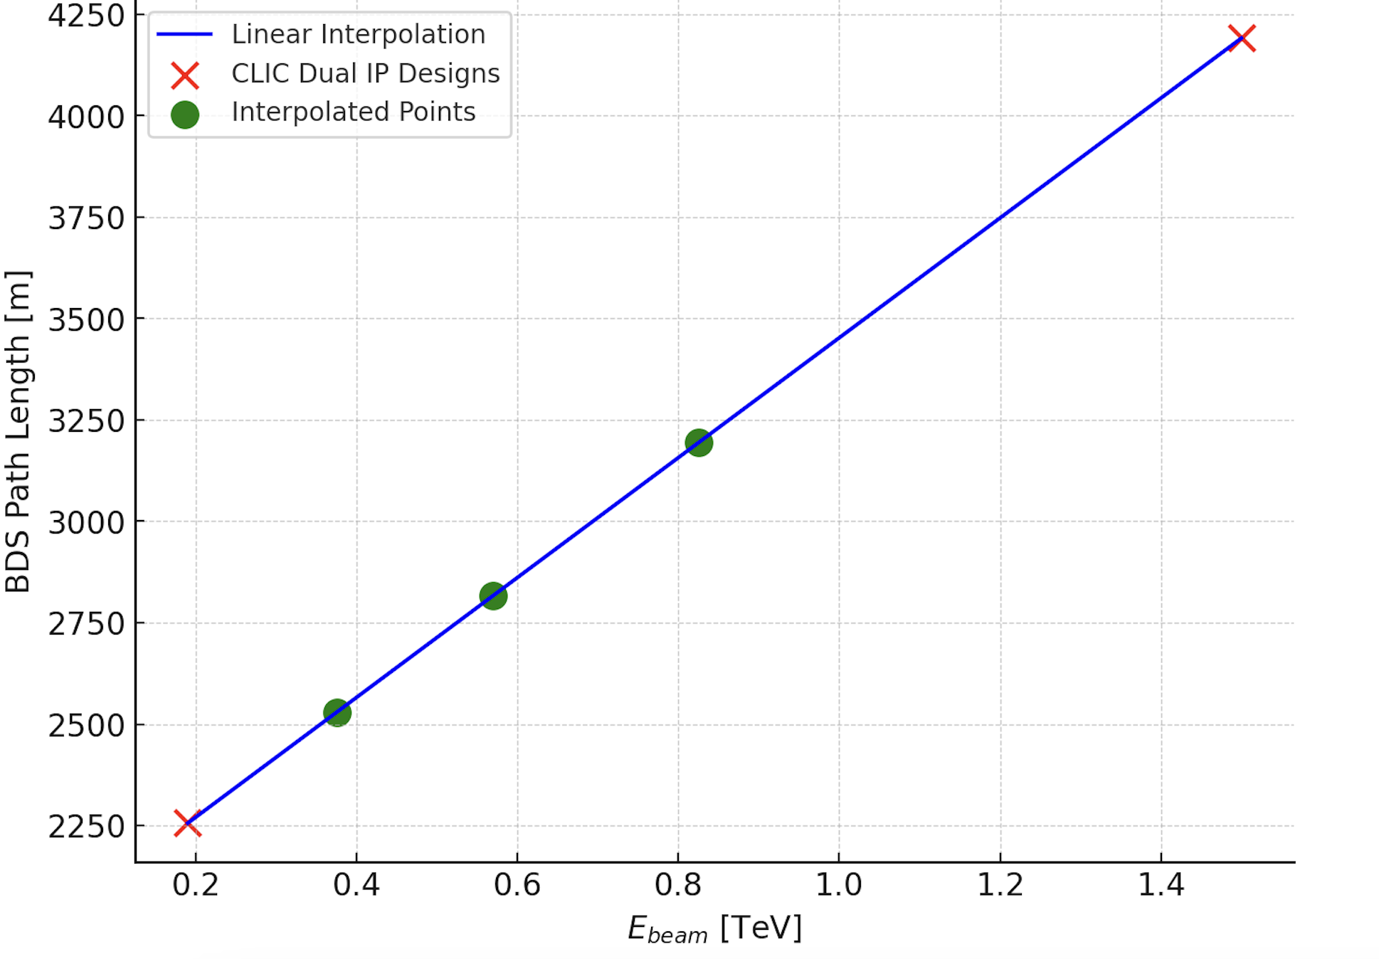
HALHF Dual BDS (scaled from CLIC)
For HALHF we could use the same idea of the design as the CLIC one
The BDS would be at least 350 m longer for the two IPs solution at 375 GeV
The luminosity loss will depend to the final optimized system (not possible to say now)
Fundamental would be the L* and the detector size, to see how to optimize the dual BDS to have the necessary space to allocate the two detectors
Lengths needs to be larger than (coming only from the two CLIC designs optimized):
  375 GeV → approx. 2600 m
  570 GeV → approx. 2850 m
  825 GeV → approx. 3200 m
Also in this case the large emittance will make the system even longer
27/02/2025

Slide 20
Conclusion for the ESPPU Document
Length of the BDS (min length from CLIC design) for one IP
  Length needs to be larger than 2.20 km for HALHF 375 GeV BDS
  Length needs to be larger than 2.45 km for HALHF 570 GeV BDS
  Length needs to be larger than 2.70 km for HALHF 825 GeV BDS
The large emittance will cause a longer system →The bend scans showed that the challenge is huge
  Strong aberrations
  Physical aperture
Dual IPs
  The minimum additional length would be 350 m because of the additional dipoles to split the two BDSs
Length needs to be larger than 2.6 km, unless we can take advantage of plasma linac (this needs R&D) or find a compromise for the emittance values
27/02/2025

Slide 21
Future Plans for HALHF BDS
The plan for the next year (Pre-CDR)? → try to have an optimized BDS for HALHF
  Design and optimize the electron BDS for HALHF
    Do we need to think to a compromise with the plasma linac?
    Could we benefit from a Damping Ring to decrease the emittance and shorten the BDS?
  Design the BDS for the positron side → complete unexplored field (could not be shorter than a minimum reference)
  Impact of 2 IPs (luminosity, length, etc.)
    Produce a BDS design for dual IPs, starting from the HALHF optimized design at one IP, starting before with the electron BDS
    How realistic we should be (transverse and longitudinal displacements)?
  Plasma-linac specific optimizations
    Define initial concepts for integration of BDS goals (e.g. beam collimation) into plasma linac → collaboration with plasma experts and possibly collaborate with 10 TeV plasma collider to achieve a new design with laser-based beam collimation
The design is very challenging and we do not have a solution yet
27/02/2025

Slide 22
Thank you for the attention!
27/02/2025

