Slide 1
HALHF Civil Engineering Implementation at CERN DESY 27th Feb 2025
Edward MacTavish, John Osborne
With thanks to Angel Navascues Cornago, and Charlotte Desponds.
SCE-SAM-FS

Slide 2
Process for Implementation at CERN
The HALHF design implementation at CERN has been based off similar ongoing CERN studies such as the LCF (Linear Collider Facility) and CLIC (Compact Linear Collider).
Key design considerations for the CERN site being:
Maintaining the same alignment as CLIC & LCF.
The same Interaction Region location on the Prévessin site.
The use of a circular main tunnel cross section.
A 2-IP design with offset detectors as used in CLIC & LCF.
Tunnel widening of the BDS tunnel into the Interaction Region.

Slide 3
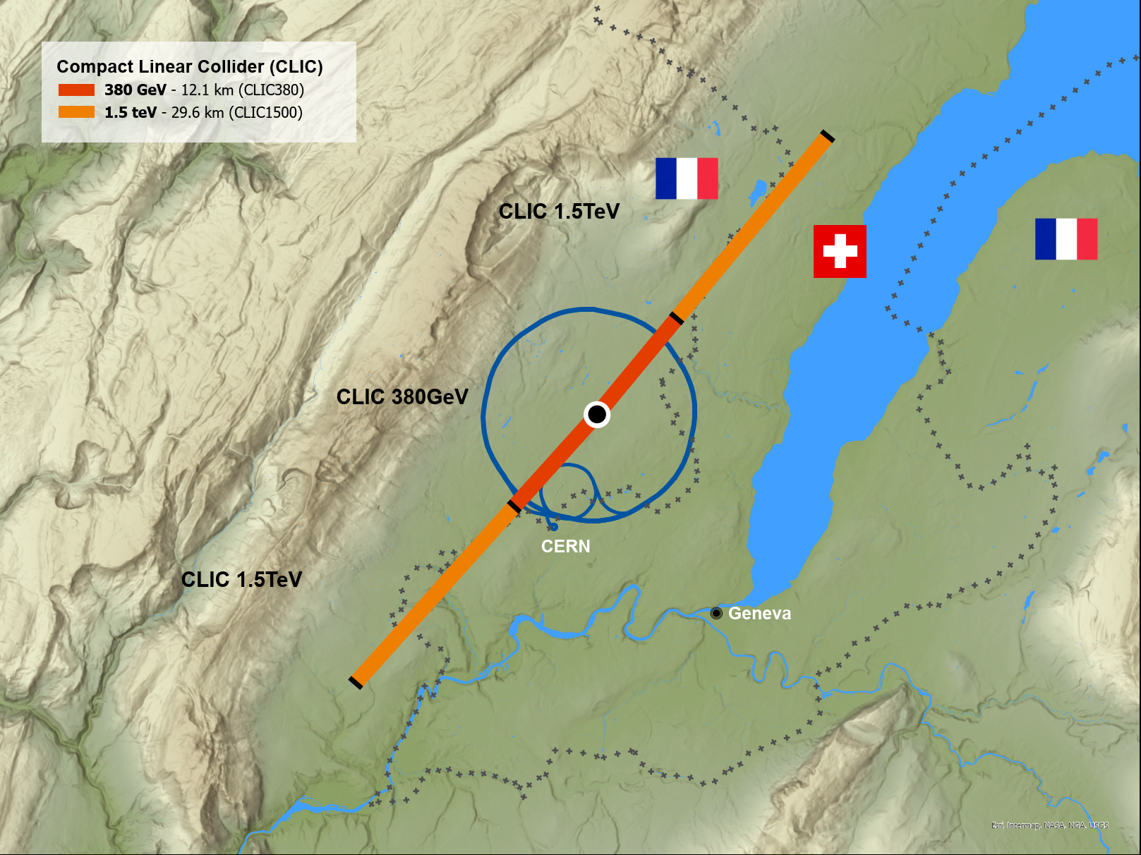
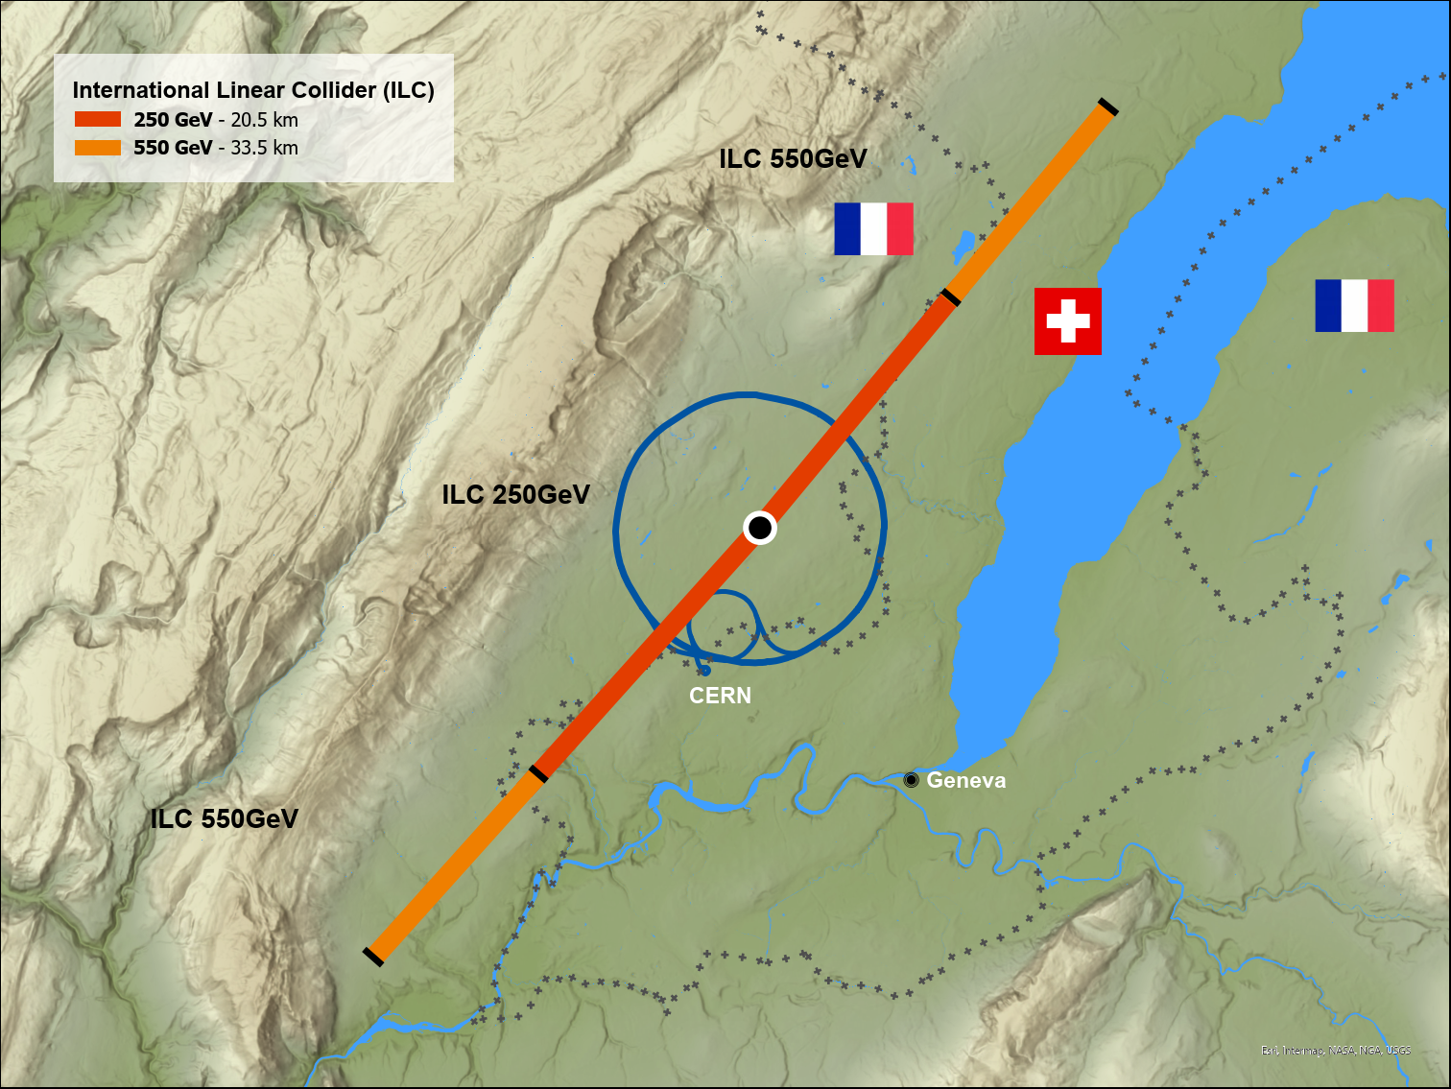
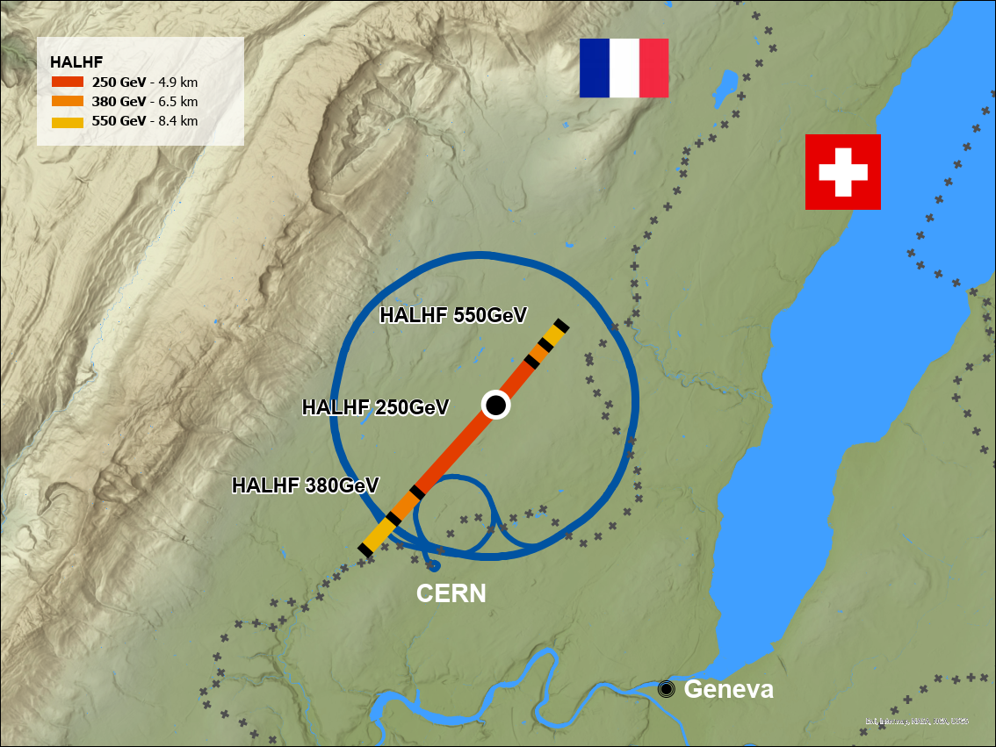
Geographical Layout
CLIC
LCF (Based off ILC Japan)
HALHF
380 GeV -> 12.1km
1.5 TeV -> 29.6km
250 GeV -> 20.5km
550 GeV -> 33.5km
250 GeV -> 4.9km
380 GeV -> 6.5km
550 GeV -> 8.4km
All 3 studies follow the same alignment.
Interaction Region on CERN Prévessin site.
HALHF machine would remain entirely within France.

Slide 4
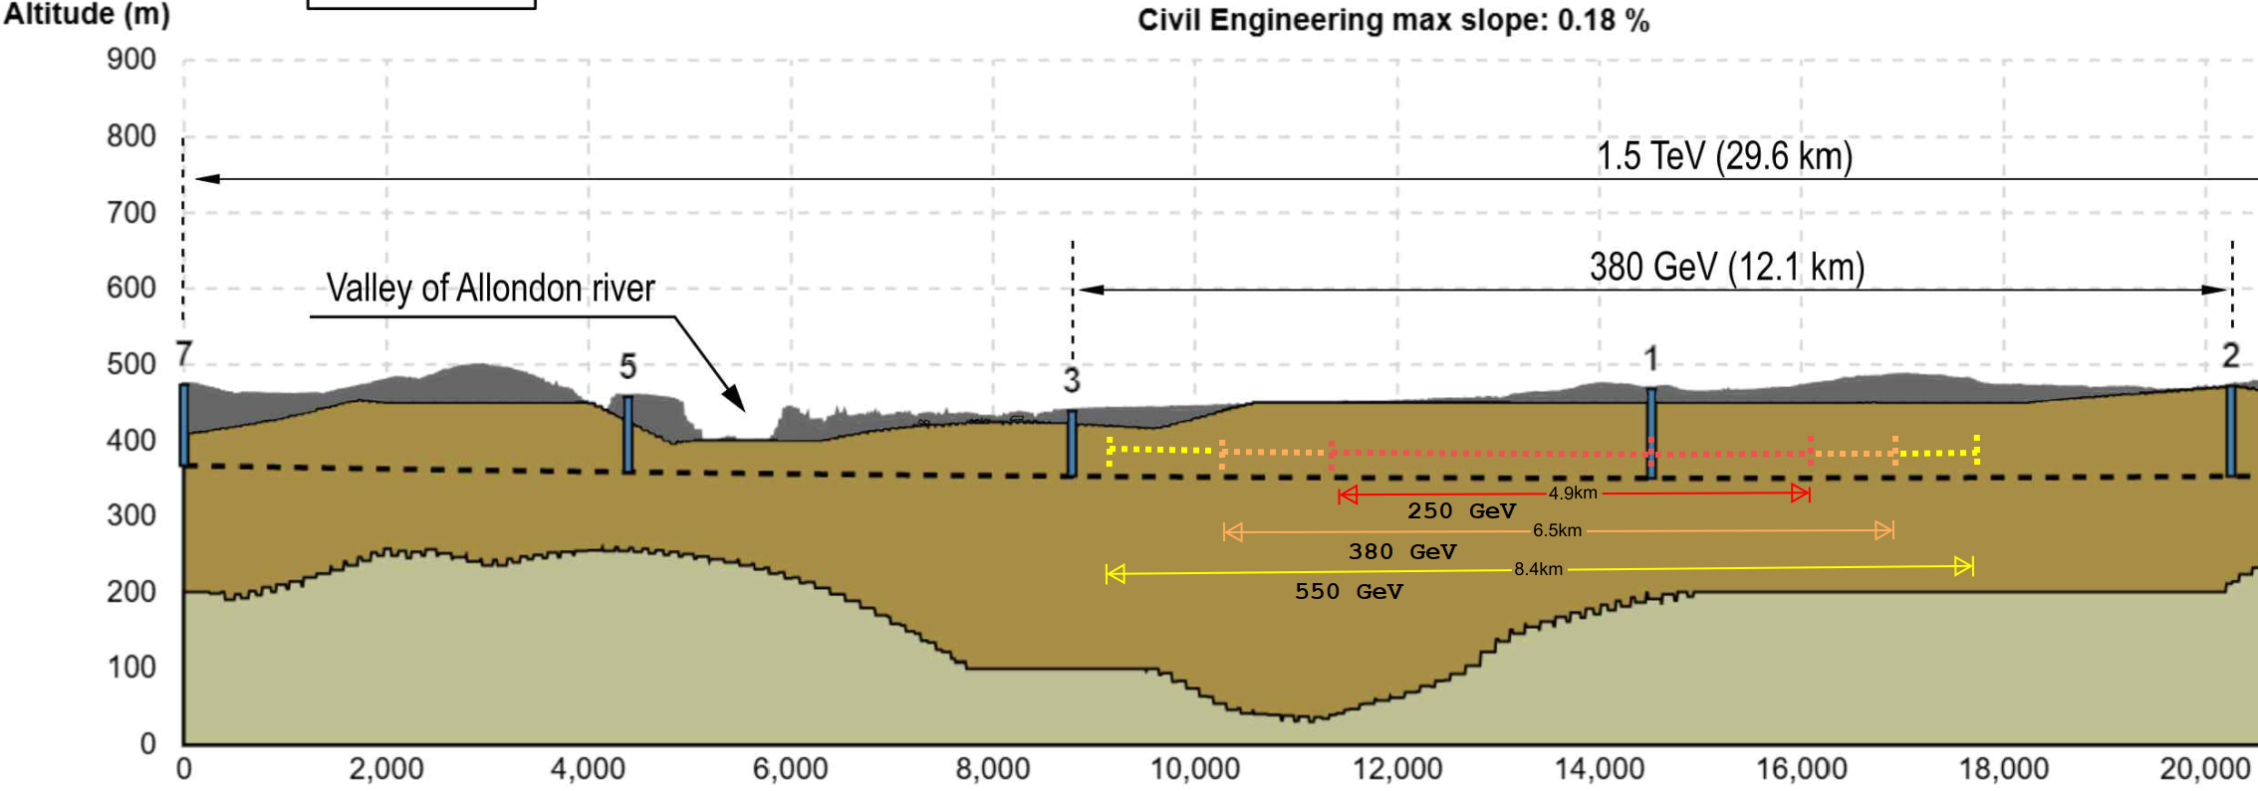
Geological Profile
HALHF energy stages on the CLIC geological profile.
Advisable to have shafts at the end of the tunnel.
Building the full length for 550 GeV first would limit number of shafts required.

Slide 5
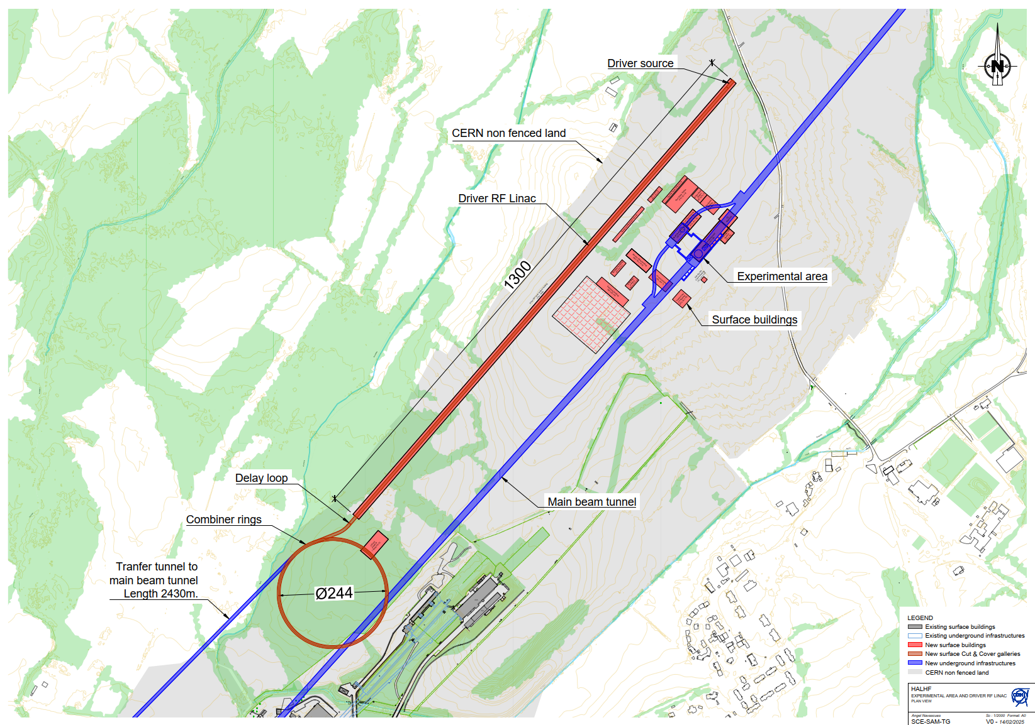
Prévessin Injection Complex and Surface Experimental Site
Displayed in red are the surface structures.
Displayed in blue are the underground structures.
Injector Complex consists of the Driver Source, Driver RF Linac & Combiner rings on the Prévessin site and CERN owned surrounding land.
The Surface Experimental site is also on CERN owned surrounding land and in the same location as for CLIC and LCF.

Slide 6
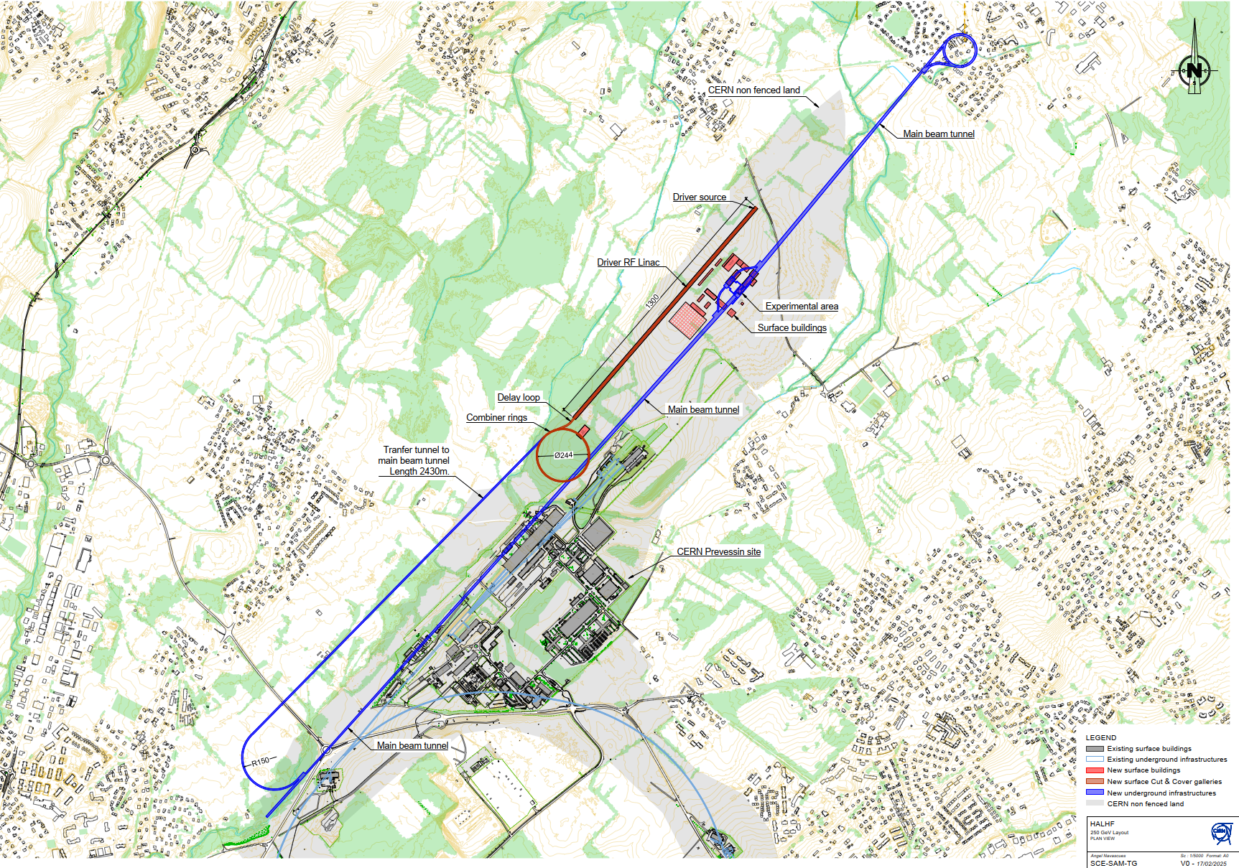
HALHF 250 GeV Machine Layout
250 GeV machine with length of 4.9km.
2430m transfer tunnel from the combiner rings to the beginning of the Plasma accelerator Linac.
Approximate 3% gradient, suitable for TBM.
For upgrade potential to 380 GeV and 550 GeV, constructing the full length tunnel would require the construction of only 1 transfer tunnel.
Likewise for the shafts. Building the full length for 550 GeV first will mean no shafts need to be built at the end of the 250 GeV and 380 GeV lengths.

Slide 7
Underground Structures Schematic

Slide 8
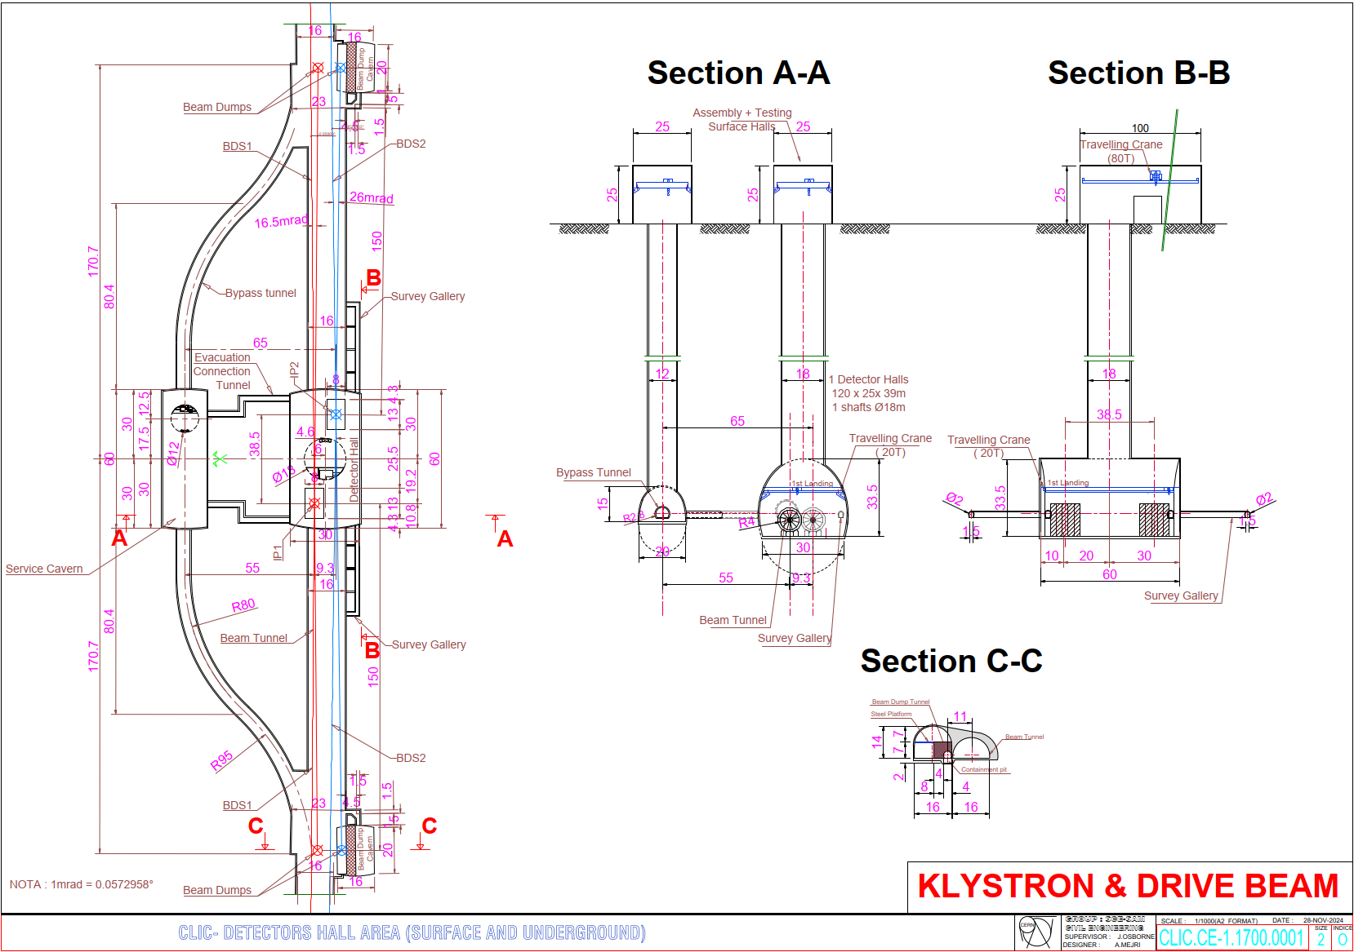
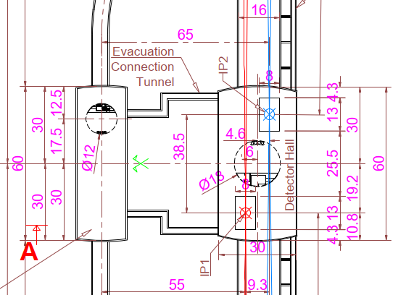
CLIC Interaction Region
Updated to facilitate 2 Detectors.
A 30m x 60m Detector Hall facilitates both detectors with their centers separated by 38.5m.
Main LINAC’s have a 20mrad crossing angle and the Beams have crossing angles of 16.5mrad and 26mrad.
BDS Tunnel has been widened to 16m to account for both beam lines and the 9.3m separation between the detectors.
Tunnel Widening occurs over 2km either side of the Detector hall.

Slide 9
Conclusions and Next Steps
These are the preliminary Civil Engineering designs based off the provided schematic and similar CERN studies.
Look into the optimisation of the injector complex and its location within the CERN site.
An initial in-house Cost and Schedule exercise can be undertaken.

Slide 10
Additional Slides

Slide 11
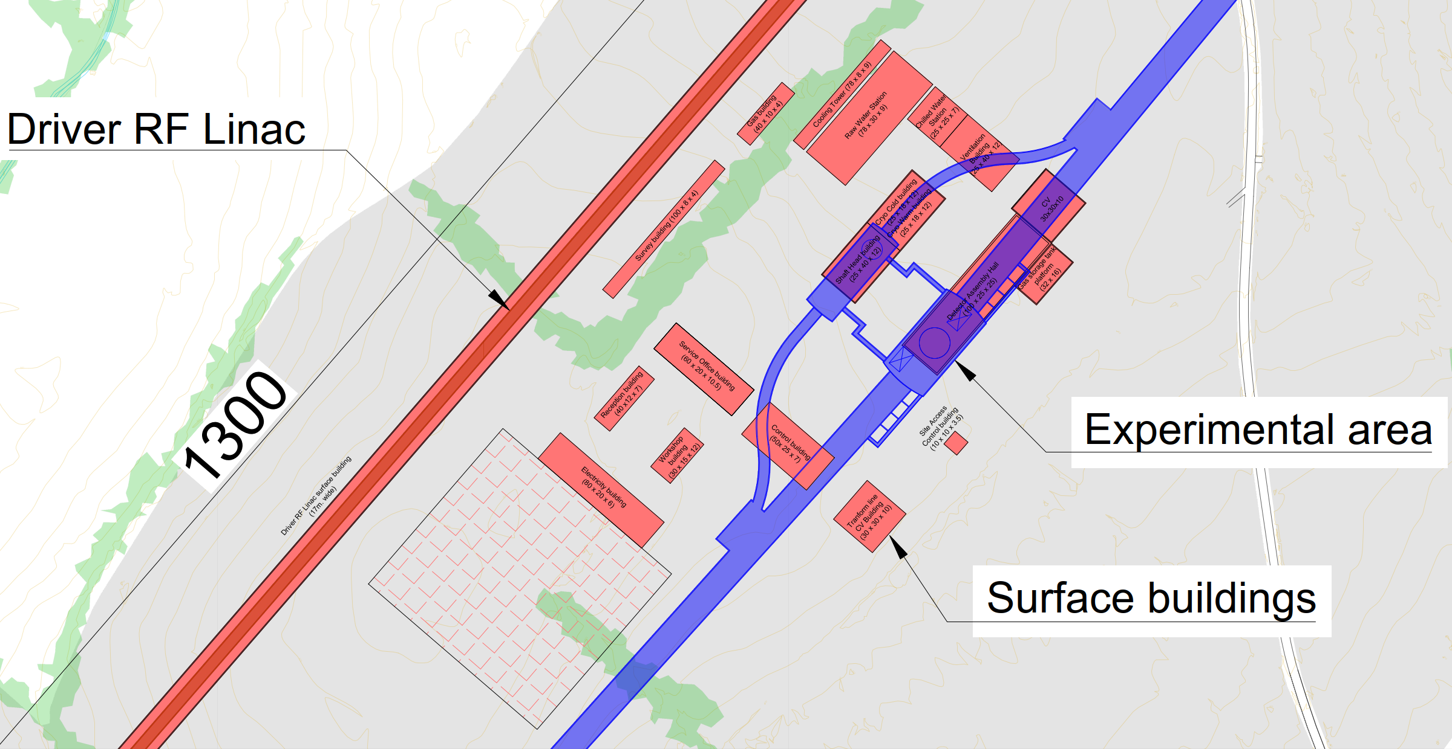
Experimental Area and Surface Site

