Slide 1
XFEL Operator Training
Low Level Radio Frequency (LLRF)
Marco Diomede, for the DESY LLRF team

Slide 2
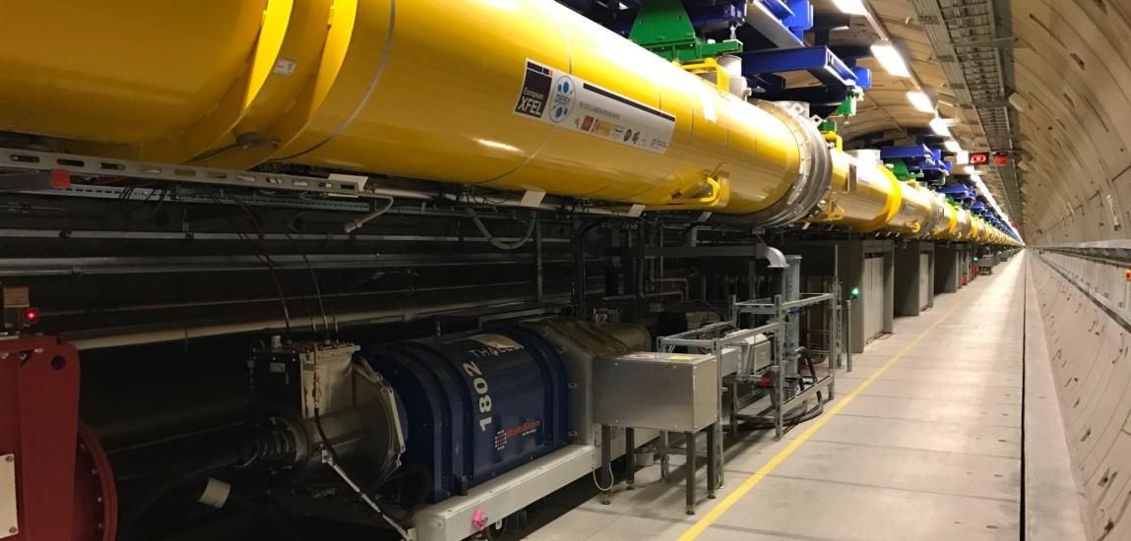

Contents
Introduction
What an operator should know
Exceptional cases and how to react

Slide 3
1. Introduction
What is LLRF?
RF cavities: equivalent circuit and main parameters
Cavity tuning and coupling
LLRF and HPRF system overview

Slide 4
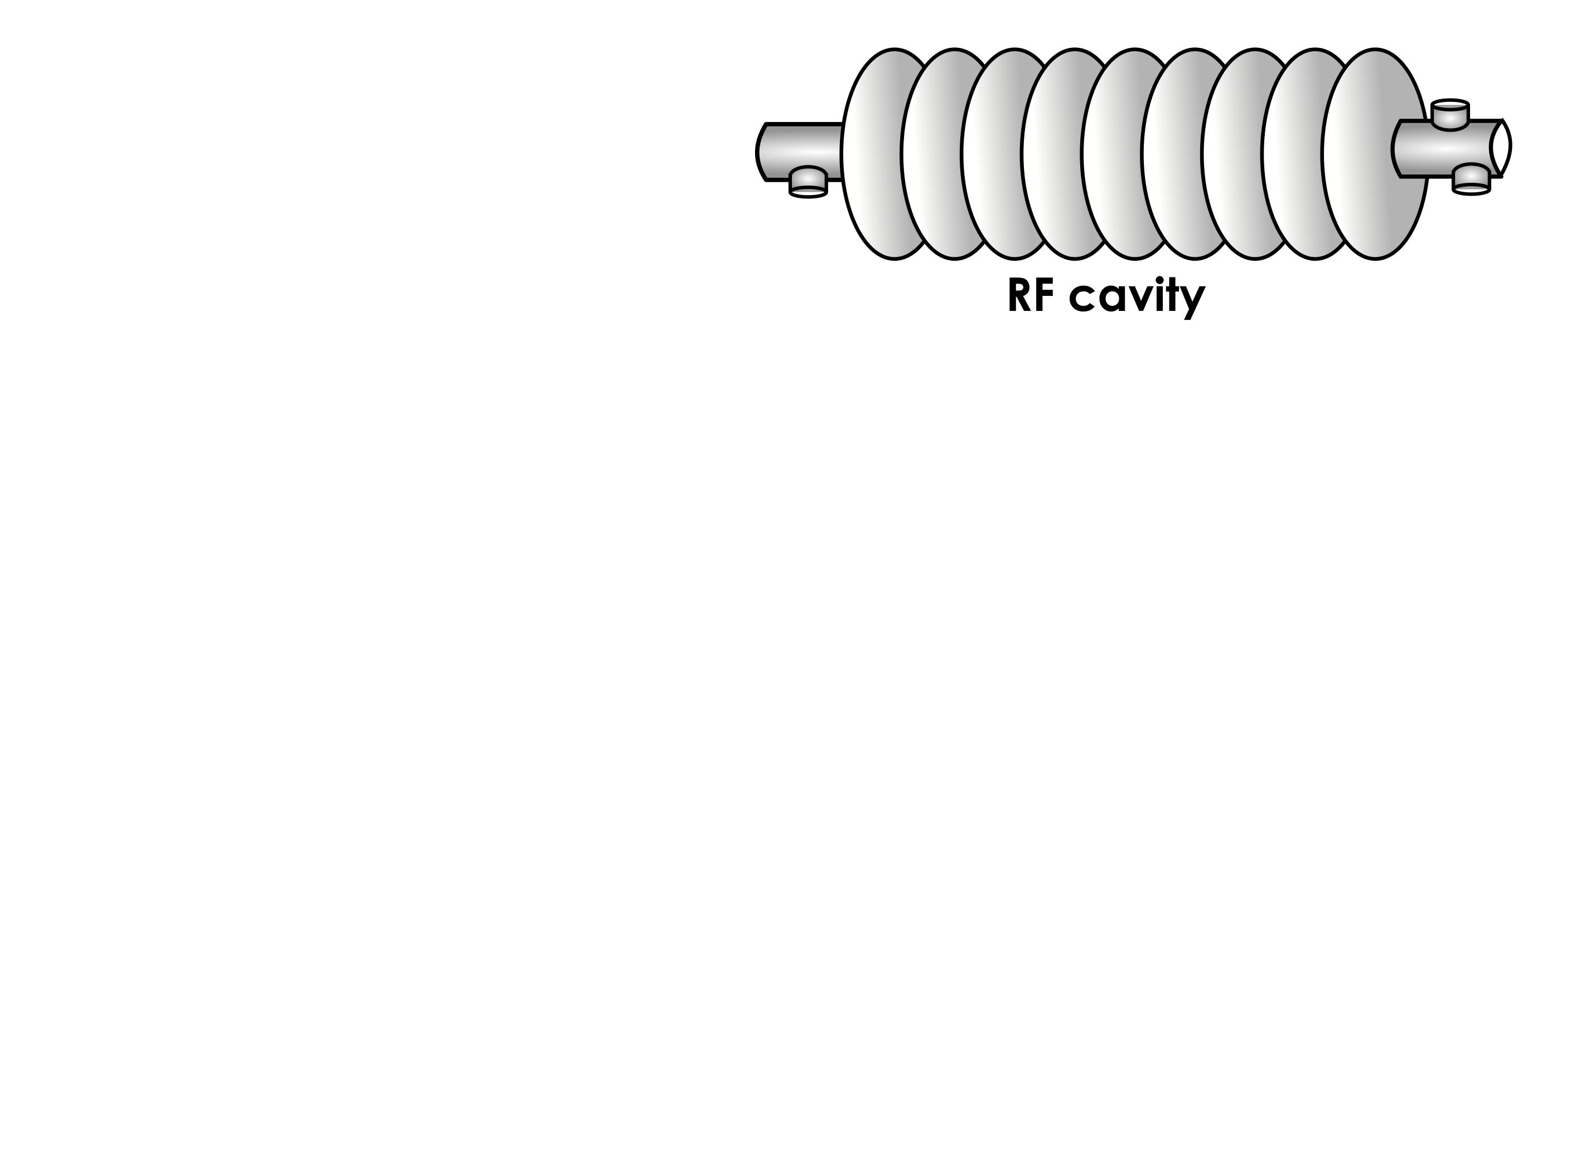
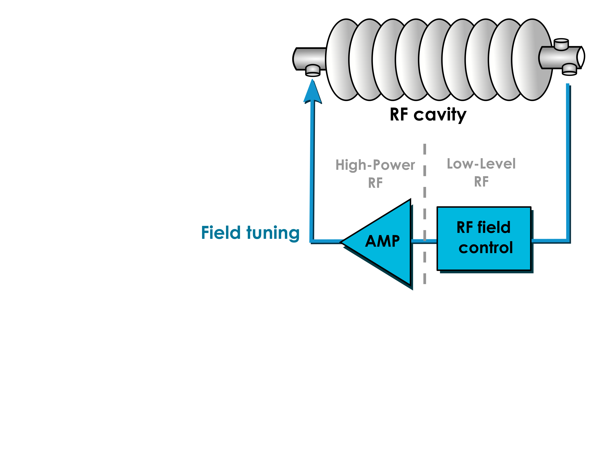
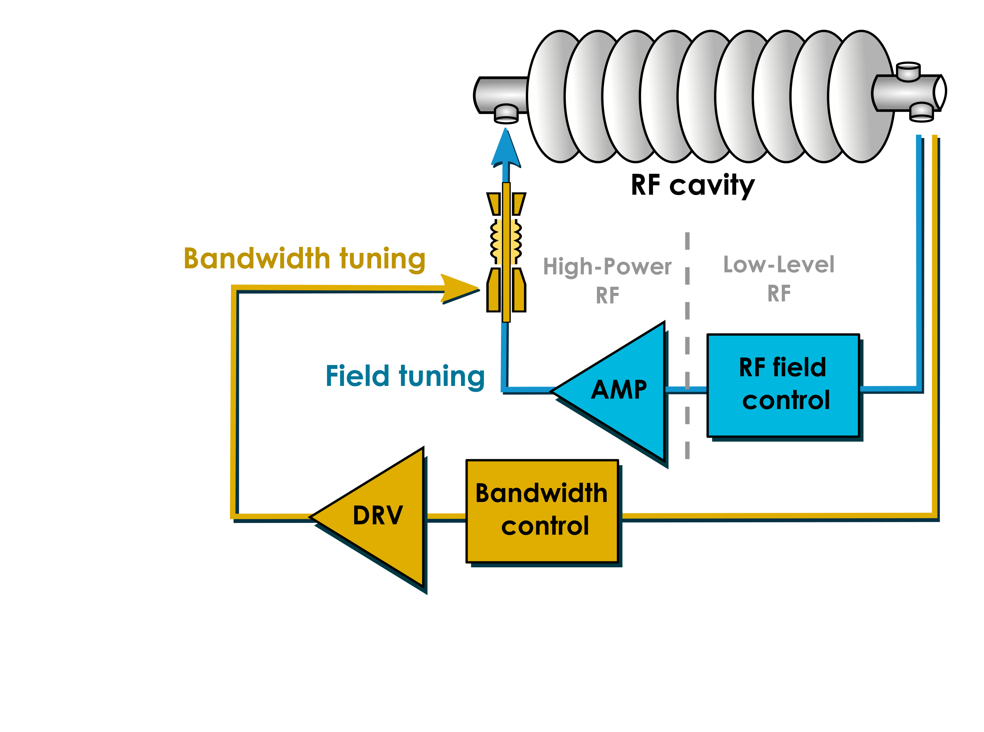
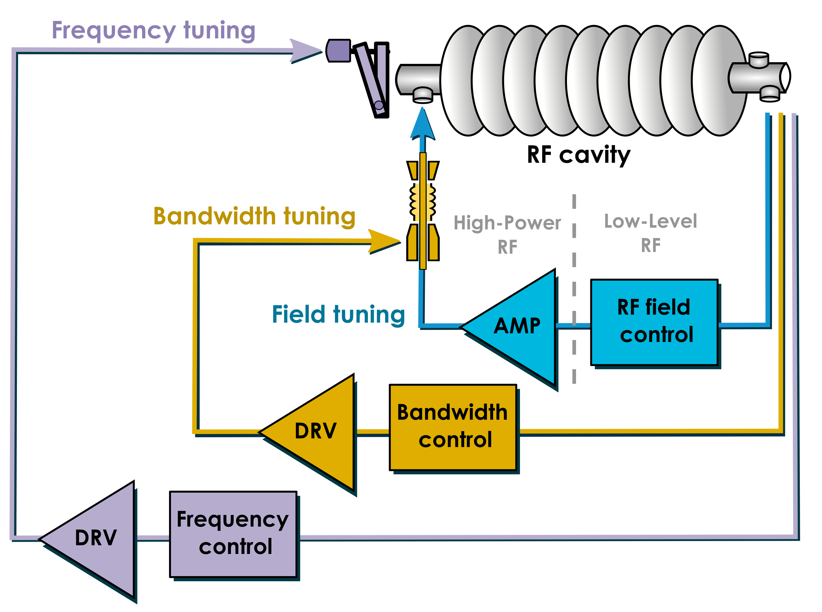
Introduction
LLRF system
Low Level Radio Frequency: Low Level means low power (i.e. < 1Watt)
Our task: digital control of accelerating fields inside the cavities
Normal conducting
Gun 1.3 @ GHz
TDS Injector @ 3.0 GHz
TDS BC2 @ 3.0 GHz
Super conducting cavities
A1 – A25 @ 1.3 GHz
AH1 @ 3.9 GHz
LLRF : measures and controls
the accelerating field inside the cavity
the bandwidth of the cavity
the resonant frequency of the cavity

Slide 5
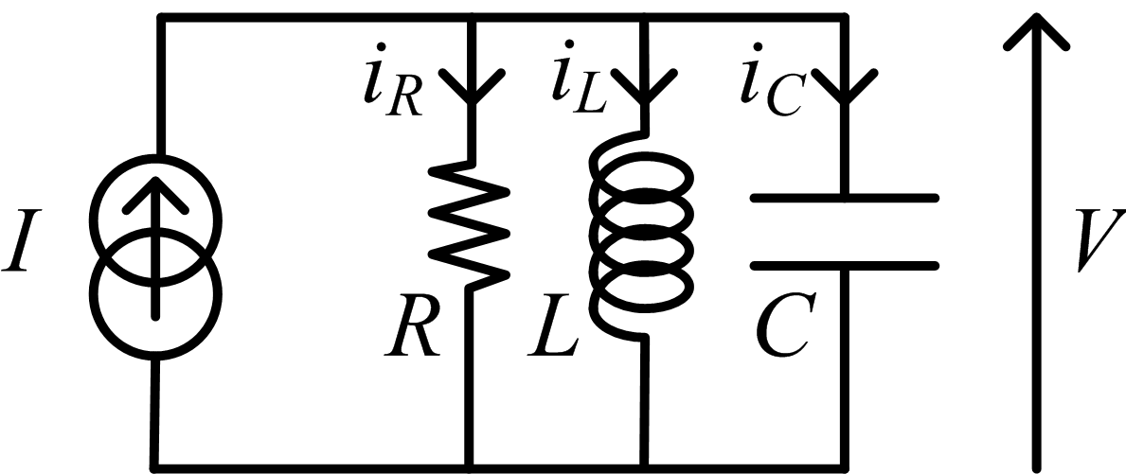
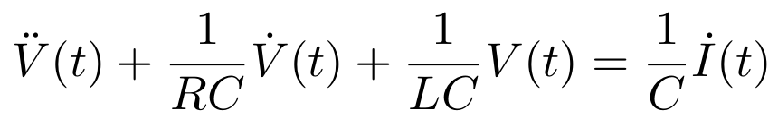
Cavity as an Electrical System
The standard RLC model (simplified)
( 1 )
( 1 ) ➔
( 1 ) & ( 2 ) ➔
( 2 )
➔
2nd order linear differential equation has a solution in the form of
$$V\left(t\right)=V_{CAV}\left(t\right)×sin⁡(ω_{RF}t)$$
envelope
carrier

Slide 6
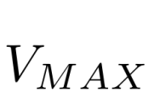
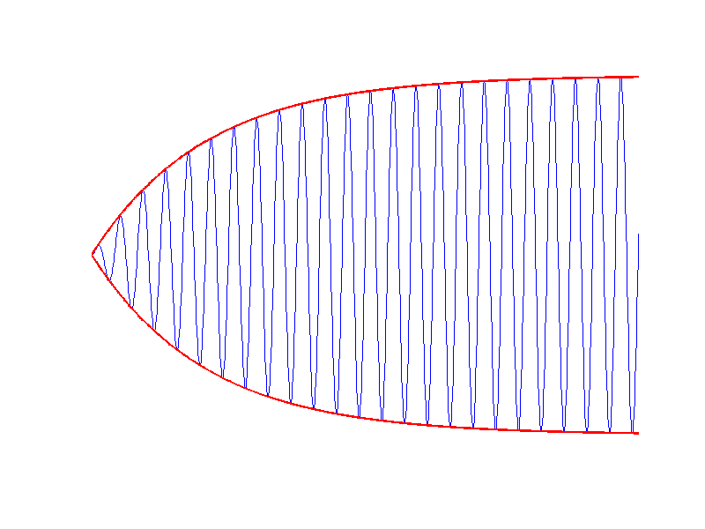
Cavity as an Electrical System
The envelope equation
$$V\left(t\right)=V_{CAV}\left(t\right)×sin⁡(ω_{RF}t)$$
V_{CAV} : envelope
$$V_{CAV}=V_{MAX}(1−e^{−\frac{t}{τ}})$$
τ is the cavity time constant
it depends on the cavity bandwidth
t
$$τ=\frac{1}{2π{ f}_{1/2}}$$
cavity half bandwidth
(i.e. half of the cavity bandwidth)
Notes:
Could present one demo here of filling a cavity with low Ql and with high Ql, observe the time constant for the fill and for the fall.

Slide 7
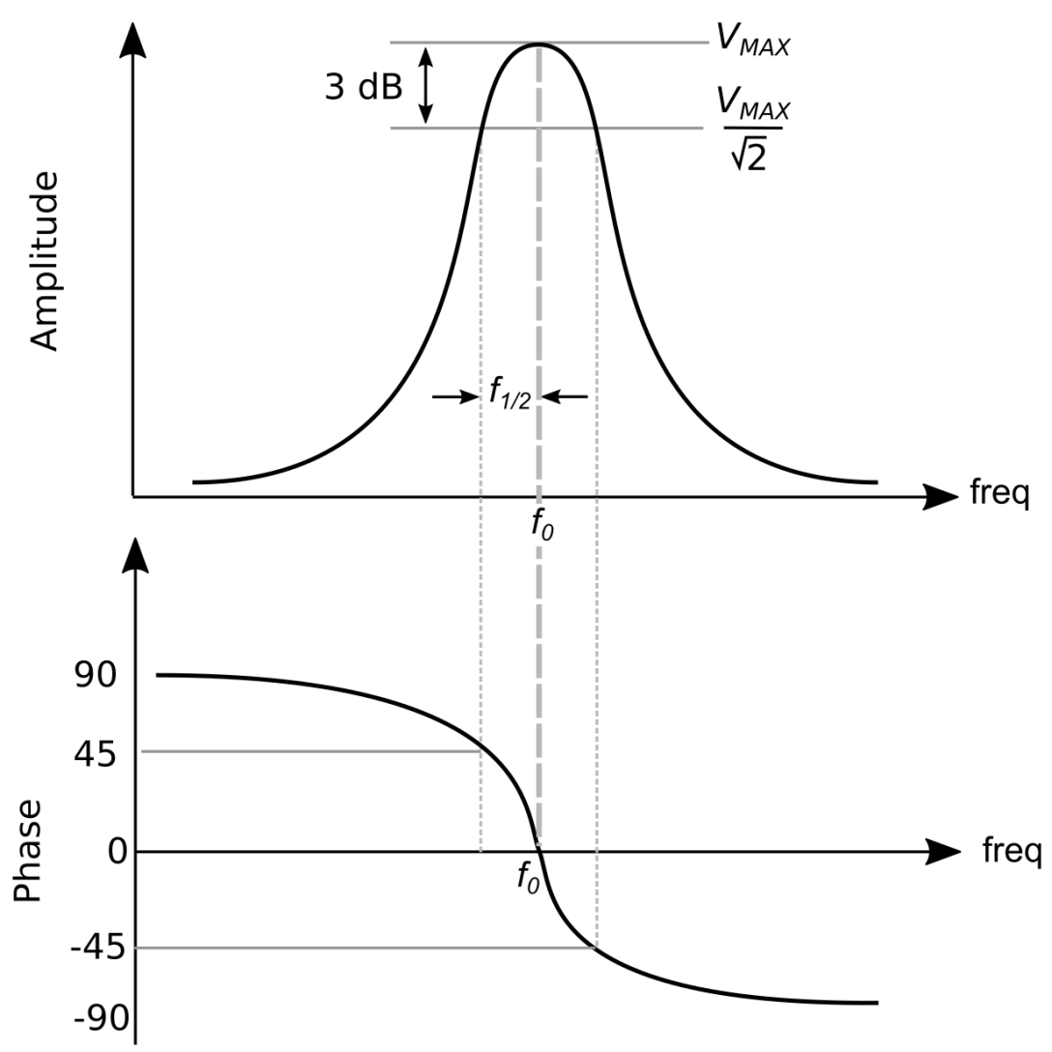
Cavity as an Electrical System
In the frequency domain
Cavity behaves as a band pass filter
Center frequency f₀
Half bandwidth f_{1/2}

Slide 8
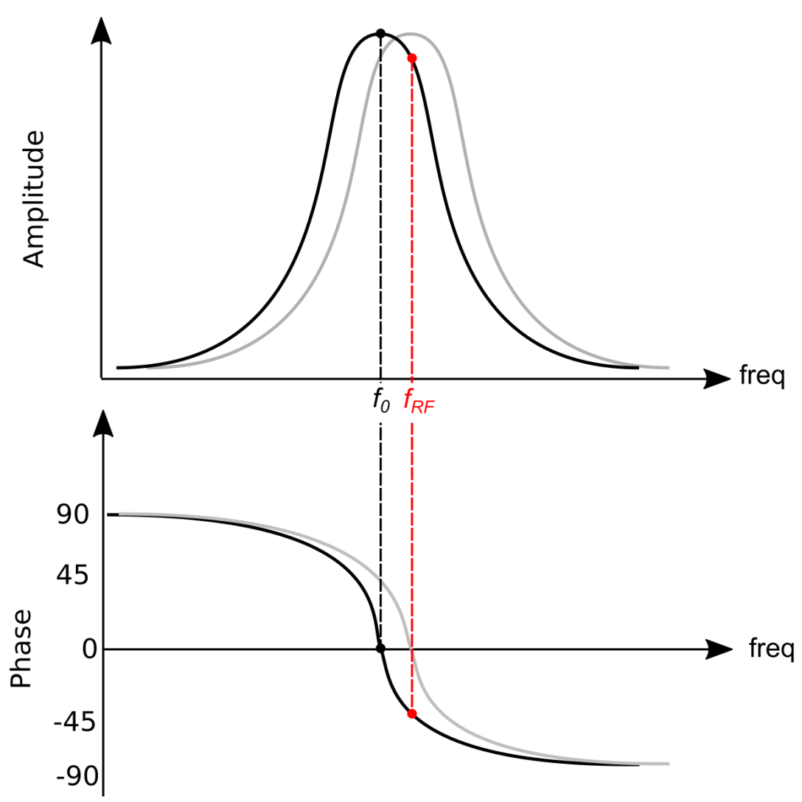

Cavity as an Electrical System
In the frequency domain
Cavity behaves as a band pass filter
Center frequency f₀
Half bandwidth f_{1/2}
We can define detuning as the difference between the cavity center frequency (f₀ = resonance frequency) and the frequency of the RF drive (f_{RF})
$$∆ω= ω0−ωRF=2π\left(f0−fRF\right)$$

Slide 9
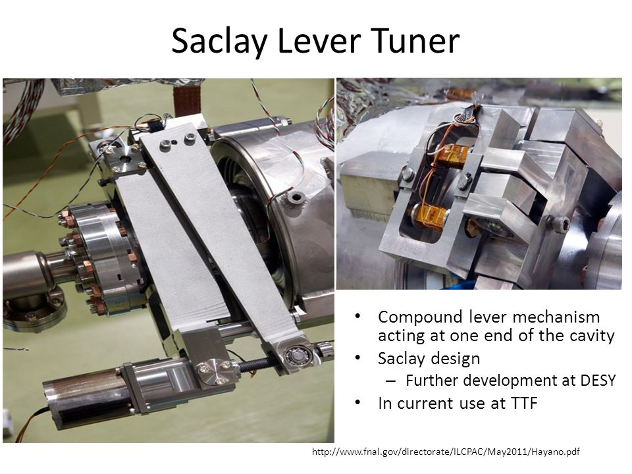
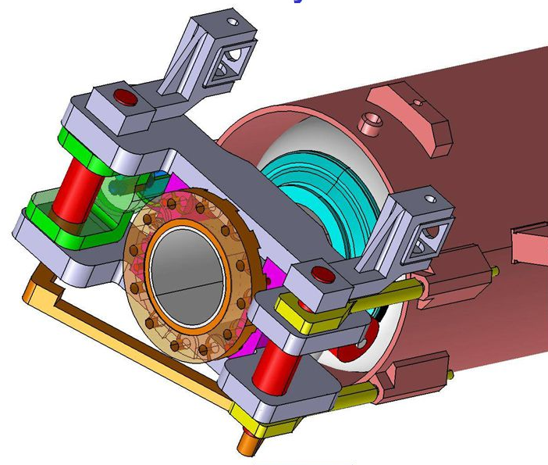
Tuner examples
Saclay type (EuXFEL)
Piezo tuner (fine)
Motor tuner (coarse)

Slide 10
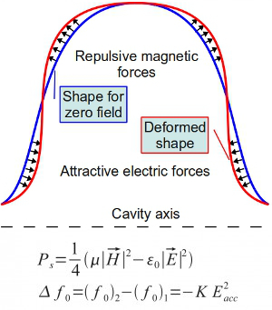
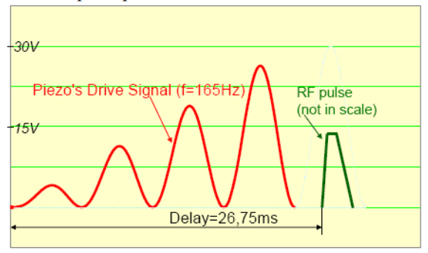
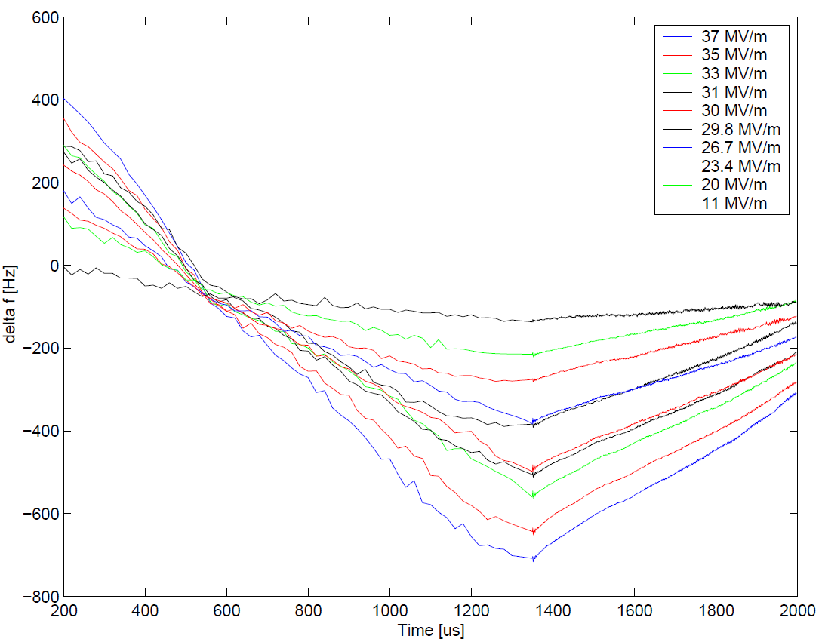
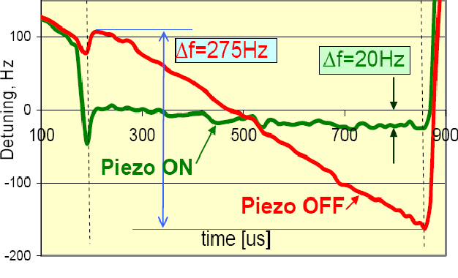

Cavity “fine” tuning
Use of piezo in pulsed mode
Lorentz Force detuning
Lorentz force detuning compensation using piezo
resonance build up
Piezo stimulus:
Frequency
Delay
AC amplitude
DC offset
Detuning increases with square of gradient
Source:
L. Lilje et al.
EPAC 2006
Example from FNAL 2007
R. Carcagno et al. SRF 2007

Slide 11
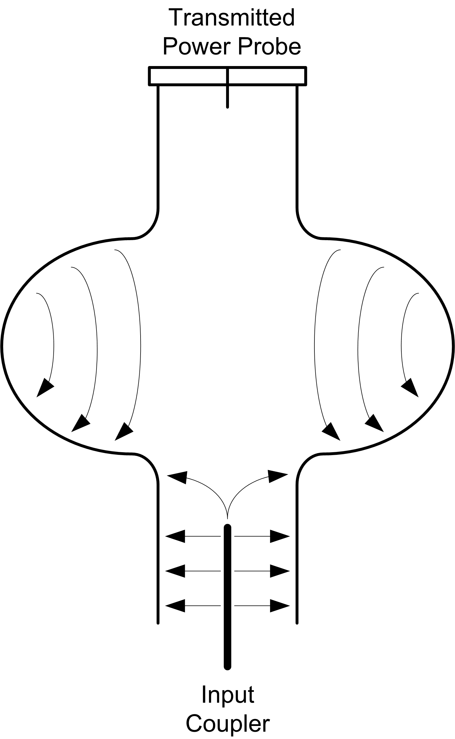
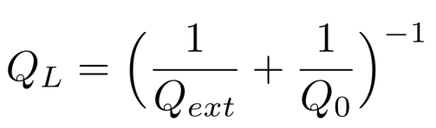
Cavity coupling
Coupling power in and out of a cavity
Input coupler
An antenna carries power from an RF source to the cavity
The strength of the input coupler is adjusted by changing the penetration of the center conductor
Output coupler (pick up)
the transmitted power probe (fixed coupler) picks up power transmitted through the cavity
Measurable “resulting” quality factor ( loaded Q)
External quality factor modified by the coupler antenna position
Cavity unloaded quality factor

Slide 12
Cavity coupling
Understanding unloaded, loaded and external coupling
Q₀ = unloaded quality factor
Measured without the cavity power coupler
Is a direct indication of the power dissipated in the cavity walls (high Q0 → low losses)
Q_{ext} = external quality factor
Can be changed when moving the coupler antenna
Impacts how the incoming RF power couples into the cavity
High Q_{ext} means slow response time, but less power required to reach high gradient
Q_{L} = loaded quality factor
“Resulting” or “Effective” quality factor
Is what can be measured during operation
Changes in Q₀ are masked by Q_{ext}
$$\frac{1}{Q_{L}}=\frac{1}{Q_{0}}+\frac{1}{Q_{ext}}$$
~ 10⁶
~ 10⁶
~ 10¹⁰

Slide 13
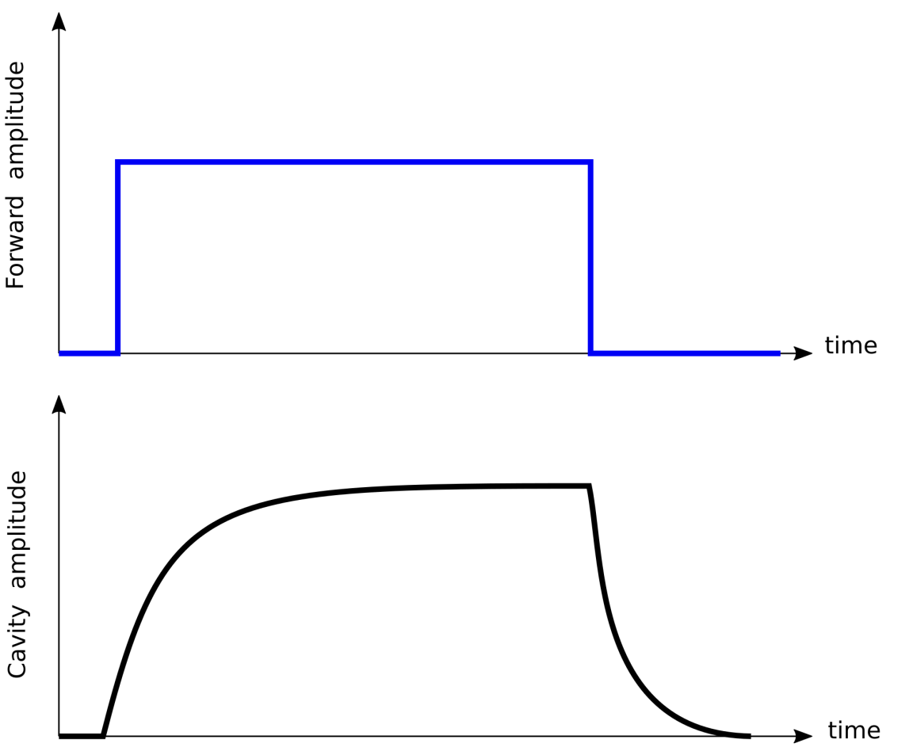

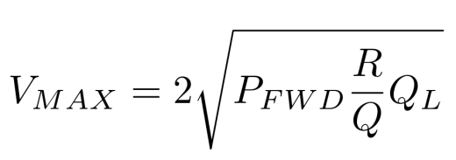

LLRF System
Feed Forward
Cavity response to a square pulse
Q_{L} affects the cavity rate of filling and cavity bandwidth
Q_{L} is there
$$=\frac{1}{2π{ f}_{1/2}}$$
Forward drive
V_{MAX} = steady state cavity voltage
Flat RF region that can be used for beam acceleration
Q_{L} is there
V_{CAV}
Q_{L} affects the cavity maximum voltage
(for a given forward power)

Slide 14
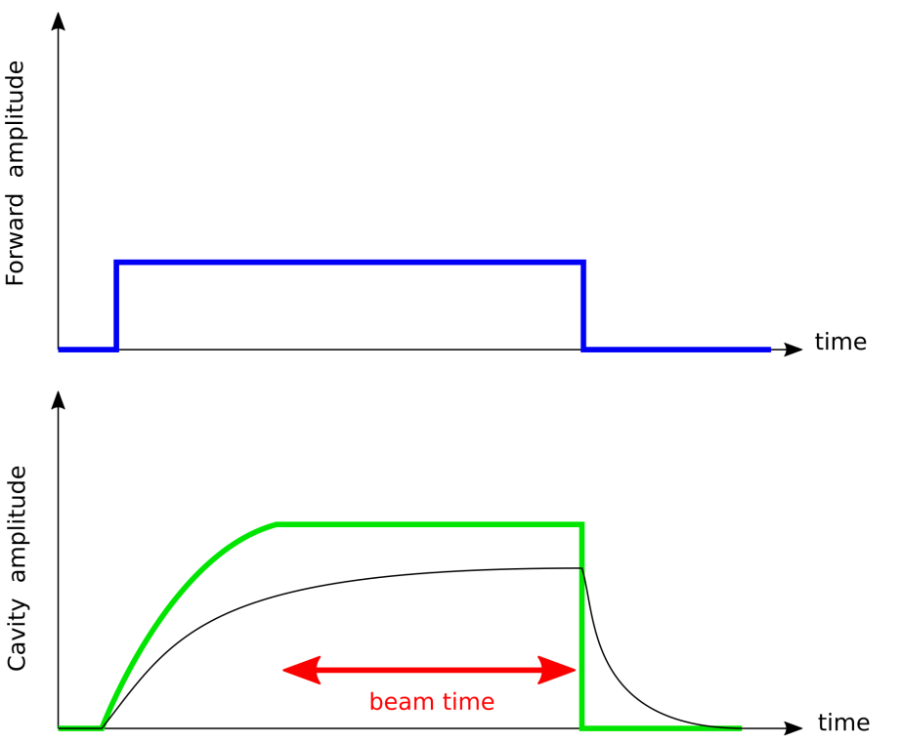
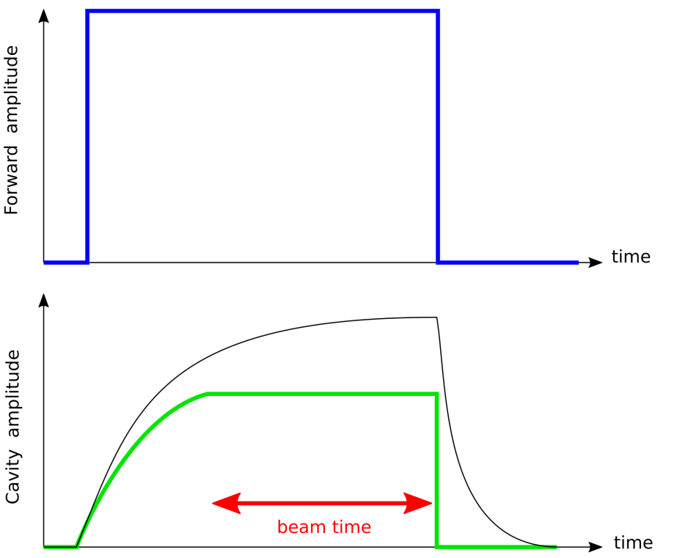
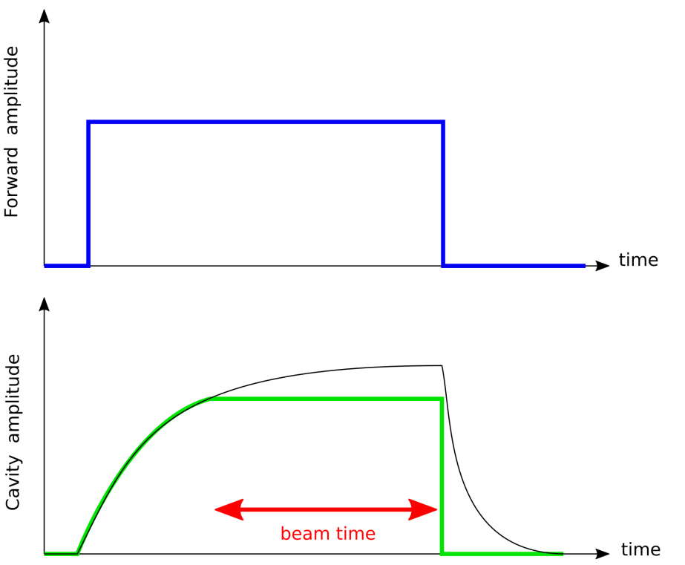


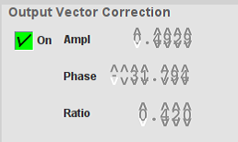
LLRF System
Feed Forward
Adjust amplitude of the forward drive to match the set point gradient at the beginning of the beam time
Forward drive
Cavity set point
Cavity voltage
OVC amplitude!

Slide 15
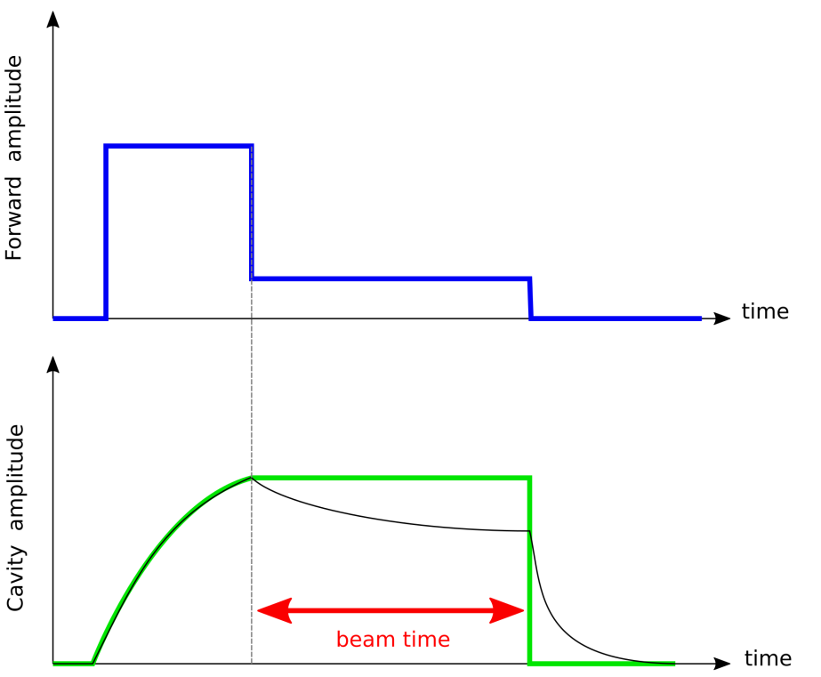
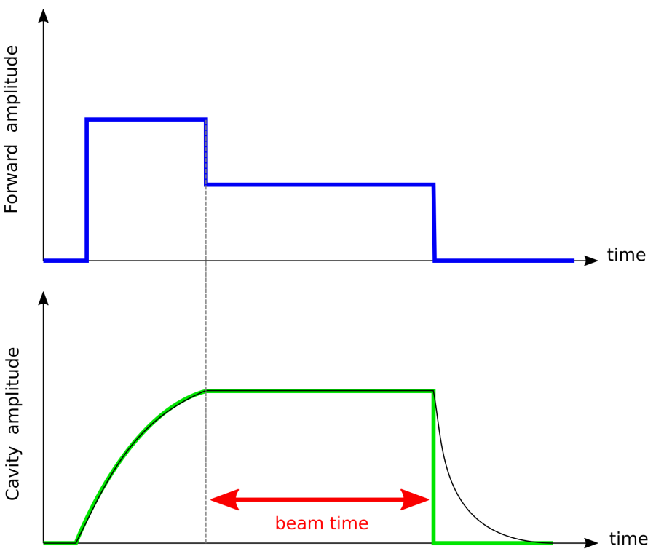
LLRF System
Feed Forward
Adjust the drive during the beam time to maintain a flat accelerating gradient
Forward drive
Cavity set point
Cavity voltage
OVC ratio!

Slide 16
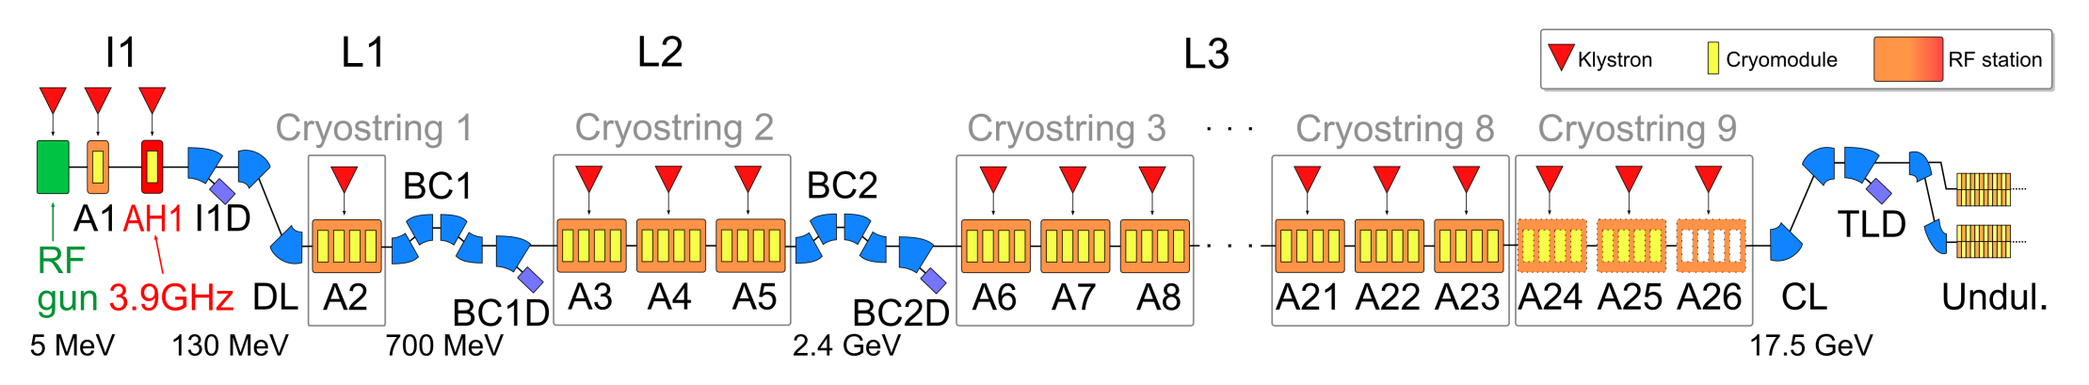
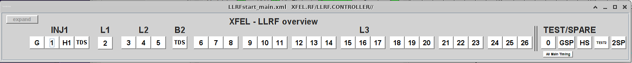
Introduction
LLRF Systems
Where are we involved?
In every RF station
29 LLRF systems
TDS-INJ
TDS-BC2
reserved for tests

Slide 17
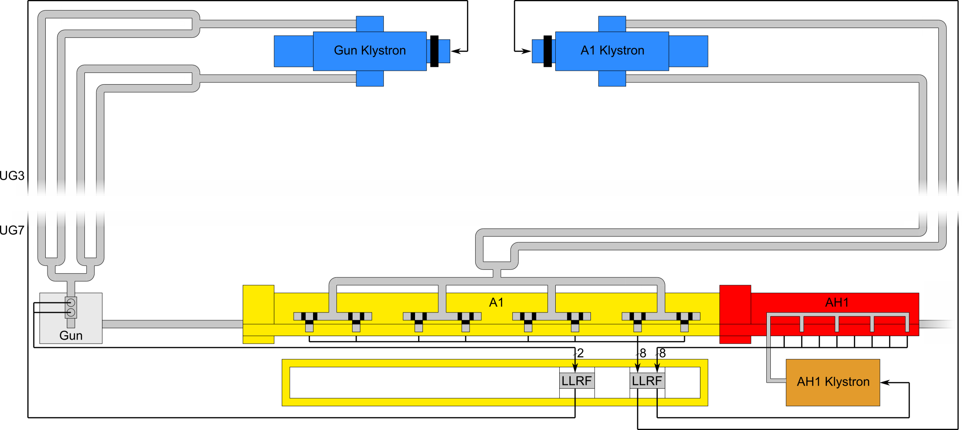
Introduction
LLRF Systems
RF Stations in the injector
A1 and AH1 share the same LLRF crate

Slide 18
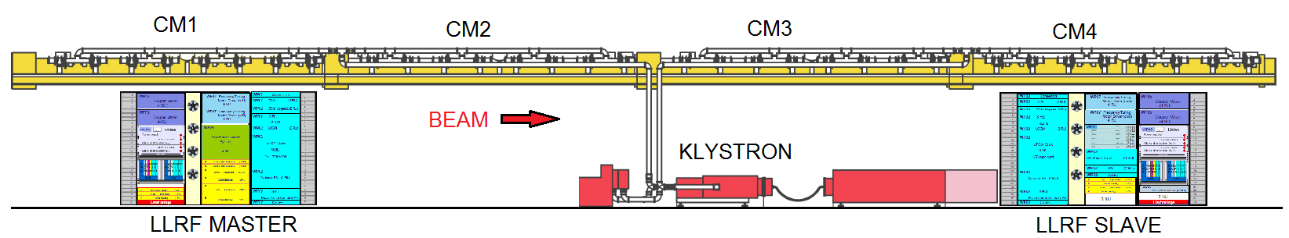
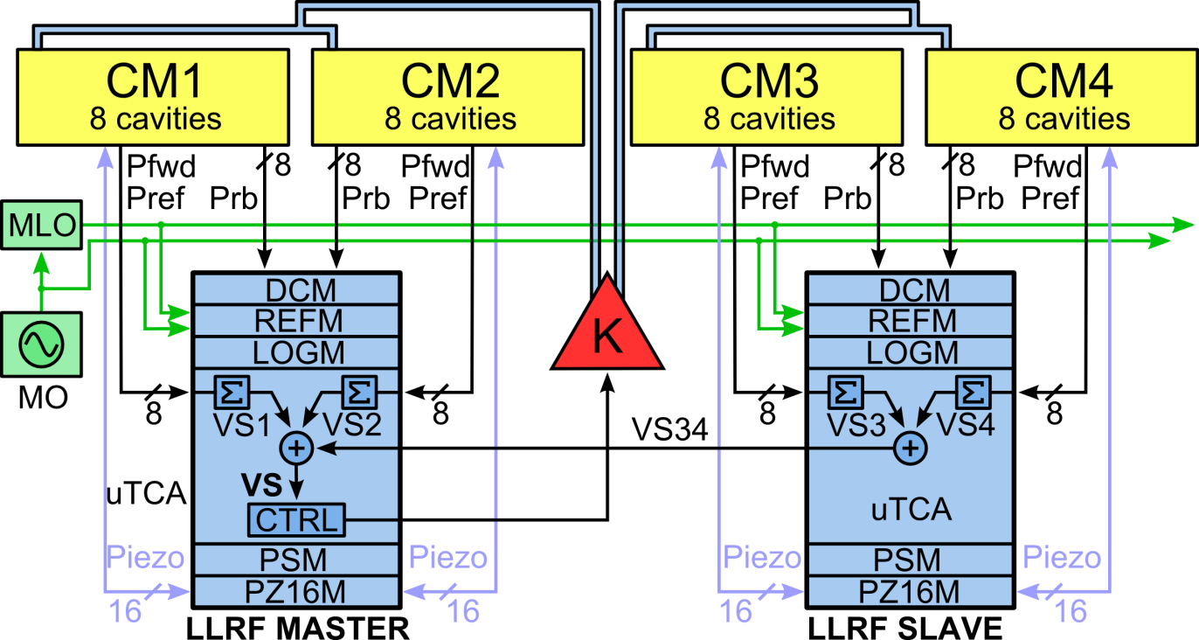
Introduction : LLRF Station Overview
XTL RF station: semi-distributed LLRF system
DCM
Drift Compensation Module
REFM
RF Reference Module
LOGM
Local Oscillator Generation Module
PSM
Power Supply Module
PZ16M
Piezo Driver Module

Slide 19
2. What an operator should know
LLRF tasks of the XFEL operator:
Turn an RF station ON / OFF
Adjust the vector-sum voltage / phase
Tune cavities, if necessary
Adjust output vector correction and ratio, if necessary
Set a certain phase as on-crest phase

Slide 20
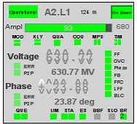
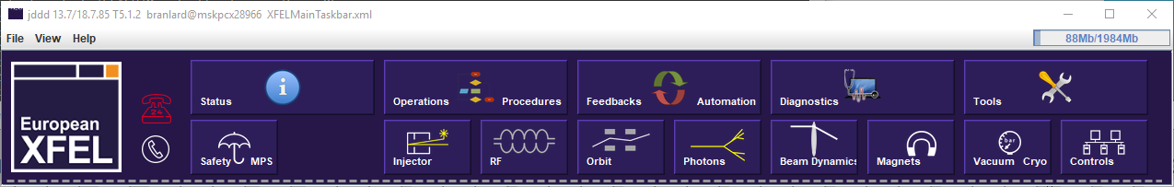
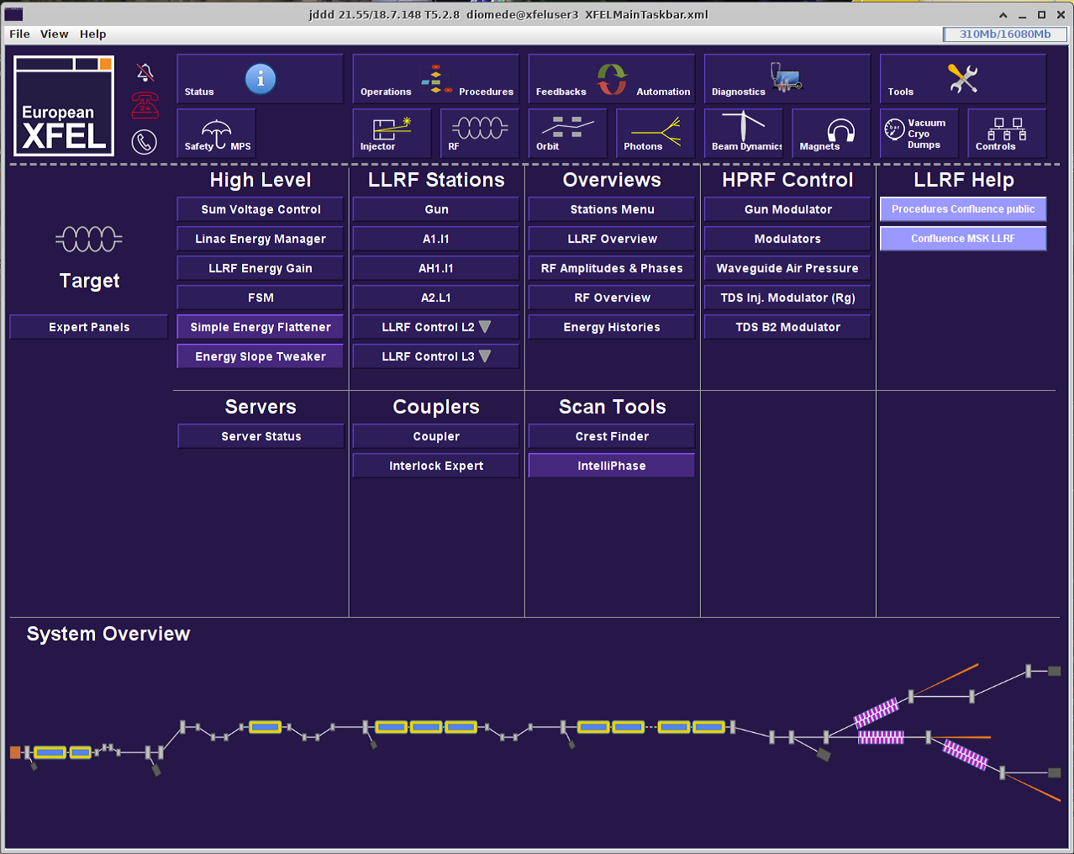
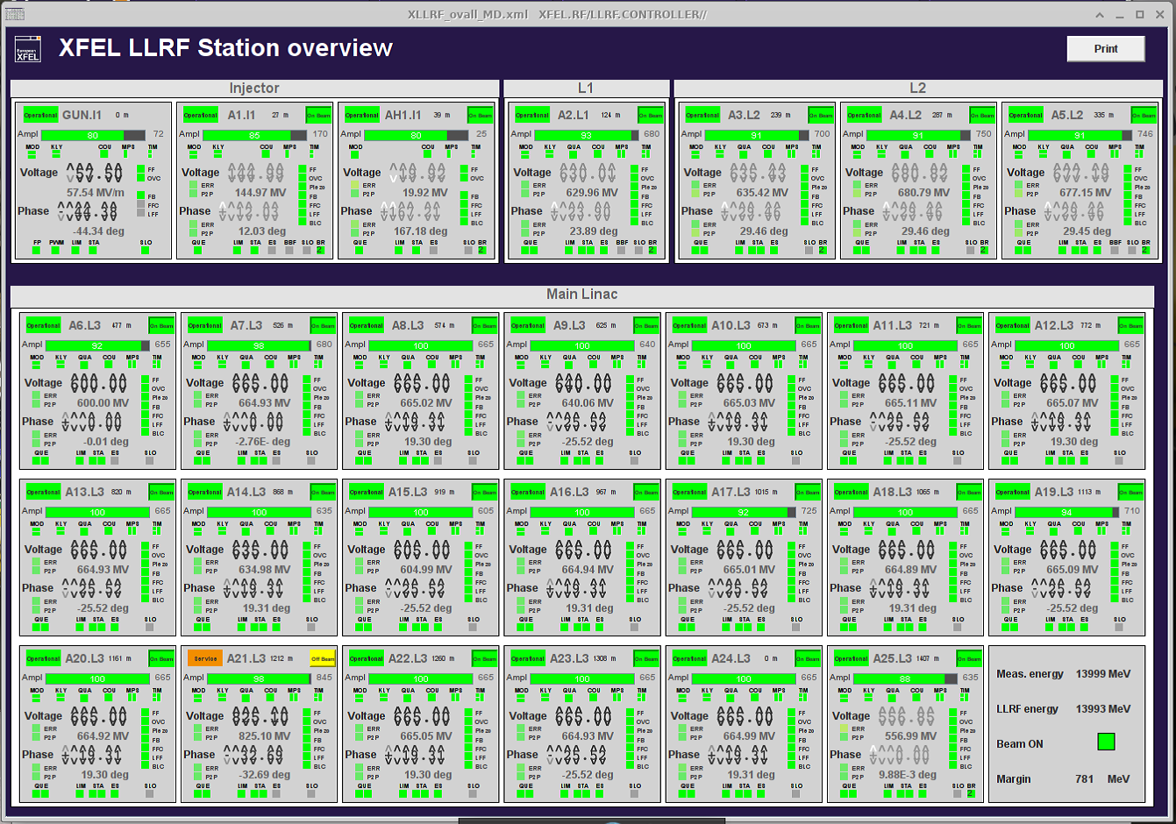
What an operator should know
LLRF overview
Check amplitude and phase set point, RF control settings and flat tops

Slide 21
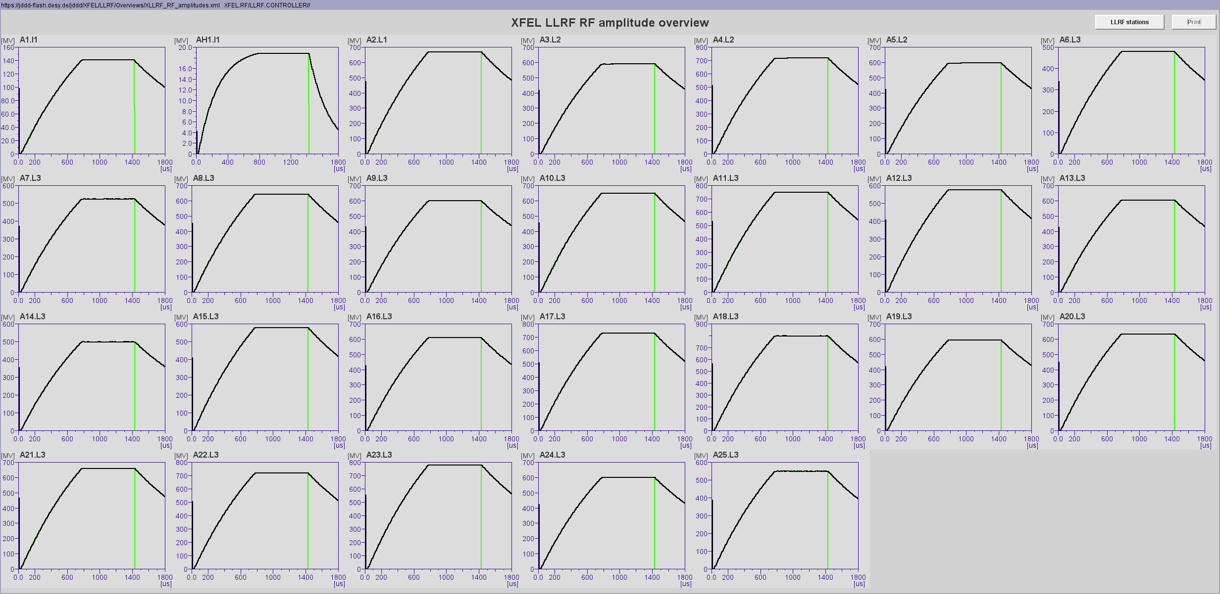
What an operator should know
RF Amplitudes
Check waveform profiles (open loop, glitches, etc…
i.e. deviation from set point)

Slide 22
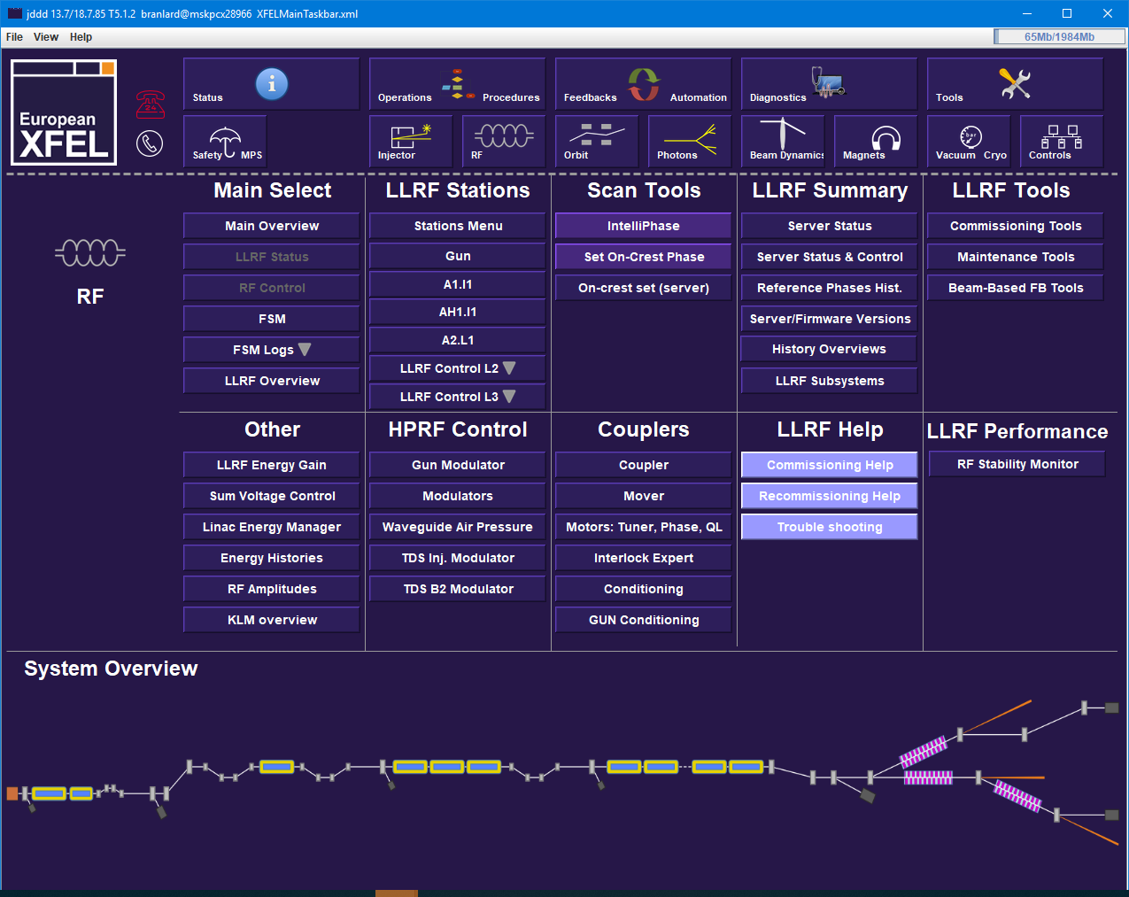
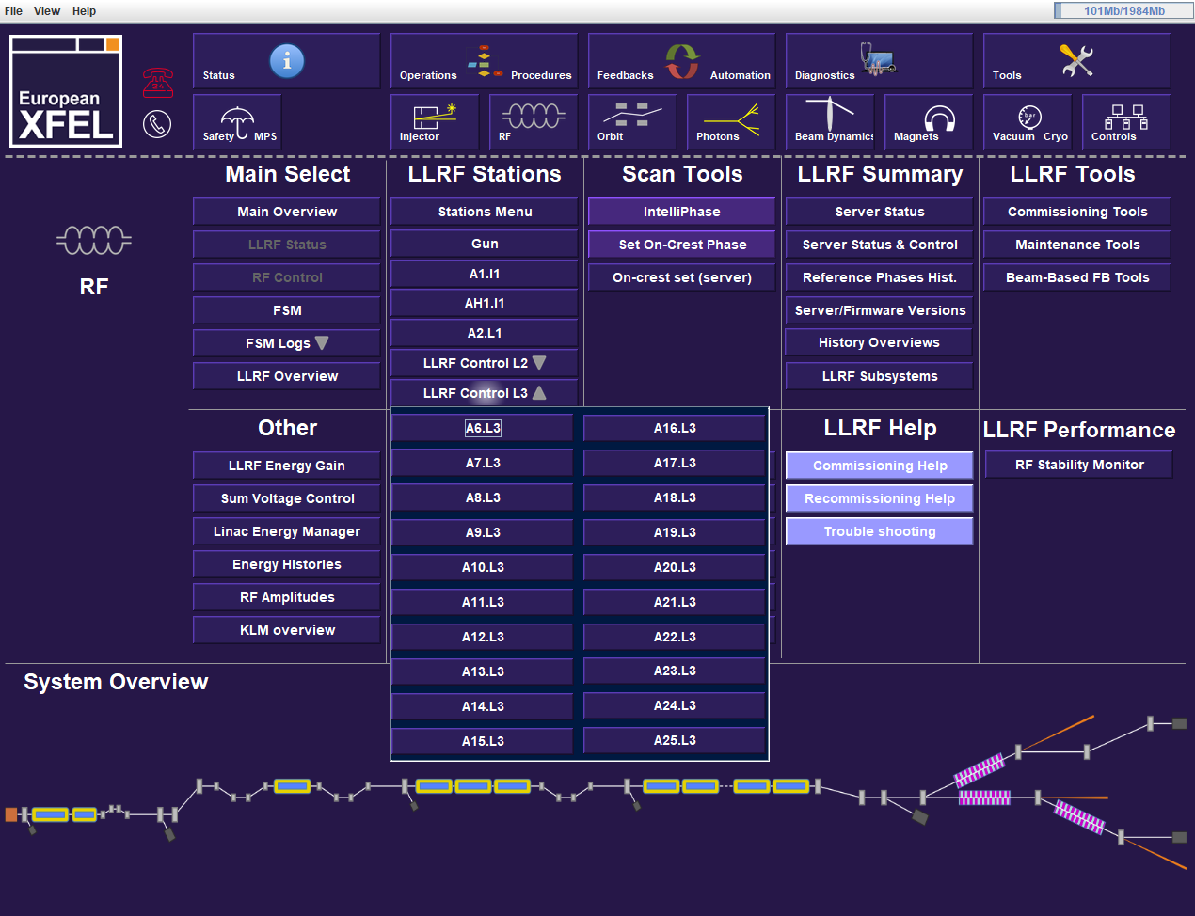
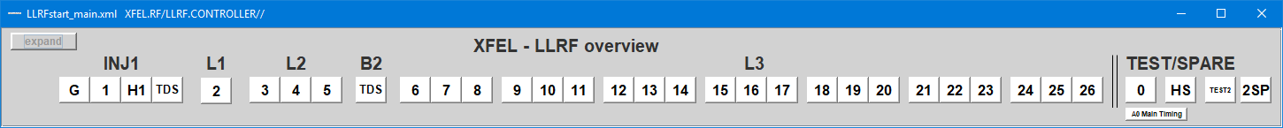
What an operator should know
LLRF selector
Navigate to the main LLRF panel of a particular RF station: INJ, L1, L2, L3

Slide 23
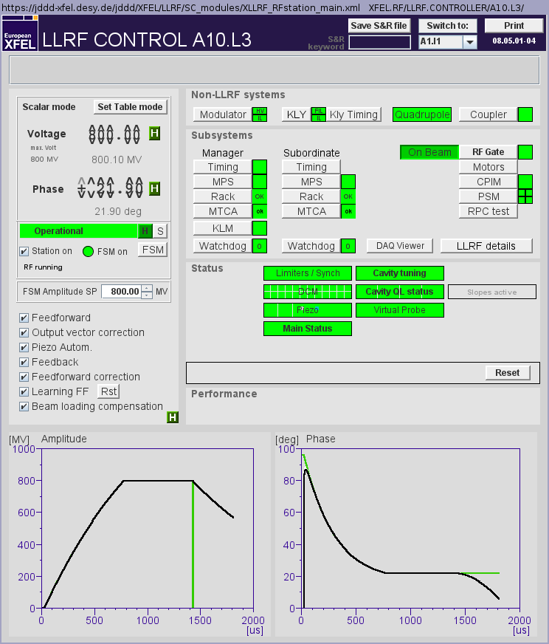
What an operator should know
Scalar/Table mode
Voltage setpoint
Phase setpoint
Non-LLRF systems!
Ramp station with FSM
Check for ON,
FSM should be green
FSM recovery voltage
Quench notifications
Cavity tuning indicator
(should be green)
Ramp-down
(open loop)
Drift compensation module (DCM)
Piezo
ALL these settings should be enabled*
* exception gun
Not green:
OK for operation but piezos are not working
Not green:
OK for operation but drifts are not compensated
Ramp-up
elog entry → LLRF
elog entry → LLRF

Slide 24
What an operator should know
Limiters
Not green:
Might lead to RF pulse cuts
elog entry → LLRF
Main status
Slopes active (yellow) : i.e. RF slope across the flat top
Not green:
Operation might still be possible
elog entry → LLRF
Error message area
(it self-clears after 5 minutes after the error is gone)

Slide 25
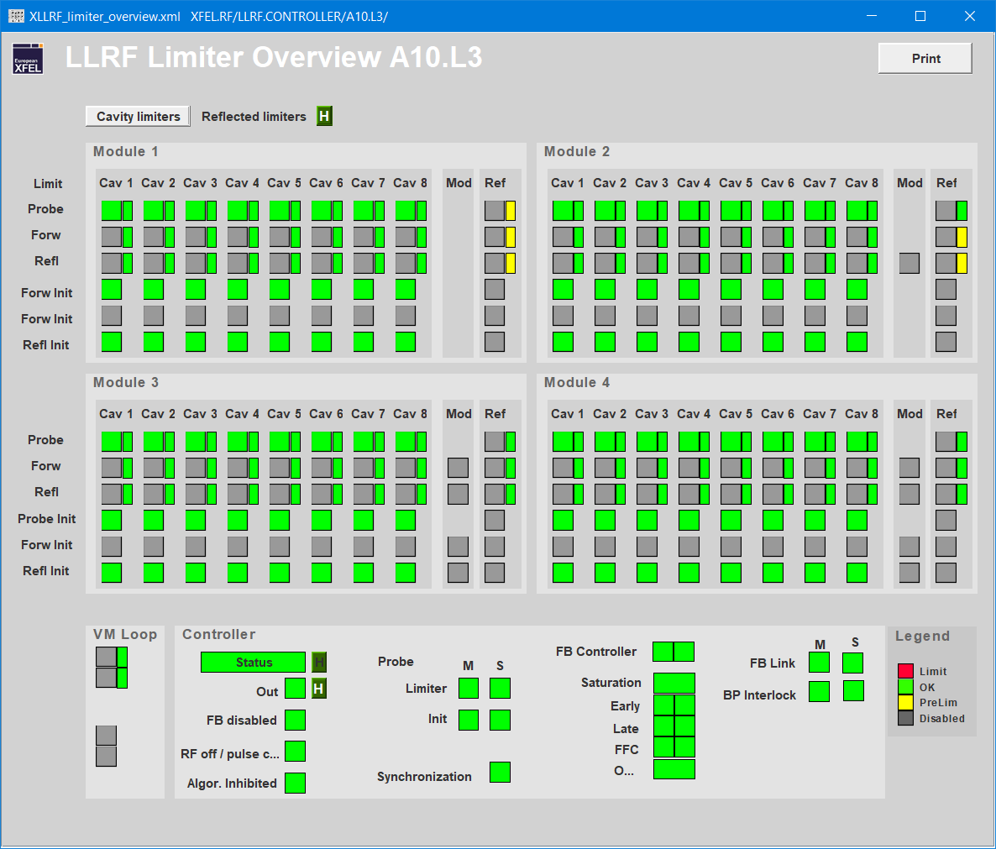
What an operator should know

Slide 26
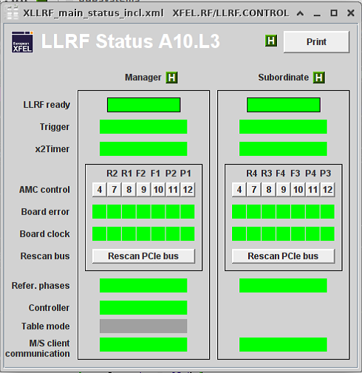
What an operator should know

Slide 27
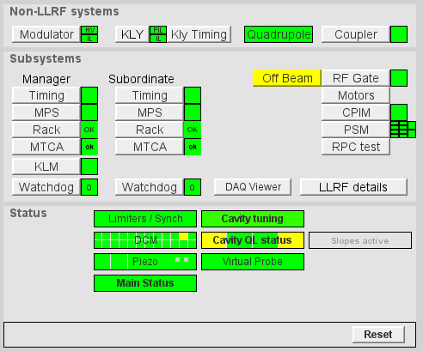
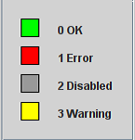
What an operator should know
LLRF color code
Color code
Operation probably not possible
Operation still possible!

Slide 28
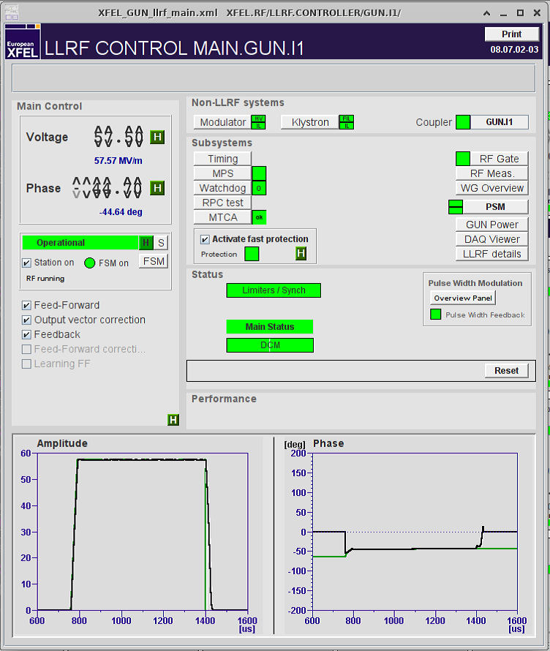
What an operator should know
Special case GUN
Note that for the gun, the following features are greyed out and should stay disabled:
Feed-forward correction
Learning FF

Slide 29
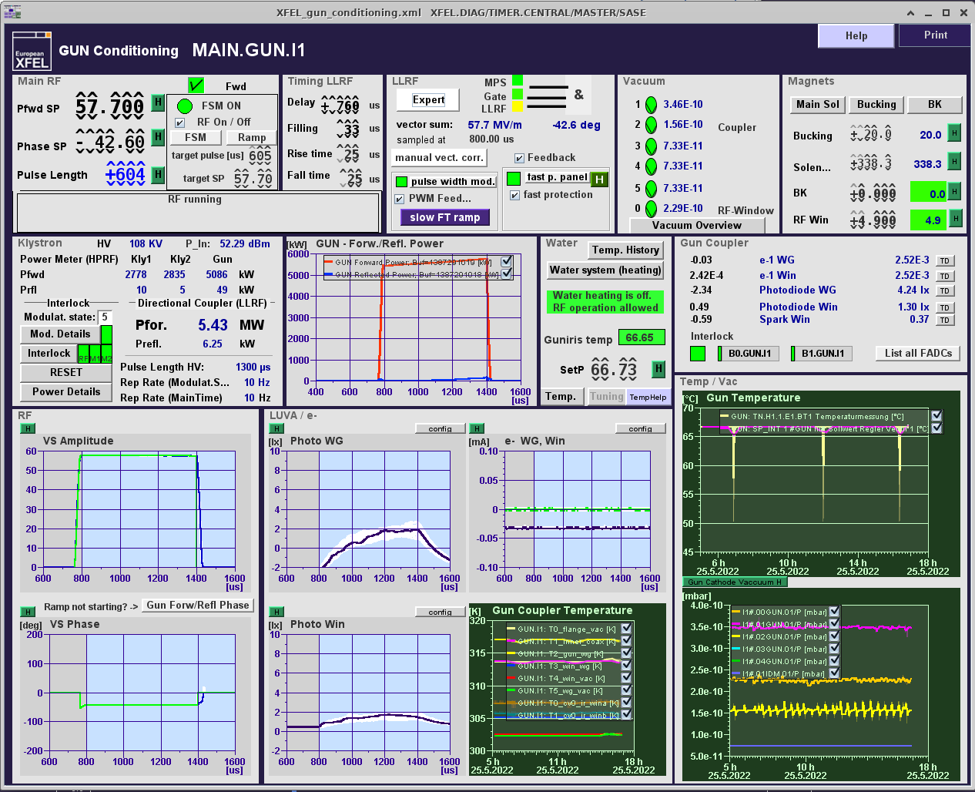
What an operator should know
Special case GUN
More familiar

Slide 30
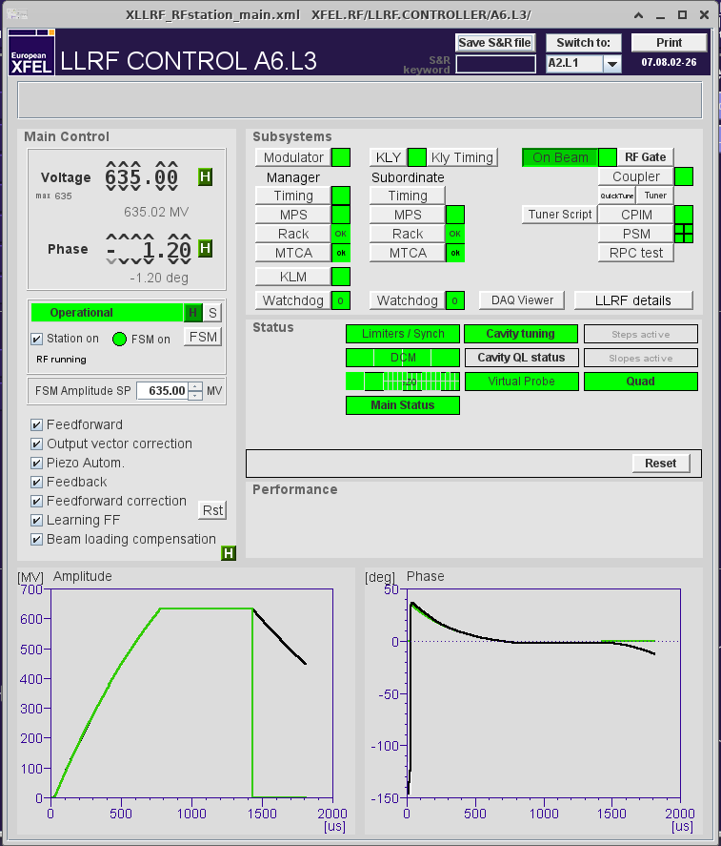
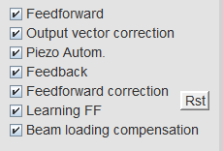
What an operator should know
Drive with FF only (i.e. open loop) no feedback trying to minimize error between signal and set point
Linear scaling of amplitude and phase drive to minimize error (automation)
Enables cavity tuning using piezos (including Lorentz force detuning)
Drive with FB (closed loop)
Applies small corrections to FF to compensate for systematic errors
Learns from pulse to pulse to adapt these small corrections
Re-initialize what has been learnt so far (i.e. start from empty correction)
Applies small correction to the drive to compensate for the presence of beam (i.e. scales with beam parameters)

Slide 31
What an operator should know
Changing RF amplitude set point
YES
Change is less than 100 MeV ?
NO
Do it in closed loop
Do it in open loop
Dial in new SP
Open the loop and adjust SP
NO
After adjustment limiters are triggering ?
YES
Adjust OVC amplitude and ratio
Note:
Changing SP phase does not require so much care, but should be also done progressively (i.e. steps of 10 deg.)
Revert to previous SP and try in open loop
Check tuning and adjust OVC phase
Close the loop
Done

Slide 32

What an operator should know
Changing RF amplitude set point in open loop (1/4)
LLRF system diagram
Only FF
Ampl. and Phase readouts lower than SP

Slide 33

What an operator should know
Changing RF amplitude set point in open loop (2/4)

Slide 34

What an operator should know
Changing RF amplitude set point in open loop (3/4)

Slide 35

What an operator should know
Changing RF amplitude set point in open loop (4/4)
To close the loop
✓
✓
✓
✓
✓
✓

Slide 36


What an operator should know
Procedures

Slide 37


What an operator should know
Tuning cavities (1/2)

Slide 38

What an operator should know
Click “Tune”
Tuning cavities (2/2)
Relax piezo DC voltage
Shows tuning [Hz] and piezo DC bias [V]
both should converge to 0
“relax piezo DC voltage” is enabled by default
Some cavities should NOT be tuned (greyed out)
Cavity detuning [Hz]
Some error message may pop up
You can choose to ignore once or twice but if problem persists, call expert
Piezo voltage (DC bias [V])

Slide 39



What an operator should know
FSM
Not directly LLRF but belongs to RF operation
Turn the station on/off
(When possible) RF trips involving LLRF, Modulator, Klystron and Coupler interlock & quench are automatically recovered by FSM (no action needed!)
The FSM log can tell what is/was the problem

Slide 40
What an operator should know
RF station color code
Station ON
Station OFF
Station TRIPPED
Note 1:
Sometimes, the station is operational but the color indicator on the main display shows yellow/red instead of green
➔ Simply disable / re-enable FSM to force a status refresh
Station ON FSM is ON
Station OFF
FSM is ON
Station DOWN
FSM is ON
FSM ON
FSM is OFF
FSM OFF
Note 2:
The Status “FSM ON and station in service” is still represented with a green circle but with a label on top (L3 panel)
➔ Unusable stations are now visible from the L3 panel, also the Energy Manager should give this information
Station OFF beam
Station ON beam

Slide 41


What an operator should know
Energy Manager – Energy control
You can set the total RF energy -> It regulates the off-crest phases in L3

Slide 42
What an operator should know
Energy Manager - automatic recovery from failure in L3
When enabled, if an RF trip is not recoverable within the defined timeout, the RF station is placed off-beam and the magnets scaled (possible to roll back if the station is recovered)

Slide 43

What an operator should know
Setting the on-crest phase
The phase at which the max energy is measured is defined as on crest phase and corresponds to the “new” 0 phase setting in the LLRF controller

Slide 44

What an operator should know
Setting the on-crest phase
For L3 this can also be done “parasitically” with the Energy Manager L3 Phase Scan (slow) -> fine tuning

Slide 45
What an operator should know
Vector Sum Set Point configurations
2 RF energy configurations are actually foreseen:
Reduced-Energy (beam energies up to 14.0 GeV) -> VS SP 665 MV almost everywhere
High-Energy (beam energy of 16.3 GeV) -> Max achievable voltage
The purpose of the Reduced-Energy mode is to
reduce power consumption (lower modulator HV)
lower the radiation level in the tunnel (e.g. less MTCA issues)
The Maximum SPs are embedded in the LLRF server and they are updated at every change of configuration according to these tables: https://xwiki.desy.de/xwiki/short/b083a

Slide 46


What an operator should know
How to deal with failing RF stations
How to deal with failing RF stations: https://xwiki.desy.de/xwiki/short/a43a1
(also LLRF mailing-list)
Quadrupole &
(in BKR)
Have a generic RF mailing-list?
(also 1.3 GHz mailing-list)
HPRF problems at AH1 → MIN expert on call
Recognize the root cause
If you are not sure, please inform all the possible groups (not only LLRF!)

Slide 47











What an operator should know
LLRF on-call service
LLRF on-call 5588
9 experts, 1 available 24/7 every week
llrf-expert@desy.de
Send log book entry to LLRF expert list
Write your name / initials
Edit the title and description
Use the Tag fields (at least Location)
Christian
Julien
Marco
Mariusz
Martin
Matthias
Max
Patrick
Valeri

Slide 48
3. Exceptional cases and how to react
Probe limiter – pulse cut
KLM limiter – pulse cut
Output/feedback limiter
Cavity quenches
Zombie station
Lost PCIe connection

Slide 49


Exceptional cases and how to react
Pulse cuts due to gradient limiters
Note:
Pulse cuts are displayed on the main panel (limiter / KLM)
The beam is cut if the RF pulse is cut
What to do:
Document in log book and send to LLRF
Open/close loop
Lower the gradient if possible
Limiter indicator is red
4. If you want, you can check what is the limiting factor
(see next 2 slides)
RF pulse is shorter

Slide 50


Exceptional cases and how to react
Pulse cuts due to gradient limiters
RF pulse is shorter
Check if a specific cavity is the reason for the cut

Slide 51

Exceptional cases and how to react
Pulse cuts due to KLM limiters
8
If all cavity limiters are green, the cut probably comes from the Klystron Lifetime Management (KLM) system.
In any case,
Document in log book and send to LLRF
Lower the gradient if possible
RF pulse is shorter

Slide 52


Exceptional cases and how to react
Limiter is red (but no cut)
What to do:
Document in log book and send to LLRF
Try open/close loop
Lower the gradient if possible
If this output limiter is red:
1. SP is too high
or
2. LLRF drive parameters need to be rechecked

Slide 53



Exceptional cases and how to react
Cavity quench (1/2)
Note:
Place the quench panel instead of the main panel in the log book (more information)
What to do:
Document in log book and send to LLRF
Lower the Voltage SP if needed

Slide 54


Exceptional cases and how to react
Cavity quench (2/2)
Repetitive quenches
Problem description:
The FSM tries to recover a station after a quench, ramps up to the same gradient and quenches again
After 3 tries, the FSM gives up
What you can try
Lower the recovery gradient in the FSM window (-10 MV ?)
Quench during ramp up
Problem description
(After a quench) the RF station trips due to quenches taking place at a much lower gradient
Chances are the Q_{L} computation got corrupted during the quench, hence corrupting the quench detection mechanism
What you can try
Disable the FSM, ramp up the station slowly (i.e. 10 MV steps) by hand, and re-enable the FSM

Slide 55


Exceptional case and how to react
“Zombie” station
The llrfCtrl server is not responsive
Chances are the hardware is still working
BUT
Likely the quench detection is no longer working
What to do:
Document in log book and send to LLRF
Agree with LLRF on-call and run coordinator when best to recover the station
MANAGER (and / or) SUBORDINATE “zombied”
SUBORDINATE “zombied”

Slide 56


Exceptional case and how to react
PCIe connection is lost
PCIe connection with the board is lost
If it involves boards 4, 11 and 12, the station cannot operate
BUT
In the other cases, the station might work till fix
What to do:
Document in log book and send to LLRF
Agree with LLRF on-call and run coordinators when best to recover the station
Main Status panel

Slide 57

Summary
LLRF tasks of the XFEL operator:
Turn an RF station ON / OFF
Adjust the vector-sum voltage / phase
Tune cavities, if necessary
Adjust output vector correction and ratio, if necessary
Set a certain phase as on-crest phase
Special cases
Pulse cut
Limiter notification
Quench
Zombie stations
Opportunity for hands-on:
LLRF maintenance ~every Tuesday
off-beam stations -> ask LLRF team (& RCs)
Document (elog) what you find not normal
Please include your name, title and description!
Thanks to Julien for the material

Slide 58

Thank you
99.9% LLRF availability
Marco Diomede
MSK
marco.diomede@desy.de
1615

Slide 59
Backup slides

Slide 60




Introduction
LLRF and RF operations
RF power coupler
Low Level Radio Frequency: Low Level means low power (i.e. < 1Watt)
Our task: digital control of accelerating fields inside the cavities
Normal conducting gun 1.3 GHz
Super conducting cavities 1.3 GHz and 3.9 GHz (AH1)
Other tasks often labelled as LLRF
Frequency control (cavity tuning)
Bandwidth adjustments (Q_{L})
Quench detection
Trip recovery
LLRF
Modulator + Klystron

Slide 61

Introduction : LLRF Station Overview

Slide 62

What an operator should know
Check for server failures (all should be green!)
Good way to catch a “zombie” station
A17 shifted OFF beam

Slide 63


What an operator should know
Error messages
Error message area:
Currently only used for multi-flat top settings but might be extended in the future
The error message latches. First try to reset, if persists, call LLRF expert
Sum of server errors should be 0 (green)
If not, elog entry to LLRF

