Slide 1
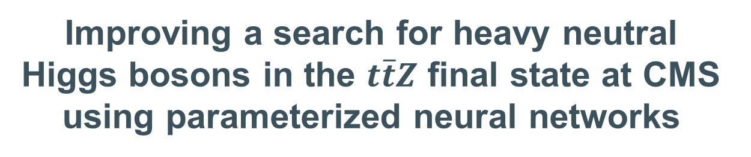
Improving a search for heavy neutral Higgs bosons in the $t\overline{t}Z$ final state at CMS using parameterized neural networks
DPG Frühjahrstagung 2025, Göttingen
Bianca Weidner, Matteo Bonanomi, Lukas Ebeling, Yannick Fischer, Johannes Haller, Daniel Hundhausen, Matthias Schröder

Slide 2
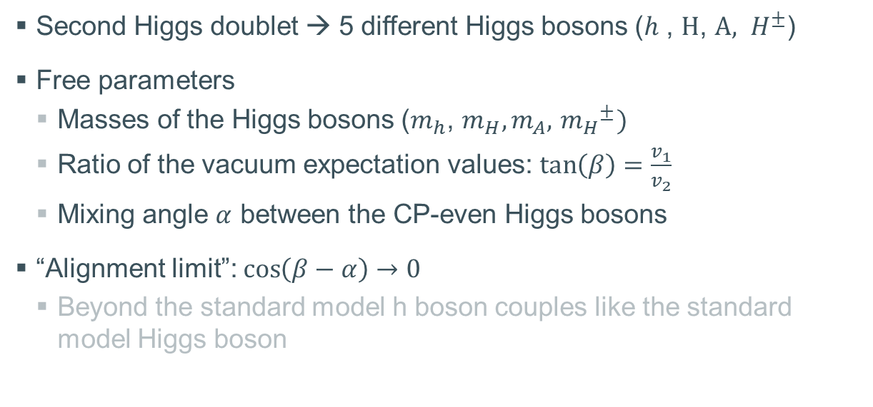


Two Higgs Doublet Models (2HDM)
Second Higgs doublet → 5 different Higgs bosons ($h$ , $H$, $A, H^{±}$)
Free parameters
  Masses of the Higgs bosons ($m_{h}$, $m_{H},m_{A},{ m_{H}}^{±})$
  Ratio of the vacuum expectation values: $\tan\left(β\right)=\frac{v_{1}}{v_{2}}$
  Mixing angle $α$ between the CP-even Higgs bosons
“Alignment limit”: $\cos\left(β−α\right)→0$
  Beyond the standard model h boson couples like the standard model Higgs boson
h
H
Neutral CP-even
A
Neutral CP-odd
$$H^{+}$$
$$H^{−}$$
Charged
arXiv: 1106.0034, 2004.04172

Slide 3
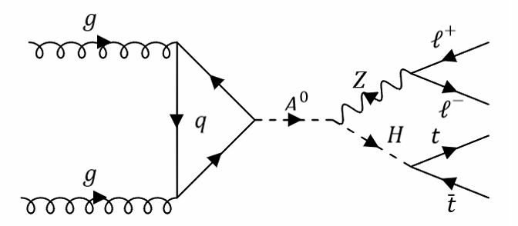

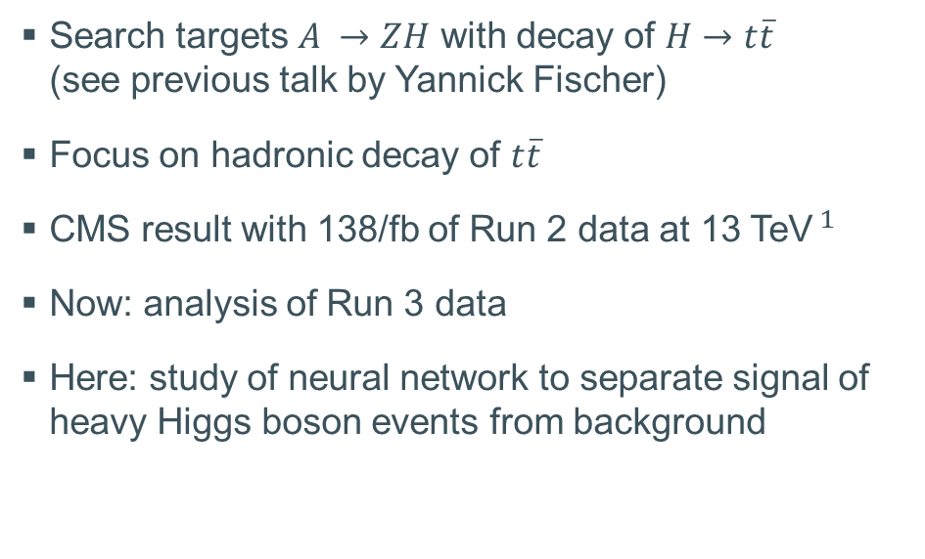

Overview
Search targets $A →ZH$ with decay of $H→t\overline{t}$ (see previous talk by Yannick Fischer)
Focus on hadronic decay of $t\overline{t}$
CMS result with 138/fb of Run 2 data at 13 TeV$^{1}$
Now: analysis of Run 3 data
Here: study of neural network to separate signal of heavy Higgs boson events from background
Limit plot Yannick
$^{1}$ [arXiv: 2412.00570 (subm. to PLB)]

Slide 4
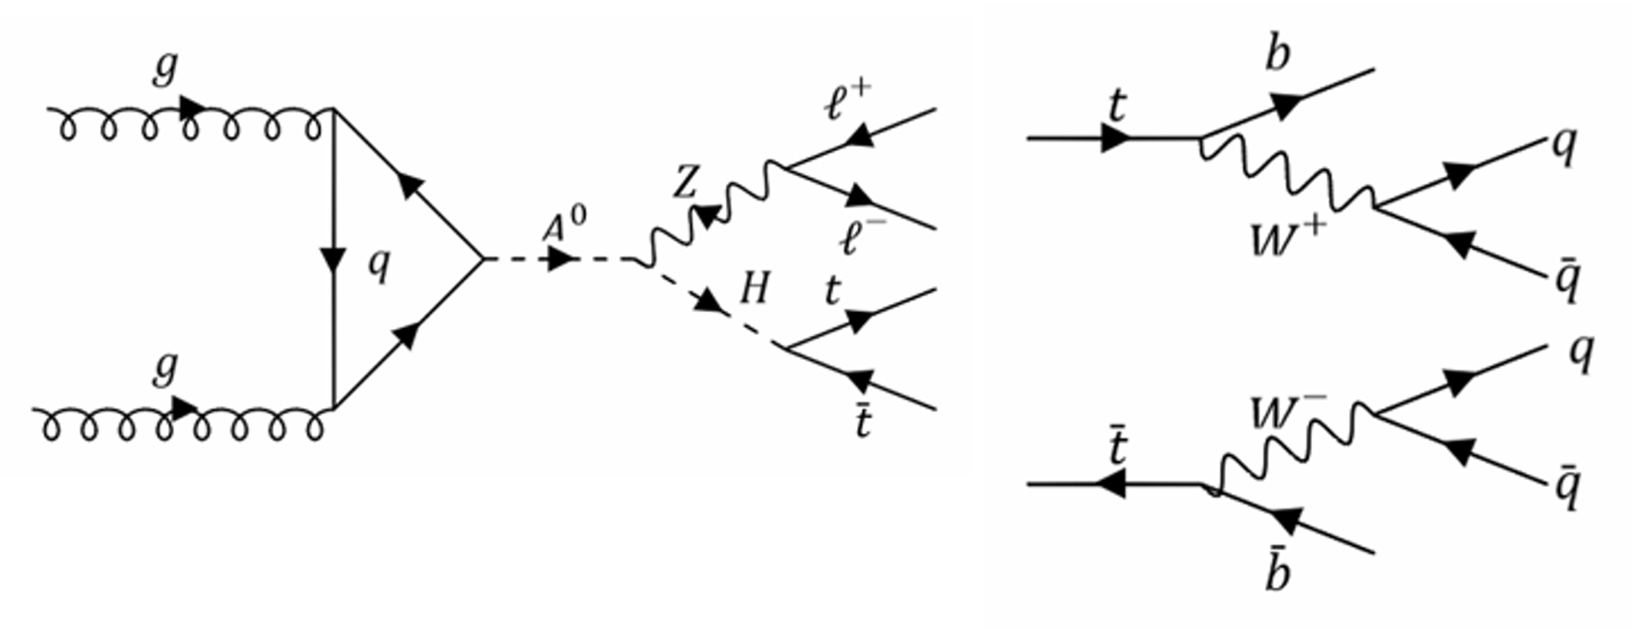
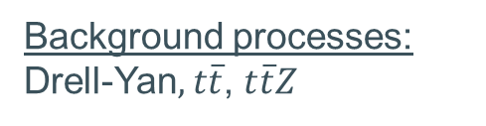

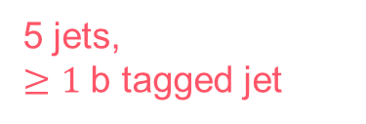
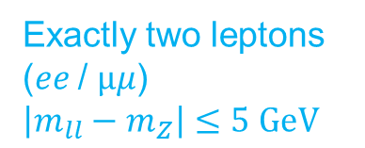


Setup for the analysis
Monte Carlo simulated events
(Run 2 – 2017)
$$\frac{Γ_{A/H}}{m_{A/H}}=0.03$$
Mass range:
$$330 GeV ≤m_{H}≤850 GeV$$
$$430 GeV ≤m_{A}≤950 GeV$$
Exactly two leptons ($ee$/ $μμ$)
$$\left|m_{ll}−m_{Z}\right|≤5 GeV$$
$$△m≥100 GeV$$
Background processes:
Drell-Yan$, t\overline{t}$,$t\overline{t}Z$
5 jets,
$≥1$ b tagged jet

Slide 5

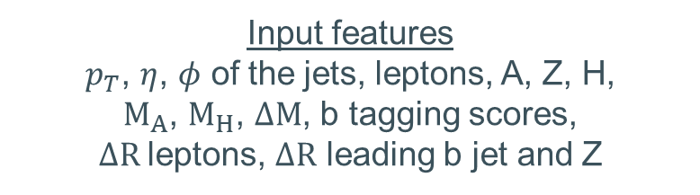

Characteristics of the neural networks (NN)
Network structure
$→$5 hidden dense layers
$→$Leaky ReLU, Sigmoid
activation function
$→$Vs weight initializer
Tuned hyperparameters
(Keras Hyperband Optimizer)
$→$Number of nodes in the layers
$→$Dropout rate
$→$Learning rate
Input features
$p_{T}$, $η$, $φ$ of the jets, leptons, A, Z, H,
$M_{A}$, $M_{H}$, $ΔM$, b tagging scores,
$ΔR$leptons, $ΔR$ leading b jet and Z

Slide 6
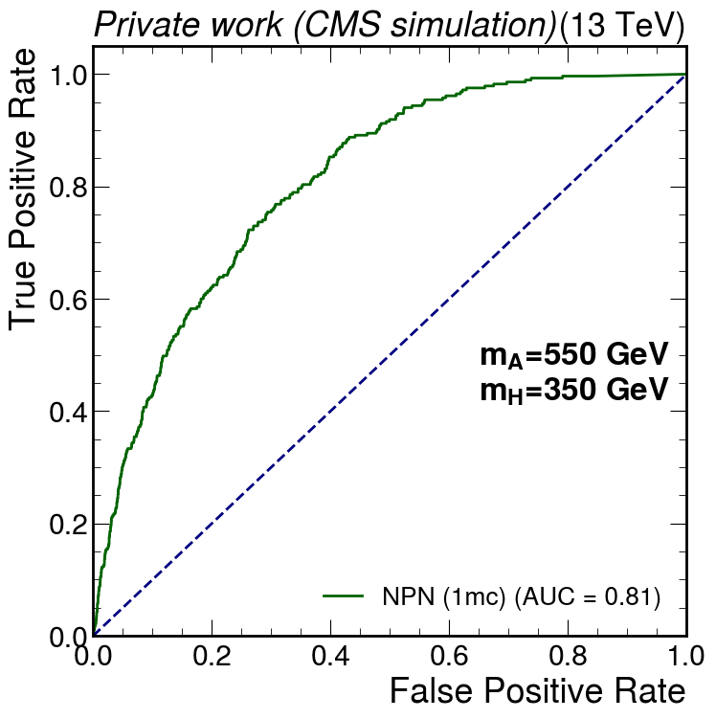
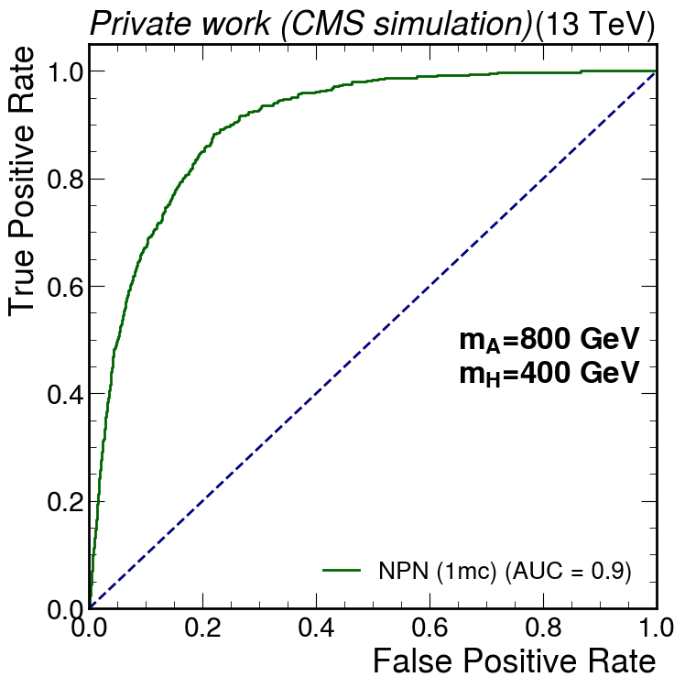

Training of individual NN
Input features$: p_{T}$, $φ$, $η, M_{A}$, $M_{H}….$
Background
Background
(550,350)
(800, 400)
(in total 79 different mass combinations considered)
Training
Training
Evaluation
Evaluation

Slide 7

ROC dedicated NN per mass combination
NN (1 mc): trained with 1 mass combination
Better performance
Performance is good, but it is impractical
For each mass combination a separate network is necessary
mc: number of mass combinations included in the training
Mass combination used for evaluation of the network
AUC: area under the ROC curve

Slide 8
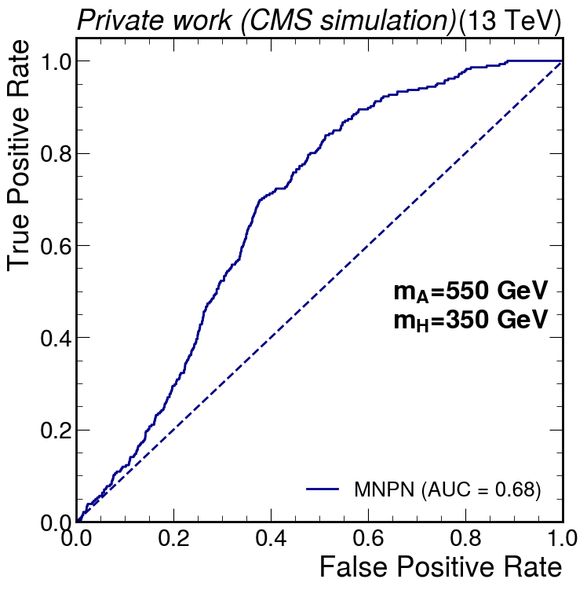
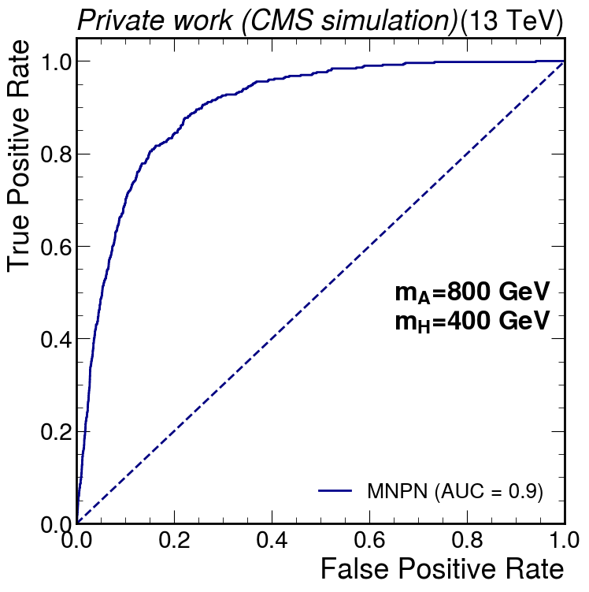
Training of individual NN
Input features$: p_{T}$, $φ$, $η, M_{A}$, $M_{H}….$
Background
Background
(800,400)
Background
(550,350)
(800, 400)
(550,350)
(in total 79 different mass combinations considered)
Training one network
Training
Training
Is there a better solution?
Evaluation: For each mass combination individually
Evaluation
Evaluation
(500,350)
(800,400)

Slide 9
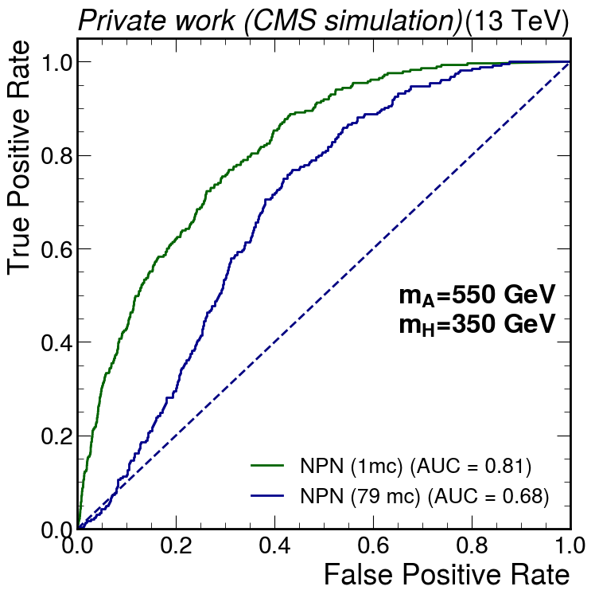
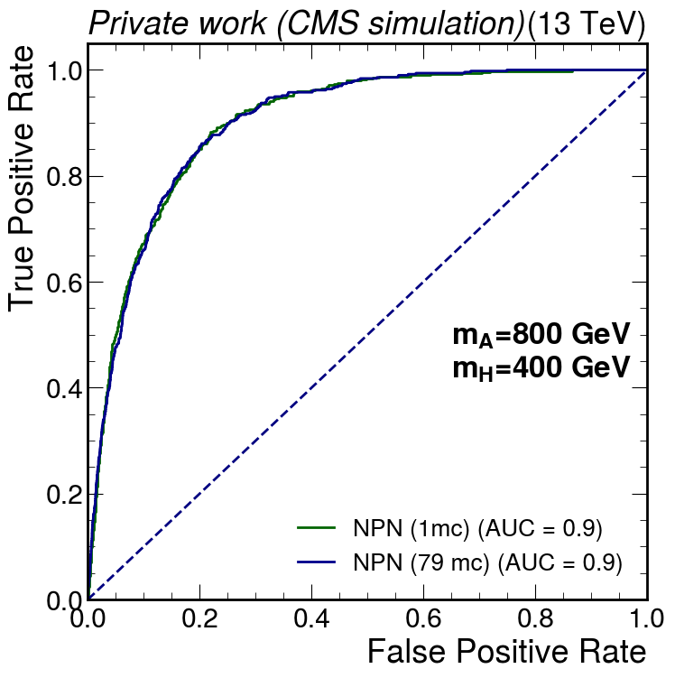
NN trained with all masses
NN (1 mc): trained with 1 mass combination
NN (79 mc): trained with 79 different mass combinations
The inclusion of all signal events into a NN leads to a decrease in performance for some mass combinations

Slide 10
Training of individual NN
Input features$: p_{T}$, $φ$, $η, M_{A}$, $M_{H}….$
Background
Background
(800,400)
Background
(550,350)
(800, 400)
(550,350)
(in total 79 different mass combinations considered)
Training one network
Training
Training
Lower performance than before
inadequate solution!
Is there a better solution?
Evaluation: For each mass combination individually
Evaluation
Evaluation
(500,350)
(800,400)

Slide 11
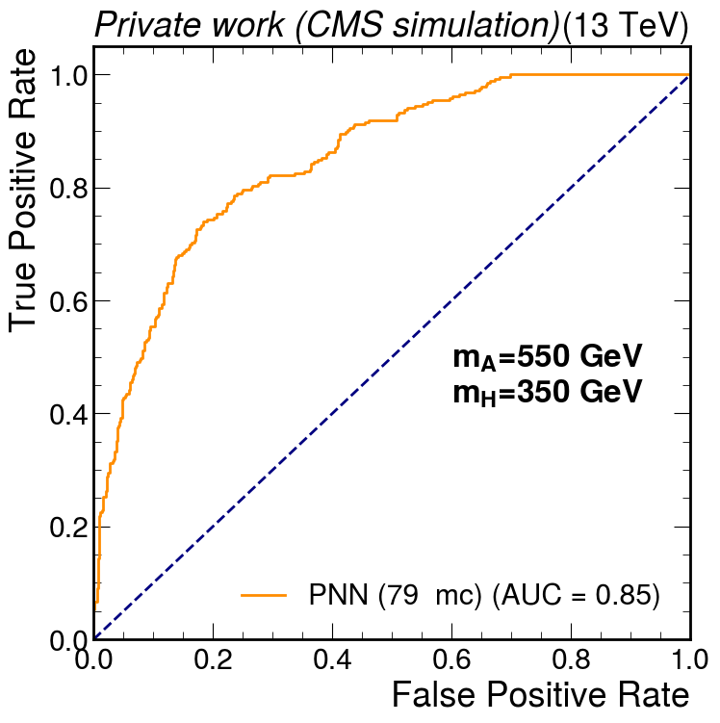
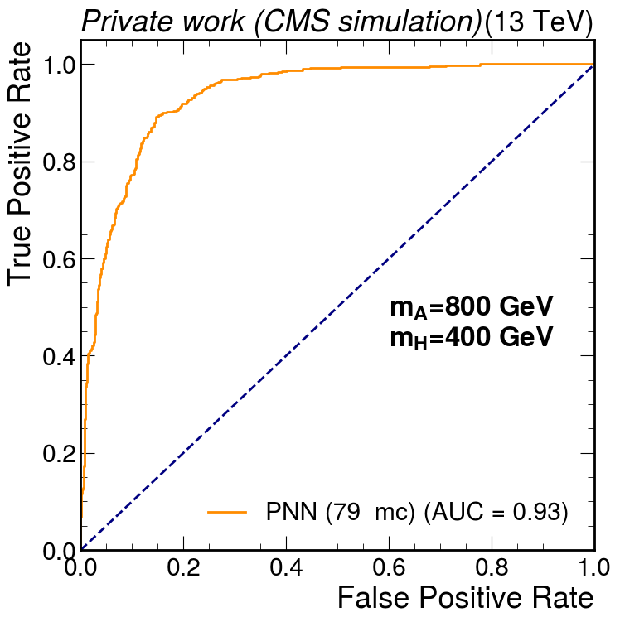
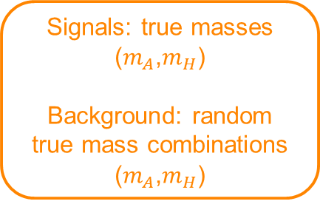
Parameterized neural network (PNN)
Input features$: p_{T}$, $φ$, $η, M_{A}$, $M_{H}….$
(800,400)
Background
(800,400)
Background
(550,350)
(550,350)
Parameterized neural network
Training one network
Training one network with parametrization
Lower performance than before
inadequate solution!
Evaluation: For each mass combination individually
Signals: true masses ($m_{A}$,$m_{H}$)
Background: random true mass combinations ($m_{A}$,$m_{H}$)
Evaluation: For each mass combination individually
(500,350)
(800,400)
(500,350)
(800,400)

Slide 12
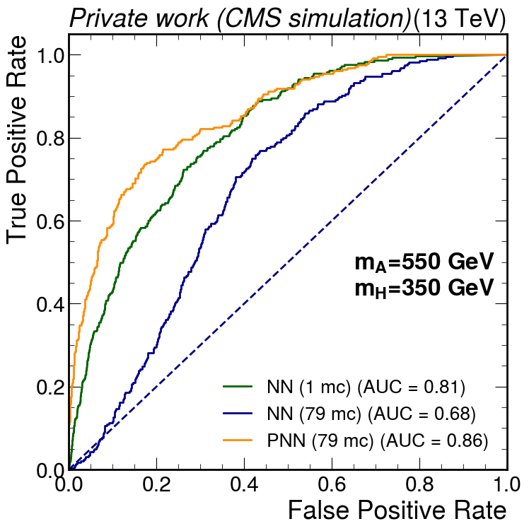
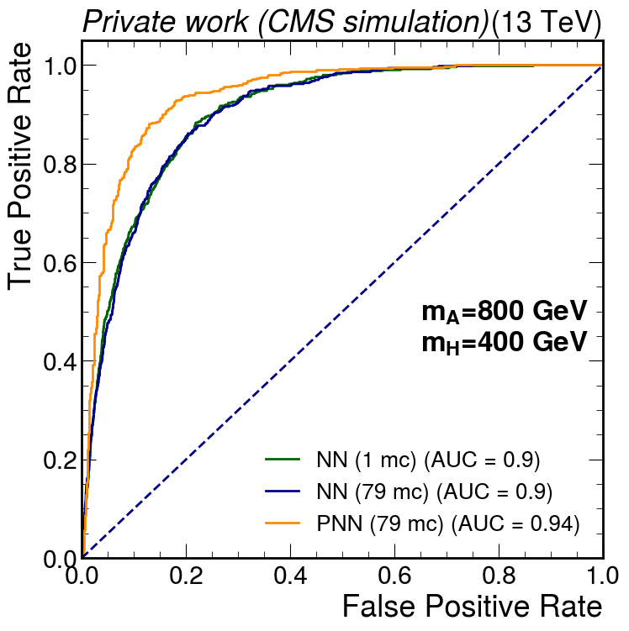
Comparison of ROC for NN and PNN
NN (1 mc): trained with 1 mass combination
NN (79 mc): trained with 79 different mass combinations
PNN (79 mc): trained with 79 different mass combinations
The inclusion of all signal events with parameterization leads to an increase in performance

Slide 13
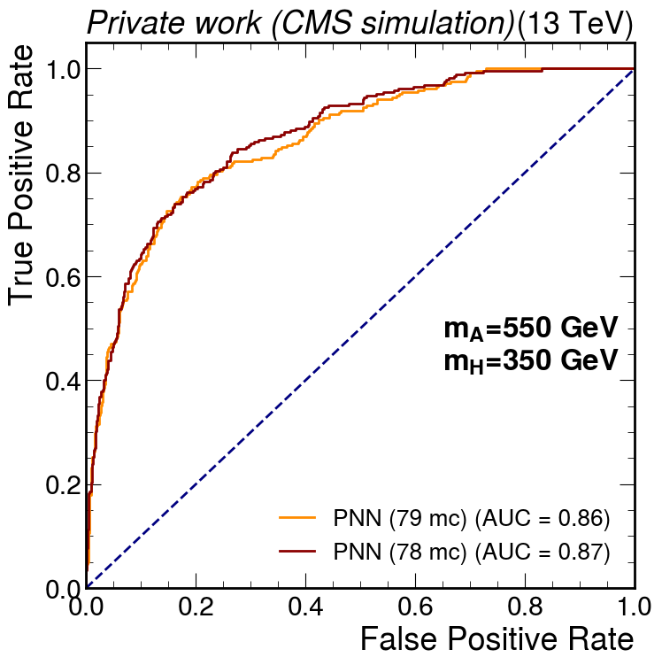
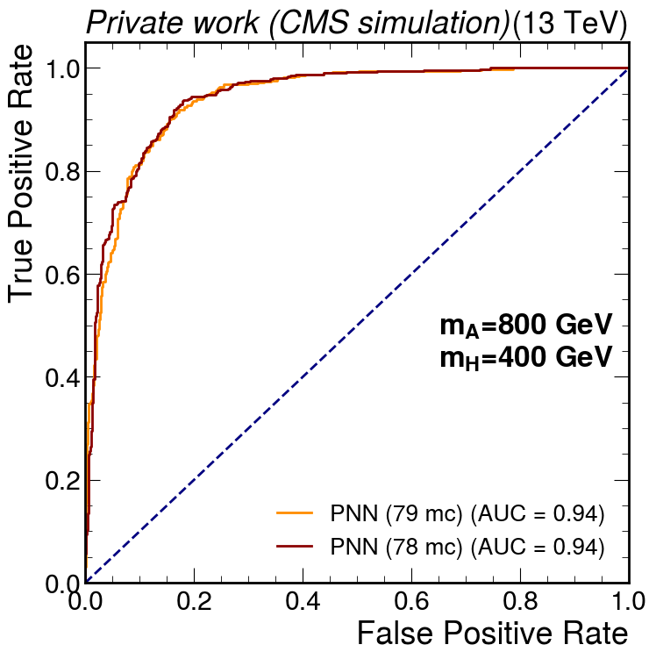
Extrapolation for unseen mass combinations
PNN (79 mc): trained with 79 different mass combinations
PNN (78 mc): trained with 78 different mass combinations;
the mass combination used for evaluation is not included in the training
PNN can generalize and extrapolate for mass combinations not included in the training

Slide 14

Advantages of PNNs
One network can be used to evaluate all mass combinations
Better performance than NN
Evaluation of mass combinations not included in the training is possible; performance is better than NN (for considered examples)

Slide 15
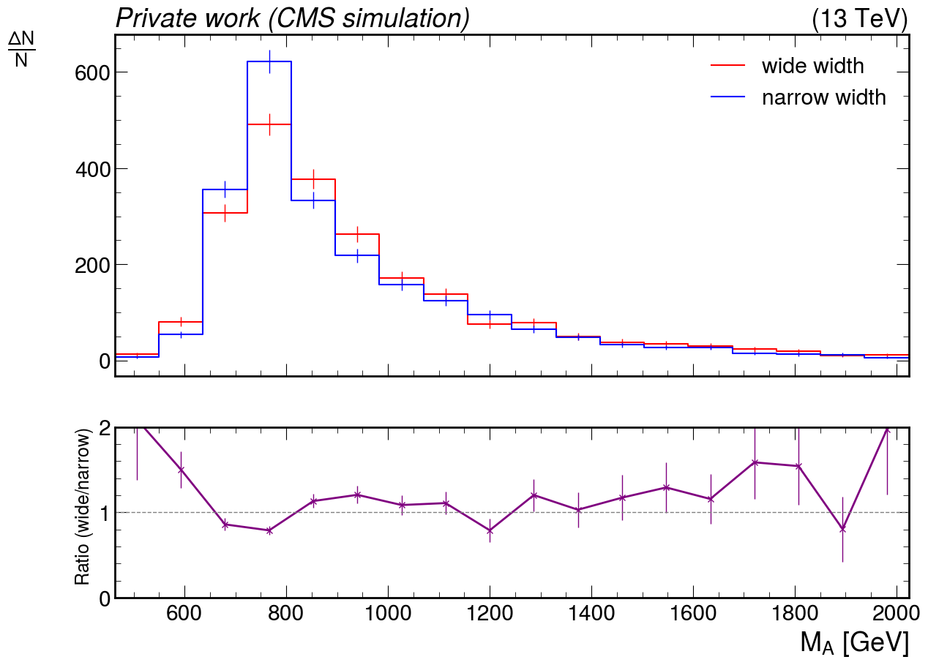


Impact of changes of the decay width
Narrow width:
Events
$$\frac{Γ_{A/H}}{m_{A/H}}=0.03$$
Wide width:
As predicted in 2HDM e.g. $m_{A}=800 GeV$, $Γ_{A}=74.75 GeV$
(for $\tan\left(β\right)=2$)
$$\frac{Γ_{A}}{m_{A}}= \frac{74.75 GeV}{800 GeV}=0.09$$
Reconstructed mass of the A boson
→ Decay width of the A boson is no longer neglectable compared to detector resolution

Slide 16
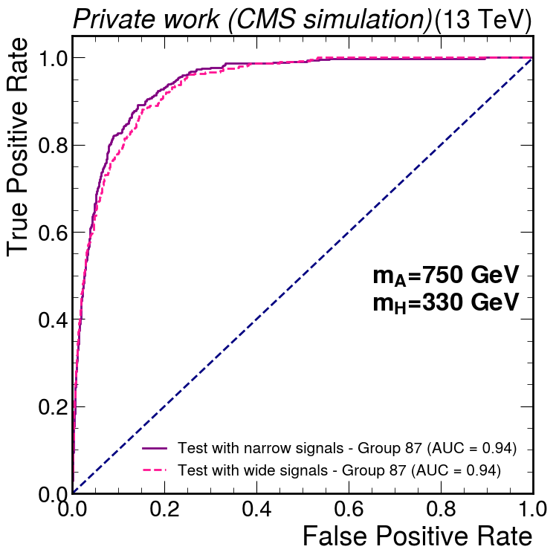
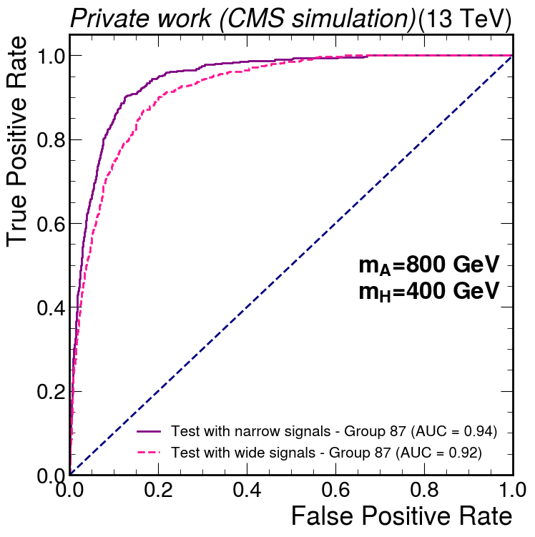


Impact of changes of the decay width
Training: narrow signal events
Testing: narrow or wide signal events in comparison
$$\frac{Γ_{A}}{m_{A}}= \frac{76.07 GeV}{750 GeV}=0.10$$
$$\frac{Γ_{A}}{m_{A}}= \frac{74.75 GeV}{800 GeV}=0.09$$
$$\frac{Γ_{A}}{m_{A}}=0.03$$
$$\frac{Γ_{A}}{m_{A}}=0.03$$
Even if we train the network with narrow signal events, the network performs nearly similar for testing with wide signal events
Neural network performs robust when the signal width is changed

Slide 17
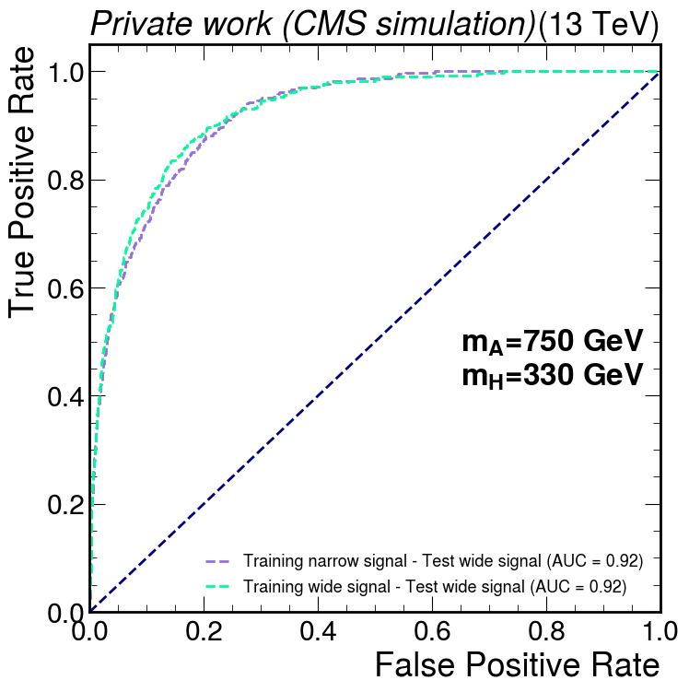
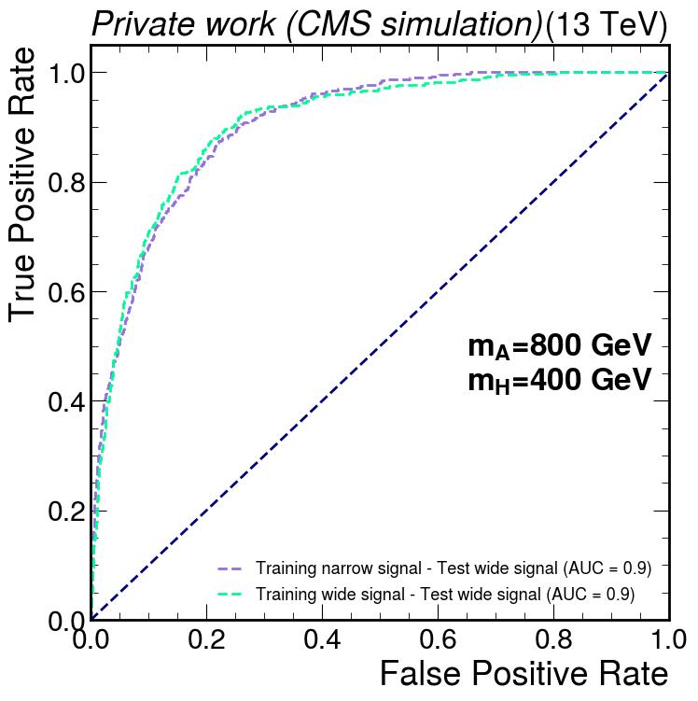
Impact of changes of the decay width
Training: narrow or wide signal events in comparison
Testing: wide signal events
→ Using wide signal events for training does not lead to an increase in performance compared to training with narrow signals when testing with wide signal events

Slide 18

Summary
Search for heavy Higgs bosons ($A →ZH→l\overline{l} t\overline{t}$)
Studied neutral networks for signal/background classification
Network performance measured using ROC and AUC score
Parameterized network trained on several mass points performs better than several individual networks
Parameterized neural network is robust to the effects of a change in the width of the A boson

