Slide 1
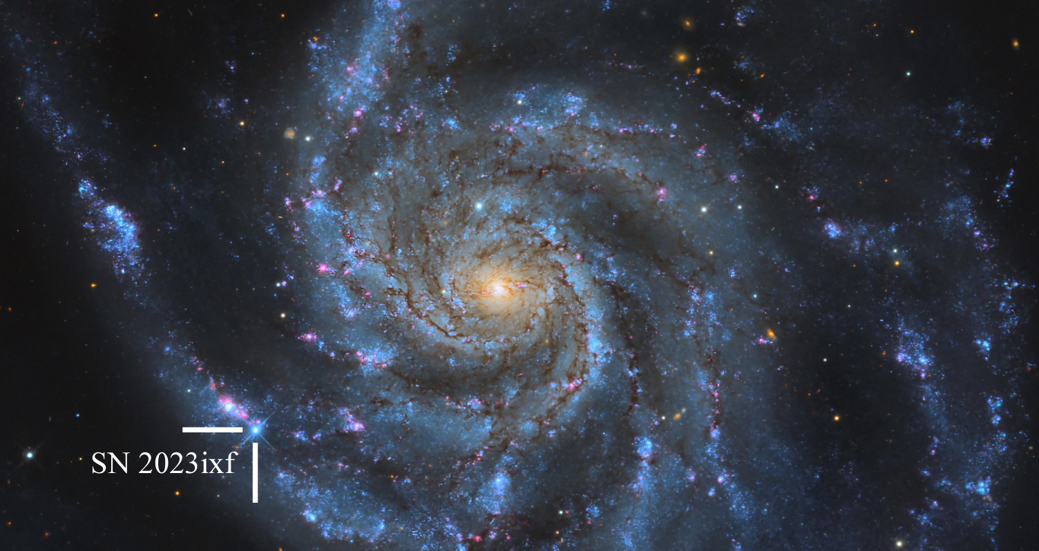

A Framework to Map Circumstellar Material Around Infant Core-Collapse Supernovae
Erez A. Zimmerman
MMS Annual Meeting
June 2, 2025
Image credit: Hossenzadeh et al. 2023

Slide 2
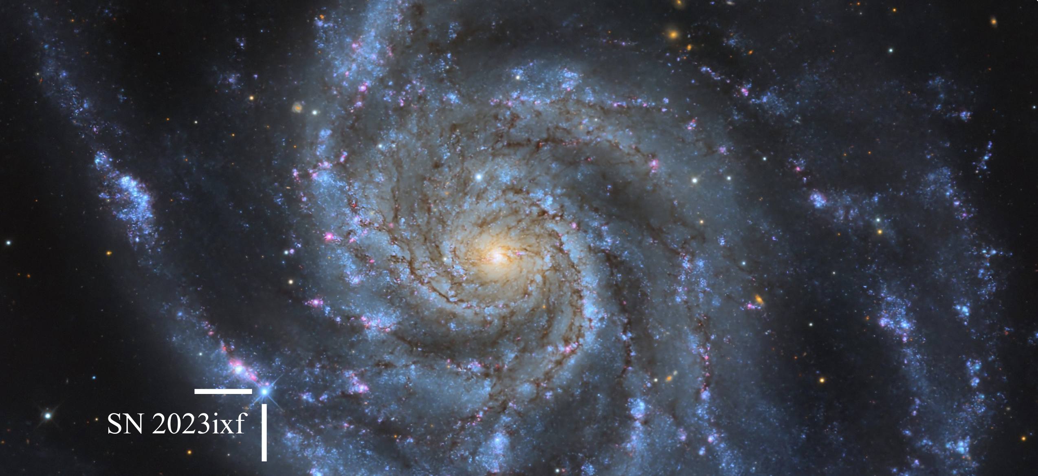
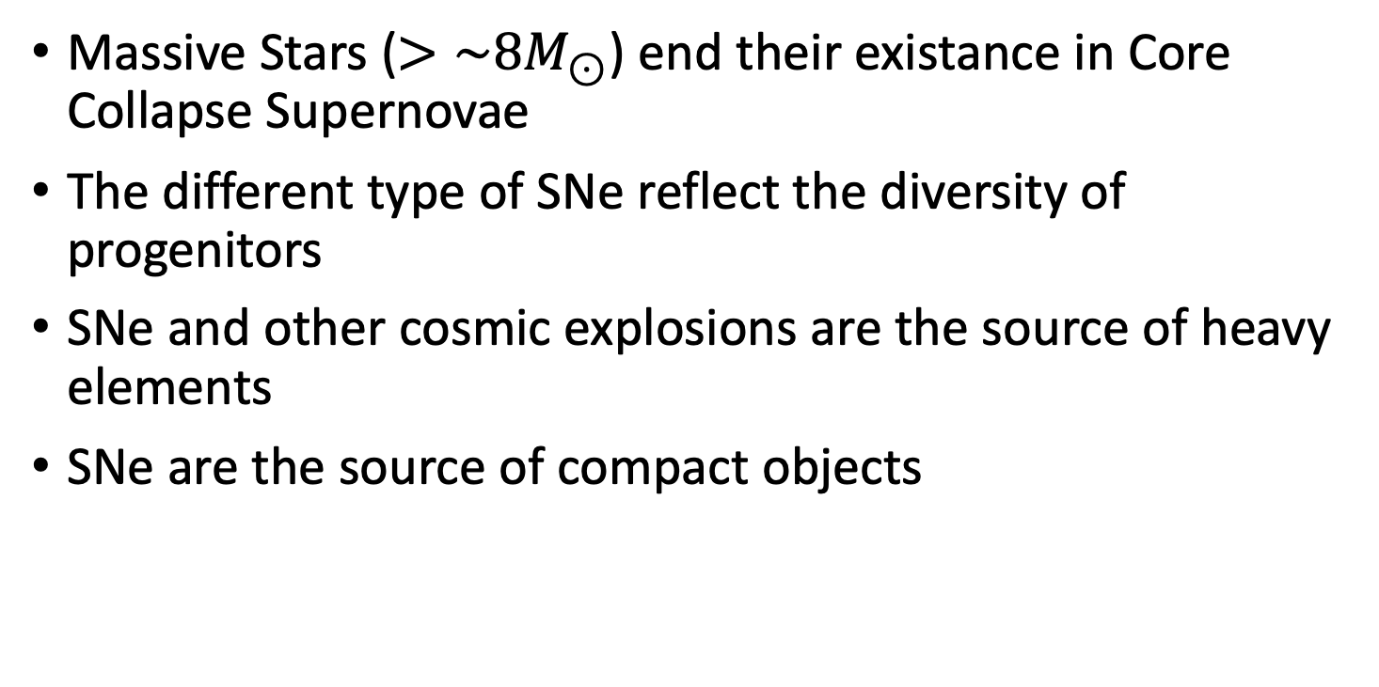
The Death of a Star
Massive Stars ($>\sim 8M_{⊙}$) end their existance in Core Collapse Supernovae
The different type of SNe reflect the diversity of progenitors
SNe and other cosmic explosions are the source of heavy elements
SNe are the source of compact objects

Slide 3
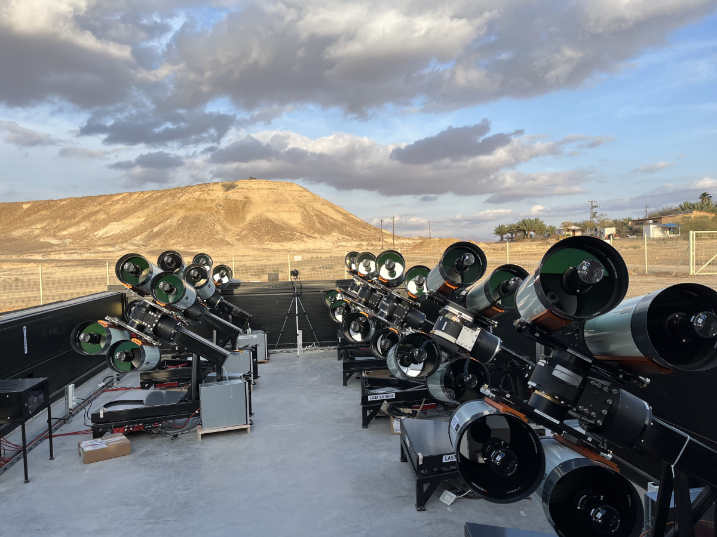
High Cadence surveys
Nightly monitoring of the sky is now possible
ZTF is the most famous example
But LAST is the coolest

Slide 4
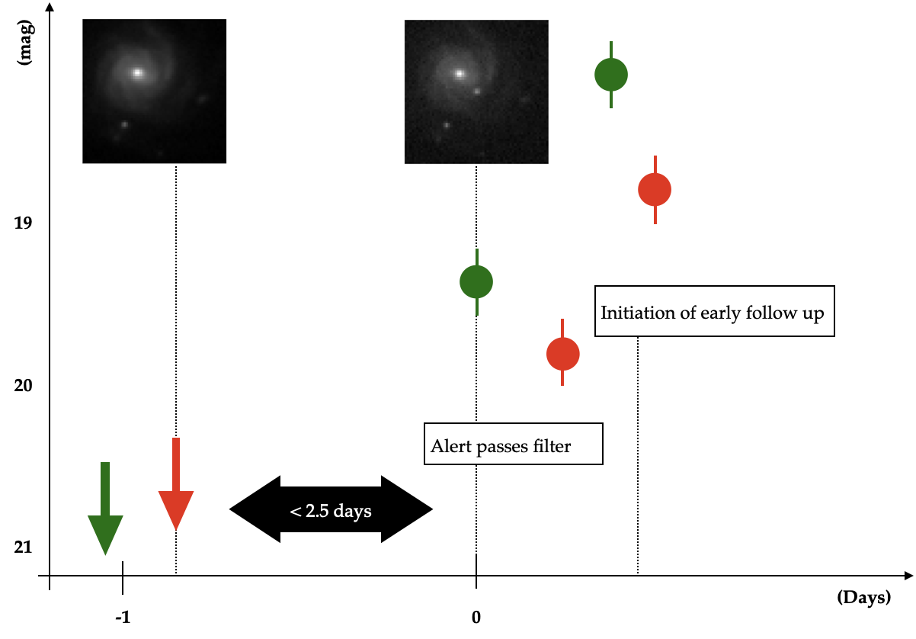
Infant Supernovae
Observing early signals require fast response
Supernovae must be identified and classified within the first day
Once the SN is discovered a follow-up campaign ensues
  High cadence observations are key
  Spectroscopy
  UV photometry

Slide 5
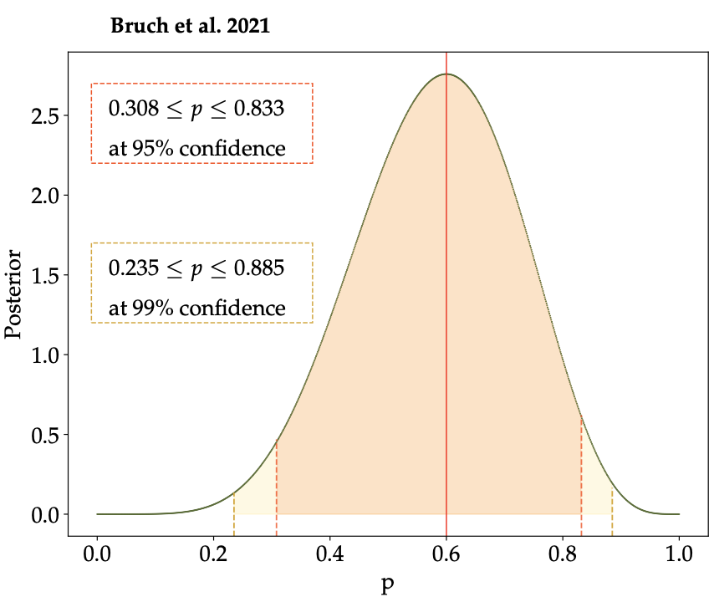
Supernovae explode withing CSM
SNe don’t explode in vaccum
Systematic studies have shown this to be the majority of cases (recently Bruch 2021,2023 et al.)

Slide 6
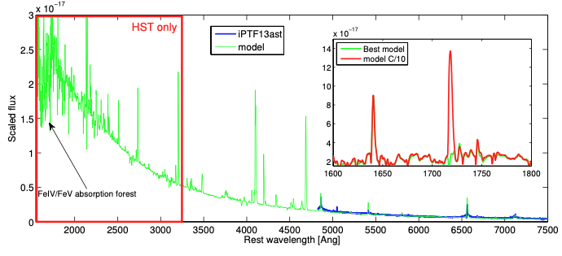
Ultraviolet
Indication on metalicity
More lines – Line abundence studies
Full sampling of the velocity field – stronger transitions in the UV
An accurate UV flux for bolometric estimation
Notes:
More distinct He II lines

Slide 7
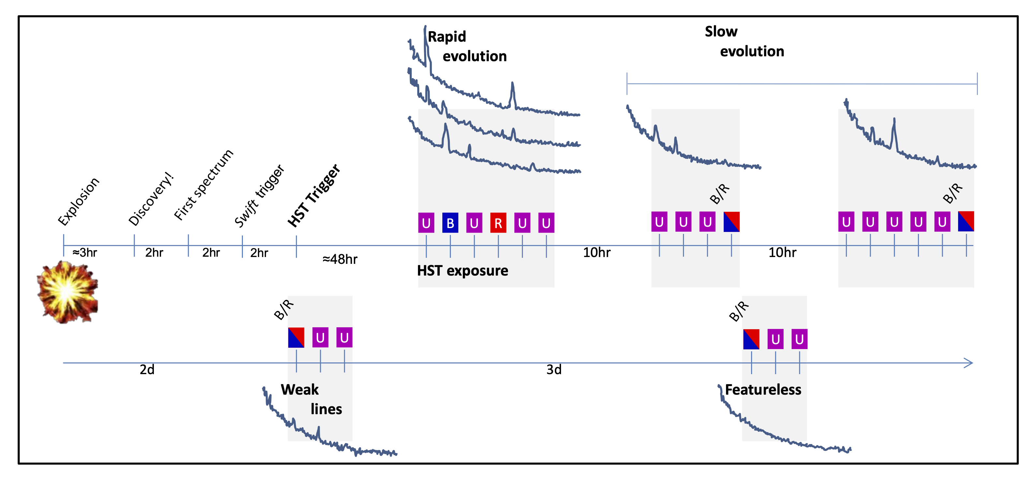
The plan

Slide 8
SN 2023ixf as an example
Image credit: Hossenzadeh et al. 2023

Slide 9
SN2023ixf
Detection by Itagaki sent to TNS on 2023-05-19 21:42 UTC in a spiral arm in M101 (6.9 Mpc; Riess et al. 2022)
Rapid spectrum with LT obtained at 22:23 UTC – Clear flash features (He I, He II, N III, N IV, C III, and C IV)
STScI notified at 23:09 UTC
Final HST phase-II file submitted at 2023-05-20 03:00 UTC
My wedding ceremony 2023-05-21 19:00 UTC
First HST visit started at 2023-05-22 04:46 UTC
2 visits 20 hours later, 2 more 3 days apart

Slide 10
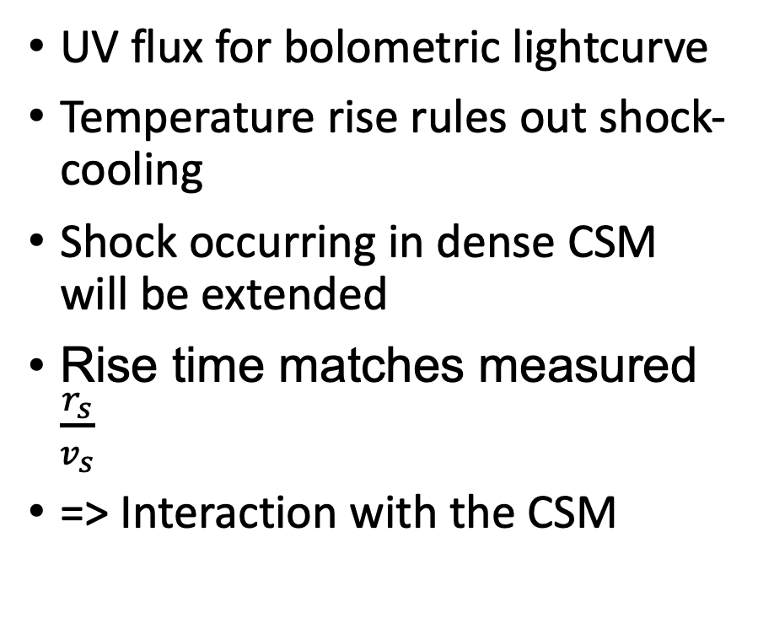
Extended shock breakout
UV flux for bolometric lightcurve
Temperature rise rules out shock-cooling
Shock occurring in dense CSM will be extended
Rise time matches measured $\frac{r_{s}}{v_{s}}$
=> Interaction with the CSM

Slide 11
Ultraviolet spectra
First UV spectrum of a SN showing flash features
Two strong narrow features
Prominent ISM lines
Photospheric lines develop in the UV prior to the optical

Slide 12
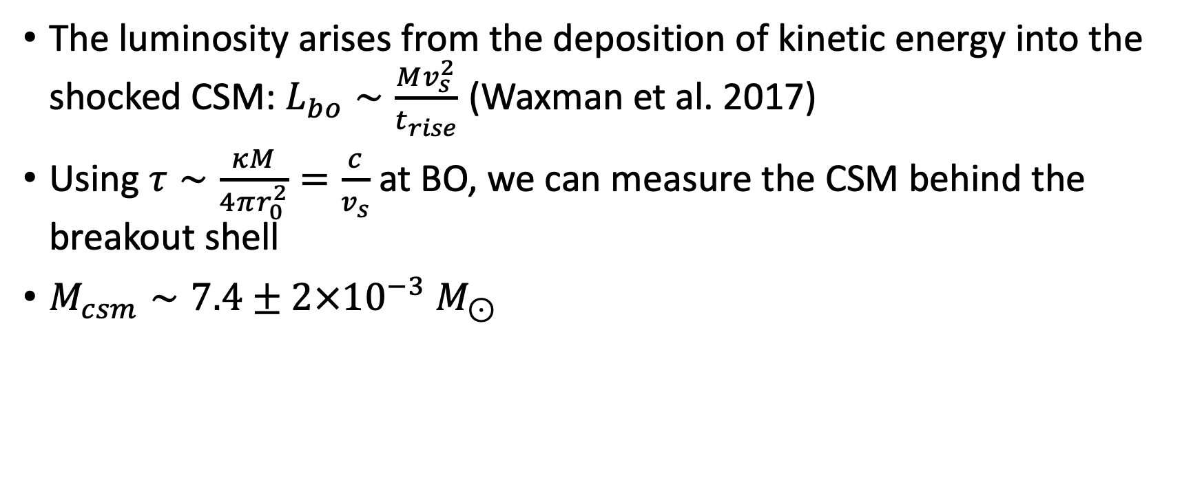
Observables
The luminosity arises from the deposition of kinetic energy into the shocked CSM: $L_{bo}∼\frac{Mv_{s}^{2}}{t_{rise}}$ (Waxman et al. 2017)
Using $τ∼\frac{κM}{4πr_{0}^{2}}=\frac{c}{v_{s}}$ at BO, we can measure the CSM behind the breakout shell
$M_{csm}∼7.4±2×{10}^{−3} M_{⊙}$

Slide 13
Source of the ionizing radiation
Flash features increase in ionization before disappearing
  Hardening spectrum
The narrow lines are sustained for more than a week
Narrow lines require a tens of eV energy source (Extreme UV)
Constant source of energy required
=> interaction with CSM

Slide 14
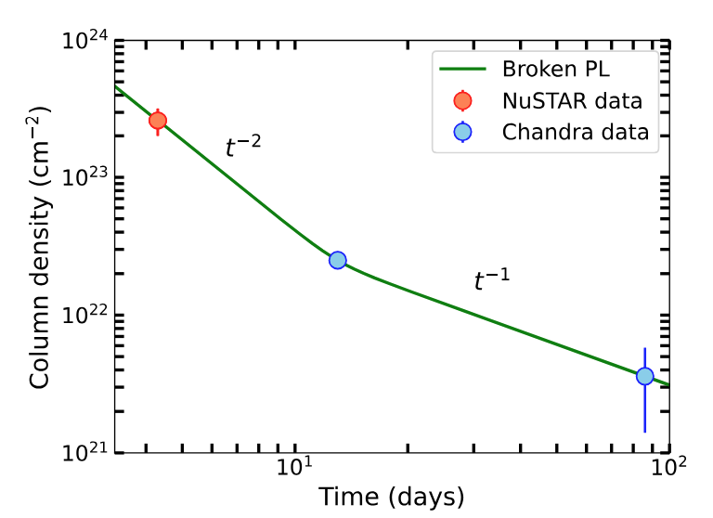
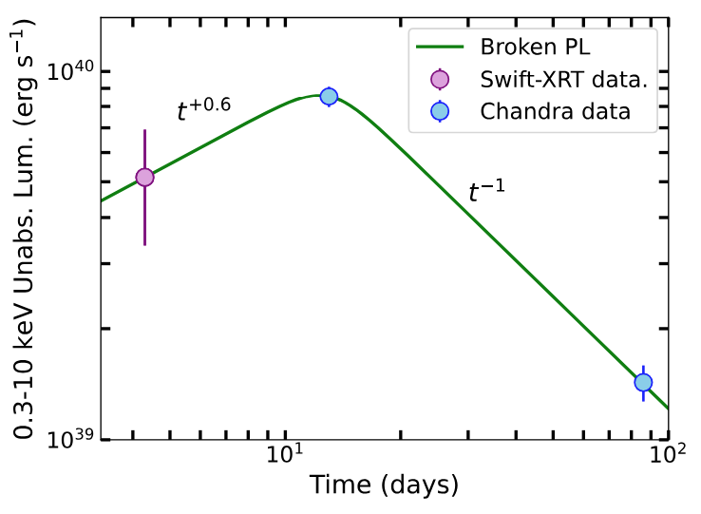
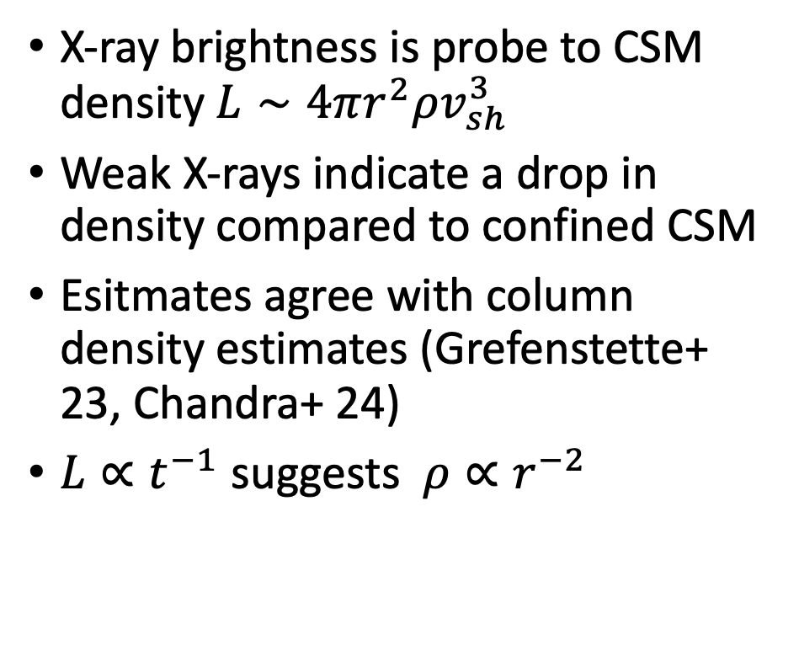
X-rays
X-ray brightness is probe to CSM density $L∼4πr^{2}ρv_{sh}^{3}$
Weak X-rays indicate a drop in density compared to confined CSM
Esitmates agree with column density estimates (Grefenstette+ 23, Chandra+ 24)
$L∝t^{−1}$ suggests $ρ∝r^{−2}$
Chandra+ 24

Slide 15


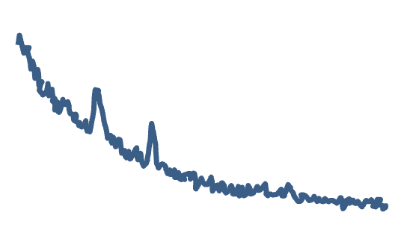
t = 2 days
L
e⁻
e⁻
e⁻
e⁻
e⁻
e⁻
e⁻
e⁻
Extreme UV
e⁻
e⁻
e⁻
e⁻

Slide 16
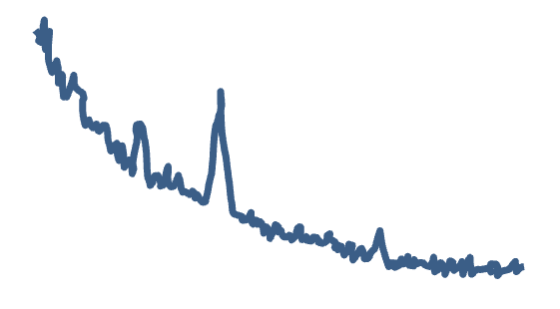

t = 4 days
L
e⁻
e⁻
e⁻
e⁻
Extreme UV
e⁻
e⁻
X-rays
e⁻
e⁻
e⁻

Slide 17
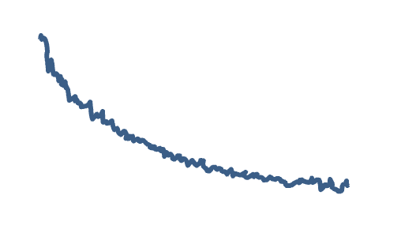
t = 9 days
L
e⁻
e⁻
e⁻
X-rays
e⁻
e⁻

Slide 18
Full CSM map

Slide 19
SN2023ixf and other objects
There is already a plethora of heating objects in the literature (Thursday session)
Observable indicators include Sustained UV colors

Slide 20
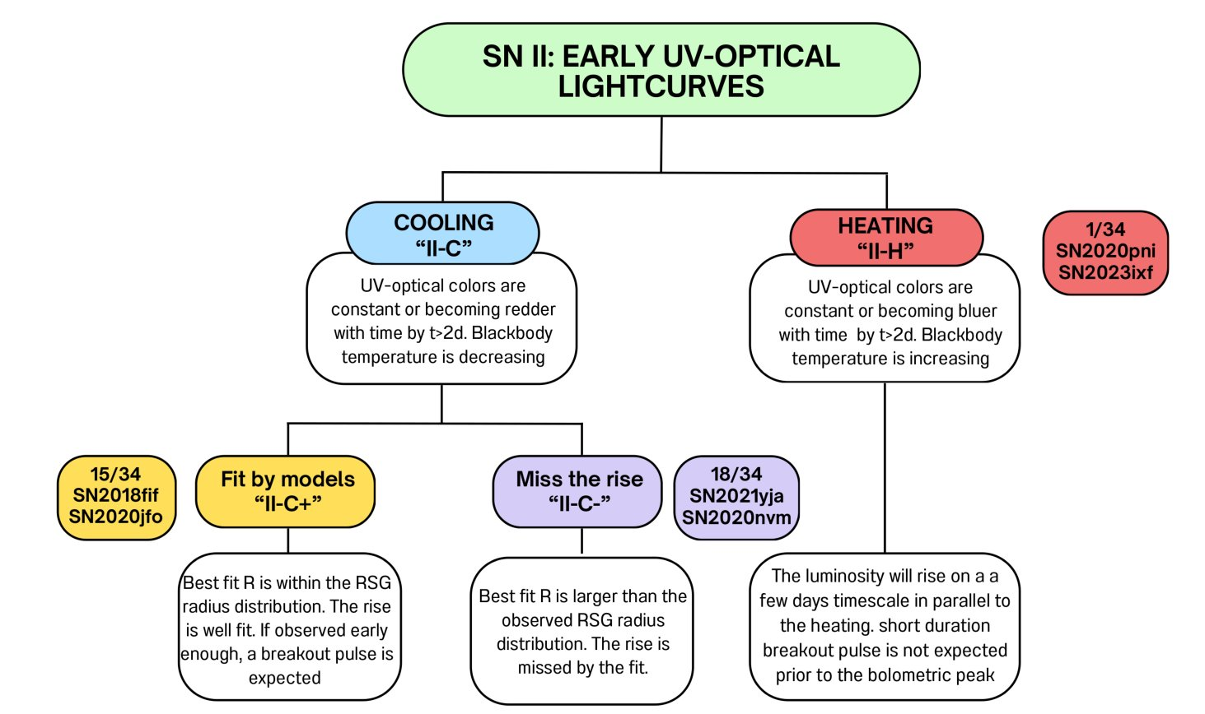
How common are heating SNe?
Irani+ 24

Slide 21
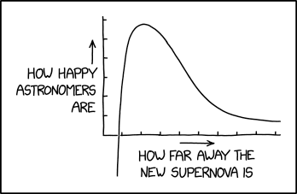
Thank you!
xkcd et al. 2024
Image credit: Hossenzadeh et al. 2023

