Slide 1



EURIZON Final Meeting
27-28 March 2025, Brussels
WP9: Remote Research Grants for Ukrainian Scientists
Title: Research and development of Ukrainian ground network of navigational aids for increasing the safety of civil aviation
Principal Investigator: Ivan Ostroumov
Team representatives: Ivan Ostroumov and Maksym Zaliskyi

Slide 2


RESEARCH PROJECT
Title: Research and development of Ukrainian ground network
of navigational aids for increasing the safety of civil aviation
Scientific area: Data, computing & digital research infrastructure
Keywords: civil aviation, data analysis, safety of air transportation, air traffic flows
Duration: 12 months ( May 2024 – April 2025) Number of team members: 3
Principal Investigator: Ivan Ostroumov
Team members: Maksym Zaliskyi and Nataliia Kuzmenko
Affiliation Institute/s: State University “Kyiv Aviation Institute”, Kyiv, Ukraine
European Partner: Viktoriia Ivannikova, Dublin City University, Ireland

Slide 3
ABSTRACT:
Research is focused on studying the effect of war in Ukraine on the global air transportation system and analysis of the impact of locked Ukrainian navigational aids network on services in European airspace.
Q1
May – July, 2024
Analysis of global air traffic losses caused by closing of Ukrainian airspace due to Russian military invasion
Q2
August – October, 2024
Evaluation of positioning performance losses in European airspace due to Ukrainian air navigation network lock
Q3
November 2024 – January 2025
Analysis of Ukrainian air navigation network configuration before February 24, 2022
Q4
February – April, 2025
design recommendations for Ukrainian air navigation service provider of possible scenarios of network modernization to increase network operational efficiency and safety of civil air transportation
Notes:
Our research is focused on studying the effect of the war in Ukraine on the global air transportation system and analysis of the impact of locked Ukrainian navigational aids network on services in European airspace. Research is structured in 4 main parts presented here…

Slide 4
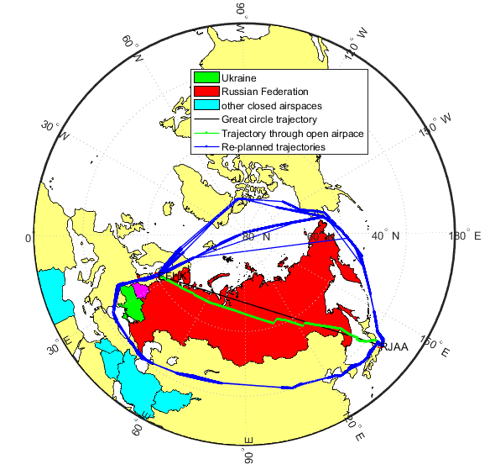
Q1. Analysis of global air traffic losses caused by closing of Ukrainian airspace
Our team provide
Airspace analysis of affected area
Identified most effected flight connections
Developed a model for airspace significance estimation
Analyzed redistribution of air traffic flows and airport
demand in neighboring countries to Ukraine
Estimated losses in transit air traffic
Analyzed reliability of aviation equipment
Flight connection:
Helsinki-Vantaa (Finland, EFHK) and Tokyo (Japan, RJAA).
Length: 4982 (+2535) NM. Duration: 9:10 (+3:21)
Notes:
in the first part we Analysed global air traffic losses caused by closing of Ukrainian airspace due to Russian military invasion.
War in Ukraine caused the closing of Ukrainian airspace on Feb 24, 2022 and significantly limited the airspaces of the Russian Federation and Belarus. In addition, Airspaces of countries in the Middle East region are at high risk of military action. The joint area of involved airspaces is the biggest airspace segregation from the period of the “Cold War”. The configuration of involved airspace caused direct flight connections between Europe and Asian destinations and between Asia and American Airports.
Our team provide
Airspace analysis of the affected area
Identified the top 100 most affected flight connections
Developed a model for airspace significance estimation
Analyzed redistribution of air traffic flows and airport
demand in neighboring countries to Ukraine
Estimated losses in transit air traffic

Slide 5
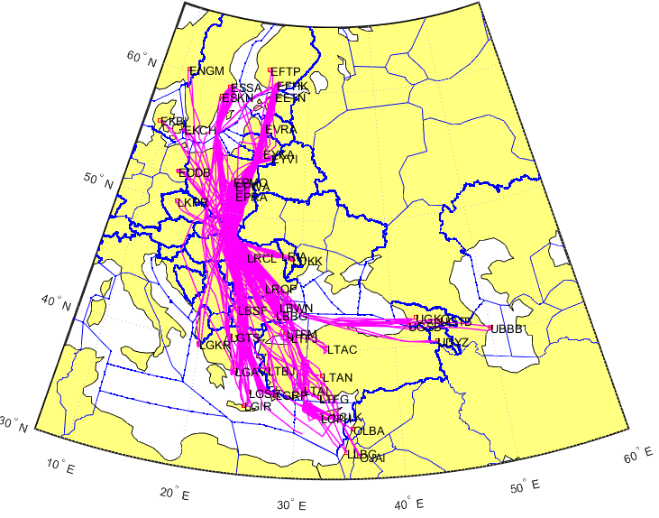
Q1. Analysis of air traffic flow redistribution in Eastern Europe
Country | Extra trajectory length, K km | Number of flights | Emission of CO₂, tones | Additional Air navigation charges, K dollars USA
Poland | 259,5 | 242 | 2651,3 | 786,2
Romania | 82,8 | 173 | 825,5 | 191,9
Slovak | 77,7 | 284 | 789,8 | 247,4
Bulgaria | 42,6 | 200 | 438,3 | 66
Lithuania | 13,6 | 95 | 136,6 | 58,6
Air traffic affected by closed airspace
Losses of Airlines
Losses of Ukrainian ANSP
Notes:
we analyzed air traffic flow redistribution in Eastern Europe based on trajectory data obtained by ADS-B technology and identified detour trajectories. It helps to analyze… extra traj, number of flights, Extra emission and additional ANC. In this table you can see results of one week traffic analysis in July 2024. Also, we analyzed losses of airlines caused by using detour trajectories and losses of Ukrainian ANSP due to not providing air navigation services.

Slide 6
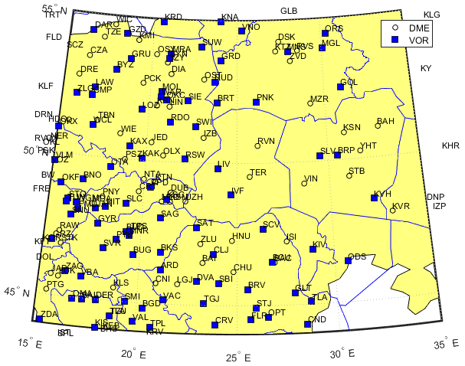
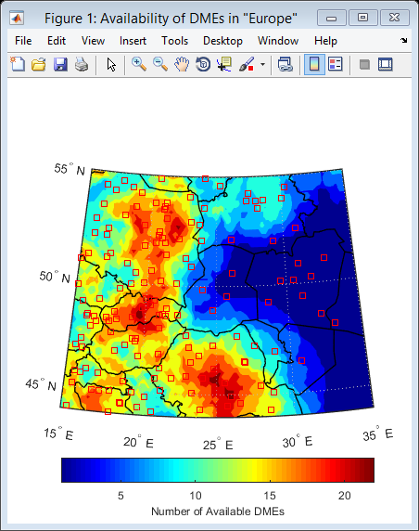
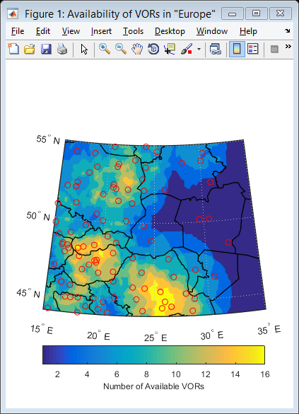
Q2. Evaluation of positioning performance losses in European airspace due to Ukrainian air navigation network lock
Losses in the amount of available pairs of radio navigation aids
Analyzed impact of Ukrainian Navigation network short down by each neighboring country
Study problem of GNSS interference in civil aviation
Notes:
Civil aviation uses networks of navigation aids as backup positioning technology in case of GNSS lock. On feb 24, 2022 Ukrainian ANSP suspended all services including the network of navigation aids. Services of Ukrainian network have been provided in neighboring airspaces before its suspension. Our team has been working on the evaluation of positioning performance losses in Euro airspace due to Uk air navigation network lock. It was detected that accuracy of positioning does not affected however reliability parameters were reduced. Results of losses in the number of available pairs of navigation aids are shown here for each affected area.

Slide 7
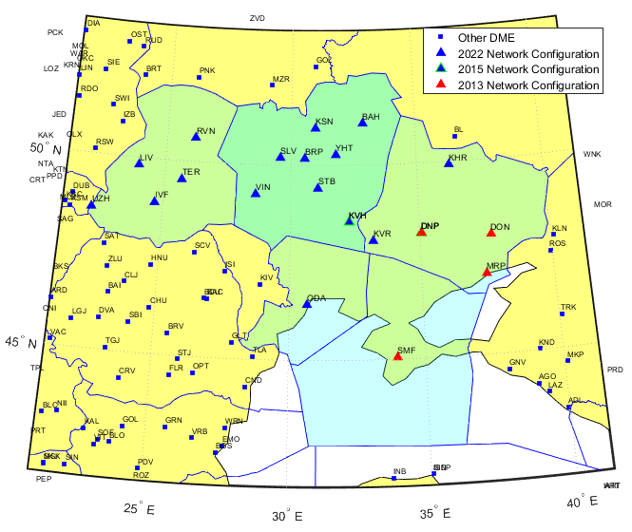
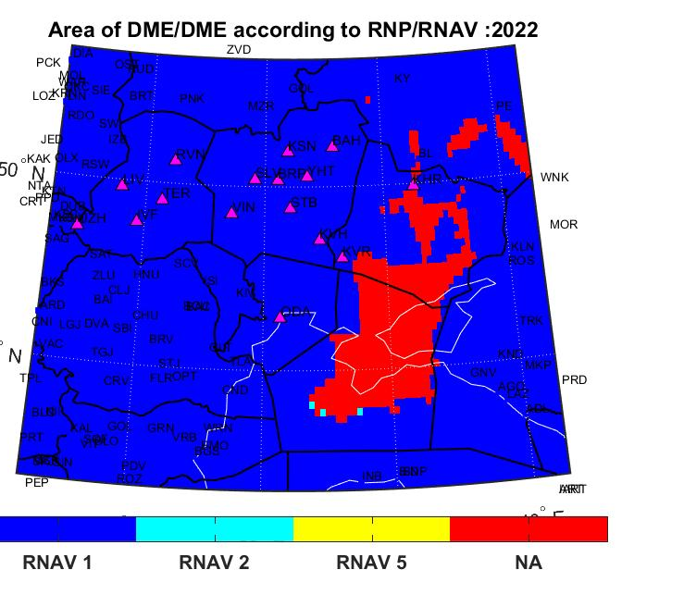
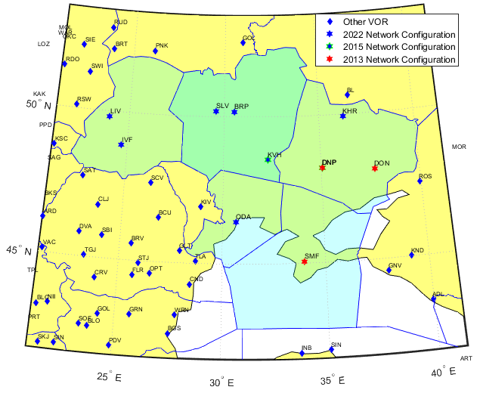
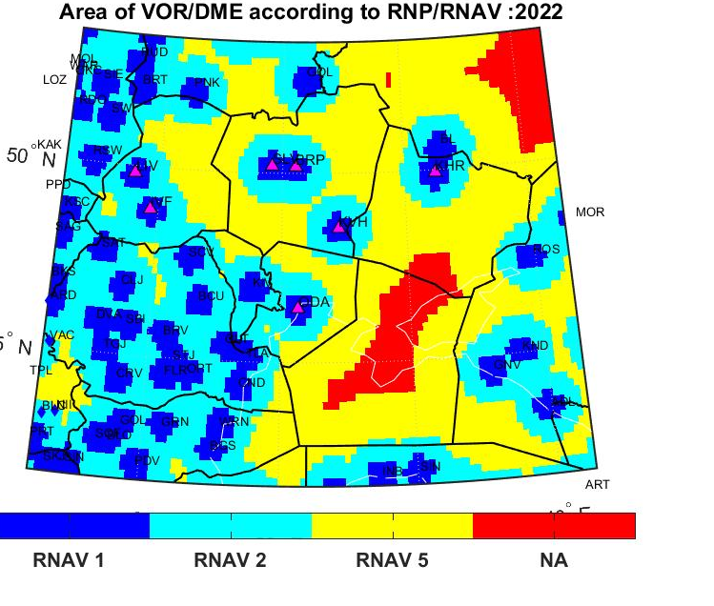
Q3-Q4. Analysis of Ukrainian air navigation network configuration
Notes:
Also we provide Analysis of Ukrainian air navigation network configuration to estimate availably area of the particular level of precision for positioning my navigation aids for different stages of network development and check correspondence with RNAV requirements for civil aviation.

Slide 8
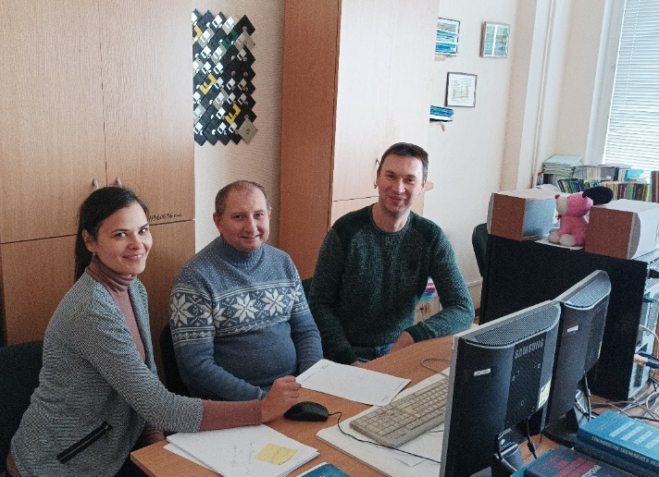
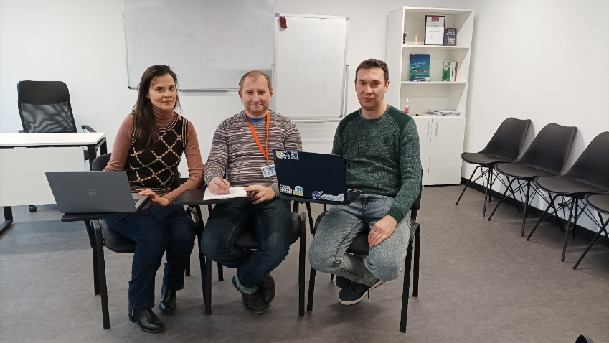
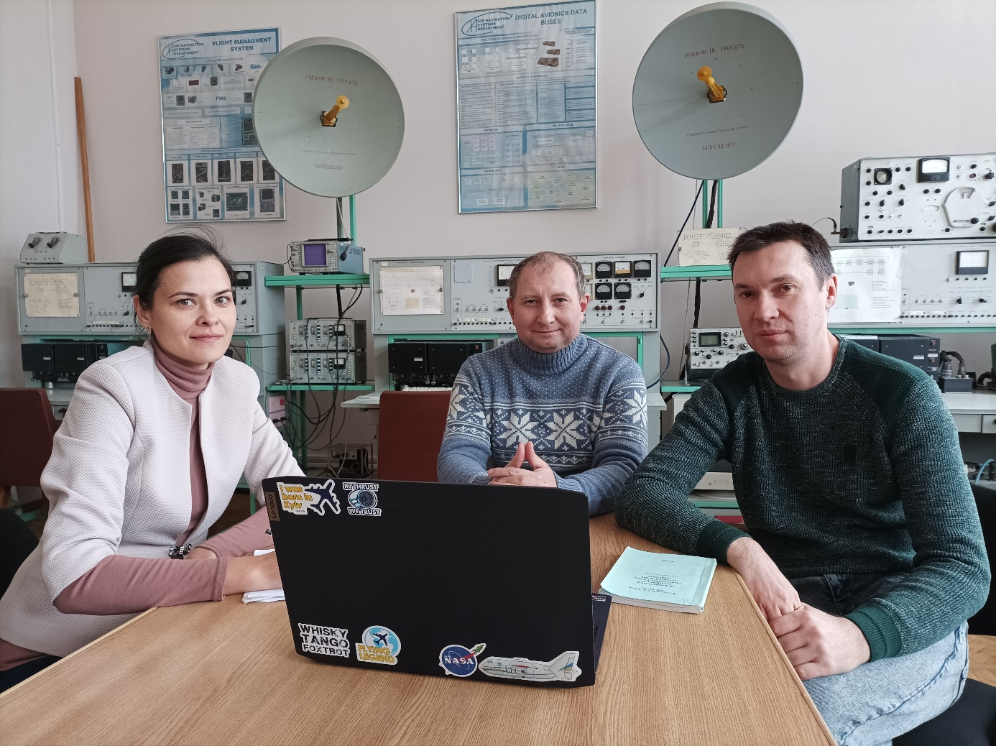
Team working under preparing ADP scholar event
Analyzing data for final software run.
Laboratory of avionics and navigation equipment,
used by team for navigation equipment performance study.
Notes:
Here is our team at Kyiv Aviation Institute. Nataliia, Maksym and I. If you visit Kyiv You are welcome to our laboratory of avionics and navigation equipment in KAI.

Slide 9
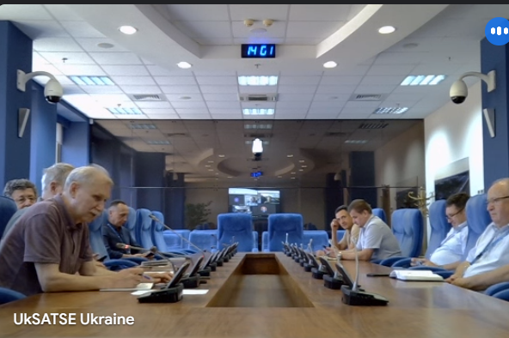
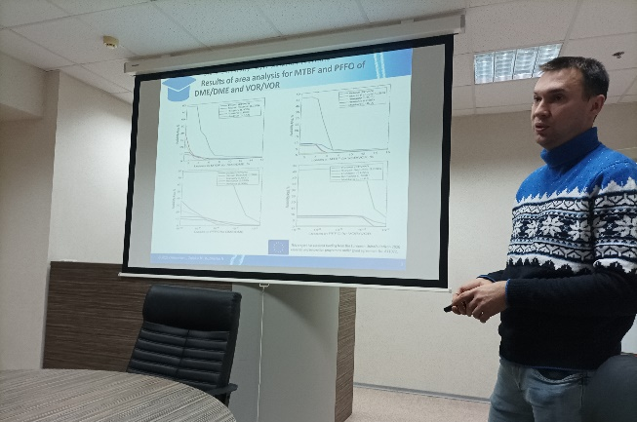
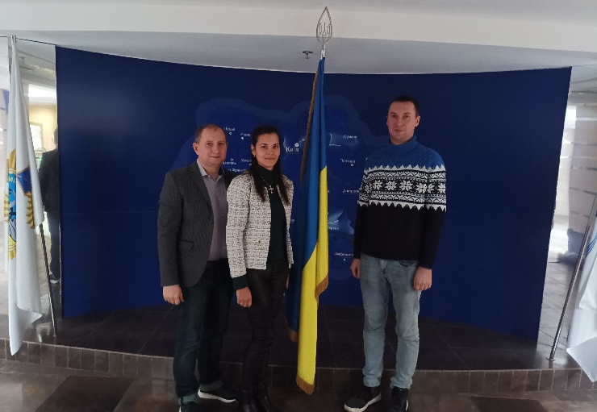
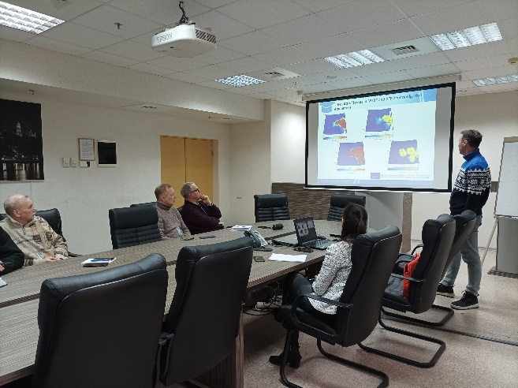
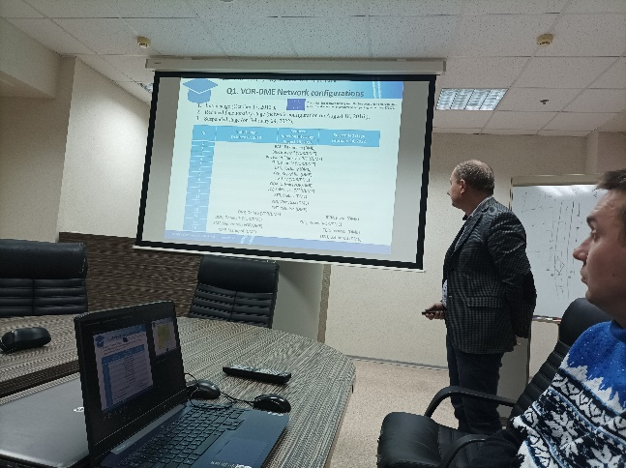
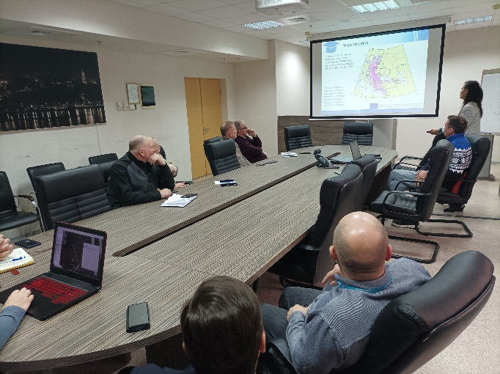
Coordination with Ukrainian Air Navigation Service Provider
June 19, 2024
December 24, 2024
Notes:
The project has been coordinated with Ukrainian ANSP. Our team communicates ANSP with different questions and two official meetings have been organized between our team and representatives of ANSP in June and December 2024.

Slide 10
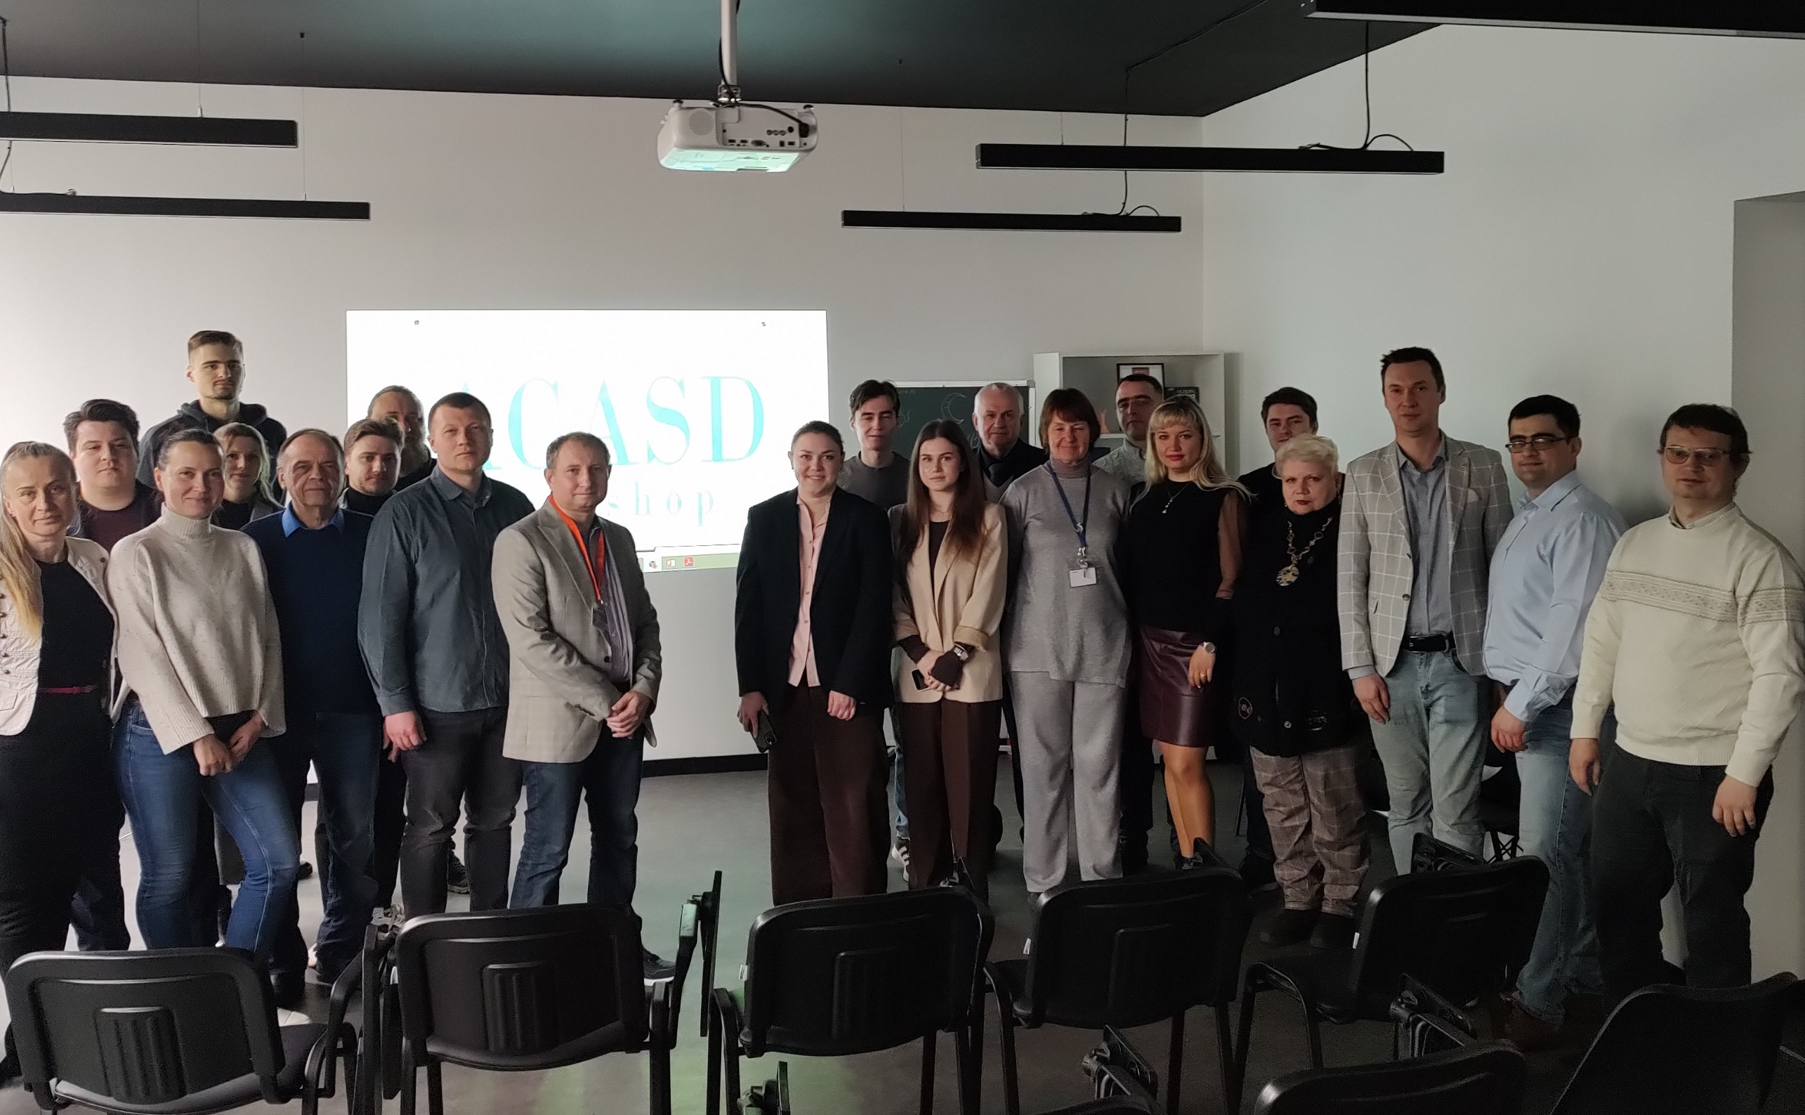
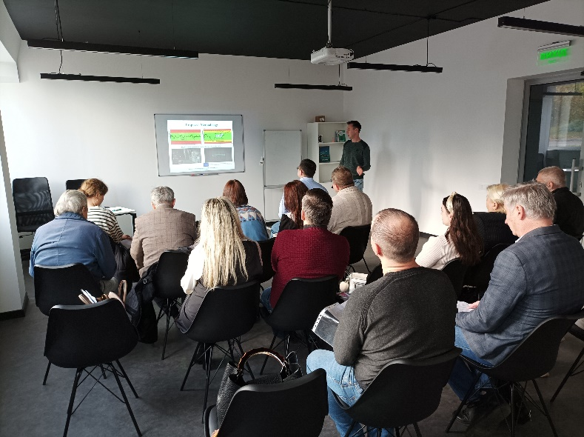
Scholar Events
International Workshop on Algorithms of Data Processing (ADP)
in-person event on November 5, 2024 at the State University “Kyiv Aviation Institute” (KAI), Kyiv, Ukraine
https://www.ans.nau.edu.ua/adp.
SCOPUS - OPEN ACCESS
3rd International Workshop on Advances in Civil Aviation Systems Development (ACASD)
in-person event on March 18-20, 2025 at the
State University “Kyiv Aviation Institute” (KAI), Kyiv, Ukraine
https://www.acasd.nau.edu.ua
Notes:
Our team organized two scholar events in KAI workshop on Algorithms of Data Processing (Nov) and International Workshop on Advances in Civil Aviation Systems Development (just previous week). Both events were organized in-person.

Slide 11
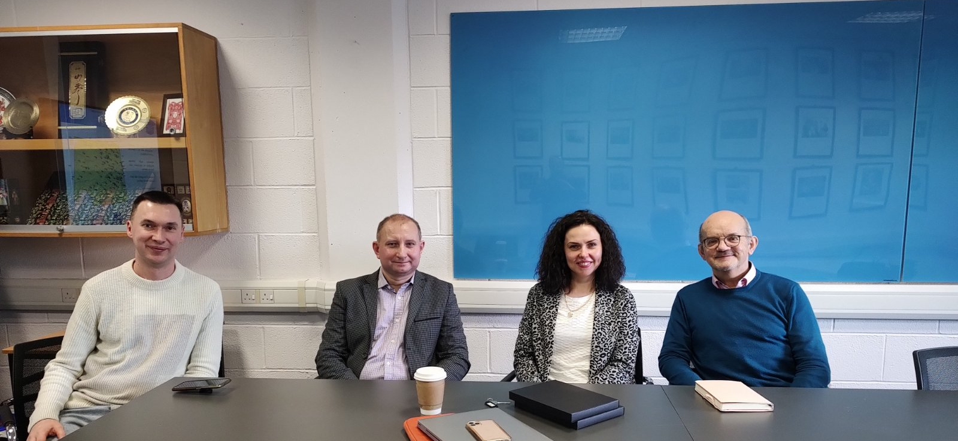
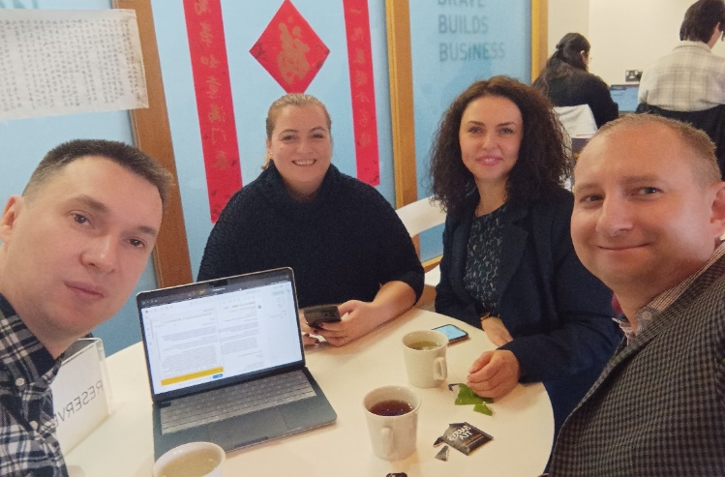
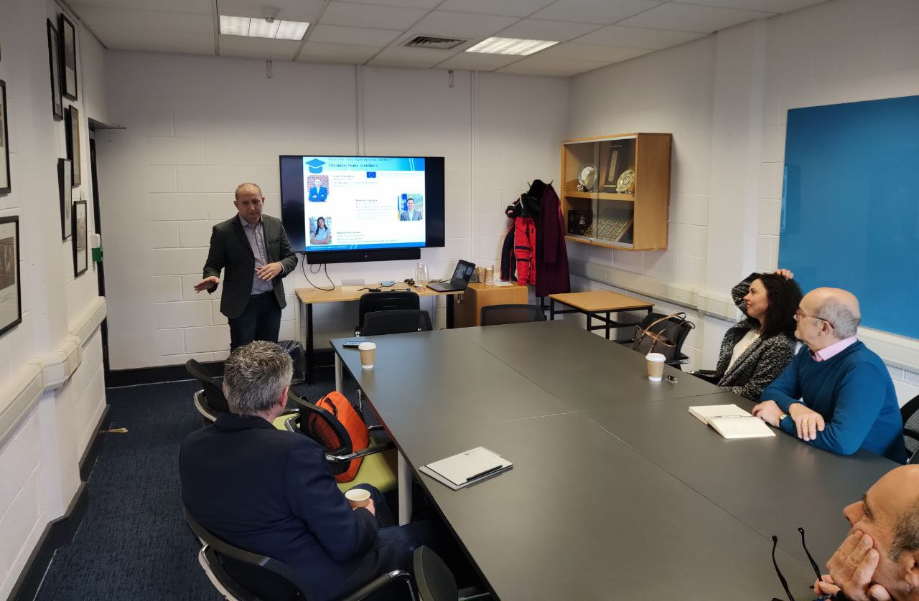
Collaboration with EU partner:
Dublin City University (DCU)
Aviation team of DCU: Prof. Marina Efthymiou, Dr. Viktoriia Ivannikova, and Dr. Cathal Guiomard
DCU team is mostly involved in the scientific investigation of air transportation development analysis, sustainable development of civil aviation, fee optimization, and carbon dioxide emission minimization in aviation
Within the EURIZON Staff Exchange Programme: Ivan and Maksym visited DCU for 4 days from January 28 to January 31, 2025
Notes:
The project is in collaboration with DCU. DCU team is mostly involved in the scientific investigation of air transportation development analysis, sustainable development of civil aviation, fee optimization, and carbon dioxide emission minimization in aviation
Many Thanks EURIZON Staff Exchange Programme for the possibility fo me and Maksym to visit DCU in Jan 2025.

Slide 12
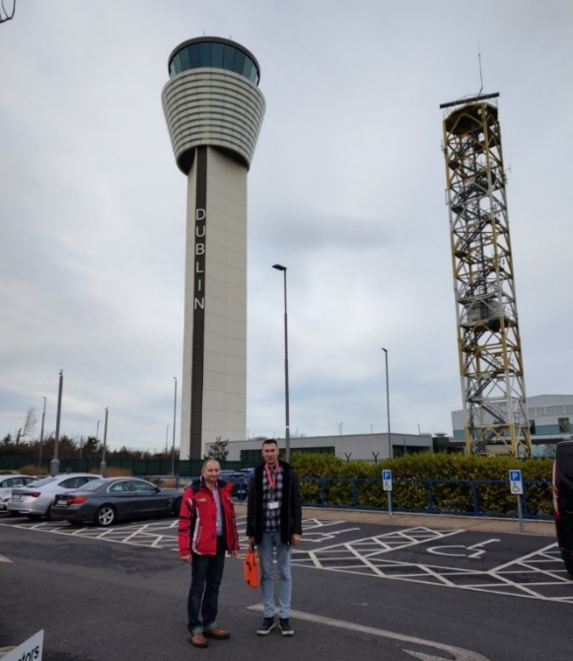
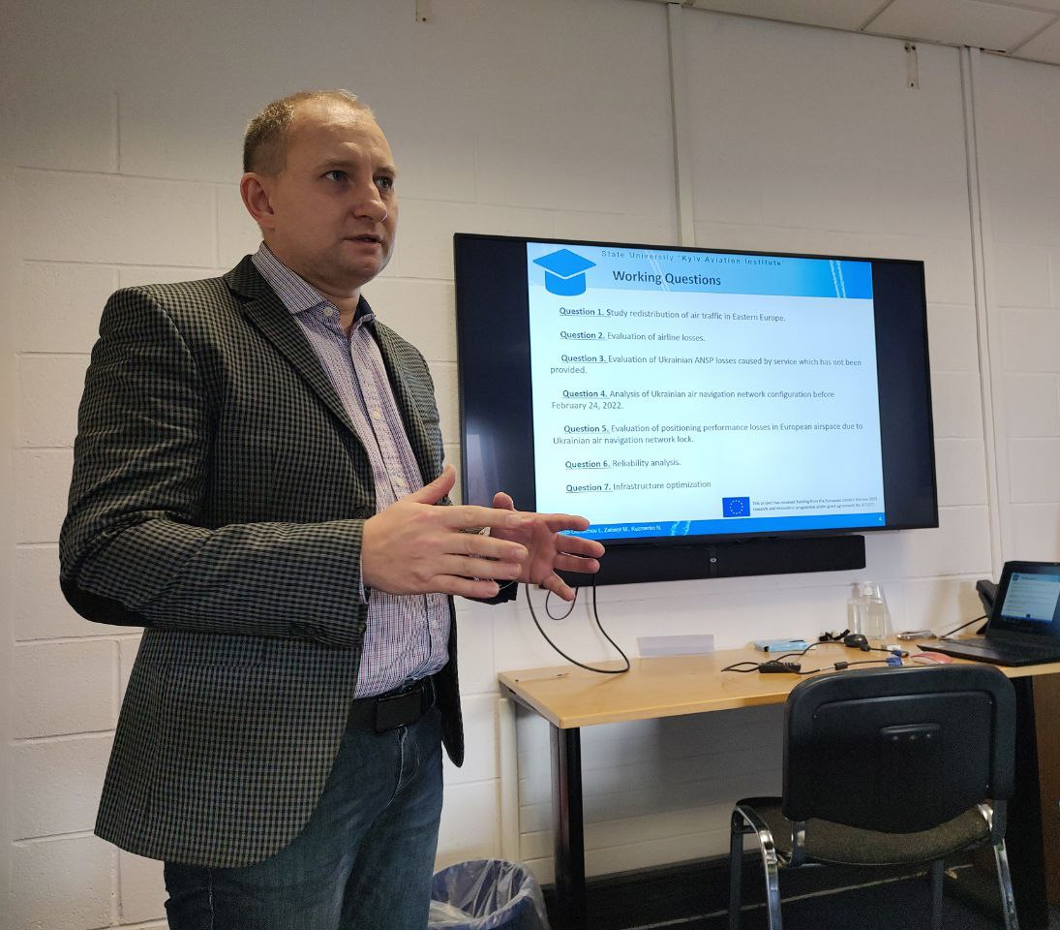
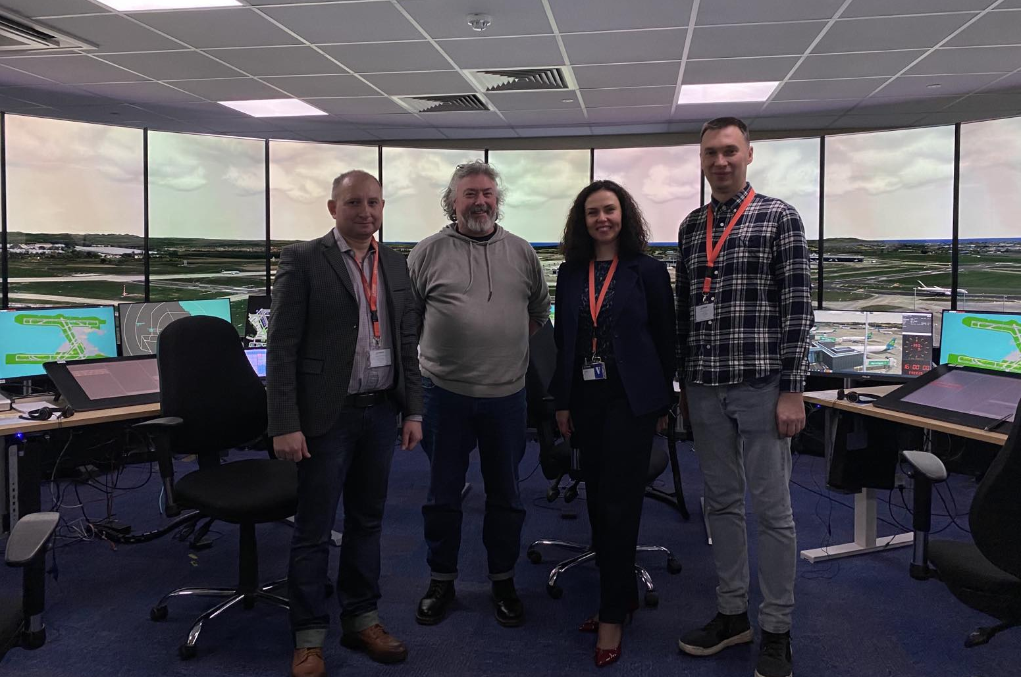
Staff exchange visit
DCU team organized a collaborative meeting with experts and representatives from AirNav Ireland to discuss obtained results
.
Notes:
During our visit we have multiple things to do. But the most exciting was that our partners organized a collaborative meeting with experts and representatives from AirNav Ireland to discuss the obtained results.

Slide 13
Dissemination
Participation in scholar events with publication in SCOPUS
The international workshop on Computational Methods in Systems Engineering (CMSE 2024), June 17, 2024, Kyiv, Ukraine, in-person (https://ans.nau.edu.ua/cmse).
The 15th International Conference – Transbaltica 2024: Transportation Science and Technology, September 19-20, 2024, Vilnius, Lithuania (https://vilniustech.lt/332103).
XII International Scientific and Practical Conference on "Information Control Systems and Technologies (ICST-ODESA-2024)", 23-25 of September 2024, Odesa, Ukraine (http://icst-conf.com).
The 5th International Conference KhPI Week on Advanced Technology, IEEE, October 7-10, 2024, Kharkiv, Ukraine (http://khpiweek.ieee.org.ua).
Fourth International Conference on System Analysis & Intelligent Computing (SAIC IEEE), on October 9, 2024, Kyiv, Ukraine (https://saic.ieee.org.ua/?page_id=96).
14th International Conference Dependable Systems, Services and Technologies (DESSERT’2024, IEEE), October 11, 2024, Greece, Athens (https://www.dessert-conf.org).
7th International Conference on Actual Problems of Unmanned Aerial Vehicles Developments (APUAVD, IEEE), October 22, 2024, Kyiv, Ukraine, in-person (https://apuavd.ieee.org.ua/programme_apuavd_2024).
International Workshop on Algorithms of Data Processing (ADP), on November 5, 2024, Kyiv Ukraine, in-person (https://www.ans.nau.edu.ua/adp).
Integrated Computer Technologies in Mechanical Engineering” – Synergetic Engineering (ICTM-2024), on December 23, 2024, Kharkiv, Ukraine (https://ictm.khai.edu).
Published articles
"Impact analysis of Russian-Ukrainian war on airspace," in Journal of Air Transport Management, vol. 124, 2025, pp. 1-14, doi:10.1016/j.jairtraman.2025.102742. (SCOPUS Q1)
Submitted articles
The approach to optimization of the structure of the repair process of aviation radio equipment.
Submitted June 14, 2024 to Transport (SCOPUS Q2, ACCEPTED).
Evaluation of positioning performance losses in European airspace due to the shutdown of the Ukrainian air navigation network.
Submitted February 3, 2025 to Journal of Air Transport Management (SCOPUS Q1, No: JATM-D-25-00062)
Statistical models for the utilization process of aviation radio equipment.
Submitted January 17, 2025 to Aviation (SCOPUS Q3, ACCEPTED)
In-process articles
Statistical Data Processing Technologies for Sustainable Aviation: A Case Study of Ukraine.
Sustainability, MDPI, SCOPUS Q1.
Notes:
In the framework of the project our team participated in multiple scholar events. Results have been published in top scholar journals.

Slide 14
CONCLUSIONS
Impact of the fellowship on the work of the team:
Remote Research Grant created an excellent background for me and my team to continue our research on global problems in air traffic redistribution and navigation networks efficiency improvement. Results of research in collaboration with European partner allow better understanding of new challenges in air transportation and improve the safety of civil aviation.
EURIZON Fellowship Programme gives a unique possibility for research teams whose work is prevented by war in Ukraine to continue their scholar work in collaboration with European research institutions for the development of worldwide scientific view.
Results of our research have been presented in about 20 reports on scholar events (7 already published) and 4 articles have been submitted to reputed scholar journals (1 has been published in Q1; 2 Accepted (Q2 and Q3)).
The team organized two in-person scholar workshops to collaborate scientist located in Ukraine (ADP+ACASD).
The fellowship created a powerful team of scientists (in collaboration with a European partner) to participate in further Programs and Research Grants.
Future plans include continuing research in:
  Analysis of total global losses in air transportation caused by war in Ukraine
  Analysis of Joint European navigation network to provide safe air transportation
  Failure prediction and maintenance strategies improvement for aviation equipment.
THANK YOU!

