Slide 1
News from KET
Komitee für ElementarTeilchenphysik
DPG Fachverband Teilchenphysik, 03.04.2025
Lutz Feld (RWTH Aachen University, KET Chair)

Slide 2
Election of a new KET for the period 11/24-11/27
Eligible voters: 1.179, voter participation: 382 Personen (32.4 %) (voter participation in 2021: 27.7%)
Election result:
  Wahlkreis 1 (Nord): Ariane Frey (Gregor Kasieczka)
  Wahlkreis 2 (Mitte): Johannes Albrecht (Markus Cristinziani)
  Wahlkreis 3 (West): Lutz Feld (Philip Bechtle)
  Wahlkreis 4 (Südost): Thomas Kuhr (Otmar Biebel)
  Wahlkreis 5 (Südwest): Monica Dunford (Markus Klute)
  Wahlkreis 6 (CERN): Michael Dührssen-Debling (Andre Sailer)
  Wahlkreis 7 (DESY): Freya Blekman (Frank Gäde)
  Wahlkreis 8 (Theorie-Nord):Gudrun Hiller (Christophe Grojean)
  Wahlkreis 9 (Theorie-Süd): Margarete Mühlleitner (Tilman Plehn)
  (The person given in parenthesis will become member of KET if the presently elected member leaves KET permanently before the three year term finishes.)
The new KET has elected a chair and a deputy: Lutz Feld and Margarete Mühlleitner

Slide 3
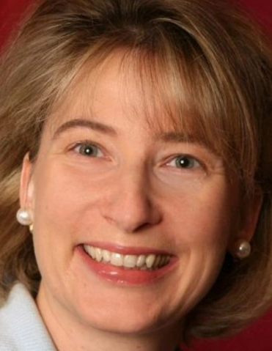
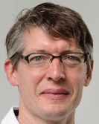
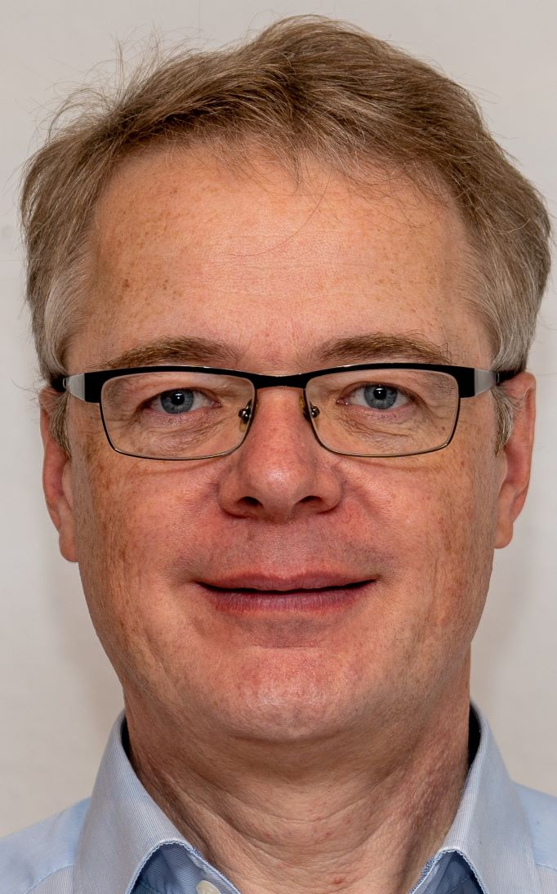
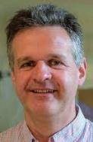
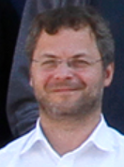
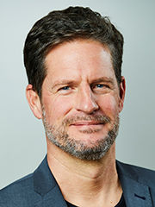

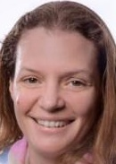
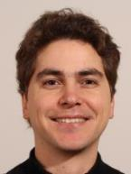
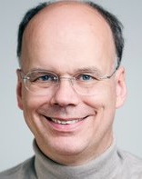
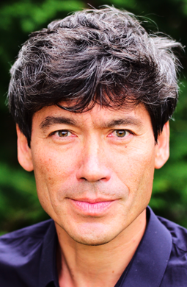
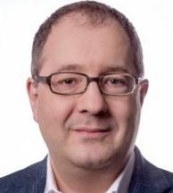
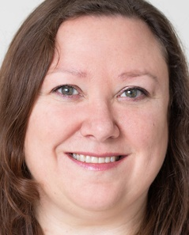
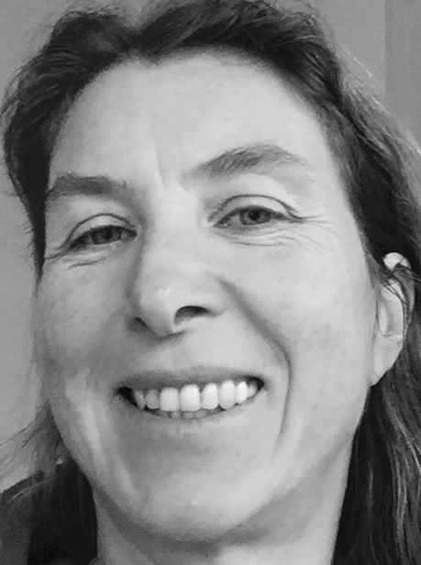
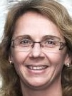
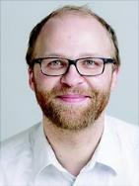
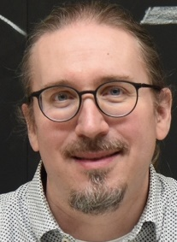
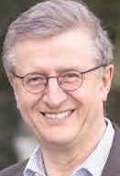
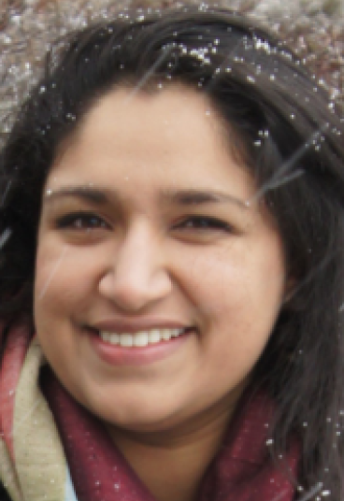
KET members (2024-2027)
Prof. Dr. Ariane Frey Göttingen University KET Member | Prof. Dr. Johannes Albrecht Dortmund University KET Member | Prof. Dr. Lutz Feld RWTH Aachen University KET Chair
Prof. Dr. Thomas Kuhr LMU Munich KET Member | Prof. Dr. Monica Dunford Heidelberg University KET Member | Dr. Michael Dührssen-Debling CERN KET Member
Prof. Dr. Freya Blekman DESY KET Member | Prof. Dr. Gudrun Hiller Dortmund University KET Member | Prof. Dr. Margarete Mühlleitner KIT Karlsruhe KET Deputy Chair
Prof. Dr. Klaus Desch Bonn University CERN Council Delegate | Prof. Dr. Heiko Lacker Humboldt University Berlin RECFA Representative | Prof. Dr. Johannes Haller Hamburg University DPG-FV Chair
Dr. Ties Behnke Hamburg DESY FH Director (interim) | Prof. Dr. Marumi Kado MPP Munich MPP Director | Prof. Dr. Hans-Christian Schultz-Coulon Universität Heidelberg GA Co-Chair
Dr. Marc Wenskat Hamburg University KfB Representative | Prof. Dr. Daniel Mohler Darmstadt Tech. University KHuK Representative | Prof. Dr. Manfred Lindner MPI-K Heidelberg KAT Representative | Dr. Simran Gurdasani DESY yHEP Representaive
ex-officio

Slide 4
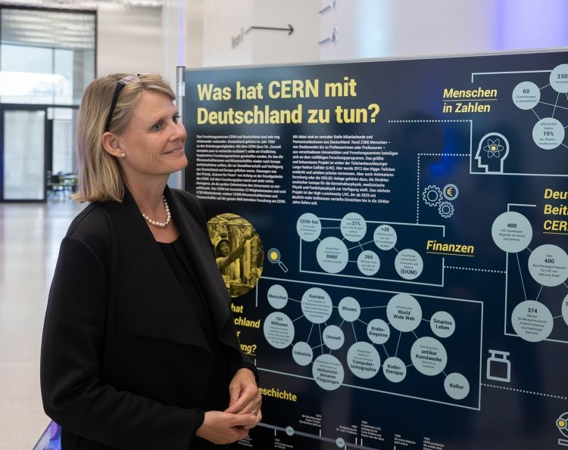
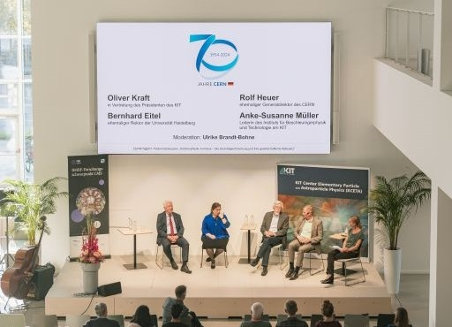
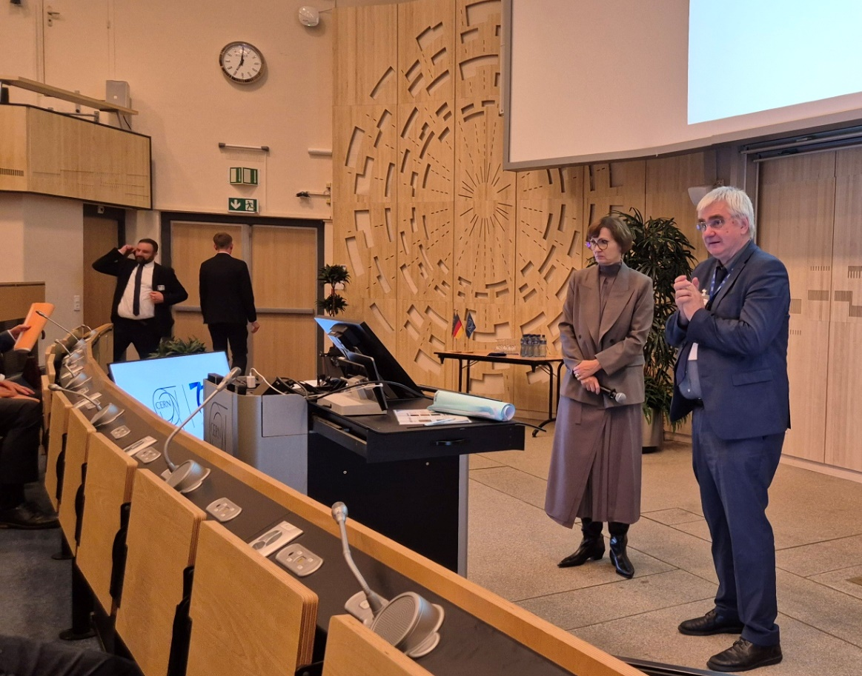
CERN70
Festakt at FUTURIUM Berlin
  with Staatssekretärin Judith Pirscher
  many thanks to Sascha Schmeling, Heiko Lacker, Marius Hoffmann, Sophia Haves, Uta Bilow, Barbara Warmbein, many more, and the BMBF!
at all particle physics sites in Germany
  43 events at 20 sites
  cern70.de
  many thanks to Uta Bilow and Barbara Warmbein
Festakt at CERN
  with Minister Bettina Stark-Watzinger
  enthusiastic speech of Ursula von der Leyen
we need to continue networking with politicians

Slide 5

Update of the European Strategy for Particle Physics
  Process set up by CERN Council
    national inputs were due by March 31, 2025
  KET has organized a series of workshops to facilitate discussions
  in Germany and to prepare the input document
    Future Collider @ CERN Community Event, Bonn, 22.-24.05.2024
    The Future of Non-Collider Particle Physics, Bad Honnef, 22.-24.11.2024
    The Future of Collider Physics, DESY, 27.-29.11.2024
    Drafting Workshop in preparation of the input to the ESPP update, Bad Honnef, 19.-22.01.2025
  „Statement by the German Particle Physics Community as Input to the Update of the European Strategy for Particle Physics” [https://www.ketweb.de/stellungnahmen/]
    agreed at the last workshop
    approved by KET on 17.3.2025
    submitted on 25.3.2025
  Many thanks to everyone who engaged in this process and contributed to discussing and writing this important document!
  KAT, KHuK, and KfB submitted additional documents to which we refer, and which reflect the main conclusions of the drafting workshop at Bad Honnef that was attended by members of all communities
    https://europeanstrategy.cern/

Slide 6
Statement by the German Particle Physics Community as Input to the Update of the European Strategy for Particle Physics
The German community agrees that Europe’s leading role in particle physics is to be secured by a flagship collider project at CERN after the LHC, which is essential to search for answers to the fundamental questions in particle physics.
A Higgs factory remains the highest priority of the German community. The German community supports the FCC-ee as the next flagship project at CERN with highest priority. Its realization requires the timely development of a solid and affordable financial plan by CERN.
Recommendations are made for scenarios in which the FCC-ee is considered not financially feasible or in which international competition calls for a complementary and more competitive collider at higher energies at CERN and related accelerator R&D efforts.
The German community considers a diverse experimental landscape of non-collider experiments essential.
Furthermore, strategic considerations are presented on CERN, DESY, and the German research landscape, on theory, on sustainability, on enabling technologies and detector development, on computing, software, algorithms, and data science, on early-career researchers, on diversity, equity and inclusion, as well as on outreach.

Slide 7
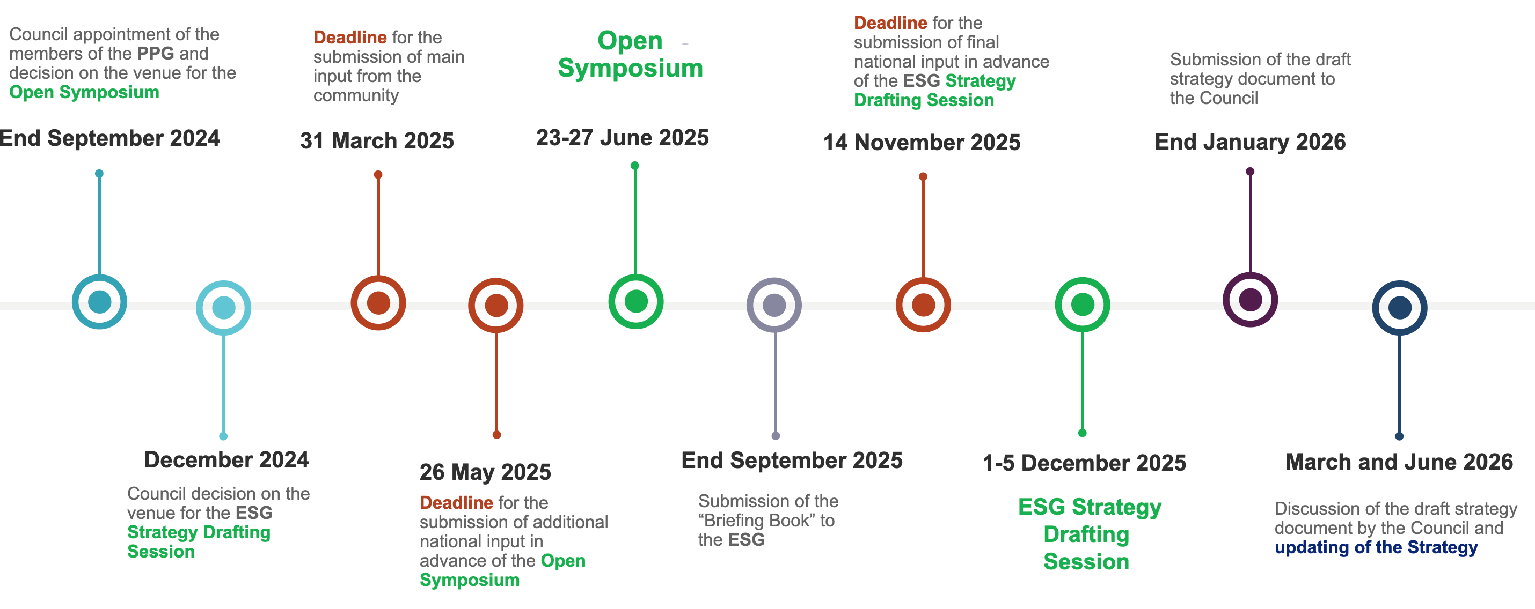
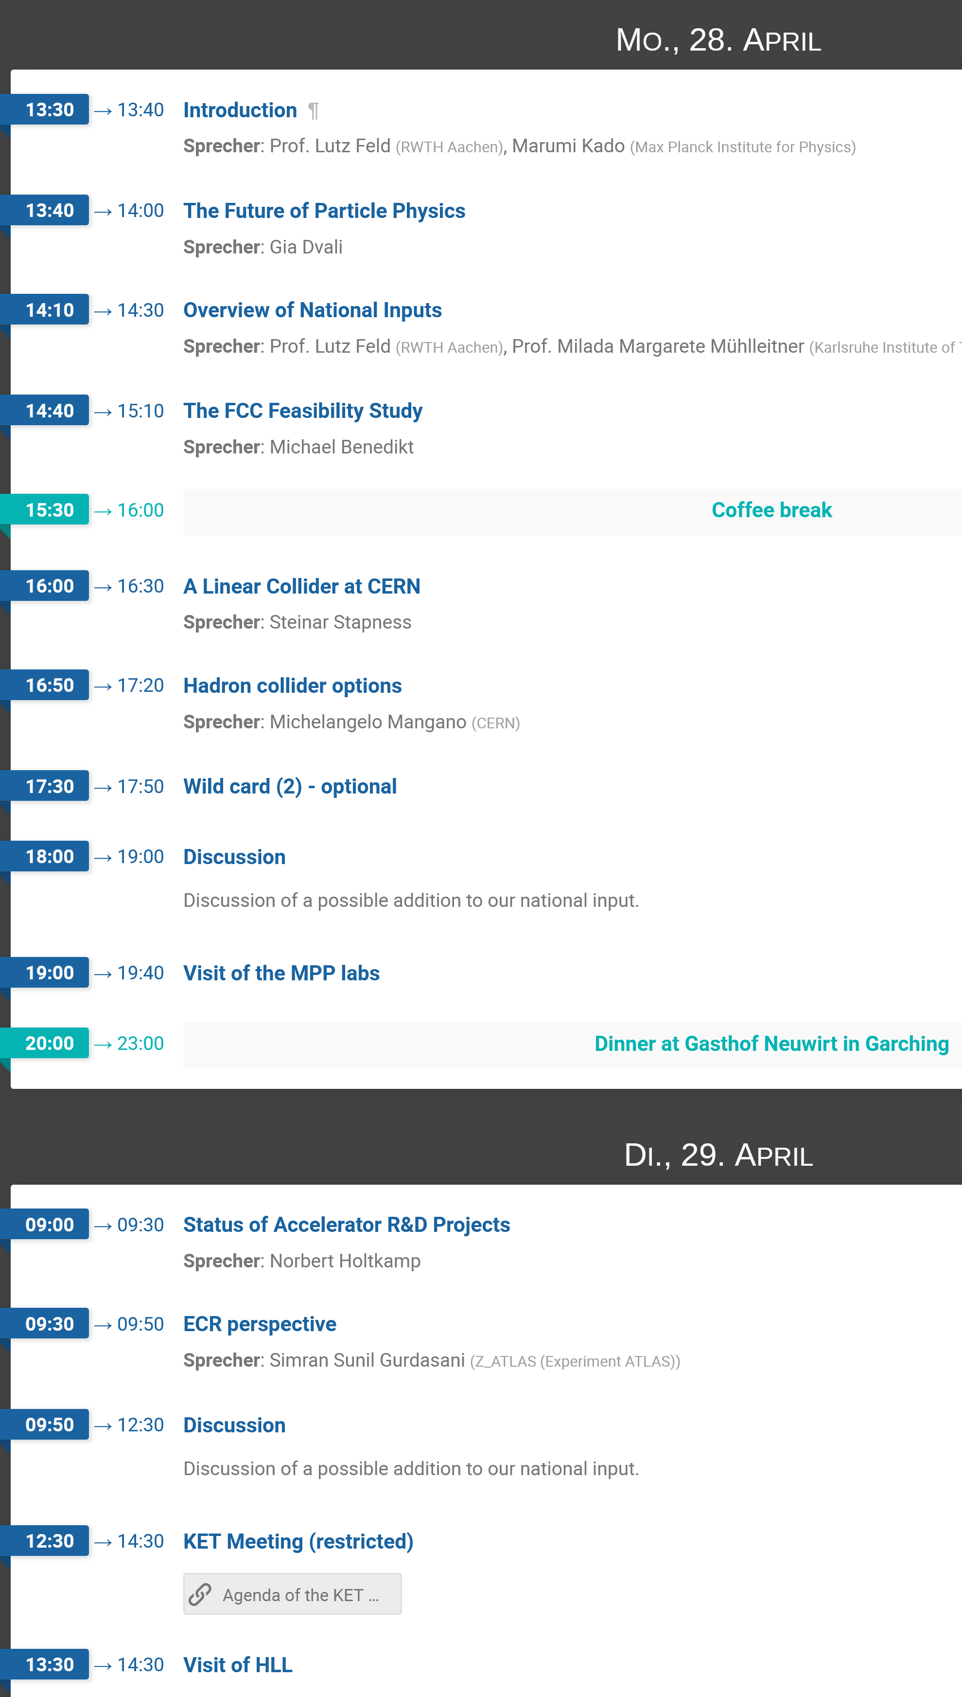

Update of the European Strategy for Particle Physics
we are here
https://home.cern/news/news/knowledge-sharing/updating-european-strategy-particle-physics
Please register for this workshop if you wish to be informed about a possible addition to our input document!
https://indico.desy.de/event/48080

Slide 8
Implementation of the ECFA Detector Roadmap
all DRD proposals are approved
work on Memoranda of Understanding ongoing
  BMBF will not sign these MoUs
  (they do not sign MoUs of “small” experiments)
  institutes will sign as “funding agencies”
  in MoU annex 2 a footnote should be added
  as appropriate: „Partly funded by the Federal
  Ministry of Education and Research (BMBF)”
three consortia are funded through ErUM-Pro:
  Silicon Detectors (J. Dingfelder, Uni Bonn, E. Garutti, Uni Hamburg)
  Calorimetry (F. Simon, KIT)
  Gaseous Detectors (J. Kaminski, Uni Bonn, B. Ketzer, Uni Bonn)
more German groups are working in (probably) all DRDs
work has started, first consortia meetings before or at the Terascale Detector Workshop [https://indico.desy.de/event/47789/]
[D. Contardo]

Slide 9
Computing and Software
KET Computing and Software Panel
  Chair: Günter Duckeck, Deputy Chair: Thomas Kuhr → Frank Gäde
ErUM-Data Funding
  Application deadline was on January 15th,
  many applications with (leading) participation from KET community
  50 applications from all ErUM communities and for all three pillars
  (federated infrastructure, software and algorithms, research data management)
  Total requested budget: ~100M Euro
  Available budget and decision schedule depends on federal budget
  Anticipated start of projects on October 1st
ErUM-Data Hub
  Essential for successful connection of actors, training, and transfer
  Concept for continuation after 2026 to be developed
  DIGUM Spokesperson: Martin Erdmann → Thomas Kuhr
Proposal for second funding period of PUNCH4NFDI is being prepared

Slide 10
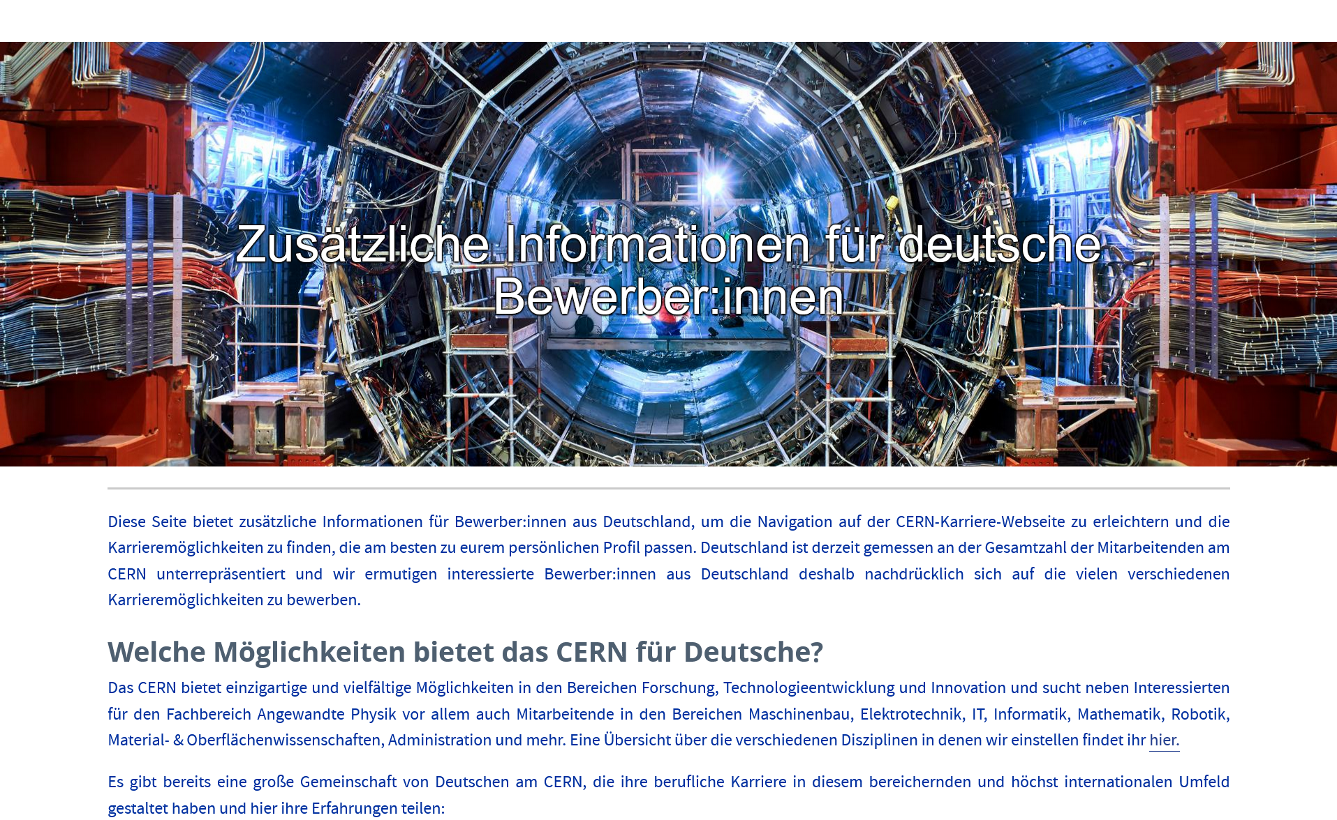
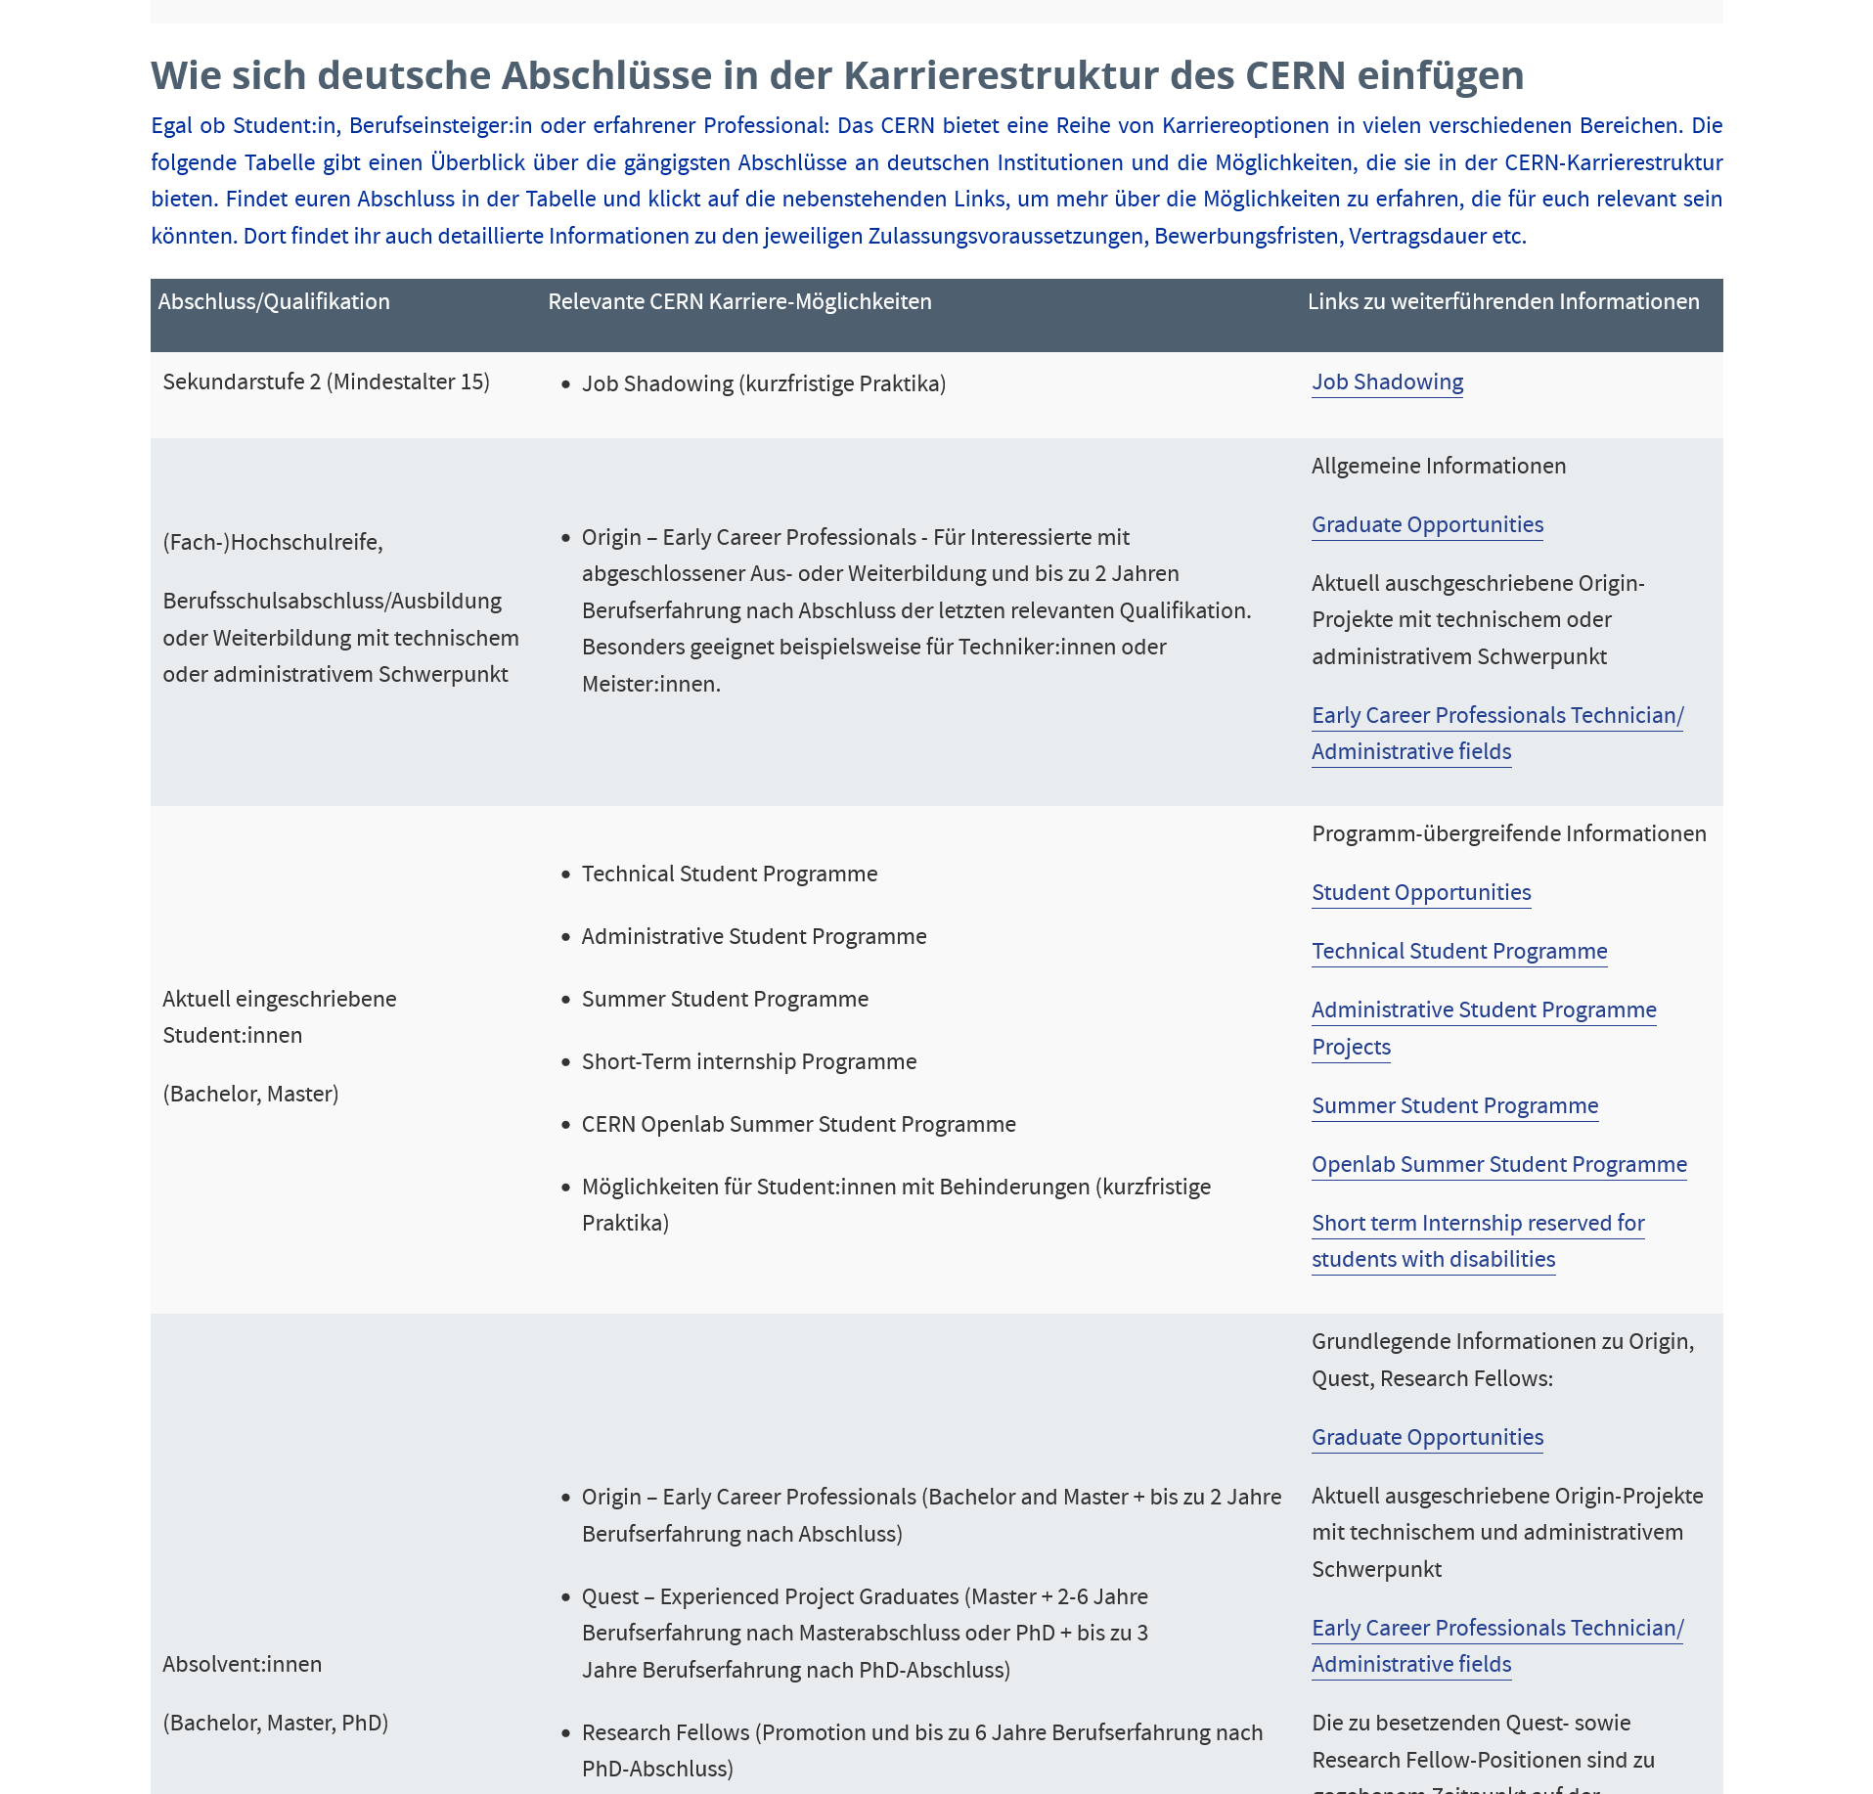
Career opportunities at CERN
proportion of Germans at CERN is improving but still too low compared to the German share in the budget of 21%
we need to fill the pipeline!
please advertise the early career opportunities:
  summer / technical student programme
  doctoral student programme
careers.cern/zusatzliche-informationen-fur-deutsche-bewerberinnen
(link available via the KET web page ketweb.de)
CERN offers a “CERN road show” which can be booked in autumn
  contacts: Flavia Düsselberg und Sabrina Holthausen,
  Talent Acquisition, CERN

Slide 11
Next steps
28. - 29. 4. 2025 Strategy workshop at MPP Garching
23. - 27. 6. 2025 Open ESPP Symposium at Venice
October 2025 possibly another strategy workshop
20. - 21. 11. 2025 KET annual meeting
Summer 2026 Update of the European Strategy for Particle Physics
Submission of ErUM-Pro applications
19. - 20. 11. 2026 KET annual meeting
…
18. - 19. 11. 2027 KET annual meeting
www.ketweb.de
KET minutes
KET statements
annual meetings etc.
dhep_exp + dhep_theo email lists

Slide 12
Additional Information

Slide 13
Considerations regarding future CERN flagship
  „Statement by the German Particle Physics Community as Input to the Update of the European Strategy for Particle Physics” [https://www.ketweb.de/stellungnahmen/]

