Slide 1
Election of the
Chairperson and Vice Chairperson of the Division Particle Physics for the period June 2025 to May 2027
Andreas Haungs, Lutz Feld
(election officers)

Slide 2
Procedure
We follow the election rules of the division: https://www.dpg-physik.de/vereinigungen/fachlich/smuk/fvt/wahlordnung
Division chairperson (Johannes Haller) appointed two election officers: Andreas Haungs, Lutz Feld (from KAT and KET)
Call for nominations sent to all members of the division on 4.2.2025
  Johannes Haller (current chairperson) is available for a second term
  Ralph Engel (current vice chairperson) has served the max. allowed two terms
1 colleague was nominated as chairperson and agreed to stand for election: Johannes Haller
6 colleagues were nominated as vice chairperson,
of which 2 agreed to stand for election: Stefan Funk and Federica Petricca
Names of candidates and CVs have been sent to members of the division on 16.03.2025
Vote today
  separate secret ballots for chair and deputy chair
  only members of the division particle physics may vote
  we use an electronic voting tool in the room and on zoom (many thanks to Anja Metzelthin)
  we will open the ballots in order and close them after a few minutes
  the relative majority of the votes cast shall be decisive

Slide 3
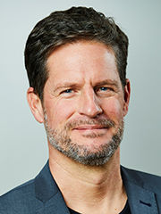
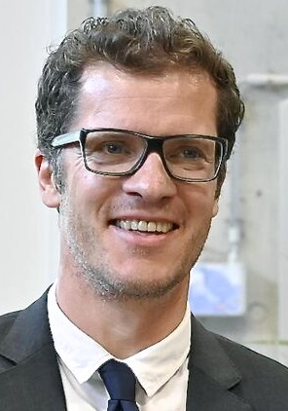
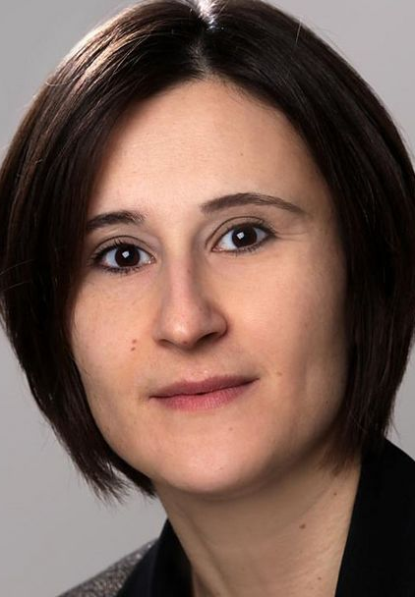
Candidates for the period June 2025 to May 2027
Chairperson
Vice Chairperson
Prof. Dr. Johannes Haller
Universität Hamburg
Prof. Dr. Stefan Funk
ECAP Erlangen
Dr. Federica Petricca
Max-Planck Institut für Physik

Slide 4

Voting
Test vote: Who is quoted as saying “Prediction is very difficult, especially if it's about the future.”? | Niels Bohr | Albert Einstein | abstain
I vote for Johannes Haller as the next chairperson of the DPG Division Particle Physics. | yes | no | abstain
As next vice chairperson of the DPG Division Particle Physics I vote for | Stefan Funk | Federica Petricca | abstain
https://voxr.com/dpg

