Slide 1
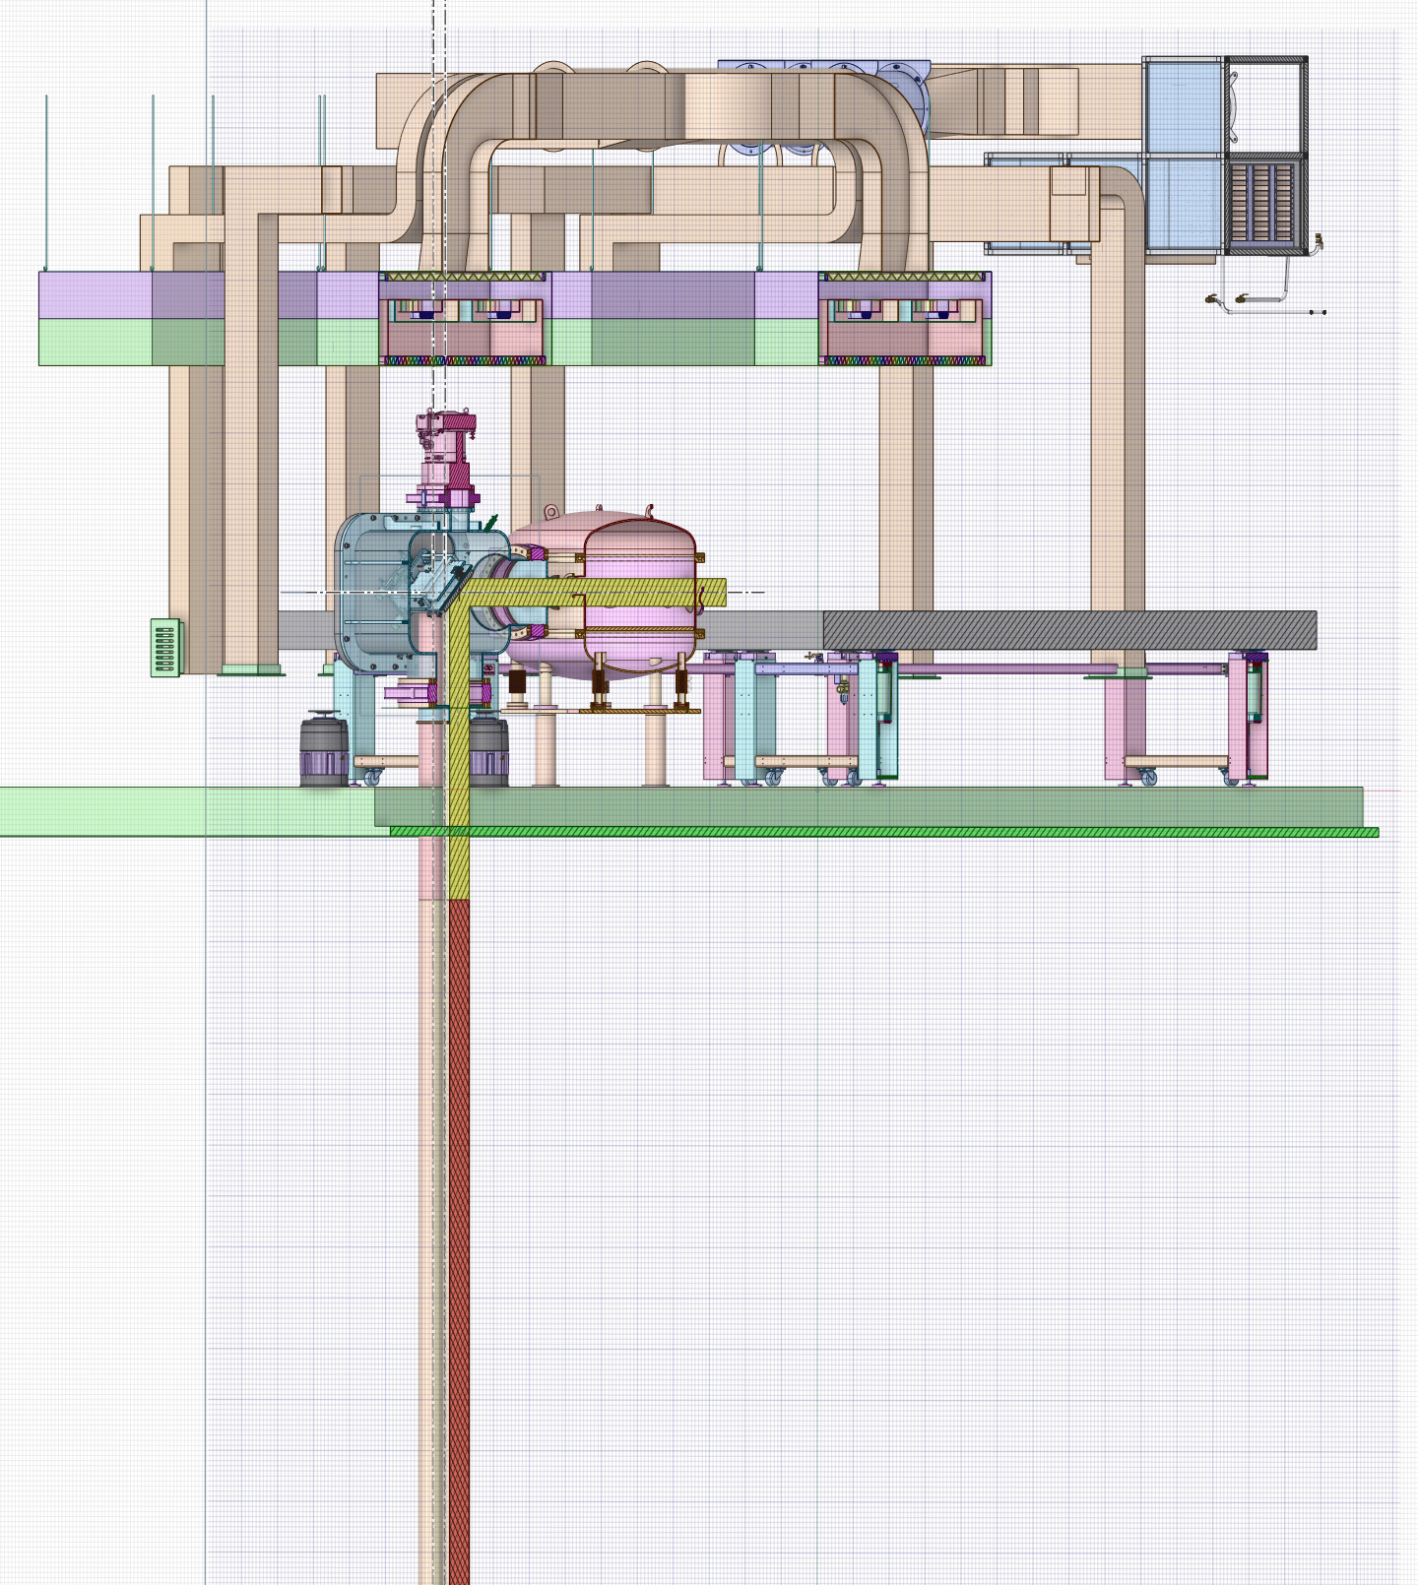
Search for the optimal location for a clean room for the JETI40 Laser.
Grigory Yakopov
JETI40 DESY Laser meeting
7February2025

Slide 2
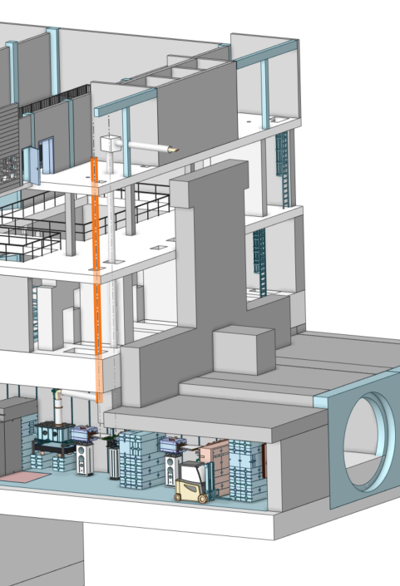
The laser beam was directed to the interaction point based on the presence of a shaft and was alignied with the shaft.
XS1 shaft

Slide 3
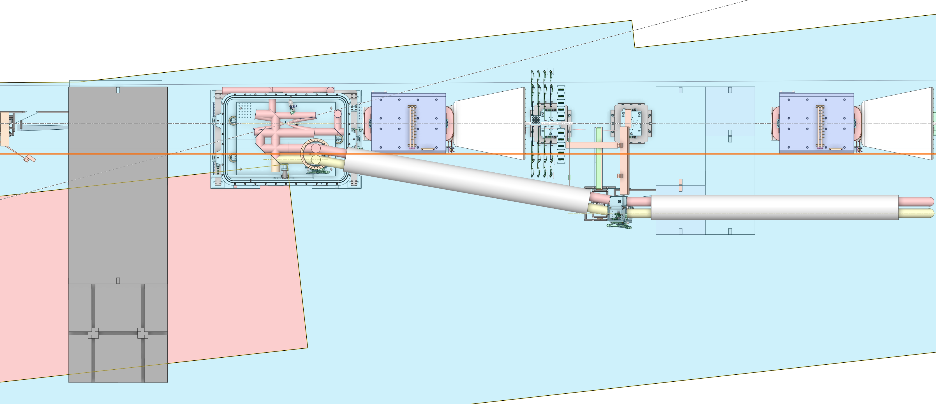
This entails the need to redirect (break) the beam in a different plane.

Slide 4
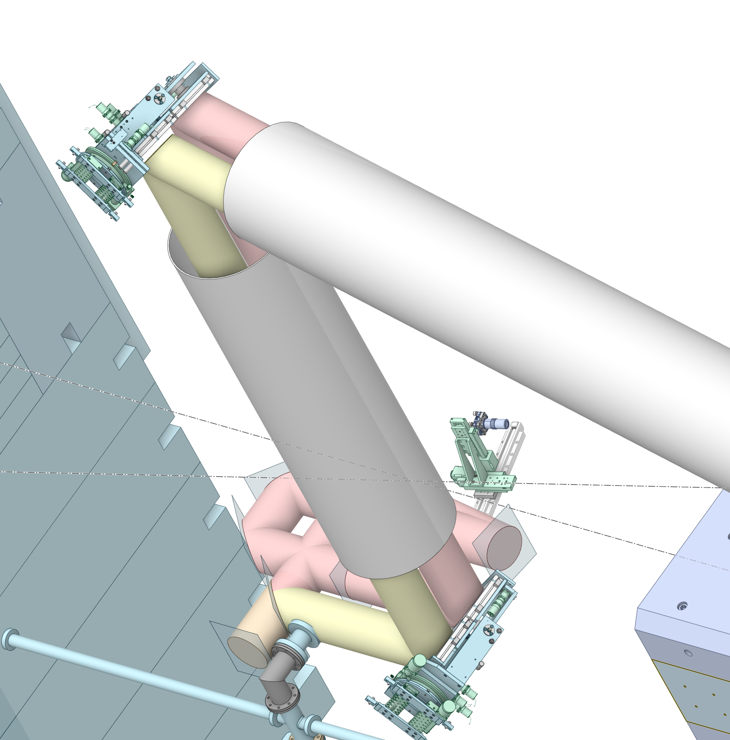
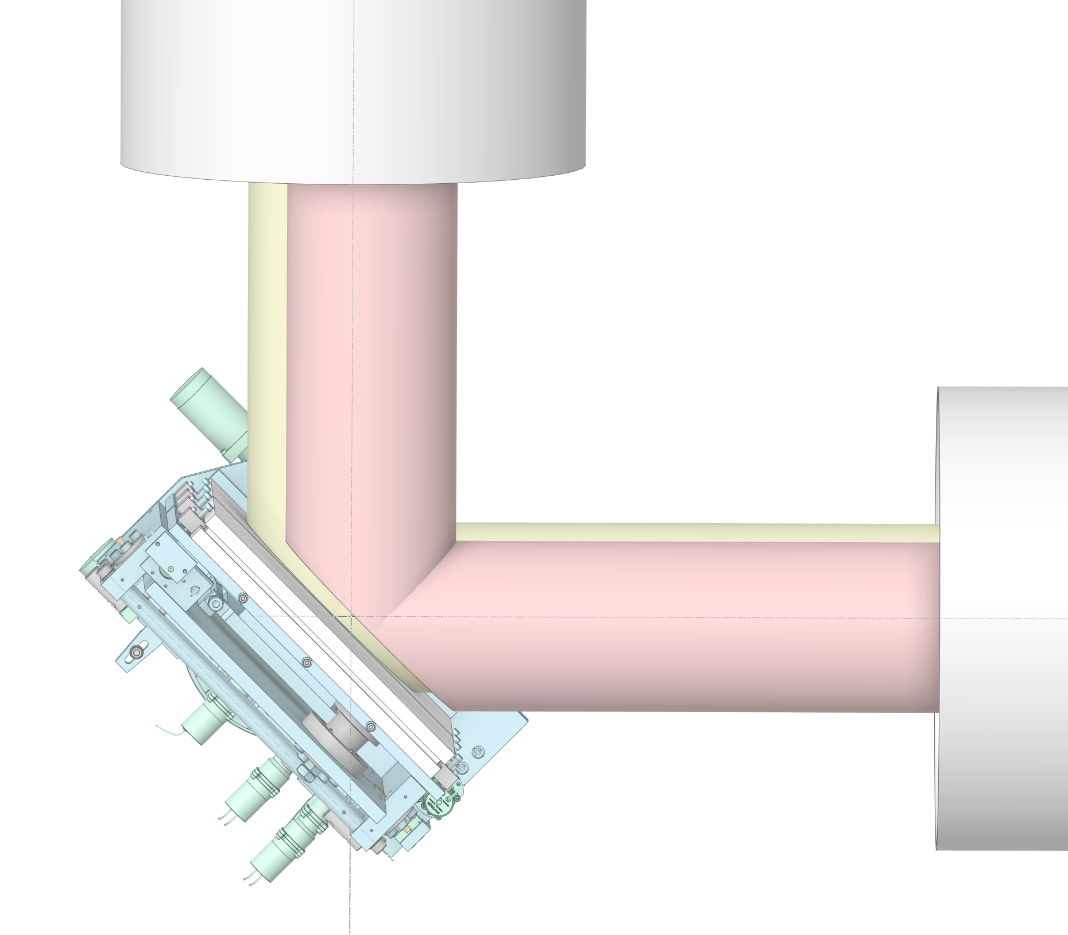
The beam redirection, in turn, requires a modification of the radiation transfer unit's design.

Slide 5
Proposed approach

Slide 6
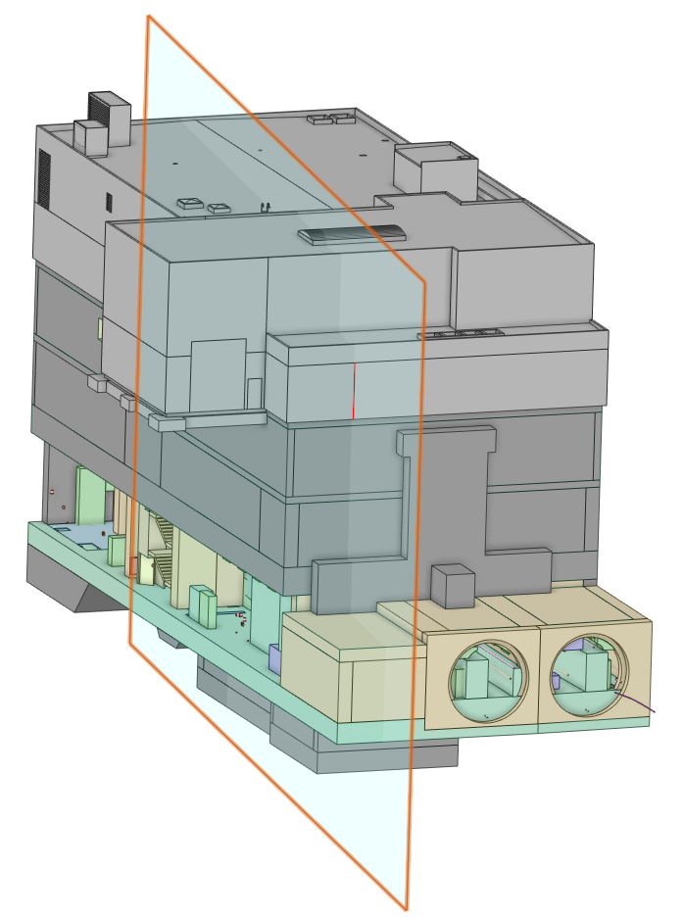
XS1 shaft

Slide 7
XS1 shaft

Slide 8
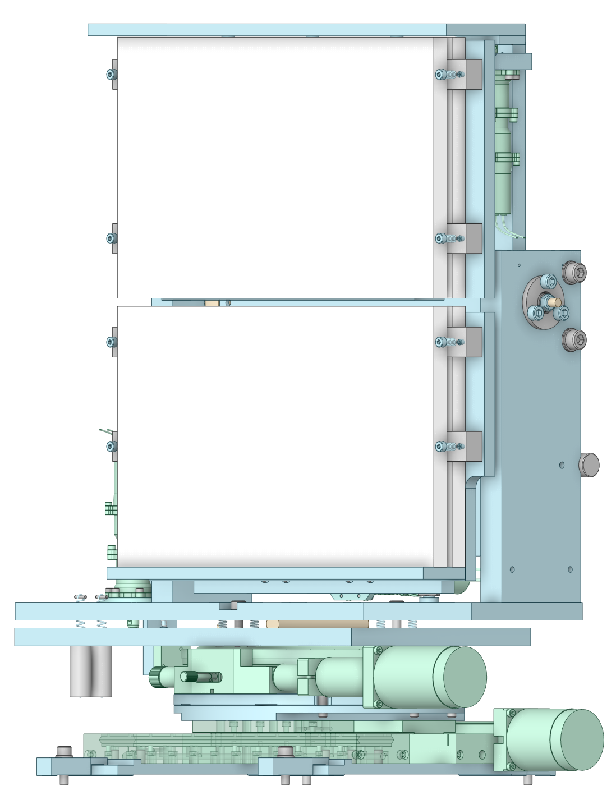
Conclusions:
If we want to use the existing beam transfer unit, the entire beam must be positioned in a single plane.
There is no need to align the laser beam with the shafts; drilling holes is simpler than redesigning the optics.
Without modifying the optical scheme inside the interaction chamber (and considering point 1), directing the beam outside the building is impossible, as it collides with the partition wall.
Based on point 3, the beam should be redirected inside the building.
Given the large amount of unused space inside the building (at least until the XFEL extension), constructing a new building for the laser seems impractical.

Slide 9
Backup

Slide 13
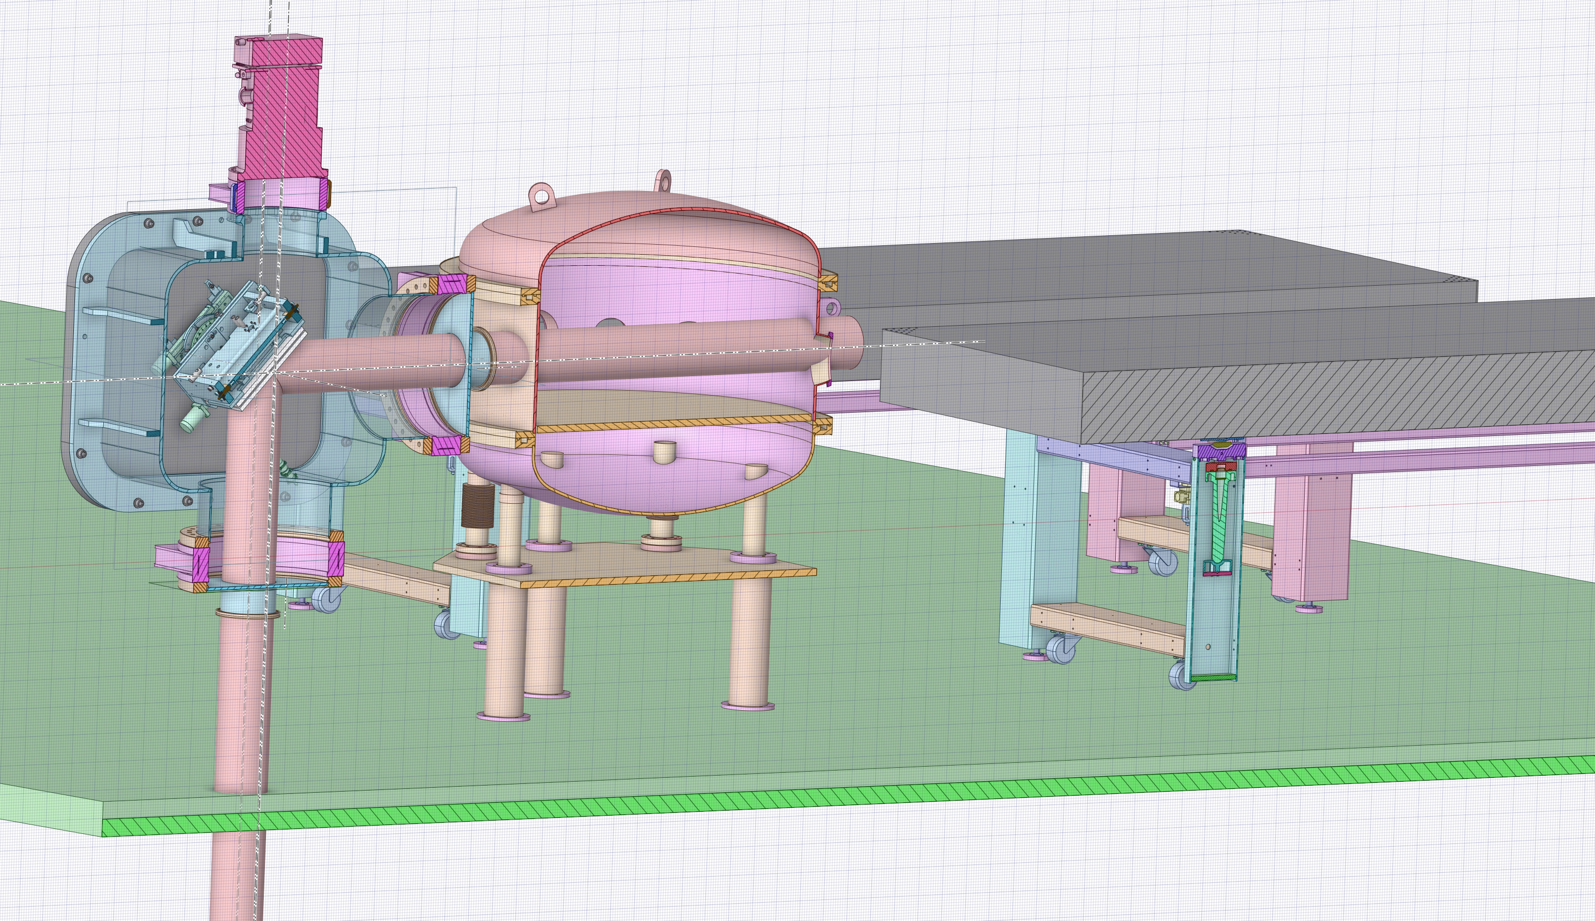

Slide 14
