Slide 1

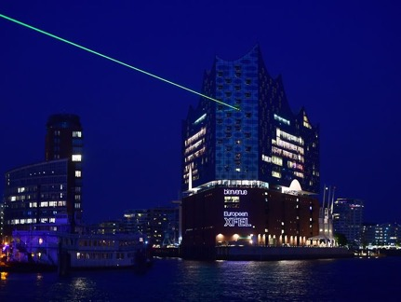
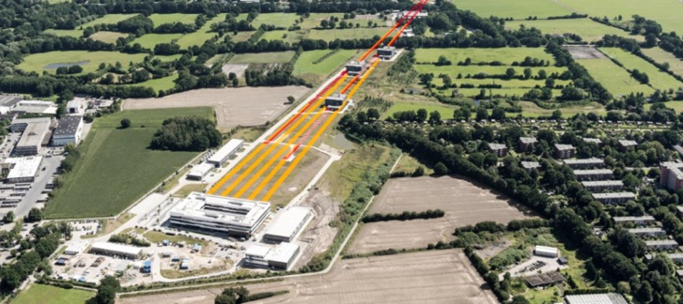
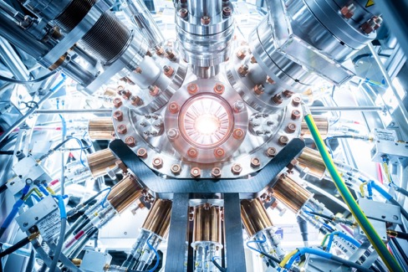
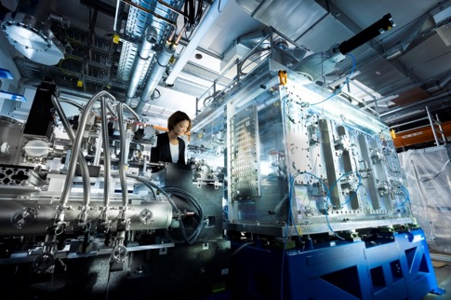
Welcome to the European XFEL !
Enlightening Science
Dr. Jan Grünert
Group leader X-ray Photon Diagnostics (XPD)
14th Longitudinal Diagnostics Workshop
29 September 2025 (12h45-13h00)

Slide 2

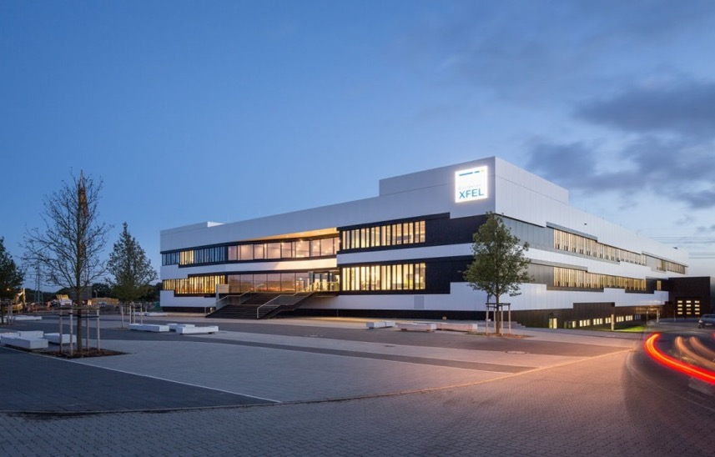
European XFEL – a user facility of superlatives
Facts and Figures
Non-profit company with 12 partner countries
Start of construction: 2009
Start of operation: 09 / 2017
Construction costs: 1.54 billion Euro
Annual op. budget: ~140 million Euro
> 500 employees (+250 @DESY)
The largest and strongest X-ray laser in the world!

Slide 3
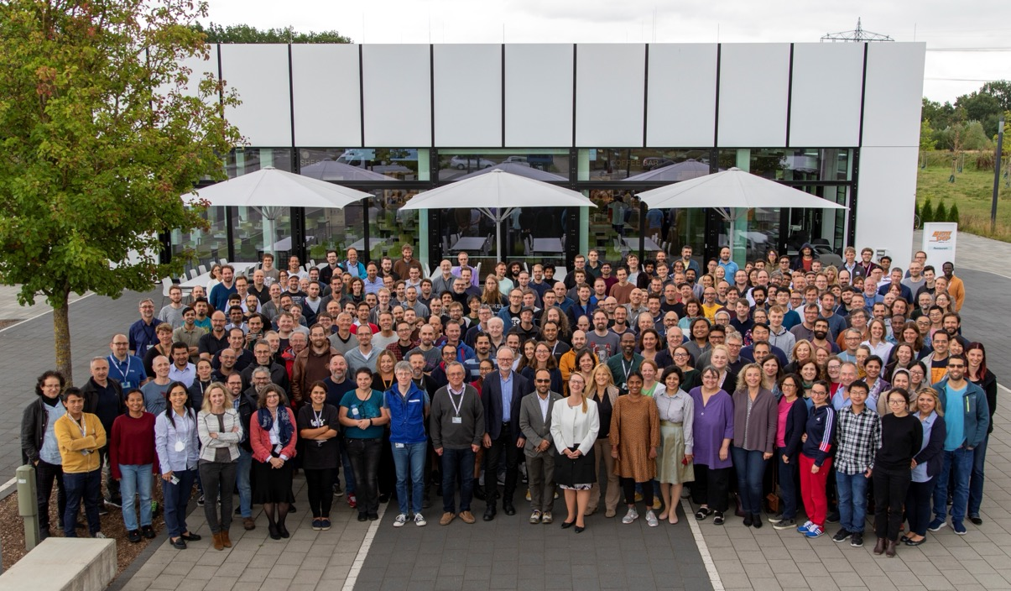
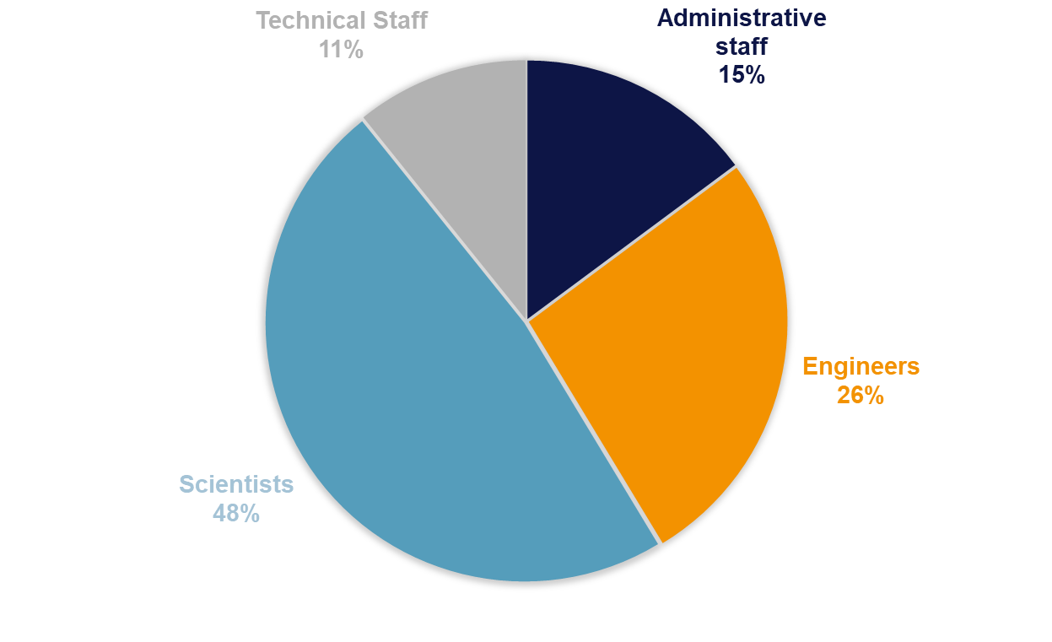
Employees
More than 500 people from over 60 countries (*) (+250 at DESY)
(*) 2023 data
Notes:
26 % of EuXFEL staff are female

Slide 4
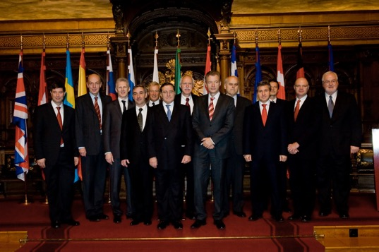
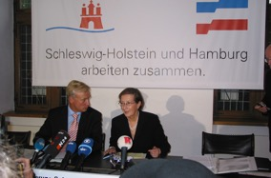
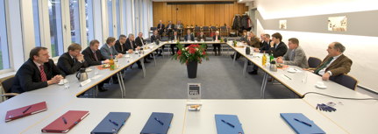
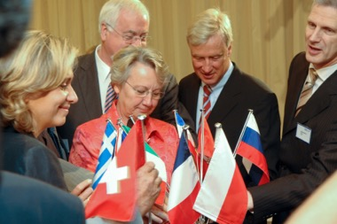
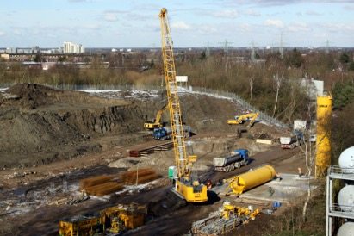
Foundation of European XFEL
European XFEL project officially launched
Civil construction begins
2007
2009
2004
2008
2009
Treaty for
founding and
construction
1st construction contracts
awarded
Signing of the international European XFEL convention

Slide 5
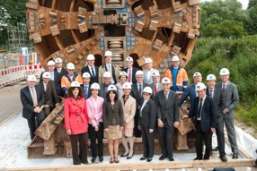
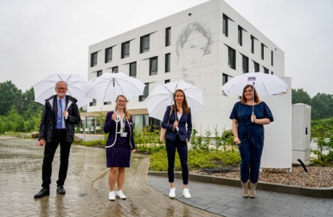
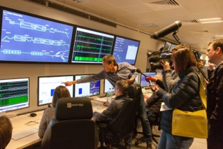
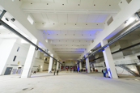
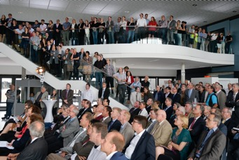
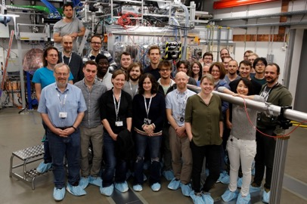
Construction of European XFEL
All scientific
instruments in
operation
Inauguration of headquarter
2015
2019
2012
2017
2021
Completion
of tunnels and
underground
construction
Facility
inauguration and start of
operation
Opening of guest
house

Slide 6

DESY and European XFEL: Strong partners
DESY is European XFEL’s largest shareholder
Facility concept developed at DESY
FLASH user facility opened to users in 2005
DESY and European XFEL cooperate on construction, commissioning and operation of the X-ray laser
DESY built the accelerator in international cooperation with partners and operates it on behalf of European XFEL

Slide 7
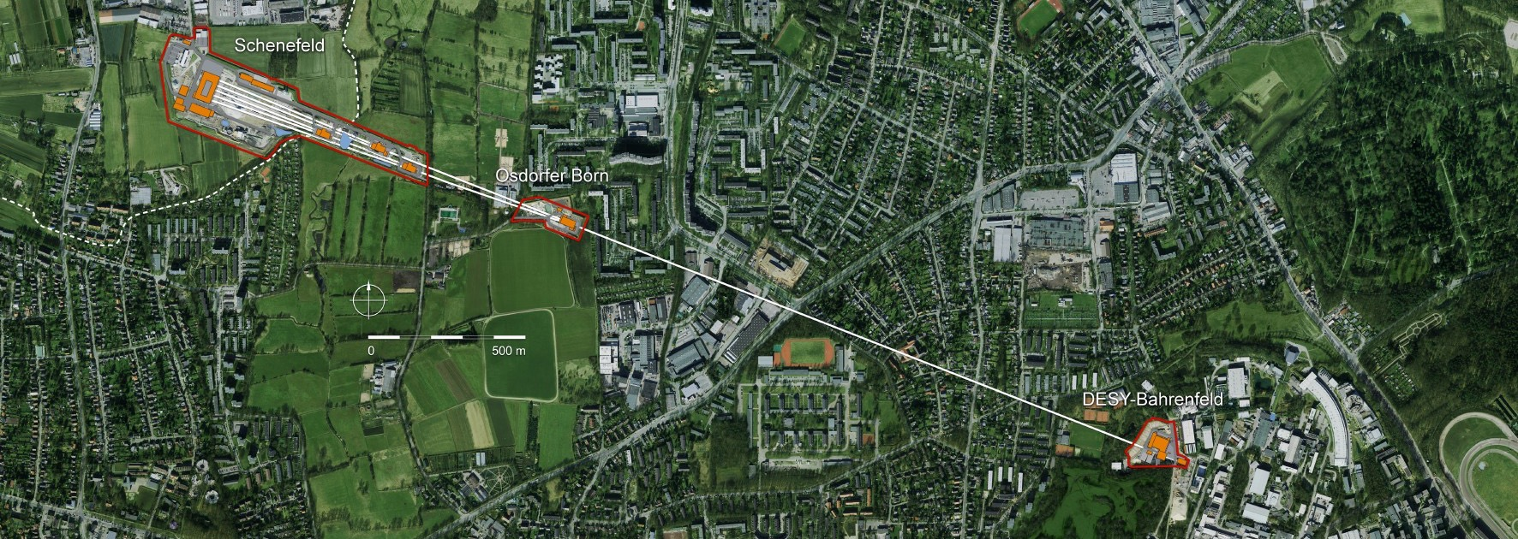
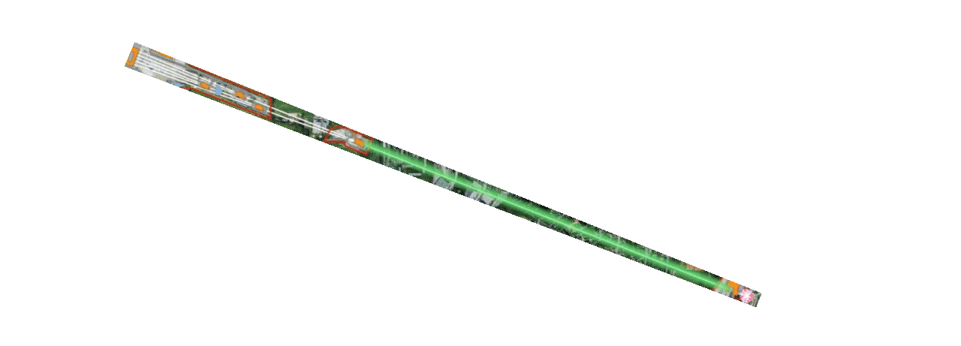
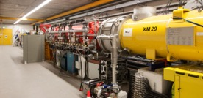
The European XFEL at a glance
Total length: 3,4 km
Injector at DESY campus

Slide 8
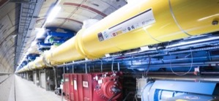
The European XFEL at a glance
Total length: 3,4 km
Superconducting linear accelerator
Injector at DESY campus

Slide 9
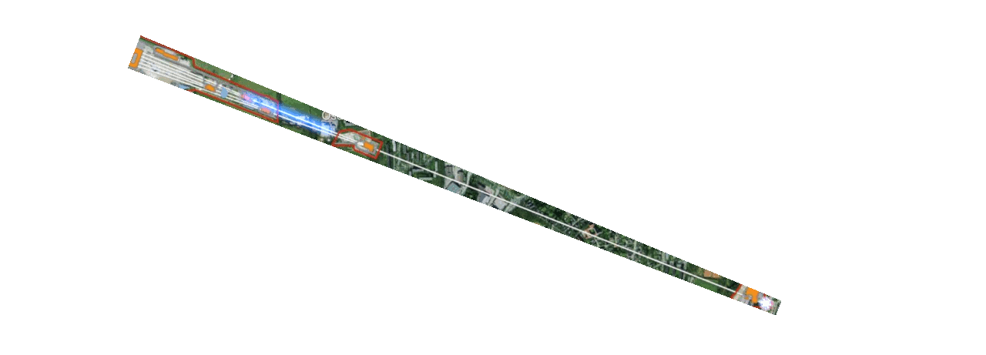
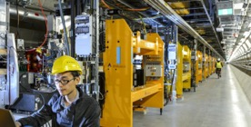
The European XFEL at a glance
Total length: 3,4 km
Superconducting linear accelerator
Undulator systems
Injector at DESY campus

Slide 10
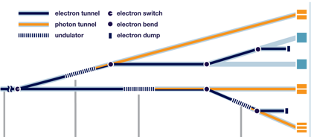
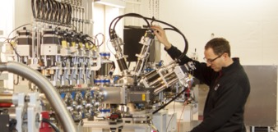
The European XFEL at a glance
Total length: 3,4 km
Superconducting linear accelerator
Scientific instruments in Schenefeld
Undulator systems
Injector at DESY campus

Slide 11
More flashes = shorter experiment times
10Hz XFEL pulse pattern: 99.4 % empty
The European XFEL can produce up to 27000 X-ray pulses / sec
Previous machines produced max. 120 pulses per second
Bunch trains: 4.5 MHz total repetition rate
More data at a faster frame rate
less time needed for experiments
100 ms
60 W / 2 ☺ (global average)
600 μs
10 kW  (train-averaged)
25 fs
100 GW (peak power)
time
up to 2700 pulses/train
up to 27000 pulses/sec
220 ns spacing
(4.5 MHz)

Slide 12
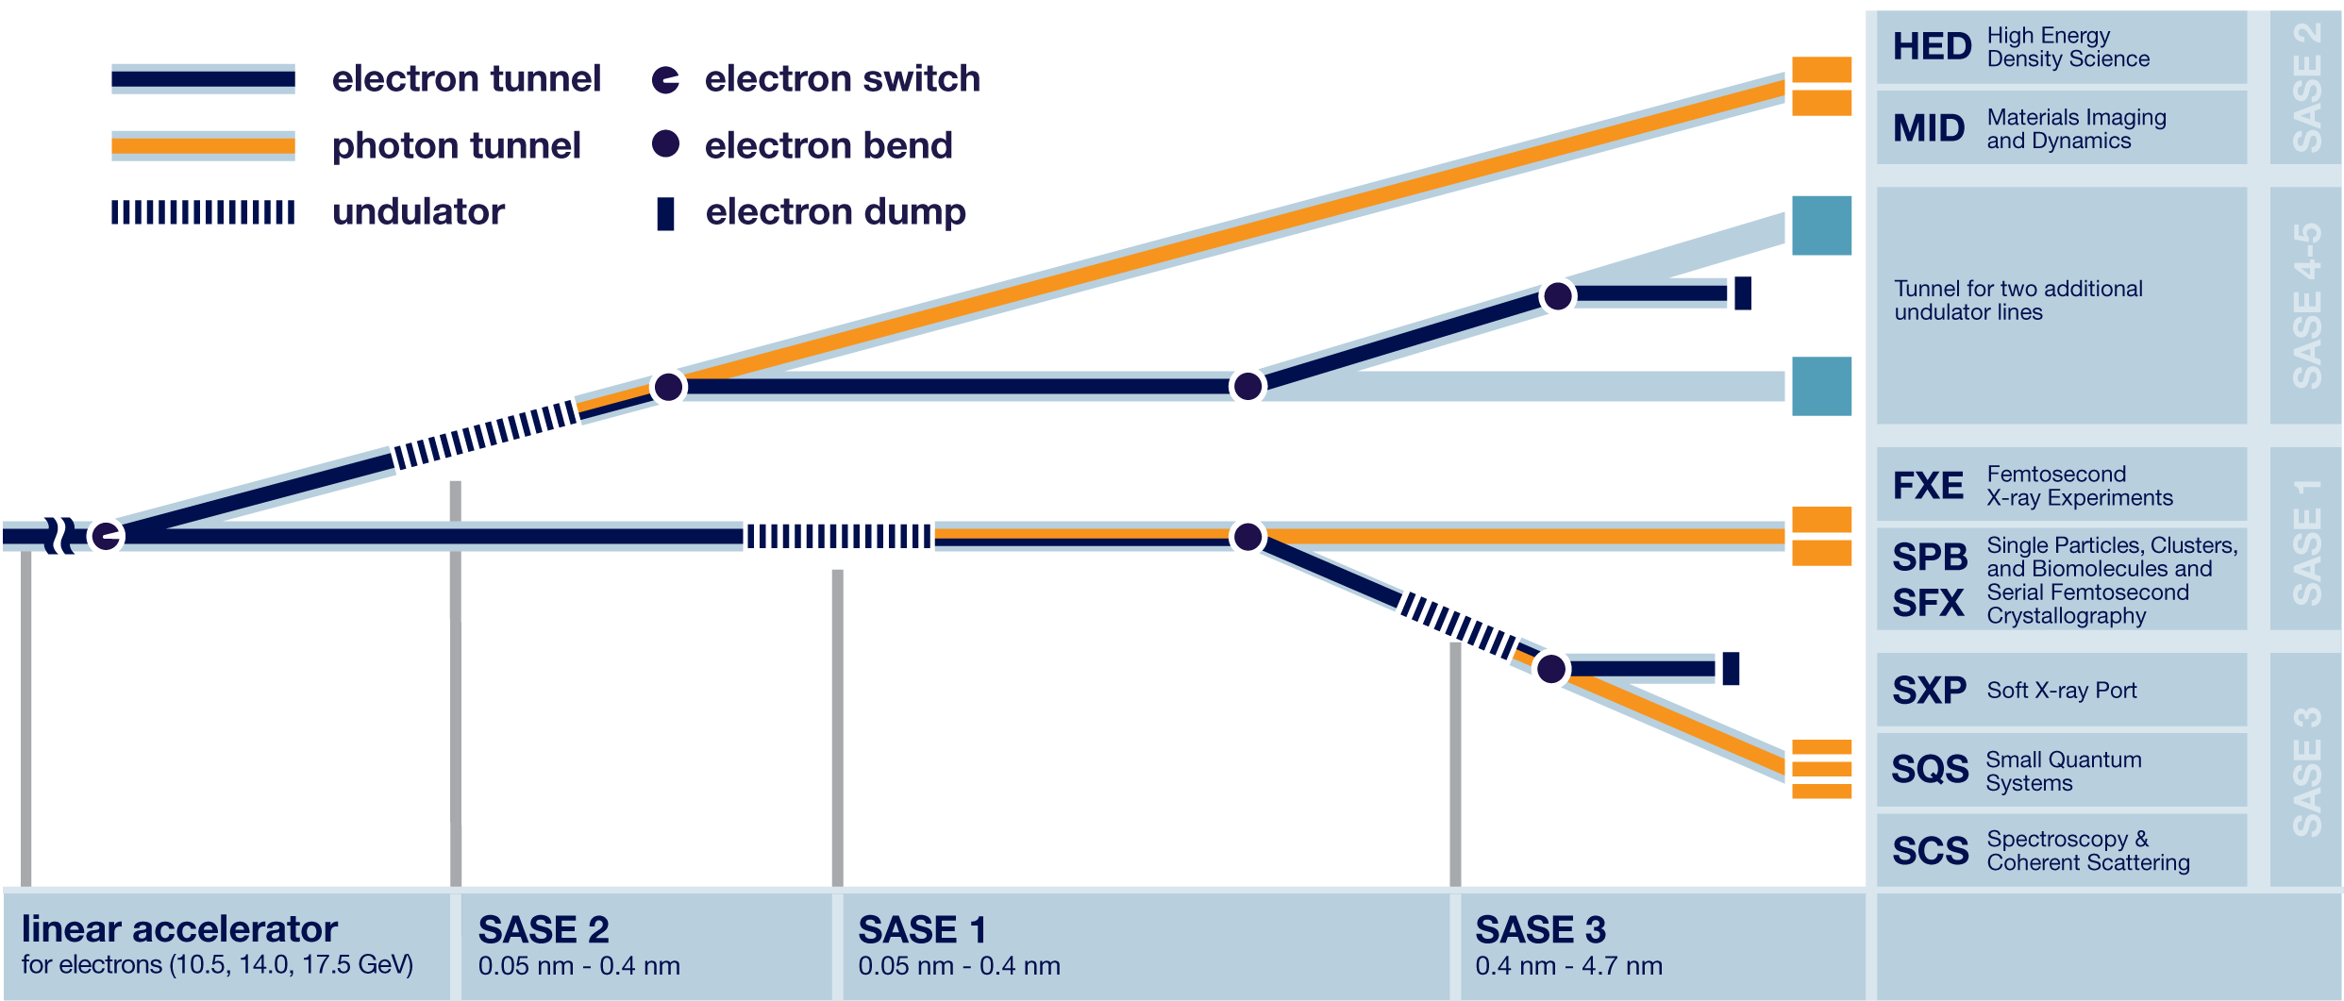
Beamline layout and experiment stations

Slide 13
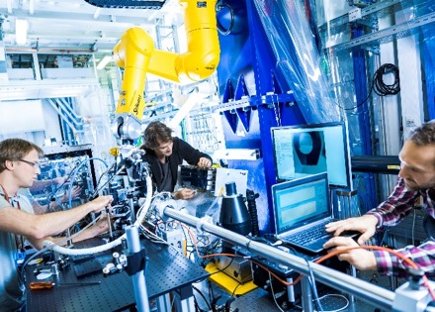
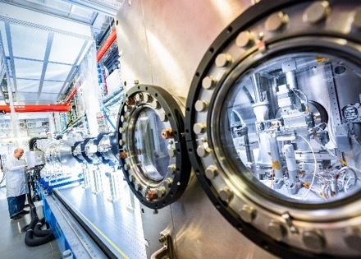
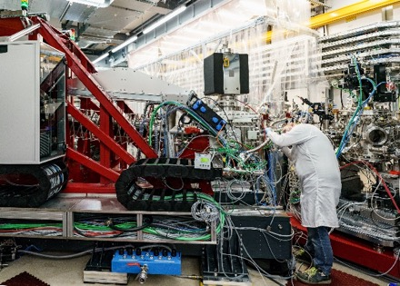
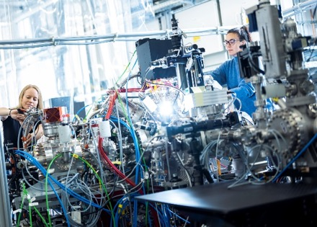
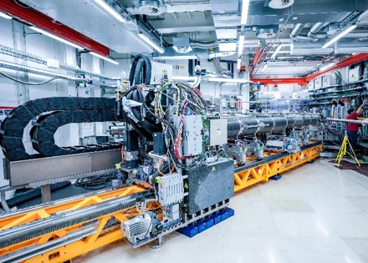
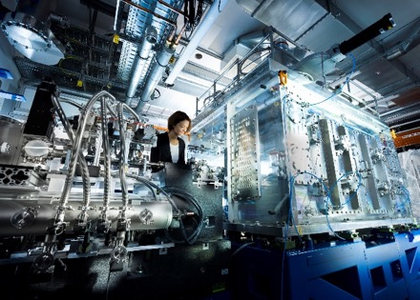
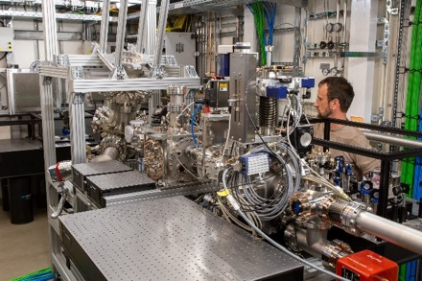

Scientific instruments
FXE (start Sep 2017)
SPB/SFX (start Sep 2017)
SCS (start Nov 2018)
SQS (start Nov 2018)
MID (start Apr 2019)
HED (start May 2019)
SXP (start summer 2023)
HXP (under construction)

Slide 14
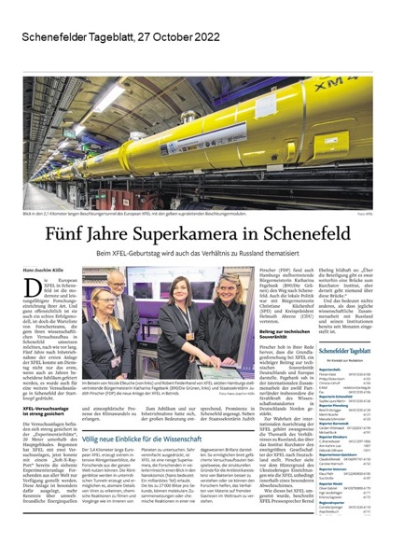
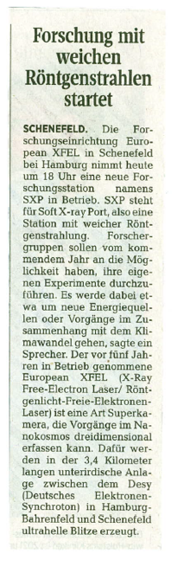
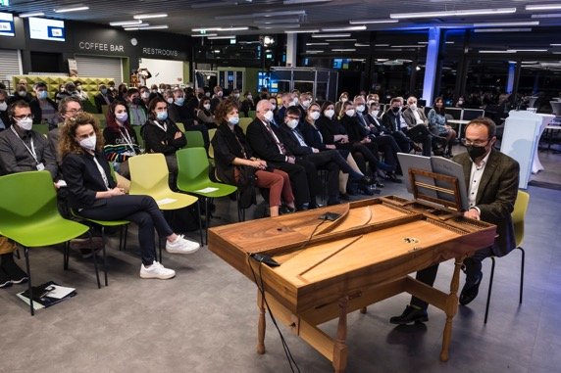
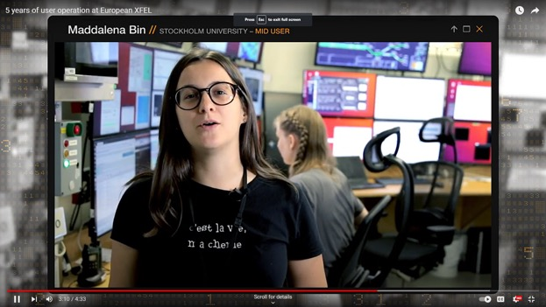
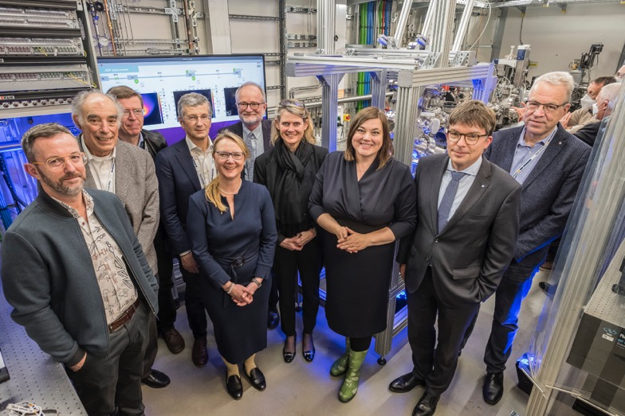
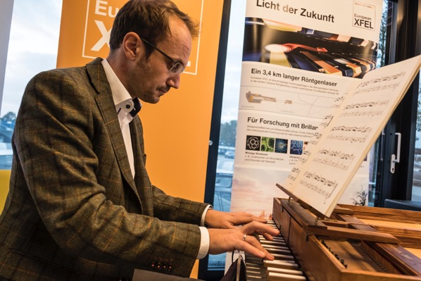
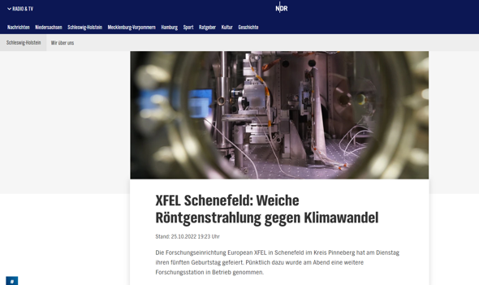
2022: Five years of user operation & Inauguration of SXP

Slide 15
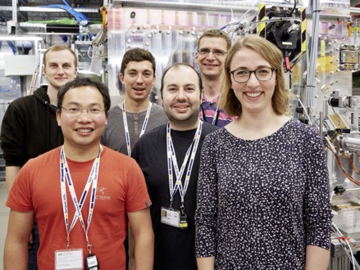
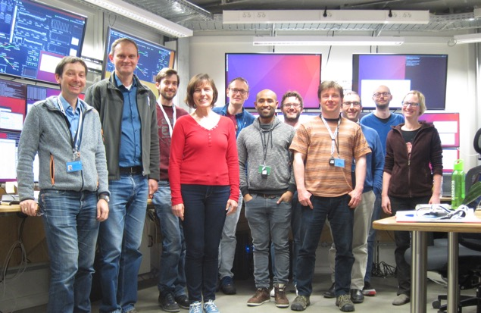
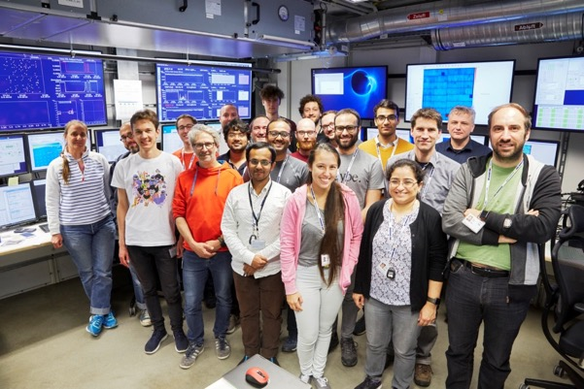
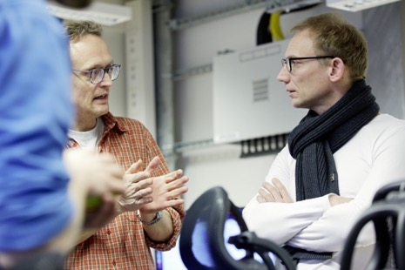
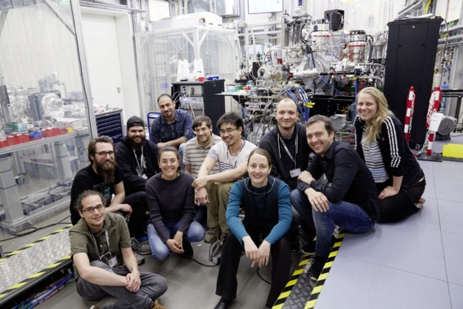
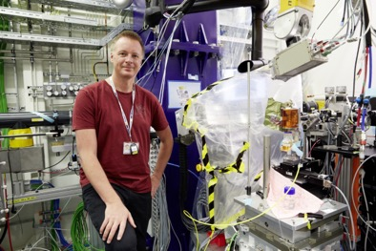
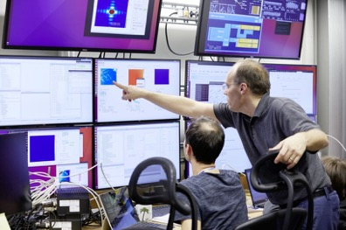
A user facility
European XFEL is a research facility open for users from around the world
One experiment takes about 3-5 days
~ 100 experiments/year
Topics defined by the user
To gain access:
Research groups write proposals
Panels of experts review the proposals
Selection based on excellence
European XFEL scientists and engineers support the users

Slide 16
The campus and tours

Slide 18
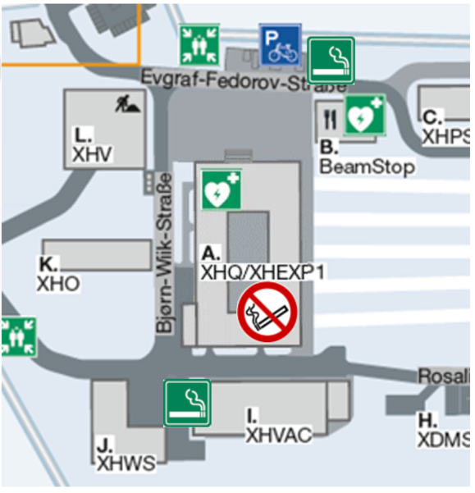

Smoking, alcohol, and intoxicating substances
Smoking, alcohol or other drugs may impede your ability to work.
Working while intoxicated is not allowed (no consumption of alcohol or other intoxications)
No smoking indoors or underground
Smoking is allowed only in designated smoking areas and at least 5m away from buildings

Slide 19
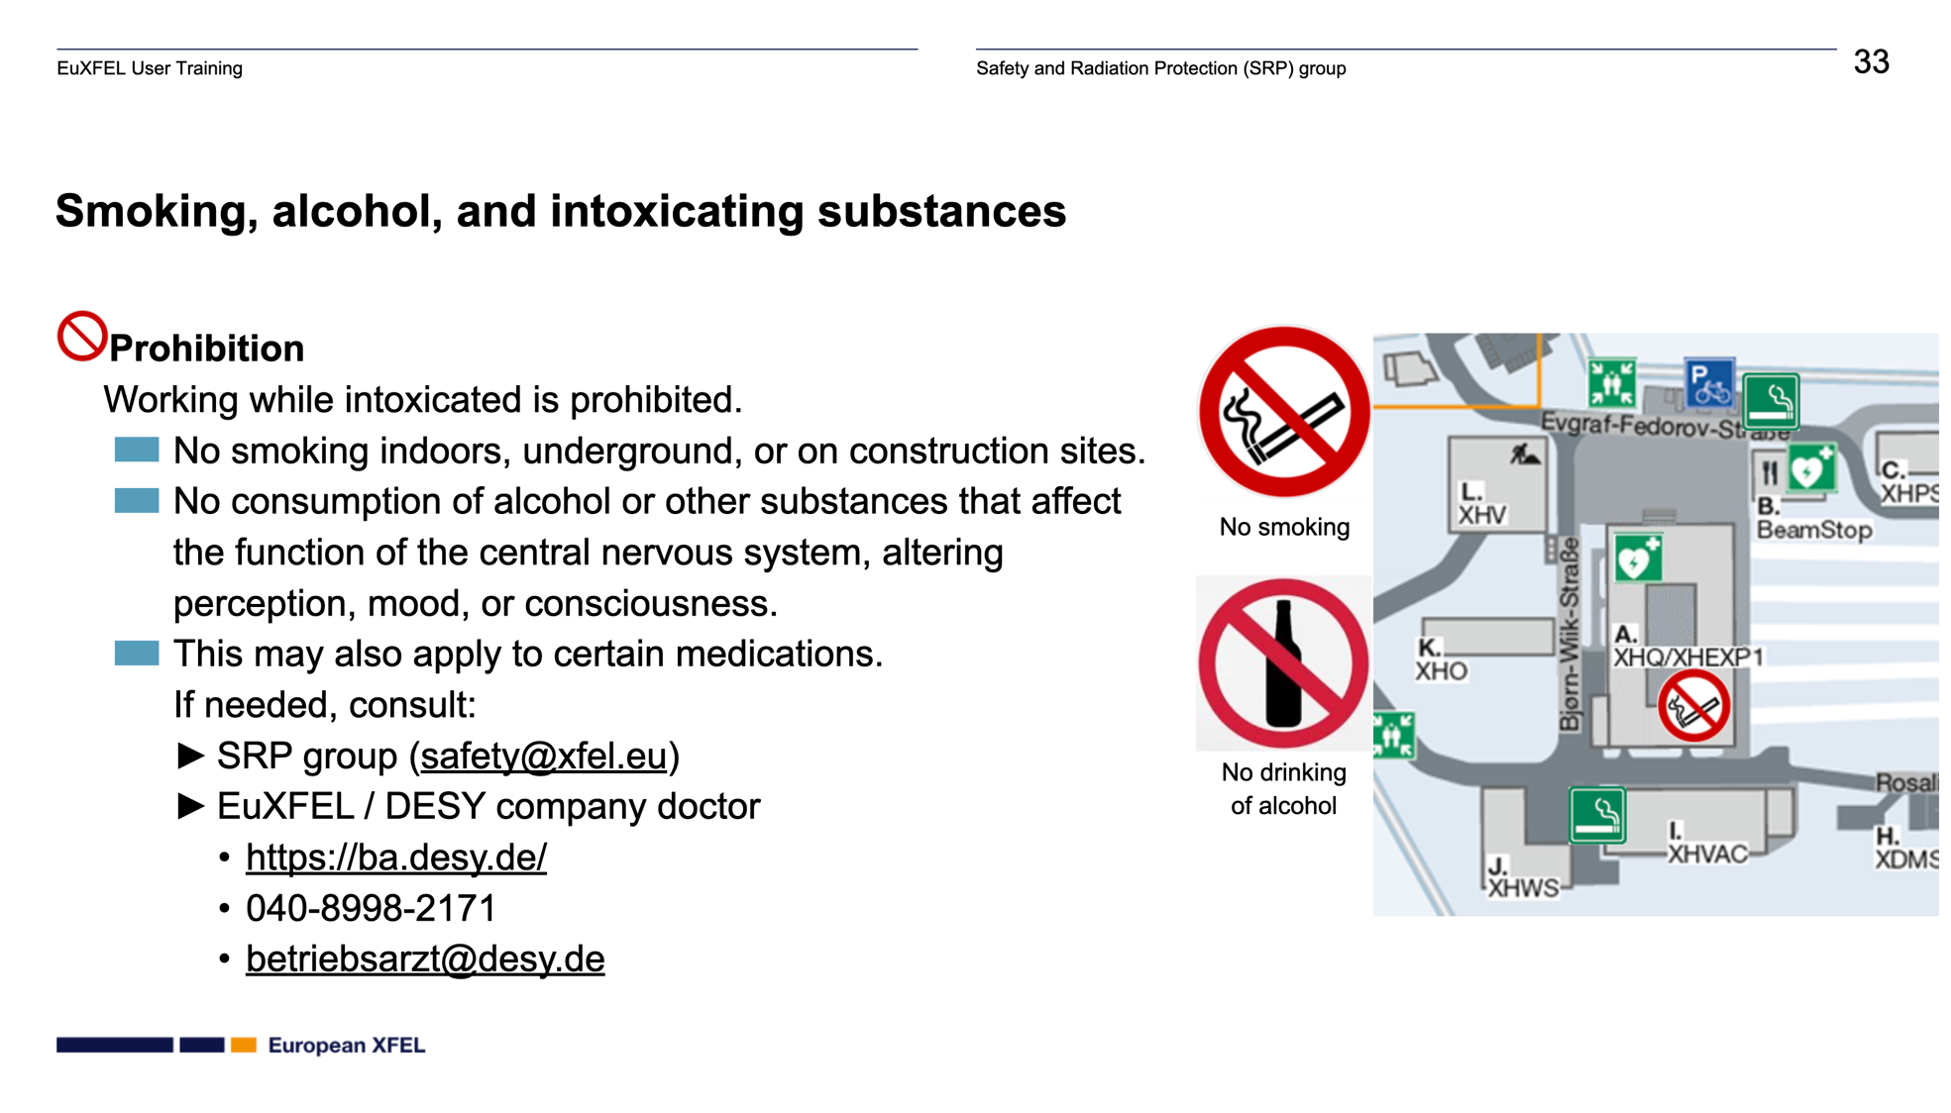

Slide 20


Slide 21


Tour of XHEXP1 (experimental hall)
N

Slide 22
Tour of XHEXP1 (experimental hall)
N

Slide 23

Tour of XHEXP1 (experimental hall)
N

Slide 24
Tour of XHEXP1 (experimental hall)
N

Slide 25
Tour of XHEXP1 (experimental hall)
N

Slide 26
Tour of XHEXP1 (experimental hall)
Access elevators and Emergency exits (stairs)
N
SASE2
SASE1
SASE3
XTD tunnels

Slide 27









A few rules for the tour
Wear flat, closed shoes
Don’t take bags and backpacks into the experiment hall
Do not take food and drinks into the experiment hall
Stay together, don’t leave the group
Don’t enter restricted areas, obey signs
Look, but don’t touch
Emergency phone number:
2500
+49-8998-2500

Slide 28

Thank you for your attention!

Slide 29




Let’s start the tour!
Photos welcome!
#xfel #europeanXFEL

Slide 30
Our User Community
1191 individual users in 2022
637 of them on site
European XFEL is open for researchers from our Shareholder countries and world-wide
In collaboration with our Shareholder country communities
Basic research
Applied research
Innovation promotion
Technology development
Notes:
Grundlagenforschung
Angewandte Forschung
Innovationsförderung
Technologie-Entwicklung

Slide 31





European XFEL, in collaboration with the users, contributes to the solutions of the future
Health
Climate & Energy
Structure & dynamics of biomolecules
to understand fundamental processes important for human health
Structure & dynamics of new materials for
more sustainable energy solutions and improved energy efficiency, storage & transport
Digitalization
Environment & Sustainability
Driving data science by managing and analyzing (AI/ML) voluminous experimental data in near-to real time
Study novel materials from sustainable sources, sustainable agriculture and geophysical processes of our planet

Slide 32







European XFEL, in collaboration with the users, contributes to the solutions of the future
Health
Climate & Energy
More efficient bacterial insecticides for agriculture and medicine
New catalysts for electrochemical water splitting: clean, large scale production of H₂
Digitalization
Environment & Sustainability
Miniaturization of magnetic recording devices: 16 nm FePt Potential magnetic storage layer
Copper complexes that act as an antibacterial agent in water under light

Slide 33


HEALTH: Antibiotic resistance
Antibiotic resistance is a leading cause of death worldwide
Bacterial enzymes play a key role in bacteria becoming resistant, for instance when they inactivate antibiotics. Filming this process can help to find new strategies against bacterial resistance
Microcrystals can be activated with a laser before the XFEL captures protein structures (here a model protein).
Notes:
Mainly SPB/SFX
Investigation of composition and structure of biomolecules, viruses etc.
Investigation of movement and change of biomolecules in the course of biological processes and thus insights into the functions as well as filming of ultrafast phenomena such as the formation or breaking of chemical bonds.
-> important e.g. for the development of new drugs and therapies or for the development of more efficient industrial production methods
Importance of knowledge about three-dimensional structures of certain proteins in viruses: "Manfred Weiss: The gene sequence of the Corona virus has been known since January 2020. Shortly after the outbreak of the disease, scientists in China succeeded in determining it using genetic methods. However, neither the function nor the weak points of the proteins - whether viruses or human proteins - can be understood from the pure sequence of amino acids. Only when the amino acids have "assembled" themselves in a complex folding process into the finished protein with a complex three-dimensional structure can they become biologically active. If the protein analysis is successful, we then know with more or less atomic precision which atom is in which position. From this, one can then determine, for example, the so-called active centre. This is the decisive point of a protein where certain biochemical reactions are initiated. Of the more than 3000 protein structures that we have been able to uncover in recent years, about half are bacteria and viruses. This is becoming increasingly important for drug development and facilitates the search for suitable active substances immensely."

Slide 34


DIGITALIZATION: Data storage for quantum computing
Need for better data storage media, efficient bit writing and good data stability
Taking snapshots and movies showing how nanoscale magnetic structures form and evolve
Nanoscale magnetic structures such as this skyrmion could become the basis for future data storage.
Notes:
Research at SCS
Material properties
Emergence of conductivity, magnetism, durability
Reducing the number of atoms to store digital information drives with higher storage density
Skyrmions:
Vortices in magnetic materials that behave like particles; are a few nm in size -> much more space-efficient in data storage (up to 1TB on a 1-Eurocent coin)
Are very stable because they have a low susceptibility to external influences such as temperatures or vibrations -> thus also has the disadvantage that they are difficult to create and change
Since they behave like particles, data storage could happen much faster in the range of picoseconds -> AI can benefit extremely from this

Slide 35


CLIMATE and ENERGY: Photocatalysis
Copying and optimising processes like photosyntheses that use sunlight to produce storable and transportable fuels
Taking detailed pictures and movies of the reactions that occur in the plant
Water can be split using photocatalysis to generate hydrogen, which can be used to produce other fuels, such as methanol.
Notes:
Research at FXE
Processes on catalysts and corresponding extremely fast processes for better understanding
Analyse capture of energy in light-sensitive catalysts and see transfer of charge between catalytic centres
Better catalysts -> better ways to produce desired products
Optimised production processes -> fewer toxic waste products

Slide 36


ENVIRONMENT and SUSTAINABILITY: Water
About 2 billion people have limited access to safe drinking water
When illuminated with visible light, Copper (Cu) complexes bound to silica can interact with molecular oxygen to produce a highly reactive oxygen species, efficiently killing bacteria
First examples of Copper complexes that act as an antibacterial agent in water under light
Notes:
At the FXE instrument scientists simulated the sun absorption process by illuminating the copper-based antibacterial compound with an intense laser pulse, and then “observed” the ultrafast changes that occur in the electronic state of copper and in the atomic structure using our very short and intense X-ray pulses. These changes occur on very fast timescales (down to 10s of fs), and are very small. At FXE, we have the sensitivity to measure tiny signals that are sensitive to the nature of the chemical bonds of copper.

Slide 37





Education and career development at European XFEL
European XFEL Ph. D. programme
~50 international Ph. D. students involved
Joint supervision with partners in Shareholder countries
Cooperations with other graduate schools
Summer schools and lectures for international students
Awards and internships for young students
EuXFEL Young Scientist Award 2023: Elke de Zitter, IBS Grenoble
EUCYS Award 2022:
Max Theimer
„The Lighthouse – European XFEL Visitor and Conference Centre“
Construction starting now, opening expected for 2024
350 m² of permanent exhibition, virtual reality experience
Physics and biochemistry school labs
Conference centre for events and meetings

Slide 38










Innovation und Transfer
Technical Problem as Opportunity
Technology trend analysis
Assessment of the innovation content and its impact
Awareness and Incentive
CULTURAL CHANGES
INNOVATION
R&D project
THIRD-PARTY FUNDING
INTELLECTUAL PROPERTY
INDUSTRIAL
COLLABORATION
PRE- PROCUREMENT
Notes:
Erkenntnis-orientierte Forschung

Slide 39


European XFEL at Science City Bahrenfeld
By the 2040s, Science City Hamburg Bahrenfeld will be a new district of Hamburg around the DESY campus, linking research, teaching, business, innovation and living
European XFEL and DESY´s PETRA IV are the future central large-scale research facilities of the Science City Bahrenfeld, in addition to parts of Hamburg University, other high-profile research institutes and an innovation and technology centre
https://www.hamburg.de/sciencecity/
Notes:
By the 2040s, Science City Hamburg Bahrenfeld will be a new part of Hamburg: a centre for basic research and applied science, an incubator for innovation and technology transfer, and a diverse residential location
To offer optimal location conditions for scientific institutions, start-ups and innovative companies, with laboratories and several thousand workplaces

Slide 40
Upgrades / future constructions
Smaller upgrades during operation
Example: gated cameras for the imagers
Mid-term (~ 2030): fill the empty tunnels (SASE4+5)
Investment ~2/3 of original photon systems budget (e.g. ~ 5 M€ for diagnostics)
Long-term (beyond 2030): European XFEL II
„cw“ operation (continuous beam rate)
„Second fan“ of tunnels

Slide 41
Upgrades / future constructions
„Second fan“

Slide 42
Upgrades / future constructions

Slide 43



Our values

Slide 44
European XFEL Mission and Vision
Mission
European XFEL offers ultrashort X-ray pulses of outstanding spatial coherence and spectral brilliance. In collaboration with international user communities, especially from our shareholder countries, we perform world-class experiments for a broad range of scientific applications. By creating research opportunities, developing novel scientific methods, and pioneering beyond state-of-the-art technologies, we strengthen the competitiveness of European science. As a culturally diverse workforce with a collaborative spirit we place user support, research and knowledge transfer at the core of our mission.
Vision
European XFEL provides the international scientific community a world-leading research facility for pushing forward the frontiers of scientific knowledge, opening new scientific avenues, and enable us to solve major societal challenges.

