Slide 1
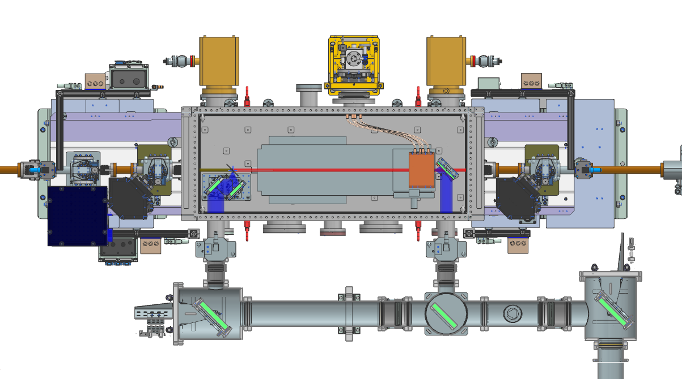
Cooling
Cooling
Electron path
Outcoupling
mirrors
DR
Outcoupling
mirrors
DLW
Alignment laser
Transport line
Filipe Giesteira, Vahit Kalender, Lukas Müller, Torsten Wohlenberg

Slide 2
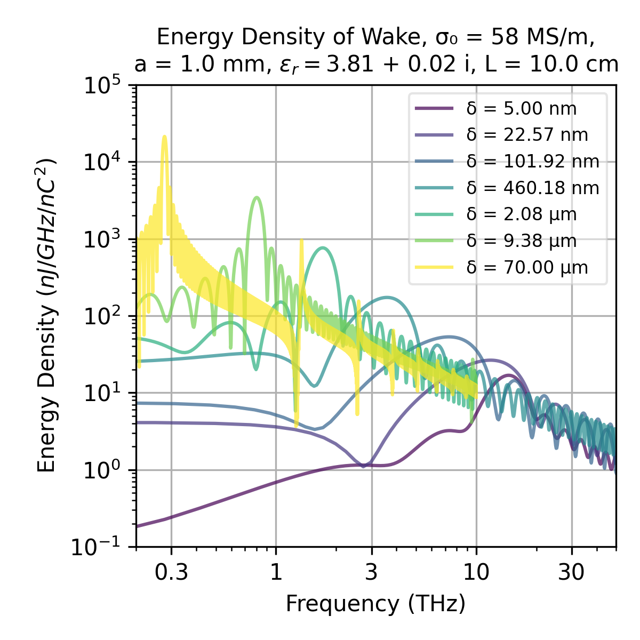
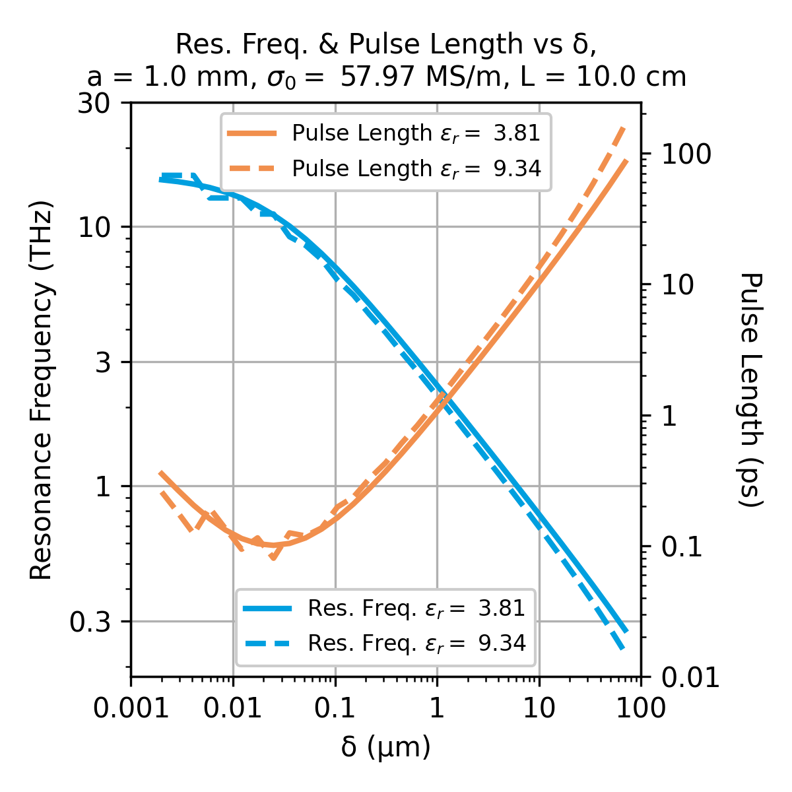
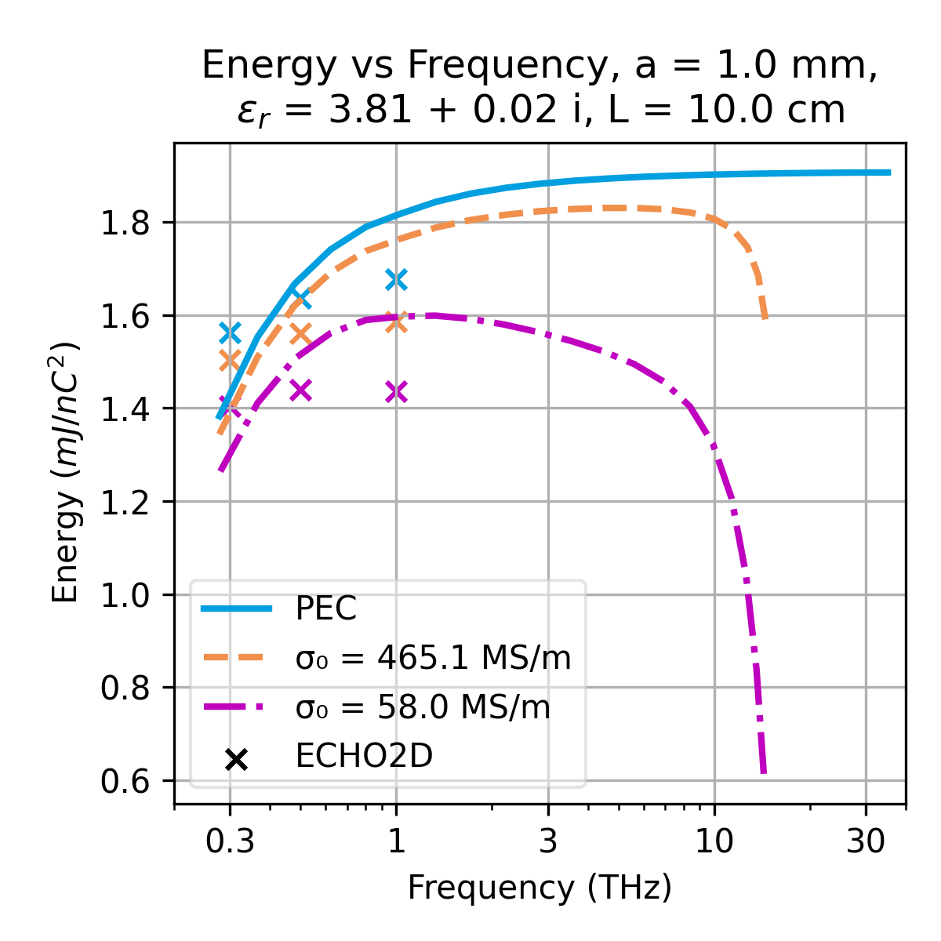
Dielectric lined waveguides

Slide 3
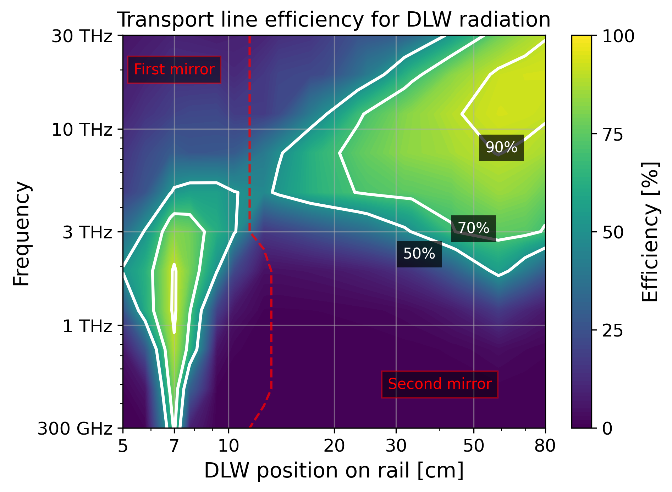
Transport to diagnostics area
Losses at through hole
All frequencies captured and transported at >70% efficiency
Dotted line indicates which mirror transports more
In practice, working point is experimentally determined
Losses at mirror edge

