Slide 1
Status of the DESY Grid Centre
Volker Guelzow for the Grid Team
DESY IT
Hamburg, October 25th, 2011

Slide 2
Outline
The 2011 DESY Grid centre status
Requests and Pledges for WLCG
The NAF@DESY
PRC relevant IT-Projects @DESY
The German Tier 2 situation
Summary

Slide 3
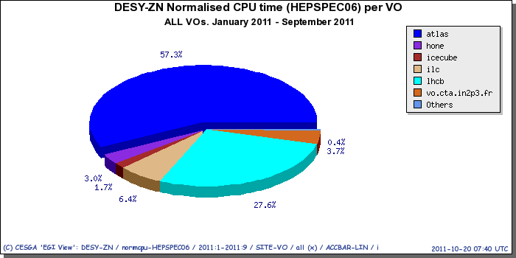
DESY Grid Centre usage by VO

Slide 4
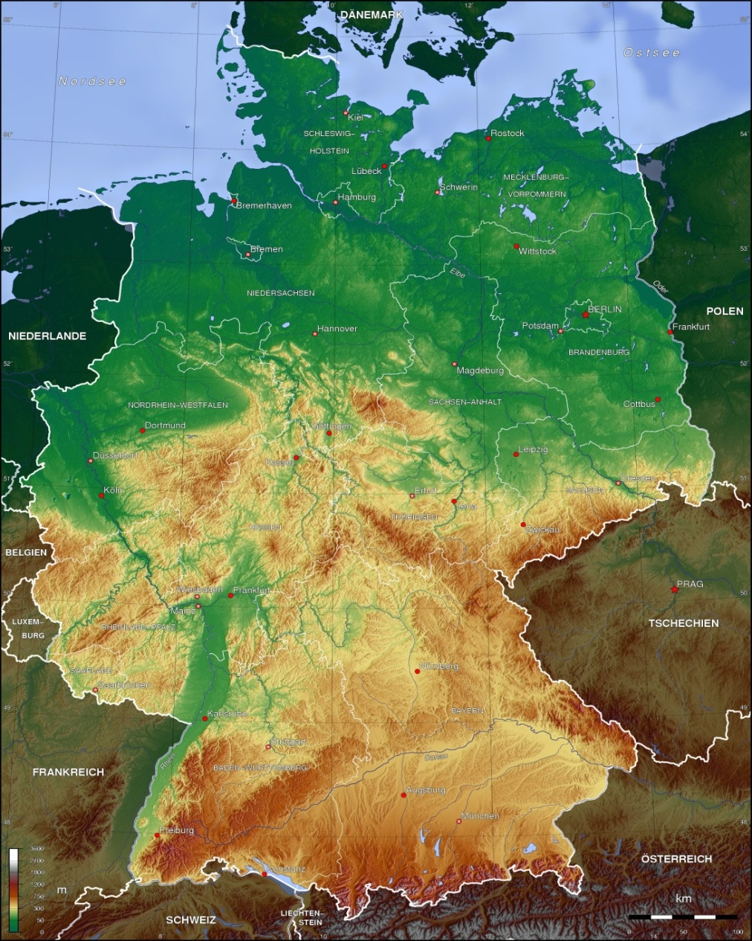
The German T2‘s (Atlas, CMS, LHCb)
Pledges for Germany
 | CPU 2012 [HS] | CPU 2012 [% Tot] | Disk 2012 [TB] | Disk 2012 [% Tot]
A DESY | 12000 | 5 | 1500 | 3
C Aachen/DESY | 23625 | 8 | 1950 | 8
A Goettingen | 3853 | 1 | 1000 | 2
A Munich | 11560 | 4 | 1340 | 3
A FR/Wupp | 8860 | 3 | 1566 | 3
L DESY | 3200 | 7 | 2 | 10
Summe CMS | 23625 | 8 | 1950 | 8
Summe Atlas | 36273 | 13 | 5406 | 11
SumDESY | 29950 |  | 2852
SumNonDESY | 33346 |  | 4506
Grand Tot Atlas-T2 | 266000 |  | 47000
GrandTot CMS- T2 | 315000 |  | 26000

Slide 5
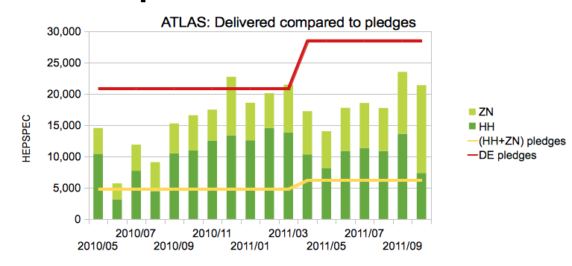
Atlas delivered vs. pledged CPU resources@DESY

Slide 6
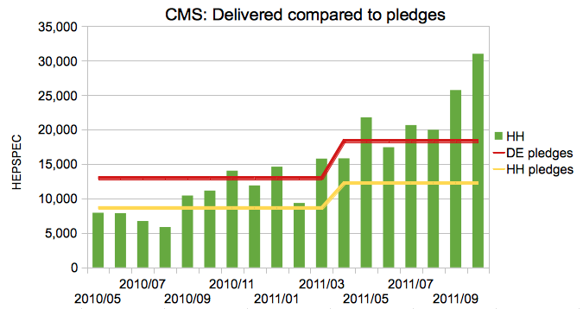
CMS delivered vs pledged computing

Slide 7
DESY T2 availability/reliability from WLCG monitoring

Slide 8
ATLAS: DESY and German Cloud contributions (1)
DESY (HH+ZN together) competing with ATLAS T1’s
All jobs since 1.1.2011:

Slide 9
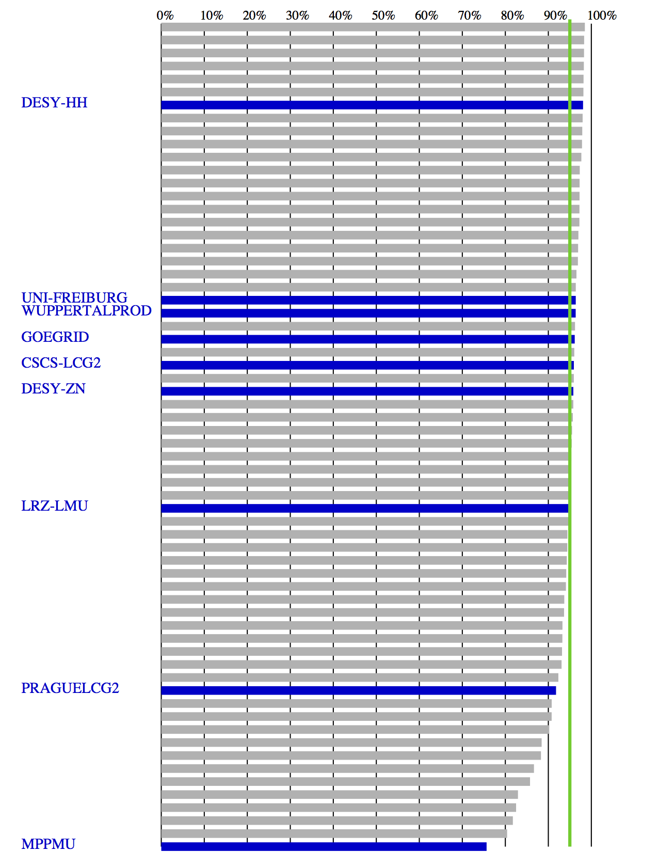
ATLAS: DESY and German Cloud contributions (2)
Excellent reliability:
ATLAS GangaRobot hourly tests: Expect 95% reliability
Aug&Sept 2011, all ATLAS T2

Slide 10
CMS Tier-2 Contribution
FNALLPC=US “interactive” analysis facility
Analysis & MC production jobs since June 2011
Still large failure fraction
- Wasting ~20% of resources
- Mainly bad user jobs
Subscribed Phedex data
“Unregistered” data | DESY[TB] | RWTH[TB]
/store/user | 290* | 113
/store/group | 14 | 78
Volume of subscribed data sets at Tier-2s
TB
TB
*580TB brutto
- Very good performance
- DESY is a very important CMS Tier-2

Slide 11
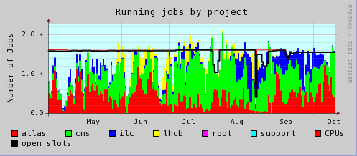
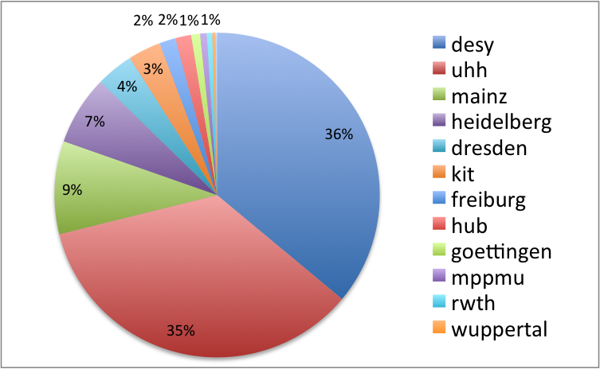
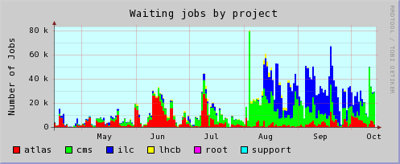
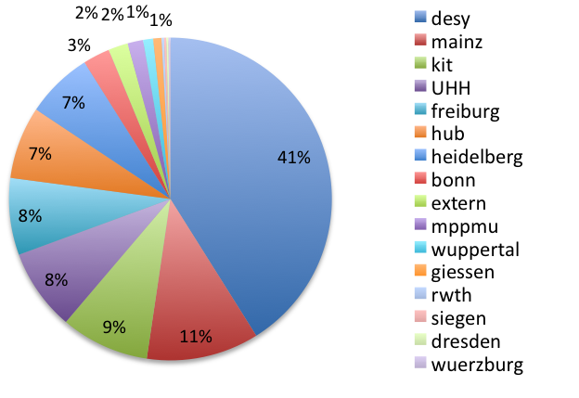
NAF usage
CPU usage 15.4-15.10.2011
NAF well utilized.
Operation very smooth and reliable since last PRC
UHH/CMS strong user (own purchases!)
Lustre usage 20.10.2011

Slide 12
NAF CPU resources
Total (with recent purchases)
41.3 kHS06
3000 Slots
Huge contribution UniHH/CMS
Detail on purchases in 2011
7.8 kHS06/576 cores: 0.5 replacement, 0.5 enlargement beginning 2011 (from DESY budget)
3 kHS06/192 cores: mostly replacement in Zeuthen recently (from DESY budget)
9.2 kHS06/672 cores: upgrade in Hamburg recently (from DESY budget)
9.2 kHS06/672 cores: upgrade in Hamburg recently (from UniHH/CMS group!)
Plan for 2012
Await technology change end 2011 (AMD Interlagos) / 2012Q1 (Intel SandyBridge), planning end of 2012Q1
In 2012: Plan for additional 10 kHS06
NAF purchases given to experiments according
to the key 4 ATLAS / 2 CMS / 1 ILC / 1 LHCB

Slide 13
Datatransfer from Storage Element (1 week sample)

Slide 14
Future plans for the NAF
Replacement of Lustre file system
call for tenders ongoing
Strengthen NAF reliability, availability and performance
reduce impact on the HH-ZN WAN network connection
make two NAF parts more independent
New features for NAF, requested by users
e.g. Fast X-Connection, collaborative tools, …
Hardware enlargement plans: See slide “NAF CPU resources”

Slide 15
PRC relevant IT-Projects@DESY
Helmholtz Alliance until end 2012
Tier 1 for Icecube and Computing for CTA in Zeuthen
LHCone: Initiative to connect T2‘s and T3‘s, needs more experience and monitoring for further decisions
European Middleware initiative (dCache) until mid 2013
Large Scale Datamanagement project starting in 2012
Active role in HPC- initiative of the HGF (may end in funding)

Slide 16
The German Tier 2 Situation
Funding of the NAF@ DESY secured through base investment
Funding of Tier 2‘s@DESY secured trough base&capital investment
Funding of ½ Tier 2 @MPI secured
Funding of Universities‘ Tier 2: Invest only secured until mid 2012
Different ideas are under debate, DESY may be asked to act as a coordinator

Slide 17
Summary
The DESY-Grid-Centre again was very reliable
The DESY T2 Centre is larger than some T1‘s centres
The DESY T2 is very attractive because of the available data
The NAF was used intensively and nationwide
The NAF is in the process of further development, major upgrades took place and are planned
dCache is still the major working horse for LHC datamanagement and DESY has the lead
DESY is very active in attracting 3rd party money
There is still an open financing issue for the Universities‘ Tier 2 after end 2012

