Slide 2
High Performance Storage for HPC: Proven HDF5 Scalability and Consistency on Pure Storage Flashblade
Michael Kaspers
Consulting Field Solution Architect
Pure Storage Germany GmbH
26th of may 2025

Slide 3
Geography : Germany, NRW
Professional
Career : Ernst & Young
Hitachi Data Systems / Hitachi Vantara
Huawei Technologies
Pure Storage
Areas of
Knowledge : AI / ML use case definition
Complex Solution Designs
Parallel IO in AI and HPC
NVIDIA integration w/ Pure Storage products
AI / HPC Storage Benchmarks
AI Pipeline Design
Cloud Native Technologies
Solution Sizing
Michael Kaspers
Consulting Field Solution Architect AI/HPC
M: mkaspers@purestorage.com

Slide 4
Introduction to Pure Storage

Slide 5
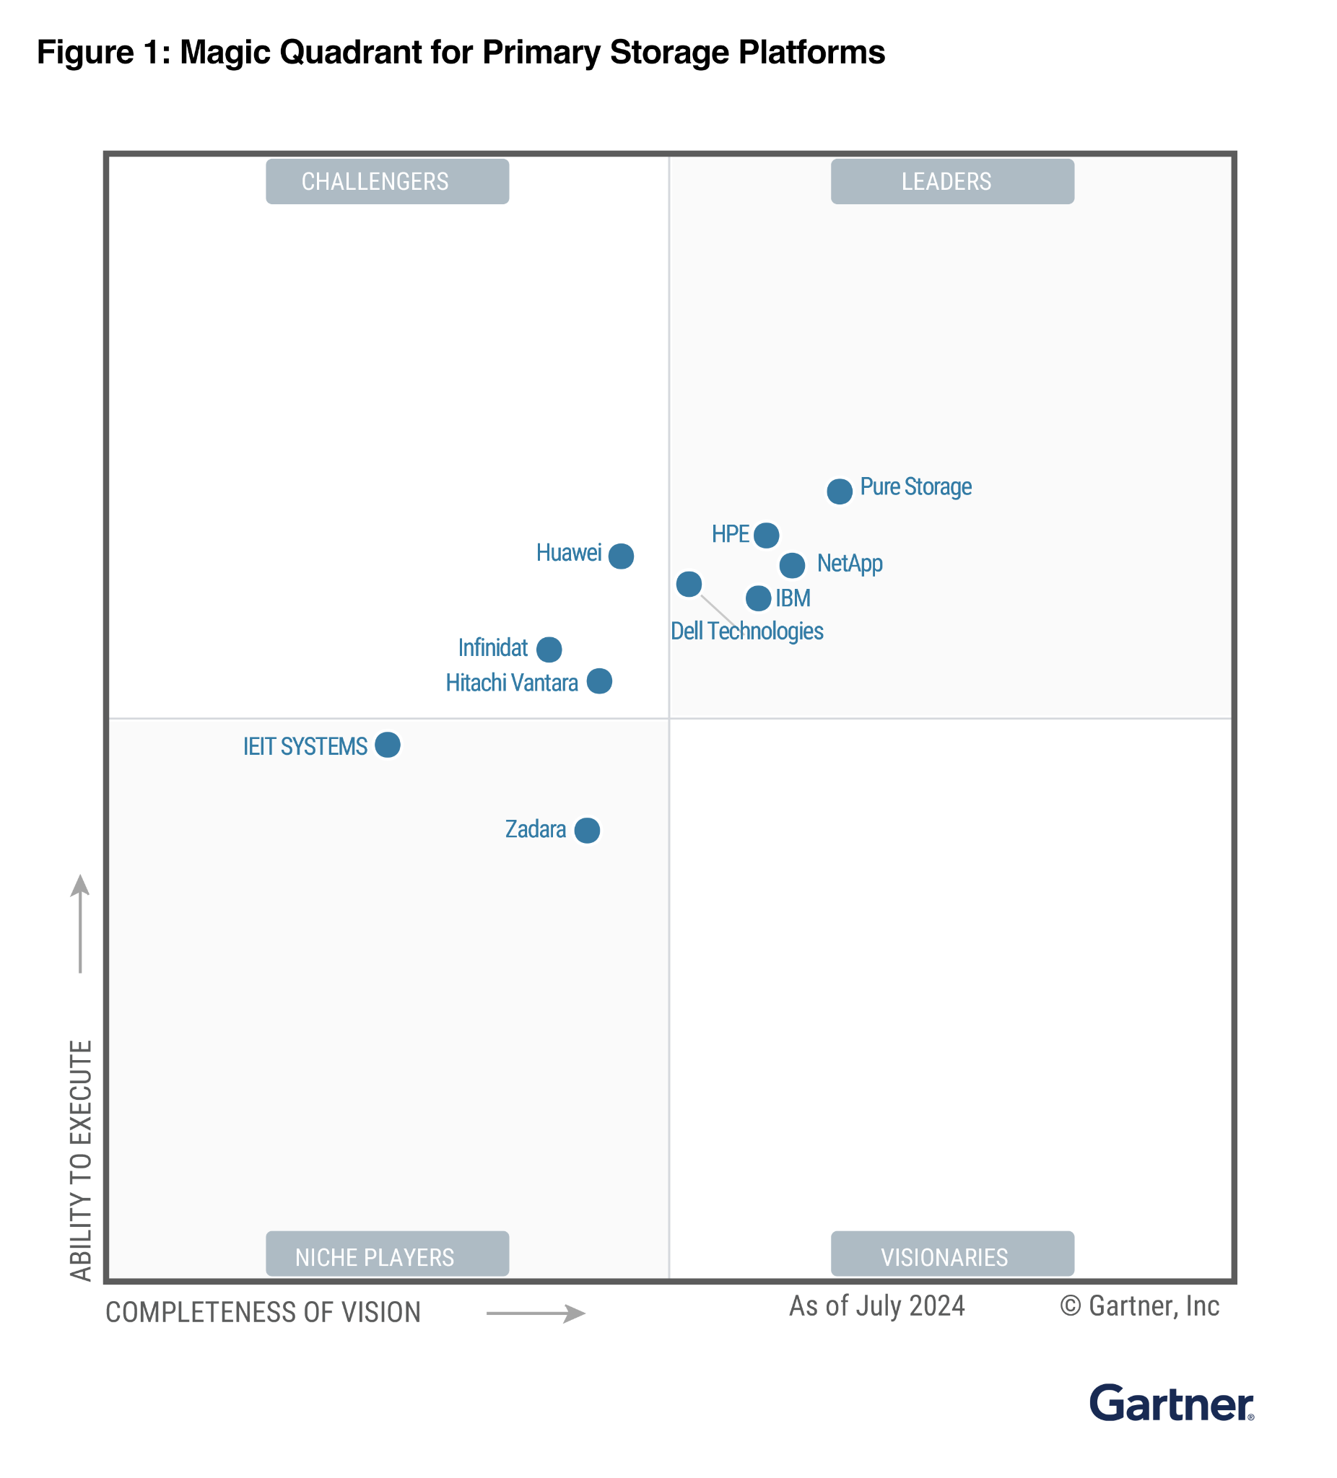
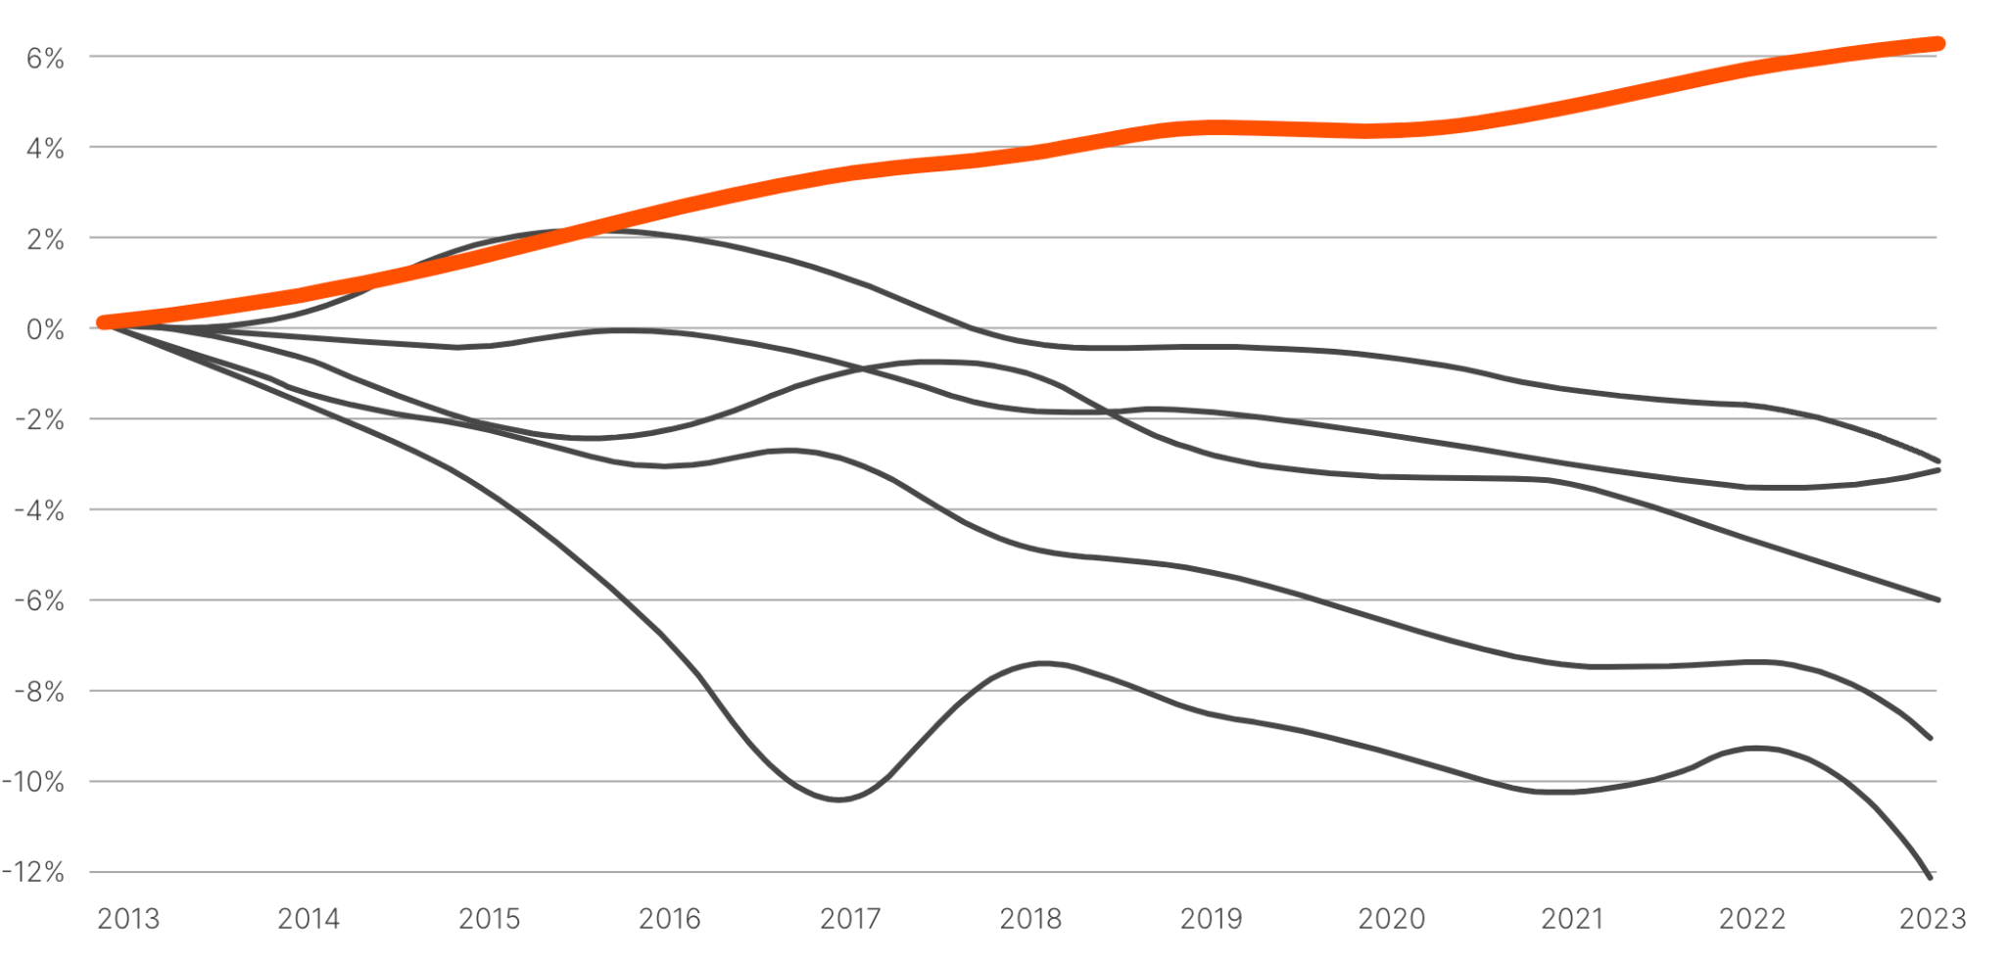
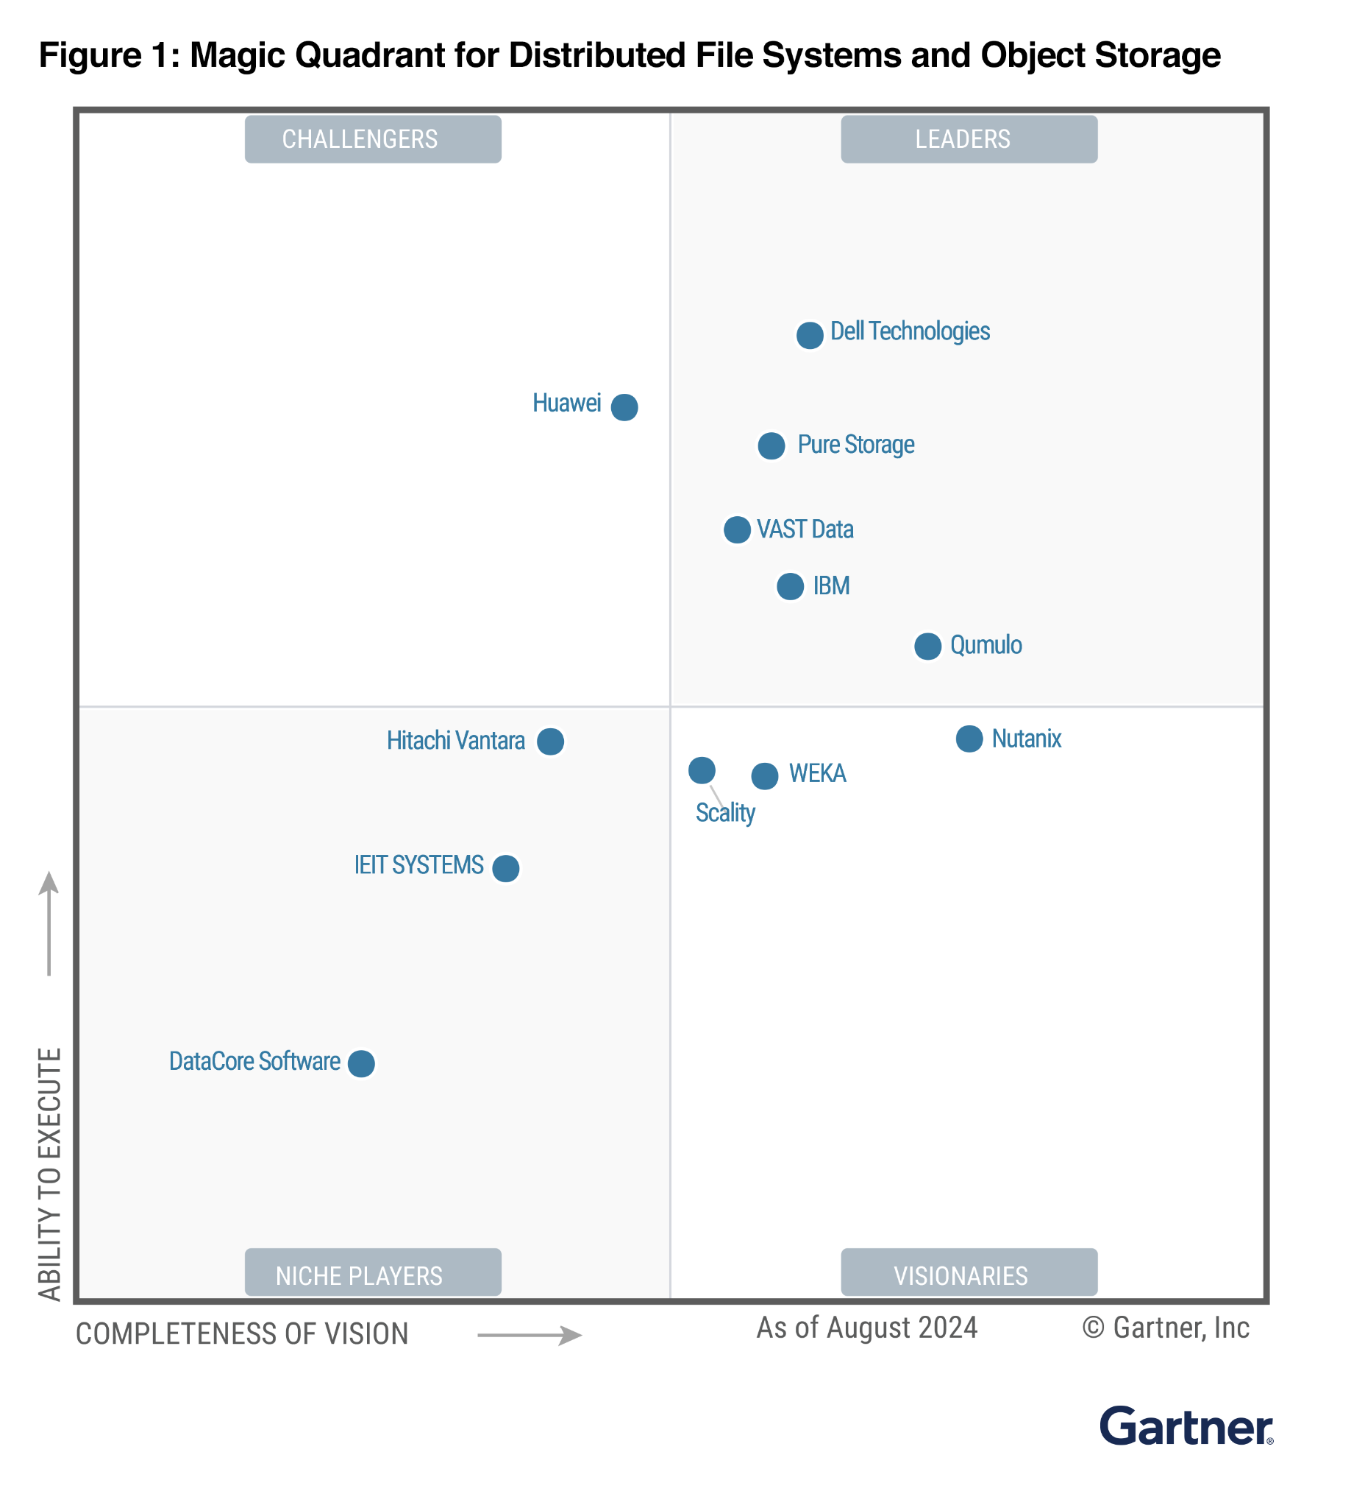
Pure Leadership At A Glance
10 Year Storage Market Share
Pure Storage has one of the highest NPS in the industry!
Pure Storage
is an MQ Leader for 11 Consecutive Years!
IDC: Market Share Changes From 2014 Through 2023
Pure’s NPS is 81
Pure Storage is a
Leader in the IDC
Container Data
Management
MarketScape
Pure Storage
is a Leader in File & Object for the Fourth Consecutive Year!
Pure Storage is Recognized in Fortune’s Best Workplaces List for Four Consecutive Years!
©2025 Pure Storage
Uncomplicate Data Storage, Forever
‹#›

Slide 6
AI and HPC Workloads at Any Scale
The Pure Storage Platform Powers All AI and HPC Workloads
Enterprise AI and HPC
RAG / Inference / Data Lake / ML
AI Factories
Large-scale AI Training/Inference, Including
Pre-processing, Training, Testing, Fine-tuning, and Deployment
Enterprise AI/ML
and HPC:
Repository training,
archive, and raw data
Enterprise HPC
and EDA:
Active chip design projects
Enterprise AI:
Training and
inference
Extreme-scale
HPC workloads
Extreme-scale end-to-end AI workflows
TCO Optimized
Enterprise-ready High Performance
Extreme Performance and Capacity
FlashBlade//E
The All-flash Unstructured Data Repository
Up to 90% Lower Operational Cost
FlashBlade//S
The Unified Fast File and Object Solution
Up to 500 GB/s Throughput
FlashBlade//EXA
The Extreme-scale Solution for Large HPC
and AI Workloads
Up to 10+ TB/s Throughput
Exascale Capacity

Slide 7
Pure Storage Flashblade and NFS

Slide 8
NFS was never designed to be fully POSIX compliant, but it has morphed to conform to the standard as much as possible.
Modern Linux kernel provides robust close-to-open processes (CTO) to maintain file consistency, synchronous metadata and data transfers to FlashBlade, reducing the risk of data loss and using locks to manage access on file(s) for single writers with multiple readers or concurrent read and write operations.
FlashBlade handles the atomic commit and consistency once it receives the data from NFS and sends an acknowledgement to the client.
NFS differs from a PFS mainly in the data path, how data is read and written to the backend storage from a performance perspective.
FlashBlade supports a 512k IO size by default, the NFS client can negotiate the IO size over TCP or RDMA with FlashBlade (NFS) where data packets are coalesced to fewer and larger writes to flash storage
NFS on FlashBlade can parallelize and evenly distribute the load over multiple TCP & RDMA connections for HPC applications, leading to high-bandwidth operations under low latency.
Metadata operations for small files on FlashBlade do not require any additional configuration or tuning for improved performance. NFS can create, list, and remove directories and files three to five times faster than PFS at scale. FlashBlade using QLC flash has demonstrated disaggregative scale with respect to high performance and capacity compared to PFS.

Slide 9
High Performance and Data Consistency Explained
1
Distribute everything across the system Metadata control, large file chunks, protocol handling
Optimize small and large file/object sizes; high performance metadata Variable-block encoding, optimized for random access, with large files distributed across the system.
Provide direct access to flash media
Expose concurrency of flash devices all the way through the Purity//FB software
MASSIVELY DISTRIBUTED TRANSACTIONAL DATABASE
KEY
VALUE
2
LOG-STRUCTURED METADATA ENGINE
DIRECT FLASH
3
DIRECT FLASH & NVRAM

Slide 10
The Pyramid
Purity Approach for Log structured Data Mapping
The Pyramid is designed from the beginning to be aligned to the particular characteristics of NAND flash
The Pyramid’s design is flexible and it allows us to use one single architectural family to satisfy the needs of different performance and capacity designs.
The Pyramid is extensible, which has made it last across numerous system generations, even as we’ve added new features and redesigned portions of it.
The Fundament of the Pure Storage Platform
Notes:
1
By deeply integrating the Pyramid with the underlying storage medium, we can eliminate lots of redundant work and leverage much of the synergies between an LSM-tree and the way that flash works. LSM-trees require garbage collection of older data; so does flash. What if we collected garbage once, collapsing the garbage collection of both the data structure and the media into one step?
Implementing a B-tree on top of flash would create write amplification every time you do a copy-on-write or you rebalance the tree. By contrast, if we buffer the stream of writes and coalesce them in batches by keeping the buffer in NVRAM and the lower layers in flash, we only write sorted and merged data down to flash. The only time data gets rewritten is when a layer of the Pyramid gets flattened, and this happens less and less as these immutable segments age.
When we talk about how Pure’s products are designed for flash and don’t have any legacy HDD code, this is one of the key things we’re talking about. Unlike other solutions which may have been designed in an era when drive seeks were the enemy and built their fundamental data structures around those realities, Pure’s solution is built at its most basic level around the particular characteristics of flash.
The same fundamental data structure has scaled from arrays with tens of terabytes to arrays with many petabytes, and across many generations of NAND flash and controller architectures. This flexibility allows us to tune the parameters of the Pyramid as we refine our code or modify our strategies and trade-offs when using different NAND types or designing our system for different performance or latency targets. We even leverage different Pyramid configurations within the same product for different purposes.
2
It’s allowed us to metaphorically change the tires on a car while it’s still on the road and is the key enabling technology for what we call Evergreen. There are Pure arrays out there right now with segments that were written years ago in prior versions of Purity that have been unchanged through controller upgrades and storage expansions.

Slide 11
Introduction to the Pyramid approach
what makes the Pyramid so special, let’s break down the three points
LSM-trees are uniquely suited to NAND flash media.
A system utilizing LSM-trees on top of NAND flash could be tuned for many different varieties of flash and many different types of workloads.
A key-value store database implemented this way would be incredibly scalable and could be used as a foundation for any storage protocol, in both scale-up and scale-out architectures.

Slide 12
Data Structures and Storage Systems
Better Science, Volume 2: Maps, Metadata, and the Pyramid |
B-Tree
The B-tree is “a self-balancing tree data structure that keeps metadata sorted and allows searches, sequential access, insertions, and deletions in logarithmic time.”
store indices of keys with associated values and that you could minimize the number of seek operations when searching for that key’s value
The first is the concept that nodes within a B-tree are immutable. They cannot be changed, and so any time you’re doing an update
This is called copy-on-write. It’s important in a storage context because ideally, you never want to overwrite existing data until you know your new data is fully written and safe. This is called atomicity in the database world—you want your operation to fully complete or not at all.
Log Structured Merge Tree
lots of writes would be a system where new writes are always appended. Nothing is ever deleted, inserted, or overwritten. Instead, new data is always written at the end of an ever-running log

Slide 13
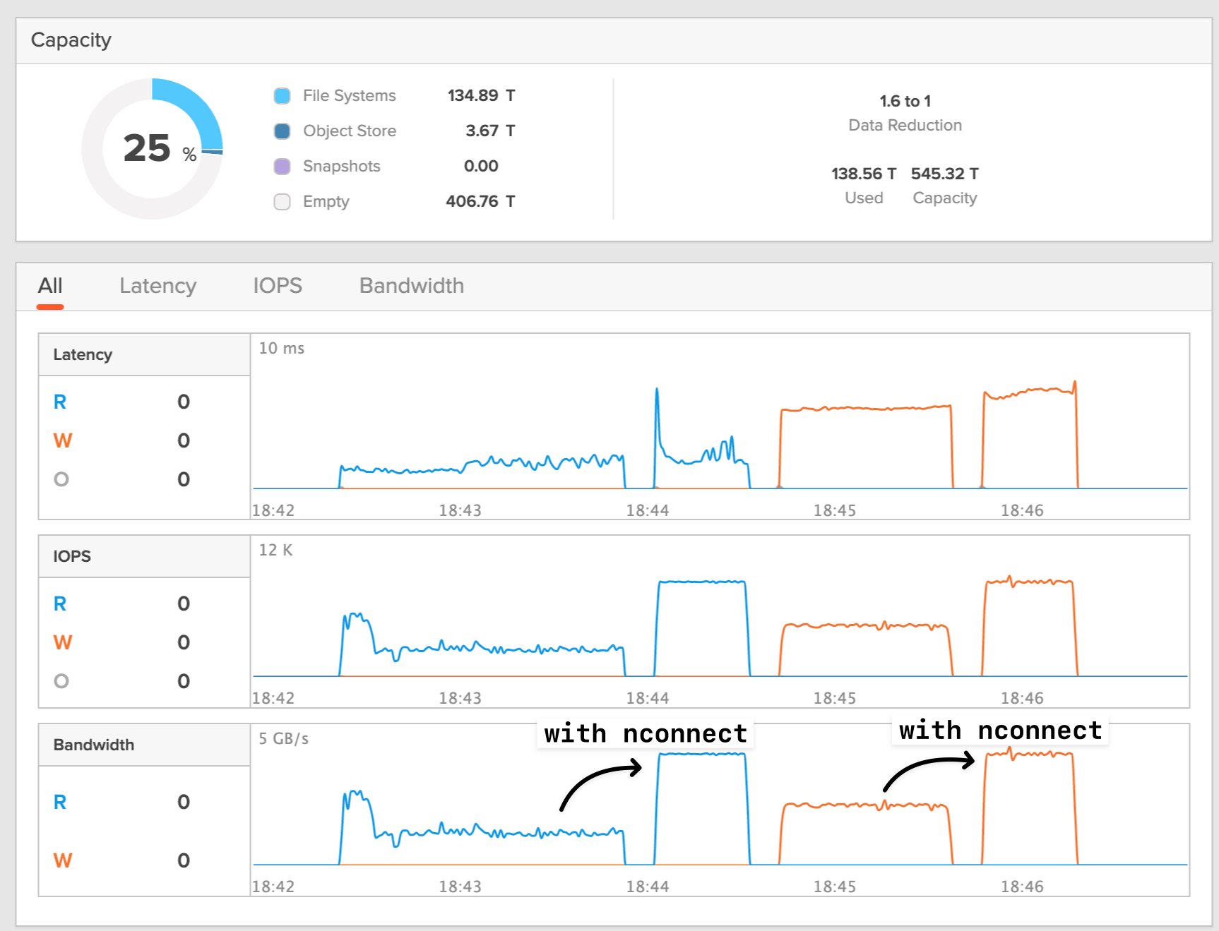
NFS Support for nConnect Linux Mount Option
Allows Linux clients to open up to 16 TCP connections for a single NFS session per Data VIP
Up to 16 TCP connections
NFSv3 supported since 3.3.0 (without Kerberos)
NFSv4.1 supported from 4.5.0 (with and without Kerberos authentication)
NFS File Systems
Notes:
NFSv3 with nconnect has been supported since Purity//FB 3.3.0. The 4.5.0 release adds nconnect support for NFSv4.1.
Benefits:
The Linux Kernel 5.3+ supports an NFS mount option called "nconnect" that enables higher single mount point throughput to and from an NFS server.
Allows opening up to 16 TCP connections on a single mount point and distributes the load of one client thru multiple TCP connections over a single IP address
Linux clients supporting nconnect:
Ubuntu 20.04 and later (Ubuntu 20.04 is the one can support this as it uses Linux kernel 5.4)
RHEL 8.3 and later for NFS 4.1 only (RHEL 8.3 backports nconnect into kernel-4.18.0-240.el8 along with packages: nfs-utils-2.3.3-35.el8 libnfsidmap-2.3.3-35.el8)
Any Linux OS using Kernel version 5.3 and later.
NOTE:
With NFSv4.1, nconnect is supported with and without Kerberos authentication starting in 4.5.0.

Slide 14
Which version HDF5 version are being validated
Important to ensure Performance and Data consistency
Parallel HDF5:
Use version 1.12 and greater of HDF5 with MPIIO backend
Serial HDF5 (SWMR - Single Writer Multiple Reader):
User version 1.14.3 and greater of HDF5 with NFS backend
HDF5 High level IO library was built for HPC environments using true shared file–systems which are fully POSIX compliant and ensure atomicity while writing and reading. Due to developments in HPC storage area also high performance NFS based systems are often been considered to run demanding HPC workloads. For Parallel HDF5 the integration with NFS backend is relatively simple due to the fact, that the required MPI layer supports NFS storage backends as Universal/Unified Filesystem.
For SWMR based data access, the atomicity of parallel file systems was a fundamental component to ensure data consistency. Starting with 1.13 and further, especially 1.14.x, the HDF groups introduces enhancements to ensure consistency and performance by introducing the superblock feature inside of HDF5.

Slide 15
Validation of HDF5 SWMR Performance & Consistency over NFS

Slide 16
Cross Node HDF5 Data Access
Validation of Cross Node Data Access using HDF5 1.14.3 in SWMR configuration
Ubuntu 22.04 - HDF5 version 1.14.3
Ubuntu 22.04 - HDF5 version 1.14.3
fbhost03
fbhost04
/mnt/hdf5
/mnt/hdf5
Comment:
HDF5_NOCLEANUP=TRUE
HDF5_USE_FILE_LOCKING=FALSE
mount -t nfs -o vers=3, nconnect=16 IP:/hdf5 /mnt/hdf5

Slide 17
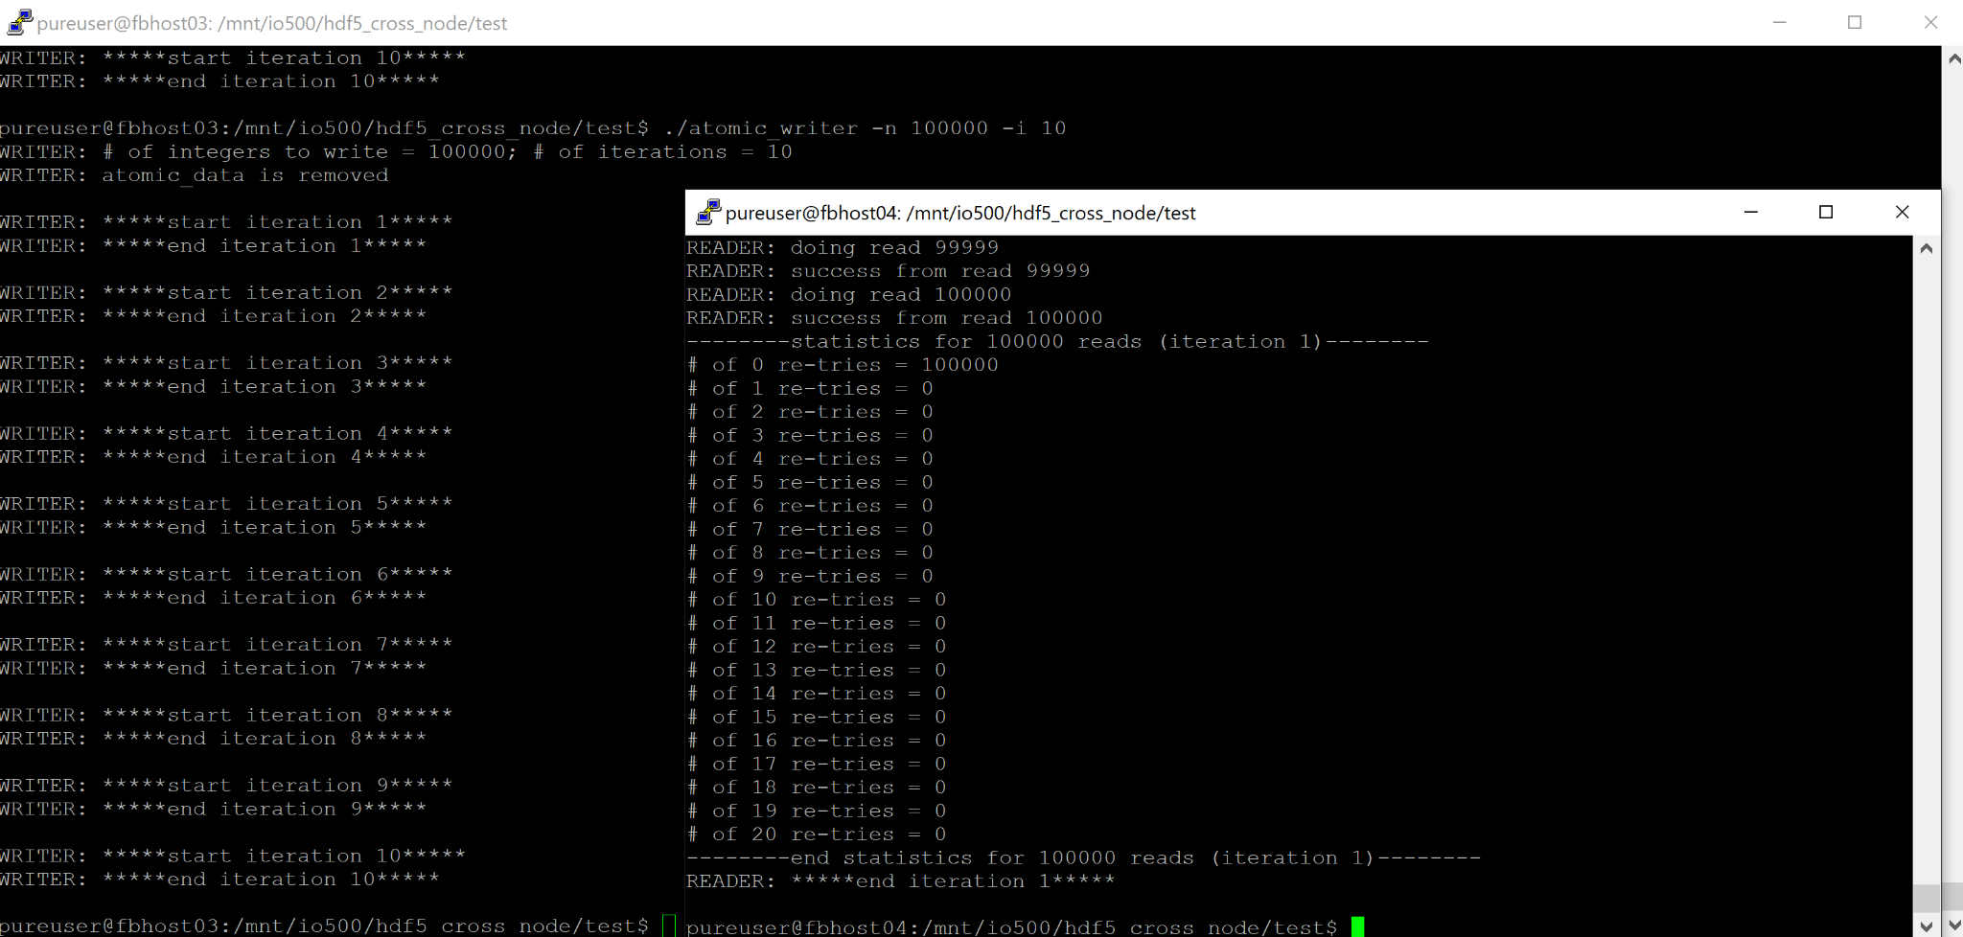
Test-Sequence-1:
Run atomic_writer on node_1 and atomic_reader on node_2
directory on both node : /mnt/io500/hdf5/cross_node_test/test/ [NFS Mount]
fbhost03 : ./atomic_writer -n 100000 –i 10
fbhost04: ./atomic_reader -n 100000 -i 1
Result:
Atomic Write happens on fbhost03 on NFS mount.
Atomic Read possible on fbhost04 of data created by fbhost03

Slide 18
Test-Sequence-2
Run HDF5 test_use_cases.sh script on NFS mount to validate HDF5 related tests are carried out
On fbhost03:
run test_use_cases.sh
Result: All uses cases tests passed
On fbhost04:
run test_use_cases.sh
Result: All uses cases tests passed
use_disable_mdc_flushes PASSED
===Parameters used:===
chunk dims=(1, 256, 256)
dataset max dims=(18446744073709551615, 256, 256)
number of planes to write=256
using SWMR mode=yes(1)
data filename=use_disable_mdc_flushes.h5
===Parameters shown===
Creating skeleton data file for testing H5Odisable_mdc_flushes()...
File created.
writing to the file
Dataset has disabled mdc flushes.
dataset rank 3, dimensions 0 x 256 x 256
All passed
use_disable_mdc_flushes -y 3 PASSED
…..
…..
waiting for new planes to read
reading planes 5 to 512
===Parameters used:===
chunk dims=(5, 256, 256)
dataset max dims=(18446744073709551615, 512, 512)
number of planes to write=512
using SWMR mode=yes(1)
data filename=use_append_mchunks.h5
launch part=Reader/Writer
number of iterations=1 (not used yet)
===Parameters shown===
Creating skeleton data file for test...
File created.
295562: continue as the writer process
dataset rank 3, dimensions 0 x 512 x 512
All passed
Opening to read use_append_mchunks.h5
All Use Case tests passed.
Check results files provided as well
fbhost03-test_use_cases.out (validated results)
fbhost04-test_use_cases.out (validated results)

Slide 19
Test-Sequence-3
Running swmr_writer and swmr reader at the same time
running swmr_writer on fbhost03:
pureuser@fbhost03:/mnt/io500/hdf5/test/swmr_test$ ./swmr_writer -f 10 1000000
Using writer random seed: 335915
running swmr_reader on fbhost04:
pureuser@fbhost04:/mnt/io500/hdf5/test/swmr_test$ ./swmr_reader -s 1 120
Using reader random seed: 127733
Check the validation outputs Attached to this report
swmr_writer and swmr_reader running in parallel on swmr_data.h5

Slide 20
Consistency Check of File using h5ls and h5stat
File consistency check using h5ls –enable-error-stack and h5stat
h5stat:
pureuser@fbhost03:/mnt/io500/hdf5-swmr-test-1306/swmr_test$ /home/pureuser/local/build/hdf5/hdf5-1.14.3/tools/src/h5stat/.libs/h5stat swmr_data.h5
Filename: swmr_data.h5
File information
# of unique groups: 1
# of unique datasets: 3100
# of unique named datatypes: 0
# of unique links: 0
# of unique other: 0
Max. # of links to object: 1
Max. # of objects in group: 3100
File space information for file metadata (in bytes):
Superblock: 48
Superblock extension: 0
User block: 0
Object headers: (total/unused)
Groups: 147/32
Datasets(exclude compact data): 922052/227500
Datatypes: 0/0
Groups:
B-tree/List: 43046
Heap: 57981
Attributes:
B-tree/List: 0
Heap: 0
Chunked datasets:
Index: 5527824
Datasets:
Heap: 0
Shared Messages:
Header: 0
B-tree/List: 0
Heap: 0
Free-space managers:
Header: 0
Amount of free space: 0
h5ls –enable-error-stack:
pureuser@fbhost03:/mnt/io500/hdf5-swmr-test-1306/swmr_test$ /home/pureuser/local/build/hdf5/hdf5-1.14.3/tools/src/h5ls/.libs/h5ls --enable-error-stack swmr_data.h5 |more
0-0000 Dataset {1/Inf, 4000/Inf}
0-0001 Dataset {1/Inf, 4000/Inf}
0-0002 Dataset {1/Inf, 4000/Inf}
0-0003 Dataset {1/Inf, 4000/Inf}
0-0004 Dataset {1/Inf, 4000/Inf}
0-0005 Dataset {1/Inf, 4000/Inf}
0-0006 Dataset {1/Inf, 4000/Inf}
0-0007 Dataset {1/Inf, 4000/Inf}
0-0008 Dataset {1/Inf, 4000/Inf}
0-0009 Dataset {1/Inf, 4000/Inf}
0-0010 Dataset {1/Inf, 4000/Inf}
0-0011 Dataset {1/Inf, 4000/Inf}
0-0012 Dataset {1/Inf, 4000/Inf}
0-0013 Dataset {1/Inf, 4000/Inf}
0-0014 Dataset {1/Inf, 4000/Inf}
0-0015 Dataset {1/Inf, 4000/Inf}
0-0016 Dataset {1/Inf, 4000/Inf}
0-0017 Dataset {1/Inf, 4000/Inf}
0-0018 Dataset {1/Inf, 4000/Inf}
0-0019 Dataset {1/Inf, 4000/Inf}
0-0020 Dataset {1/Inf, 4000/Inf}
0-0021 Dataset {1/Inf, 4000/Inf}
0-0022 Dataset {1/Inf, 4000/Inf}

Slide 21
Validation of Parallel HDF5 Performance on NFS

Slide 22
About the phdf5 setup
phdf5 requires MPI - we used OpenMPI
open-mpi 4.1.6, hdf5-1.14.3
fbhost01
NFSv3
1x VIP
open-mpi 4.1.6, hdf5-1.14.3
8x100G
fbhost02
single data mount. parallel hdf5 requires open-mpi for parallel access.
open-mpi 4.1.6, hdf5-1.14.3
fbhost04

Slide 23
Check the features compiled with phdf5
h5cc –showconfig
Features:
---------
Parallel HDF5: yes
Parallel Filtered Dataset Writes: yes
Large Parallel I/O: yes
High-level library: yes
Build HDF5 Tests: yes
Build HDF5 Tools: yes
Threadsafety: no
Default API mapping: v112
With deprecated public symbols: yes
I/O filters (external): deflate(zlib)
MPE:
Map (H5M) API: no
Direct VFD: no
(Read-Only) S3 VFD: no
(Read-Only) HDFS VFD: no
dmalloc: no
Packages w/ extra debug output: AC,B2,CX,D,F,HL,I,O,S,ST,T,Z
API tracing: yes
Using memory checker: no
Memory allocation sanity checks: yes
Function stack tracing: no
Strict file format checks: yes
Optimization instrumentation: yes

Slide 24
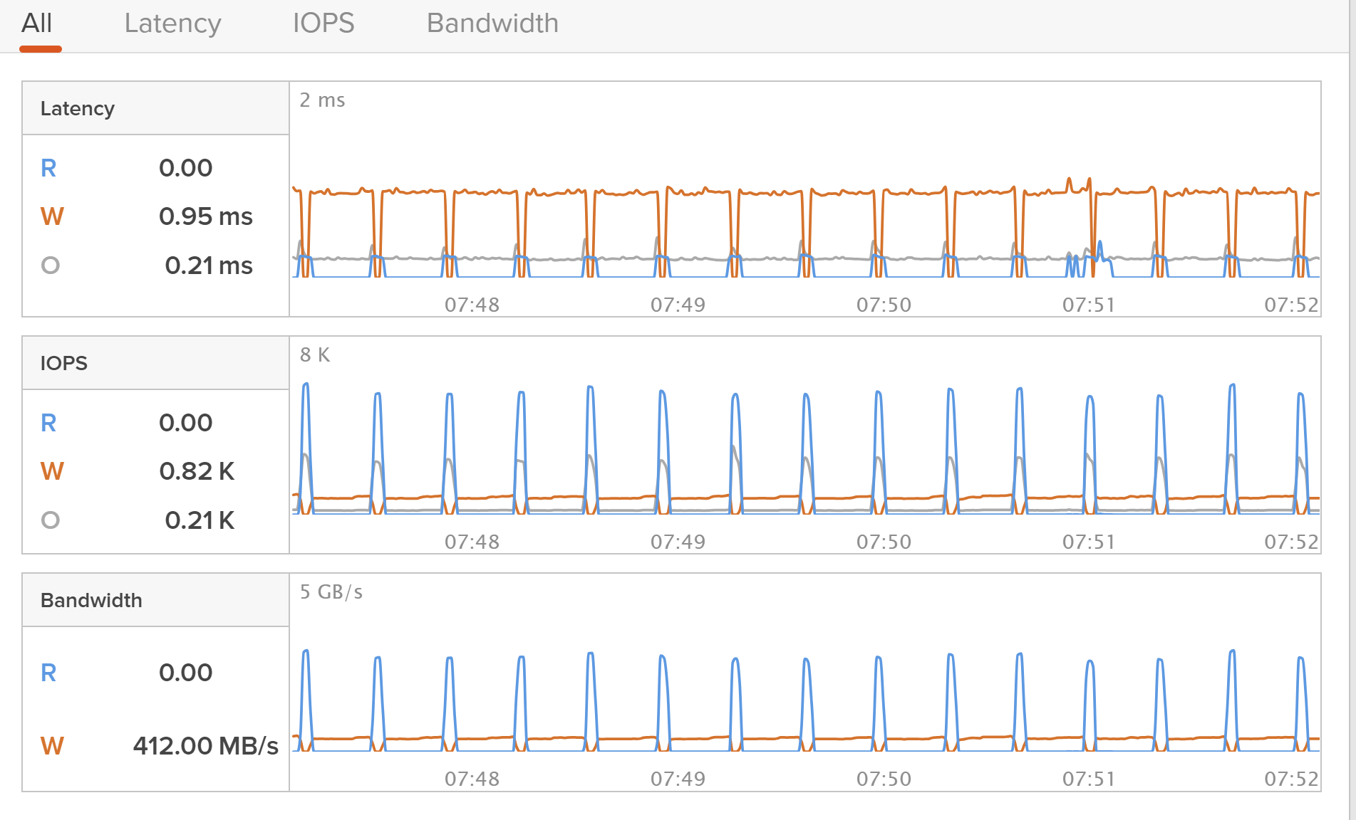
Running h5perf w/o MPI Client side optimization
pureuser@fbhost01:/mnt/io500/luxprovide$ mpirun --mca btl tcp,self -host fbhost01:48 /home/pureuser/local/hdf5/bin/h5perf -A phdf5 -B 4M -e 16M -p 48 -P 48 -x 128M -X 512M -d 10 -a 100M -i 5 -F 10 -I
Number of processors = 48
Transfer Buffer Size: 16777216 bytes, File size: 7680.00 MB
# of files: 10, # of datasets: 10, dataset size: 768.00 MB
IO API = PHDF5 (w/MPI-IO driver)
Write (5 iteration(s)):
Maximum Throughput: 443.57 MB/s
Average Throughput: 437.72 MB/s
Minimum Throughput: 432.27 MB/s
Write Open-Close (5 iteration(s)):
Maximum Throughput: 432.92 MB/s
Average Throughput: 428.97 MB/s
Minimum Throughput: 425.42 MB/s
Read (5 iteration(s)):
Maximum Throughput: 2899.08 MB/s
Average Throughput: 2866.38 MB/s
Minimum Throughput: 2824.66 MB/s
Read Open-Close (5 iteration(s)):
Maximum Throughput: 2810.36 MB/s
Average Throughput: 2781.15 MB/s
Minimum Throughput: 2743.91 MB/s
HDF5 Library: Version 1.14.3
rank 0: ==== Parameters ====
rank 0: IO API=phdf5
rank 0: Number of files=10
rank 0: Number of datasets=10
rank 0: Number of iterations=5
rank 0: Number of processes=48:48
rank 0: Number of bytes per process per dataset=16MB
rank 0: Size of dataset(s)=768MB:768MB
rank 0: File size=7680MB:7680MB
rank 0: Transfer buffer size=16MB:16MB
rank 0: Block size=4MB
rank 0: Block Pattern in Dataset=Interleaved
rank 0: I/O Method for MPI and HDF5=Independent
rank 0: Geometry=1D
rank 0: VFL used for HDF5 I/O=MPI-IO driver
rank 0: Data storage method in HDF5=Contiguous
rank 0: Env HDF5_PARAPREFIX=not set
rank 0: Dumping MPI Info Object (up to 256 bytes per item):
object is MPI_INFO_NULL
rank 0: ==== End of Parameters ====

Slide 25
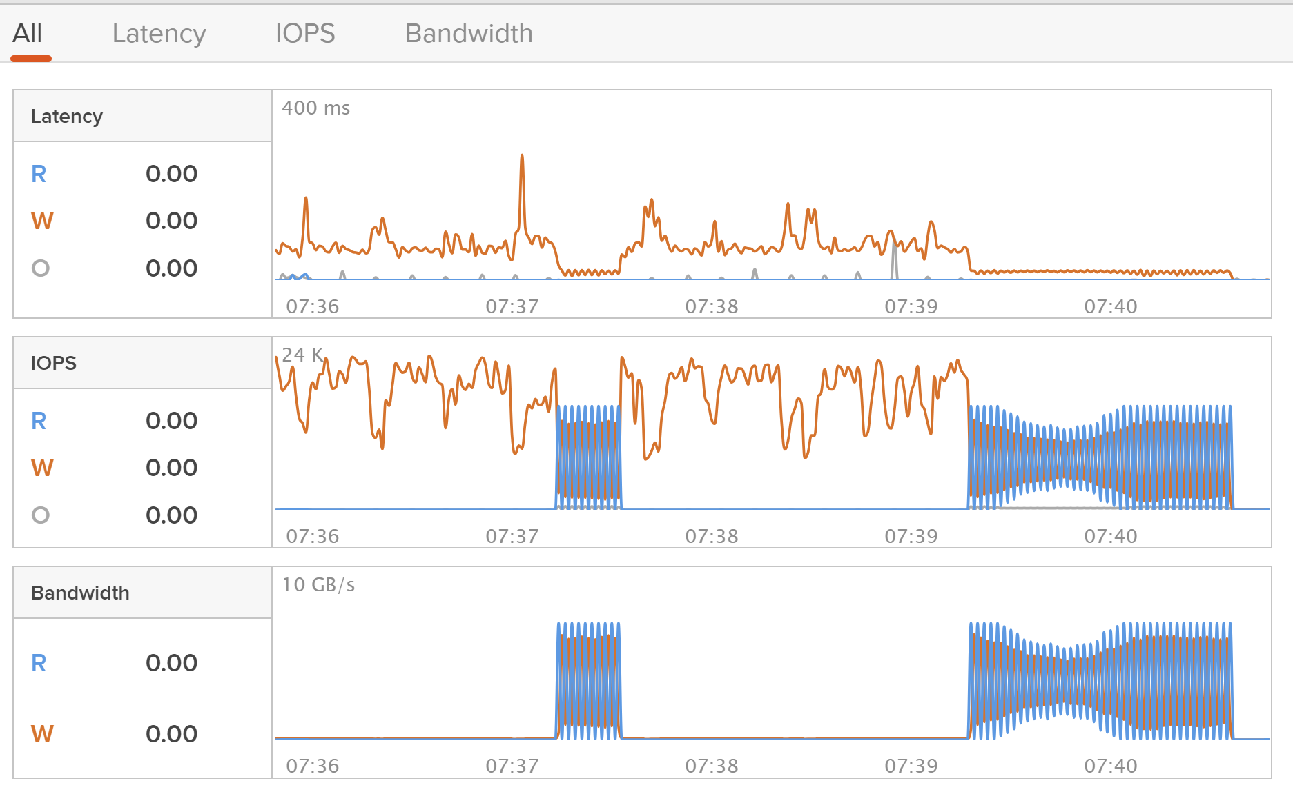
Running h5perf w/ MPI Client Optimization
pureuser@fbhost01:/mnt/io500/luxprovide$ mpirun --mca fs_ufs_lock_algorithm 1 --mca btl tcp,self -x LD_PURE_PATHFILE=/mnt/io500/purepreload.paths -x LD_PRELOAD=/usr/lib/libpurestoragepreload.so -x LD_PURE_LOG_TOPICS=2 -host fbhost01:48 /home/pureuser/local/hdf5/bin/h5perf -A phdf5 -B 4M -e 16M -p 48 -P 48 -x 128M -X 512M -d 10 -a 100M -i 5 -F 10 -I
Number of processors = 48
Transfer Buffer Size: 16777216 bytes, File size: 7680.00 MB
# of files: 10, # of datasets: 10, dataset size: 768.00 MB
IO API = PHDF5 (w/MPI-IO driver)
Write (5 iteration(s)):
Maximum Throughput: 6920.41 MB/s
Average Throughput: 1469.71 MB/s
Minimum Throughput: 669.48 MB/s
Write Open-Close (5 iteration(s)):
Maximum Throughput: 6373.78 MB/s
Average Throughput: 1439.78 MB/s
Minimum Throughput: 663.06 MB/s
Read (5 iteration(s)):
Maximum Throughput: 10882.87 MB/s
Average Throughput: 10837.53 MB/s
Minimum Throughput: 10808.83 MB/s
Read Open-Close (5 iteration(s)):
Maximum Throughput: 9801.47 MB/s
Average Throughput: 9717.71 MB/s
Minimum Throughput: 9591.79 MB/s
HDF5 Library: Version 1.14.3
rank 0: ==== Parameters ====
rank 0: IO API=phdf5
rank 0: Number of files=10
rank 0: Number of datasets=10
rank 0: Number of iterations=5
rank 0: Number of processes=48:48
rank 0: Number of bytes per process per dataset=16MB
rank 0: Size of dataset(s)=768MB:768MB
rank 0: File size=7680MB:7680MB
rank 0: Transfer buffer size=16MB:16MB
rank 0: Block size=4MB
rank 0: Block Pattern in Dataset=Interleaved
rank 0: I/O Method for MPI and HDF5=Independent
rank 0: Geometry=1D
rank 0: VFL used for HDF5 I/O=MPI-IO driver
rank 0: Data storage method in HDF5=Contiguous
rank 0: Env HDF5_PARAPREFIX=not set
rank 0: Dumping MPI Info Object (up to 256 bytes per item):
object is MPI_INFO_NULL
rank 0: ==== End of Parameters ====

Slide 26
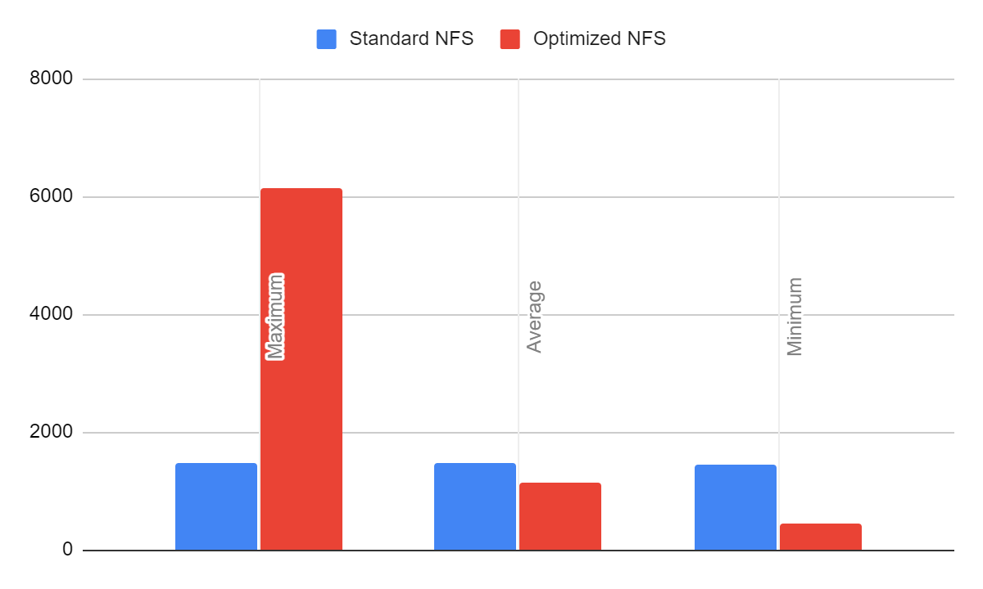
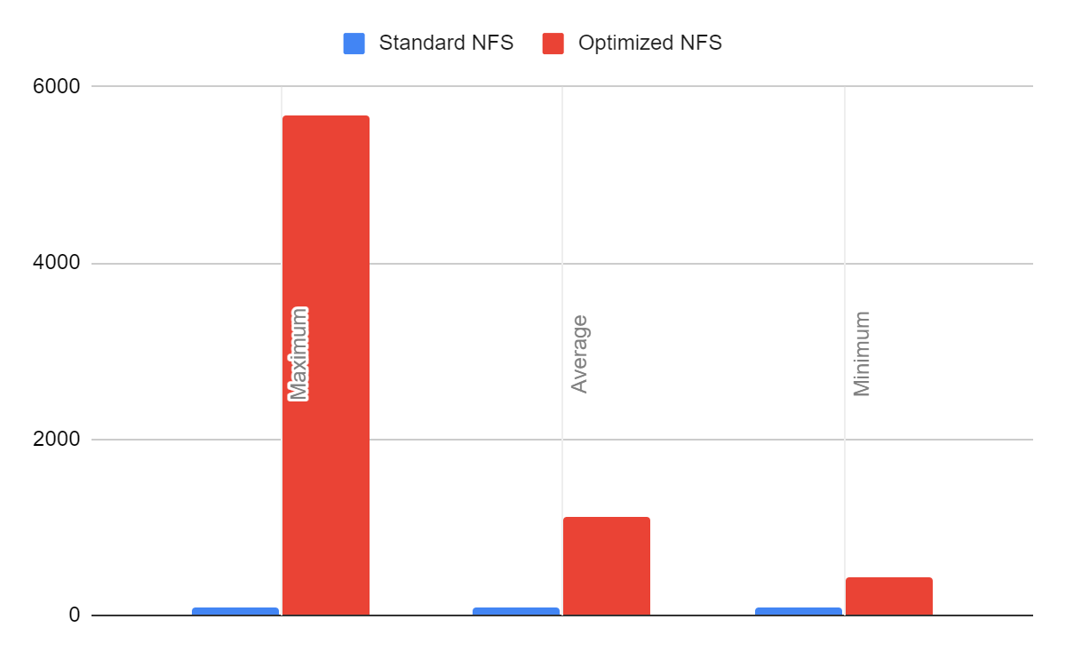
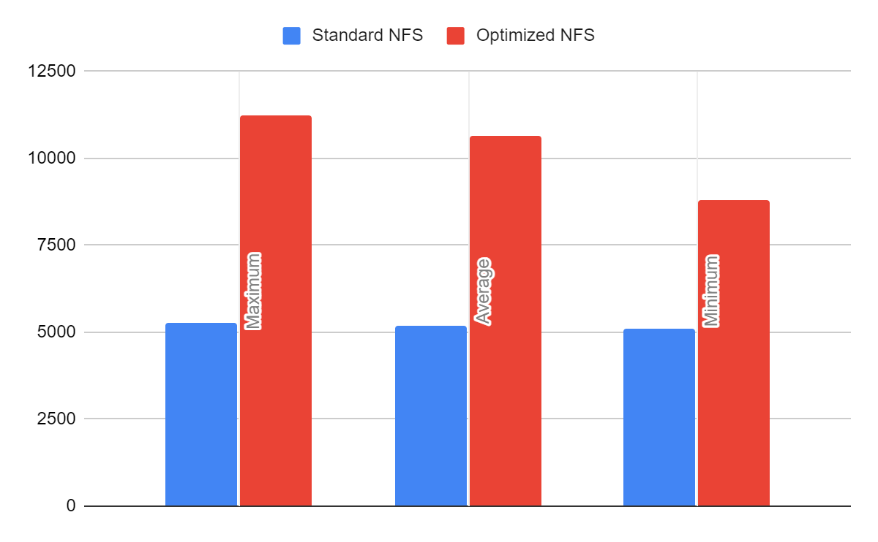
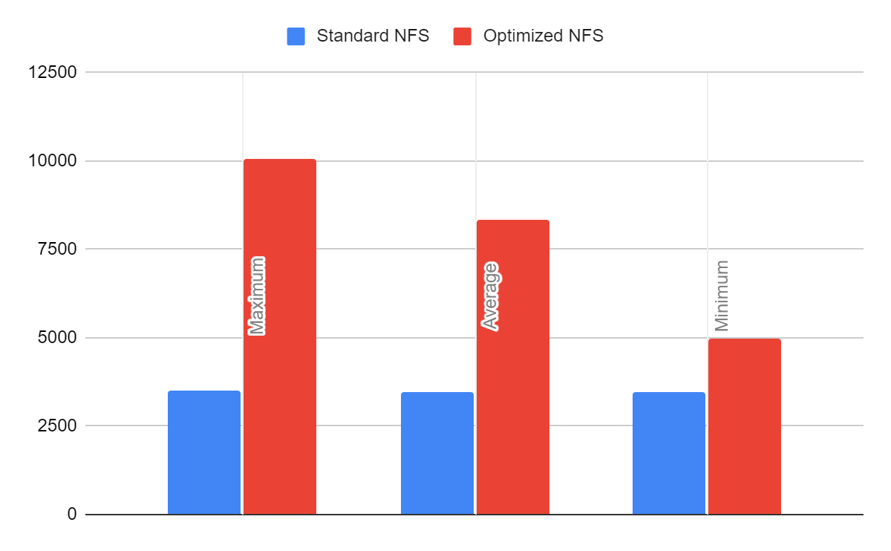
Non Optimized vs Optimized NFS
Write
Write Open-Close
Read
Read Open-Close

Slide 27
Pure Storage Flashblade and HDF5
Highly efficient NFS Storage platform for HDF5
Pure Storage Flashblade
Highly Consistent and Performance NFS Storage
HDF5 SWMR
Guarantees Atomic Commits over NFS
Parallel HDF5
High Performance Parallel transactions over NFS

Slide 28
Q&A

