Slide 1
Innovative Data Acquisition Solutions with HSDS at MAX IV Synchrotron Felix Engelmann, Jason Brudvik, Michele Cascella, Zdenek Matej MAX IV Laboratory, Lund University

Slide 2
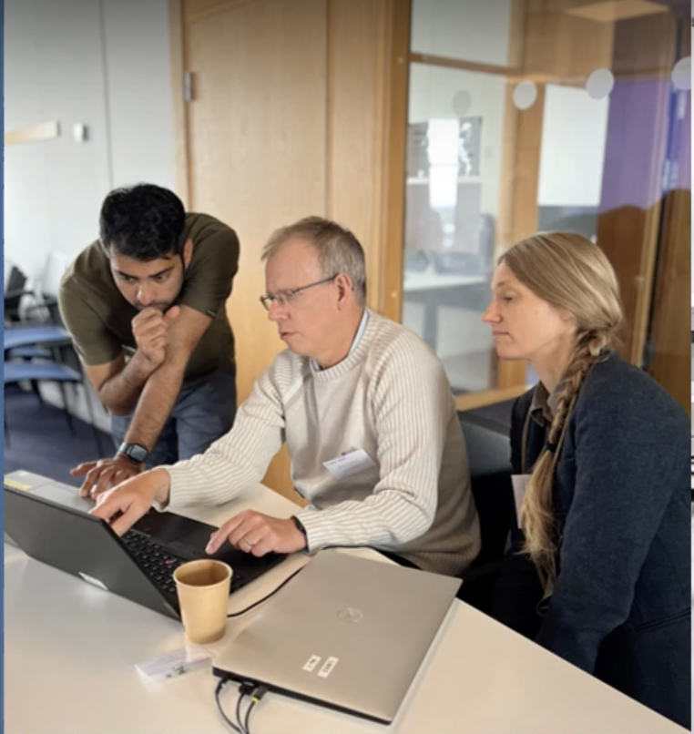
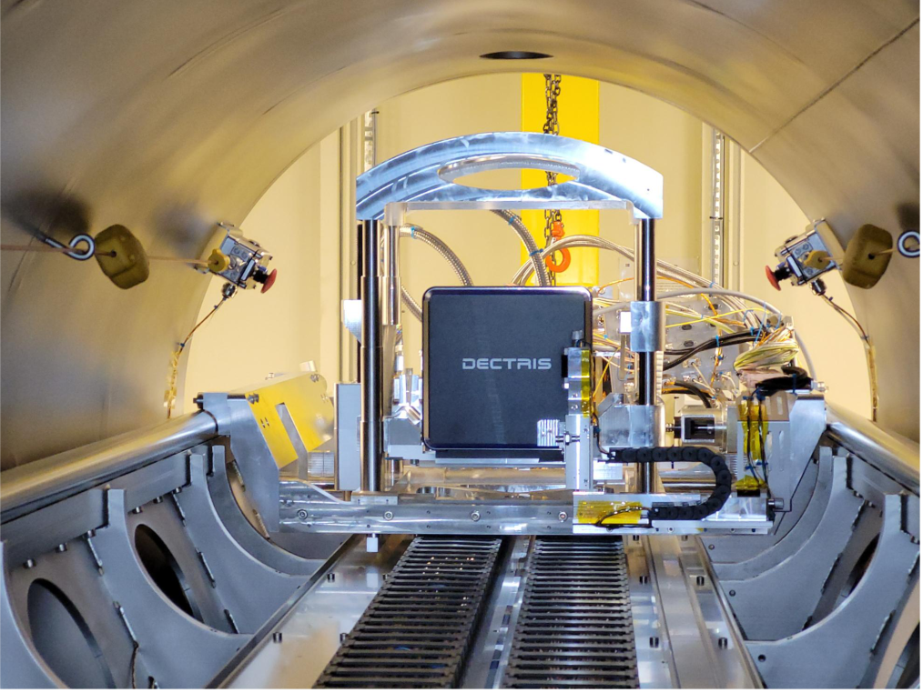
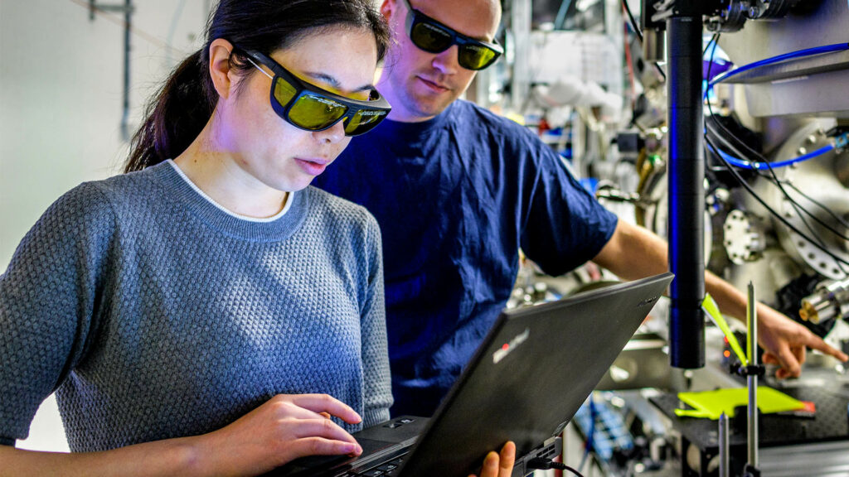
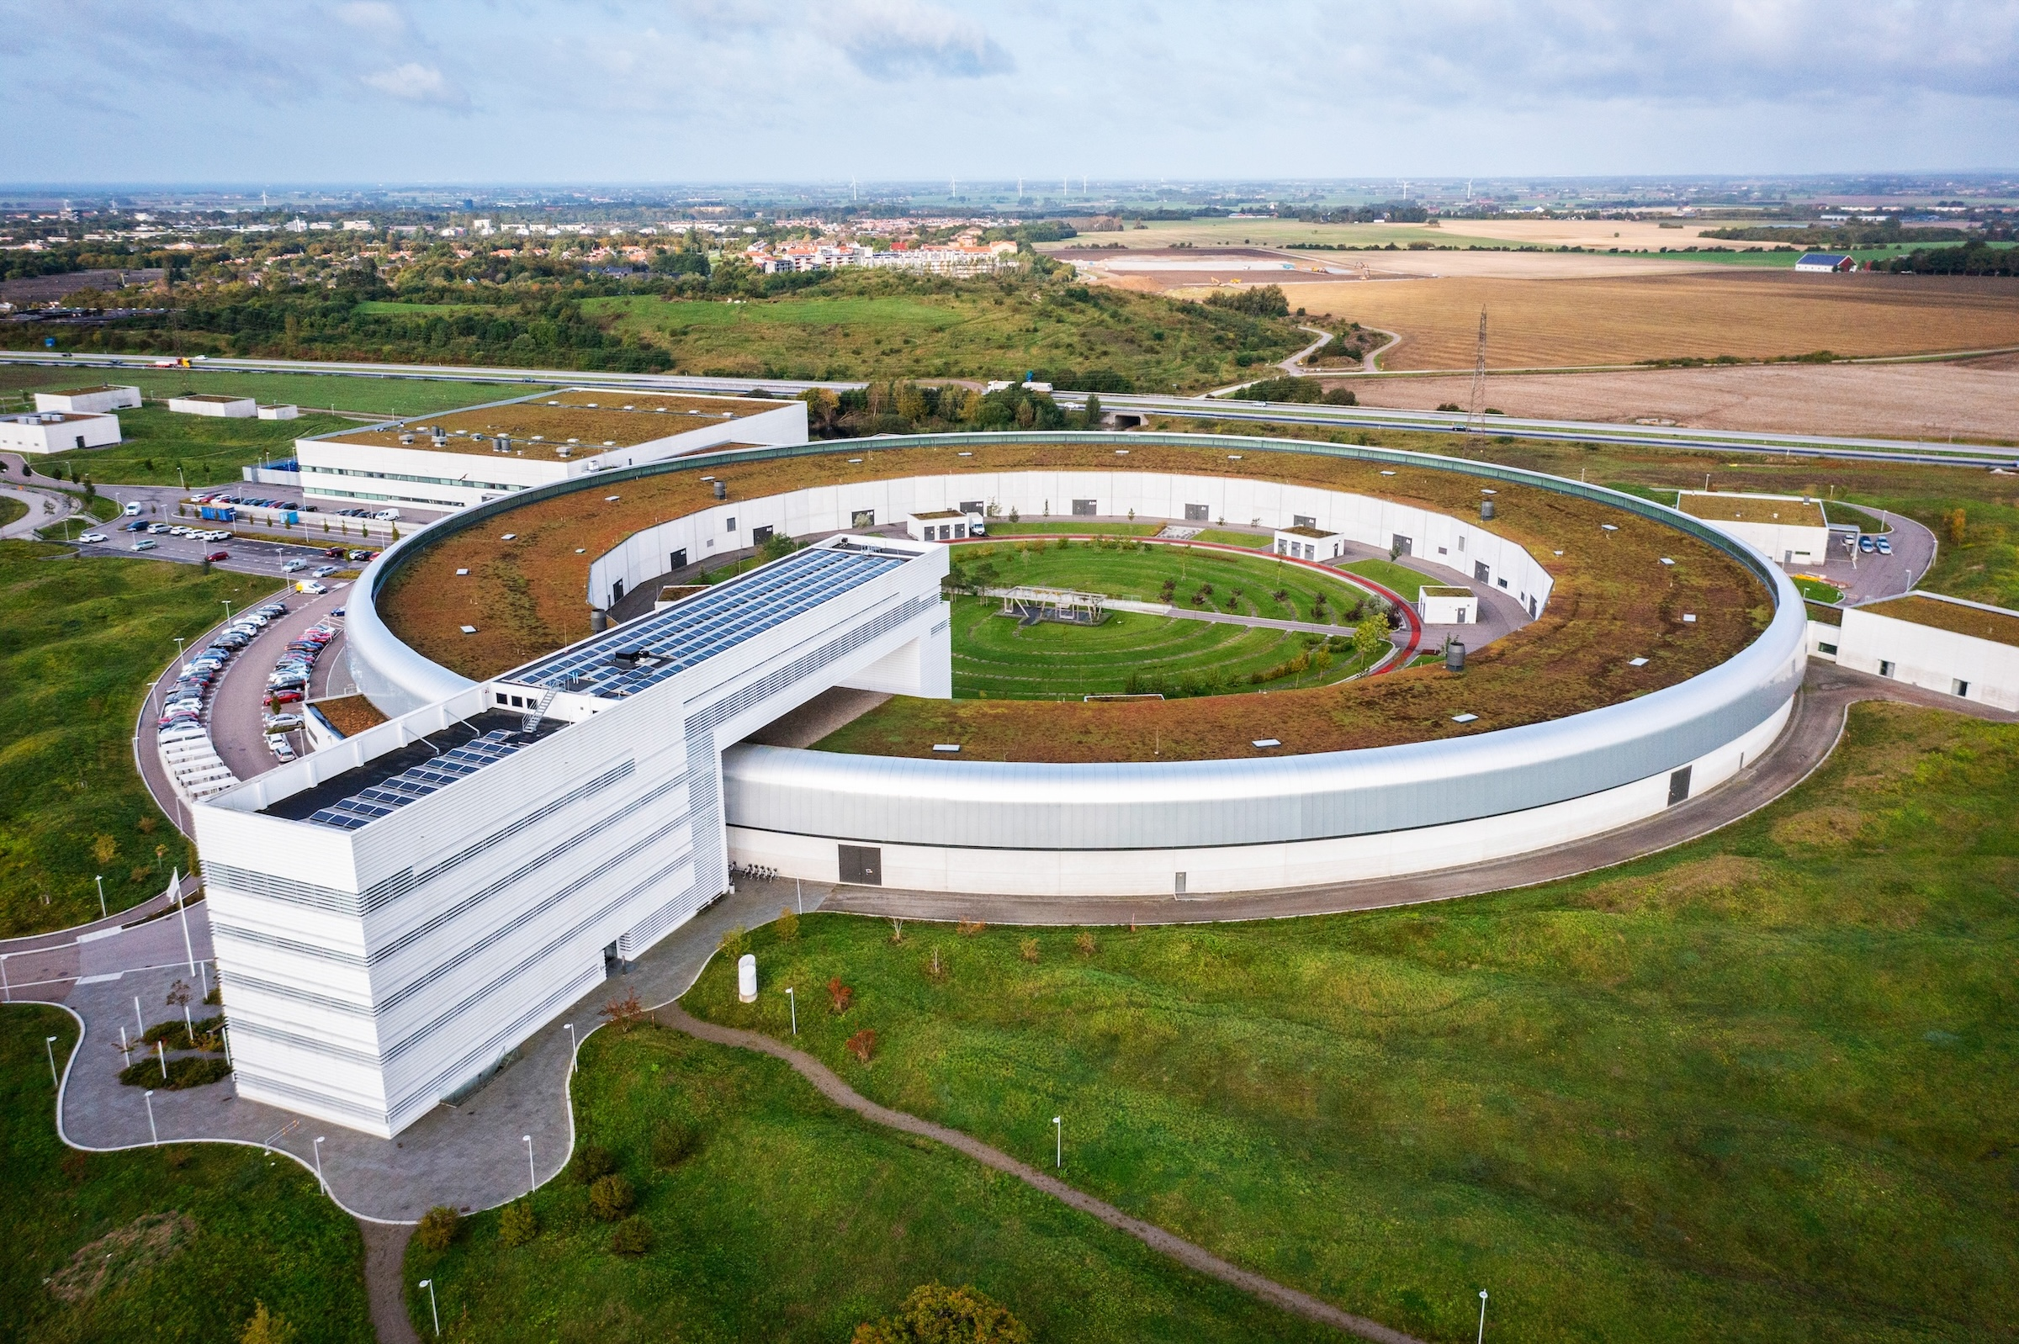
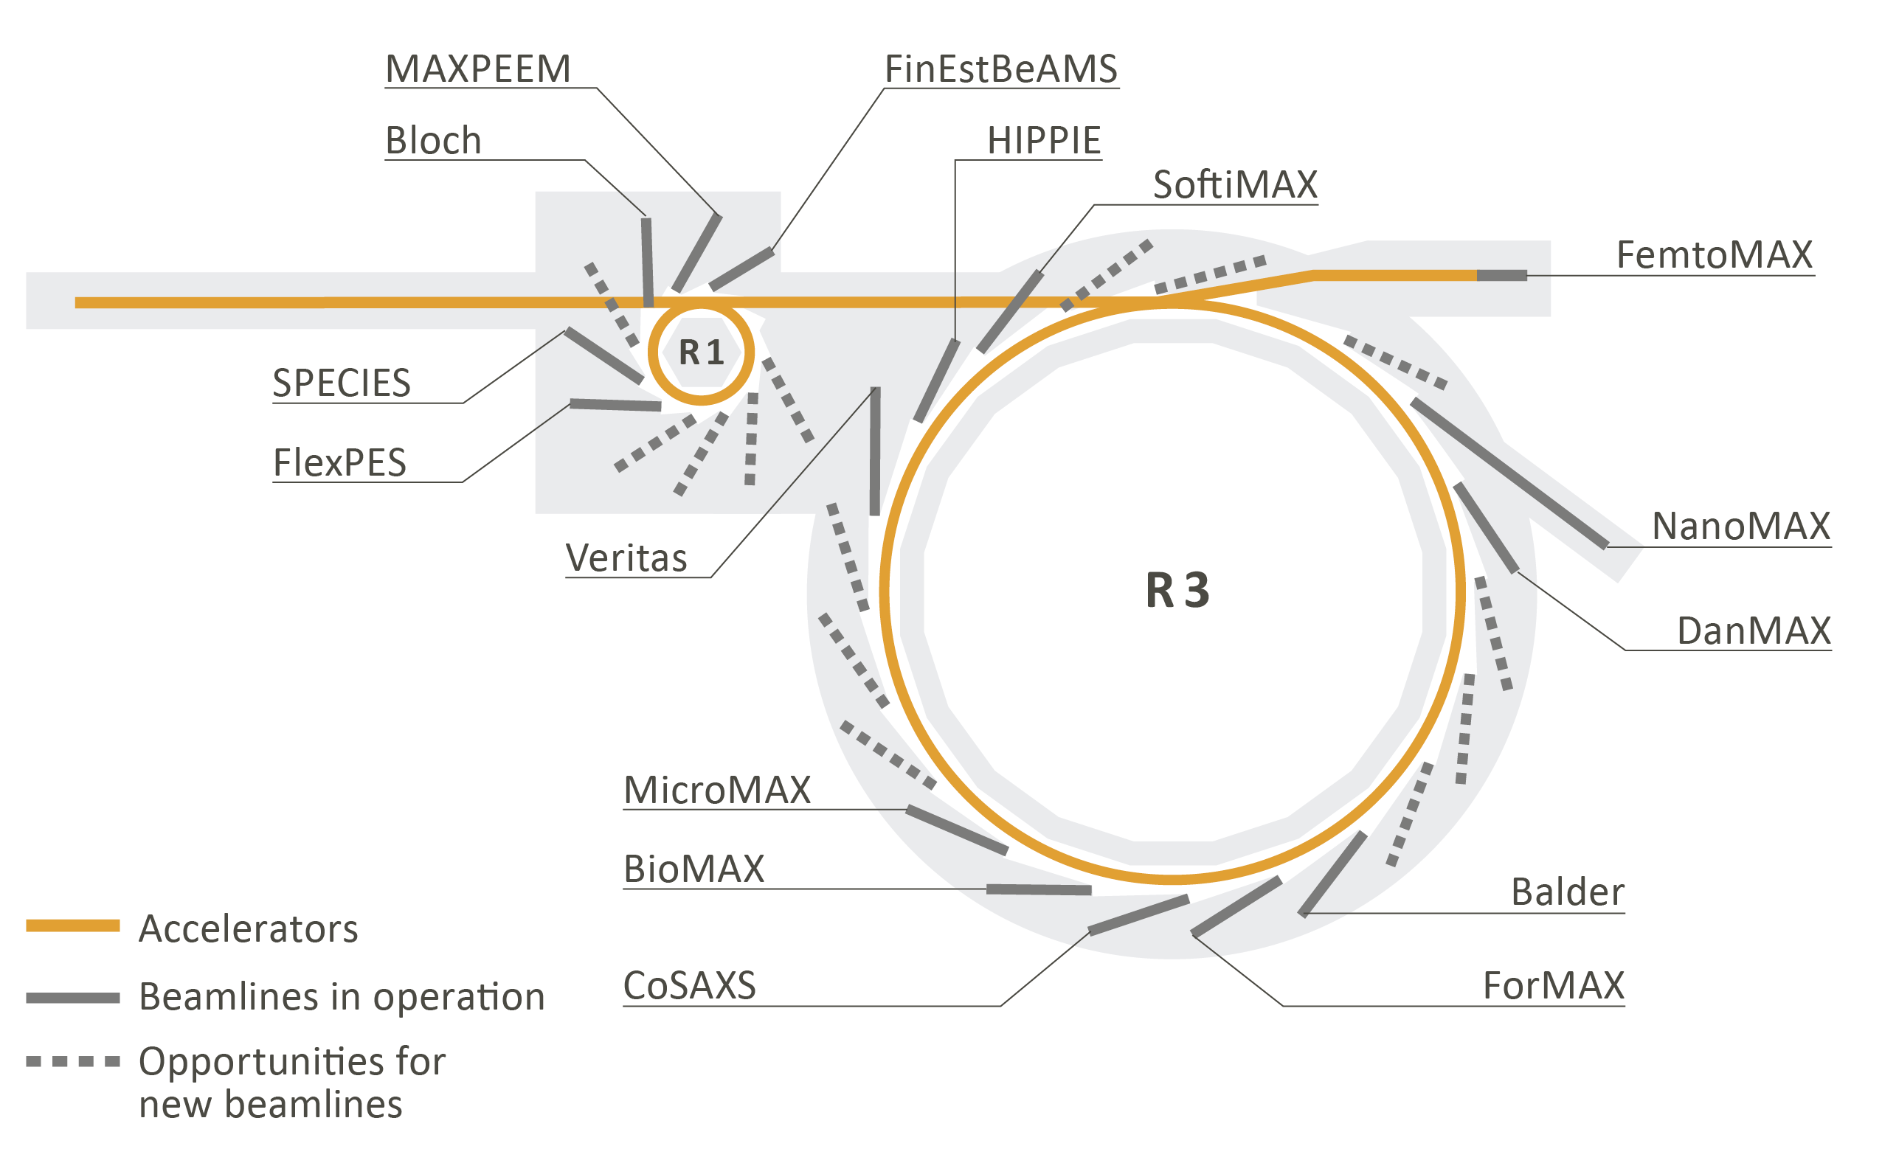
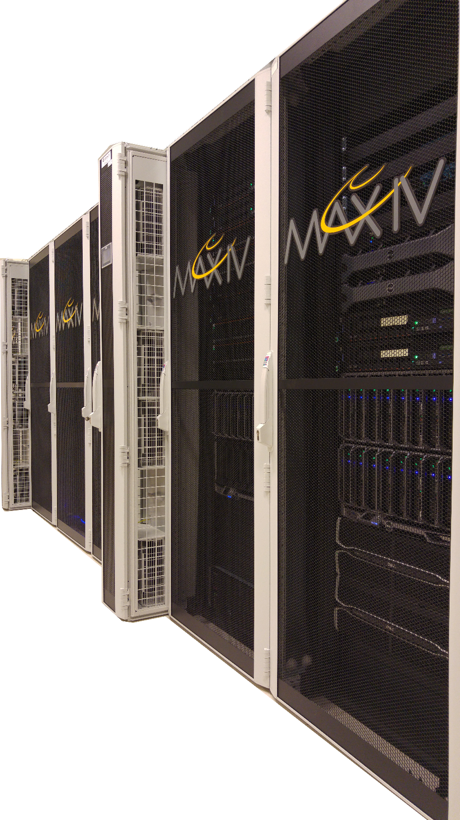
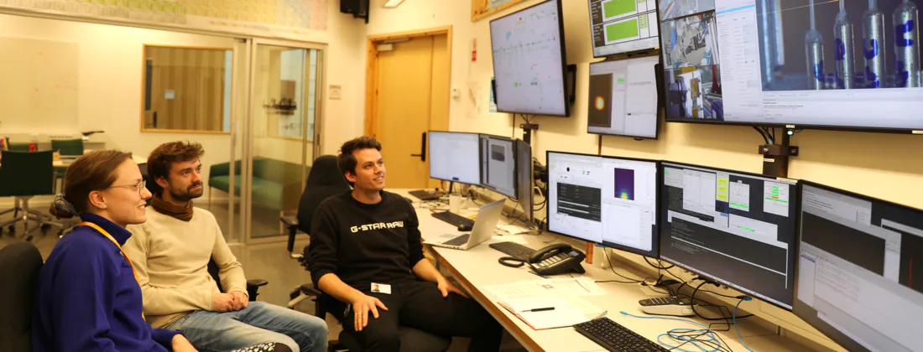
MAX IV synchrotron distributed data processing and visualisation
remote
on-site
detectors
© Credit: LINXS
edge HPC
16 beamlines, 350 staff, 1600 users/y
Data: HDF5 with NeXus convention
control room
clouds

Slide 3
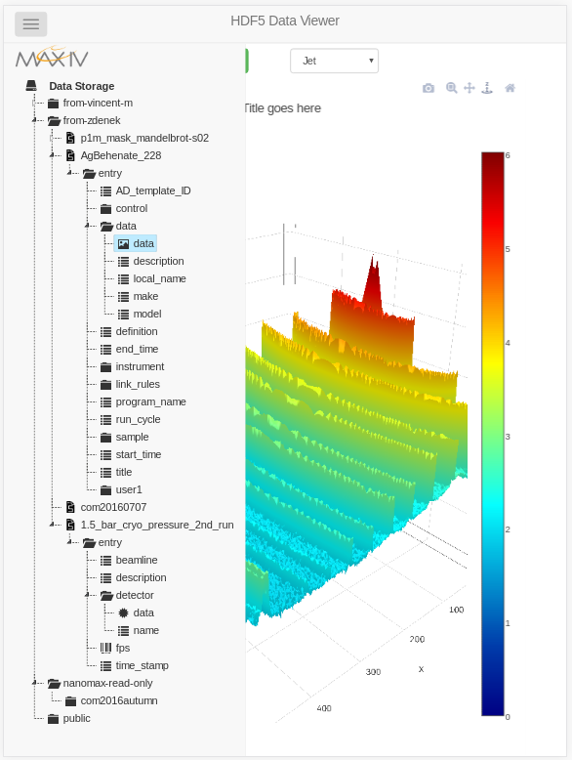
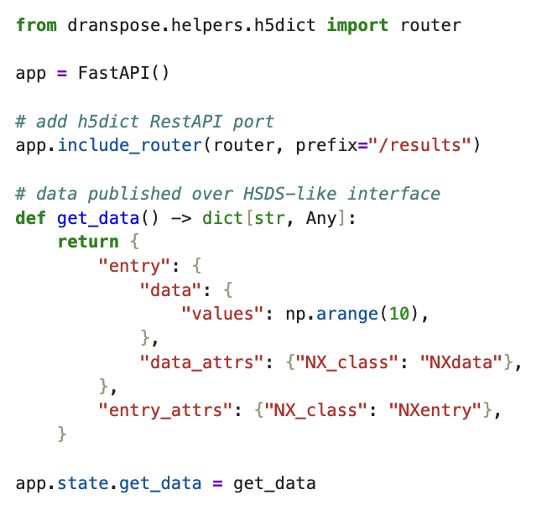
Timeline HDF5 at MAX IV synchrotron
2014 … HDF5 at MAX-Lab
2016 … HDF5 at MAX IV
2018 … HSDS AWS S3 Project at MAX IV
2023 … HSDS tutorial at HUG
2016 … h5pyd & HSDS by HDF group
2016 … MAX IV HDF5 web GUI
2020 … HSDS posix storage by HDF group
2024 … HSDS in production at MAX IV

Slide 4
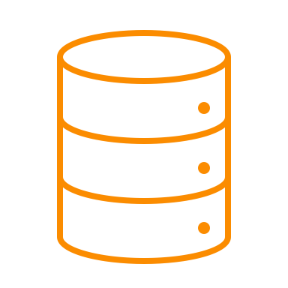
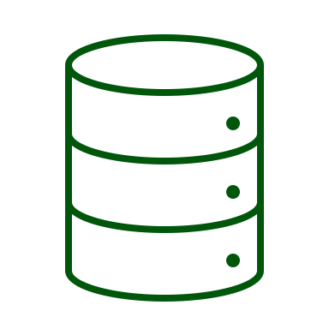
Data acquisition classical and ”live” data processing
VDS (virtual datasets)
SWMR (single writer multiple readers)
direct chunk write/read
final data later archived or published
raw
.h5
stream
processed or compressed
user data analysis & visualisation
various data sources
.h5
shared network storage
.h5,.tiff
intermediate data later scratched
ephemeral data later overwritten

Slide 5
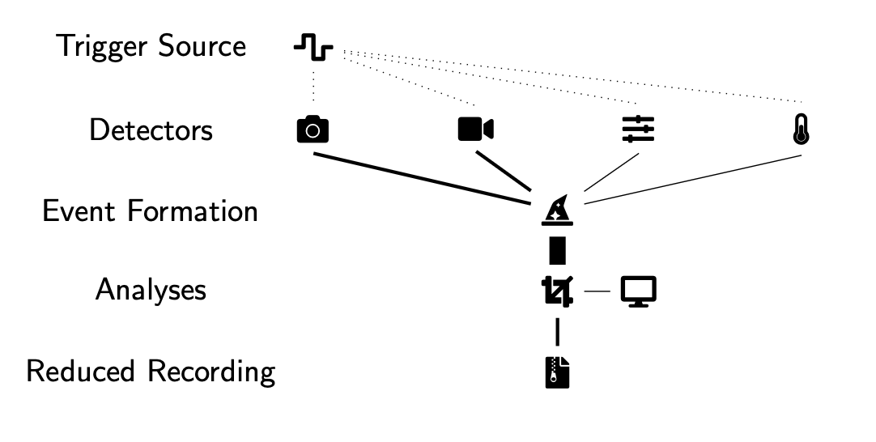
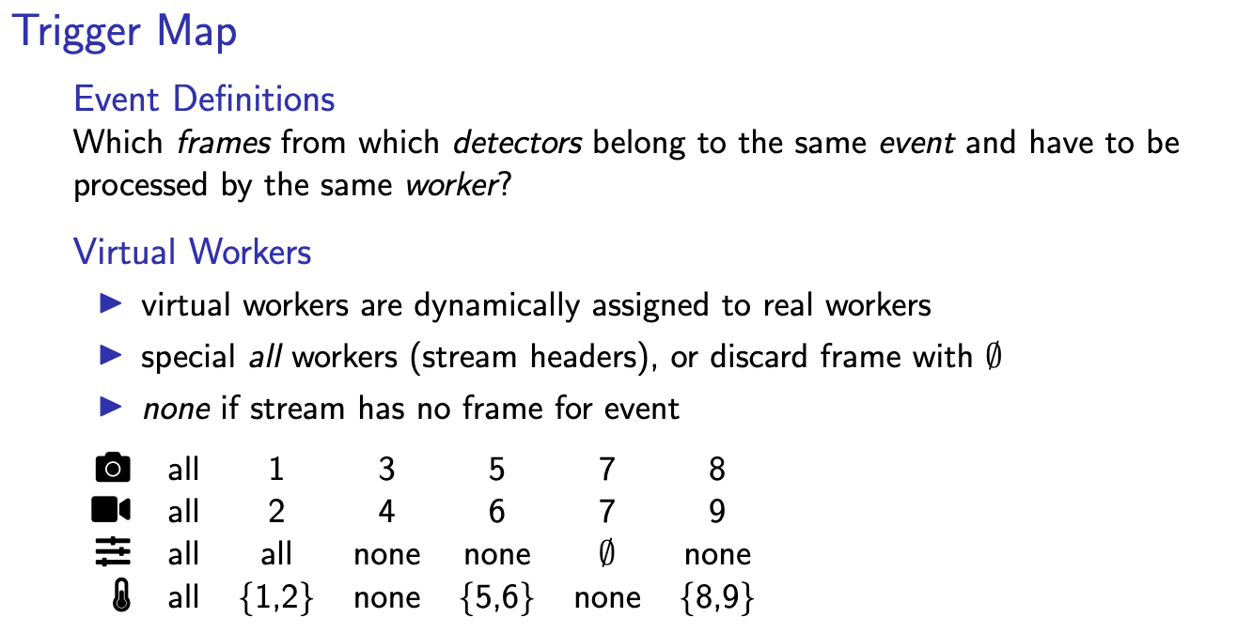
dranspose A constrained map-reduce live analysis pipeline for fast experimental feedback
by Felix Engelmann et al.: https://dranspo.se
parallel and distributed
the 1st step:
dranspose replaced the intermediate data processing HDF5 files by ZMQ data streams
shared storage NOT required for the intermediated files

Slide 6
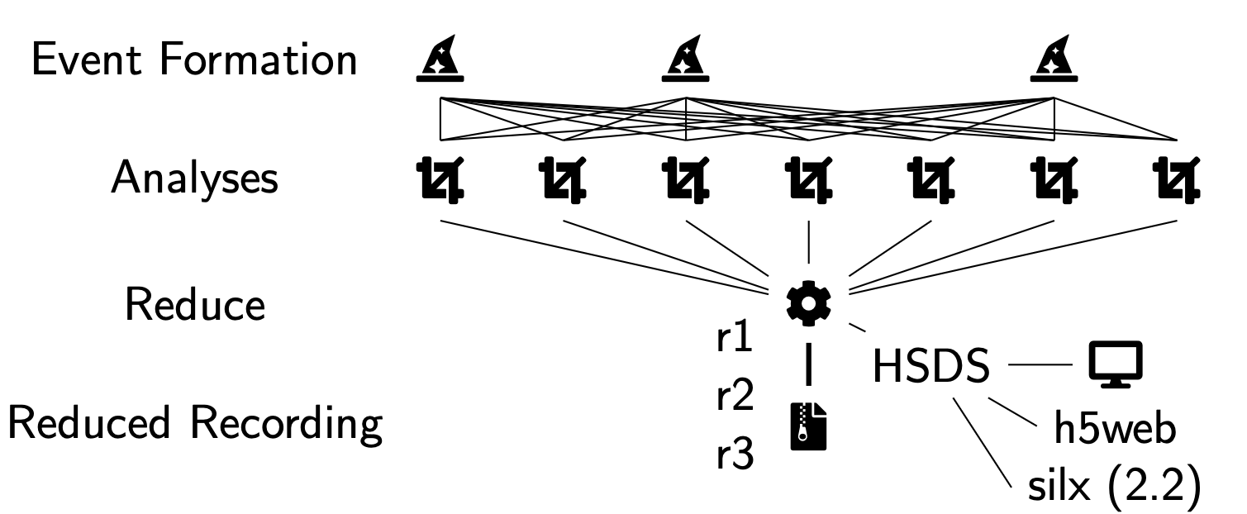
dranspose A constrained map-reduce live analysis pipeline for fast experimental feedback
by Felix Engelmann et al.: https://dranspo.se
the 2nd step:
dranspose + HSDS replaced application specific visualisation by HDF5 tools
shared storage NOT required anymore (local is enough)

Slide 7
Data acquisition with HSDS
VDS (virtual datasets)
SWMR (single writer multiple readers)
direct chunk write/read
stream
processed or compressed
user data analysis & visualisation
various data sources
shared network storage
(HSDS)
.h5
shared storage NOT required anymore (local is enough)
ephemeral data later overwritten

Slide 8
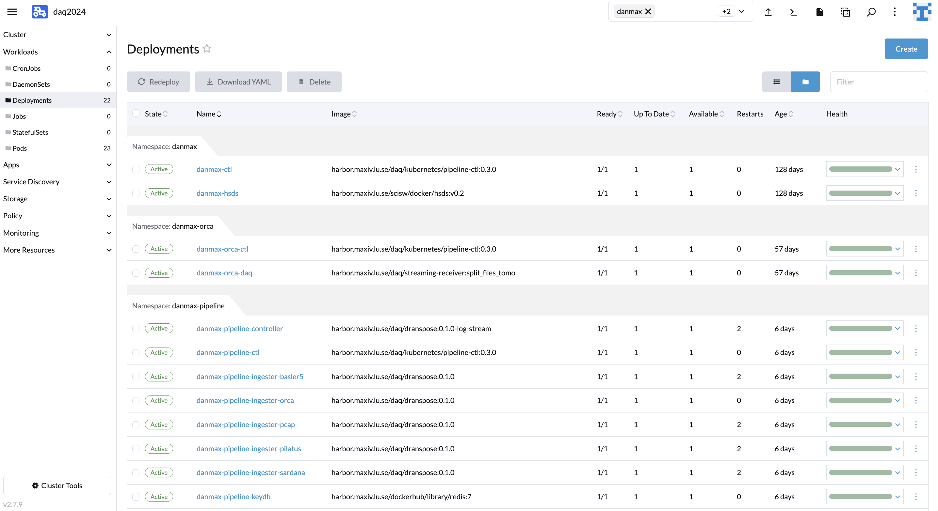
Implementation DAQ applications with HSDS
k8s are not the requirement!
HSDS with the posix backend can be run on desktop or HPC. Also h5py can be a backup solution. Both are used for development.
K8s - Rancher
simply deployment
custom image
based on conda
single pod
posix storage

Slide 9
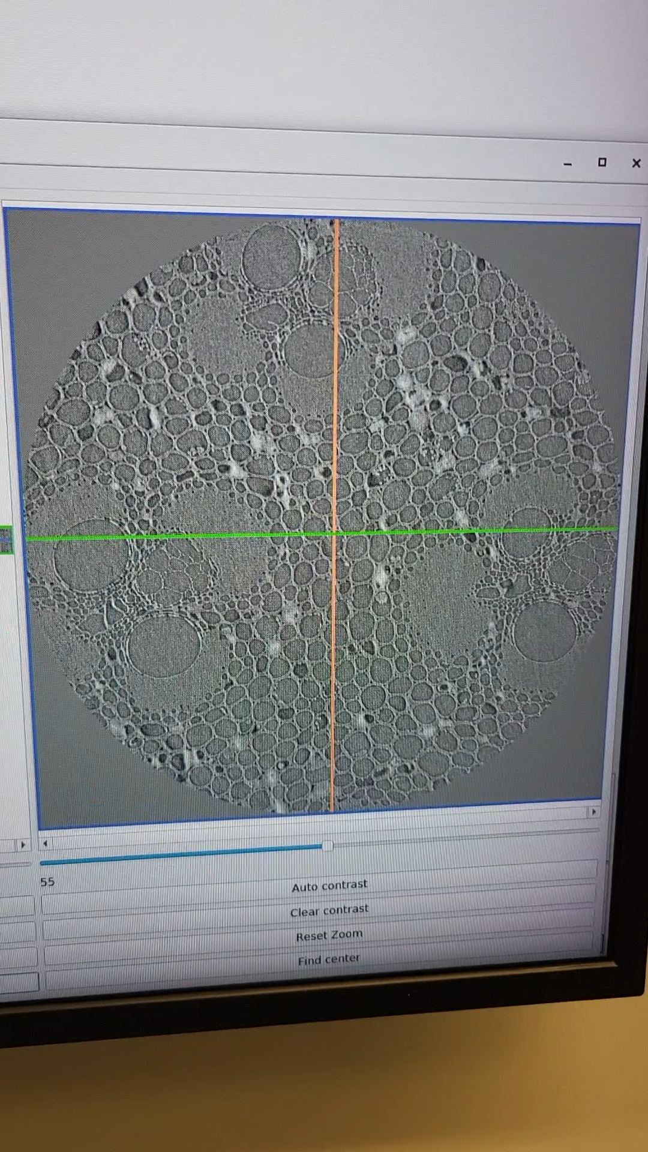
Example DAQ applications with HSDS: streaming tomography
live- viewer
camera- daq-controller
https
pipeline-controller
https
dcu-frame-grabber
daq-frame receiver
ZMQ
camera ingester
camera
worker-0
stomo
https
worker-1
https
motor enc. + Pandabox
PCAP (rot. angle) receiver
PCAP ingester
worker-2
client
HSDS
beamline
basic-DAQ
DAQ-dranspose-pipeline
on explicit “hsget”
https
PCAP- daq-controller
image-file
HDF5 - DXchange
hdf5-file
sardana recorder motor positions

Slide 10
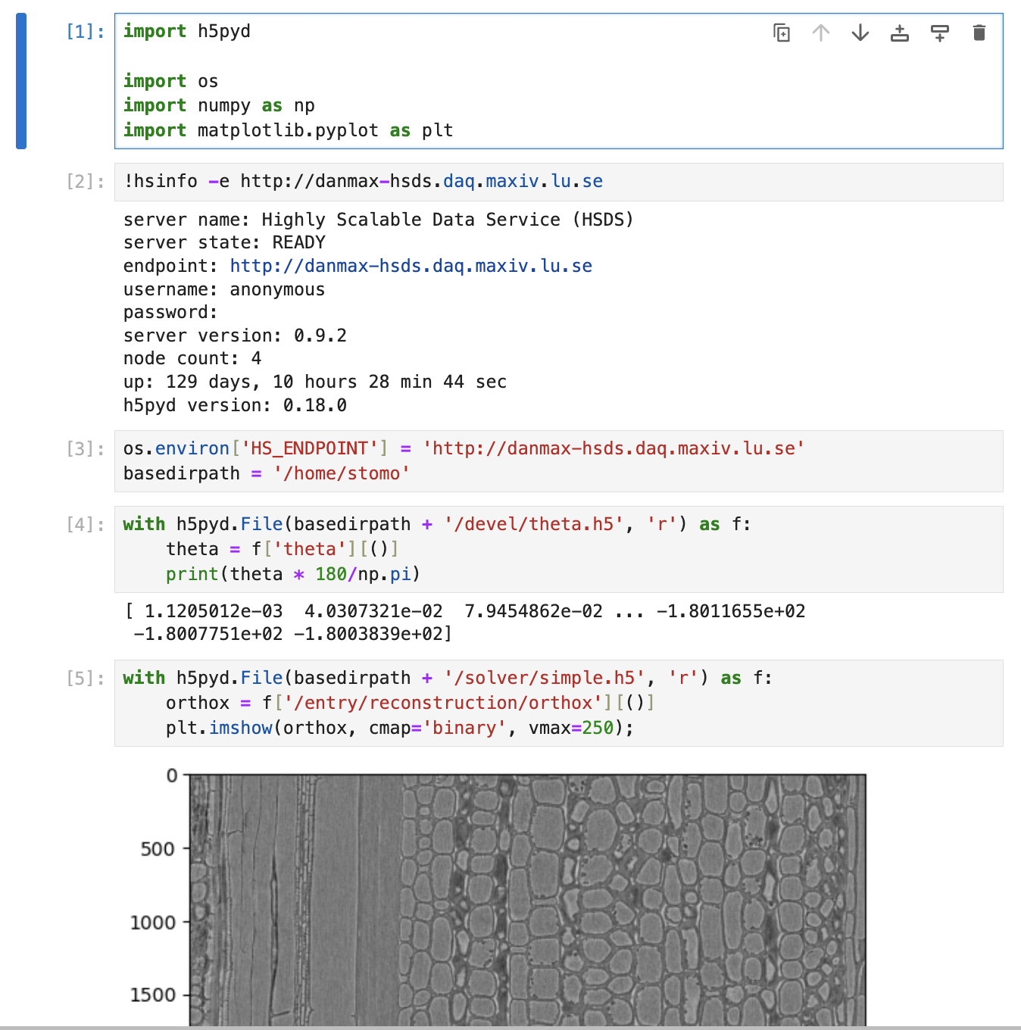
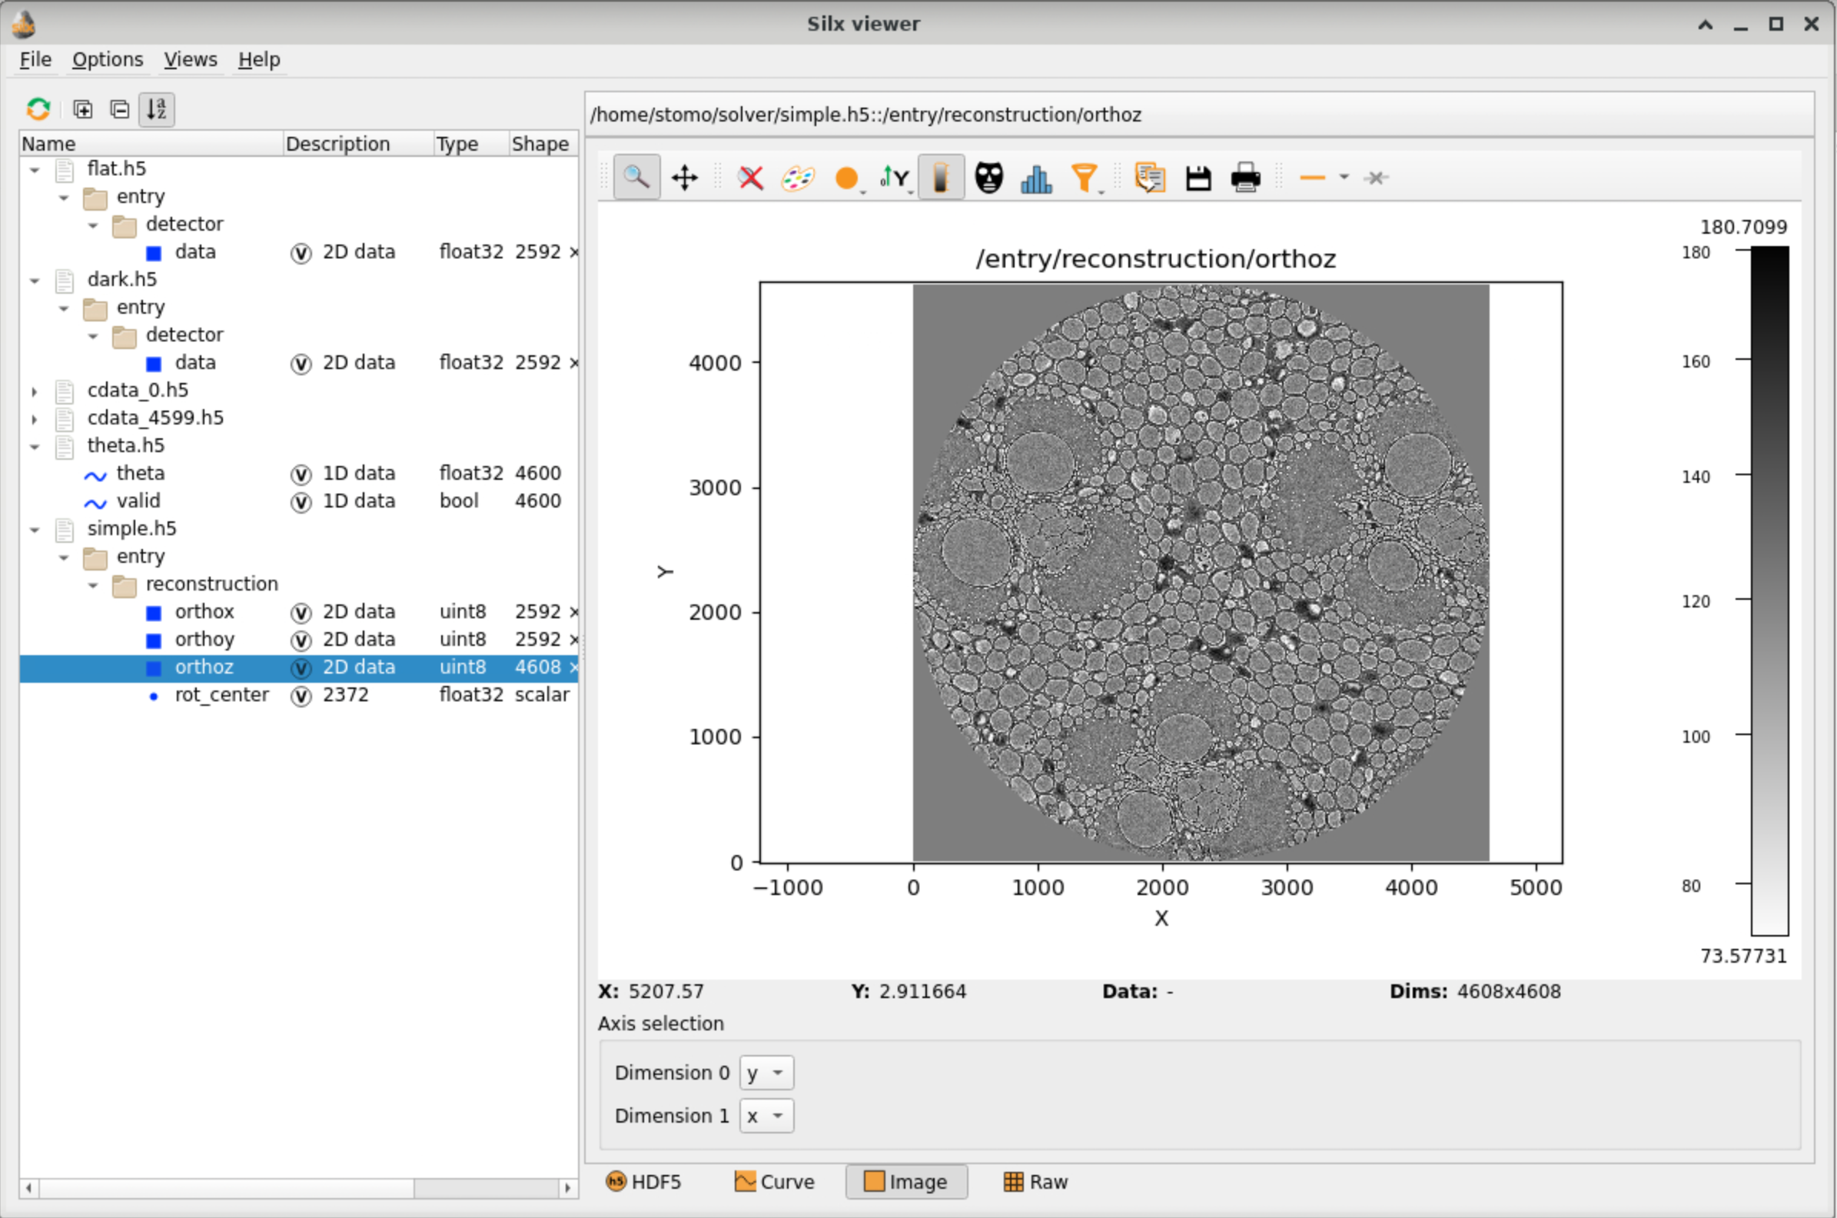
DAQ applications with HSDS Leveraging HDF5 sw ecosystem
silx view http://danmax-hsds.daq.maxiv.lu.se/home/stomo/solver/simple.h5

Slide 11
Data acquisition with in-memory HSDS API
VDS (virtual datasets)
SWMR (single writer multiple readers)
direct chunk write/read
stream
processed or compressed
user data analysis & visualisation
various data sources
(HSDS)
(in memory HSDS)
.h5
no “files”
still using HDF5 data model
ephemeral data later overwritten
ephemeral data in-memory only

Slide 12
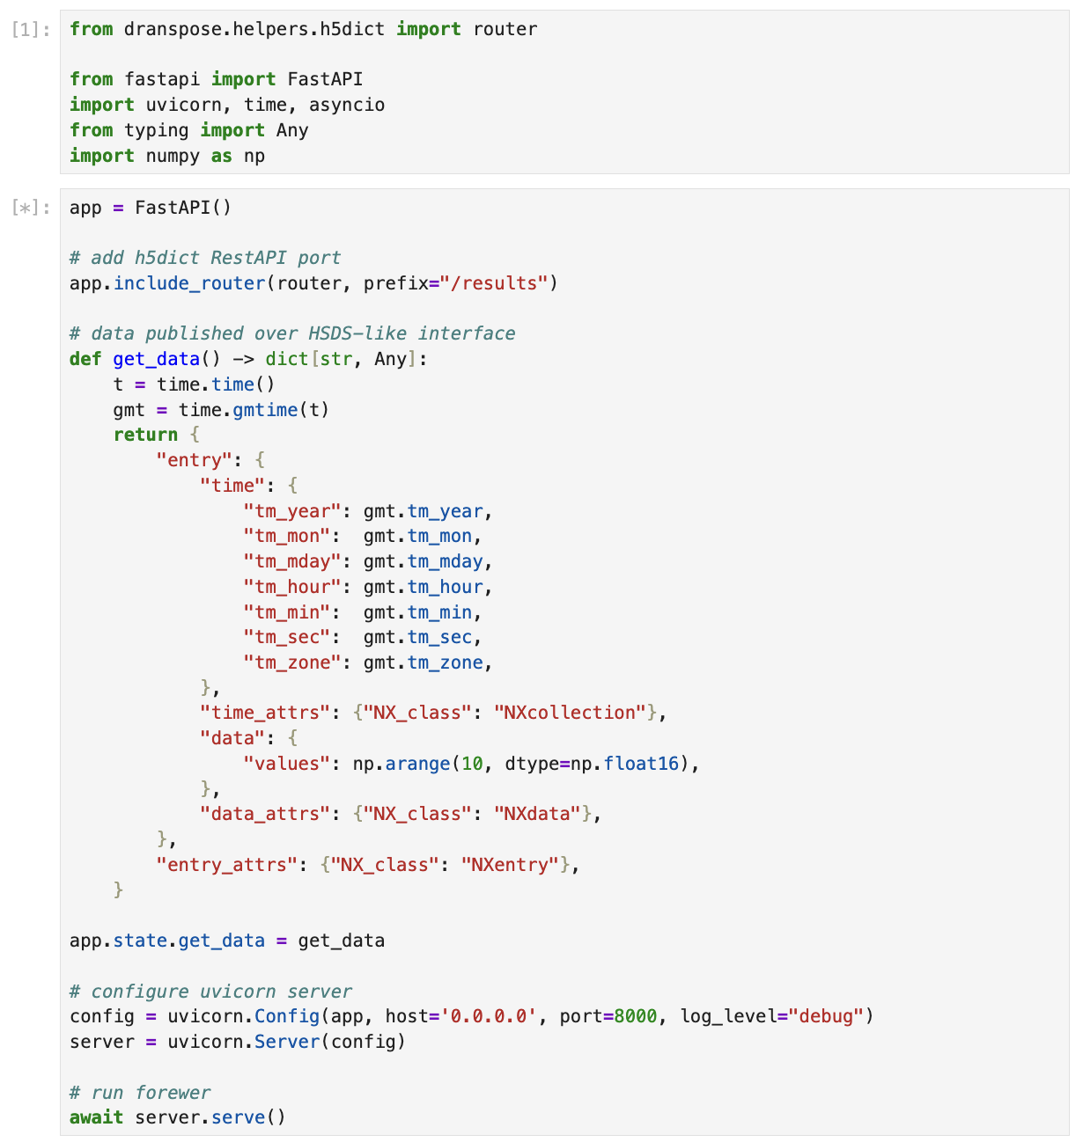
dranspose.helpers.h5dict.router read-only in-memory python dictionary exposed as HSDS-like API
publisher.ipynb
consumer.ipynb

Slide 13
Summary Recent trends in DAQ with HSDS at MAX IV
utilizing HSDS instead of shared network storage
enabled by the “posix” storage backend
leveraging HSDS API and related HDF5 sw ecosystem
h5pyd, silx 2.2, h5web
(read-only) remote access to in-memory datasets
with HDF5 data model
Felix Engelmann – ICDT, Ohio State University
Michele Cascella – MAX IV SciData (Lund) Jason Brudvik – ESS (Lund)
Andrii Salnikov, Dmitrii Ermakov – MAX IV IT (Lund)
HDF group and HDF community

