Slide 1
KaraboHDF5 Storing Scientific Data at the European XFEL
Jose Luis Vázquez-García
Data Department
Controls Software Engineer
Hamburg, May 26, 2025

Slide 2
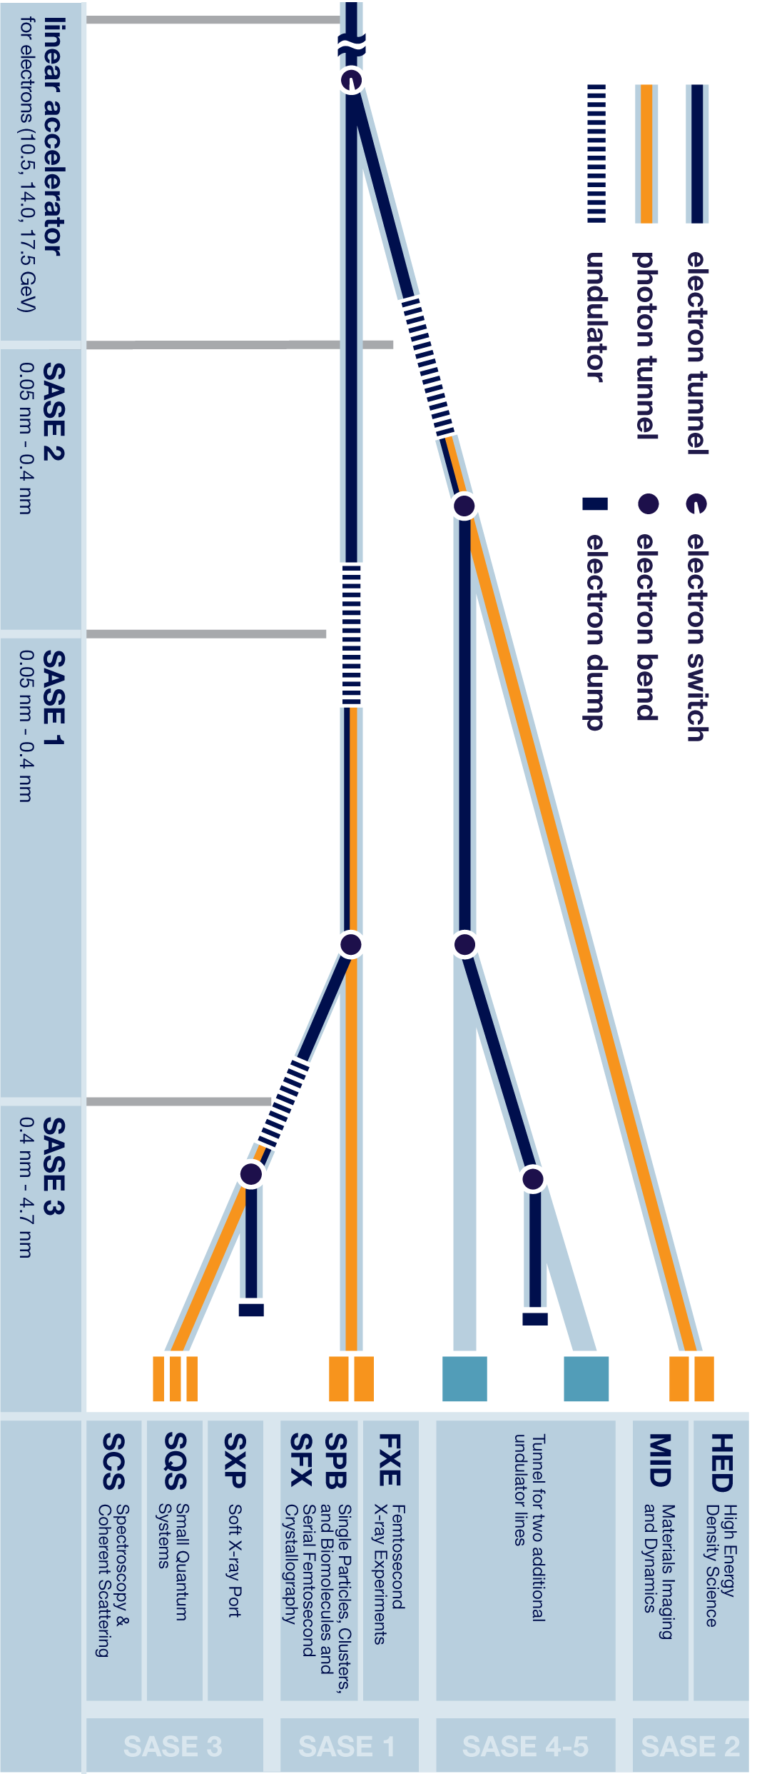
The European XFEL
X-ray Free Electron Laser
3 SASE¹ lines, 7 instruments
Characteristics
High volume of generated data (~PB/day)
High speed of data generation (~15 GB/s)
¹ Self-amplified Spontaneous Emission

Slide 3
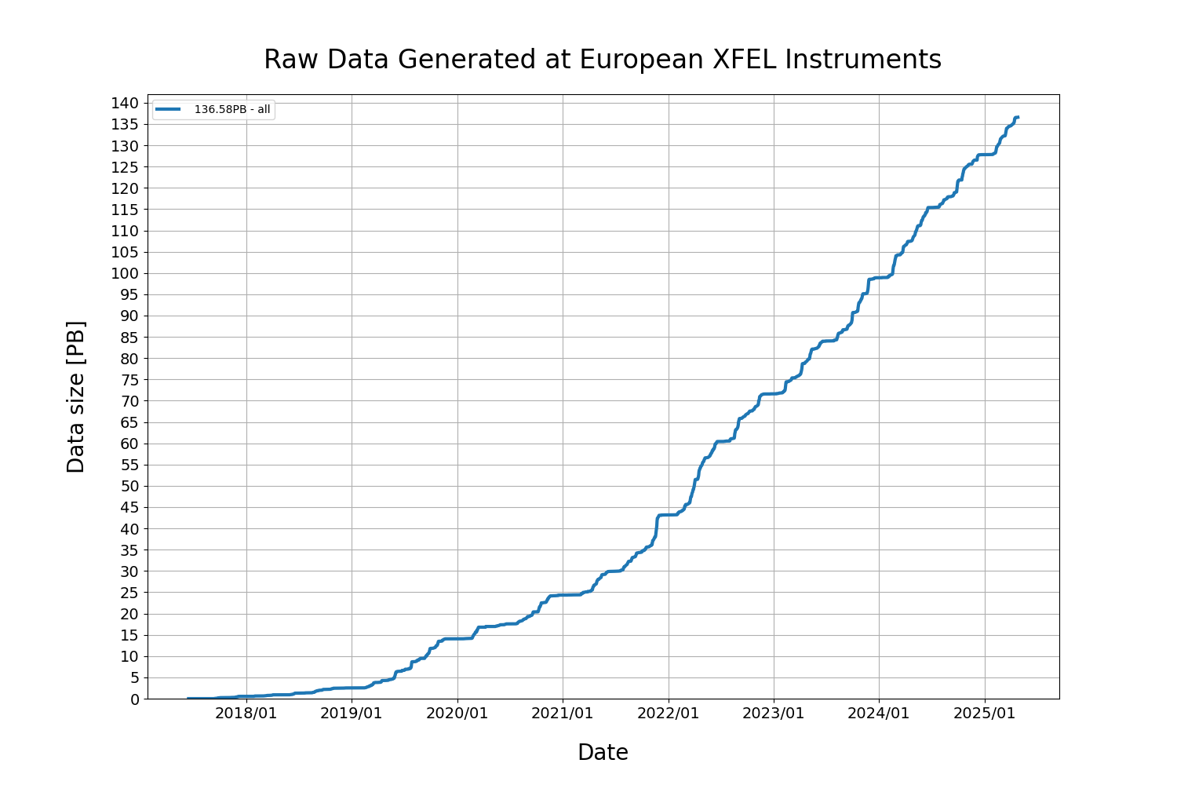
The European XFEL
X-ray Free Electron Laser
3 SASE¹ lines, 7 instruments
Characteristics
High volume of generated data (~PB/day)
High speed of data generation (~15 GB/s)
Problems:
Storage hardware cannot be expanded forever.
Both hardware and software must be able to handle high speed of data generation
¹ Self-amplified Spontaneous Emission

Slide 4
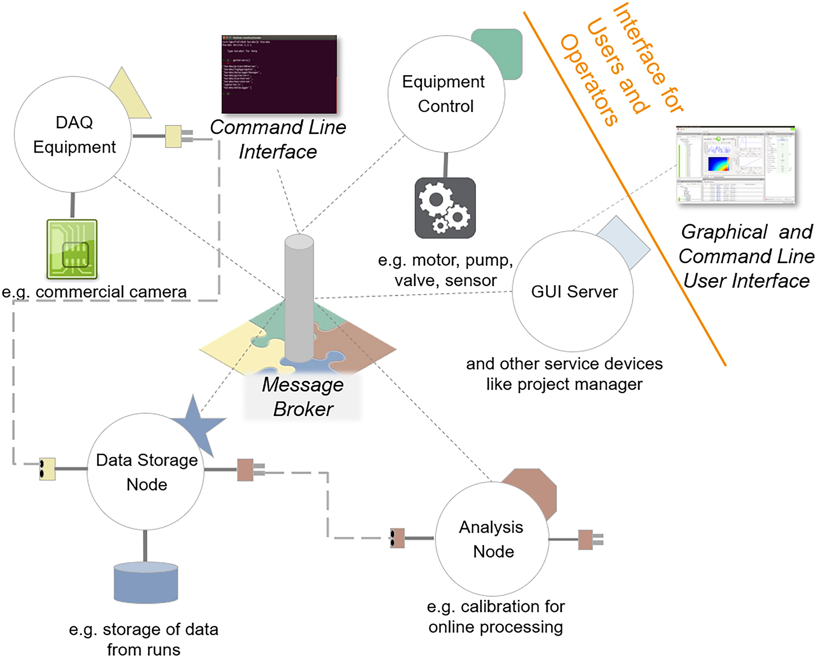
The control system: Karabo (i)
SCADA system, written from scratch in C++ and Python.
Event-driven, fault-tolerant, highly distributed.
Modular:
Karabo devices make up the system.
Karabo Hash: flexible data structure to store and communicate data between devices.

Slide 5
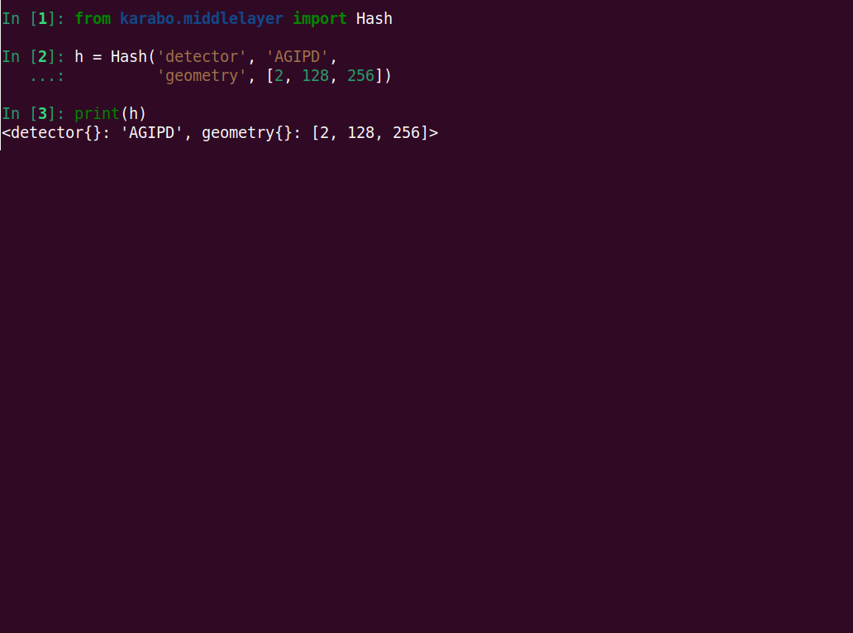
The control system: Karabo (ii)
The Hash:
De facto karabo standard data structure to store and transmit data.
Flexible hierarchical container.
Keyword – value container.
Values can be almost any type, including other hashes.
Attributes (keyword-value pairs) can be attached to values.
Provides a tree-like interface to data.

Slide 6
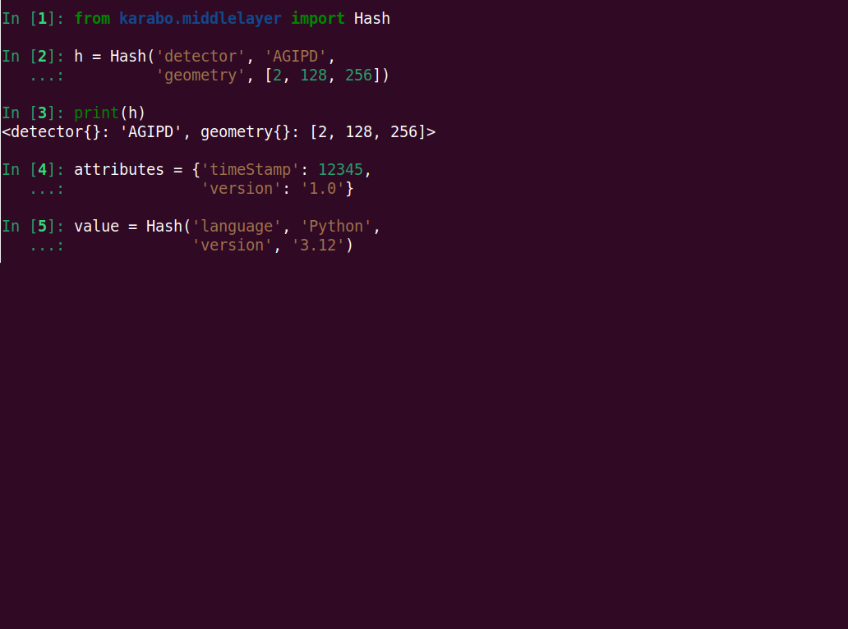
The control system: Karabo (ii)
The Hash:
De facto karabo standard data structure to store and transmit data.
Flexible hierarchical container.
Keyword – value container.
Values can be almost any type, including other hashes.
Attributes (keyword-value pairs) can be attached to values.
Provides a tree-like interface to data.

Slide 7
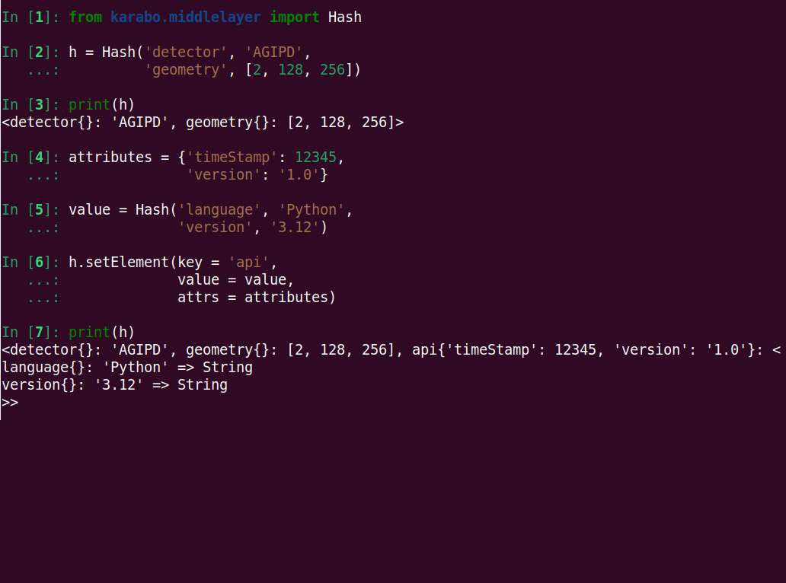
The control system: Karabo (ii)
The Hash:
De facto karabo standard data structure to store and transmit data.
Flexible hierarchical container.
Keyword – value container.
Values can be almost any type, including other hashes.
Attributes (keyword-value pairs) can be attached to values.
Provides a tree-like interface to data.

Slide 8
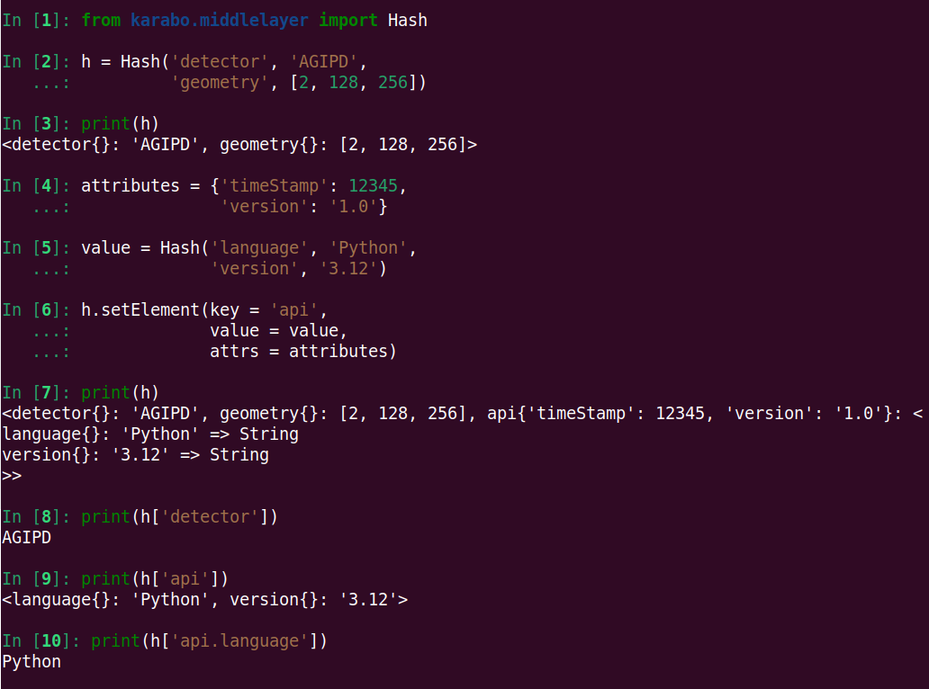
The control system: Karabo (ii)
The Hash:
De facto karabo standard data structure to store and transmit data.
Flexible hierarchical container.
Keyword – value container.
Values can be almost any type, including other hashes.
Attributes (keyword-value pairs) can be attached to values.
Provides a tree-like interface to data.

Slide 9
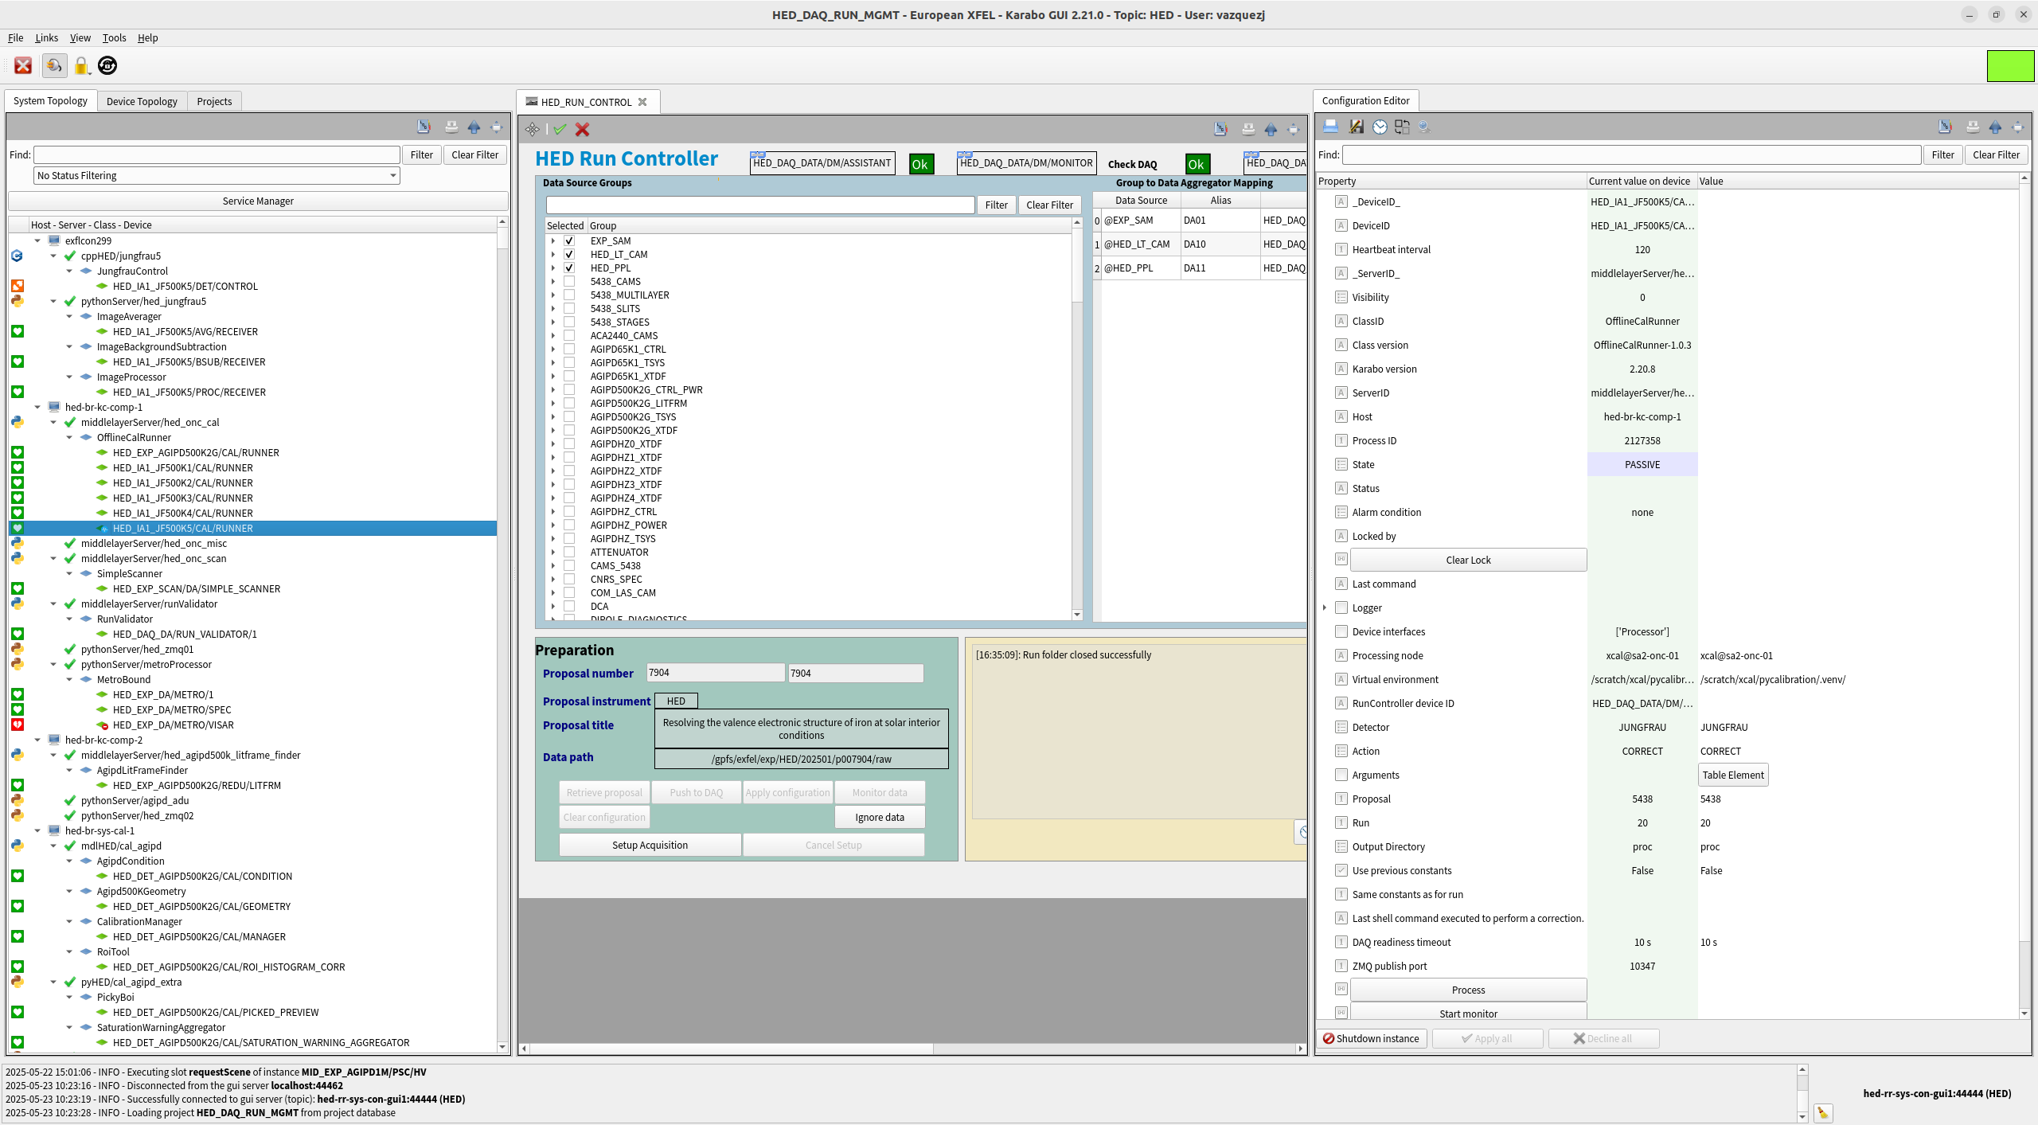
The control system: Karabo (iii)

Slide 10
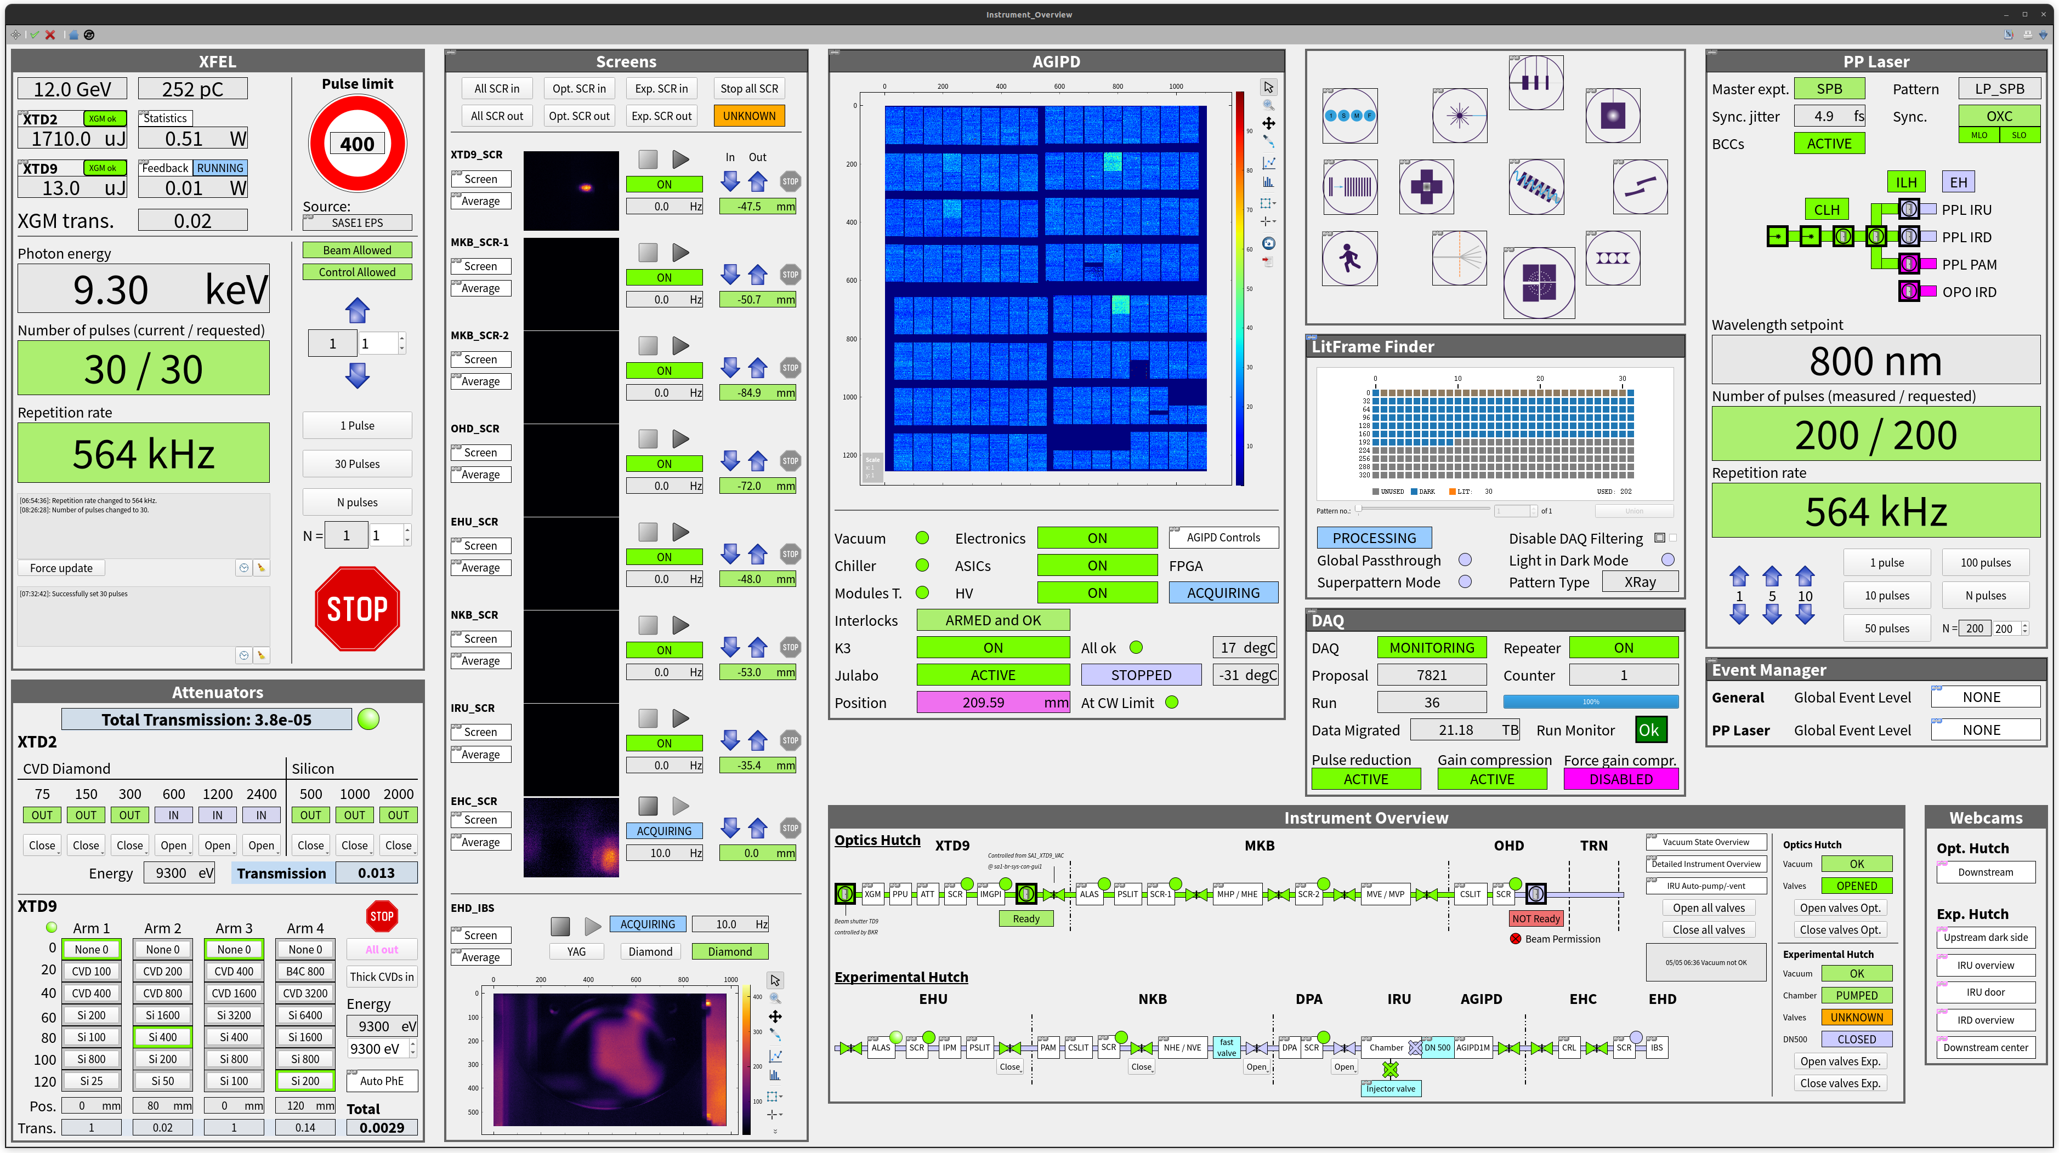
The control system: Karabo (iii)

Slide 11
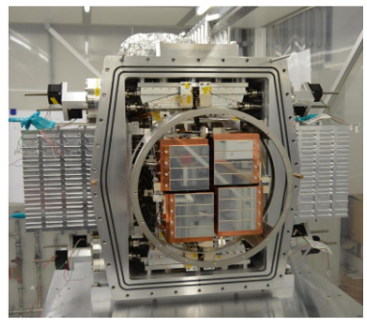
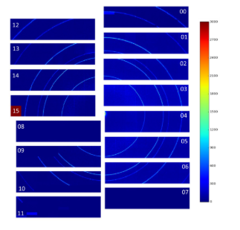
Data Generation (i)
Data sources
Fast 2D sources:
AGIPD
LPD
MSSC
Other imagers:
Jungfrau
Gotthard
etc...
Auxiliary data:
Digitizers
Motors
etc…
Data characteristics:
Fast (up to 15 Gbps for XTDF imagers)
Size (several PB/day)
AGIPD Imager (front) and captured image shown in Karabo (back)

Slide 12
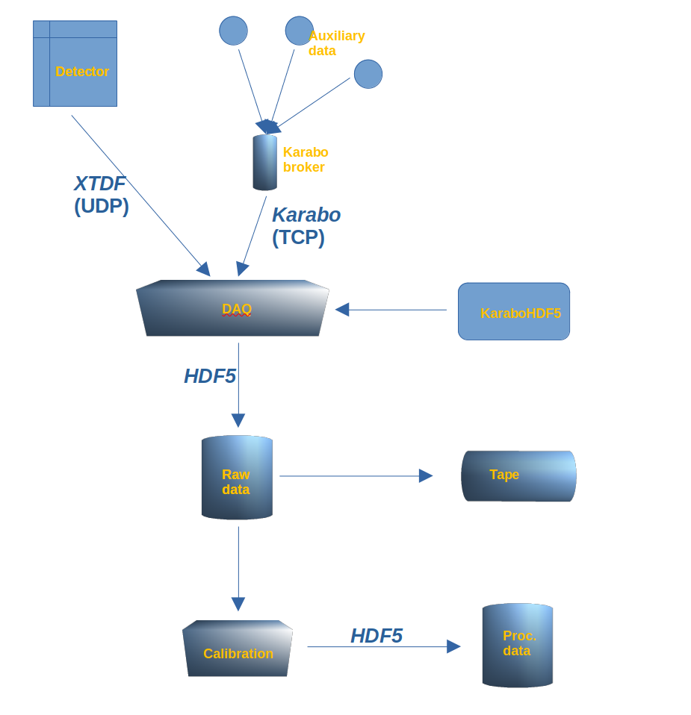
Data Generation (iii)
Many data formats must be handled

Slide 13
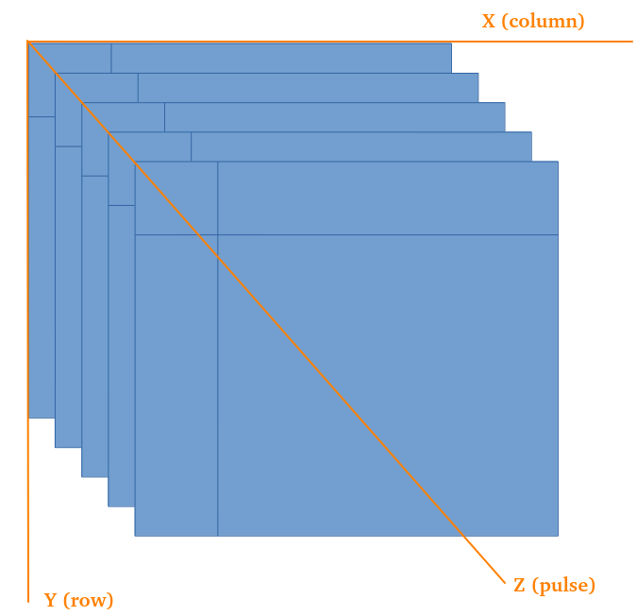
Data Reduction: when storing the data
Data compression
Preliminary tests with data compressed with zlib + HDF5 did not provide enough storage speed.
HDF5 compression + chunking fits the requirements:
On acquisition start, create a file template with chunks along the 3rd axis (pulses).
Chunks with no data will not be written.
Imager data in XTDF format

Slide 14
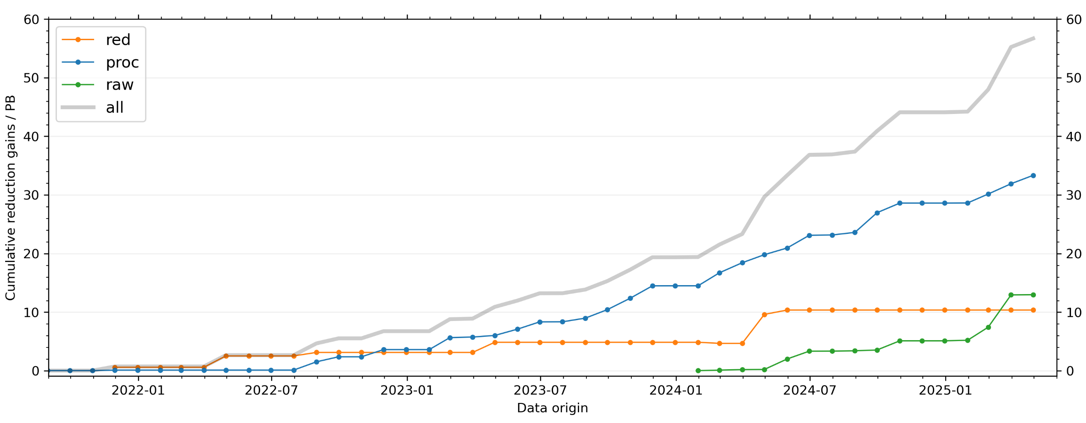
Data Reduction: when storing the data
Data compression
Preliminary tests with data compressed with zlib + HDF5 did not provide enough storage speed.
HDF5 compression + chunking fits the requirements:
On acquisition start, create a file template with chunks along the 3rd axis (pulses).
Chunks with no data will not be written.

Slide 15
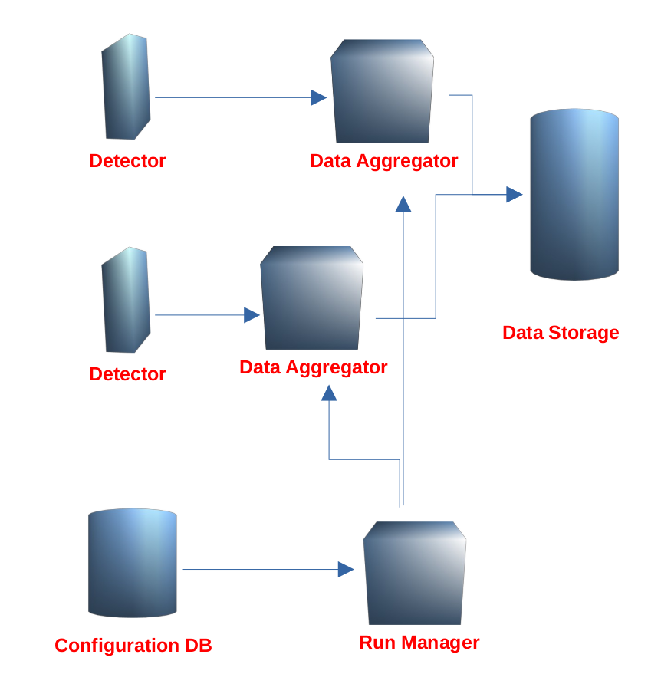
The DAQ (i)
Data Acquisition System: Detectors + Hardware + Karabo devices
Data Aggregators:
A Data Aggregator is a Karabo device
Each aggregator gathers data from a given set of sources.
Stores its data in one HDF5 file (one file per aggregator).
Real-time data recording is possible, by storing data in several HDF5 files in parallel.
The DAQ can be scalated, by adding more aggregators.

Slide 16
The DAQ (ii)
Sustained writing rates to gpfs storage over 15 GB/s

Slide 17
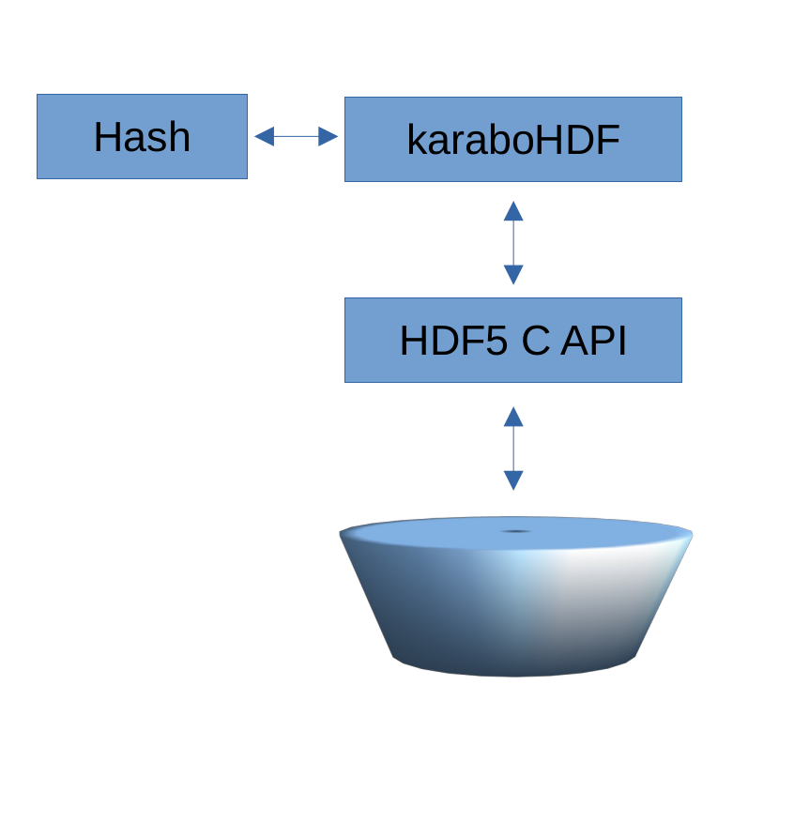
KaraboHDF5 (i)
C++ library written on top of the HDF5 C API.
Maps Hash data structures to HDF5 data objects.
A Hash can be mapped to a Group.
A value can be mapped to a Dataset.
Attributes of a Hash entry map to HDF5 attributes of a Dataset.
karaboHDF5 uses compression and data chunking to optimise storage.
Storage

Slide 18
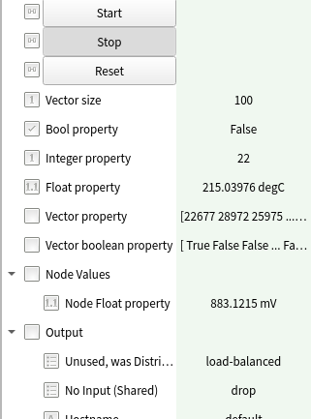
KaraboHDF5 (ii)

Slide 19
KaraboHDF5 (ii)

Slide 20
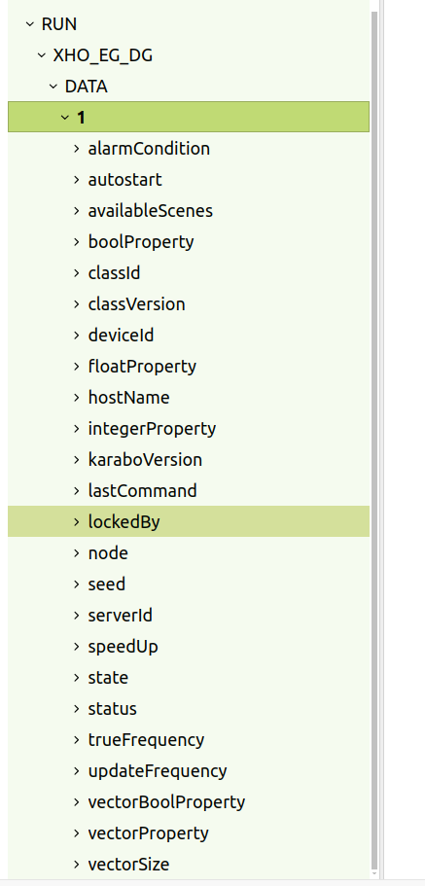
KaraboHDF5 (ii)

Slide 21
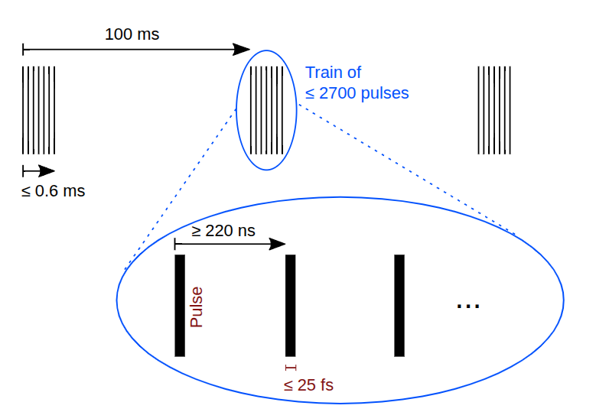
Data Reduction: before storing the data
Sheer amount of data is a problem: let’s try to reduce it before saving the data.
Pulse-based reduction.
Ignore images for pulses that have no information.
Train-based reduction.
Ignore trains for pulses that have no information.

Slide 22
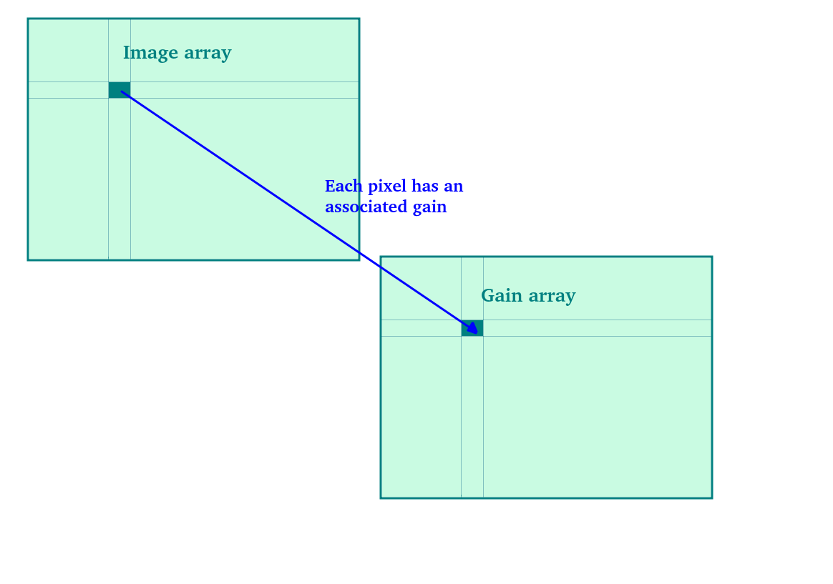
Data Reduction: before storing the data
Sheer amount of data is a problem: let’s try to reduce it before saving the data
Pulse-based reduction.
Ignore images for pulses that have no information.
Train-based reduction.
Ignore trains for pulses that have no information.
Gain compression, for AGIPD detectors.
Each pixel can have one of three gain stages, depending on incident number of photons.
In case of fixed gain, the gain array can be discarded.

