Slide 1
HUG25 – HDF Viewer Roundtable
HDF5 Compass
May 26-28, 2025 | Hamburg, Germany
John Readey
The HDF Group
Notes:
Scot

Slide 2
Overview
HDF Compass is a Python 3 application to view HDF5 files (and other supported formats)
Runs on Windows, Mac, and Linux
Modern looking UI with wxPython (even if it is 10 years old now)
No editing capability – just a viewer (some may consider this a feature!)
Can handle arbitrary large files (data is pulled in as needed)
Basic 2D plotting
Can open files or arbitrary resources on the web (e.g. OpenDAP service)

Slide 3
History
Originally developed by Andew Collette circa 2013
  Was a chance to highlight h5py (also originally developed by Andrew)
  Wanted a Python-based viewer with a modern UI and without all the backage of HDFView
  Designed from the ground up to be extensible (HDF5 is an equal citizen among all the plugins)
THG assumed ownership in 2014
  Andrew was moving on to other things and didn’t have time to work on it
  I (John Readey) worked sporadically on it in 2014-2015, but time was limited
Some outside developers have made contributions add features (support for wxPython new release and Python 3)
Limited adoption, but (IMO) still a very solid app

Slide 4
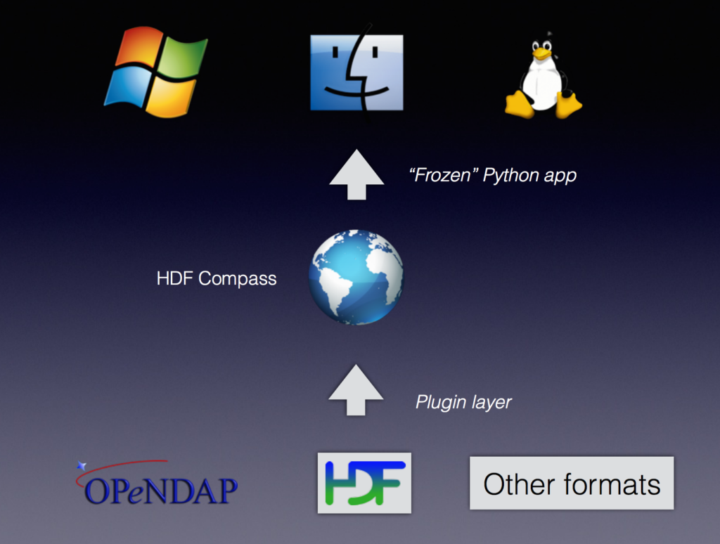
HDF Compass Architecture

Slide 5
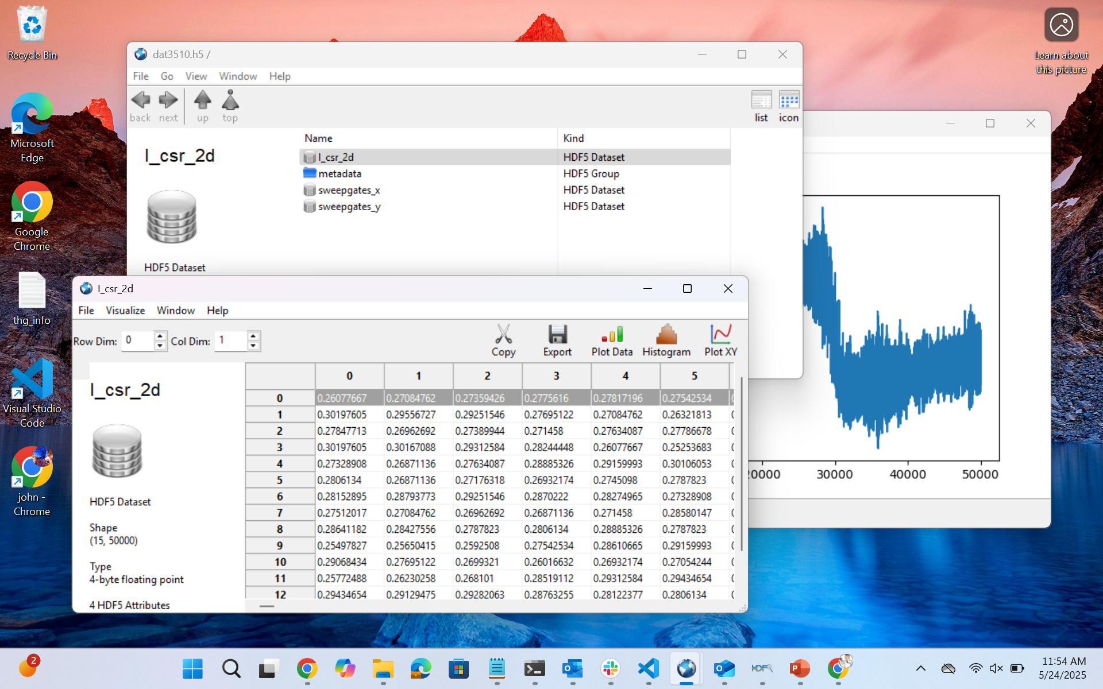
Compass User Interface

Slide 6
HDF Compass Future
Currently no commitment to do any work on behalf of THG
Ideas that would be nice to explore (from my point of view):
  Add a Zarr plugin
  Add h5pyd/HSDS plugin
  Resource explorer for web resources
  Support HDF5 files on S3 (using ros3 vfd)

