Slide 1
Shiver me timbers! - Sharded Storage for HDF5
Quincey Koziol, Principal Engineer | EuroHUG25

Slide 2
HDF5 Native File Format Today

Slide 3
HDF5 Native File Format Today
HDF5 was built and optimized for high-speed POSIX I/O
Self-describing, sequential data layout, in single file*
Many custom data structures
B-trees, heaps, etc.
Blocks of dataset elements: contiguous & chunked layout

Slide 4
HDF5 Native File Format Today
HDF5 was built and optimized for high-speed POSIX I/O
Self-describing, sequential data layout, in single file*
Many custom data structures
B-trees, heaps, etc.
Blocks of dataset elements: contiguous & chunked layout
When running parallel applications with MPI, we compensated quickly
Require applications to perform collective metadata modification

Slide 5
HDF5 Native File Format Today
HDF5 was built and optimized for high-speed POSIX I/O
Self-describing, sequential data layout, in single file*
Many custom data structures
B-trees, heaps, etc.
Blocks of dataset elements: contiguous & chunked layout
When running parallel applications with MPI, we compensated quickly
Require applications to perform collective metadata modification
When cloud computing with object storage arose,

Slide 6
HDF5 Native File Format Today
HDF5 was built and optimized for high-speed POSIX I/O
Self-describing, sequential data layout, in single file*
Many custom data structures
B-trees, heaps, etc.
Blocks of dataset elements: contiguous & chunked layout
When running parallel applications with MPI, we compensated quickly
Require applications to perform collective metadata modification
When cloud computing with object storage arose, we avoided it for 10 years ☹

Slide 7
HDF5 Native File Format Today
HDF5 was built and optimized for high-speed POSIX I/O
Self-describing, sequential data layout, in single file*
Many custom data structures
B-trees, heaps, etc.
Blocks of dataset elements: contiguous & chunked layout
When running parallel applications with MPI, we compensated quickly
Require applications to perform collective metadata modification
When cloud computing with object storage arose, we avoided it for 10 years
Then started finding ways to compensate
Highly Scalable Data Service (HSDS)
Cloud-hosted
JSON + dataset blocks
Requires server / service
“Cloud-optimized” HDF5 access with read-only S3 VFD
Uses native file format, stored as single object

Slide 8
Zarr

Slide 9
Zarr
Chunked-First Dataset Storage
Uses the Storage System to Index its Datasets
More Centralized Metadata

Slide 10
Zarr
Chunked-First Dataset Storage
Datasets are primarily stored in chunked form
Uses the Storage System to Index its Datasets
More Centralized Metadata

Slide 11
Zarr
Chunked-First Dataset Storage
Datasets are primarily stored in chunked form
Uses the Storage System to Index its Datasets
Each chunk is stored as a separate file / object
Exactly what object storage systems are optimized for
Eliminates an entire category of metadata from file format
No B-trees indices, etc.
Can algorithmically compute chunk “location” from chunk coords
Enables trivial support for concurrent reads, and non-overlapping writes
More Centralized Metadata

Slide 12
Zarr
Chunked-First Dataset Storage
Datasets are primarily stored in chunked form
Uses the Storage System to Index its Datasets
Each chunk is stored as a separate file / object
Exactly what object storage systems are optimized for
Eliminates an entire category of metadata from file format
No B-trees indices, etc.
Can algorithmically compute chunk “location” from chunk coords
Enables trivial support for concurrent reads, and non-overlapping writes
More Centralized Metadata
Critical metadata (such as dataset shape, type, etc.) is stored in JSON files
Includes attributes on objects
Easy to fetch in a single IO operation
Leverages naming conventions and storage system for many metadata aspects

Slide 13
Compared to Zarr

Slide 14
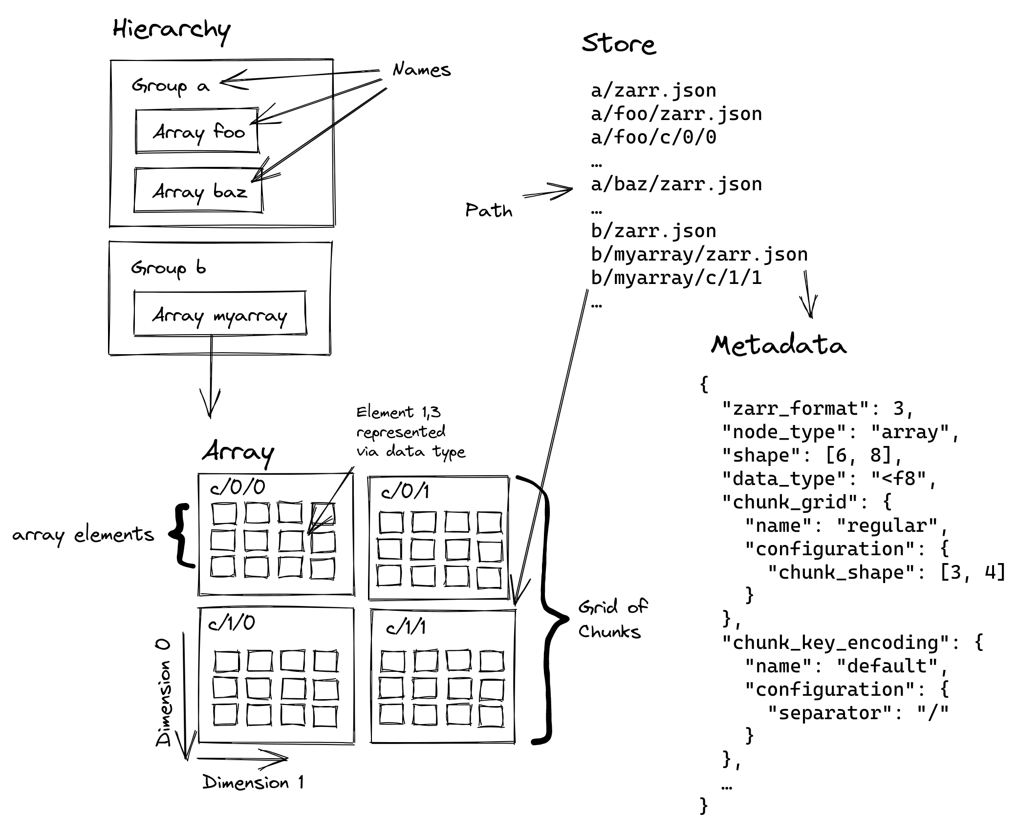
Compared to Zarr

Slide 15
Compared to Zarr

Slide 16
Compared to Zarr

Slide 17
Compared to Zarr

Slide 18
HDF5 - Rebasing for the Win

Slide 19
HDF5 - Rebasing for the Win
What would a modern HDF5 file format look like?
Targeting: POSIX file systems and object stores and cloud storage

Slide 20
HDF5 - Rebasing for the Win
What would a modern HDF5 file format look like?
Targeting: POSIX file systems and object stores and cloud storage
What to keep
Programming API
Data model concepts: groups, datasets, attributes, links, etc.
Self-describing format
Scalable I/O on array data

Slide 21
HDF5 - Rebasing for the Win
What would a modern HDF5 file format look like?
Targeting: POSIX file systems and object stores and cloud storage
What to keep
Programming API
Data model concepts: groups, datasets, attributes, links, etc.
Self-describing format
Scalable I/O on array data
What to leave behind
Metadata combined in same file as raw data
Custom file data structures

Slide 22
HDF5 - Rebasing for the Win
What would a modern HDF5 file format look like?
Targeting: POSIX file systems and object stores and cloud storage
What to keep
Programming API
Data model concepts: groups, datasets, attributes, links, etc.
Self-describing format
Scalable I/O on array data
What to leave behind
Metadata combined in same file as raw data
Custom data structures
What to add
Sharded dataset storage
Database for metadata

Slide 23
Things to Keep
Programming API
Today’s applications can transparently access sharded storage, without modification
Sharded storage will be implemented as a VOL connector
Data Model Concepts
Critical to semantic model of HDF5
Datasets, Groups, Attributes, Links, Dataspaces, Datatypes
Self-Describing Format
But make this more robust, so future format variants can always be auto-detected
Scalable Array I/O
The sine qua non of HDF5

Slide 24
Things to Leave Behind
Metadata combined in same file as raw data
Wow, was this a bad idea!
At least in the ”small fragments of metadata scattered everywhere” form
Page-aligned blocks of metadata probably would have been OK
Custom file data structures
At least most of them
The world did not need 2 more B-tree implementations, 3 kinds of heaps, etc.

Slide 25
Things to Add
Sharded dataset storage
Learn from and exceed Zarr’s capabilities
Sharded storage is much more friendly to object stores & cloud storage
Use a database for storing metadata
Tuned and maintained B-trees, paged I/O, caching, etc.
Opens up ability to query metadata in standard & scalable ways
Local, remote, and cloud possible
i.e. SQLite as well as MySQL and DynamoDB

Slide 26
What will this look like?

Slide 27
What will this look like?
“Bundles & Buckets VOL Connector”

Slide 28
What will this look like?
“Bundles & Buckets VOL Connector”
“Transparent” Upgrade to Native VOL Connector
Applications should be able to use B&B connector as default
Fully backward compatible w/native format

Slide 29
What will this look like?
“Bundles & Buckets VOL Connector”
“Transparent” Upgrade to Native VOL Connector
Applications should be able to use B&B connector as default
Fully backward compatible w/native format
B&B connector implemented as either single or pair of VOL connectors:
Pass-through – to native VOL connector
Pass-down – to sharded storage VOL connector

Slide 30
What will this look like?
“Bundles & Buckets VOL Connector”
“Transparent” Upgrade to Native VOL Connector
Applications should be able to use B&B connector as default
Fully backward compatible w/native format
B&B connector implemented as either single or pair of VOL connectors:
Pass-through – to native VOL connector
Pass-down – to sharded storage VOL connector
Stackable under existing pass-through connectors
Async, logging, etc.

Slide 31
What will this look like?
“Bundles & Buckets VOL Connector”
“Transparent” Upgrade to Native VOL Connector
Applications should be able to use B&B connector as default
Fully backward compatible w/native format
B&B connector implemented as either single or pair of VOL connectors:
Pass-through – to native VOL connector
Pass-down – to sharded storage VOL connector
Stackable under existing pass-through connectors
Async, logging, etc.
Exposes its own pluggable interfaces
Metadata access, storage layout, etc.

Slide 32
What will this look like?
“Bundles & Buckets VOL Connector”

Slide 33
What will this look like?
“Bundles & Buckets VOL Connector”
On POSIX file system, treat a directory as an HDF5 container
Easy for library detect when opening:
If the name provided is a file, open as a native format file
If the name provided is a directory, open as a bundle
A directory and its contents make up a bundle
Creation property for new containers

Slide 34
What will this look like?
“Bundles & Buckets VOL Connector”
On POSIX file system, treat a directory as an HDF5 container
Easy for library detect when opening:
If the name provided is a file, open as a native format file
If the name provided is a directory, open as a bundle
A directory and its contents make up a bundle
Creation property for new containers
In a cloud or on-prem object store
Can be auto-detected when opening a container by existing “file open” algorithm within library
A bucket and its contents make up a bundle
Creation property for new containers

Slide 35
What will this look like?
“Bundles & Buckets VOL Connector”
On POSIX file system, treat a directory as an HDF5 container
Easy for library detect when opening:
If the name provided is a file, open as a native format file
If the name provided is a directory, open as a bundle
A directory and its contents make up a bundle
Creation property for new containers
In a cloud or on-prem object store
Can be auto-detected when opening a container by existing “file open” algorithm within library
A bucket and its contents make up a bundle
Creation property for new containers
Bundle / Bucket contents
Directory: As needed, by metadata or dataset layout plugin
Object: Either a bootstrap file, a metadata database, or a dataset layout shard

Slide 36
What will this look like?
“Bundles & Buckets VOL Connector”
Bootstrap bundle configuration from JSON “superblock” file
Easy to read and understand
Self-describing
Specifies the mechanism for reaching the metadata database
Object name or connection info to reach remote / cloud database

Slide 37
What will this look like?
“Bundles & Buckets VOL Connector”
Metadata Database File / Connection
Pluggable and vendor neutral
Start w/SQLite, then DynamoDB

Slide 38
What will this look like?
“Bundles & Buckets VOL Connector”
Metadata Database File / Connection
Pluggable and vendor neutral
Start w/SQLite, then DynamoDB
Must allow for “mounting” sub-containers
Allows for dynamic and hybrid containers
Possibly allows for “meta-containers” that can index many existing containers
Enables queries across all underlying containers

Slide 39
What will this look like?
“Bundles & Buckets VOL Connector”
Metadata Database File / Connection
Pluggable and vendor neutral
Start w/SQLite, then DynamoDB
Must allow for “mounting” sub-containers
Allows for dynamic and hybrid containers
Possibly allows for “meta-containers” that can index many existing containers
Enables queries across all underlying containers
Schema / Tables:
Links
Therefore: entire group hierarchy for file
Eliminates time-consuming JIT exploration of hierarchy
Attributes
Modulo “big” ones that can be stored in their own shards
Object metadata
Dataset dimensions, datatype, storage layout, etc.

Slide 40
What will this look like?
“Bundles & Buckets VOL Connector”
Dataset storage
Want to allow for many options that leverage storage system, e.g.:
Typical chunking
Aggregate many small datasets into single object
Sub-filing
Column-oriented storage
e.g. shard by datatype instead of dataspace
Sparse, hierarchical, irregular, etc.

Slide 41
What will this look like?
“Bundles & Buckets VOL Connector”
Dataset storage
Want to allow for many options that leverage storage system, e.g.:
Typical chunking
Aggregate many small datasets into single object
Sub-filing
Column-oriented storage
e.g. shard by datatype instead of dataspace
Sparse, hierarchical, irregular, etc.
Therefore:
Pluggable interface for dataset layout
Always requiring a new layout to be within the base library has limited innovation
Make a flexible and robust cache part of the “VOL connector toolkit”

Slide 42
What will this look like?
“Bundles & Buckets VOL Connector”
Dataset storage
Want to allow for many options that leverage storage system, e.g.:
Typical chunking
Aggregate many small datasets into single object
Sub-filing
Column-oriented storage
e.g. shard by datatype instead of dataspace
Sparse, hierarchical, irregular, etc.
Therefore:
Pluggable interface for dataset layout
Always requiring a new layout to be within the base library has limited innovation
Make a flexible and robust cache part of the “VOL connector toolkit”
Also:
Needs mechanism for storing variable-sized data elements
So: Allow layout plugins to create metadata database as needed

Slide 43
What will this look like?
“Bundles & Buckets VOL Connector”
In the future
Move native connector out of HDF5 library distribution, into standalone DLL
Leave only the “knowledge” about the file format-specific aspects of the file in the native VOL connector
Probably means extracting the metadata cache, the IO pipeline, etc. from the library

Slide 44
What will this look like?
“Bundles & Buckets VOL Connector”
In the future
Move native connector out of HDF5 library distribution, into standalone DLL
Leave only the “knowledge” about the file format-specific aspects of the file in the native VOL connector
Probably means extracting the metadata cache, the IO pipeline, etc. from the library
Expose “VOL construction kit” API routines
Anything that will be common across many connectors
Continues and deepens “VOL developer” API routines

Slide 45
What will this look like?
“Bundles & Buckets VOL Connector”
In the future
Move native connector out of HDF5 library distribution, into standalone DLL
Leave only the “knowledge” about the file format-specific aspects of the file in the native VOL connector
Probably means extracting the metadata cache, the IO pipeline, etc. from the library
Expose “VOL construction kit” API routines
Anything that will be common across many connectors
Continues and deepens “VOL developer” API routines
Should end up with 3 libraries:
Non-VOL connector “Core” APIs – routines that don’t operate on data
H5I, H5E, H5P, etc.
VOL construction toolkit APIs – routines that operate on data in format-agnostic ways
Efficient gather/scatter, data transform pipeline, etc.
Native VOL connector
Everything that works with data in the native format

Slide 46
Impact
Objective​ | Benefit​
Multithreaded Concurrency​ | >4x read perf when training for multithreaded apps​
Sharded Storage​ ​ | >100x IO performance for on-prem object stores​
 | >150x IO performance for cloud object stores​
GPU-Native IO Pipeline​ ​ ​ | >2x IO performance to local/parallel file systems, using GDS optimizations​
 | >6x decompression performance with nvComp​
 | >10x type conversion with threaded CUDA kernels​

Slide 47
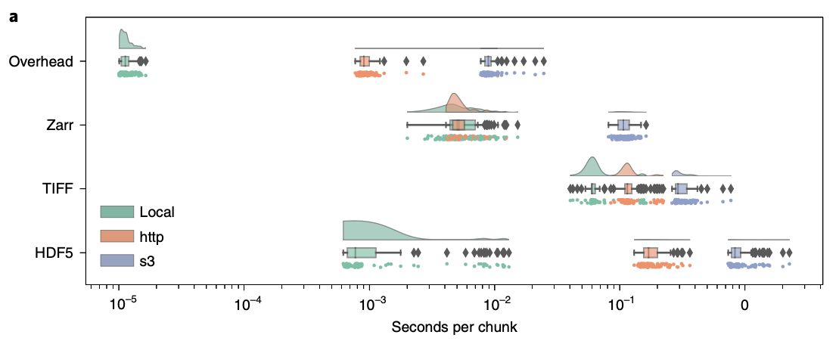
Performance Justification¹
OME-NGFF: a next-generation file format for expanding bioimaging data-access strategies, Fig. 1a
¹ https://www.nature.com/articles/s41592-021-01326-w

Slide 48
Further On The Horizon
Add support for concurrent bundle access
Multiple processes accessing a database is well-known technology
Sharding datasets enables easier modifications to both structure and contents of datasets
However, MPI doesn’t support collective IO to multiple files
So, we may want to implement a multi-file collective IO library and provide it for developers

