Slide 1
Streamlining HDF5's AI Workloads Benchmarking
Dlyaver Djebarov*, Radita Liem*, Sarah Neuwirth#, Jean Luca Bez†, Suren Byna‡
*Chair for High Performance Computing, IT Center, RWTH Aachen University
#Johannes Gutenberg University Mainz
†Lawrence Berkeley National Laboratory
‡The Ohio State University

Slide 2
Motivations
Rapid adoption of AI in science and everyday life
Increased requirements for I/O systems
Limited number of benchmarks
Problem: Setting up the correct environment
Proposal: Extension of the existing h5bench benchmark with AI workloads
Preserving the context of traditional and ML HPC workloads

Slide 3
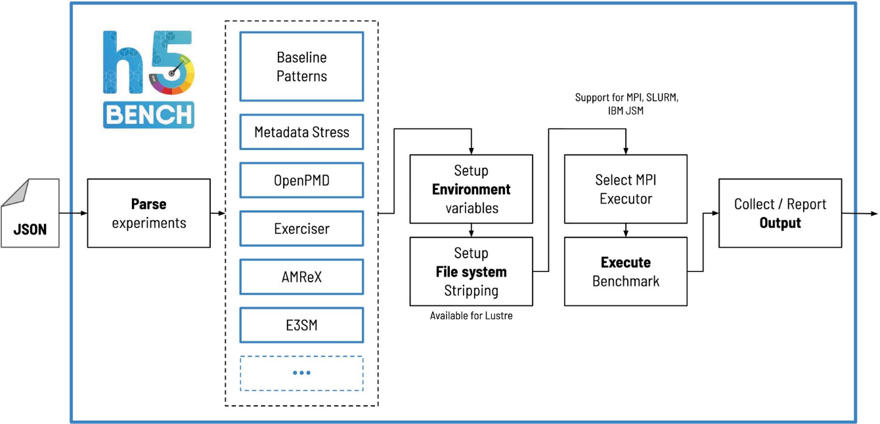
h5bench
The latest suite of parallel I/O benchmarks for HDF5.
Support for various HDF5-based I/O workloads, such as AMR, OpenPMD, and E3SM-IO.
Therefore, our extension brings broader pattern support to h5bench.
The overview of h5bench suite architecture [1]

Slide 4
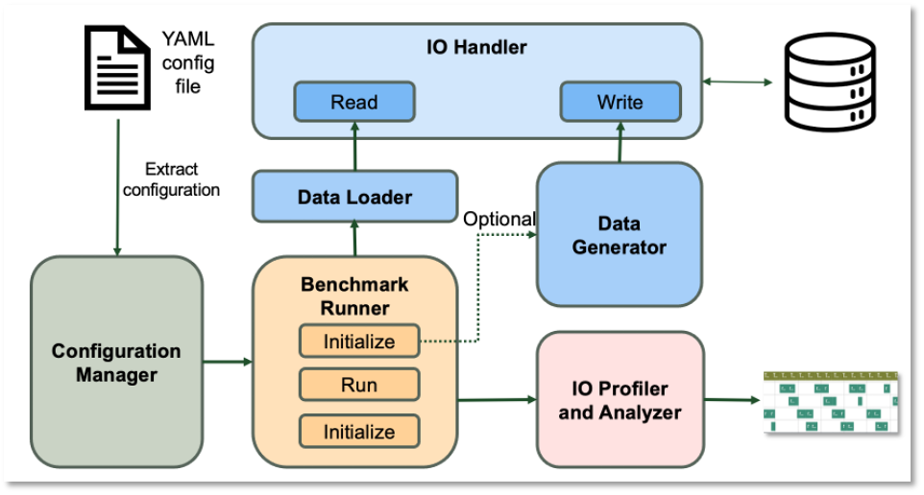
DLIO Benchmark
DLIO Benchmark is a widely recognized MLPerf Storage Benchmark kernel.
Was developed to emulate I/O patterns and behaviors typical of deep learning applications.
DLIO enables predictable and reproducible I/O behavior unlike real ML apps.
Supports other common AI data formats such
as TFRecord and npz, not only HDF5.
Requires the installation of ML library
dependencies.
The emulated I/O patterns for extension
development were obtained from
DLIO benchmark analysis.
The overview of DLIO Benchmark architecture [2]

Slide 5
Pattern Extraction
Log VFD – Virtual File Driver designed to capture metrics and access activity for HDF5 files.
The output consists of multiple lines, each of which contains:
range of accessed bytes
type of accessed memory
type of performed operation
268437440 bytes ≈ 256 MiB
67108864 bytes = 64 MiB
Log of reading a single data sample.

Slide 6
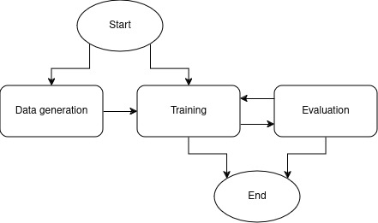
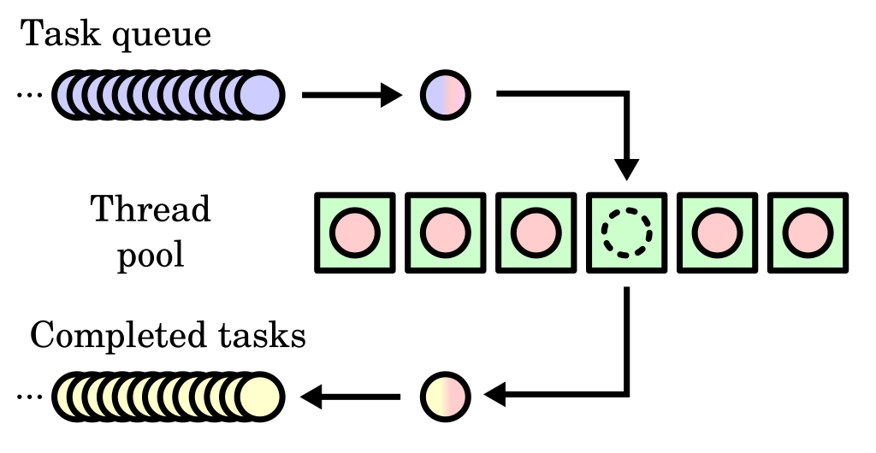
Implementation
Workflow consists of data generation, training and evaluation.
The calculations are emulated by the sleep() function.
Multiprocessing is implemented using the thread pool principle, where each thread is created using a fork().
H5bench extension workflow
A thread pool scheme [3]

Slide 7
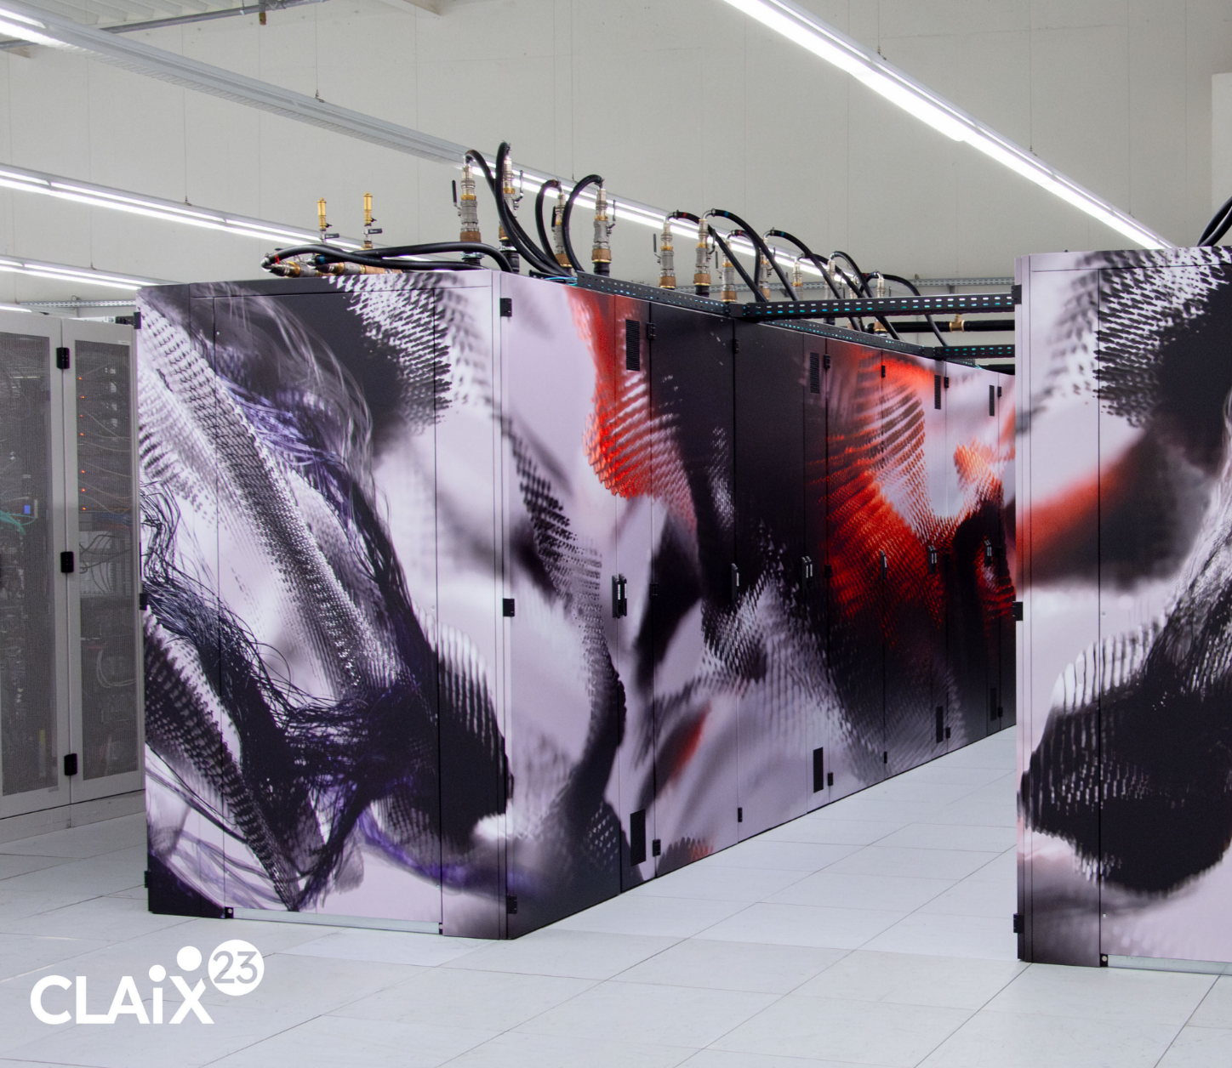
Experimental Setup
CLAIX23 – supercomputer cluster at RWTH Aachen University.
Intel Xeon 8468 Sapphire Rapids CPUs.
Fat-tree topology utilizing the InfiniBand network with a bandwidth up to 25 GB/s.
Lustre – RAID0 type with 16 MB stripe size and stripe count from 1 to 16. Shared storage resource.
BeeOND – RAID0 type with 512K chunk size, four storage targets, and one storage pool. Each node has a 1.4TB SSD and used exclusively.
CLAIX-23 [4]

Slide 8
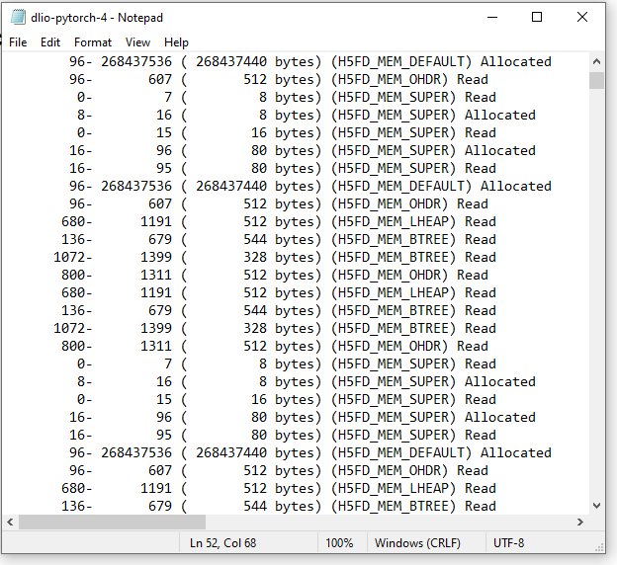
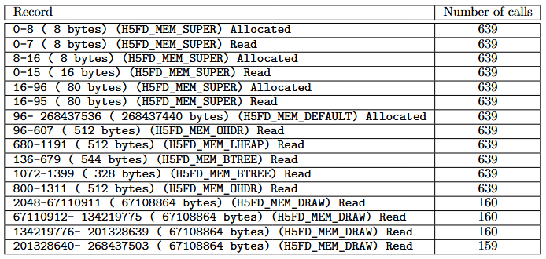
Sanity Check: Comparing logs
We compared the access patterns produced by the benchmark and the original DLIO code with the same settings using Log VFD.
The logs are the same up to permutation.
Summary
Raw log

Slide 9
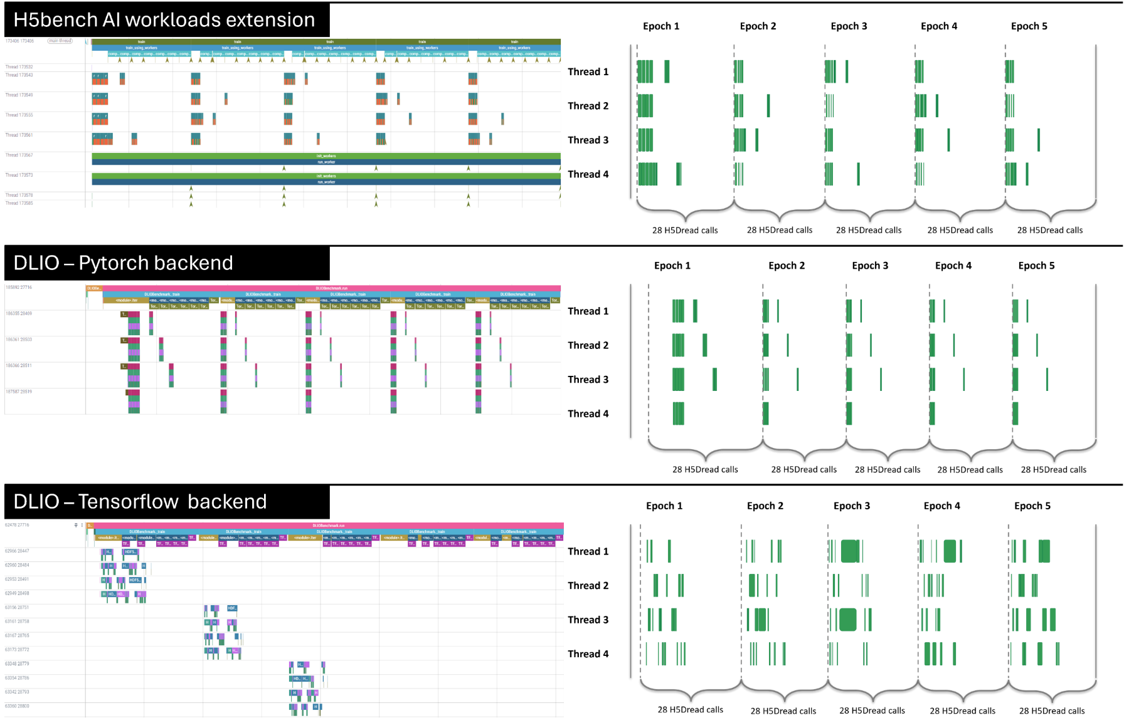
Sanity Check: Verifying I/O Patterns Across DLIO Backends
We conduct a runtime and pattern analysis of DLIO with PyTorch and TensorFlow and our extension.
The left-hand side is DFTracer’s trace visualization.
The right-hand side is the extracted H5Dread calls.
While visual patterns vary across frameworks, the underlying HDF5 I/O behavior remains consistent.
Our extension isolates pure HDF5 patterns — enabling clean, backend-agnostic analysis.

Slide 10
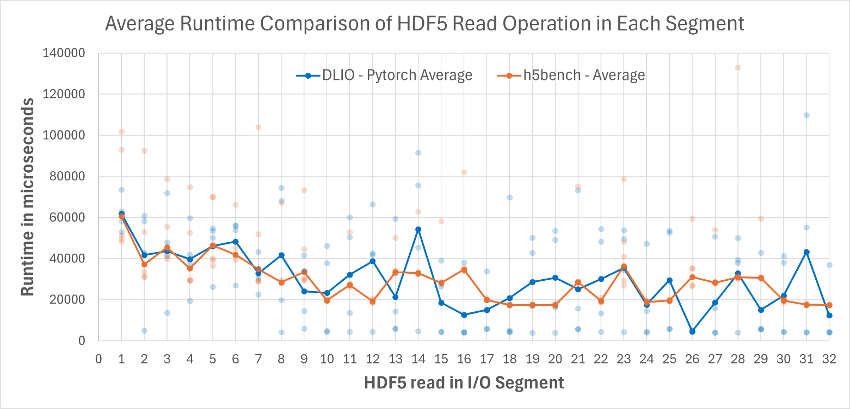
HDF5 Read Operation Runtime Comparison
Comparing the DLIO PyTorch backend with our h5bench extension using identical configurations.
One process
8 training files
4 samples per file
BeeOND fs
Varying I/O times while consistently maintaining an overall pattern on average.

Slide 11
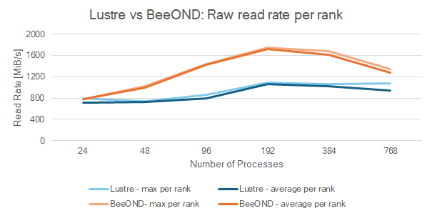
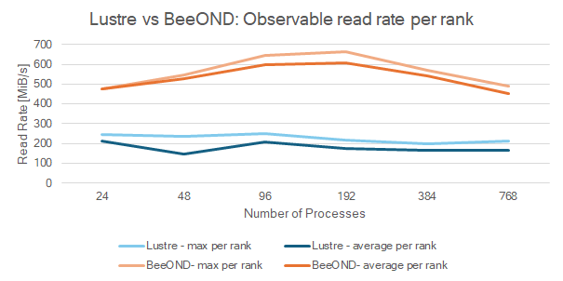
Scaling Tests: Lustre vs BeeOND
We run h5bench extension with 1 to 32 nodes with 24 processes for each node in Lustre and BeeOND with 384 GB of data for training phase and 96 GB for evaluation phase.
It reveals that the BeeOND fs in our cluster achieves a higher read rate performance than Lustre fs.
The reason: BeeOND uses SSDs on compute nodes → it aligns with our current finding that our BeeOND setup is more suitable for ML workloads.

Slide 12
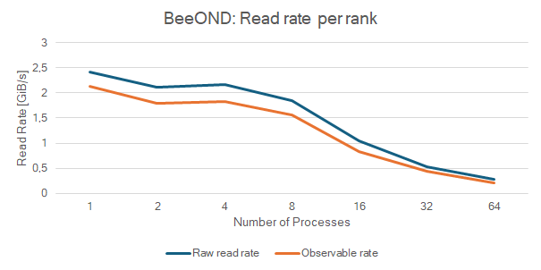
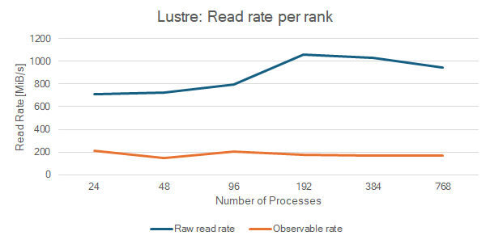
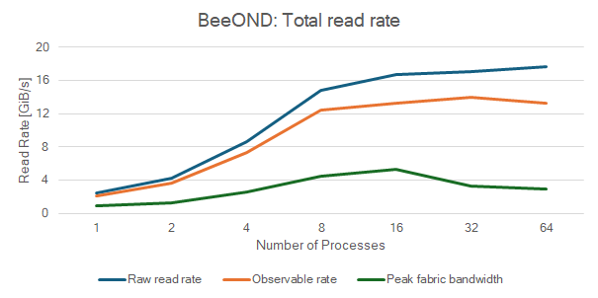
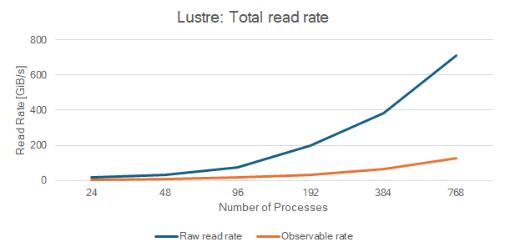
Scaling Tests
BeeOND
Lustre

Slide 13
Scaling Tests
BeeOND
One node
The read rate per rank declines
Node becomes fully utilized
Peak network bandwidth is reached
Observed fabric bandwidth degradation → small measurement intervals

Slide 14
Scaling Tests
BeeOND
Lustre

Slide 15
Scaling Tests
Lustre
Multiple nodes
Workload scales as the number of processes increases
Jump between 96 and 192 processes
Node and network effects?

Slide 16
Scaling Tests
BeeOND
Lustre

Slide 17
Conclusion
Our h5bench extension successfully mimics HDF5 call patterns from real AI workloads in DLIO.
Striping the Python environment confirmed that underlying HDF5 calls remain consistent, underscoring the need to isolate I/O from ML library effects.
Scaling tests demonstrate that the extended benchmark behaves as expected for both AI and traditional HPC workloads.
Planned to be integrated into h5bench v1.6 soon.
Eliminates the need to install ML libraries dependencies for a HDF5 focused performance tuning.
Supports researchers in evaluating system performance in AI contexts.
Helps sysadmins to focus on tuning HDF5 for AI workloads.

Slide 18
Future Work
We aim to analyze the impact of network and data transfer strategies in various ML libraries.
We plan to deepen our understanding of I/O impact of various file formats like TFRecord and npz, compared to the traditional HPC file formats and I/O strategies.
Additionally, we want to integrate checkpoint write operations in HDF5, which may become relevant for future AI applications.
Including workloads from variety of applications beyond DLIO will provide deeper insights into system performance across a broader range of AI and HPC workloads.

Slide 19
Thank you!
If you have any question: Dlyaver Djebarov (djebarov@itc.rwth-aachen.de)
…or read my bachelor thesis
DOI: https://doi.org/10.18154/RWTH-2024-10149
GutHub pull request to the h5bench repository:

Slide 20
Sources
[1] - Bez, Jean Luca, et al. "h5bench: A unified benchmark suite for evaluating HDF5 I/O performance on pre‐exascale platforms." Concurrency and Computation: Practice and Experience 36.16 (2024): e8046.
[2] - https://dlio-benchmark.readthedocs.io/en/latest/overview.html, visited on 26.5.2025
[3] - https://en.wikipedia.org/wiki/Thread_pool, visited on 26.5.2025
[4] - https://help.itc.rwth-aachen.de/service/rhr4fjjutttf/article/fbd107191cf14c4b8307f44f545cf68a/, visited on 26.5.2025

Slide 21
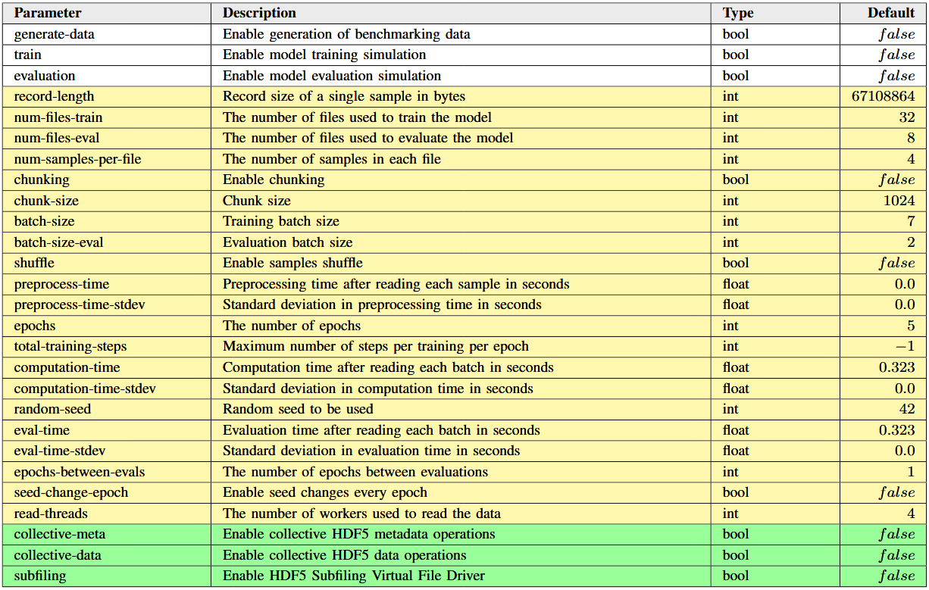
AI workloads specific parameters
White background
AI workflow stages
Yellow background
DLIO configurations
Green background
HDF5 specific features

Slide 22
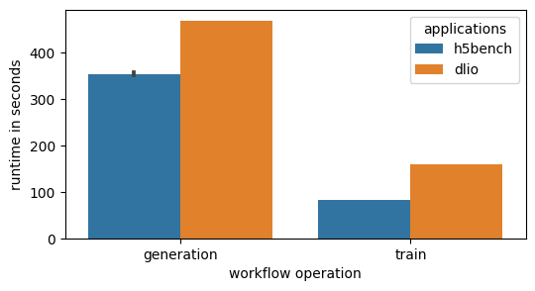
Runtime comparison
Unet3D – Convolutional neural network used for image segmentation
168 files × 1 sample × 146600628 bytes ≈ 23 GB of training data
4 nodes × 8 threads = 32 threads in total
Batch size of 4 samples
Constant difference!
BeeOND
Notes:
Generation 132% faster!
Training 193% faster!

Slide 23
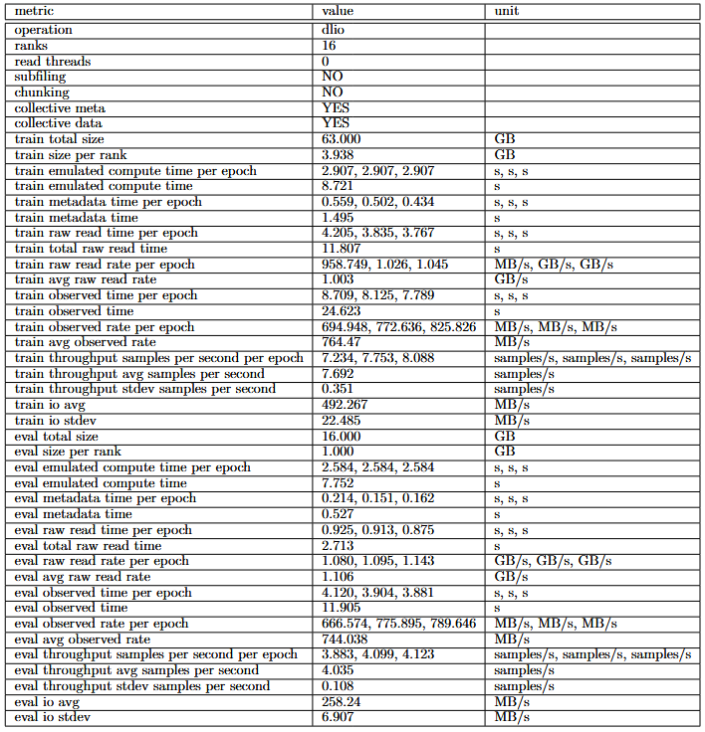
Sample output

