Slide 1
Analysis of big data sets, visualization, live interaction
PUNCH 2.0 - Use Cases
March 18th, 2025
[astro / astroparticles]
Markus Demleitner - Matthias Hoeft - Gernot Maier
Elena Sacchi - Christoph Wissing

Slide 2
Initial discussion points
Needs:
users want to discover and explore very large data set
selection / query / cross correlation on server / remote site with advanced statistics
visualization (rendering, 3D) / manipulation / zooming
Open questions:
queries / filters need to understand statistics
how to include simulations?
sharing

Slide 3

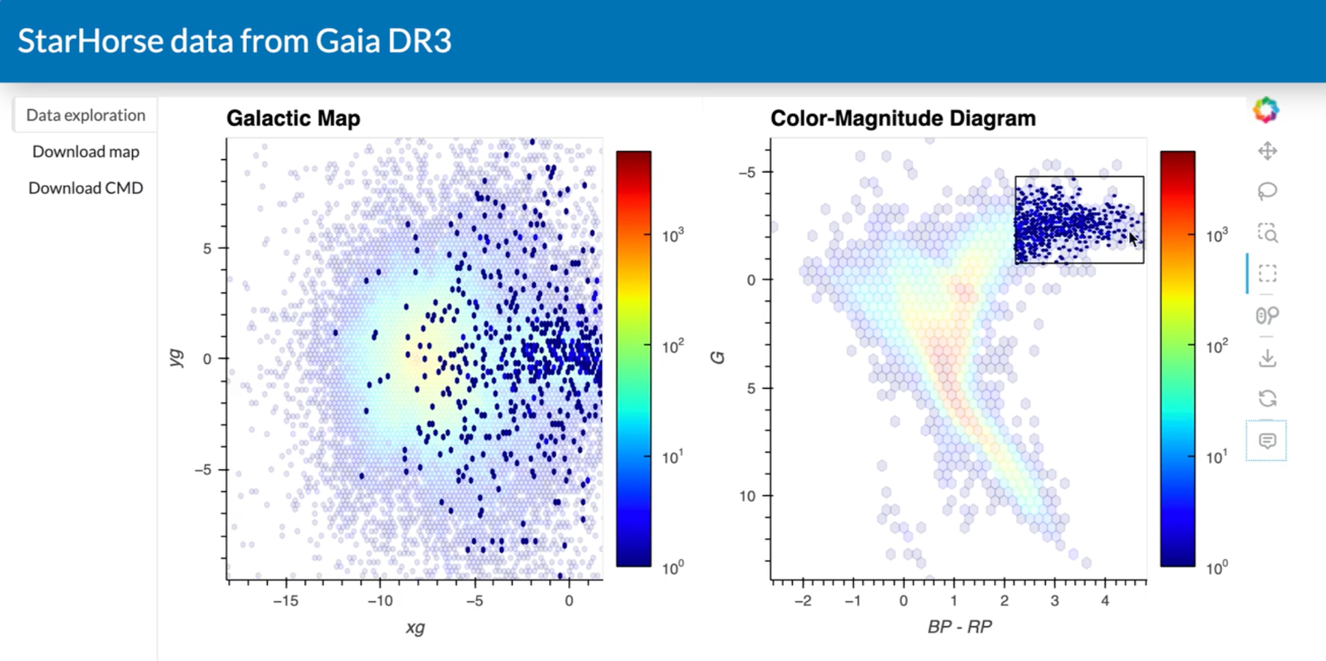
Example of live application (see PUNCH GM Nov 2024)
TAP Service (Gaia Archive)
panel & holoviews (app.py)
visualization & live interaction with data
S3 Storage

Slide 4
Use case #1: Statistically sane remote selection
Description
A user wants to build a luminosity function of galaxies in the early universe.
selection of candidates from large catalogues (think Euclid)
advanced statistics (which is necessary because they are working at low SNR)
evidence from several sources is integrated; since most of the source tables are very large as well, this integration will also largely have to happen remotely.
The catalogue of candidates is already small enough to be visualised and further processed locally, but the selection criteria need to be iterated by locating, retrieving and quickly analysing auxiliary data (spatial and spectral) for the candidate sources, ideally from the entire VO.
Requirements
(1) A set of functions and operators, together with what types they can be applied to, needs to be defined. We need to define a formalism to express them (i.e., an expression grammar, probably as part of the IVOA’s ADQL)
(2) An implementation within a concrete database system (probably postgres). A particular challenge will be exploiting indexes or even defining indexes over distribution-valued columns.
Pillar considerations
Requirement (1) sounds like a problem for interoperability.
Requirement (2) might fit in there as well, but you could also argue it’s just “tooling”.

Slide 5
Use case #2: (Re)processing of large data sets from (radio astronomical) observations
Description
Current and upcoming large telescopes/infrastructures generate (and treasure) an enormous amount of observational data.
For instance:
large radio interferometers provide huge data cubes (sky position and frequency)
each observations can result in tens of TB or larger
the data will be analysed by the consortia which have proposed the observation
users may develop much cleverer ways to analyse the data cubes, for instance, to find faint sources or to determine Faraday space distributions.
With PUNCH infrastructures more users can (re)analyse the data using own or modified pipelines, by:
connecting storage and compute facilities
provide an easy method to publish a software environment
provide an easy and homogeneous way of user management
establish a standardised and easy to reuse way of publishing workflows

Slide 6
Use case #2: (Re)processing of large data sets
Which elements do they involve? Connection to TA / pillars and requirements on them. A federated infrastructure with connects storage and compute facilities.
Which problems do they solve? The data size, difficulties to set up software environment and non-public example workflows
prevent users from doing their own analysis.
Which gaps do they fill? See question above.
How could they be generalized / what is generic? Re-analysis of large data volumes is a generic problem.
End-to-end FAIR use case? This depends on the data provider, their could still be restricted access. However, this helps to make data and analysis much easier public hence FAIR.
Connection to DRP? – a digital output of a research process (which category: publication, data set, software)
DRPs can be essential to provide and describe example workflows.
How is the use case viewed from outside of PUNCH?
How to federate storage and compute, access management, how make software environment,
standardised workflows (DRPs) is useful for other disciplines as well.

