Slide 1
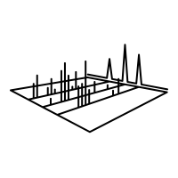
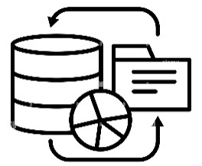
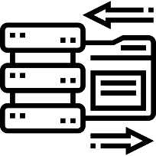
PUNCH use case: Workflow for future observations
Molecularphysics
Astrophysics
Producers
Consumers
CDMS Toolbox
XCLASS Toolbox
Atoms, Molecules, Solids, …
VAMDC Toolbox
PUNCH uses cases 18.03.2025

Slide 2
—----------------------- 10 Questions: ----------------------------------
Which elements do they involve? Connection to TA / pillars and requirements on them.
CDMS/VAMDC: Federated infrastructure/Data Management/DRP & SDP
XCLASS: Code to data/DRP & SDP
Which problems do they solve?
WSU of ALMA next generation: increase in data rate x 100
FAIR principles already included/incorporated
Which gaps do they fill?
Bridge the gap between astrophysical observations and interpretation (molecular spectra: abundances, temperature …)
How could they be generalized / what is generic?
AMO data needed in many other applications, e.g. climate science
AMO physics, Plasma physics, solid state physics,
End-to-end FAIR use case?
Intrinsic part of CDMS/VAMDC
Transfer FAIR principles to XCLASS code and products (DRPs)

Slide 3
6. Connection to DRP? – a digital output of a research process (which category: publication, data set, software, …)
XCLASS: software and applications
CDMS: data sets, meta data, quality control
How is the use case viewed from outside of PUNCH?
AMO Physics
Define input – procedure – output? Specify workflow.
CDMS: Experimental spectra, analysis, molecular parameters, synthetic spectra at any physical conditions
XCLASS: Analysis of observed spectra on the basis of CDMS
Operation model? - what is required for the use case, and how to organize that?
Proven infrastructure, data base organization,
Data models need to be widened to accept more types of molecules
ML requirements for XCLASS
Design of laboratory/experimental only data base: Model independent data base
Sustainability?
CDMS: Beginning 1998, common AMO data format: 2007 – 2012, well defined DRPs
Create more instances of CDMS and similar data bases

Slide 4
Outline of the steps of the use case:
Bold in the answers to the Questions
€€€: Improve the analysis tools for CDMS
(speed, automated analysis, ML, …)
Code development for XCLASS for larger data bandwidth
Transfer FAIR principles to XCLASS code and
products (DRPs) ➔ Science
Connections: Analysis of big data sets, visualization, live interaction
€€€: Training people
€€€: Support and Consulting of users
(producers and consumers)

Slide 6
Roles

