Slide 1
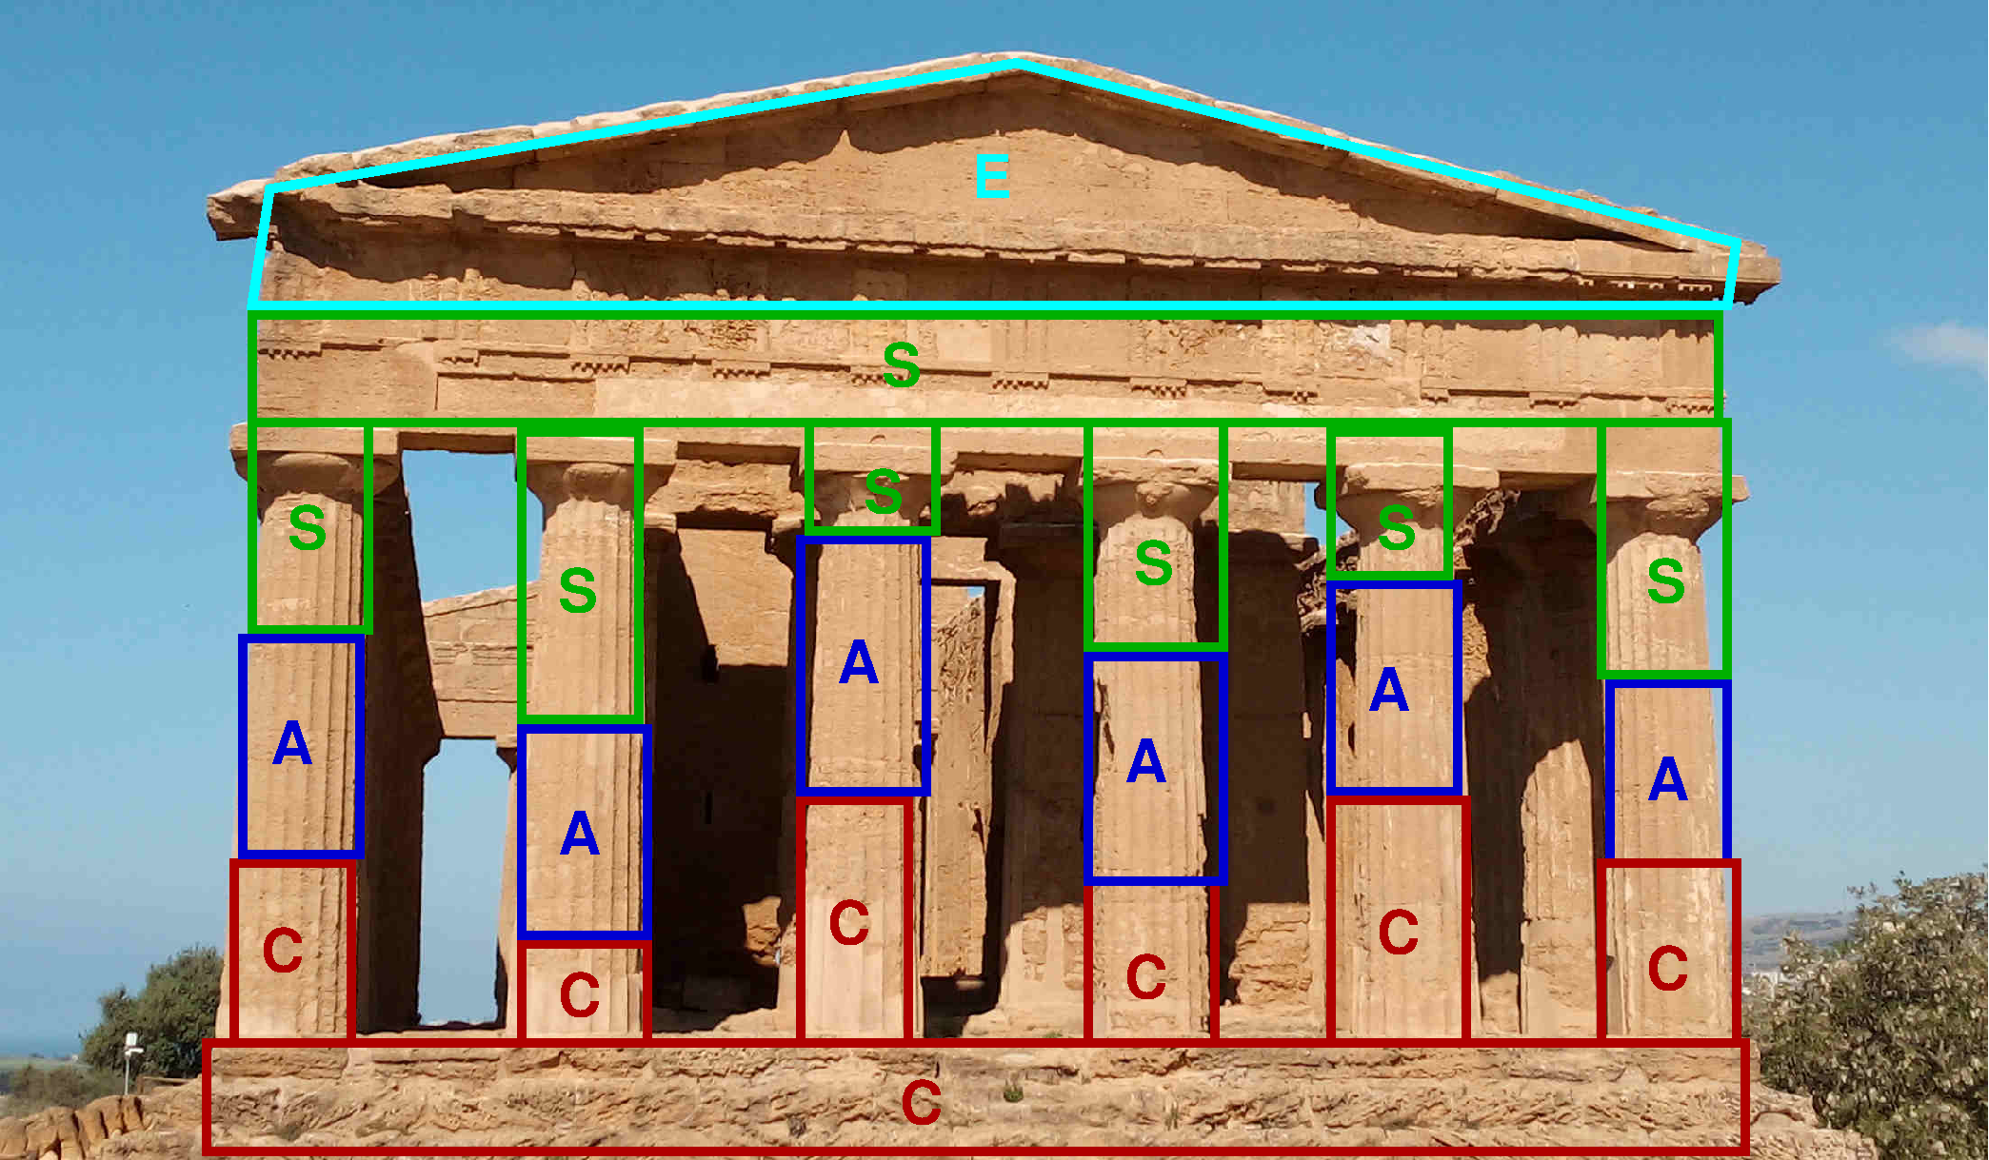
Connections
Support
Assembly
Components
Ground / foundation

Slide 2
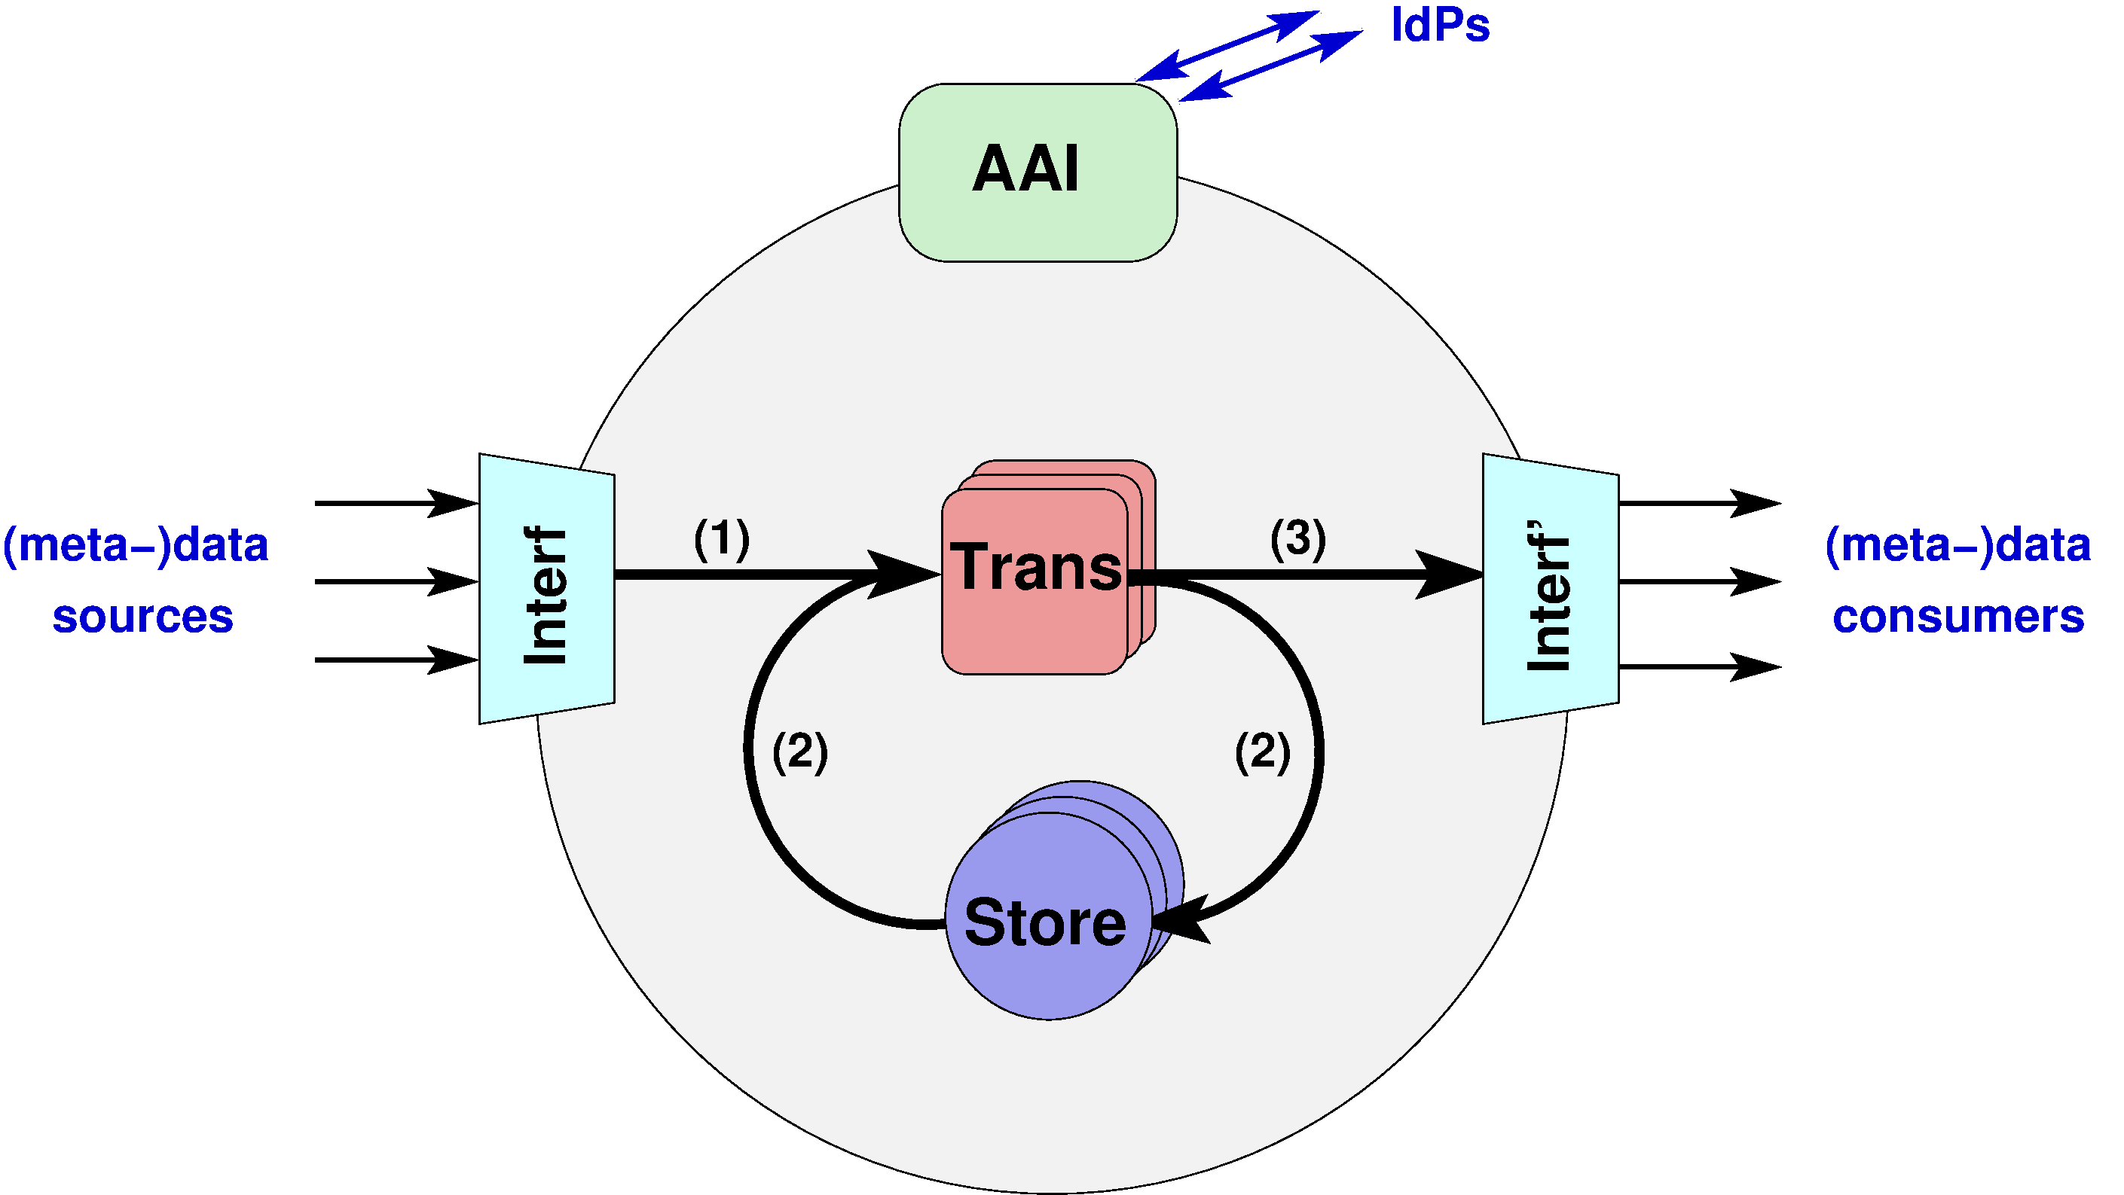
Components required by generic DM use cases
AAI: Authentication and Authorization Infrastructure
Examples: Unity AAI, Indigo IAM, . . .
Trans: (Meta-)Data Transformations
Examples: c4p, file transfer service (e.g. CERN FTS, globus online), metadata cross-walk, DOI minting, . . .
Interf, Interf’’: Input and output Interface(s)
Examples: Ingestion or markup tools, DAQ systems, web portals, landing pages, search
or harvesting interfaces (e.g. OAI-PMH), APIs, . . .
Store: (Meta-)Data Storage
Examples: s4p, metadata catalogue, file catalogue (SciCat or “BasCat”), code or SW
repository (gitlab, CVMFS), container registry (dockerhub), . . .
There are typically multiple components of the same class

Slide 3
Actions required by generic DM use cases
The components need to be assembled into (eco-)systems which are more or less specific for the use-cases, and which support the following generic actions (indicated by labeled arrows in the figure):
Ingestion of the data and metadata from use-case specific sources. This is done through appropriate interfaces (Interf). The (meta-)data might then be either directly stored in suitable storage components (Store), or first passed through additional transformations (Trans). Of course, the latter can also be viewed as part of the interface. During ingestion the (meta-)data might/should be validated with respect to the required standards (e.g. data format, metadata schema, etc.)
The (meta-)data stored within the system may be (repeatedly) transformed and stored again. Such transformations might be a) trivial (i.e. equivalent to the identity map), for instance, if the transformation consists simply in moving or copying the data from one storage system to another one, e.g. by making use of a file transfer service or an orchestration system (like FTS or Rucio)
b) correspond to applying very complex functions to the (meta-)data, like in the case of (a chain of) analysis steps, which may require large computing resources (e.g. from C4P or on dedicated HPC systems)
3) Retrieving or exposing of the (meta-)data by or to data consumers through corresponding interfaces (Interf’), possibly after passing through additional transformations (Trans). The data consumers themselves might be humans or other (analogous!) data management (eco-)systems.
The above data processing actions might be triggered or controlled by further classes of control actions

Slide 4
What are the concrete things to be done for this?
Components mostly exist from PUNCH 1.0 and elsewhere, but may need improvements and (use-case specific) extensions
Interface to DAQ and slow-control data of individual experiments (custom per experiment?)
Search interface / GUI for metadata search
Improvements to catalogue (configuration possibilities etc.)
Access control service - configuration and choice of policy engine (hierarchical delegation of permissions etc.)
Assembling of the components into use-case specific and optimized (eco-)systems. adapting interfaces and client tools
Community-specific / use case-specific / experiment-specific / site-specific …
Choice and set-up of IAM, adaption of interfaces / configurations to storage / compute etc., MoU with provider,
Support and consulting of users as well as maintenance of components
Suggestion:
Service manager as central coordinating instance
Software engineers for implementation
Requires $≥$2 FTE over the full time of the consortium

Slide 5
Which elements do they involve? Connection to TA / pillars and requirements on them
S4P, C4P, metadata catalogues, file catalogues, FTS, AAI, Rucio, REANA, DRPs, OAI-PMH, …
Otherwise, the DM use cases typically will involve all pillars discussed so far.
Which problems do they solve?
Integrated FAIR data management solutions for small / medium-sized experiments or projects at PUNCH institutions with collaborations and infrastructures distributed across different institutions / sites.
Which gaps do they fill?
distributed RDM services and federation of infrastructure
support for complex schemata (and queries) of scientific metadata
light-weight storage interfaces
fine-grained access control
data relocation and (automated) transfer (and transformation?) services
file/replica catalog
publishing of "large" data
community-specific (data-sharing and -use) policies
hierarchical delegation of management (e.g. of permissions and resources)

Slide 6
How could they be generalized / what is generic?
Generalization to non-trivial transformations (e.g. compute or analysis steps)
Applicability to other fields in PUNCH, and beyond
End-to-end FAIR use case?
The ALPS II, LUXE or BabyIAXO experiments at DESY, Lohengrin at Bonn, ILDG, GLOW, …
Connection to DRP? – a digital output of a research process (which category: publication, data set, software, …)
The proposed infrastructure and services should support all DRP categories.
How is the use case viewed from outside of PUNCH?
Benevolently – potential interest from other communities in physics and beyond
Define input – procedure – output? Specify workflow.
See graphics on pgage 1, text on page 2 and examples on next pages
Operation model? - what is required for the use case, and how to organize that? Sustainability?
Sustainability and operation model in the Helmholtz / DESY context

Slide 7
Example: Radio Astronomy (GLOW)
Users: international
Transformations: trivial (only transfer)
Storage: single storage element, metadata and file catalogue (to separate descriptive and administrative metadata)
Interfaces: data exploration and discovery via browsing through content-sorted view on collection, optional data publishing
Metadata schema: community-specific, complex (defined by VO), not including DC
Read access: public or restricted to collaboration
Write access: single group
Data growth: up to about 10 TB (50'000 data objects) per year

Slide 8
Example: ILDG
Users: international (world-wide federation of regional sub-communities)
Transformations: trivial (only replication and/or transfer)
Storage: various storage elements, metadata and file catalogue
Interfaces (all optional): markup and search (parametric in schema), metadata harvesting, data publishing
Metadata schema: community-specific, complex (defined by ILDG), not including DC
Read access of data: VO-wide or restricted by embargo (metadata always public)
Write access: fine-grained control delegated to collaborations/projects
Data growth: up to about 1 PB (50'000 data objects) per year

Slide 9
Example: Detector data from small / medium experiments
Mostly similar (or in-between) ILDG and GLOW (assuming moderate data rates).
A major difference may be the need for experiment- or facility-specific interfaces for data ingestion: a stream of data (and metadata) might need to be ingested in an automatic way.
Moreover, different sources, like the DAQ system of the detector and monitor/control data from
the facility, might need to be combined and synchronized.

Slide 10
Example: Monte Carlo simulations for small / medium experiments
Mostly similar (or in-between) ILDG and GLOW.
However, the Monte Carlo simulation itself might be considered as non-trivial transformation of (ingested) input parameters, i.e. part of the dataflow within the eco-system itself.
Moreover, the metadata might be minimal, e.g. only including input parameters and details of (or references to) the simulation software.

