Slide 1
Education, Training, Outreach, and Citizen Science
PUNCH4NFDI — TA 7
PUNCH4NFDI General Meeting
28.03.2025

Slide 2
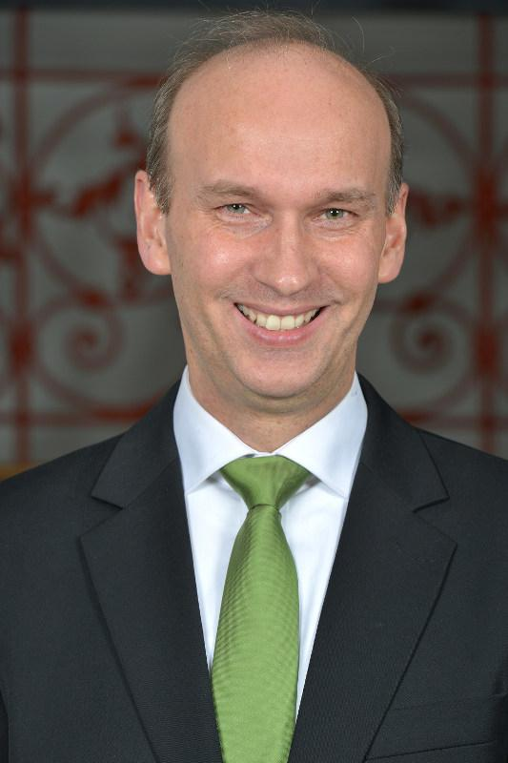
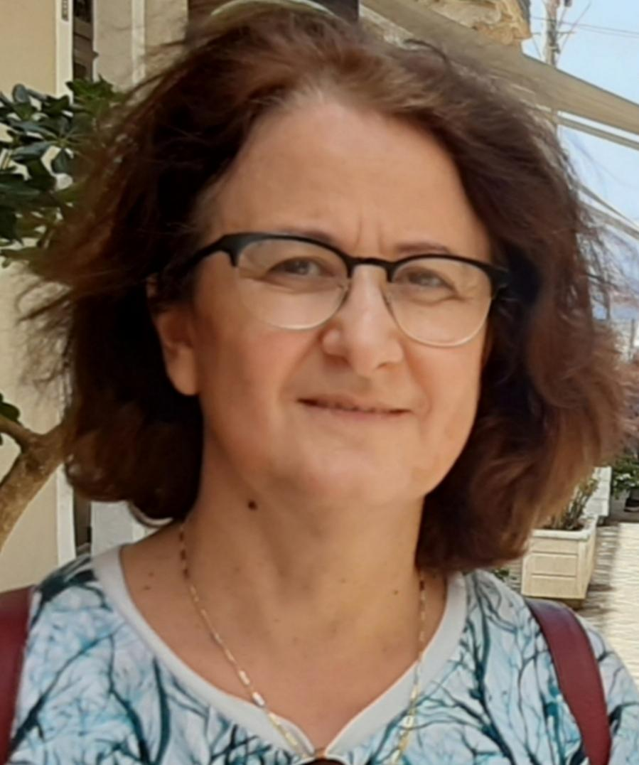
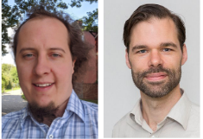
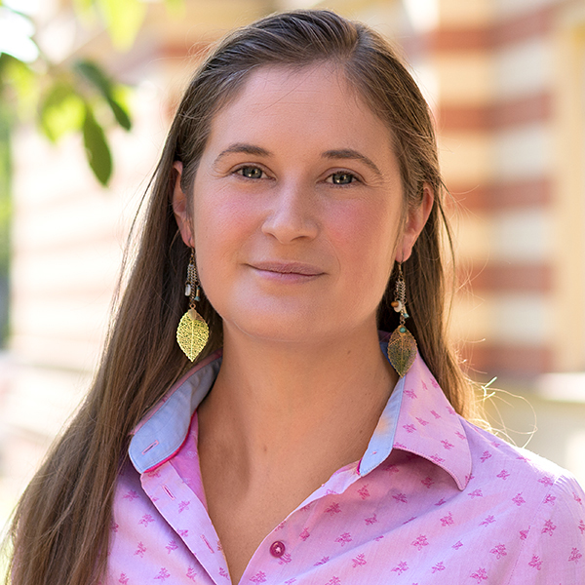
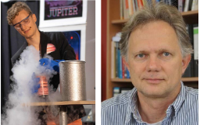
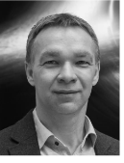
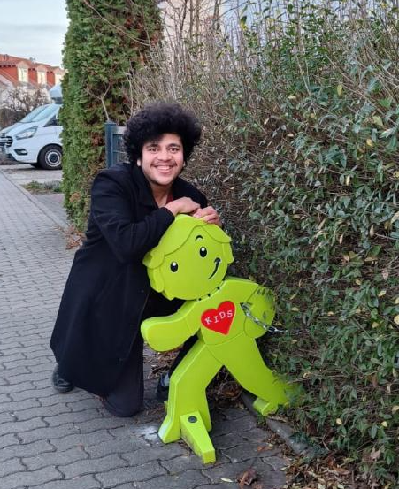
TA7 People
WP1
Training Experts
GAU Goettingen
WP2
Educating Students
TU Dortmund
Arnulf Quadt Baida Achkar
Carsten Burgard Kevin Kröninger
WP3
Outreach & Schools
Uni Bonn
WP4
Citizen Science
MPIfR/Uni Bonn
Sonja Felder David Ohse Frank Bertoldi
Michael Kramer Pranav Limaye

Slide 3
TA7 Goals
WP1
Provide a broad and a high-quality training for Ph.D. students, postdocs & senior scientists
Establish the PUNCH4NFDI Young Academy (regular events & courses)
Provide a documentation and archive services/Material for the training (cooperation with the TIB)
WP2
Provide educational resources for university-level teaching with a focus on NFDI issues
Develop proposals for the integration of topics related to research data management into university curricula
WP3
Clarify the relevance of data for discoveries in modern physics and make it accessible to the general public
Offers for different interaction groups: pupils, teacher, hobby scientists, ...
WP4
Actively engage the public in citizen science projects such as Einstein@Home
Provide incentives and access to data infrastructure and methods to involve the public in ongoing research

Slide 4
TA7 - WP1 : TRAINING EXPERTS

Slide 5
Key Activities and Responsibilities
Key Areas | Details
Leadership & Meetings | Responsible for overseeing key deliverables and coordination within Task Area 7. Chaired monthly TA7 meetings; presented biweekly updates @MB meetings. Compiled TA7 contributions to the PUNCH4NFDI Midterm Evaluation Report and Poster. Reviewed the proposals RDMTraining4NFDI and DALIA4NFDI.
PUNCH Young Academy Technical Training Program, Material , Documentation | REANA Training (Feb, Virtual – Advanced Level) Containers Training (Apr, Virtual – Intermediate, Advanced Levels) Professional Git & Clean Code Training (May, Virtual – Beginner, Intermediate Levels) PUNCH4NFDI Tools & Services Training (Nov, Bonn & Virtual – Advanced Level) Training materials accessible via Indico pages of events and some on punch results page Feedback gathered using regular post-training questionnaire ErUM-Data-Hub Synergy: Mutual program promotion fostered a collaborative learning environment and enhanced knowledge sharing.
PUNCH Young Academy Mentoring Services | Career development guidance and support for early-career scientists through the PYA one-to-one mentoring service Second round (2024) ongoing with three mentor-mentee tandems LHC-ErUM-FSP Office & PUNCH4NFDI Synergy: PUNCH4NFDI researchers participated in free online soft skills workshops in November via LHC-ErUM-FSP.

Slide 6
Major Achievements & Publications
Key Areas | Details
Reports Published: | D-TA7-WP1-2 Report: "Establishment of the PUNCH4NFDI Young Academy." D-TA7-WP1-4 Report: "Critical Review of the measures developed and Development of a Feedback System to Guide Education and Training."
Surveys & Feedback: | Biyearly surveys to collect suggestions about the PYA offers , gathering insights to refine the training offerings. Post-training questionnaire to gather feedback for improvement purposes.
Conferences & Outreach: | Poster at "RDM@Campus" Joint Conference (Göttingen eResearch Alliance, Sep 23–25, 2024): Conference Link Poster on DESY syncandshare Joint NFDI Poster at the Open Science Festival 2024 (Mainz, Sep 17-18, 2024): Festival Link Poster on Google Drive

Slide 7
Ongoing Work & Future Plans
Key Areas | Details
Documentation & Internal Collaboration | Ongoing migration of WP1 records and coordination with TA7-WPs Continuous documentation of PYA training events on intra.punch4nfdi Member of the support team @PUNCH Helpdesk system for Training.
PUNCH Young Academy Mentoring Services | 3rd round PYA one-to-one mentoring service, launched on 03.03.2025 Panel Session on “challenges faced by female scientists in the fields of Physics, Data Science, and Engineering.” under preparation within Women4punch
Training Programs | Professional Git and Clean Code, PUNCH tools and services, last development….

